Slide 1
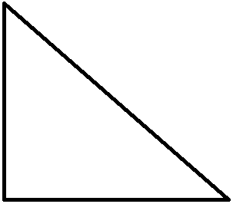
Question 3: a) Top Finger
-
+

Slide 2
Question 3: a) Middle Finger
-
+
+
-

Slide 3
Question 3: a)Botton Finger
-
+
+
-
-
+

Slide 4
Question 3: b) Adding a New Finger
-
New Finger
+
-
+
+
-
-
+

Slide 5
Question 3: Why?
-
+
-
+
+
-
-
+
-
-
+
+
+
-
+
-
-
-
-
-
+
+
+
+

Slide 6
Question 3: Why?
Note that with the adding a new finger give us a combination of “+” and “-” in every area. Therefore in this areas both positive and negative torque can be generated to keep the object steady.

Slide 7
Question 4: a) Moment-Labeling

Slide 8
Question 4: a) Moment-Labeling
-
+
+
+
-
+
-
-

Slide 9
Question 4: b) Drawing a force
The areas inside the friction cones can be labeled as “+-”.
In the areas with “+-” a torque in both orientations (positive or negative) can be applied to keep the object steady.
The vector of a for force that can not be resisted must enter an area of only “++” or “--”. Lets shade these areas on the next figure:

Slide 10
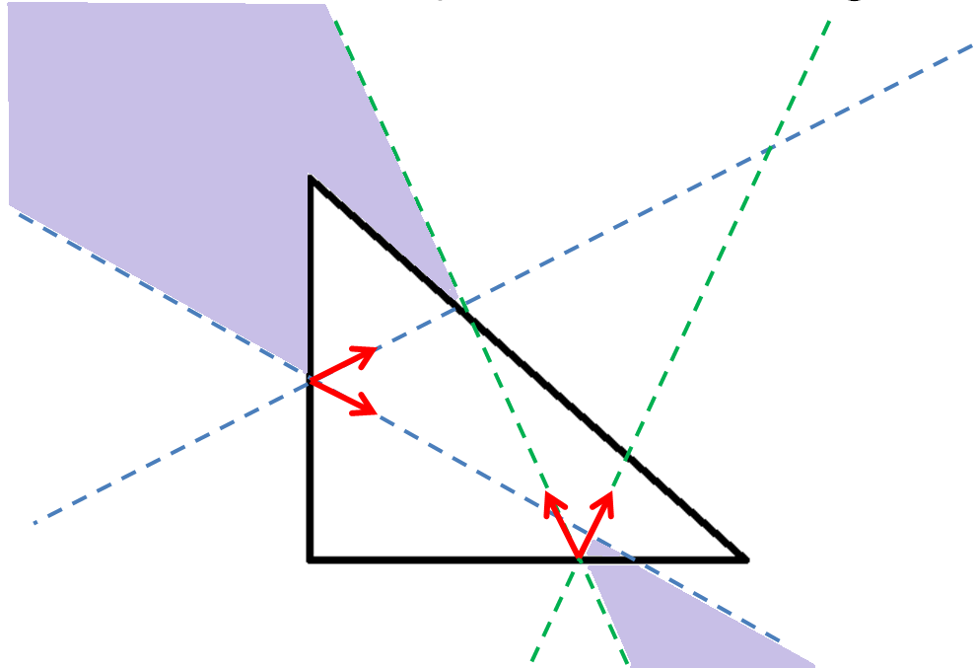
Question 4: b) Shading Areas

Slide 11
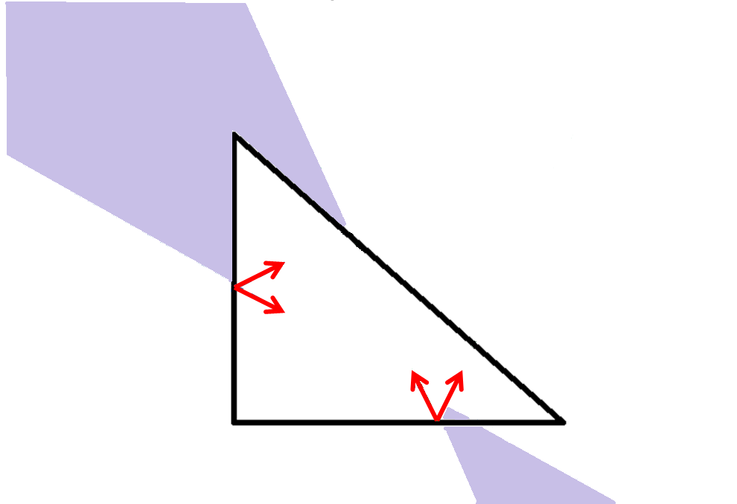
Question 4: b) Shading Areas
Counter-Force Up
PS: The magnitude of the forces are proportional of the length of the vector
Force Down

Slide 12
Question 4: b) Why?
Note that force represented in Green that counters the force in Blue enters a shaded region.
Therefore, the contacts might not be able to resist a force in Blue by applying the force in Green.

Slide 13



Question 6: Pentagon
y
108°
x
The better the friction cones face each other, the less friction we will need. (The more friction makes α bigger, making the friction cone wider)
α

Slide 14
Question 6: Pentagon
y
108°
x
The better the friction cones face each other, the less friction we will need. (The more friction makes α bigger, making the friction cone wider)
α

Slide 15
Question 6: Hexagon
y
α
x
128°
In this trivial example α=0. What makes the friction not necessary to hold the object (μ=0).
α

Slide 16


Question 6: Hexagon
y
128°
x
α
The better the friction cones face each other, the less friction we will need. (The more friction makes α bigger, making the friction cone wider)
α

Slide 17
Question 6: Hexagon
y
128°
x
α
The better the friction cones face each other, the less friction we will need. (The more friction makes α bigger, making the friction cone wider)
α

Slide 18
Question 6: Pentagon Corners
y
108°
x
The better the friction cones face each other, the less friction we will need. (The more friction makes α bigger, making the friction cone wider)
α

Slide 19
Question 6: Pentagon Corners
y
108°
x
The better the friction cones face each other, the less friction we will need. (The more friction makes α bigger, making the friction cone wider)
α

Slide 20
Question 6: Hexagon Corners
y
128°
x
The better the friction cones face each other, the less friction we will need. (The more friction makes α bigger, making the friction cone wider)
α
α

Slide 21
Question 6: Hexagon Corners
y
128°
x
The better the friction cones face each other, the less friction we will need. (The more friction makes α bigger, making the friction cone wider)
α
α

