Slide 1
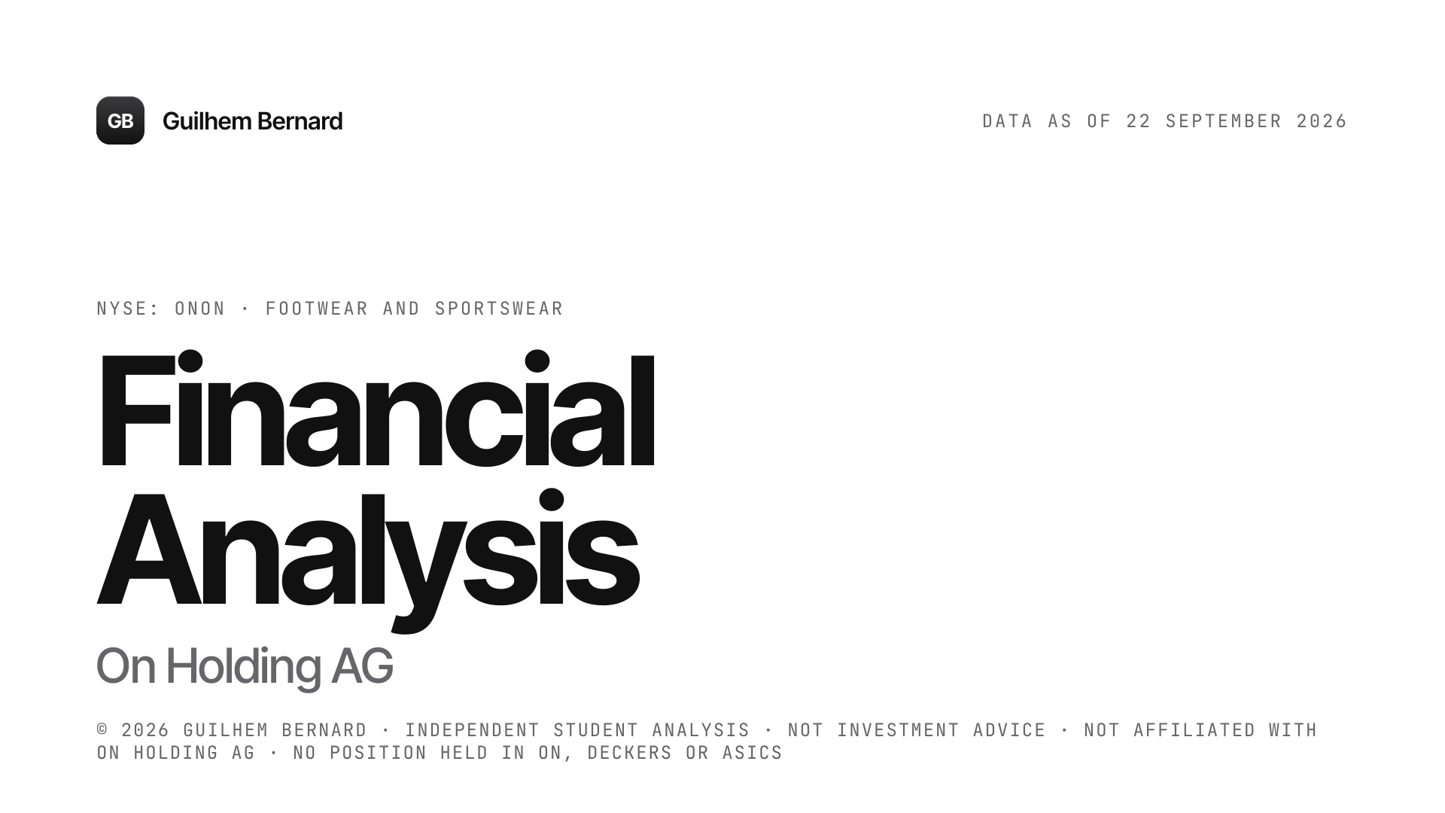
Notes:
A financial analysis of On Holding, built from its annual reports and results releases, with data frozen at 22 September 2026. The question: can management's promises still be trusted, and what was the market paying for them?

Slide 2
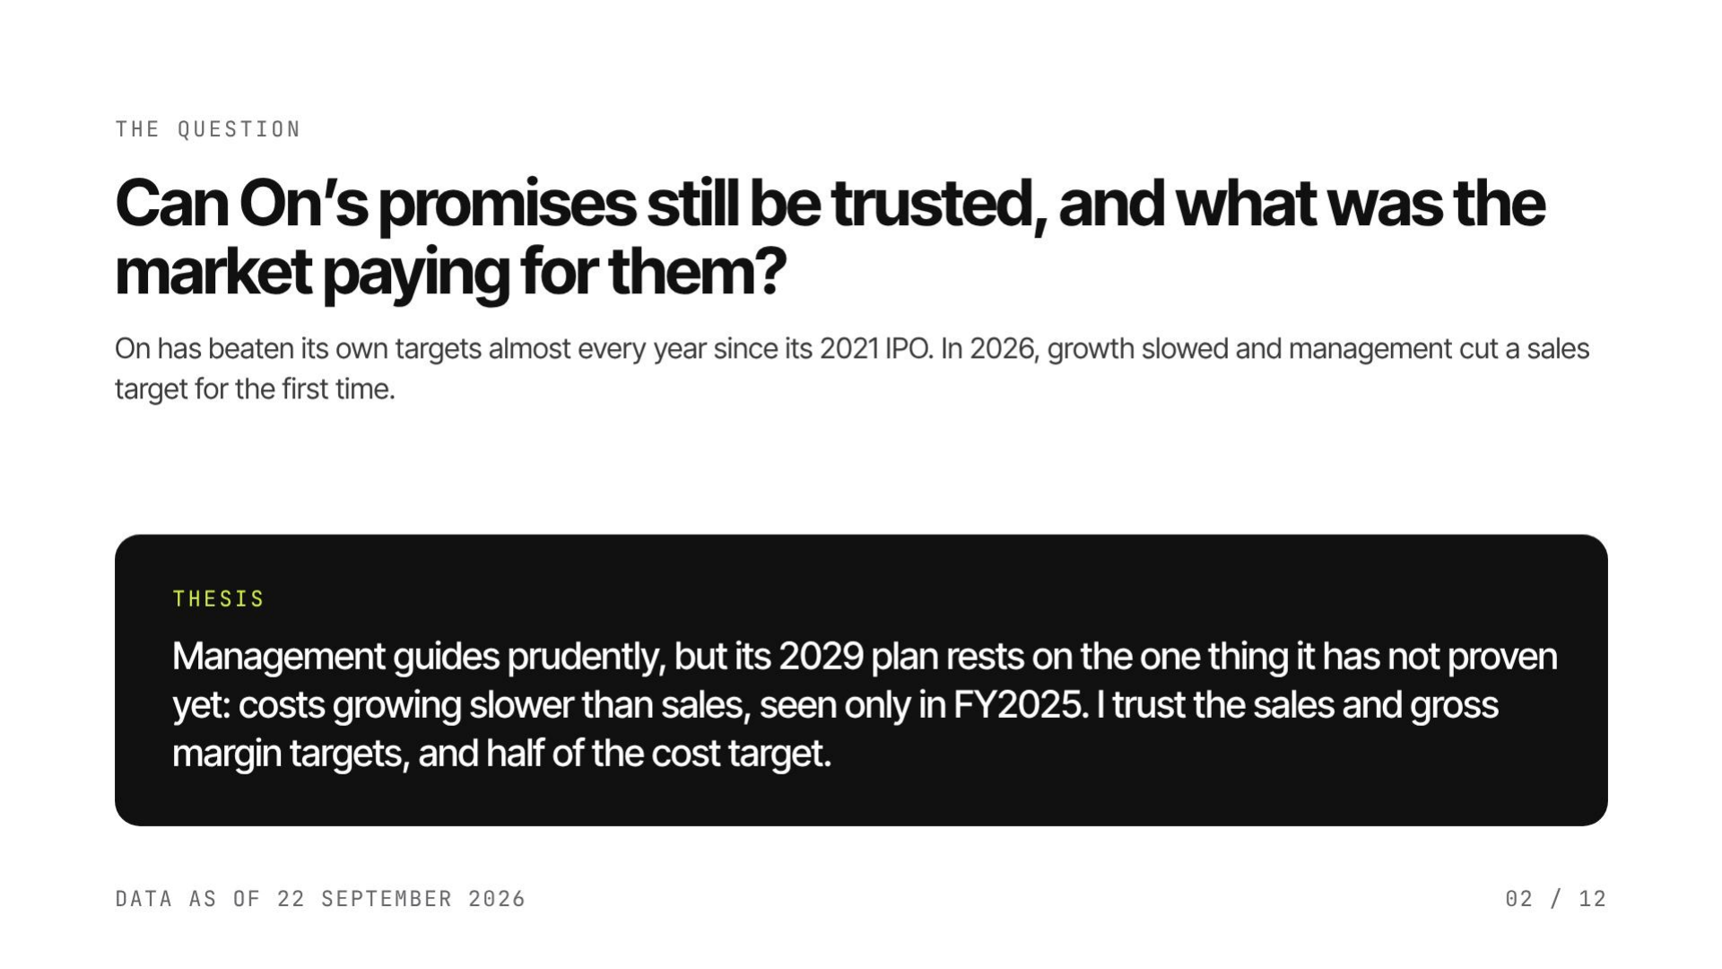
Notes:
One question drives the whole report: can management's promises still be trusted? The track record says yes on sales and gross margin. The 2029 plan adds a promise on costs that has never been kept so far.

Slide 3
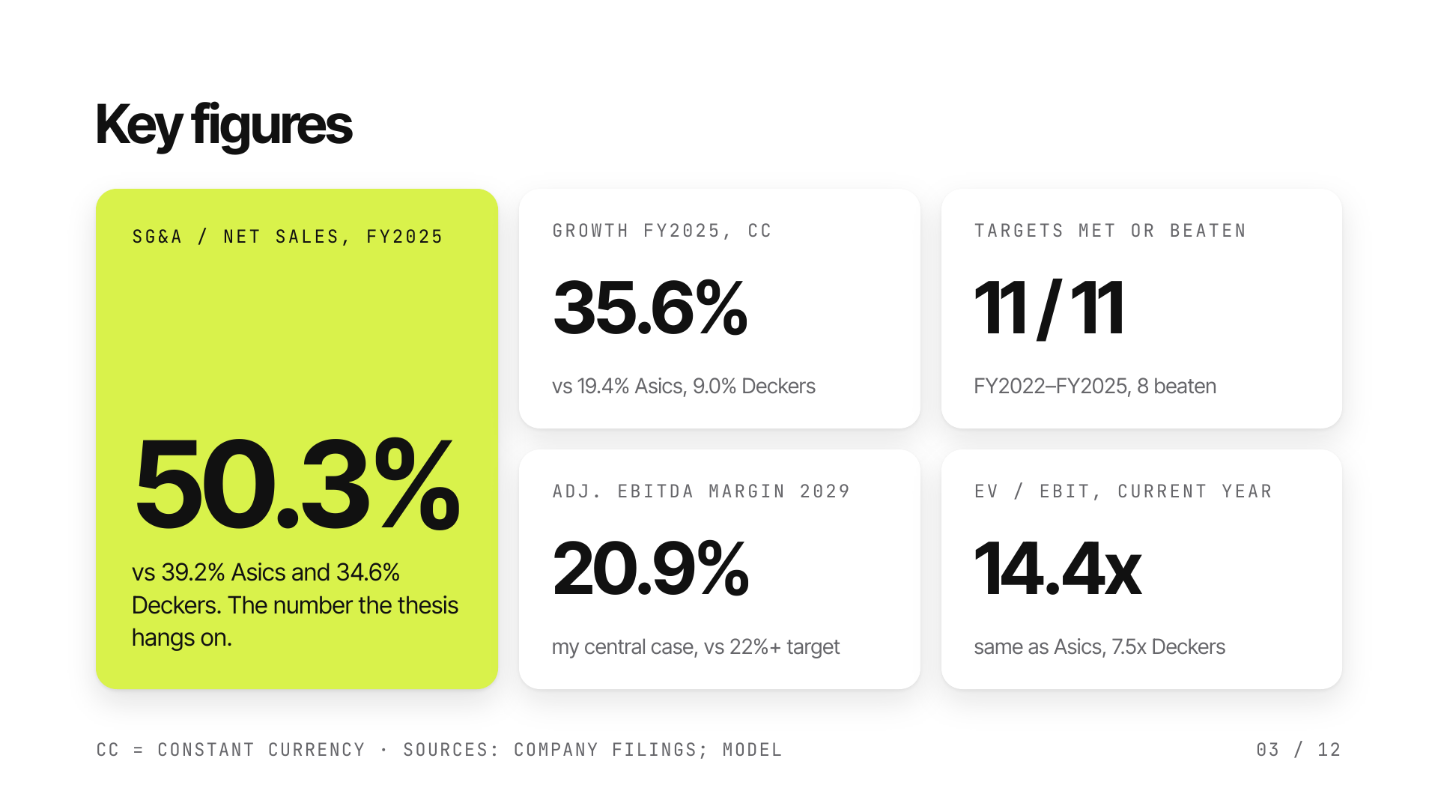
Notes:
Five key figures. Fast growth, a record of beaten targets, but half of sales spent on SG&A. My 2029 margin is below management's, and the September 2026 price was the same multiple as Asics.

Slide 4
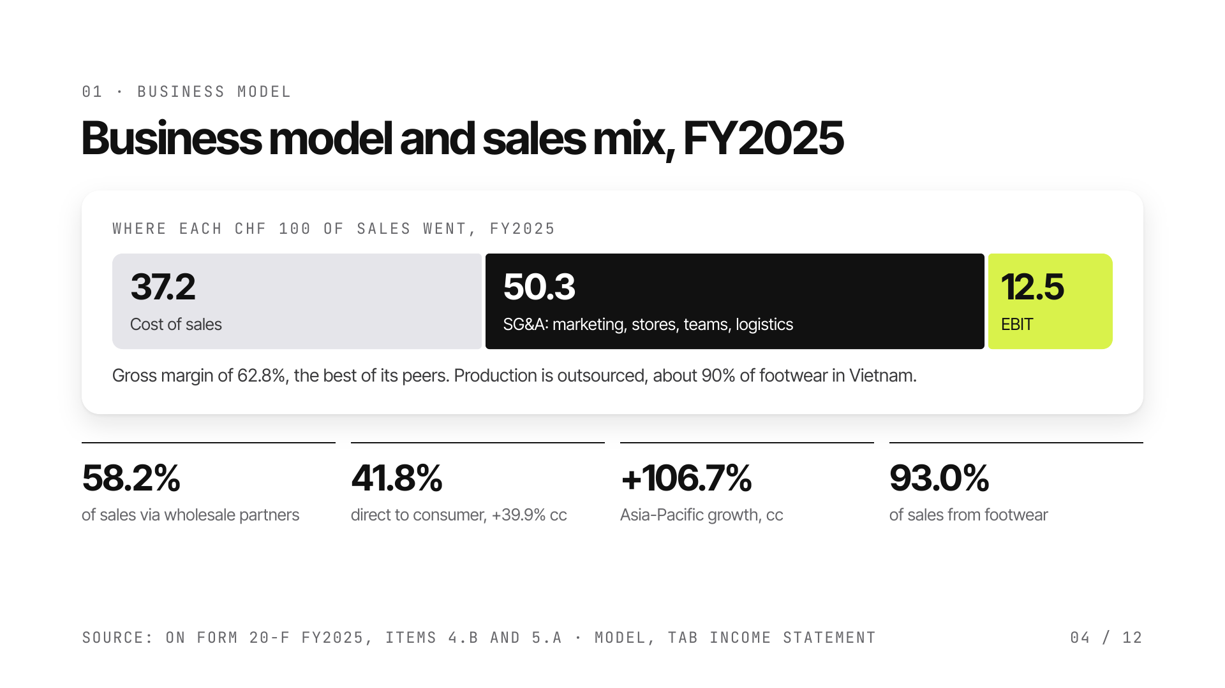
Notes:
Out of every 100 francs of sales, On keeps 62.8 as gross profit, then spends 50.3 on SG&A. What is left is 12.5 francs of operating profit. The model protects a premium price: few markdowns and a growing share of direct sales.

Slide 5
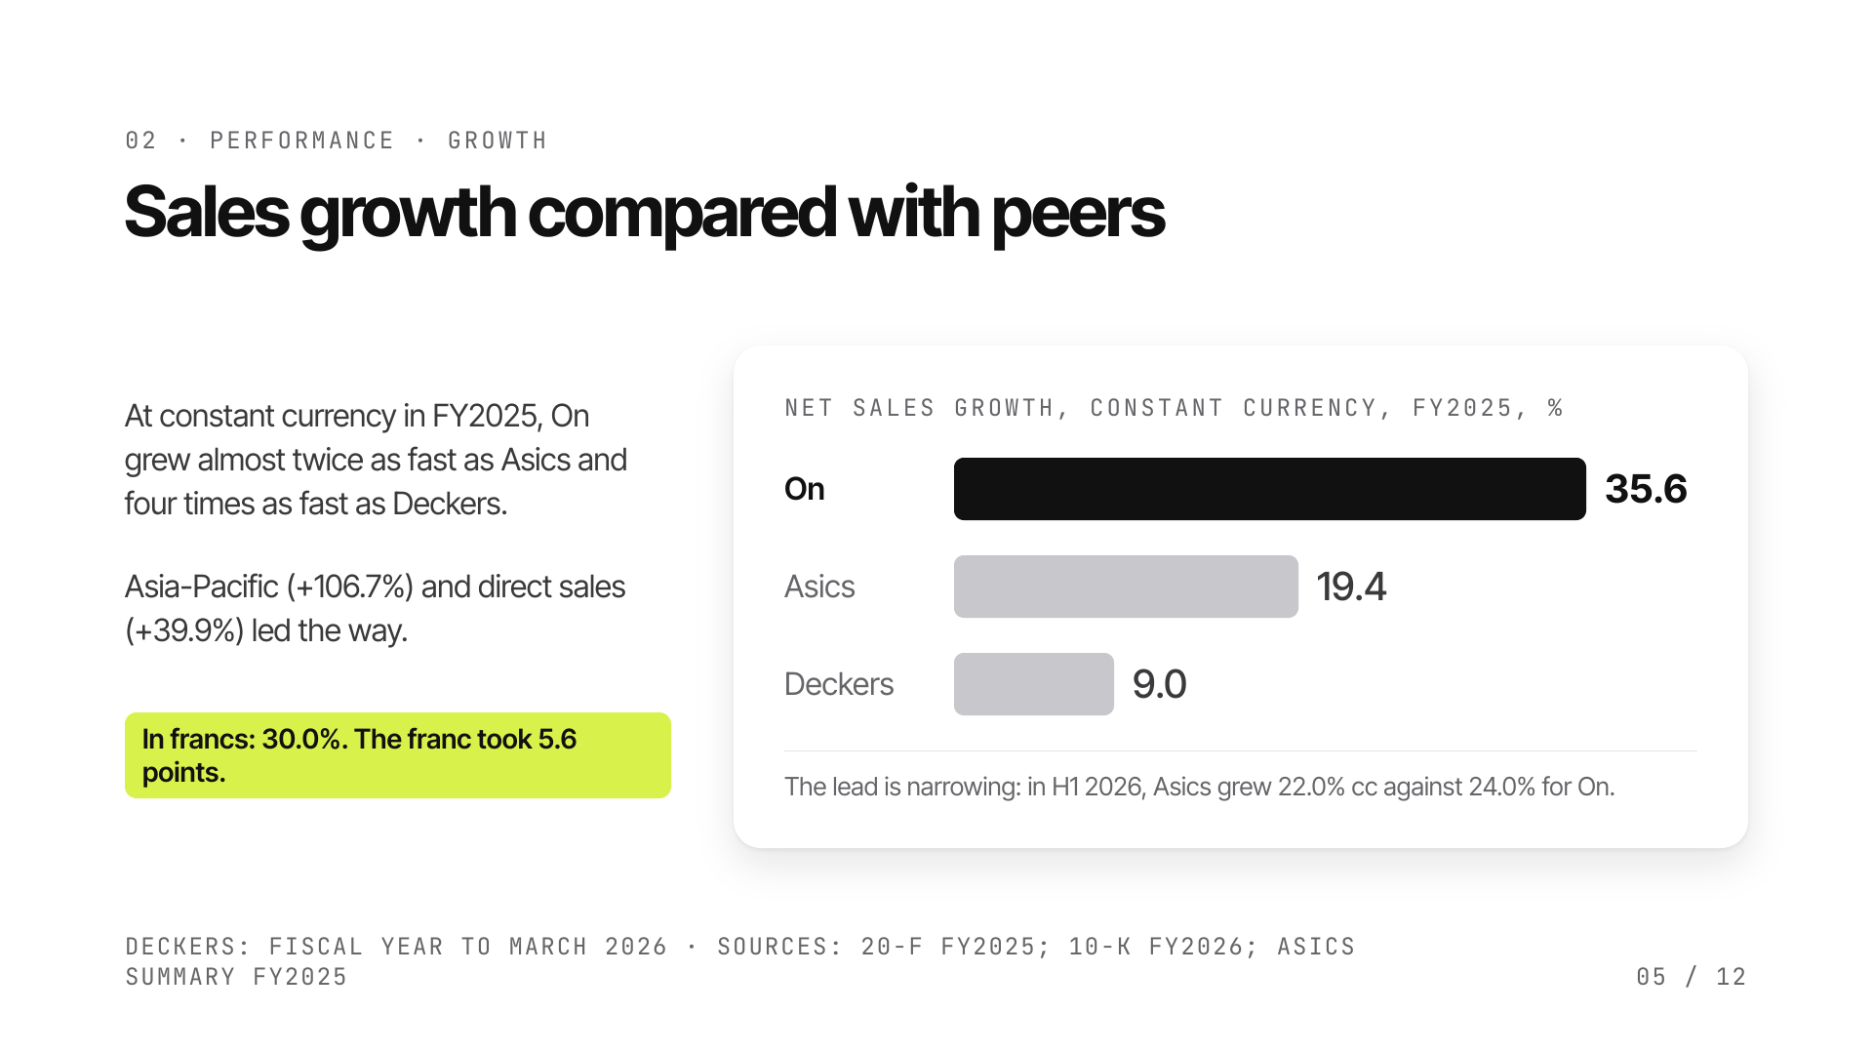
Notes:
Growth is always compared at constant currency: On reports in francs but sells in dollars and euros, so a strong franc shrinks reported growth. The lead over Asics was clear in 2024 and 2025, but it is narrowing in 2026.

Slide 6
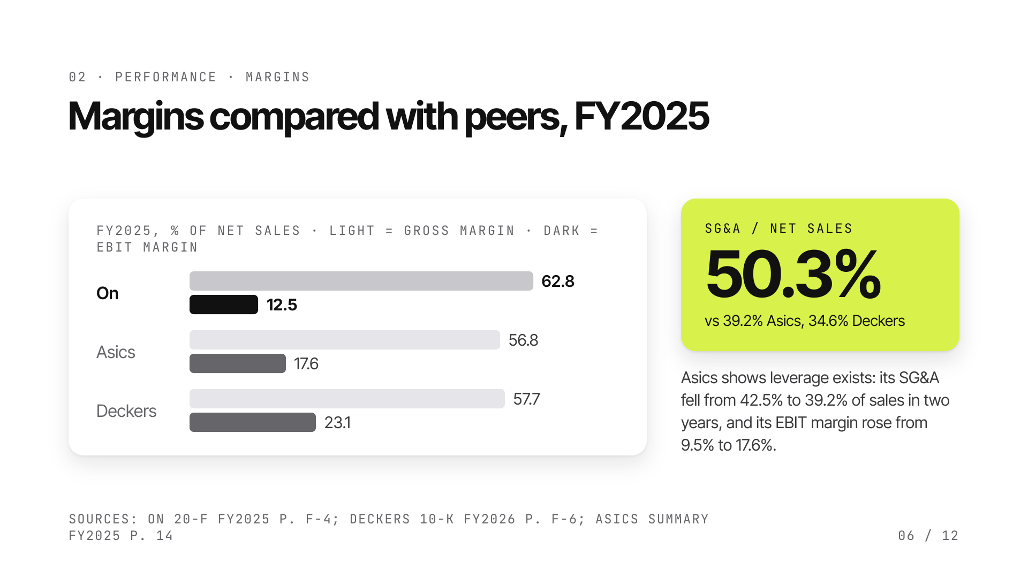
Notes:
On keeps more of each sale than its peers at gross level, then spends it on stores, marketing, teams and athletes. Share-based compensation explains only 2.1 points of the 50.3%. The 2029 plan is a bet that SG&A will finally fall as a share of sales, as it did at Asics.

Slide 7
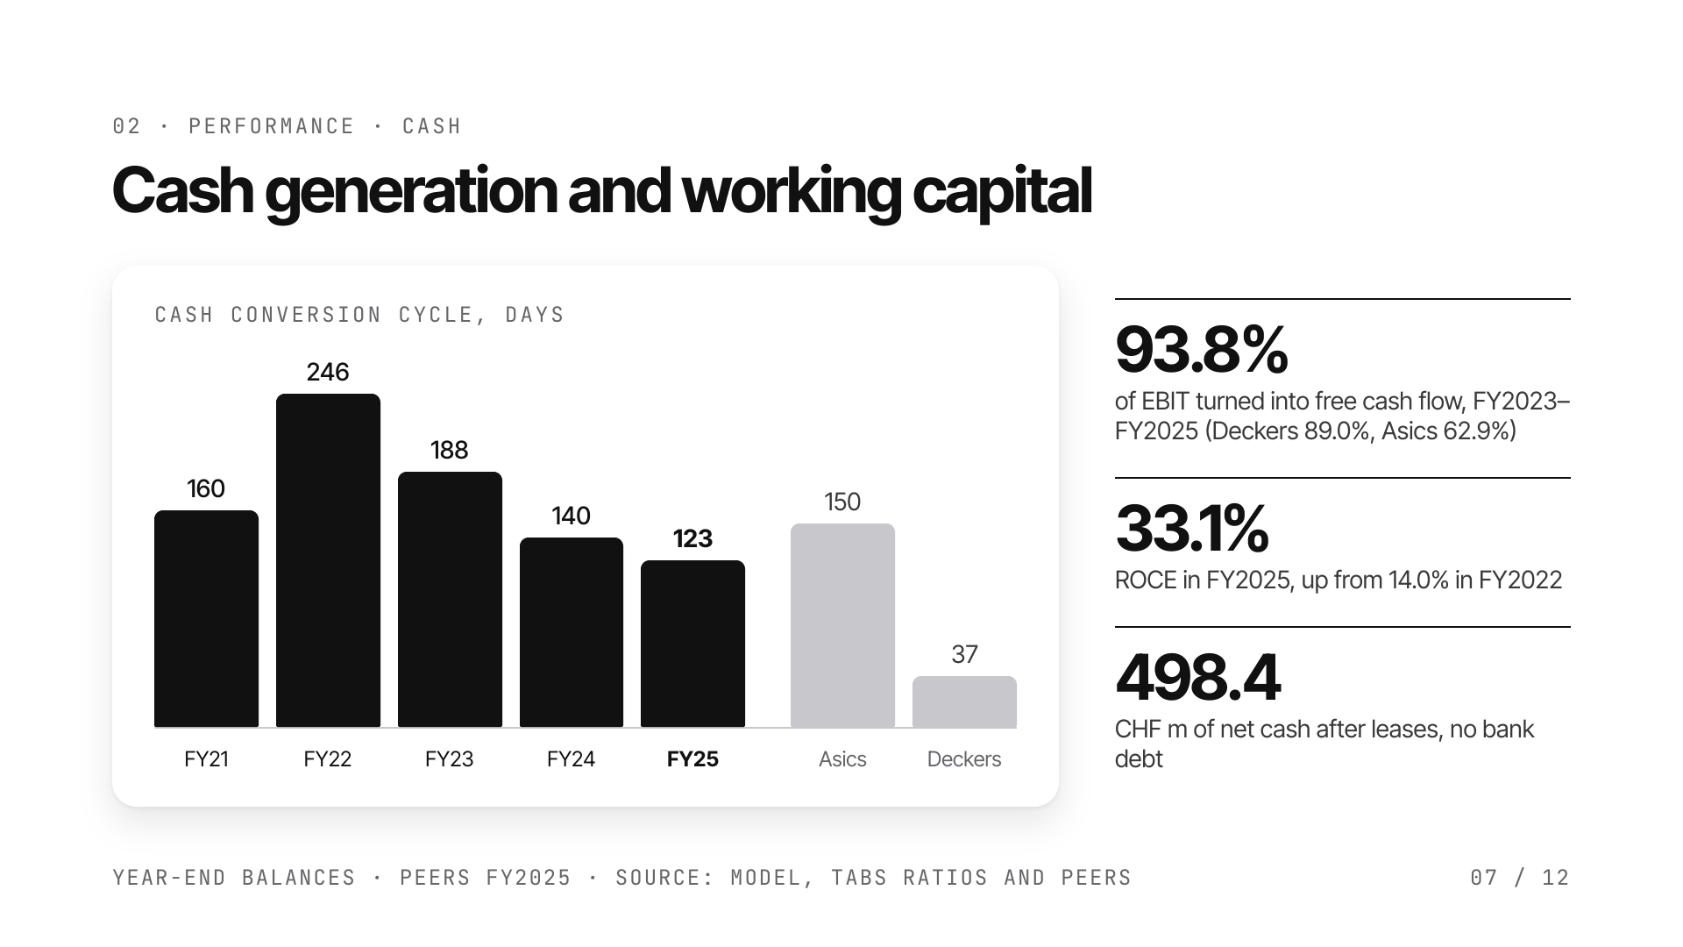
Notes:
In 2022 On built inventory to secure supply, then sold it down. Over three years it converts its EBIT into cash as well as Deckers. Its free cash flow margin is low only because its EBIT margin is low. Deckers' March year-end, after UGG's winter peak, flatters its days.

Slide 8
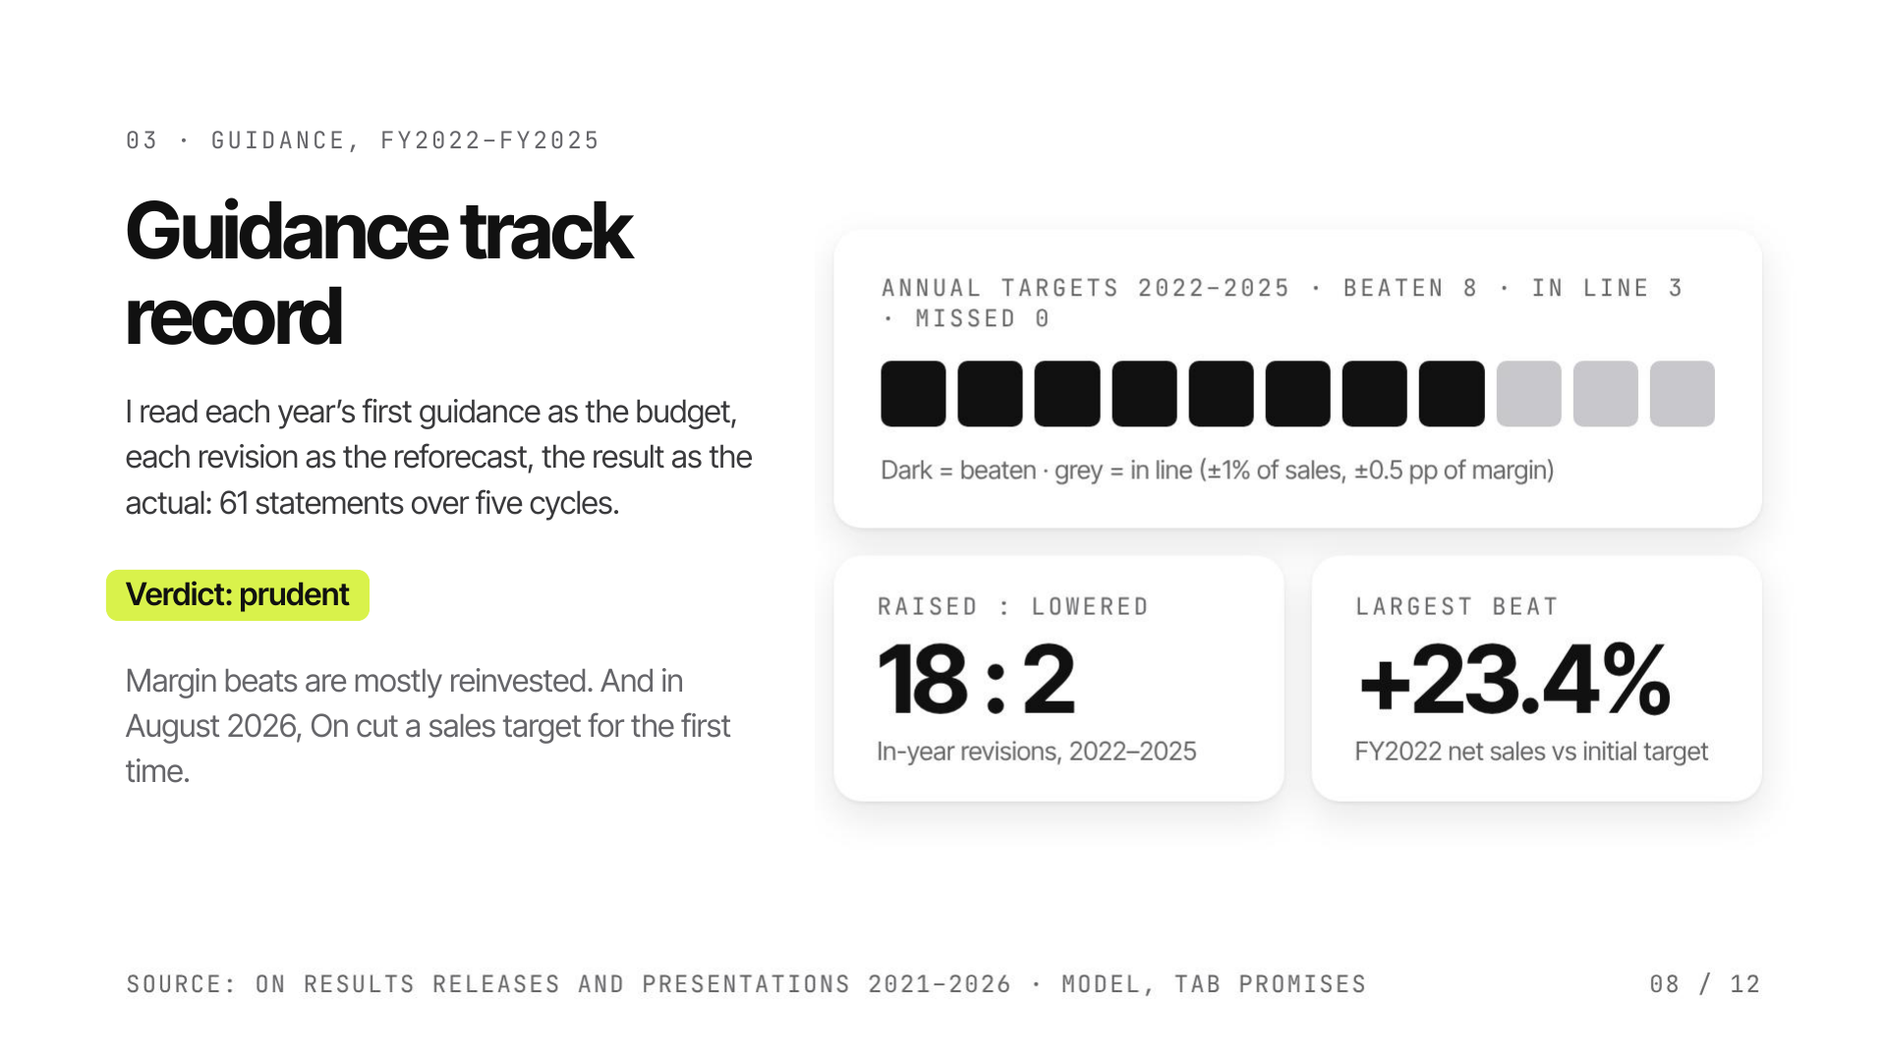
Notes:
Net sales beat the initial guidance every year, gross margin in all three guided years. Adjusted EBITDA margin is the exception: it lands on target because the gross margin surplus is reinvested. The 2026 cut looks chosen: On slows wholesale deliveries to protect full prices.

Slide 9
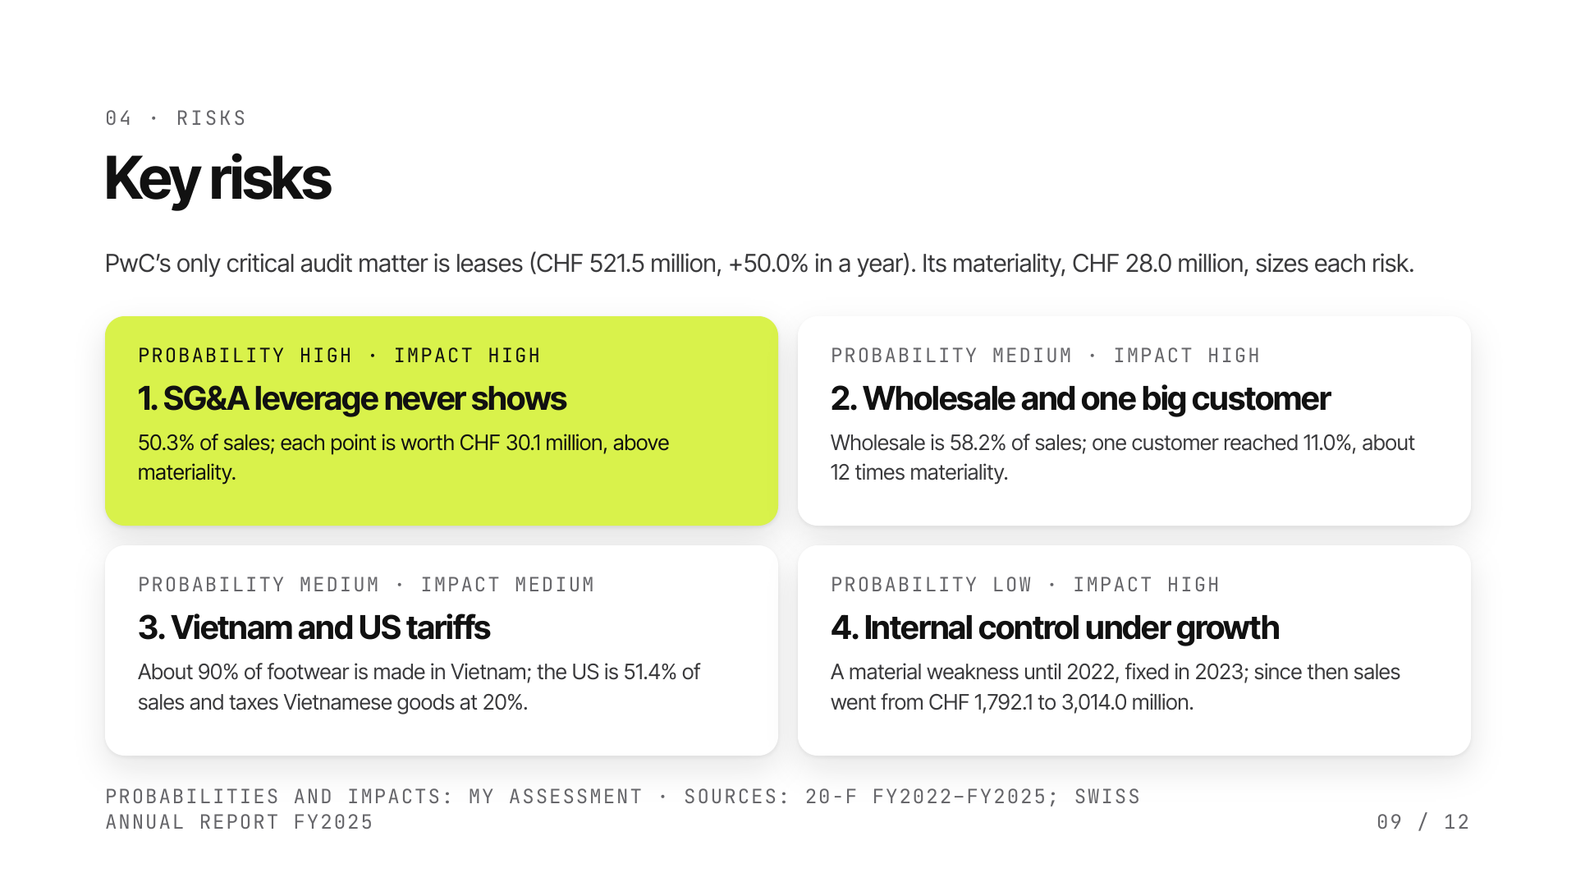
Notes:
I read the accounts as an internal auditor would. The auditor's only critical audit matter is leases, as On opens stores and warehouses. The four risks I retain are sized against PwC's group materiality. The first one, SG&A leverage, is also the heart of the forecast.

Slide 10
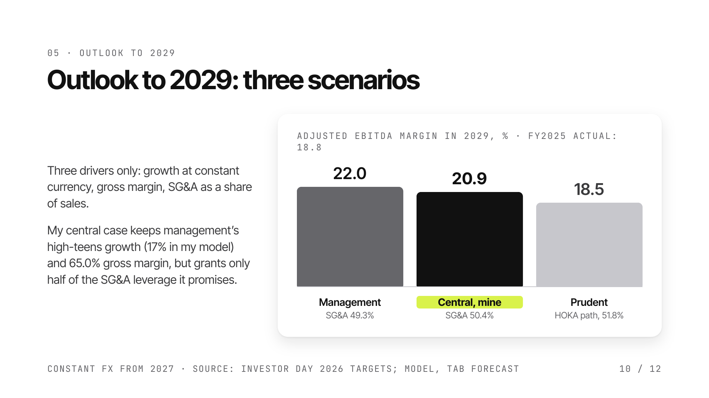
Notes:
Management's 2029 targets are internally consistent. I believe the sales and gross margin targets because they were beaten every year. I give half credit to the SG&A leverage because SG&A rose from 49.1% to 50.3% of sales between 2022 and 2025, and football and golf add costs. The prudent case follows HOKA's slowdown.

Slide 11
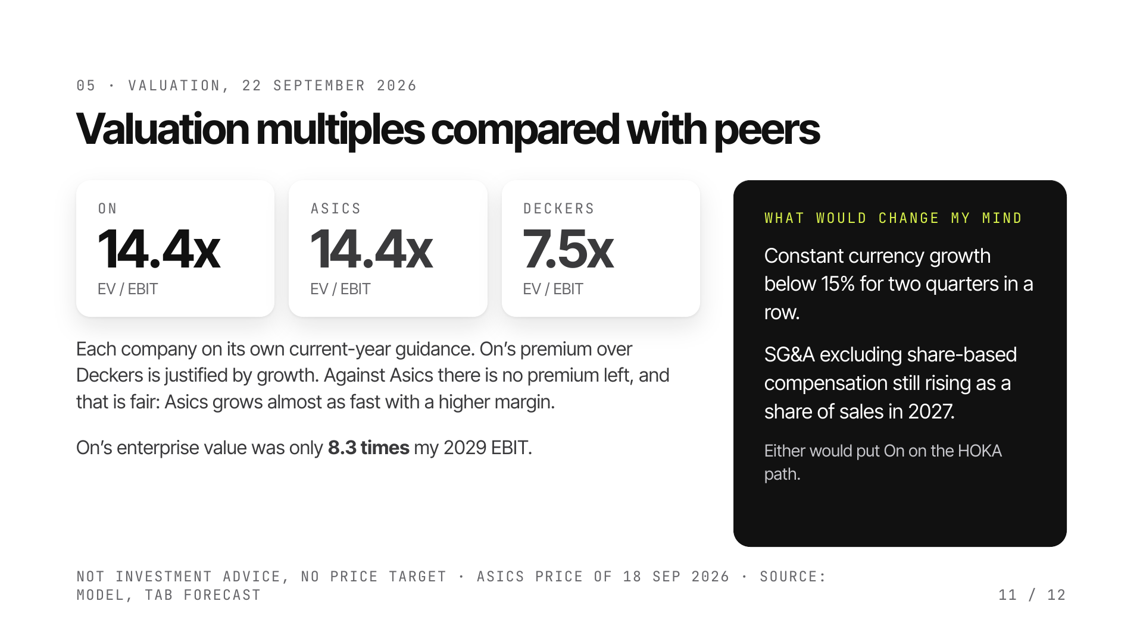
Notes:
EV/EBIT is the headline multiple because On's adjusted EBITDA is lifted by IFRS 16 and by excluding share-based compensation. P/E: 19.6x for On, 24.0x for Asics, 10.8x for Deckers. If On is still valued like Asics in 2029, my central case implies an enterprise value 1.7 times that of September 2026; on the HOKA path, valued like Deckers, 0.64 times.

Slide 12
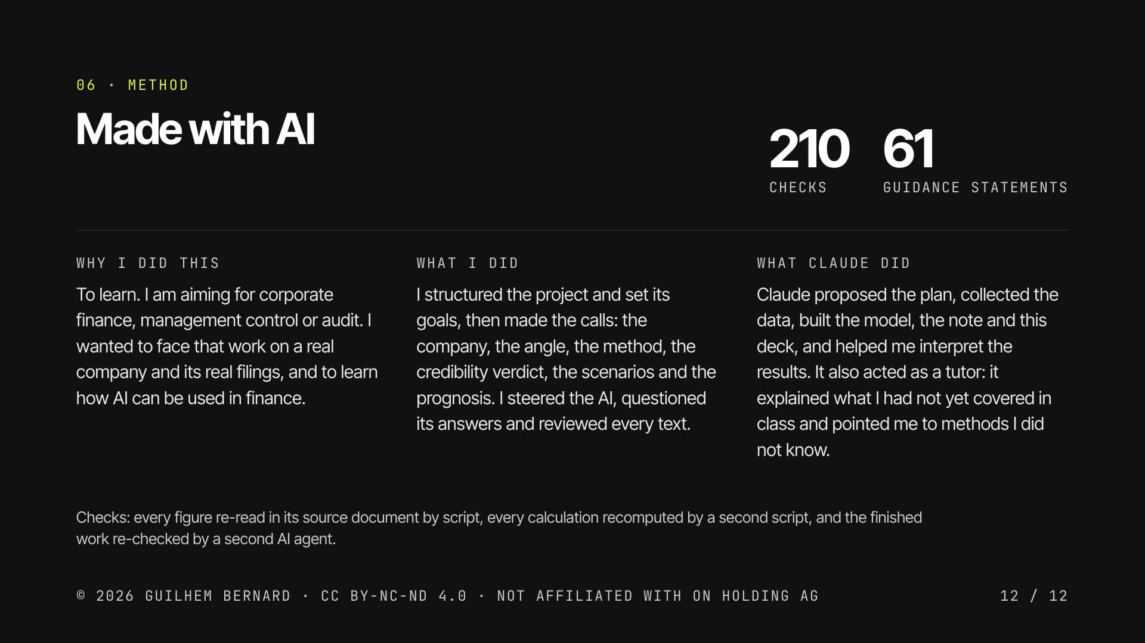
Notes:
I did this project to learn: to face the work I am aiming for on a real company and its real filings, and to learn how AI can be used in finance. I structured the project and made the calls; Claude collected the data, built the model and the documents, helped me interpret the results and explained what I had not yet covered in class. Every figure was re-read in its source document by script, and every calculation recomputed by a second script. The finished work was re-checked against the sources by a second AI agent: 654 figures, no wrong value. The full note and the Excel model are on the project page.

