Slide 1
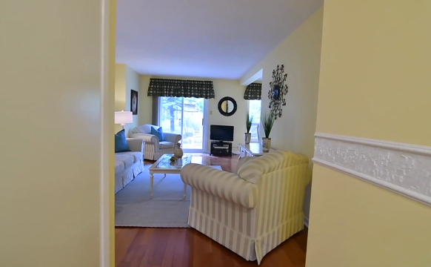
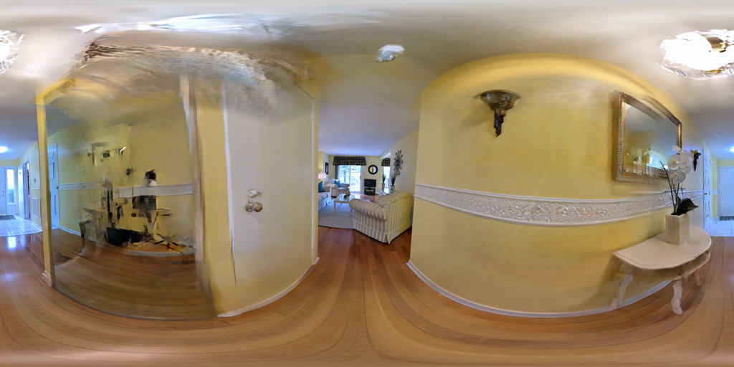
Framework overview
observations & geometry
restoration
3D feedback
Pinhole video → geometry-aware restoration → equirectangular 360° video
CAPTURE & RECONSTRUCTION
RENDER–RESTORE–DISTILL
PANORAMIC SYNTHESIS
World-locked overlapping
pinhole renders
ArtiFixer
Final
ArtiFixer3D+
Frame
extraction
video-to-video
Restored
pseudo-
observations
video restoration
Pinhole input video
one common temporal stream
Synchronized
panoramic rendering
spherical snake: stable directions + smooth turns
COLMAP
intrinsics · camera poses
sparse geometry
Spherical fusion / ERP projection
overlapping frustums · circular horizontal seam
Geometry-constrained
ArtiFixer3D distillation
Posed real frames
same camera centres
observations + calibrated cameras
real-image anchors
depth + overlap consistency
geometry preserved · appearance refined
3D feedback
Shared 3D
Gaussian Scene
Equirectangular 360°
video (ERP)
Initial 3DGRUT /
3D Gaussian Scene
source camera centres + source-facing orientation
No native spherical topology: propagation comes from temporal continuity, overlap, and shared 3D feedback

