Slide 1
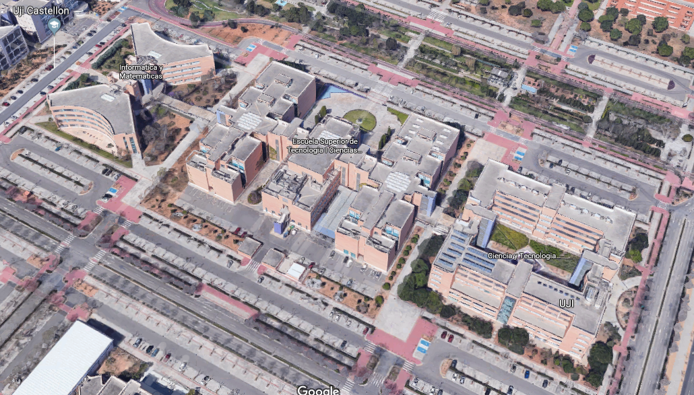
Indoor Location using Wi-Fi Signals
Guilherme Ribeiro

Slide 2
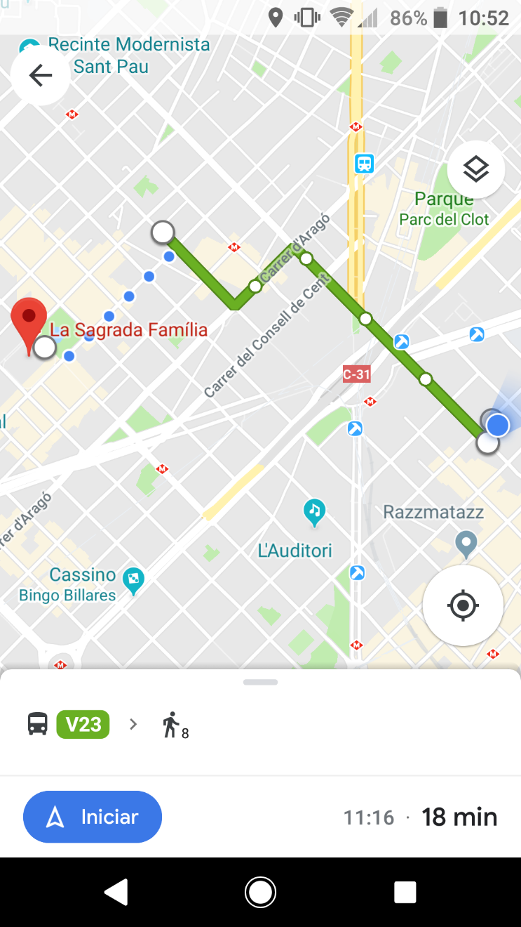
Context
Smartphones are very common now a days
People are used to use GPS based apps for location and route guide

Slide 3
Problem
GPS does not work inside buildings, shopping malls, airports etc.
How to overcome this issue?
Beacons
Wi-Fi signals

Slide 4
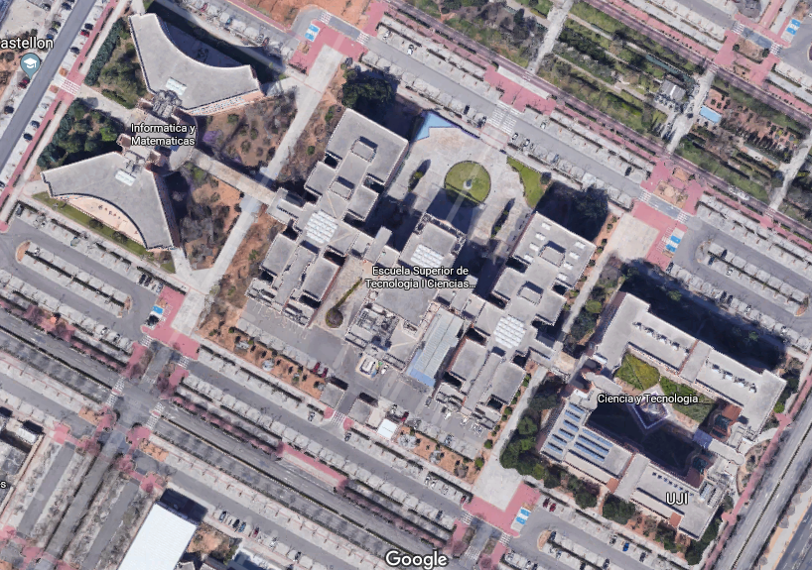
Data
Universitat Jaume I
3 Buildings
4 or 5 floors
110.000m²

Slide 5
Data
20 different users
25 different smartphone devices
529 attributes
520 Wireless Access Points (WAP)
Range: -104dBm to 0dBm
Building, Floor, Latitude, Longitude…
19.937 rows of training records
Fixed positions
1.111 rows of validation records
Random positions

Slide 6
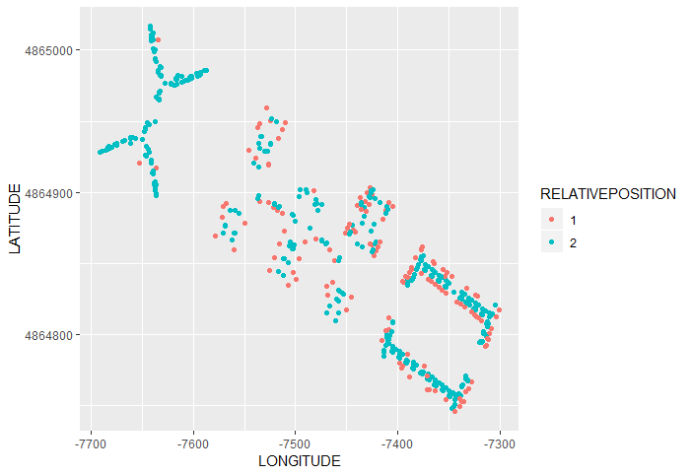
Data - Training

Slide 7
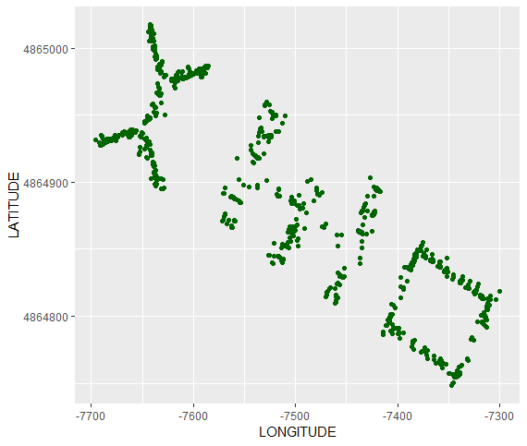
Data - Validation

Slide 8
Approach/Analysis
Divide and conquer
First, find the Building which a person is
Then, knowing the Building, find the Floor, Latitude and Longitude
Find the best algorithm for each problem based on its metrics
Random Forest
SVM
K-NN
Tune the algorithms selected to find their optimal parameters

Slide 9
Approach/Analysis
Replace the +100 values for -105 for all WAPs
Filter all WAPs with low variance
Sample the data in a representative way
Building prediction
10 points per floor per building
Floor, Latitude and Longitude prediction
Max of 5 points per room

Slide 10
Results
Building Prediction
SVM was chosen
 |  | Reference
 |  | 0 | 1 | 2
Prediction | 0 | 536 | 0 | 0
 | 1 | 0 | 307 | 0
 | 2 | 0 | 0 | 268
Accuracy | Kappa
1 | 1

Slide 11
Results
Floor predictions
Building 0
Building 1
Building 2
Random Forest
SVM
Random Forest
Accuracy | Kappa
0.9720149 | 0.9603814
Accuracy | Kappa
0.8078176 | 0.7280044
Accuracy | Kappa
0.9328358 | 0.9087625
 |  | Reference
 |  | 0 | 1 | 2 | 3
Prediction | 0 | 72 | 1 | 1 | 0
 | 1 | 3 | 207 | 3 | 0
 | 2 | 3 | 0 | 159 | 2
 | 3 | 0 | 0 | 2 | 83
 |  | Reference
 |  | 0 | 1 | 2 | 3
Prediction | 0 | 26 | 19 | 0 | 0
 | 1 | 1 | 95 | 1 | 0
 | 2 | 3 | 28 | 83 | 3
 | 3 | 0 | 1 | 3 | 44
 |  | Reference
 |  | 0 | 1 | 2 | 3 | 4
Prediction | 0 | 21 | 1 | 0 | 0 | 2
 | 1 | 3 | 107 | 1 | 0 | 0
 | 2 | 0 | 3 | 52 | 0 | 0
 | 3 | 0 | 0 | 1 | 37 | 4
 | 4 | 0 | 0 | 0 | 3 | 33

Slide 12
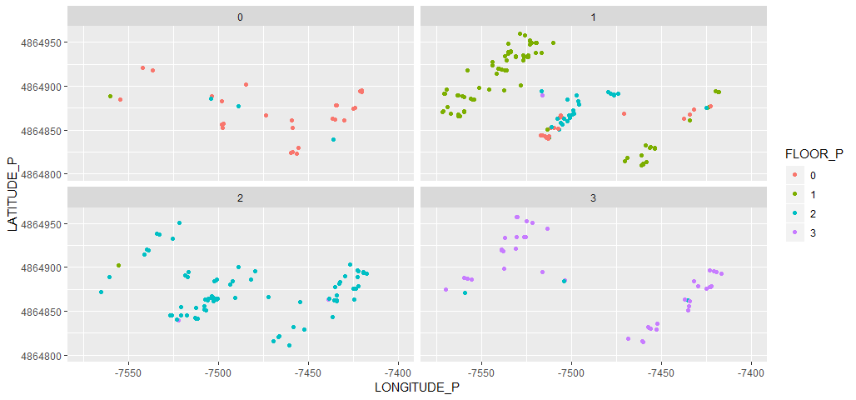
Error Analysis
Floor prediction for Building 1

Slide 13
Results
Latitude and Longitude predictions
Building 0
Building 1
Building 2
K-NN
Random Forest
K-NN
Latitude
RMSE | R² | MAE
5.1132279 | 0.9749703 | 3.5007124
Latitude
RMSE | R² | MAE
11.7345699 | 0.9002153 | 8.7780720
Latitude
RMSE | R² | MAE
9.7121582 | 0.8910852 | 6.8210913
Longitude
RMSE | R² | MAE
6.1092082 | 0.9479081 | 4.2998259
Longitude
RMSE | R² | MAE
9.2490759 | 0.9606184 | 7.0192680
Longitude
RMSE | R² | MAE
11.2548716 | 0.8752998 | 7.4059147

Slide 14
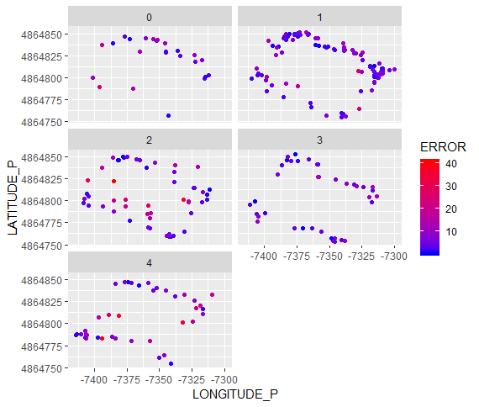
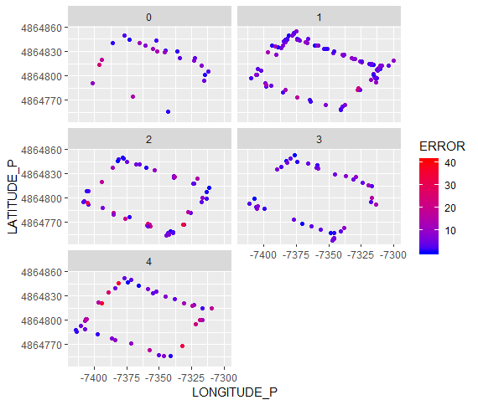
Error Analysis
Latitude prediction error in Building 2

Slide 15
Conclusions
We can get 100% accuracy in validation set for building prediction
We need further investigation on building 1 for floor prediction
Pre and post processing together could improve the model
Post processing on Latitude and Longitude based on building boundaries might decrease the errors

Slide 16
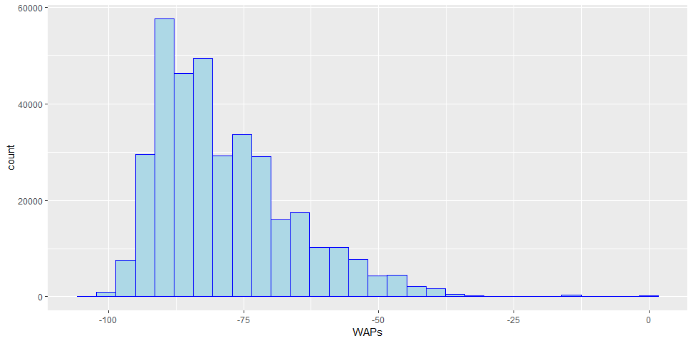
Appendix
WAPs signals strength distribution

Slide 17
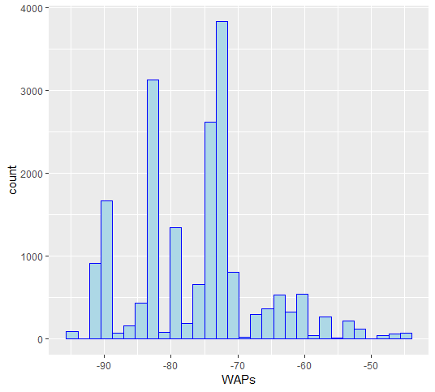
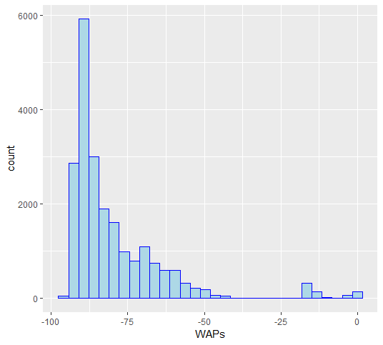
Appendix
WAPs signals strength distribution
Phone 17
Phone 19

