Slide 1

Cyclic Redundancy Check
Arquitetura de Computadores Avançada
Paulo Sousa, 80000
Bruno Castro, 80190

Slide 2
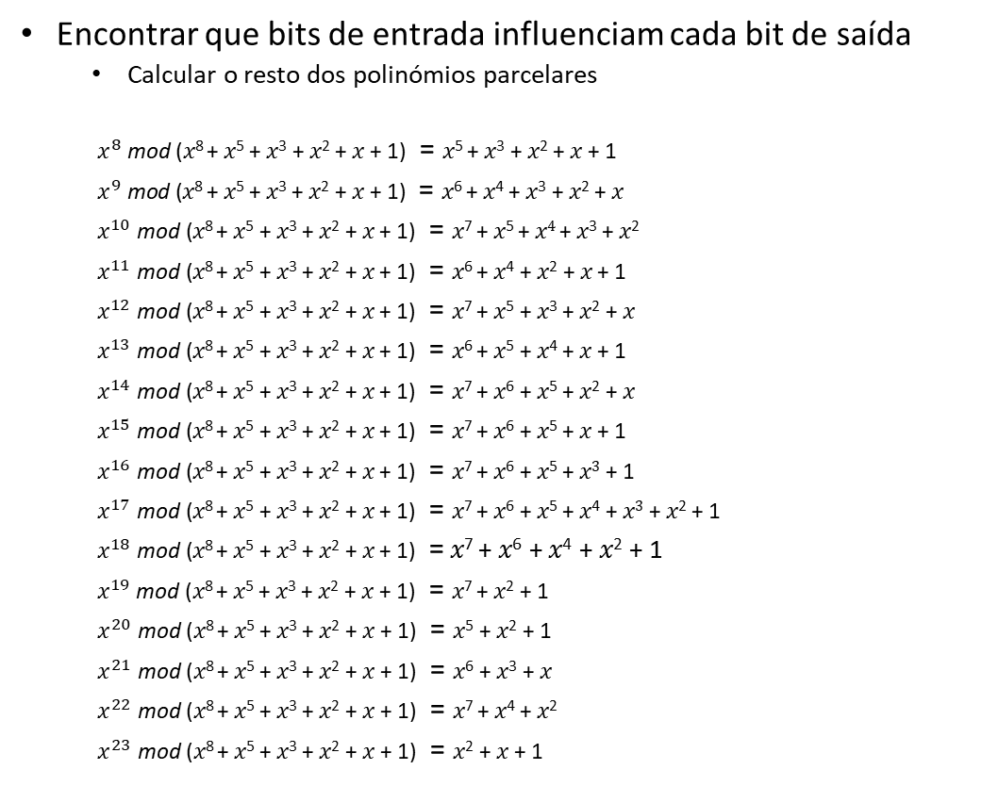
Solução
Encontrar que bits de entrada influenciam cada bit de saída
Calcular o resto dos polinómios parcelares
${ x}^{8} \text{mod}\text{ (}x\text{8 }\text{+} x\text{5}\text{ +} x\text{3}\text{ +} x\text{2}\text{ +} x \text{+ 1)}$ = $x\text{5 }\text{+} x\text{3}\text{ +} x\text{2}\text{ +} x \text{+ 1}$
${ x}^{9} \text{mod}\text{ (}x\text{8 }\text{+} x\text{5}\text{ +} x\text{3}\text{ +} x\text{2}\text{ +} x \text{+ 1)}$ = $x\text{6 }\text{+} x\text{4}\text{ +} x\text{3}\text{ +} x\text{2}\text{ +} x$
${ x}^{10} \text{mod}\text{ (}x\text{8 }\text{+} x\text{5}\text{ +} x\text{3}\text{ +} x\text{2}\text{ +} x \text{+ 1)}$ = $x\text{7 }\text{+} x\text{5} \text{+} x4 \text{+} x\text{3}\text{ +} x\text{2}$
${ x}^{11} \text{mod}\text{ (}x\text{8 }\text{+} x\text{5}\text{ +} x\text{3}\text{ +} x\text{2}\text{ +} x \text{+ 1)}$ = $x\text{6 }\text{+} x\text{4}\text{ +} x\text{2}\text{ +} x \text{+ 1}$
${ x}^{12} \text{mod}\text{ (}x\text{8 }\text{+} x\text{5}\text{ +} x\text{3}\text{ +} x\text{2}\text{ +} x \text{+ 1)}$ = $x\text{7 }\text{+} x\text{5}\text{ +} x\text{3}\text{ +} x\text{2}\text{ +} x$
${ x}^{13} \text{mod}\text{ (}x\text{8 }\text{+} x\text{5}\text{ +} x\text{3}\text{ +} x\text{2}\text{ +} x \text{+ 1)}$ = $x\text{6 }\text{+} x\text{5}\text{ +} x\text{4}\text{ +} x \text{+ 1}$
${ x}^{14} \text{mod}\text{ (}x\text{8 }\text{+} x\text{5}\text{ +} x\text{3}\text{ +} x\text{2}\text{ +} x \text{+ 1)}$ = $x\text{7 }\text{+} x\text{6}\text{ +} x\text{5}\text{ +} x\text{2}\text{ +} x$
${ x}^{15} \text{mod}\text{ (}x\text{8 }\text{+} x\text{5}\text{ +} x\text{3}\text{ +} x\text{2}\text{ +} x \text{+ 1)}$ = $x\text{7 }\text{+} x\text{6}\text{ +} x\text{5}\text{ +} x \text{+ 1}$
${ x}^{16} \text{mod}\text{ (}x\text{8 }\text{+} x\text{5}\text{ +} x\text{3}\text{ +} x\text{2}\text{ +} x \text{+ 1)}$ = $x\text{7 }\text{+} x\text{6}\text{ +} x\text{5}\text{ +} x3 \text{+ }\text{1}$
${ x}^{17} \text{mod}\text{ (}x\text{8 }\text{+} x\text{5}\text{ +} x\text{3}\text{ +} x\text{2}\text{ +} x \text{+ 1)}$ = $x\text{7 }\text{+} x\text{6}\text{ +} x\text{5}\text{ +} x\text{4}\text{ +} x3 \text{+} x\text{2} \text{+ }\text{1}$
${ x}^{18} \text{mod}\text{ (}x\text{8 }\text{+} x\text{5}\text{ +} x\text{3}\text{ +} x\text{2}\text{ +} x \text{+ 1)}$ =$x\text{7 }\text{+} x\text{6}\text{ +} x\text{4}\text{ +} x\text{2}\text{ + 1}$
${ x}^{19} \text{mod}\text{ (}x\text{8 }\text{+} x\text{5}\text{ +} x\text{3}\text{ +} x\text{2}\text{ +} x \text{+ 1)}$ = $x\text{7 }\text{+} x\text{2}\text{ + 1}$
${ x}^{20} \text{mod}\text{ (}x\text{8 }\text{+} x\text{5}\text{ +} x\text{3}\text{ +} x\text{2}\text{ +} x \text{+ 1)}$ = $x\text{5}\text{ +} x\text{2}\text{ + 1}$
${ x}^{21} \text{mod}\text{ (}x\text{8 }\text{+} x\text{5}\text{ +} x\text{3}\text{ +} x\text{2}\text{ +} x \text{+ 1)}$ = $x\text{6}\text{ +} x\text{3} \text{+ }x$
${ x}^{22} \text{mod}\text{ (}x\text{8 }\text{+} x\text{5}\text{ +} x\text{3}\text{ +} x\text{2}\text{ +} x \text{+ 1)}$ = $x\text{7 }\text{+} x\text{4}\text{ +} x\text{2}$
${ x}^{23} \text{mod}\text{ (}x\text{8 }\text{+} x\text{5}\text{ +} x\text{3}\text{ +} x\text{2}\text{ +} x \text{+ 1)}$ = $x\text{2}\text{ +} x \text{+ 1}$
Bit | x⁷ | x⁶ | x⁵ | x⁴ | x³ | x² | x¹ | x⁰
0 |  |  | 1 |  | 1 | 1 | 1 | 1
1 |  | 1 |  | 1 | 1 | 1 | 1
2 | 1 |  | 1 | 1 | 1 | 1
3 |  | 1 |  | 1 |  | 1 | 1 | 1
4 | 1 |  | 1 |  | 1 | 1 | 1
5 |  | 1 | 1 | 1 |  |  | 1 | 1
6 | 1 | 1 | 1 |  |  | 1 | 1
7 | 1 | 1 | 1 |  |  |  | 1 | 1
8 | 1 | 1 | 1 |  | 1 |  |  | 1
9 | 1 | 1 | 1 | 1 | 1 | 1 |  | 1
10 | 1 | 1 |  | 1 |  | 1 |  | 1
11 | 1 |  |  |  |  | 1 |  | 1
12 |  |  | 1 |  |  | 1 |  | 1
13 |  | 1 |  |  | 1 |  | 1
14 | 1 |  |  | 1 |  | 1
15 |  |  |  |  |  | 1 | 1 | 1

Slide 3
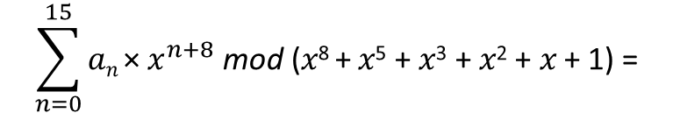
Solução
= (a₂ ⊕ a₄ ⊕ a₆ ⊕ a₇ ⊕ a₈ ⊕ a₉ ⊕ a₁₀ ⊕ a₁₁ ⊕ a₁₄) × x⁷ +
+ (a₁ ⊕ a₃ ⊕ a₅ ⊕ a₆ ⊕ a₇ ⊕ a₈ ⊕ a₉ ⊕ a₁₀ ⊕ a₁₃) × x⁶ +
+ (a₀ ⊕ a₂ ⊕ a₄ ⊕ a₅ ⊕ a₆ ⊕ a₇ ⊕ a₈ ⊕ a₉ ⊕ a₁₂) × x⁵ +
+ (a₁ ⊕ a₂ ⊕ a₃ ⊕ a₅ ⊕ a₉ ⊕ a₁₀ ⊕ a₁₄ ) × x⁴ +
+ (a₀ ⊕ a₁ ⊕ a₂ ⊕ a₄ ⊕ a₈ ⊕ a₉ ⊕ a₁₃) × x³ +
+ (a₀ ⊕ a₁ ⊕ a₂ ⊕ a₃ ⊕ a₄ ⊕ a₆ ⊕ a₉ ⊕ a₁₀ ⊕ a₁₁ ⊕ a₁₂ ⊕ a₁₄ ⊕ a₁₅) × x² +
+ (a₀ ⊕ a₁ ⊕ a₃ ⊕ a₄ ⊕ a₅ ⊕ a₆ ⊕ a₇ ⊕ a₁₃ ⊕ a₁₅) × x +
+ (a₀ ⊕ a₃ ⊕ a₅ ⊕ a₇ ⊕ a₈ ⊕ a₉ ⊕ a₁₀ ⊕ a₁₁ ⊕ a₁₂ ⊕ a₁₅)
= ((a₂ ⊕ a₁₀) ⊕ (a₄ ⊕ a₆) ⊕ a₇ ⊕ (a₈ ⊕ a₉) ⊕ a₁₁ ⊕ a₁₄ ) × x⁷ +
+ ((a₁ ⊕ a₃) ⊕ (a₅ ⊕ a₇) ⊕ a₆ ⊕ (a₈ ⊕ a₉) ⊕ a₁₀ ⊕ a₁₃) × x⁶ +
+ ((a₀ ⊕ a₂) ⊕ (a₄ ⊕ a₆) ⊕ (a₅ ⊕ a₇) ⊕ (a₈ ⊕ a₉) ⊕ a₁₂) × x⁵ +
+ ((a₁ ⊕ a₃) ⊕ (a₂ ⊕ a₁₀) ⊕ a₅ ⊕ (a₉ ⊕ a₁₄)) × x⁴ +
+ ((a₀ ⊕ a₂) ⊕ a₁ ⊕ a₄ ⊕ (a₈ ⊕ a₉) ⊕ a₁₃) × x³ +
+ ((a₀ ⊕ a₁₅) ⊕ (a₁ ⊕ a₃) ⊕ (a₂ ⊕ a₁₀) ⊕ (a₄ ⊕ a₆) ⊕ (a₉ ⊕ a₁₄) ⊕ (a₁₁ ⊕ a₁₂)) × x² +
+ ((a₀ ⊕ a₁₅) ⊕ (a₁ ⊕ a₃) ⊕ (a₄ ⊕ a₆) ⊕ (a₅ ⊕ a₇) ⊕ a₁₃) × x +
+ ((a₀ ⊕ a₁₅) ⊕ a₃ ⊕ (a₅ ⊕ a₇) ⊕ (a₈ ⊕ a₉) ⊕ a₁₀ ⊕ (a₁₁ ⊕ a₁₂))
= ((a₂ ⊕ a₁₀ ⊕ a₈ ⊕ a₉) ⊕ (a₄ ⊕ a₆) ⊕ a₇ ⊕ a₁₁ ⊕ a₁₄ ) × x⁷ +
+ ((a₁ ⊕ a₃) ⊕ (a₅ ⊕ a₇ ⊕ a₈ ⊕ a₉) ⊕ a₆ ⊕ a₁₀ ⊕ a₁₃) × x⁶ +
+ ((a₀ ⊕ a₂ ⊕ a₈ ⊕ a₉) ⊕ (a₄ ⊕ a₆ ⊕ a₅ ⊕ a₇) ⊕ a₁₂) × x⁵ +
+ ((a₁ ⊕ a₃) ⊕ (a₂ ⊕ a₁₀ ⊕ a₉ ⊕ a₁₄) ⊕ a₅) × x⁴ +
+ ((a₀ ⊕ a₂ ⊕ a₈ ⊕ a₉) ⊕ a₁ ⊕ a₄ ⊕ a₁₃) × x³ +
+ ((a₀ ⊕ a₁₅ ⊕ a₁ ⊕ a₃) ⊕ (a₂ ⊕ a₁₀ ⊕ a₉ ⊕ a₁₄) ⊕ (a₄ ⊕ a₆) ⊕ (a₁₁ ⊕ a₁₂)) × x² +
+ ((a₀ ⊕ a₁₅ ⊕ a₁ ⊕ a₃) ⊕ (a₄ ⊕ a₆ ⊕ a₅ ⊕ a₇) ⊕ a₁₃) × x +
+ ((a₀ ⊕ a₁₅) ⊕ a₃ ⊕ (a₅ ⊕ a₇ ⊕ a₈ ⊕ a₉) ⊕ a₁₀ ⊕ (a₁₁ ⊕ a₁₂))
$$\sum_{n=0}^{15}{an \text{×}{ x}^{n+8} \text{mod}\text{ (}x\text{8 }\text{+} x\text{5}\text{ +} x\text{3}\text{ +} x\text{2}\text{ +} x \text{+ 1) }\text{=}}$$

Slide 4
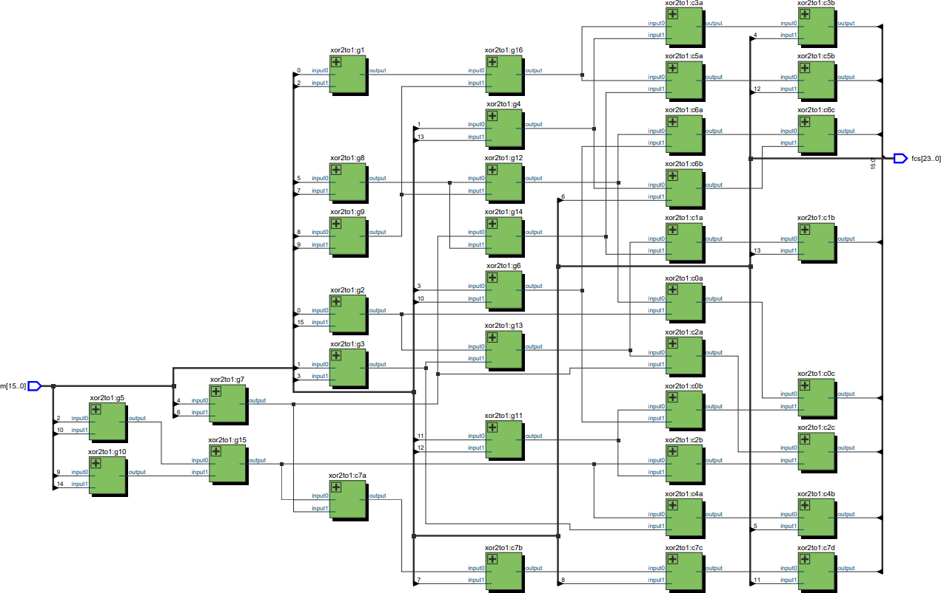
Encoder
Número de gates X-OR 2 : 37
Número de atraso de propagação de gates X-OR 2 no pior caso: 6

Slide 5
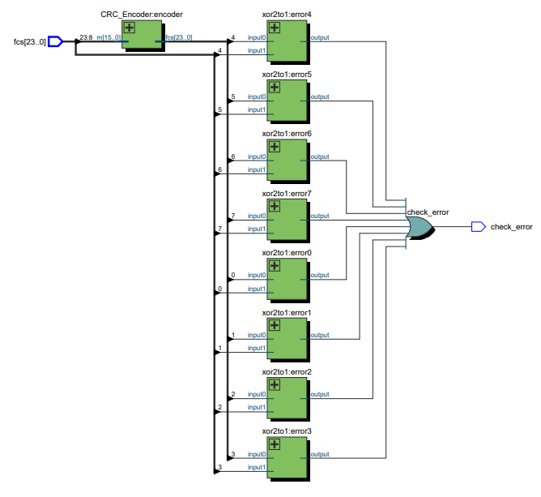
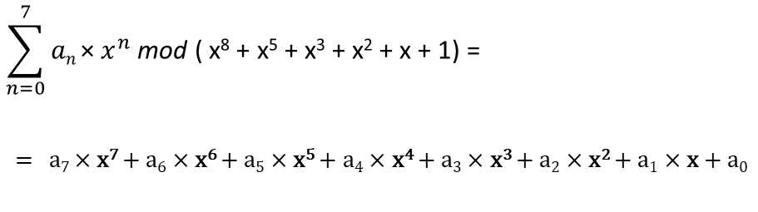
Checker
$$\sum_{n=0}^{7}{an \text{×}{ x}^{n} \text{mod}\text{ ( }\text{x}\text{8}\text{ + }\text{x}\text{5}\text{ + }\text{x}\text{3}\text{ + }\text{x}\text{2}\text{ + }\text{x}\text{ + 1) }\text{= }}$$
= a₇ × x⁷ + a₆ × x⁶ + a₅ × x⁵ + a₄ × x⁴ + a₃ × x³ + a₂ × x² + a₁ × x + a₀
Número de gates X-OR 2 : 37 + 8 = 52
Check_error:
0 = sem erro
1 = com erro

