Slide 1
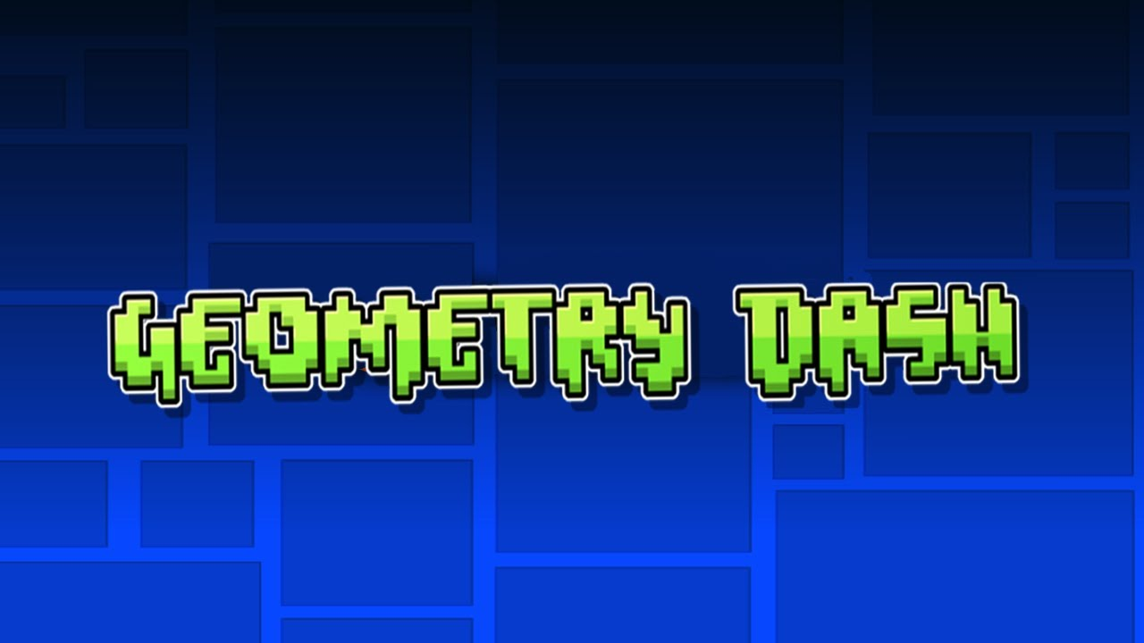

Slide 2

Idea
Demo
What’s left?

Slide 3
Idea
The idea was to create a game similar to the
geometry dash game that already exists in 2D on
the play store and I will try to recreate it in 3D
using three js.
ATRAS

Slide 4
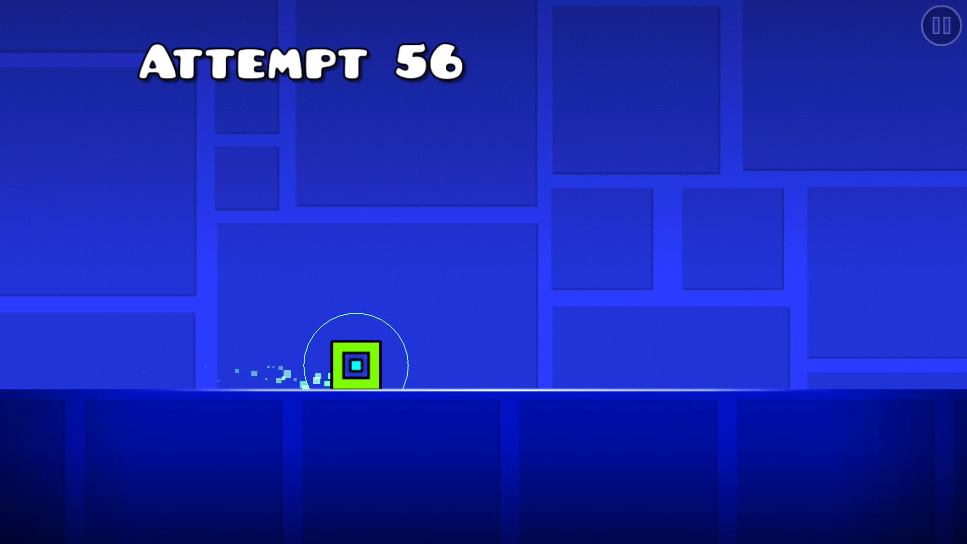
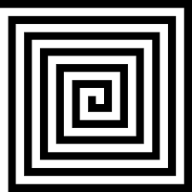

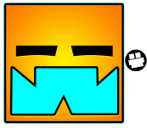
URL: https://guilhermedu.github.io/ICG/

Slide 5
What’s left?
More Shadows
collision logic
Scoreboard
Camera Locked
Mouse Movement
Add difficulty to the game
Improve lighting planning

Slide 6


Thanks!

