Slide 1

Code and Conquer
The Data Science Uprising
Code and Conquer
The Data Science Uprising
Gui freire oliveira

Slide 2


A WORD OF CAUTION BEFORE YOU START
The content of this eBook was generated by ChatGPT without direct human curation. As such, some information may be imprecise or inaccurate. This eBook is not intended to serve as formal educational material, but rather as an inspiration — a demonstration of how artificial intelligence can enhance creativity and assist in generating new ideas and content. Readers are encouraged to verify all technical details independently and use this work as a starting point for exploration, not as a definitive guide.

Slide 3
ENTER THE DATA BATTLEFIELD
We live in an era where data fuels every strategic decision — from business forecasts to personalized healthcare. In this digital battlefield, data scientists are the new tacticians, wielding algorithms and code to turn chaos into clarity. This uprising is not just about mathematics or programming; it’s about harnessing the synergy between data intuition and machine precision. By mastering Python, pandas, and scikit-learn, you gain command of the most effective weapons in data warfare — tools that let you extract patterns, predict outcomes, and automate insights. The following chapters prepare you for this conquest, from cleaning the trenches of raw data to deploying machine learning models that win real-world battles.

Slide 4
1.
The Arsenal: Core Tools of Data Science

Slide 5
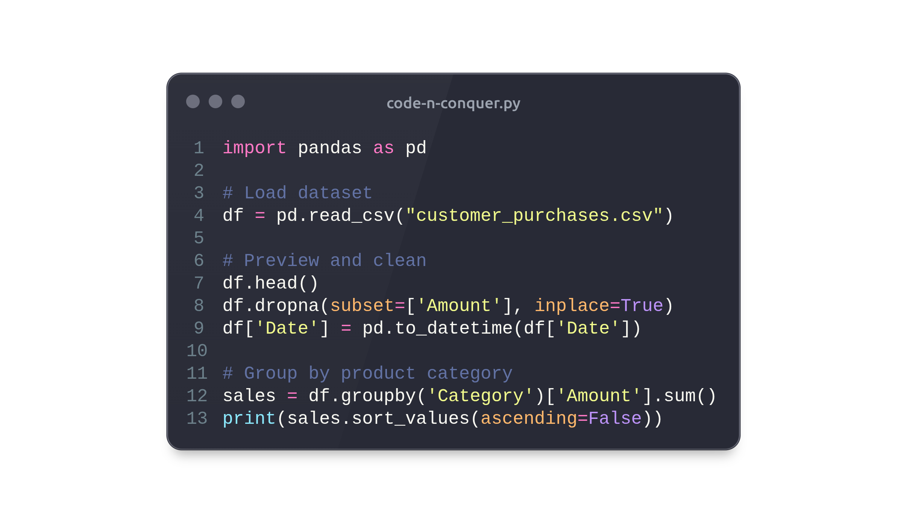
PANDAS — THE TACTICAL COMMANDER
Pandas is the backbone of any data science operation — it structures, cleans, and transforms data into an analyzable form. With pandas, vast tables of raw information become navigable through DataFrames, enabling you to inspect, filter, and summarize data effortlessly. For example, in retail analytics, pandas helps identify best-selling product categories and seasonal buying patterns by aggregating and grouping sales data. A simple command like df.groupby('Category')['Amount'].sum() can reveal where most revenue originates, guiding strategic marketing and inventory decisions. It is not just a library; it’s a commander giving you control over the battlefield of numbers.

Slide 6
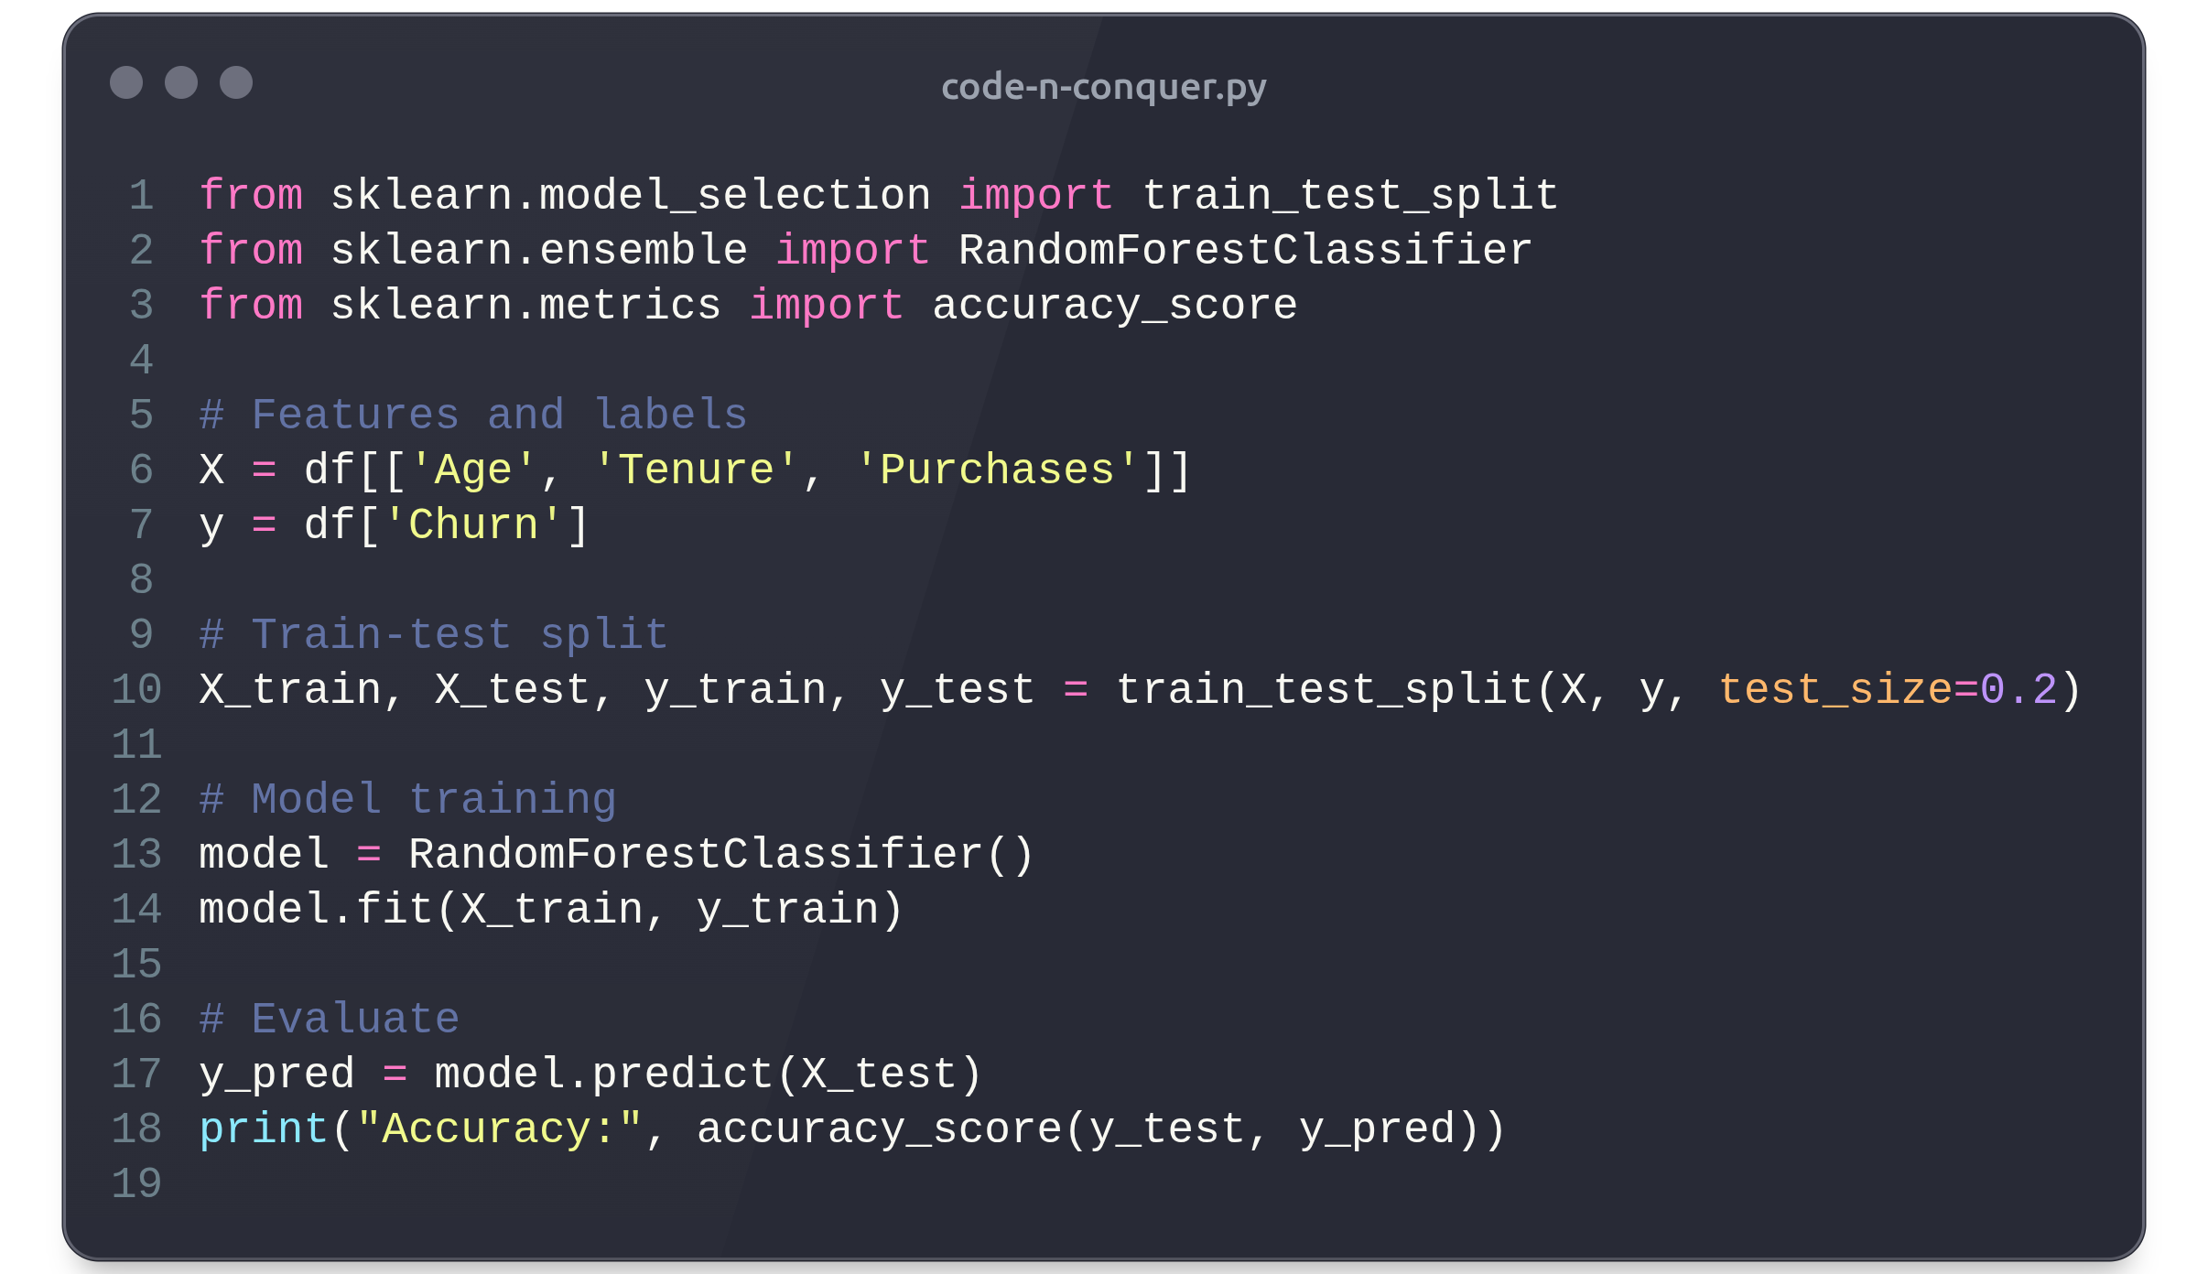
SCIKIT-LEARN — THE MACHINE’S MIND
Scikit-learn is where intelligence takes form — it equips you to train, test, and deploy predictive models using structured data. Whether you’re classifying customer churn or predicting stock prices, scikit-learn provides efficient implementations of algorithms from decision trees to neural networks. For instance, a telecom company can train a Random Forest Classifier to predict customer churn by analyzing user age, tenure, and purchase history, allowing them to proactively retain at-risk clients. Beyond modeling, scikit-learn standardizes workflows with consistent APIs for preprocessing, feature selection, and evaluation — turning raw data into operational intelligence with elegance and precision.

Slide 7
2.
Strategic Offensives: Machine Learning in Action

Slide 8
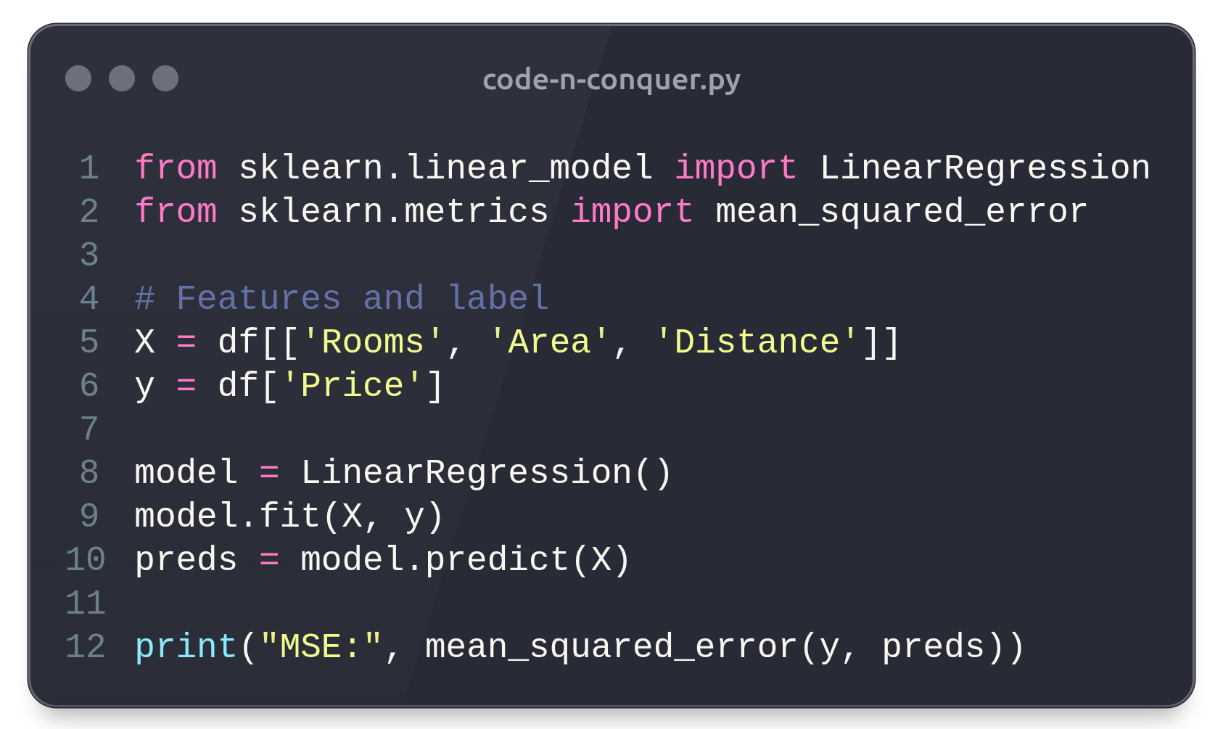
REGRESSION — PREDICTING THE FUTURE
Regression models are the predictive snipers of data science, allowing you to estimate continuous outcomes such as prices, demand, or performance. Using Linear Regression in scikit-learn, you can model relationships between variables — for instance, predicting house prices based on rooms, area, and distance from the city center. This is exactly how real estate companies determine optimal pricing strategies by understanding how features influence value. Regression analysis doesn’t just predict — it quantifies impact, helping decision-makers see how a single variable shift (like location or square footage) can alter outcomes in the competitive housing market.

Slide 9
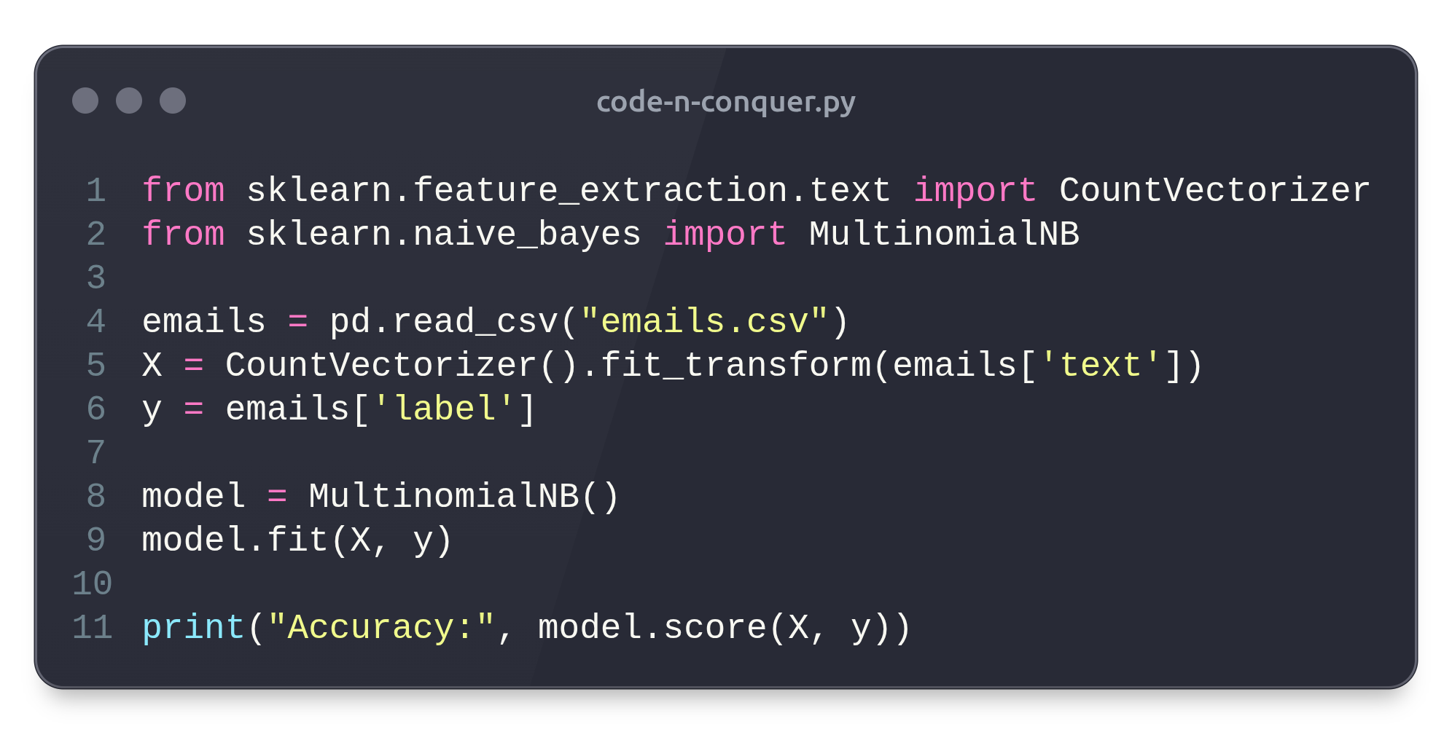
CLASSIFICATION — DECIDING THE WINNER
Classification algorithms are decisive strategists — they separate one class from another, enabling spam filters, fraud detection, and medical diagnostics. For example, a Naive Bayes Classifier can analyze email content to distinguish spam from legitimate messages, learning from word frequencies and patterns in labeled datasets. This form of supervised learning is vital wherever binary or multiclass outcomes exist, such as predicting loan approvals or disease presence. Through efficient preprocessing and feature engineering, classification models transform seemingly random information into actionable insight — an essential move in every data-driven battle for clarity.

Slide 10
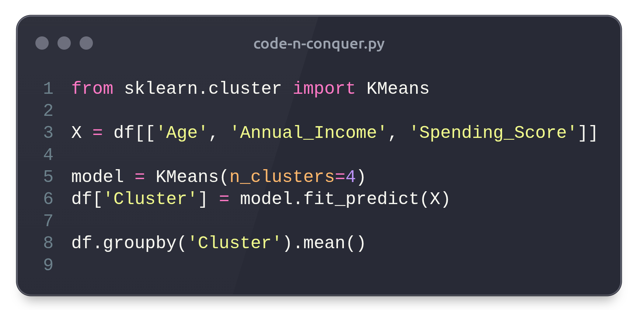
CLUSTERING — THE ART OF DIVISION
Clustering operates without supervision, discovering hidden structures in unlabeled data — much like reconnaissance units uncovering enemy formations. A classic technique, K-Means Clustering, is widely used in marketing to segment customers by behavior and demographics. By analyzing age, income, and spending habits, it divides a customer base into distinct clusters, enabling personalized campaigns that boost engagement. In the corporate world, clustering has become the foundation of customer insight, allowing organizations to understand diverse audiences without any prior assumptions. The power lies in revealing the patterns you didn’t know existed — and exploiting them strategically.

Slide 11
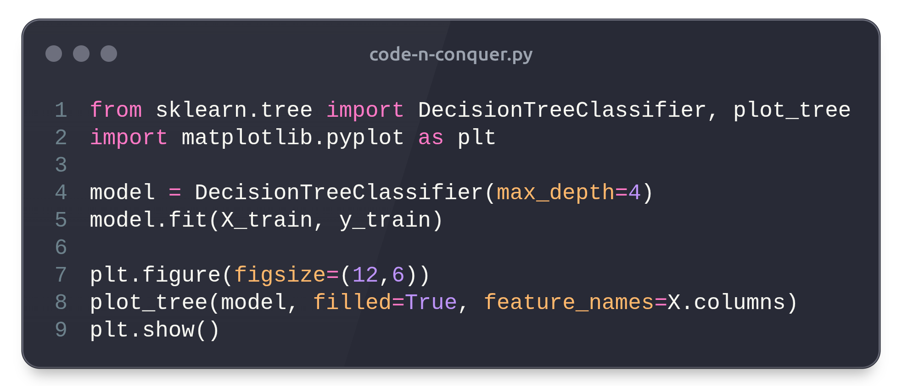
DECISION TREES — THE TACTICAL PLANNER
Decision Trees are intuitive and explainable models that map out the reasoning process behind predictions. Each branch represents a question, and each leaf an outcome — making them both powerful and transparent. A bank, for instance, can train a DecisionTreeClassifier to predict loan approvals based on income, credit score, and debt ratio, visually showing how each factor influences decisions. Unlike black-box models, decision trees are interpretable, making them ideal in regulated industries where explainability is critical. They bring order to complex decision-making — turning abstract data into clear, visual intelligence.

Slide 12
3.
Advanced Warfare — Ensemble and Deep Learning

Slide 13
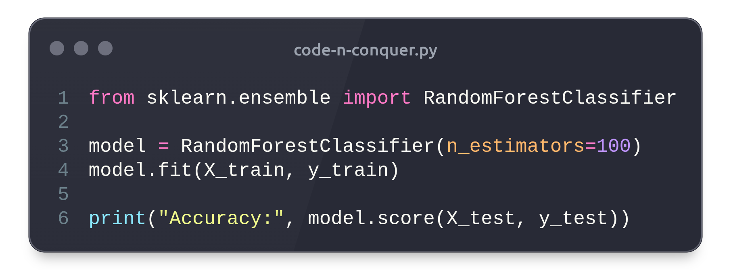
ENSEMBLE LEARNING — STRENGTH IN UNITY
In warfare, multiple units working together outperform a lone soldier — the same logic drives Ensemble Learning. Techniques like Random Forests and Gradient Boosting combine multiple models to achieve higher accuracy and resilience. For example, financial institutions use ensemble models to detect fraudulent transactions by analyzing spending patterns, time intervals, and user behaviors, dramatically reducing false positives. Each model contributes a “vote,” ensuring that the final prediction is balanced and robust. Ensemble methods embody the philosophy that collective intelligence, when properly coordinated, always outperforms isolated efforts.

Slide 14
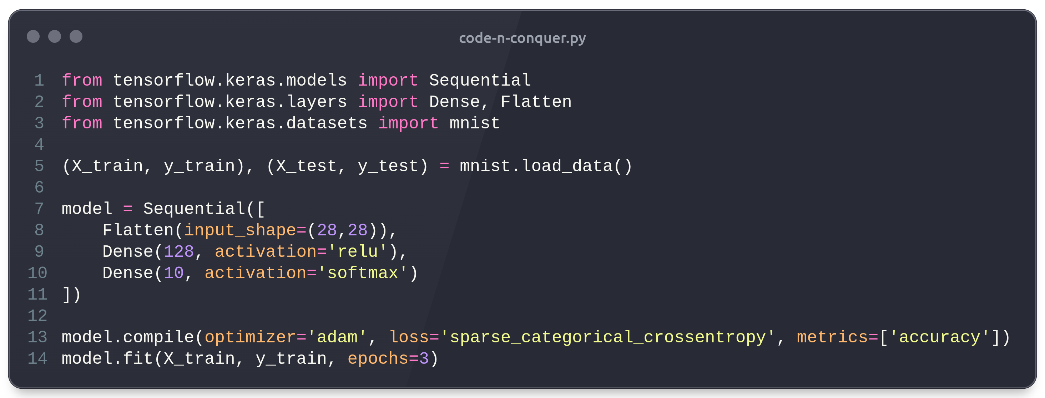
NEURAL NETWORKS — THE HEAVY ARTILLERY
Neural Networks are the heavy artillery of modern data science — capable of crushing complex, non-linear problems that traditional models can’t handle. Inspired by the human brain, they excel in image recognition, speech processing, and natural language understanding. For instance, a deep neural network trained on handwritten digits (MNIST dataset) can achieve near-human accuracy in classification tasks. Businesses use neural networks to power facial recognition systems, detect defects in manufacturing, and analyze medical imagery. With frameworks like TensorFlow and PyTorch, deploying neural models is now faster and more accessible — giving every data scientist a chance to wield deep learning power effectively.

Slide 15
4.
The Data General’s Wisdom

Slide 16
CLEAN DATA WINS BATTLES
The first rule of data science warfare: never fight with dirty data. Inconsistent, missing, or misformatted data can sabotage even the best algorithms. Pandas offers a full arsenal of cleaning tools — from dropna() for removing incomplete records to fillna() for intelligent replacements. Standardizing formats, removing duplicates, and normalizing numeric scales ensures fairness and accuracy in modeling. As the saying goes, 80% of a data scientist’s time is spent preparing the data — because no victory is possible without a well-trained army, and in this case, your army is the dataset itself.

Slide 17
TRAIN SMART, NOT HARD
Efficient training is about quality, not quantity. Always split data into training and testing sets to prevent overfitting — the trap of models that perform well in practice but fail in the field. Cross-validation and hyperparameter tuning through GridSearchCV are essential tactics for robust generalization. Feature scaling and selection also enhance model accuracy by focusing learning on relevant signals. In essence, a disciplined training pipeline is like a military drill — repetitive, structured, and built for reliability under pressure.

Slide 18
MONITOR THE BATTLEFIELD
Deployment is not the end — it’s the beginning of continuous vigilance. Models can drift over time as real-world data evolves, causing accuracy decay. Monitoring key metrics and retraining models with fresh data ensures sustained performance. Visualization dashboards built with Power BI, Streamlit, or Plotly help track shifts and communicate insights to stakeholders. True mastery in data science isn’t about creating a single perfect model, but maintaining an ecosystem of adaptive, evolving intelligence that keeps winning long after deployment.

Slide 19
5.
Conclusion

Slide 20
CONCLUSION: VICTORY THROUGH INSIGHT
To code and conquer is to transform complexity into clarity, uncertainty into strategy, and raw data into intelligence. The uprising of data science is not about machines replacing humans — it’s about humans empowered by machines to make sharper, faster, and fairer decisions. The tools you’ve learned — pandas, scikit-learn, and Python’s ecosystem — are not just technologies but instruments of transformation. Every dataset hides a story waiting to be discovered. And as you continue your journey, remember: in this new era, those who command data command the future.

Slide 21
Acknowledgments

Slide 22



THANK YOU FOR REACHING THE END!
YOU ARE NOW A FIVE STARS GENERAL (YES WE DO HAVE THE FIFTH STAR IN THE WAR AGAINST DATA!)
THIS EBOOK WAS CREATED BY AI AND DESIGNED BY HUMAN (ME!) AS A PROJECT FOR THE COURSE ON FUNDMANETALS OF GENERATIVE AI BY DIO/UNIVERSIA.
THE TEXT IS CREATED USING CHATGPT AND COVER IMAGE USING MICROSOFT COPILOT.
ORIGINAL GITHUB REPOSITORY OF THE COURSE
THE STEP-BY-STEP TO CREATE THIS EBOOK IS OUTLINED ON MY GITHUB REPOSITORY
GUILHERME (GUI) FREIRE OLIVEIRA
Data Scientist | Computatioal Physicist
BJJ purple belt
My Linkedin Profile

