Slide 1
Edge Caching for Future Telecommunication Systems
Guilherme Iecker Ricardo
Postdoctoral Researcher
guilhermeieckerricardo@gmail.com
https://guilhermeir.github.io

Slide 2










Short Bio
Université Paris Dauphine, France
Computer Networks, L3 and M1
UFRJ, Brazil
Penn State, USA (BSMP)
Université Côte d’Azur, France
Inria SAM / EURECOM
Lecturer
To date
B.Eng.
2016
M.Sc.
2018
Ph.D.
2021
Postdoc
2023
Coppe/UFRJ, Brazil
Research Engineer, RNP, Brazil
Orange Labs, France
MORE Department
Postdoc
To date
CNAM, France
CEDRIC - ROC
Guilherme I. Ricardo - Short Bio.
1

Slide 3
5G+/6G Systems Challenges
eMBB
Augmented Reality Applications
Cloud Gaming
5G+/6G
mMTC
URLLC
URLLC
Industrial Internet of Things
Smart Highways
Smart Cities
Remote medical procedures
Guilherme I. Ricardo – Telecommunication Systems Challenges
3
Notes:
1. Add back the animation
2. replace figures with standalone images
3. include green and intelligent words?

Slide 4




What is the Edge?
Internet’s Edge
Radio Access Nets
(RAN)
Cloud
Servers
Edge
Router
BS
Internet’s
Core
AP
ISP Access Nets
User Equipment (UEs)
Home/Institutional Access Nets
Guilherme I. Ricardo – Where is the Edge?
4
Notes:
1. This slide is supposed to be the definition of edge.
2. I have to
(1) include the host icons and show new names (check orange presentation)
(2) add a transparent square with the benefits of the edge paradigm

Slide 5

Mobile Edge Computing as an Enabling Technology
Mobile Edge Orchestrator (MEO)
Cloud
Servers
Edge
Router
BS
Internet’s
Core
AP
User Equipment (UEs)
Far-Edge
Hosts
Near-Edge
Hosts
Guilherme I. Ricardo - (Mobile) Edge Computing as an Enabling Technology
5
Notes:
This slide is a placement for the slide with the transparent square

Slide 6
How does MEC help address 5G+/6G challenges?
URLLC
Application end-points proximity
- Reduced end-to-end latency
- Data center network and cloud servers offload
Edge Network Engineering
mMTC
eMBB
- Scalable, efficient resource management
- Low-cost, “green” deployments
URLLC
mMTCeMBB
In-Edge Artificial Intelligence
- Intelligent, data-oriented network control
- Enables cross-domain use cases (e.g., smart cities)
Guilherme I. Ricardo - How does MEC help address 5G+/6G challenges?
6
Notes:
This slide is a placement for the slide with the transparent square

Slide 7
How have I contributed to the state-of-the-art?
IoT/WSN [1]
Caching and Service Migration [2-7]
Open RAN
Link Scheduling
MAC for WSN
Edge Caching
Edge Caching
Task Distribution
Resource Management
Disaggregation
CU-DU-RU Placement
Optimization Model
Stochastic Process
Convex (e.g., relaxations, bounds)
Integer (e.g., B&B, heuristics)
Stochastic (e.g., adaptive policies)
Modeling
Operations
Research
Simulation
Synthetic scenarios
Realistic scenarios
Data-oriented Approaches
Reinforcement Learning
Deep Learning
Network Science
Guilherme I. Ricardo - How have I contributed to the state-of-the-art?
7
Notes:
This slide is supposed to show the different challenges I have studied

Slide 8
Edge Caching – Setup and Components
Catalog of files
MEO
Partial replication
Full provision
Backhaul
Network
Cloud
Servers
Internet’s
Core
Files have “popularity”
BSs store a fraction of catalog
Goal: retrieval delay (URLLC)
Primary characteristics
Small-Cell Base Stations (BSs)
Guilherme I. Ricardo - Edge Caching - Setup and Components
8

Slide 9
Edge Caching – CoMP-based Operation
Request (u2, f4):
Important Relation
Case I: Cache Miss
MEO
Backhaul
Network
Cloud
Servers
Request (u2, f2):
Case II: Cache Hit
Internet’s
Core
Request (u2, f1):
Case III: Multiple Hits
Guilherme I. Ricardo - Edge Caching - CoMP-based Operation
9

Slide 10
Problem Overview and Frameworks
Centralized decisions (e.g., MEO)
Global network information
Average performance optimization
Two stages: Placement + Provision
Centralized, Static Framework [2,3]
Question: How to manage caches in order to provide files with the smallest delay possible?
Challenges:
  Catalog size vs. cache capacity
  Randomness behind requests
  UE-BS topological organization
  Definition of the delay model
Individual decisions (BSs)
Limited network information
Local performance gain decisions
Adaptive policies
Distributed, Online Framework [3-5]
Guilherme I. Ricardo - Problem Overview and Frameworks
10
Notes:
Centralized = Caching problem (File placement)
Distributed =

Slide 11
Centralized, Static Framework [1, 2]
File Allocation Optimization Problem
Minimize retrieval delay averaged over all possible requests
File allocation must satisfy caches’ capacity constraint
Binary variables indicating whether BS b caches file f or not
Characteristics
Non-convex
Non-linear
NP-Hard
Submodular
Guilherme I. Ricardo – Centralized, Static Framework
11
Notes:
Centralized = Caching problem (File placement)
Distributed =

Slide 12
Distributed, Online Framework [3, 4]
Cache = Priority queue
Least-Recently-Used (LRU) core
Cache update operations:
Adaptive, Online Policy: qLRU-Δ
LRU cache implementation (at BS b)
MTFs
Insertions
Evictions
Insertion/Eviction
...
Front
(MRU)
Rear
(LRU)
Move-to-the-Front (MTF)
Guilherme I. Ricardo – Distributed, Online Framework
12
Notes:
Centralized = Caching problem (File placement)
Distributed =

Slide 13
qLRU-Δ: Probabilistic Cache Updates
Case 1
Case 2
Initial
State
Initial
Allocation:
1
2
3
Initial
Allocation:
4
1
2
Insertion/Eviction
Upon cache miss
Event
Request (u,4)
Cache Miss
Request (u,2)
Cache Hit
Probability
Probability
Move-to-the-Front (MTF)
Upon cache hit
Prob. proportional to delay reduction, i.e.,
Action
Move to the Front (MTF)
Insertion/Eviction
4
1
2
3
2
4
1
2
Final
State
Resulting
Allocation:
4
1
2
Resulting
Allocation:
2
4
1
Guilherme I. Ricardo – qLRU-Δ:Probabilistic Cache
13
Notes:
Centralized = Caching problem (File placement)
Distributed =

Slide 14
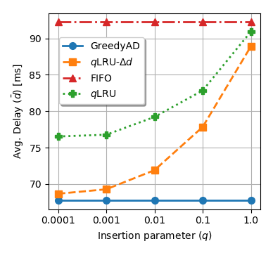
qLRU-Δ: Probabilistic Cache Updates
Case 1
Case 2
Initial
State
Initial
Allocation:
1
2
3
Initial
Allocation:
4
1
2
Insertion/Eviction
Upon cache miss
Parameter q
Event
Request (u,4)
Cache Miss
Request (u,2)
Cache Hit
Probability
Probability
Move-to-the-Front (MTF)
Upon cache hit
Prob. proportional to delay reduction, i.e.,
Action
Move to the Front (MTF)
Insertion/Eviction
4
1
2
3
2
4
1
2
Final
State
Resulting
Allocation:
4
1
2
Resulting
Allocation:
2
4
1
Guilherme I. Ricardo – qLRU-Δ:Probabilistic Cache Updates
13
Notes:
Centralized = Caching problem (File placement)
Distributed =

Slide 15
Optimality of qLRU-Δ – Assumptions
IRM
We model the requests for files using the Independence Reference Model (IRM), where requests for different files are independent and follow a Poisson process with rate λ.
CTA
Instant cache capacity may be violated, so files are not evicted for new insertions. However, files have an associated timer, the Characteristic Time. When time is up, the file is evicted, even without insertions.
EA
Exponentialization Approximation (EA) allows us to simplify files’ dynamics as independent stochastic processes that can be represented by Continuous Markov Chains.
q→0
We assume that Insertion/Eviction probability is very small, tending to zero. By doing so, we produce a process where only really important files will be inserted.
Guilherme I. Ricardo - Optimality of qLRU-Δ - Assumptions
14
Notes:
Centralized = Caching problem (File placement)
Distributed =

Slide 16
Optimality of qLRU-Δ – Assumptions
IRM
We model the requests for files using the Independence Reference Model (IRM), where requests for different files are independent and follow a Poisson process with rate λ.
Optimality Result
CTA
Instant cache capacity may be violated, so files are not evicted for new insertions. However, files have an associated timer, the Characteristic Time. When time is up, the file is evicted, even without insertions.
Under IRM and considering CTA and EA, if q→0, then a network of qLRU-Δ caches converges to the optimal solution of the centralized, static optimization problem.
EA
Exponentialization Approximation (EA) allows us to simplify files’ dynamics as independent stochastic processes that can be represented by Continuous Markov Chains.
q→0
We assume that Insertion/Eviction probability is very small, tending to zero. By doing so, we produce a process where only really important files will be inserted.
Guilherme I. Ricardo - Optimality of qLRU-Δ - Assumptions
14
Notes:
Centralized = Caching problem (File placement)
Distributed =

Slide 17
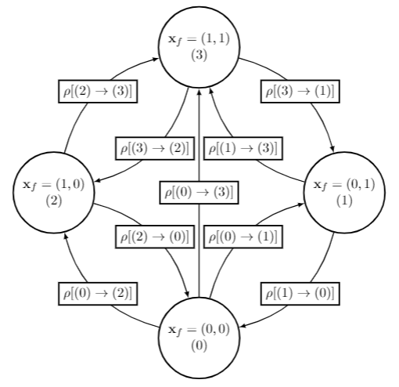
Optimality of qLRU-Δ – Intuition
States
States
All possible allocations for file f across all BSs in the network
Upward Transitions
Thinned request process with probability q
Downward Transitions
Thinned CTA eviction process with probability p
Guilherme I. Ricardo - Optimality of qLRU-Δ - Intuition
14
Notes:
Centralized = Caching problem (File placement)
Distributed =

Slide 18
Optimality of qLRU-Δ – Intuition
File Allocation (Relaxed) Problem
Stochastically Stable States
CTMC’s stationary distribution:
KKT Conditions
Guilherme I. Ricardo - Optimality of qLRU-Δ - Intuition
15
Notes:
Centralized = Caching problem (File placement)
Distributed =

Slide 19
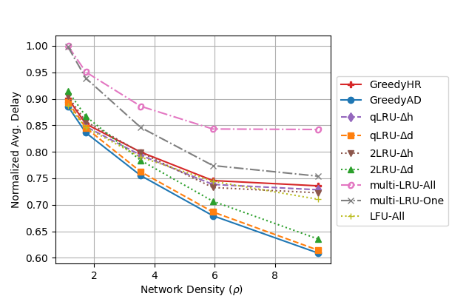
Optimality of qLRU-Δ – Intuition
File Allocation (Relaxed) Problem
Stochastically Stable States
CTMC’s stationary distribution:
KKT Conditions
Guilherme I. Ricardo - Optimality of qLRU-Δ - Intuition
15
Notes:
Centralized = Caching problem (File placement)
Distributed =

Slide 20
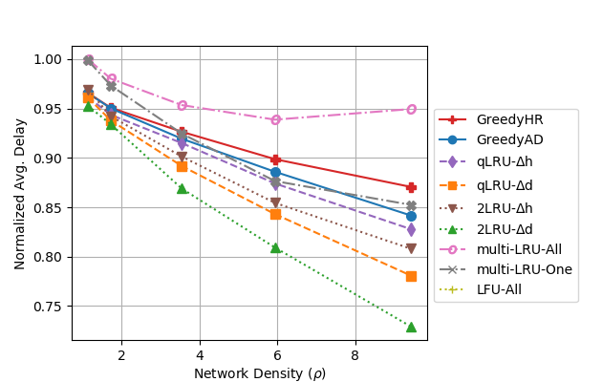
Performance of qLRU-Δ under more realistic setups
Guilherme I. Ricardo - Performance of qLRU-Δ under more realistic setups
16
Notes:
Centralized = Caching problem (File placement)
Distributed =

Slide 21
Conclusions and Future Work
Edge Caching
Future Work (in general)
+ Flexible applicability (objectives)
+ Optimal convergence
+ Quick, responsive approach
- Convergence time
- Small q fails to capture variability
→New PHY-aware caching techniques
→Handling temporal locality
Responsive solutions for resource allocation and CU-DU-RU placement in future telecom architectures. For example:
→Online Learning
→Stochastic Optimization
→Machine Learning
Guilherme I. Ricardo – Conclusions and Future Work
16
Notes:
Centralized = Caching problem (File placement)
Distributed =

Slide 22
Thank you!

Slide 23
References
[7] G. I. Ricardo, A. Benhamiche, N. Perrot, and Y. Carlinet, "Heuristic Distribution of Latency-Sensitive Tasks in Multi-Access Edge Computing Systems," in IEEE Global Communications Conference (GLOBECOM) NetMan6G Workshop, 2022.
[6] G. I. Ricardo, A. Benhamiche, N. Perrot, and Y. Carlinet, "Latency-Constrained Task Distribution in Multi-Access Edge Computing Systems," in IEEE International Conference on Cloud Networking (CLOUDNET).
[5] G. I. Ricardo, G. Neglia and T. Spyropoulos, "Caching Heterogeneous Size Content in Small Cell Networks
with CoMP Joint Transmissions," in IEEE Global Communications Conference (GLOBECOM), 2021.
[4] G. Neglia, E. Leonardi, G. I. Ricardo, T. Spyropoulos, "A Swiss Army Knife for Dynamic Caching in Small Cell Networks," in IEEE Transactions on Networking, 2021.
[3] G. I. Ricardo, A. Tuholukova, G. Neglia and T. Spyropoulos, "Caching policies for delay minimization in small cell networks with coordinated multi-point joint transmissions," in IEEE Transactions on Networking, 2021.
[2] G. I. Ricardo, G. Neglia and T. Spyropoulos, "Caching Policies for Delay Minimization in Small Cell Networks with Joint Transmissions," in IEEE International Conference on Communications (ICC), 2020.
[1] G. I. Ricardo, J. F. de Rezende and V. C. Barbosa, "Scheduling Wireless Links in the Physical Interference Model by Fractional Edge Coloring," in IEEE Wireless Communications Letters, 2020.
Notes:
TODO

