Slide 1

MSc DISSERTATION DEFENSE
DEPT
Defense via Ensemble and Purification Transformer
A streaming defense against realizable adversarial network traffic
Guilherme Silvério de Carvalho Romeiro Leitão
Supervisor: Prof. Fernando Manuel Valente Ramos
Instituto Superior Técnico, Universidade de Lisboa · 2026

Slide 2
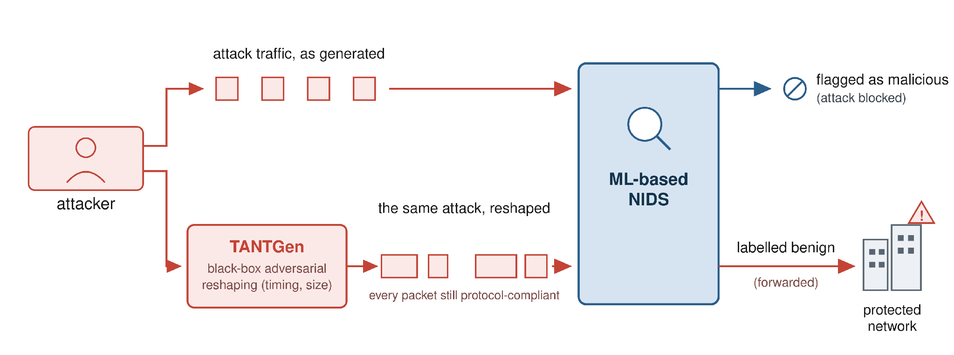
MOTIVATION
ML-based intrusion detection can be evaded
Reshape only packet timing and sizes, keep every packet protocol-compliant, and an ongoing attack passes as benign.
The attack keeps doing its work; the detector now lets it in.
DEPT · Defense via Ensemble and Purification Transformer
2 / 19

Slide 3
MOTIVATION
Much of the defensive literature measures the wrong threat
A perturbed image is still an image.
A perturbed feature vector of traffic is only a threat if some sendable packet sequence actually produces it.
Defenses are often trained against feature-space perturbations no real packet sequence can produce, or assume white-box attackers.
The robustness they report refers to a threat that may not occur as measured.
A realistic attacker is…
1
Black-box
probes outcomes, holds no gradients
2
Realizable
checksums, lengths and protocol semantics stay consistent
3
Live
manipulates flows as they happen
In this thesis, every claim about the defense refers to traffic that can exist on the wire.
DEPT · Defense via Ensemble and Purification Transformer
3 / 19

Slide 4
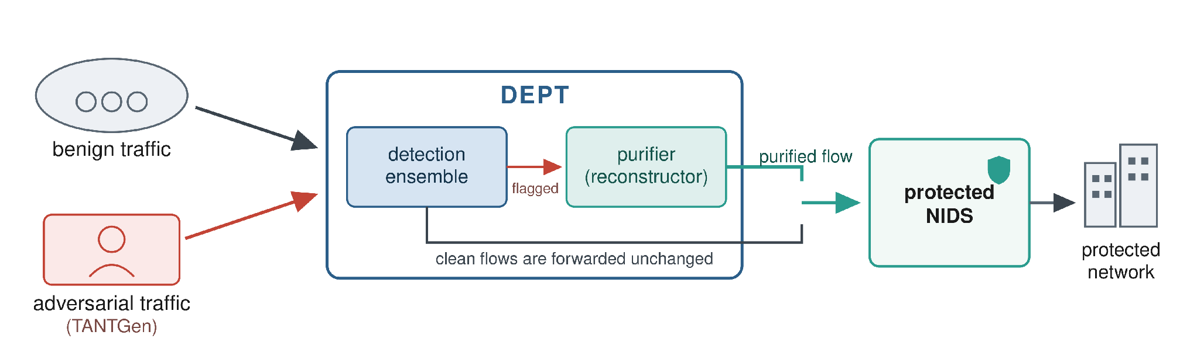
MOTIVATION
Threat model
The attacker, here TANTGen
Black-box Transformer generator
Perturbs timing (iat), size (size), or both
Protocol-compliant by construction
The defense is:
Streaming: a verdict packet by packet, mid-flow
Realistic: trained on realizable traffic only
Realizable itself: repaired flows leave as valid packets
Gray-box: TANTGen’s axes, not its model or gradients
DEPT complements the protected NIDS. It answers one question: was this flow tampered with? If so, purify it.
DEPT · Defense via Ensemble and Purification Transformer
4 / 19

Slide 5
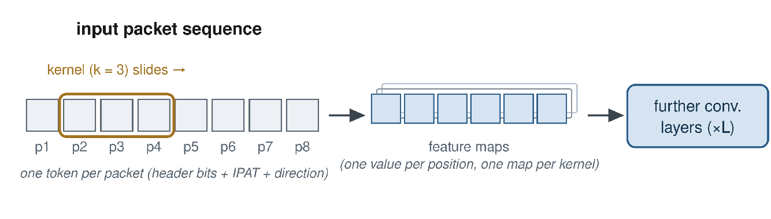
BACKGROUND
The two base learners
Random forest
Bagged decision trees: each cuts the feature space with axis-aligned tests; the forest averages the votes.
Cheap and strong on tabular statistics.
Decisive property: the decision function is piecewise constant. No gradient for an attacker to follow.
Temporal convolutional network
Kernels slide along the packet sequence, one feature map per kernel (below).
Dilated: tap spacing grows with depth (1, 2, 4), so the receptive field reaches 29 packets cheaply.
Causal: the output at packet t uses only packets ≤ t.
DEPT · Defense via Ensemble and Purification Transformer
5 / 19

Slide 6
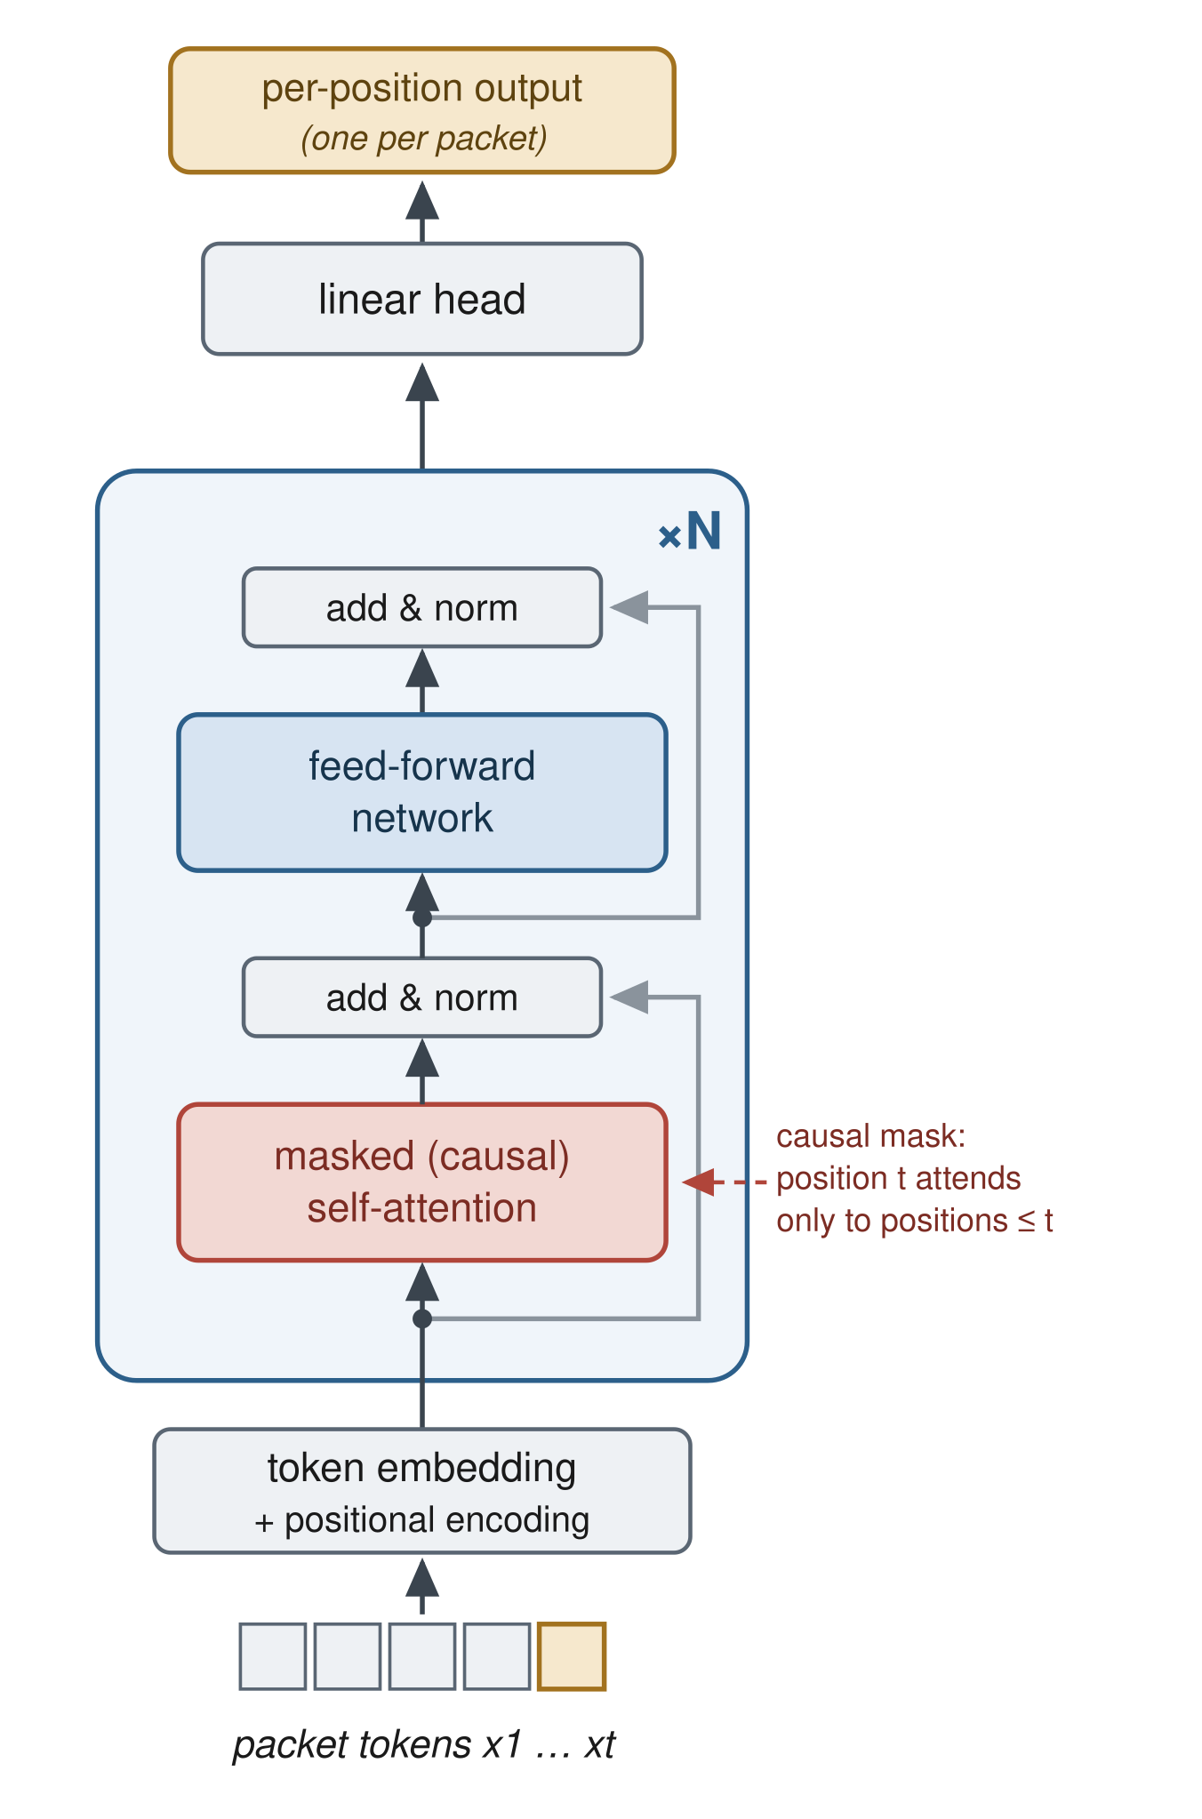
BACKGROUND
Attention, with a causal mask
Self-attention lets every position weigh every other by a learned relevance, reaching long-range structure that a fixed convolution window usually cannot.
Attention(Q, K, V) = softmax( QKᵀ / √dₖ ) V
Decoder-only: a causal mask restricts position t to positions ≤ t. Usually the setup for generation — but the mask is what any streaming output needs.
DEPT uses this block twice, for the meta-learner and the purifier, and neither is autoregressive: causality is what buys it streaming validity, not generation.
DEPT · Defense via Ensemble and Purification Transformer
6 / 19

Slide 7
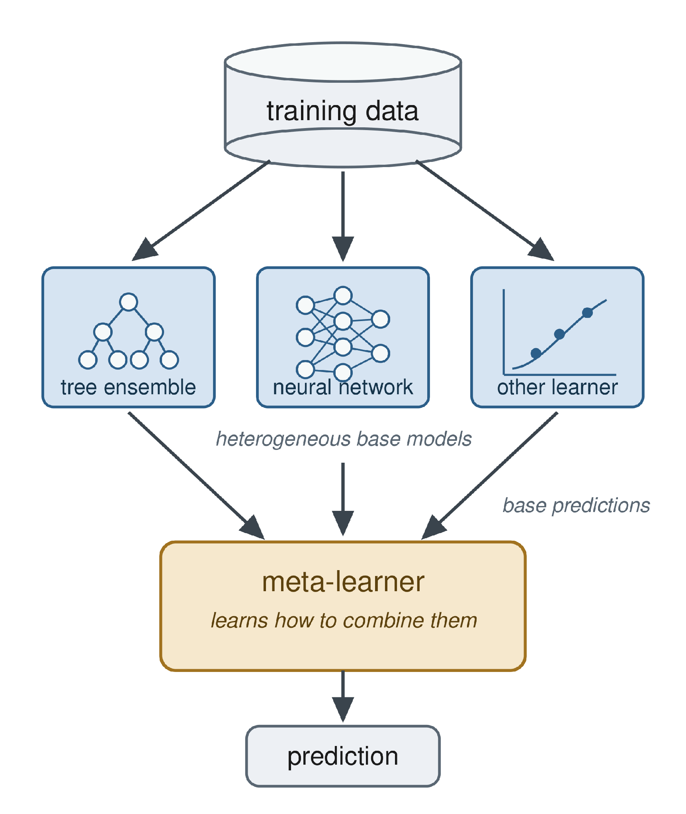
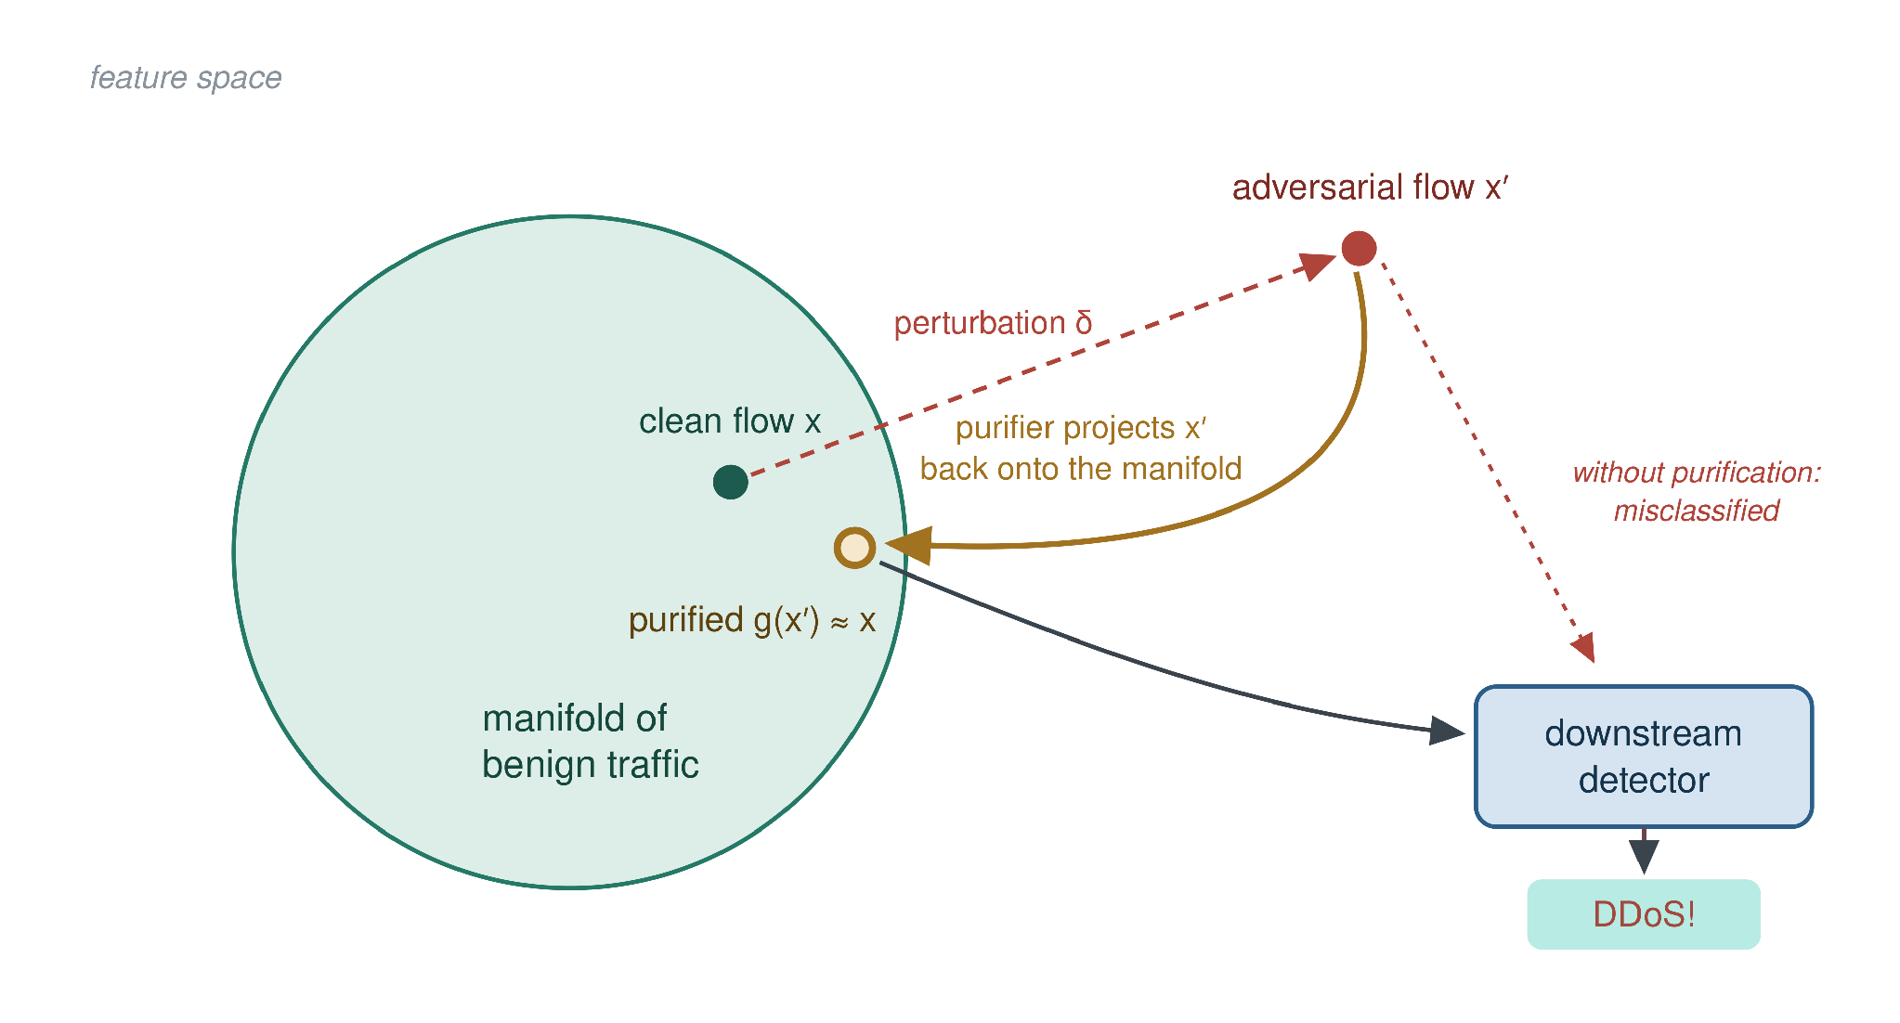
BACKGROUND
Two classical ideas, adopted for security and availability reasons
Stacking
Train heterogeneous bases and learn how to combine them. Transferability needs similar, differentiable surfaces, so DEPT stacks a forest with a network: one gradient doesn’t necessarily cross both. The members also speak at different rates.
Purification
Project a flagged flow back onto the benign manifold instead of dropping it — dropping turns every false positive into denial of service. A causal Transformer predicts the correction, and the flow is realized back into sendable packets before the protected NIDS sees its adversarial form.
DEPT · Defense via Ensemble and Purification Transformer
7 / 19

Slide 8
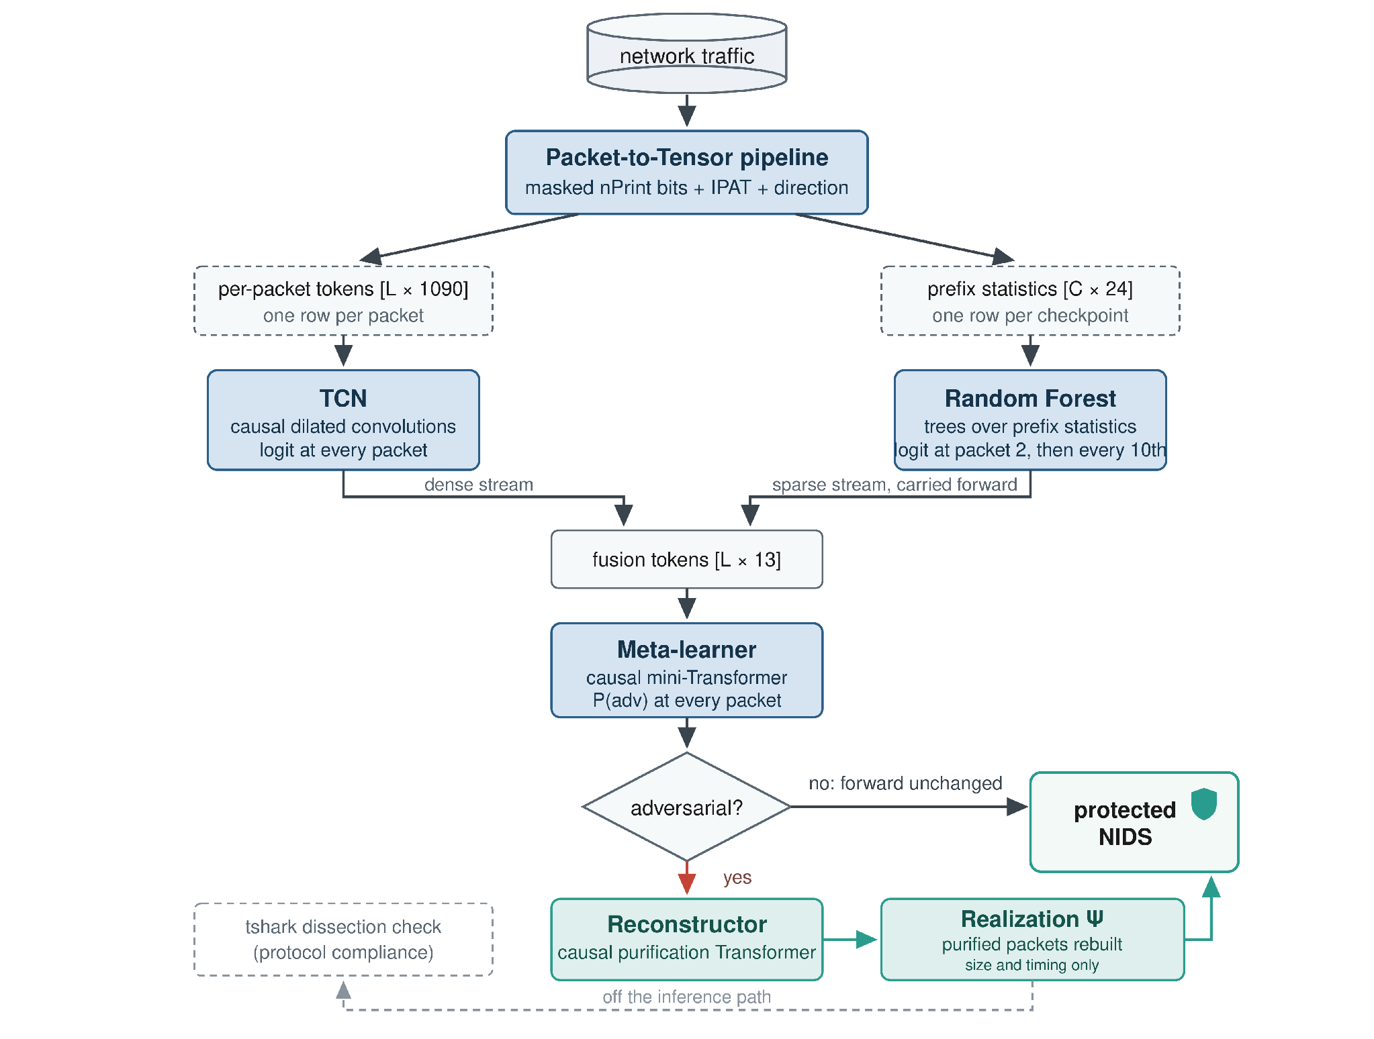
DEPT
The DEPT architecture
Two base learners, two views of the same flow: the TCN reads a dense per-packet stream, the RF votes on sparse prefix statistics.
1
The meta-learner fuses both streams into a per-packet probability of manipulation.
2
Only flagged flows pay for purification; unflagged traffic passes untouched.
3
Causal end to end.
4
DEPT · Defense via Ensemble and Purification Transformer
8 / 19

Slide 9
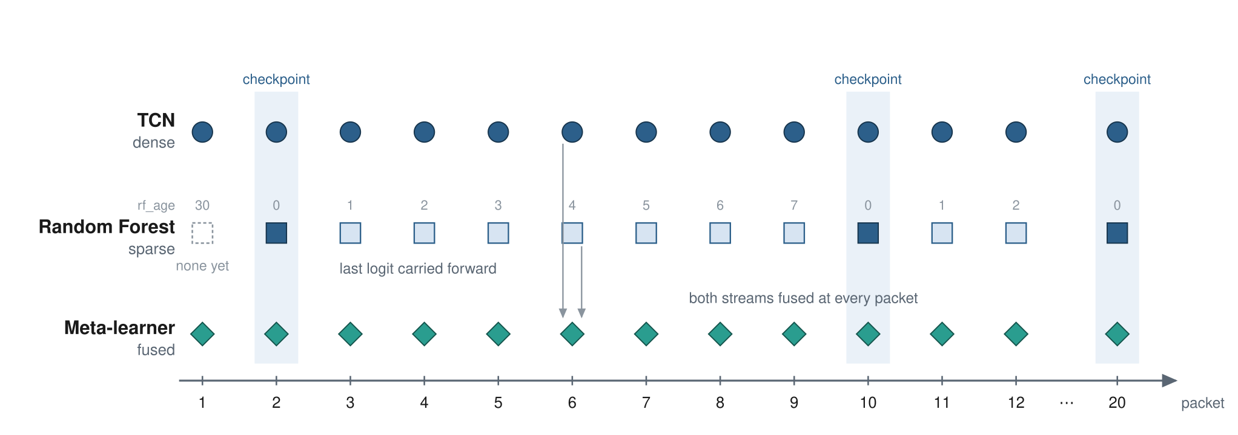
DEPT
Two views, two cadences
Dense view
nPrint bits, tri-state: 1 set · 0 unset · −1 layer absent (IPv4, TCP, UDP, ICMP: 1088), + timing, direction. Identity zeroed: behaviour, not addresses.
Sparse view
mean · std · min · max of IAT, size, payload length & entropy, TCP flags, direction: 24 incremental stats, at packet 2 then every 10th (rf_age).
Why this close to packets
Every purified value is a real packet property, so it could be written back onto packets. Payload content is never parsed.
DEPT · Defense via Ensemble and Purification Transformer
9 / 19

Slide 10
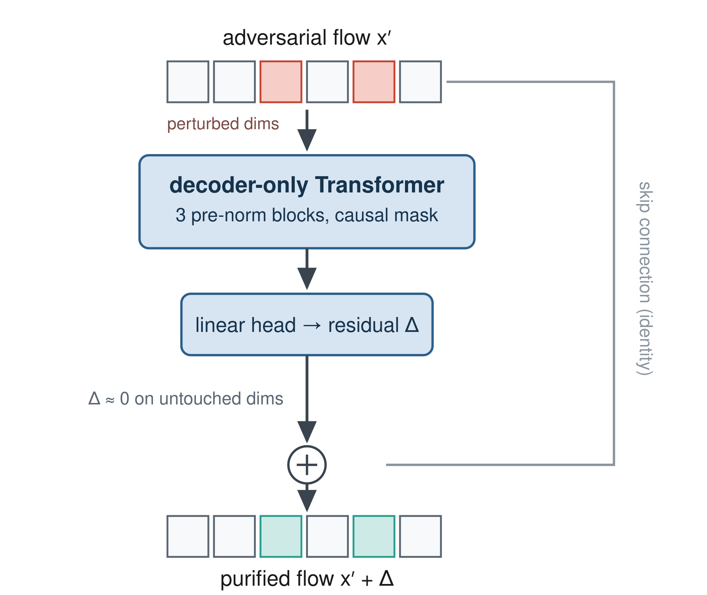
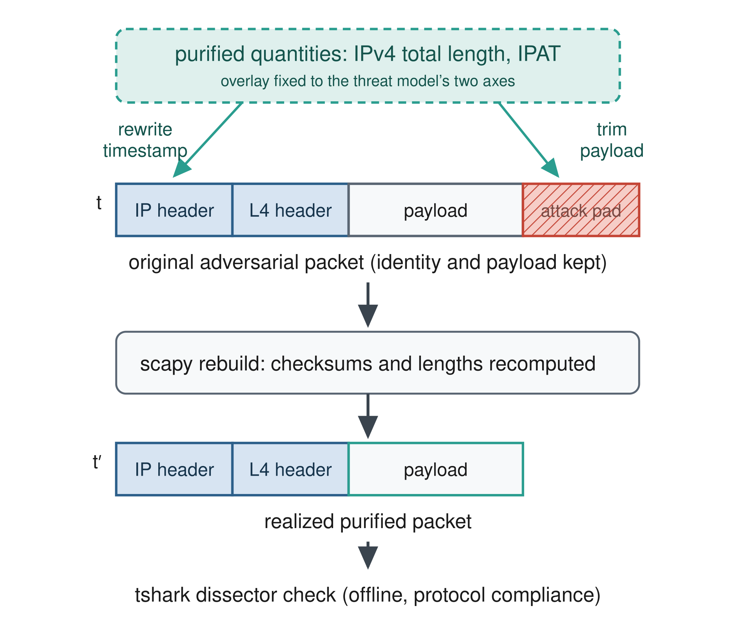
DEPT
Purify in feature space, realize in traffic space
Purify · feature space
Residual head: “change nothing” is the default, so capacity goes to the few dimensions the attacker moved. Training carries no hint of where the perturbation lives: the objective is attack-agnostic.
Realize · traffic space
Overlay the purified size and timing onto the original packets and recompute dependent fields; tshark scores compliance offline. Only these two axes return to the wire corrected.
DEPT · Defense via Ensemble and Purification Transformer
10 / 19

Slide 11
EVALUATION
Evaluation: corpus and research questions
10
3
3
8.6M
61.5M
70/15/15
traffic sources
public datasets
perturbation modes
flows
packets
flow-level split
Kitsune · CIC-IDS2017 · CIC-DDoS-2019, each in three TANTGen modes, one shared split
RQ1 — ensemble robustness
Does heterogeneous stacking measurably raise the cost of a gradient-guided evasion attack?
RQ2 — purification effectiveness
Does purification close the detection gap seen by the independent NIDS each attack was built to evade?
The CIC-DDoS-2019 floods dominate the corpus: comparisons use base-rate-robust metrics, reported per source and per mode.
DEPT · Defense via Ensemble and Purification Transformer
11 / 19

Slide 12
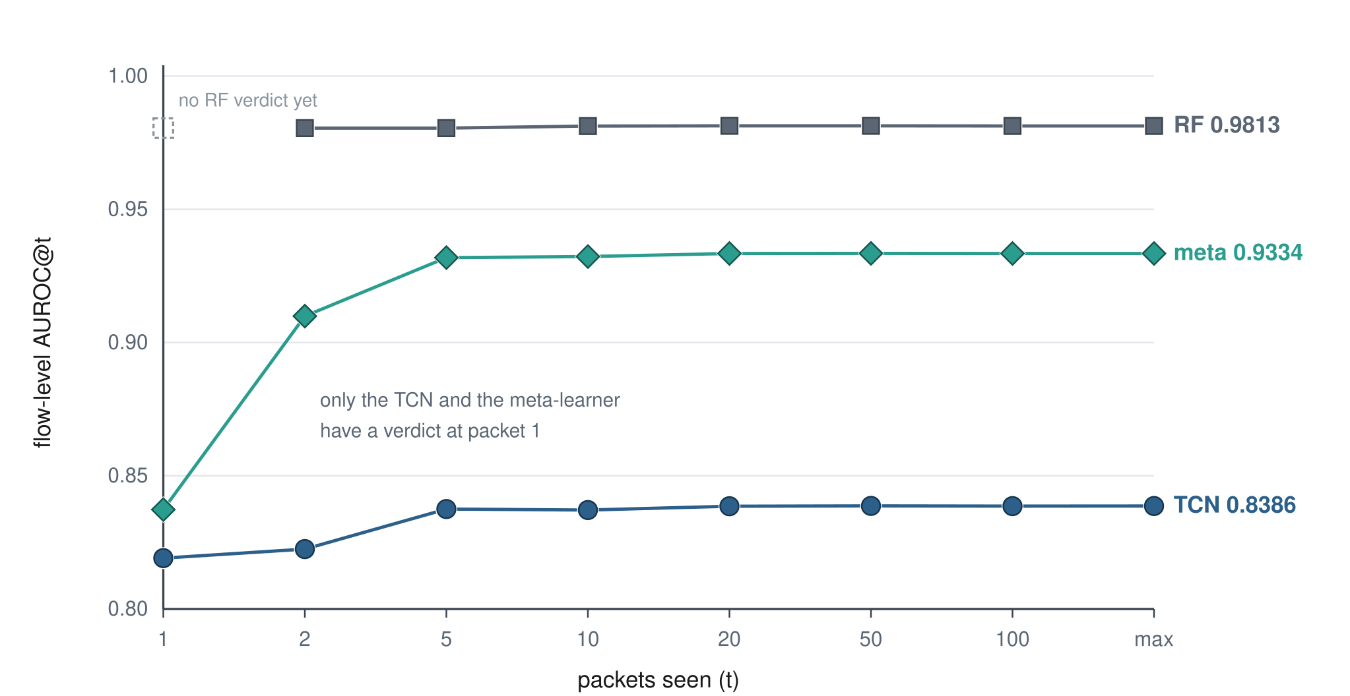
EVALUATION
Detection: what “fusion” achieves
 | RF | TCN | Meta
first verdict | pkt 2 | pkt 1 | pkt 1
AUROC@1 | — | 0.819 | 0.837
AUROC@2 | 0.981 | 0.823 | 0.910
AUROC@max | 0.981 | 0.839 | 0.933
The Random Forest alone is the strongest stream from packet 2 onward. Not what the design predicted.
Fusion buys the best packet-1 verdict, where the forest is silent, and a higher cost of evasion.
DEPT · Defense via Ensemble and Purification Transformer
12 / 19

Slide 13
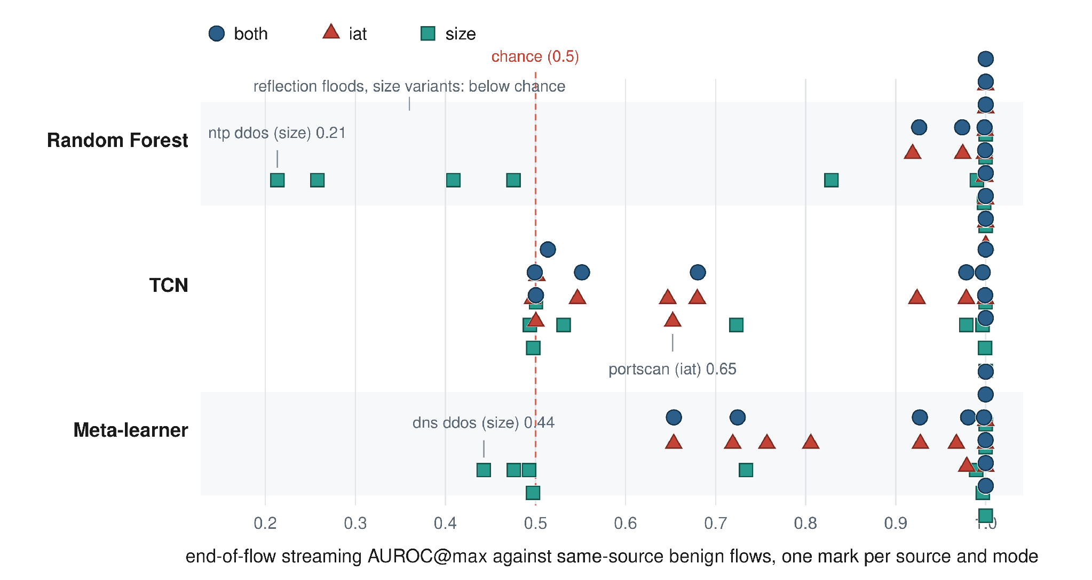
EVALUATION
Detection, source by source
Timing-only variants: hard for the TCN, trivial for the forest.
The TCN is blind on the one- and two-packet reflection floods, with nothing to convolve over; mirai is the stubborn middle case.
Four size-mode floods sit at or below chance for every model.
DEPT · Defense via Ensemble and Purification Transformer
13 / 19

Slide 14
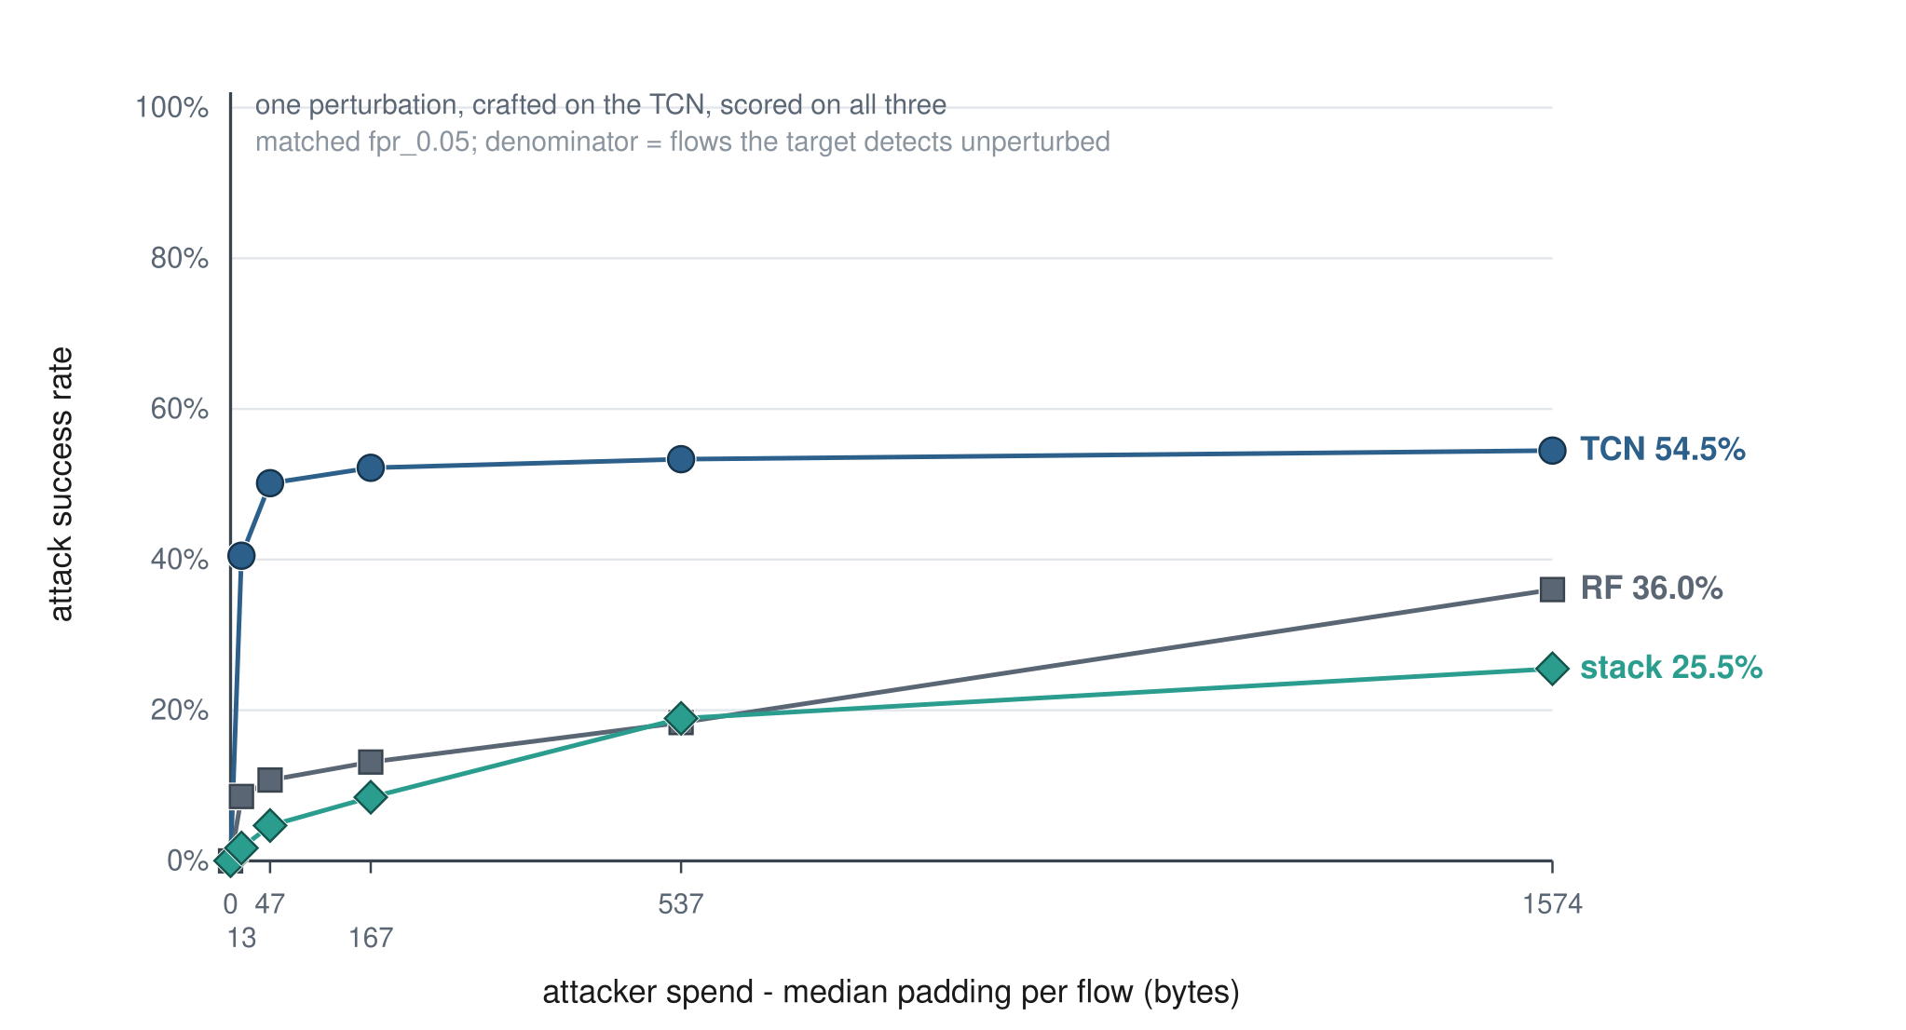
RQ1 · ENSEMBLE ROBUSTNESS
Heterogeneity raises the attacker's cost
One perturbation, crafted on the TCN's white-box gradients, replayed on all three targets at a matched 5% FPR.
Never evaded, at any budget
45.5%
64.0%
74.5%
TCN
Random Forest
fused stack
The perturbations that break the TCN transfer poorly to the forest; the stack is harder than either alone.
As the TCN degrades, the meta-learner shifts its reliance onto the forest (share 0 → 0.53): the design claim, observed.
DEPT · Defense via Ensemble and Purification Transformer
14 / 19

Slide 15
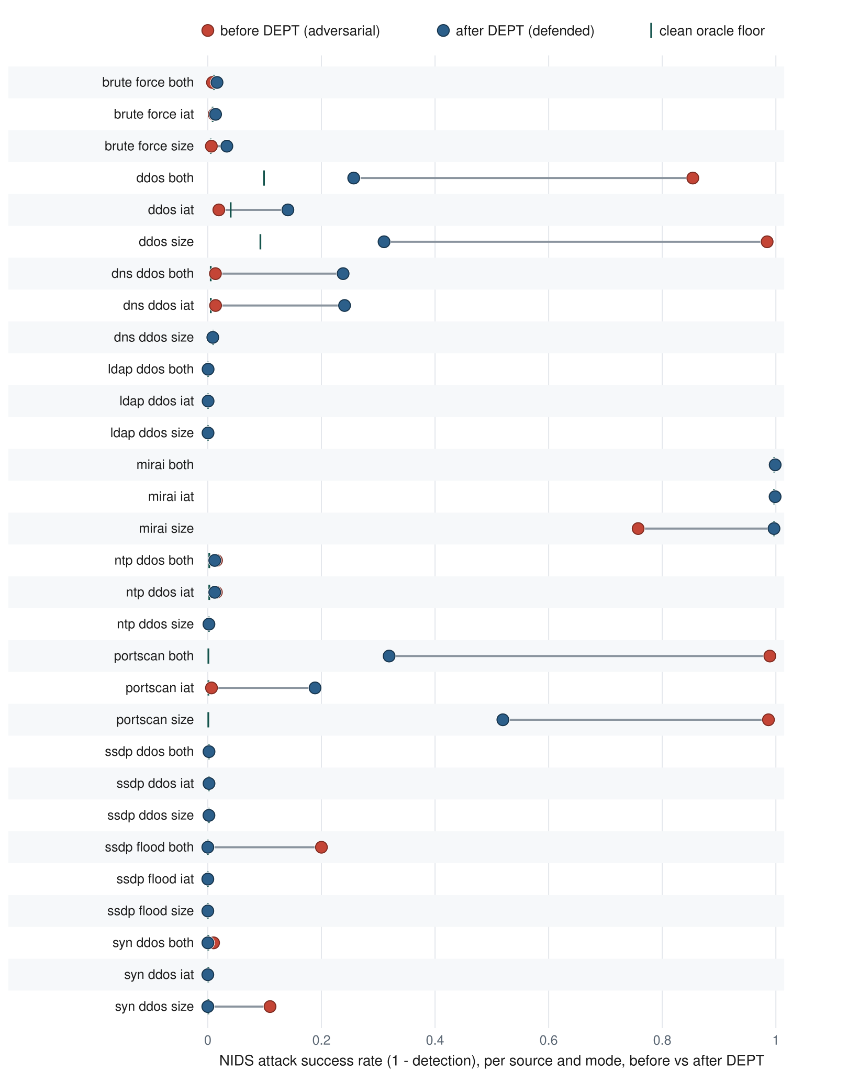
RQ2 · PURIFICATION EFFECTIVENESS
Judged by the detector each attack was built to evade
17×
63%
lower reconstruction error on the perturbed dimensions
of the destroyed detection recovered
21.1% → 11.6%
97.2%
attack success, end to end
of realizable packets parse cleanly in tshark
DEPT · Defense via Ensemble and Purification Transformer
15 / 19

Slide 16
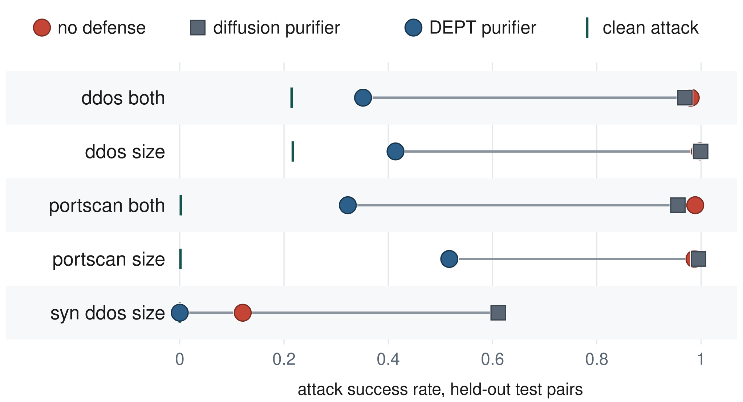
RQ2 · PURIFICATION EFFECTIVENESS
Against a published purifier
DEPT's purifier swapped for the diffusion purifier of Merzouk et al. (DBSec 2025): same flows, realization and detectors.
Attack success on held-out flows
31.5%
40.3%
18.9%
no defense
diffusion
DEPT
Where TANTGen evaded (left), DEPT restores much of the lost detection; the diffusion purifier recovers almost none.
Elsewhere both can lower detection: the diffusion purifier slows timing-sensitive floods; DEPT loses on dns_ddos.
The setup favours DEPT: it trains on TANTGen pairs, while the baseline sees only clean traffic and was adapted to DEPT's per-packet view.
DEPT · Defense via Ensemble and Purification Transformer
16 / 19

Slide 17
LIMITATIONS
Where DEPT fails
Size-mode reflection floods sit at or below chance for every model.
On three, the edit left flows bit-identical to their originals. On DNS, specialists fail too: the representation cannot express the difference; payload content is probably where to look.
1
Purifying non-evading traffic harms detection (by up to 24 points).
The denoiser removes signal the protected NIDS was still using.
2
The gate answers the wrong question.
It predicts whether a flow is adversarial; the pipeline needs to know whether purifying this flow will help. The data shows these are not the same thing.
3
DEPT · Defense via Ensemble and Purification Transformer
17 / 19

Slide 18
CONCLUSIONS
Conclusions
RQ1 · Yes
A non-differentiable member measurably raises evasion cost: 74.5% of flows never evade the stack.
RQ2 · Yes, under a condition
63% of destroyed detection recovered; attack success 21% → 12%.
✓
✓
Two artefacts outlive the system
A reusable corpus of realizable adversarial traffic.
A modular detect-purify pipeline, not tied to these models or to TANTGen.
Future work, set by the failures
A gate that predicts the benefit of purification
Realization derived from the residual correction itself
A meta-learner that never falls below its best base learner
Longer term: the defense as an RL agent vs. an evolving attacker
A defense is only worth measuring against an attack that can exist on the wire.
DEPT · Defense via Ensemble and Purification Transformer
18 / 19

Slide 19
Thank you.
Questions?
DEPT · Defense via Ensemble and Purification Transformer

Slide 20
BACKUP
Why the receptive field is 29 packets
d = 4
d = 2
d = 1
packets
Highlighted nodes are the dependency cone of the rightmost output: it reaches back, never forward.
Three blocks, two convolutions each, k = 3, dilations 1, 2, 4: 1 + 2(k−1)·Σ 2ⁱ = 29 packets.
DEPT · Defense via Ensemble and Purification Transformer

Slide 21
BACKUP
Label convention
Every raw-capture flow is labelled benign, native attacks included; every TANTGen flow is adversarial.
1
This follows from the threat model: detecting the flood or scan is the protected NIDS's job; DEPT only detects and fixes manipulation.
2
Consequence: a source whose features TANTGen barely moves is close to unlabellable for any detector.
3
DEPT · Defense via Ensemble and Purification Transformer

Slide 22
BACKUP
One global model or ten specialists?
No outright winner
Ten per-attack specialist stacks, re-trained under the same protocol; neither regime wins outright (13 of 30 combinations indistinguishable).
Where each wins
Specialists win on timing-mode floods; the global model wins only on mirai and on below-chance slices.
Deployment cost
A specialist deployment needs a router that names the attack first — the very classification problem the detector exists to solve.
Architectural problem
The meta-learner below forest problem recurs in the specialists: not a training-scope issue.
DEPT · Defense via Ensemble and Purification Transformer

Slide 23
BACKUP
Model configurations
 | RF | TCN | Meta | Reconstructor
input per step | 24 | 1090 | 13 | 1090
structure | 200 trees, d. 20 | 3 blocks, 128 ch | 2 layers, d = 64 | 3 layers, d = 128
parameters | — | 806K | 68K | 678K
loss | Gini | balanced CE | bal. CE + aux | smooth-L1
The meta-learner trains on the validation split, where the base predictions are out-of-fold.
Attacker controls for RQ1: query-matched random search, AutoPGD as an independent check, best-of per flow.
DEPT · Defense via Ensemble and Purification Transformer

Slide 24
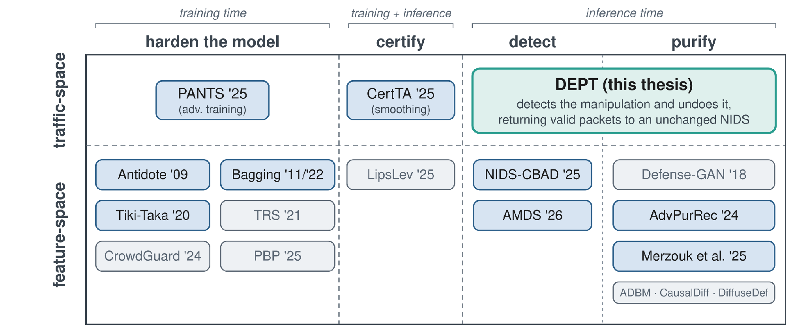
BACKUP
Where DEPT sits among published defenses
Published defenses harden the model in advance (PANTS), certify its predictions (CertTA), or detect/purify feature vectors.
DEPT detects AND undoes the manipulation on the traffic itself, at inference time, in front of an unchanged NIDS.
DEPT · Defense via Ensemble and Purification Transformer

Slide 25
BACKUP
What the meta-learner sees: the fusion token
slot | value | why it is there
0 | Random Forest logit, carried forward between checkpoints | a learned placeholder before packet 2: a zero would read as an undecided forest
1 | TCN logit | refreshed at every packet, from packet 1
2–3 | rf_age (packets since the forest last spoke, clipped at 30) and a checkpoint flag | tells the fuser how stale the forest's opinion is
4–12 | inter-arrival time, direction, IPv4 length ÷ 1500, six TCP flags | a compact view of the current packet; no header bits
Deliberately minimal: no header bits, so the meta-learner combines its two bases instead of becoming a third detector (2 causal layers, 4 heads, 68K parameters).
Loss: balanced cross-entropy plus a “beat the best base” term (weight 0.5).
Weakness: the forest's evidence arrives as one sparse, carried-forward slot, which attention under-weights. Meta-learner 0.933 against forest 0.981 AUROC.
DEPT · Defense via Ensemble and Purification Transformer

Slide 26
BACKUP
RQ1 in numbers: attack success by budget
budget (B/pkt) | median pad (B/pkt) | median delay (ms/pkt) | TCN | RF | stack
8 | 3.0 | 0.004 | 40.5% | 8.5% | 1.7%
32 | 14.0 | 0.041 | 50.1% | 10.7% | 4.7%
128 | 49.5 | 0.419 | 52.2% | 13.1% | 8.5%
512 | 159.8 | 3.677 | 53.3% | 18.4% | 18.9%
1,460 | 402.0 | 28.513 | 54.5% | 36.0% | 25.5%
never evaded |  |  | 45.5% | 64.0% | 74.5%
flows |  |  | 3,374 | 7510 | 7,597
One perturbation per flow, crafted on the TCN and replayed unchanged on all three targets; matched 5% false-positive rate; attack success counted over the flows each target detects unperturbed (denominator).
On the TCN itself random search slightly beats PGD (40.1% vs 37.2% at 8 B, 52.8% vs 50.7% at 1460 B), but neither wins on every flow, so the reported attacker takes the better of the two per flow.
The stack is ahead at the three small budgets and at 1460 B; at 512 B it ties with the forest.
DEPT · Defense via Ensemble and Purification Transformer

Slide 27
BACKUP
Which numbers, which population?
figure | where | flows scored | purified | value
detection restored | section 5.6 | 384,963 held-out test pairs | every pair | 63.0%
attack success, end to end | section 5.7.1 | full streams of every attack, training flows included (2.70M scored) | flagged flows | 21.1% → 11.6% (49.3% restored)
same as above, unseen flows only | section 5.7.1 | flows neither the gate nor the purifier saw in training | flagged flows | 31.4% → 17.7%
against the diffusion purifier | section 5.7.2 | held-out test pairs | every flow | 31.5% none, 40.3% diffusion, 18.9% DEPT
where TANTGen evaded | section 5.7.2, Ch. 6 | the five evaded variants: ddos and portscan both and size, syn_ddos size | every flow | 63.5% DEPT vs 0.5% diffusion
harm where it did not evade | sections 5.6, 5.7.1 | dns_ddos iat: test pairs / full streams | every pair / flagged | −23.7 / −22.7 points
Purification and the comparison use held-out test pairs; the end-to-end baseline uses full streams, which include training flows, hence the unseen-flows row.
We should compare numbers within a row, not across rows: each row measures one population.
DEPT · Defense via Ensemble and Purification Transformer

Slide 28
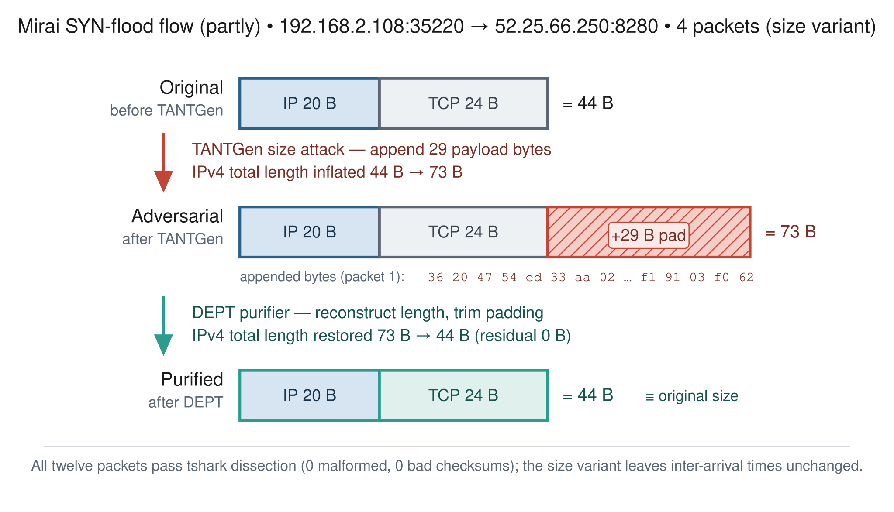
BACKUP
One packet, end to end
44 B
on the wire
73 B
padded by TANTGen
44 B
restored by DEPT
A Mirai SYN-flood datagram from the held-out test split.
DEPT · Defense via Ensemble and Purification Transformer

Slide 29
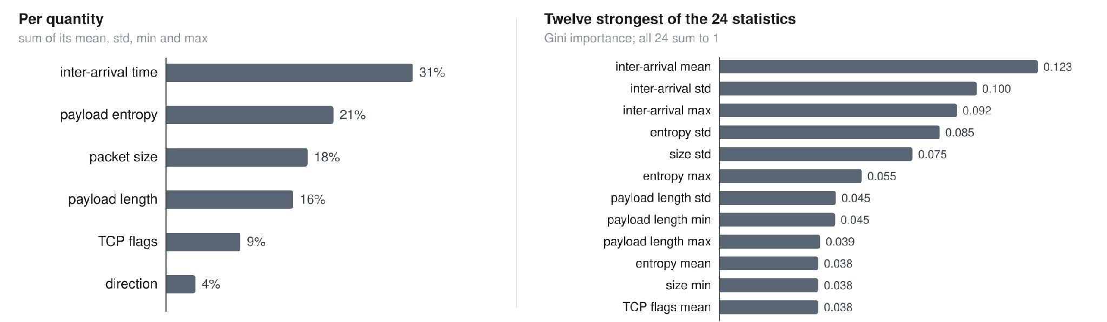
BACKUP
What the Random Forest relies on
Timing first: the inter-arrival statistics hold about a third of the importance. That is why the forest catches the timing-only variants so well (slide 13).
Payload entropy comes second, and the TCN never sees it, since nPrint only encodes headers: the two members really read different evidence.
This is Gini importance from the training run.
DEPT · Defense via Ensemble and Purification Transformer

Slide 30
BACKUP
Accuracy
 | Random Forest | TCN | meta-learner
scored on | 1.84M checkpoints | 1.29M flows | 1.29M flows
manipulated share | 73.7% | 83.7% | 83.7%
accuracy | 91.0% | 76.2% | 75.4%
balanced accuracy | 93.4% | 72.1% | 85.1%
recall, manipulated | 88.3% | 78.2% | 70.8%
recall, untouched | 98.5% | 66.1% | 99.5%
precision, manipulated | 99.4% | 92.2% | 99.9%
AUROC per flow | 0.981 | 0.839 | 0.933
Fixed 0.5 threshold, end of flow. The forest only speaks at checkpoints, so its threshold numbers are per checkpoint and not directly comparable with the other two; the AUROC row is per flow for all three.
Always answering “manipulated” would score 84% accuracy on the flows (74% on checkpoints): here accuracy mostly reflects the class mix. Balanced accuracy and AUROC rank the models the same way.
DEPT · Defense via Ensemble and Purification Transformer

