Slide 1

DEPLOY
+
FASTER,
DEPLOY
APPJET
WITH
Born to simplify.
Appjet
Your seamless solution for hassle-free application setup and server deployment configuration.
Aluno: Guilherme Malhado 202201171
Orientador: Professor Doutor João Ventura

Slide 2
APPJETsolutioning
Manual server configuration and application deployment are time-consuming and error-prone processes.
Complex toolchains like Ansible, Kubernetes, and Jenkins offer solutions but are often cumbersome for smaller-scale projects.
Ansible provides infrastructure automation but requires significant configuration and management overhead.
Kubernetes offers container orchestration but demands expertise in containerization and cluster management.
Jenkins facilitates continuous integration and deployment but requires extensive setup and maintenance.
APPJET aims to bridge the gap by offering a simpler, file-based configuration approach for automation.
Unlike existing tools, APPJET provides a streamlined solution with a binary and specific configurations, making it more accessible to end-users.
Being Open-source, AppJet allows individuals and teams to deploy their own instances, potentially enabling new business models around server provisioning and deployment services.

Slide 3




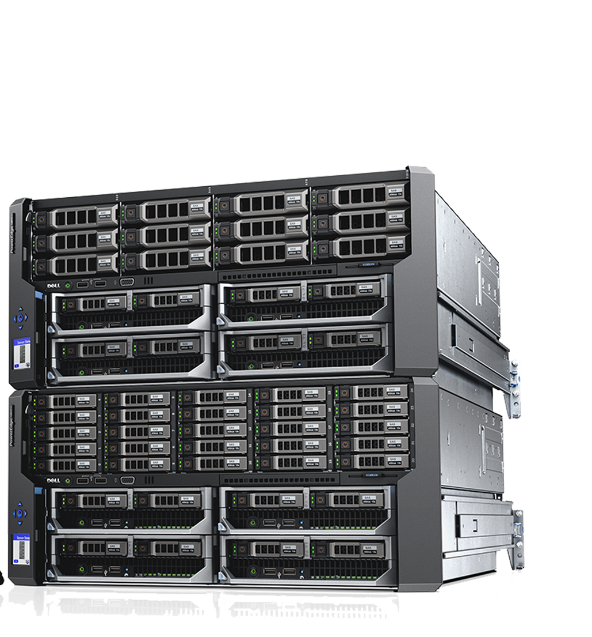


APPJET Center
Server A.1
APPJET
Global Platform Website
HTTP/JSON
Decision
Manager
Cluster A
HTTP/JSON
Server A.2
Docs
Tutorials
Servers
Monitoring
HTTP/JSON
Cluster N
Server A.N
SCP
AUTH TOKEN
DATABASE
ACLI

Slide 4
APPJET
Project objective: Develop a platform simplifying server configuration and streamlining web application deployment.
Components: Server daemon as a Service for Windows* or linux servers, a centralized per-company authentication Identity Provider and Decision Manager server, a command-line client application and a web-site for all the related documentation and also for server monitoring.
Server perspective: AppJet as a service accessing a zone for installing applications within containers.
Facilitation: Integration with an HTTP server for browser accessibility.
Client perspective: "appjet" command as a binary for configuring and deploying applications.
Application configurations: Such as repository settings, version of python or java... etc
Streamlining: Simplified process for configuring and deploying applications on servers.
Efficiency: Faster deployment of web applications through streamlined processes.

Slide 5



APPJET pros & cons
Some Problems
With APPJET
Automation and Acceleration
Simplicity for End Users
Open-Source Flexibility
Potential Business Models
Easy and Fast to install and use
Open Source, open comunity
Community & Support
Limited Third-Party Integrations
Compatibility Issues
Emerging platform, small community in comparison to other bigger platforms
Legacy Apps,
Windows Servers, docker,etc.
As it is a PoC, I doesn’t cover all the scenarios on the Work Market

Slide 6


Schedule
DEPLOYFASTER,DEPLOYWITHAPPJET
Generate Actionable Insights
Refinement &
Optimization
Project
Delivery
Finished
Documentation
And monitoring
Platform
Planning &
Initiation
V1
V2
Master degree
conclusion
With Professor
Finish appjet platform
Finished
Dissertation V1
Development Phase
User feedback
Dissertation Refinement
3/24
6/24
9/23
10/23
11/23
12/23
1/24
2/24
4/24
5/24
Gattering & Creating Documentation
Tech Stack Definition &
Tech Study deep dive
Mid-Term
Presentation
NOW
Important Milestones

Slide 7
Go Live
APPJET
Open Source

Slide 8
Thanks
Do you have any questions?
202201171@estudantes.ips.pt
DEPLOYFASTER,DEPLOYWITHAPPJET
Aluno: Guilherme Malhado 202201171
Orientador: Professor Doutor João Ventura

