Slide 1

Battleships

Slide 2
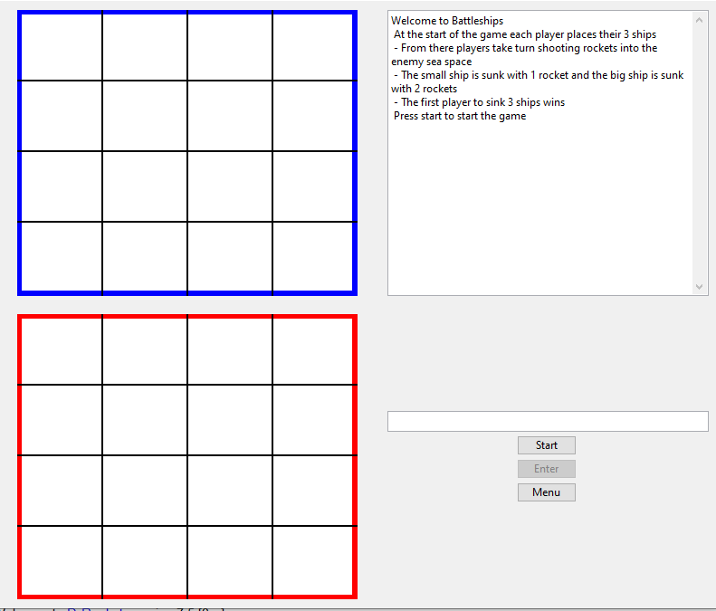
How it looks:
The GUI for the game will show the two players grids and the list of rules.

Slide 3
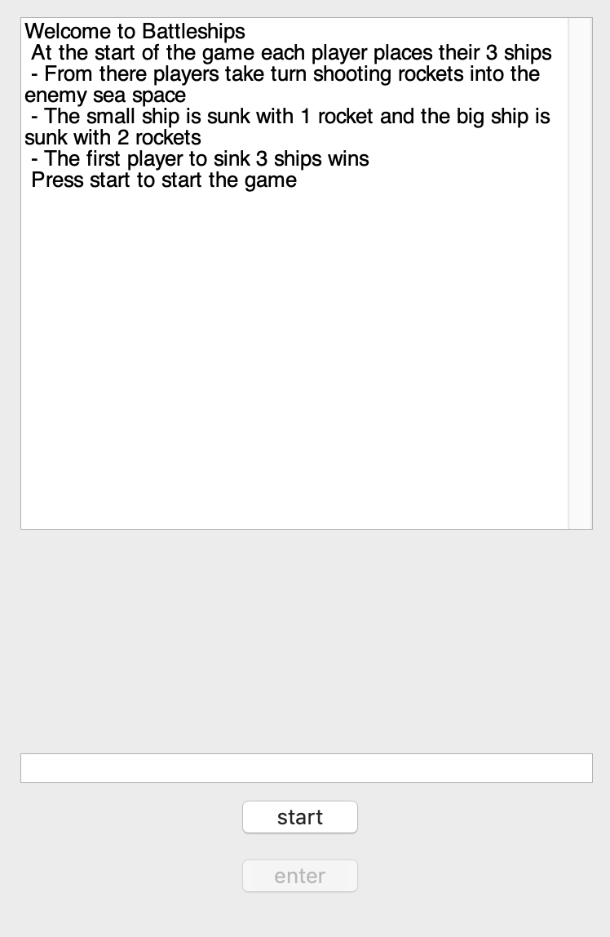
Game rules
The objective of Battleships is to sink all of the opponent’s ships before they sink yours.
Players start by placing their ships on their board. Because the game is not played over LAN and played on one computer, players should turn around when the other player places their ships.
Once the ships have been placed, players take turns guessing where the opponent’s ships are. If they guess correctly, part of the ship is exposed and they get an extra turn.
When all parts of a ship is found, the ship is sunk and the player who sunk it gets a point. The first player to reach the chosen score, wins the game.

Slide 4
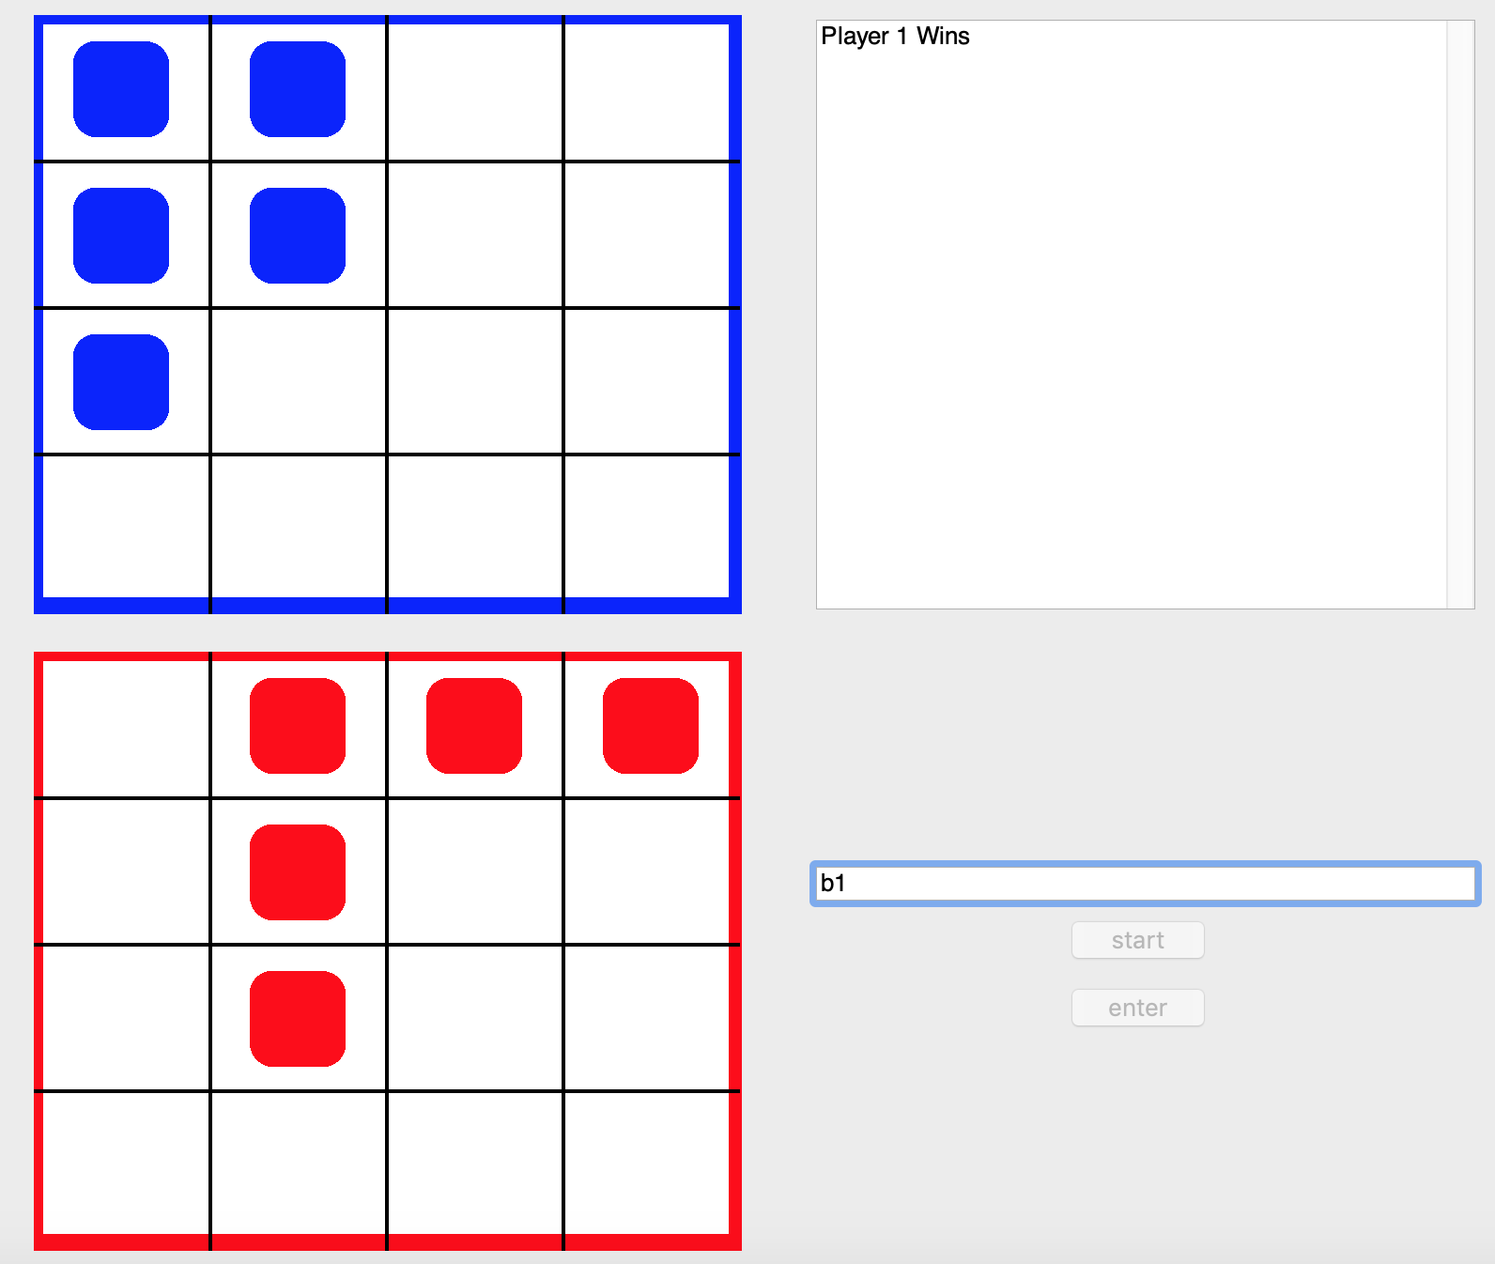
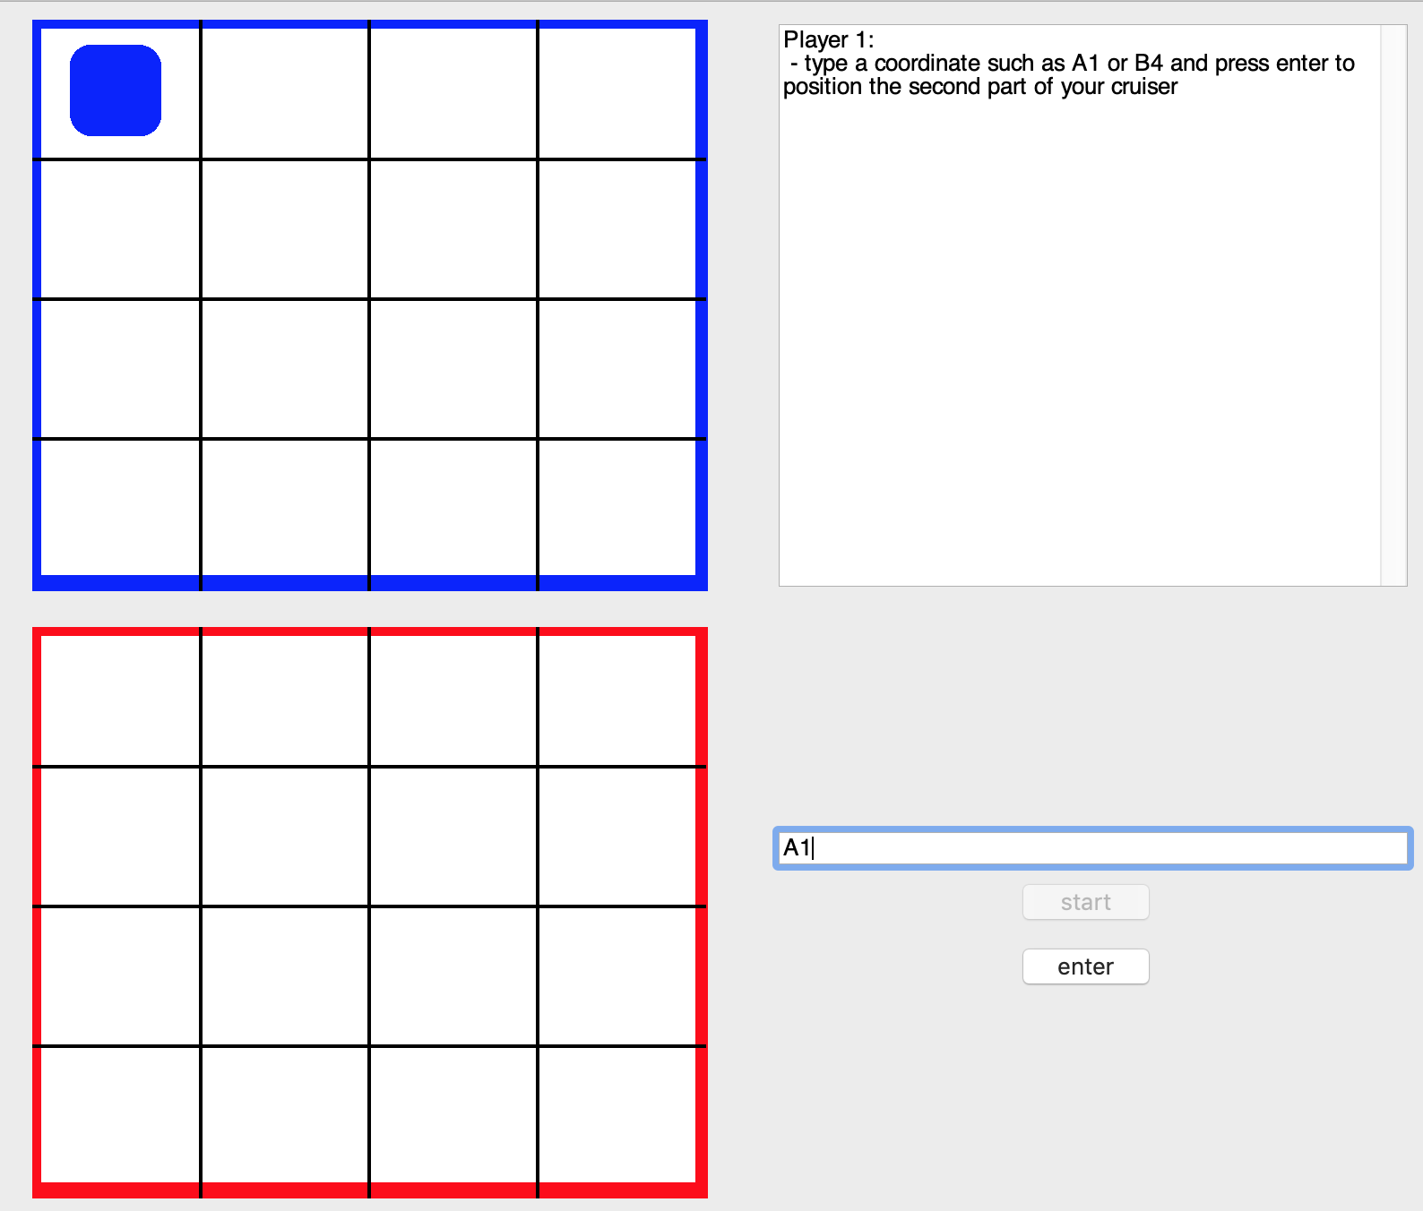
Implementing the game rules
Positions on the grid are chosen by typing a coordinate in a text box followed by selecting the “enter” button below it.
For example, entering “A1” would select the top-left position of the grid.
Once a player has won, a message will be displayed on the top-right side of the screen letting them know they have won. No further moves are able to be made at this point.

Slide 5
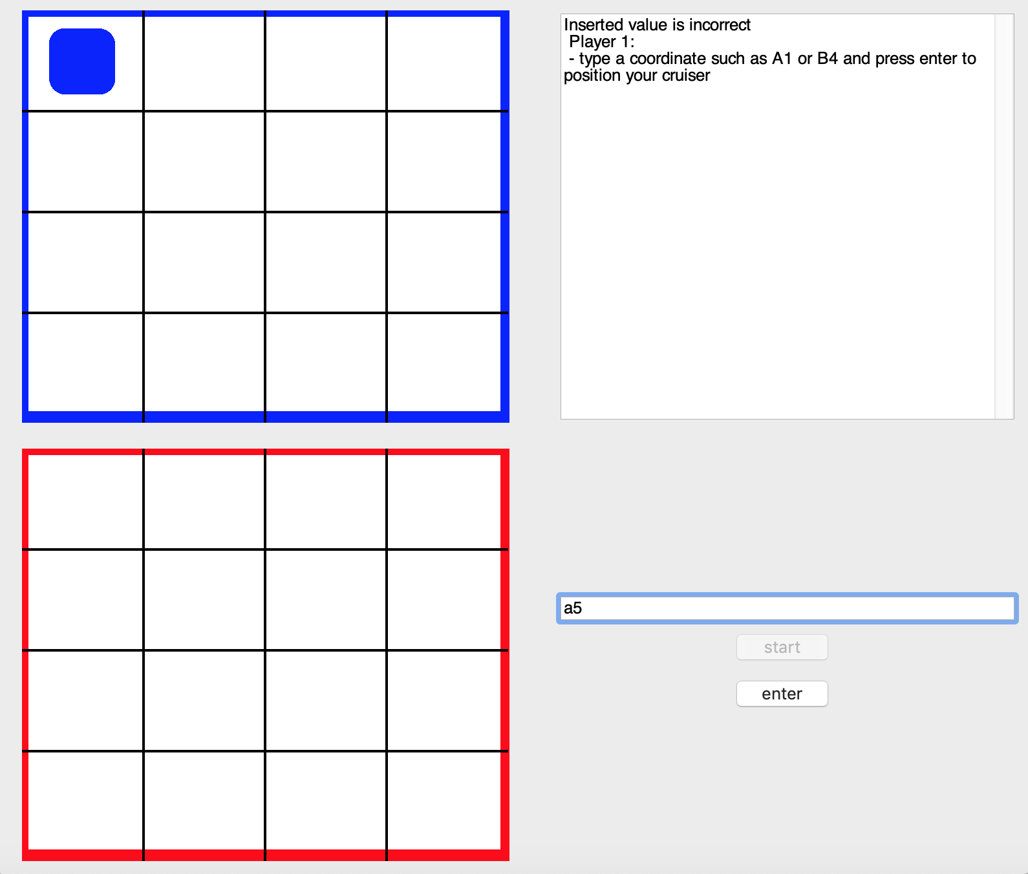
Illegal moves
Error messages are displayed on the top-right side of the GUI if the user makes as invalid move, such as a coordinate not on the grid, an already existing point, or an input with incorrect syntax, a message will be displayed letting the player know that the player has inserted a value that is incorrect.

Slide 6
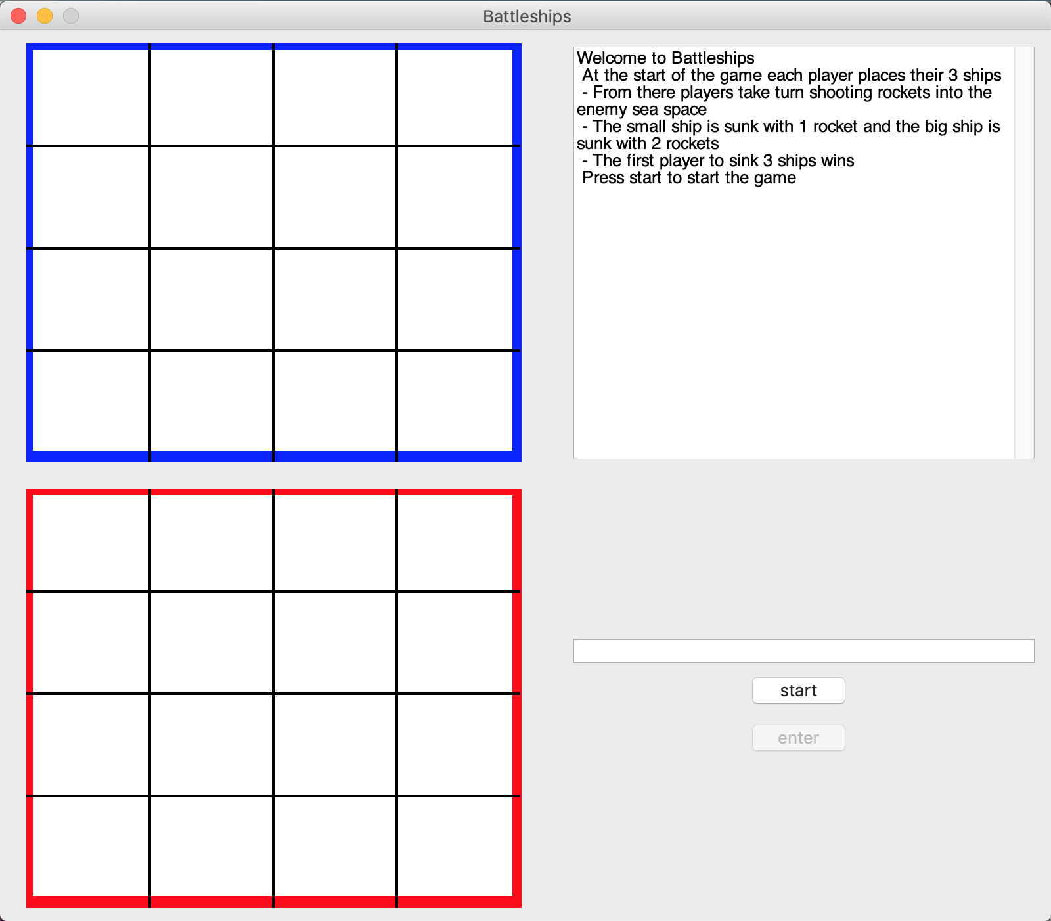
Meeting the user needs
The user interface is simple to use. Instead of cramming in too much into the game screen, it’s just split into 4 parts.
The 2 grids standing out the most as these will be what the users interact with.
The rules part of the screen stands out the least as users will only generally only look at it once at the start of the game.

Slide 7
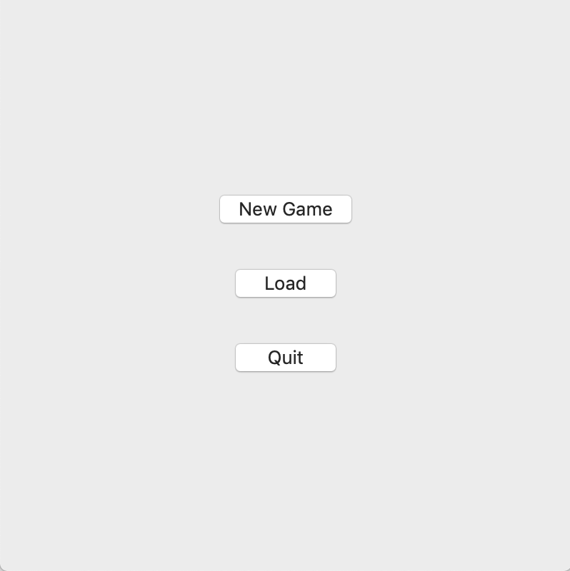
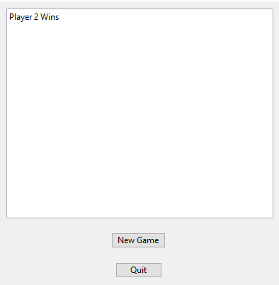
GAME SCREENS
Start screen / settings
Game Screen
Finish Screen

Slide 8
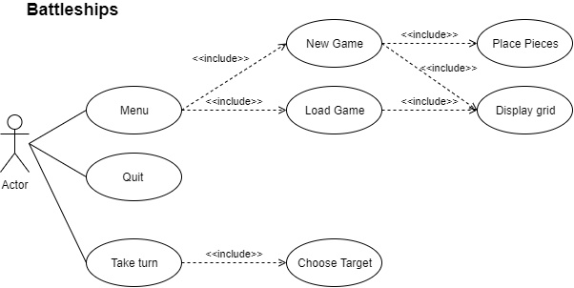
Use case

Slide 9
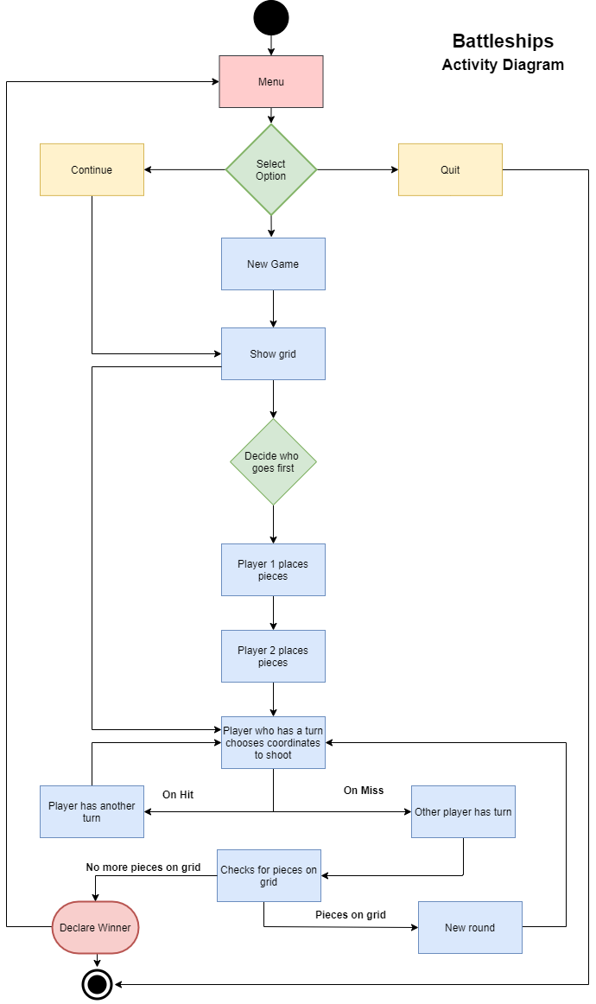
Activity diagram

Slide 10
extensions
(Single player mode / play against AI) – This can be done using several IF statements. The ships would be placed by linking the 4x4 grid to separate variables (or list) and using the random function to choose a point in the grid to place a part of a ship, the random function would then be used to choose what direction to extend the ship. After placing the ships, the random function would be used for the AI to guess the player’s ships. Every time the random function is used, whether for placing ships or guessing them, it would first check whether the grid space / variable is taken / guessed already. All the variables for the grid spaces would be false by default and turned true after choosing a spot with the random function.

Slide 11
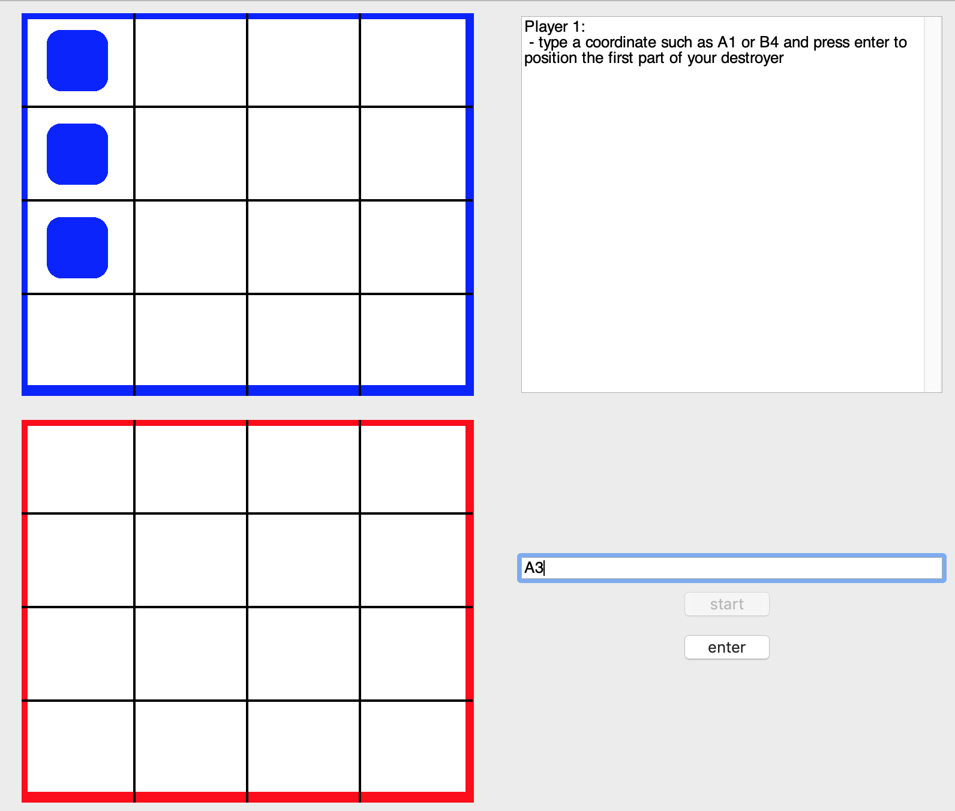
extensions
Difficulty – A difficulty setting in the start menu would set how many ships are placed on the grid and how many have to be sunk to win the game. The lengths of the ships placed would be pre-set so the AI would place the same length ships as the player.
Online / LAN – It’s possible to add a LAN option to the game so that you can play against someone on 2 different computers which would take away the need to turn around when the opponent is placing their ships at the start of the games.

Slide 12
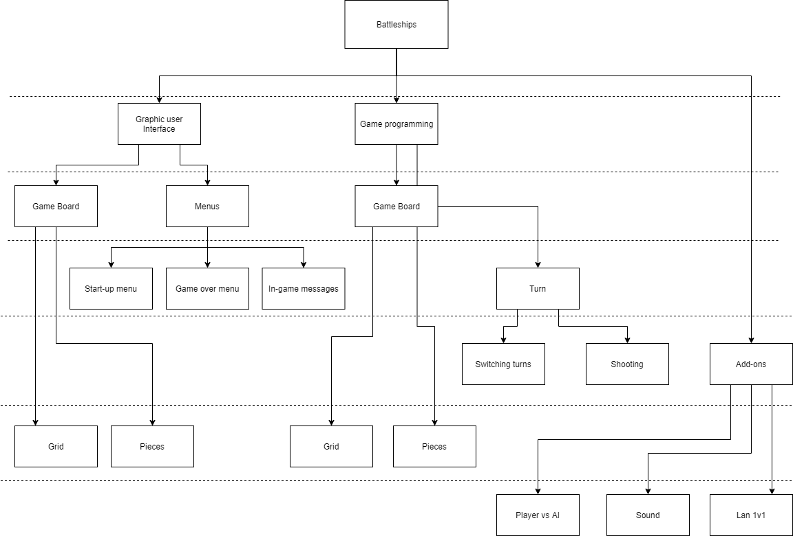
ToP Down

