Slide 1
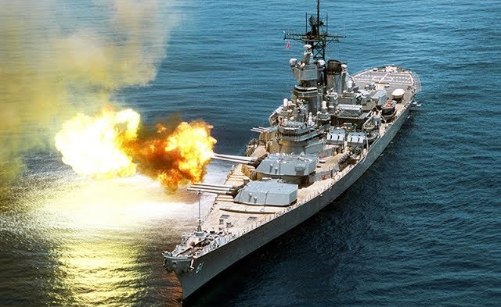
Battleships
Group:
Guilherme Meirelles
Kandauda Perera
Abbas Momin
Darek Mucus

Slide 2
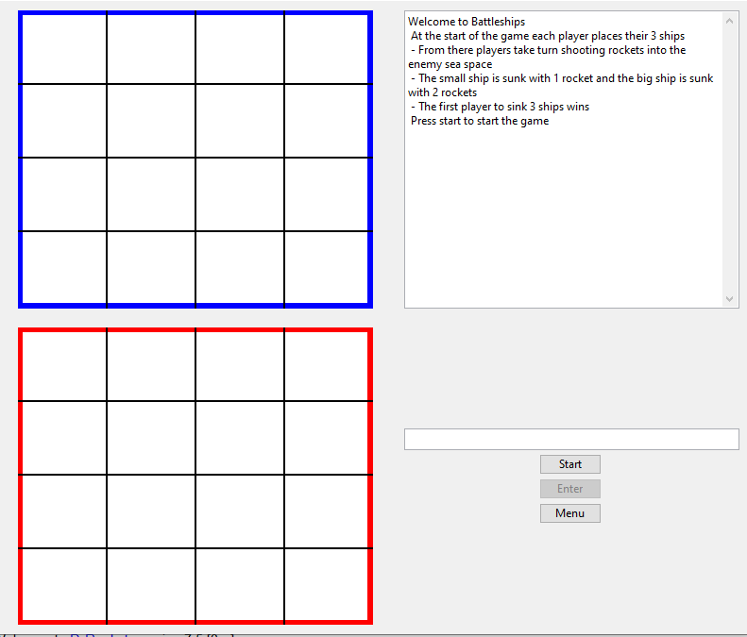
How it looks:
The GUI for the game will show the two players grids and the list of rules.

Slide 3
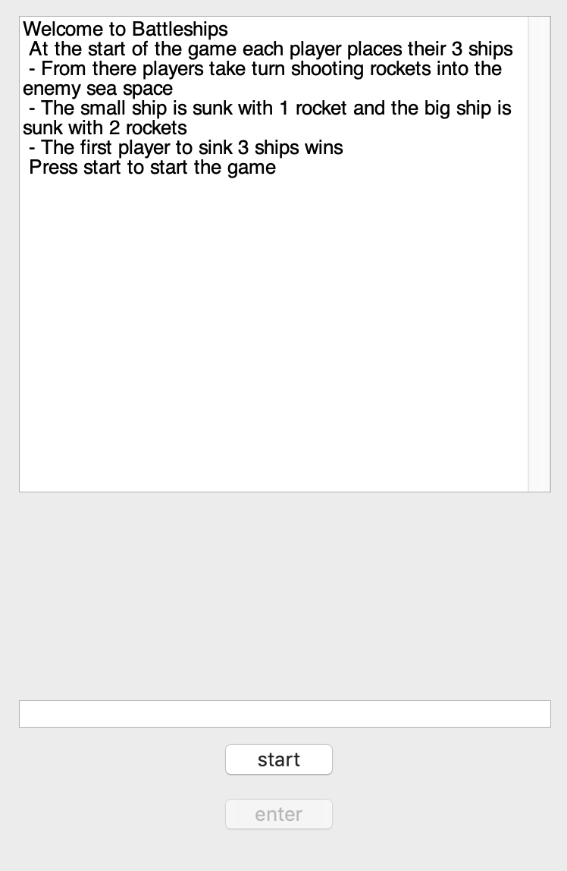
Game rules
The objective of Battleships is to sink all of the opponent’s ships before they sink yours.
Players start by placing their ships on their board. Because the game is not played over LAN and played on one computer, players should turn around when the other player places their ships.
Once the ships have been placed, players take turns guessing where the opponent’s ships are. If they guess correctly, part of the ship is exposed and they get an extra turn.
When all parts of a ship is found, the ship is sunk and the player who sunk it gets a point. The first player to reach the chosen score, wins the game.

Slide 4
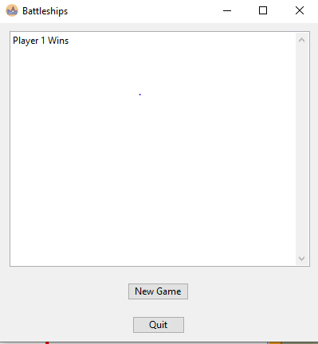
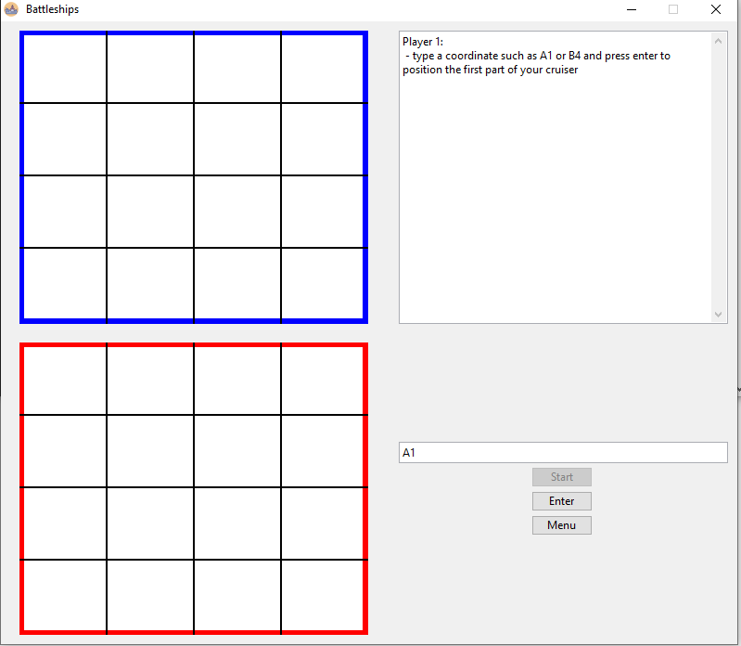
Implementing the game rules
Positions on the grid are chosen by typing a coordinate in a text box followed by selecting the “enter” button below it.
For example, entering “A1” would select the top-left position of the grid.
Once a player has won, a box will pop up showing the winner.

Slide 5
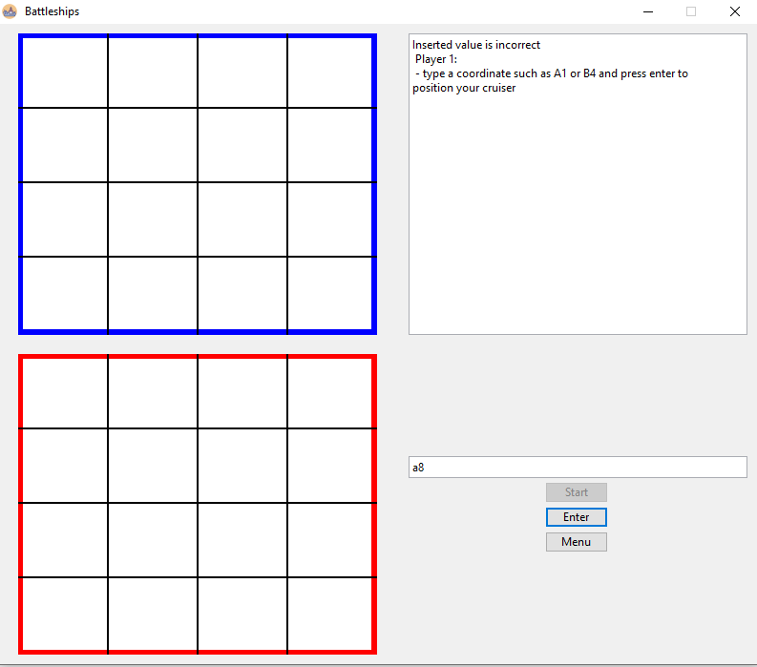
Illegal moves
Error messages are displayed on the top-right side of the GUI if the user makes as invalid move, such as a coordinate not on the grid, an already existing point, or an input with incorrect syntax, a message will be displayed letting the player know that the player has inserted a value that is incorrect.

Slide 6
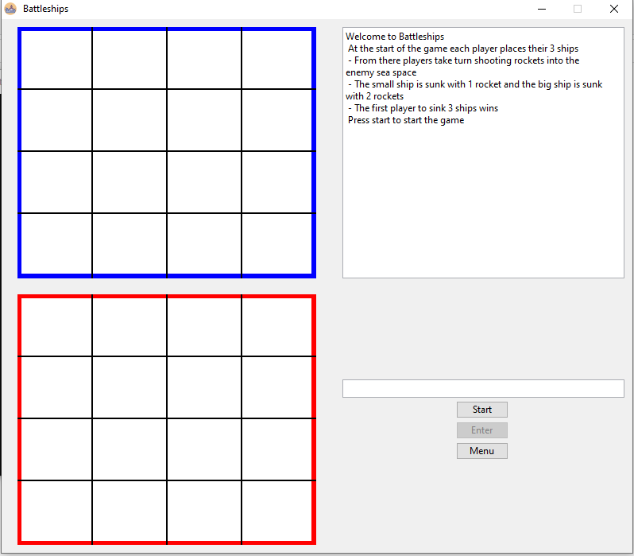
Meeting the user needs
The user interface is simple to use. Instead of cramming in too much into the game screen, it’s just split into 4 parts.
The 2 grids standing out the most as these will be what the users interact with.
The rules part of the screen stands out the least as users will only generally only look at it once at the start of the game.

Slide 7
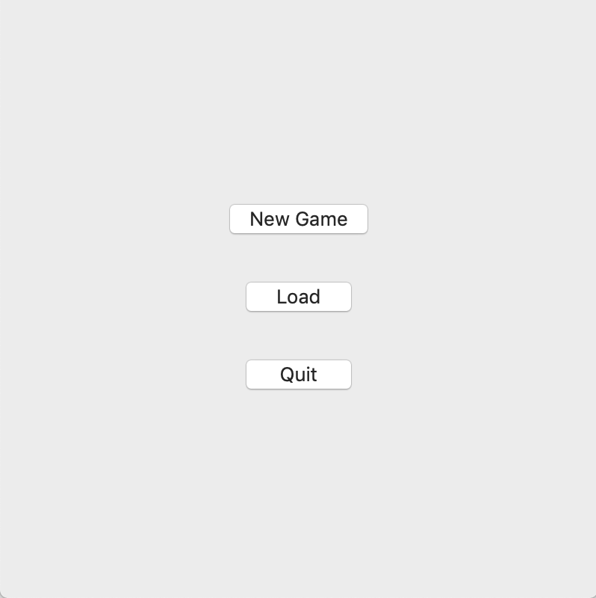
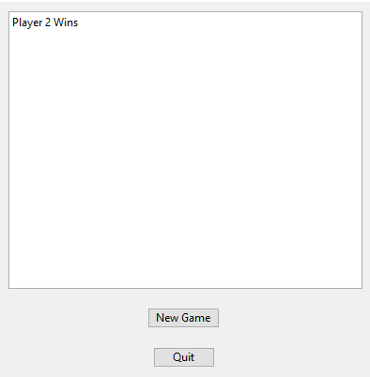
GAME SCREENS
Start screen / settings
Game Screen
Finish Screen

Slide 8
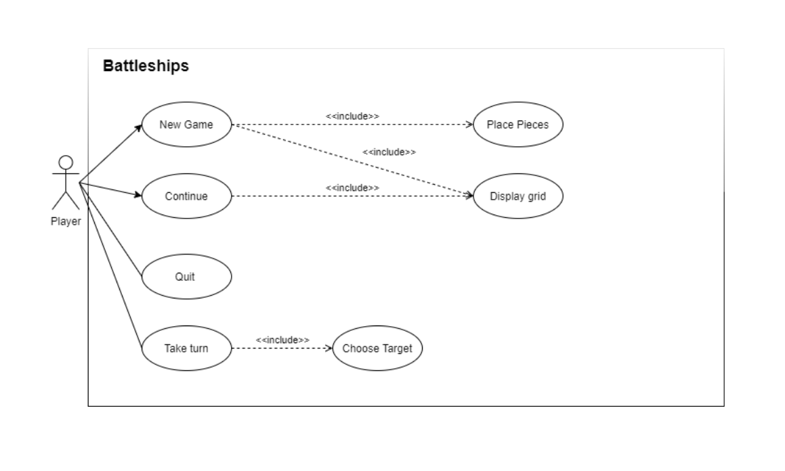
Use case

Slide 9
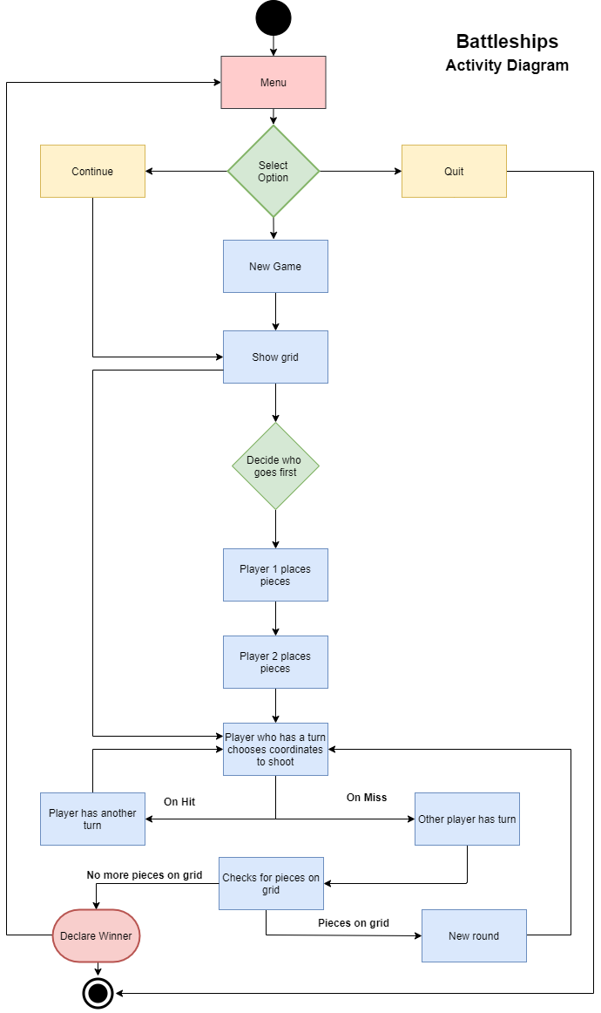
Activity diagram

Slide 10
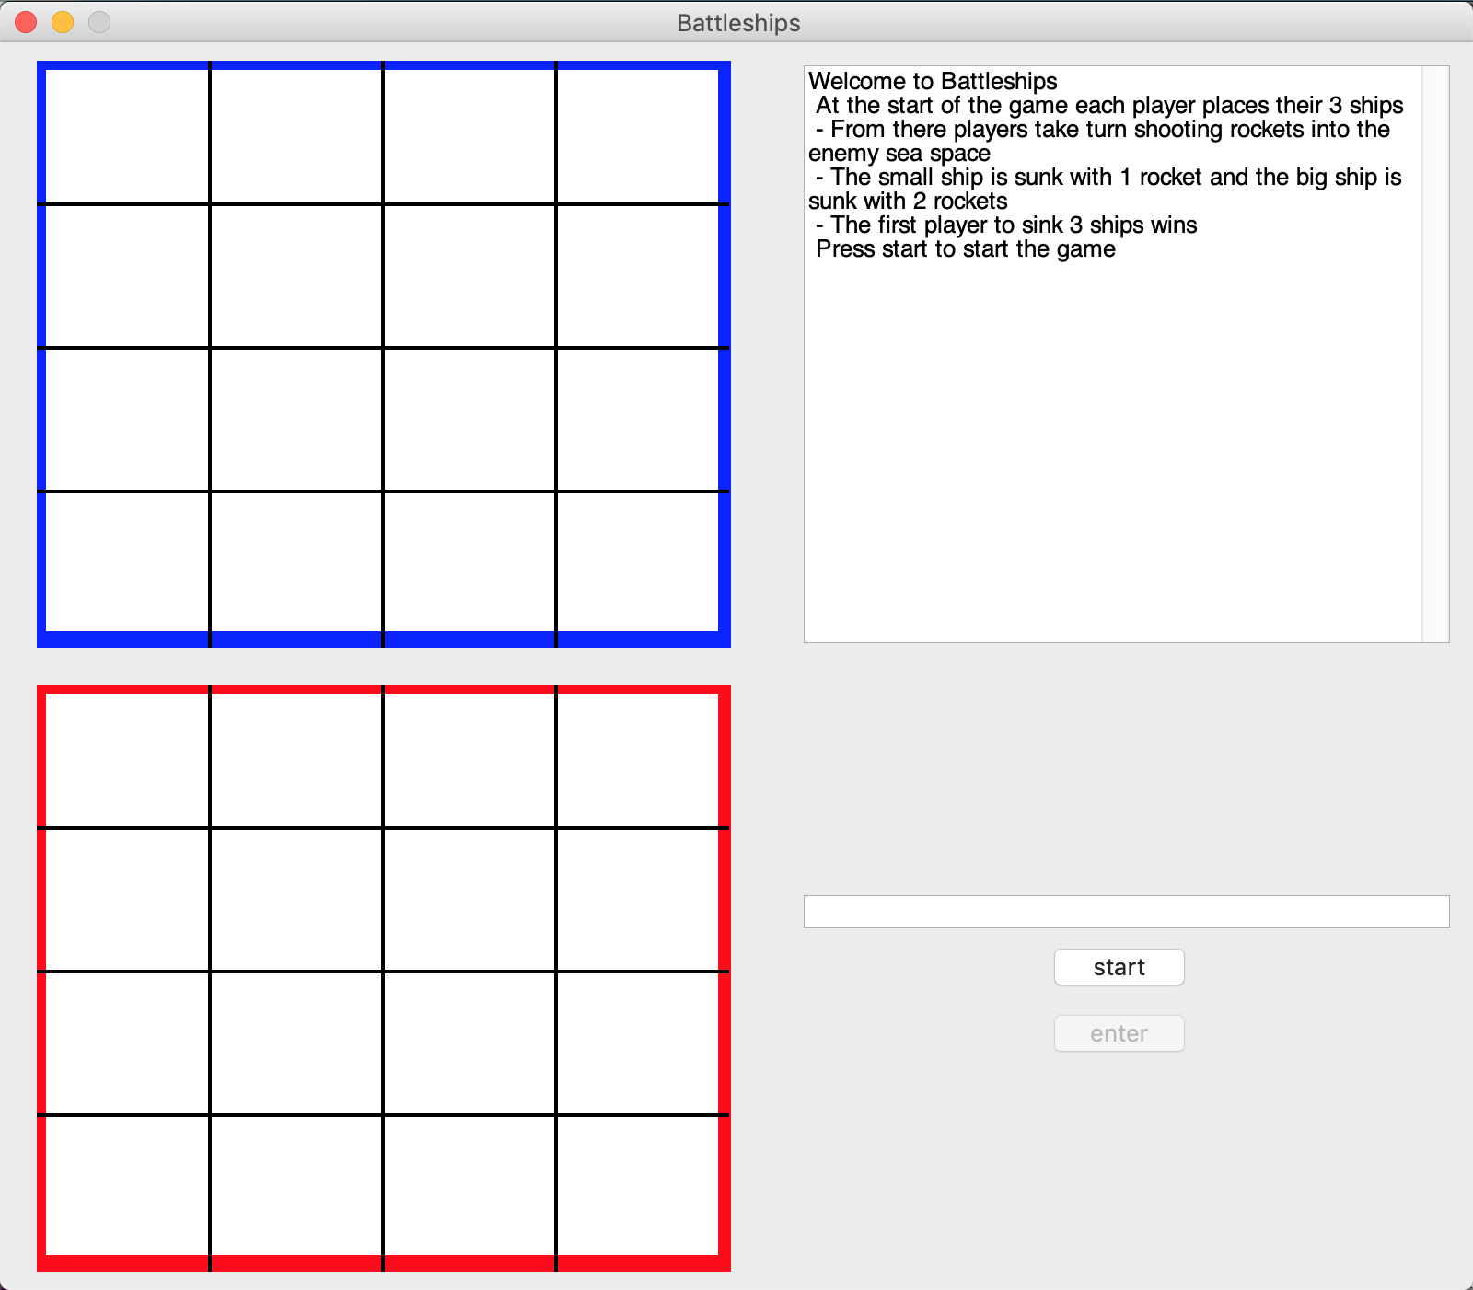
extensions
Single Player PvE – Allow the Player to play against A.I. locally with different difficulty levels.
Online / LAN PvP- Adding networking to allow the game to be played in two machines.
Mouse Controls – Using mouse inputs instead of coordinates.

Slide 11
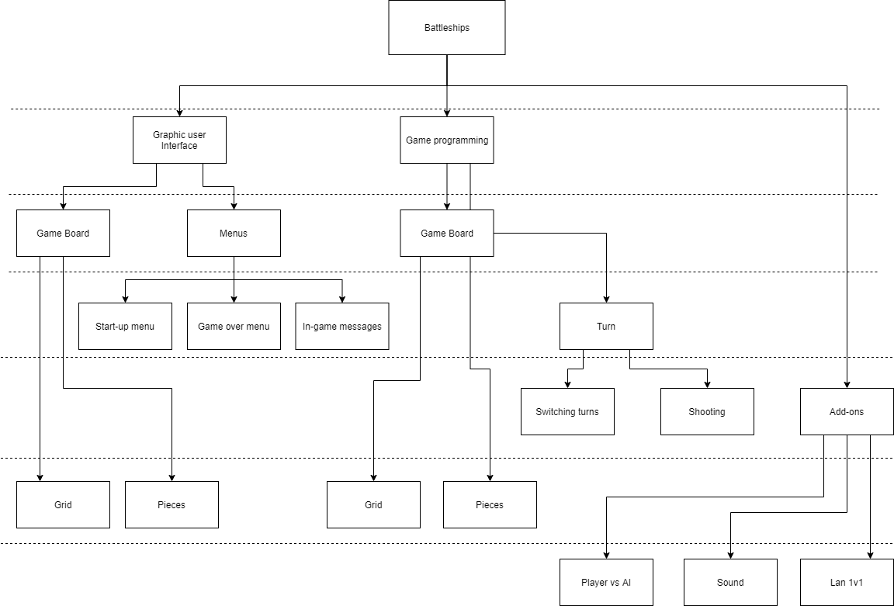
ToP Down

