Slide 1

Absolute Orientation Java Evaluation Code
Jan Portisch, SAP
November, 2021

Slide 2
Ontology Alignment Evaluation Initiative (OAEI)
Web Link: http://oaei.ontologymatching.org/2021/
The Ontology Alignment Evaluation Initiative (OAEI) is running evaluation campaigns every year since 2004.
The organization provides datasets which are publicly available.
Participants submit matcher implementations.
The OAEI testifies the performance.

Slide 3
TestCase and Track
A TestCase is an individual matching task consisting of:
Source
Target
Reference
A Track is a collection of one or more TestCases.

Slide 4
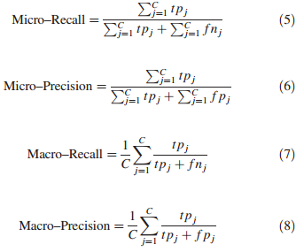
Evaluating Multiple Datasets (Micro/Macro Scores)
Micro average Sum up individual TP, FP, and FN for different test cases.
Macro average Average precision and recall of different test cases.

Slide 5
Anatomy Track
Web Link: http://oaei.ontologymatching.org/2021/anatomy/index.html
Two anatomical ontologies that are to be matched (one matching task).

Slide 6
Multifarm Track
Web Link: http://oaei.ontologymatching.org/2021/multifarm/index.html
Small ontologies that were translated in 8 languages.
Multilingual matching task.
Contains also “same-ontology” test cases, i.e. identical ontologies were translated in two different languages → our approach should perform well here!
Evaluated using macro scores.

Slide 7


Implementation
CSV
This Project

Slide 8
Thank you.
Contact information:
Jan Portisch
jan.portisch@sap.com

