Slide 1

LEICedin
Group project for the Human Computer Interaction class
Faculty
Rui Rodrigues (lectures)
Teresa Galvão (recitations)
Students (G101)
Alexandre Nunes (202005358)
Gonçalo Pinto (202004907)
Guilherme Magalhães (202005285)

Slide 2
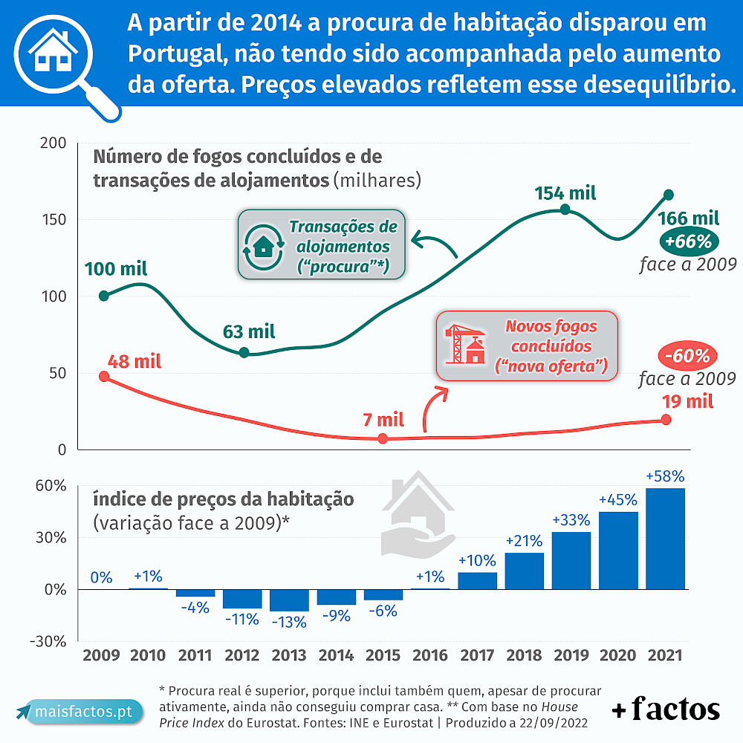
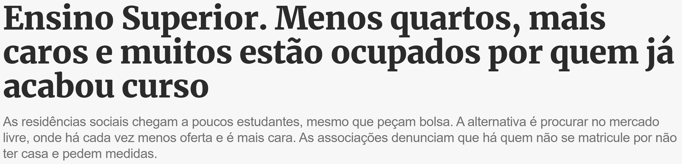
Problem
Number of students is increasing rapidly (by 15000 last year)
Newly graduates are unable to move out of their rooms
Barely any public student housing being built
Private student housing increasing slowly (8000 in the next 3 years)
Overall housing prices are already rising

Slide 3
Initial Idea
Our app
NOT
Career Advancement
Scholarships or charities
Advice or a forum
Employment
Provide access to entry level jobs (with no qualifications or experience required) targeted to college students
Housing
Provide access to rooms or houses being rented specifically to college students
We only want to help people get to next year

Slide 4
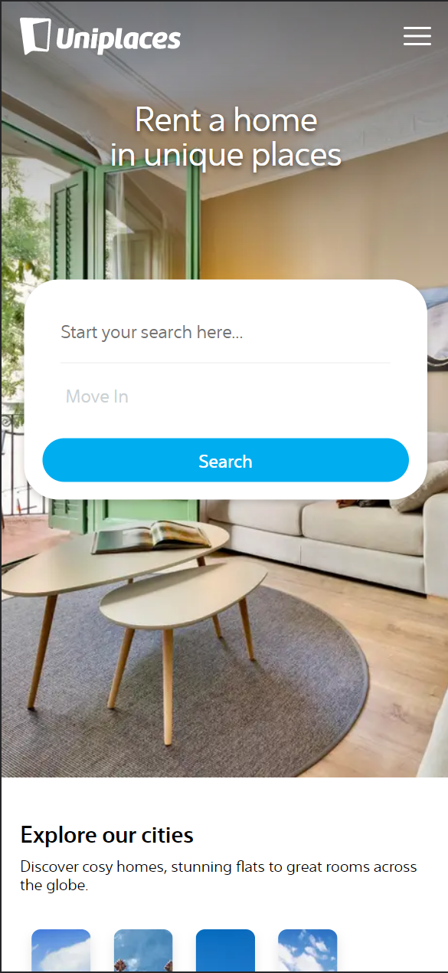
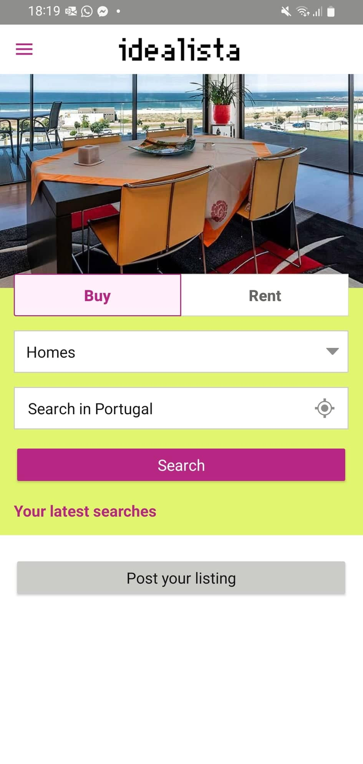

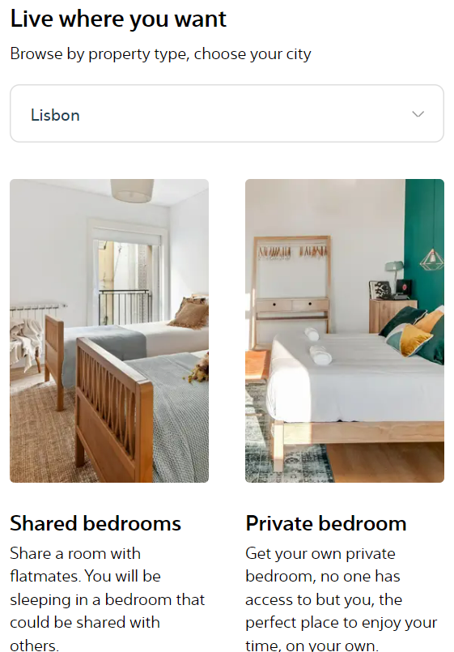
Related Services
(from questionnaire)
Browser app
Mobile app
Very similar to browser, but more “app like” (no scroll, simpler design)
Immediate call-to-action
Product description, marketing and more call-to-actions
Scroll

Slide 5
Questionnaire
23 responses, 16 probable users
Mostly female

