Slide 1

LEICedin
Group project for the Human Computer Interaction class
Faculty
Rui Rodrigues (lectures)
Teresa Galvão (recitations)
Students (G101)
Alexandre Nunes (202005358)
Gonçalo Pinto (202004907)
Guilherme Magalhães (202005285)

Slide 2
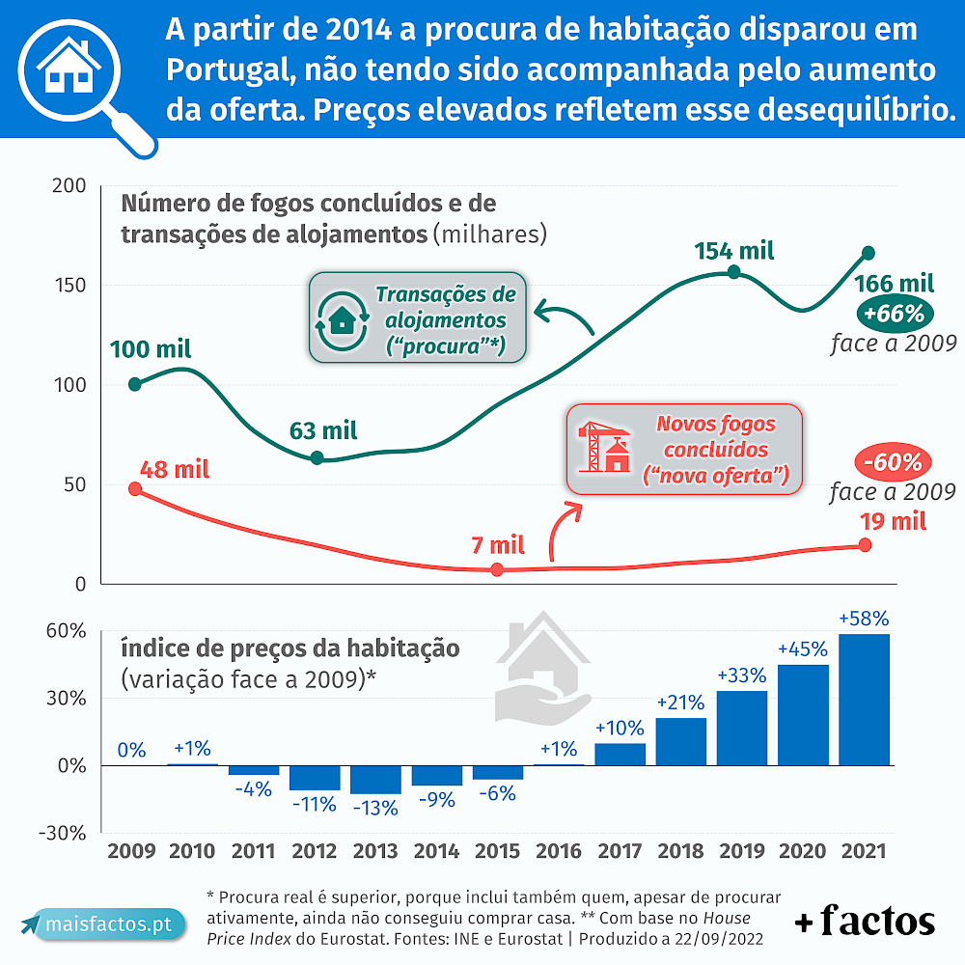
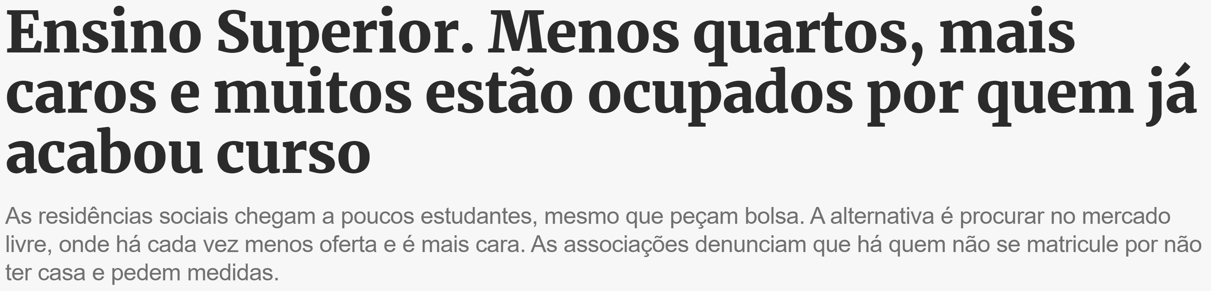
Problem
Number of students is increasing rapidly (by 15000 last year)
Newly graduates are unable to move out of their rooms
Barely any public student housing being built
Private student housing increasing slowly (8000 in the next 3 years)
Overall housing prices are already rising

Slide 3
Initial Idea
Our app
NOT
Career Advancement
Scholarships or charities
Advice or a forum
Employment
Provide access to entry level jobs (with no qualifications or experience required) targeted to college students
Housing
Provide access to rooms or houses being rented specifically to college students
We only want to help people get to next year

Slide 4
Questionnaire
23 responses, 16 possible users
Mostly females, 3rd year students between the ages of 18 and 23
Invalid responses 57,5% male
Valid responses 62,5% female
Ten responses for Portuguese people not living with their parents
Four responses for student-workers
Three responses for Erasmus students (thanks Paula)
Eight were living too far from FEUP
Six are living in a house with roommates
Nine are satisfied with their accommodations
Only one has to work to pay expenses
Two are working full time, one 25 hours and one 9 hours
Two are satisfied and two unsatisfied
Only one didn’t want to give us his salary
None of them are interested in working or moving from their current stay

Slide 5
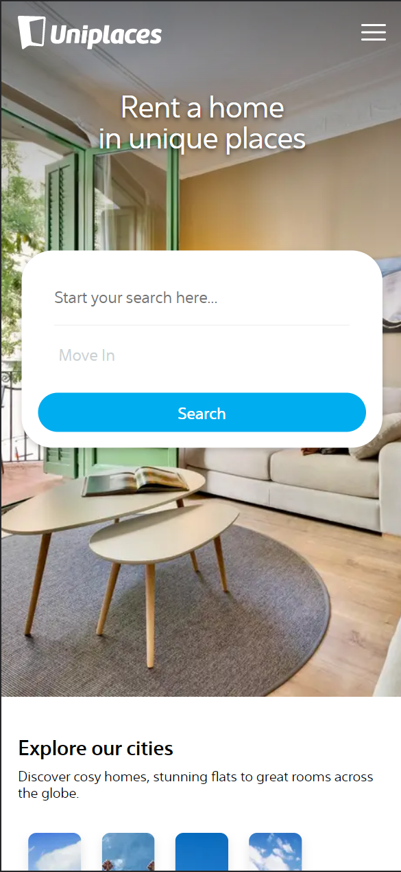
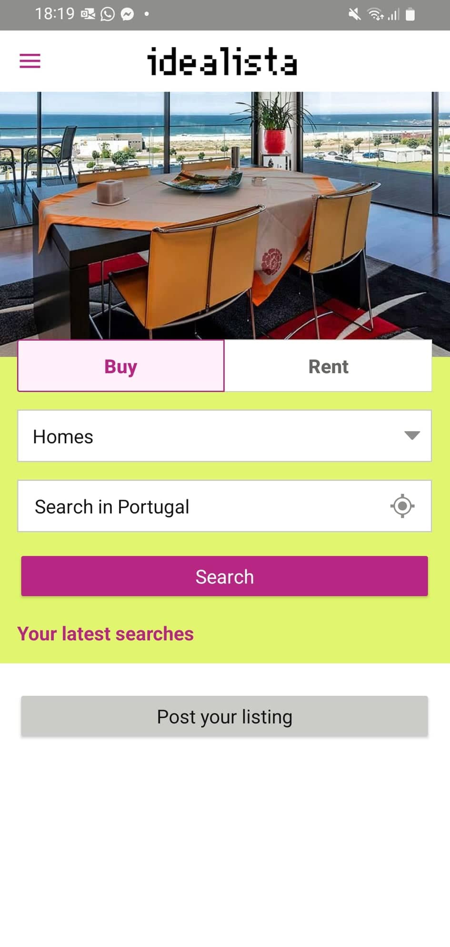
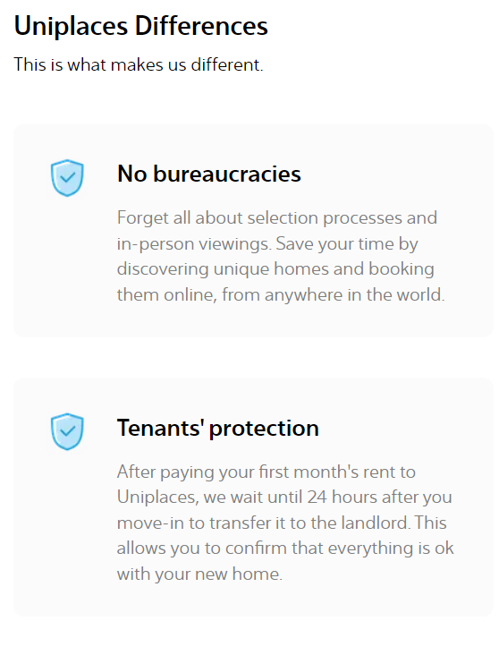
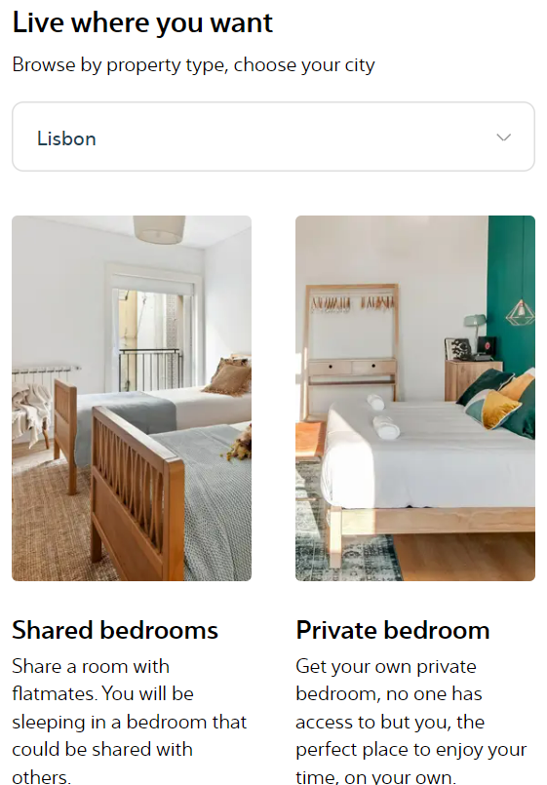
Related Services
(from questionnaire)
Browser app
Mobile app
Very similar to browser, but more “app like” (no scroll, simpler design)
Immediate call-to-action
Product description, marketing and more call-to-actions
Scroll

Slide 6


Persona example: Carlos Silva
Profile
Carlos is 20 and a 3rd year LEIC student living with his parents. Six months ago a friend told him as a receptionist/security guard at a high-end apartment complex and he’s now working full time, making 1300€ a month.
He’s very self-centered with one exception: his girlfriend. Although he has yet to pay for a meal the truth is he’s building his life around her.
Independent
Proud
Motivations
He likes being able to give gifts to his girlfriend
He’s proud that he got a “good” job considering he had no qualifications or experience
Frustrations
He’s working a lot and feels he has less time for his girlfriend
He’d like a less customer-oriented job
He doesn’t feel like he’s advancing towards long term goals
Stubborn
Impatient
Incomplete version, please check the PDF

Slide 7
Activity Scenario Example
A co-worker of Carlos quit his job. Considering the company needs to replace him quickly, Carlos decided to share the opportunity with colleagues from LEIC.
Therefore, he registered in LEICedin and created a new job offer. Since he himself works in the same position (security), he was able to provide reliable information about the day-to-day of his job is like in the description. He also included the pay, hours worked, benefits and his boss’ contact details.
One person contacted Carlos to ask a quick question (he allowed this in the post). Afterwards that person (presumably) used the provided contact and was eventually hired.

Slide 8
Conceptual Model
Actions
create, delete, edit job posting
create, delete, edit room posting
access, contact job posting
access, contact room posting
Objects
user (name, contact, isStudent)
job posting (description, pay, hours, contact)
room posting (description, cost, location, contact)
Relations
user has job postings
user has room postings
user (isStudent) responds to job posting
user (isStudent) responds to room posting

Slide 9
Functionalities and Tasks
Example of Functionalities:
Search an offer by name/location
Order the offers list
Contact the seller
Example of Tasks:
Search offers in a certain street
Order the offers by price
Send CV to seller

Slide 10
Usability Requirements
Efficacy
The use of the platform is carried out intuitively, with only 5% of users making a mistake.
Efficiency
Users can find an interesting offer in less than 2 minutes.
Satisfaction
The platform must match the expectations of 80% of new users.

Slide 11
Related Services
(from questionnaire)
Browser app
Mobile app
Very similar to browser, but more “app like” (no scroll, simpler design)
Immediate call-to-action
Product description, marketing and more call-to-actions
Scroll

