Slide 1
Vortex Detection and Fitting in Turbulent Flows
Guilherme Lindner
Jean Marc Foucaut
Jean-Philippe Laval
Ilkay Solak
International Master in Turbulence
Ecole Centrale, Lille
30/06/2017

Slide 2
Summary
Introduction
Methodology
Validation
Results
Conclusion
Future work
Vortex Detection and Fitting in Turbulent Flows – Guilherme Lindner

Slide 3

What is a vortex?
Introduction Methodology Validation Results Conclusion Future work
Vortex Detection and Fitting in Turbulent Flows – Guilherme Lindner

Slide 4
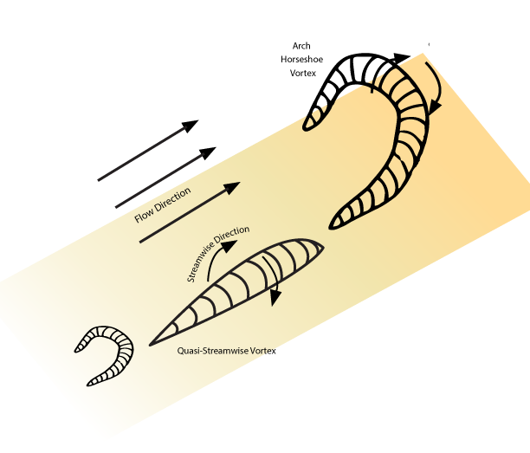
coherent structures VS vortices
Introduction Methodology Validation Results Conclusion Future work
Green, Sheldon I. (1995)
Vortex Detection and Fitting in Turbulent Flows – Guilherme Lindner

Slide 5
Detection methods
Introduction Methodology Validation Results Conclusion Future work
Q criterion
Δ criterion
Swirling strength criterion
Vortex Detection and Fitting in Turbulent Flows – Guilherme Lindner

Slide 6
Swirling strength criterion
Introduction Methodology Validation Results Conclusion Future work
a
Vortex Detection and Fitting in Turbulent Flows – Guilherme Lindner

Slide 7
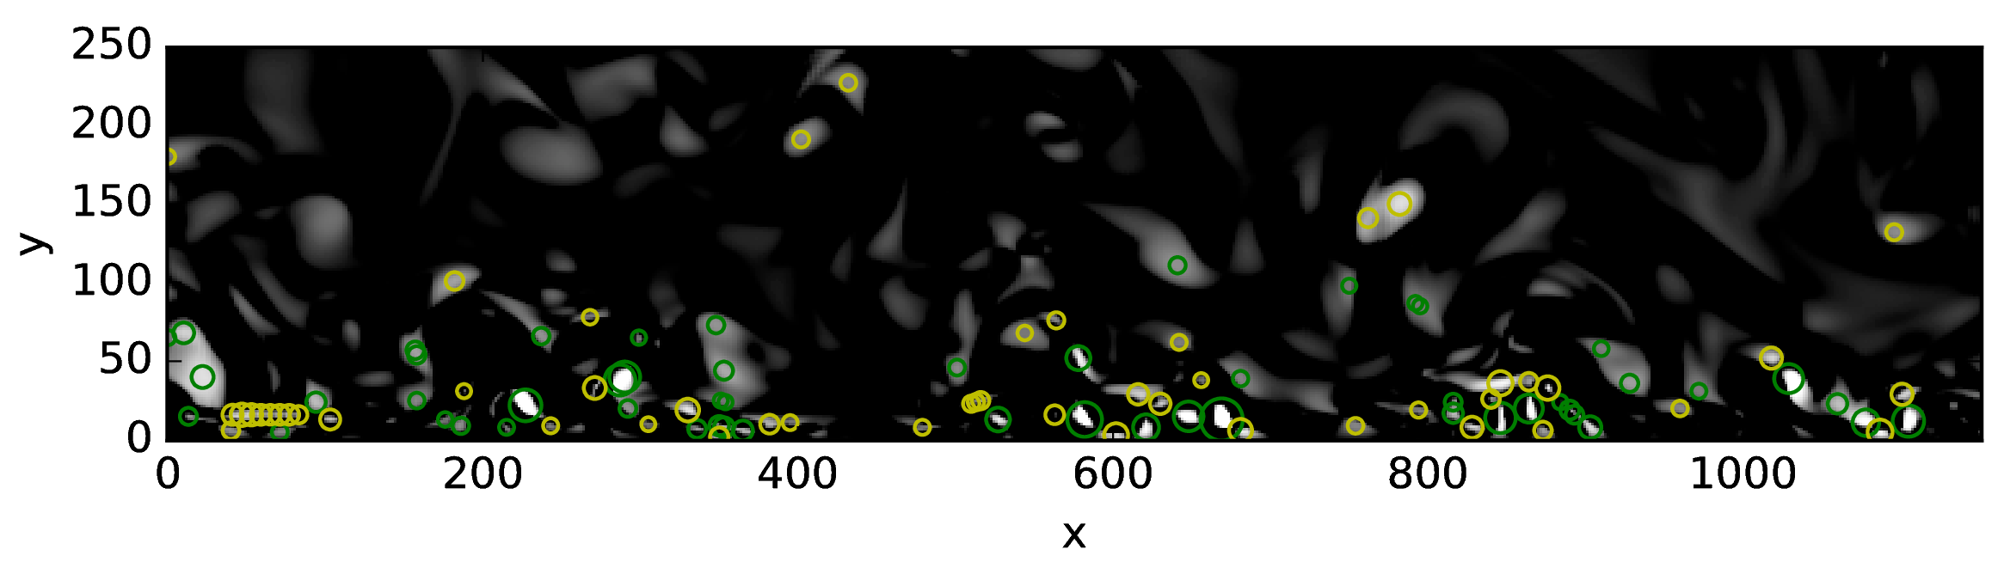
Localization of the extrema
Introduction Methodology Validation Results Conclusion Future work
swirling strength field
Vortex Detection and Fitting in Turbulent Flows – Guilherme Lindner

Slide 8
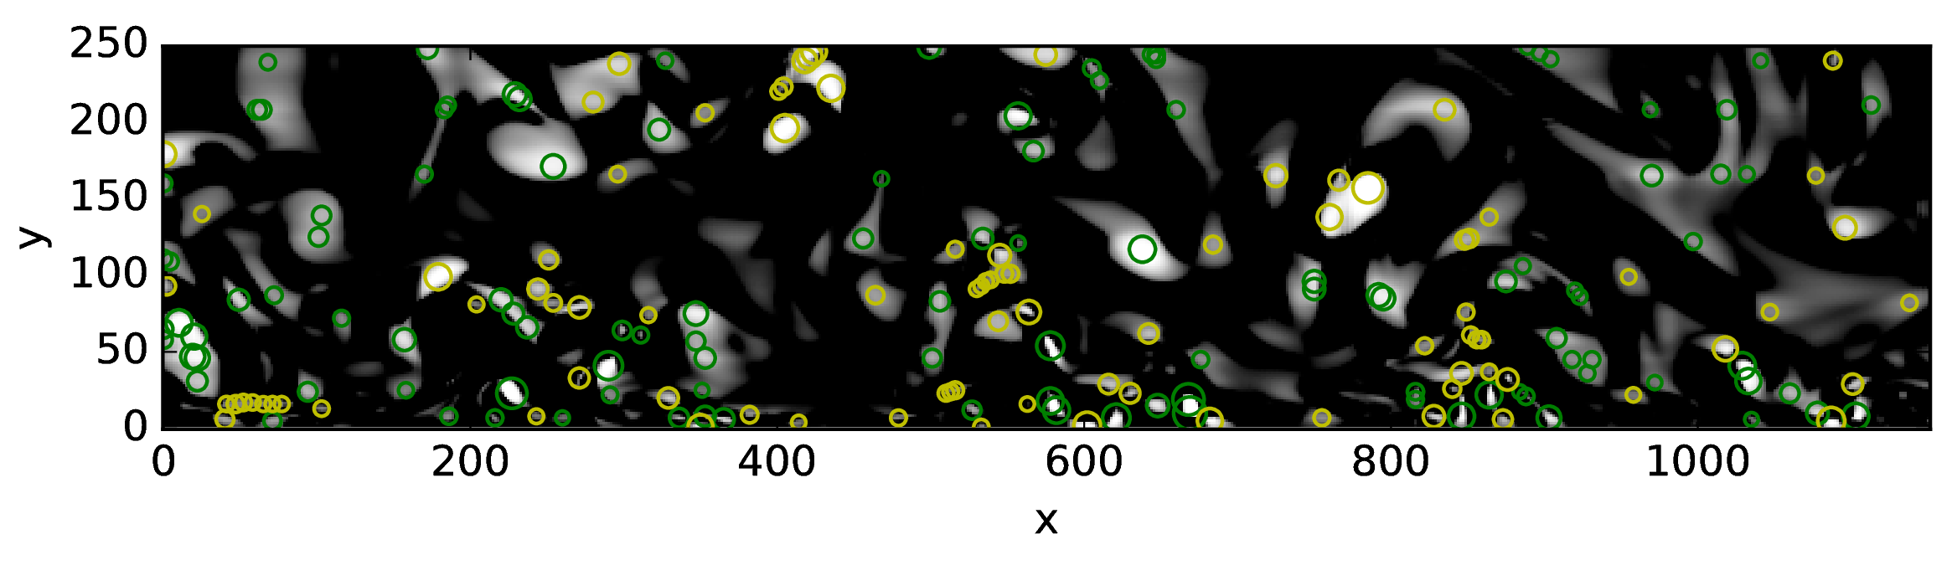
Localization of the extrema
Introduction Methodology Validation Results Conclusion Future work
Fluctuation of swirling strength field by applying Reynolds decomposition
Vortex Detection and Fitting in Turbulent Flows – Guilherme Lindner

Slide 9
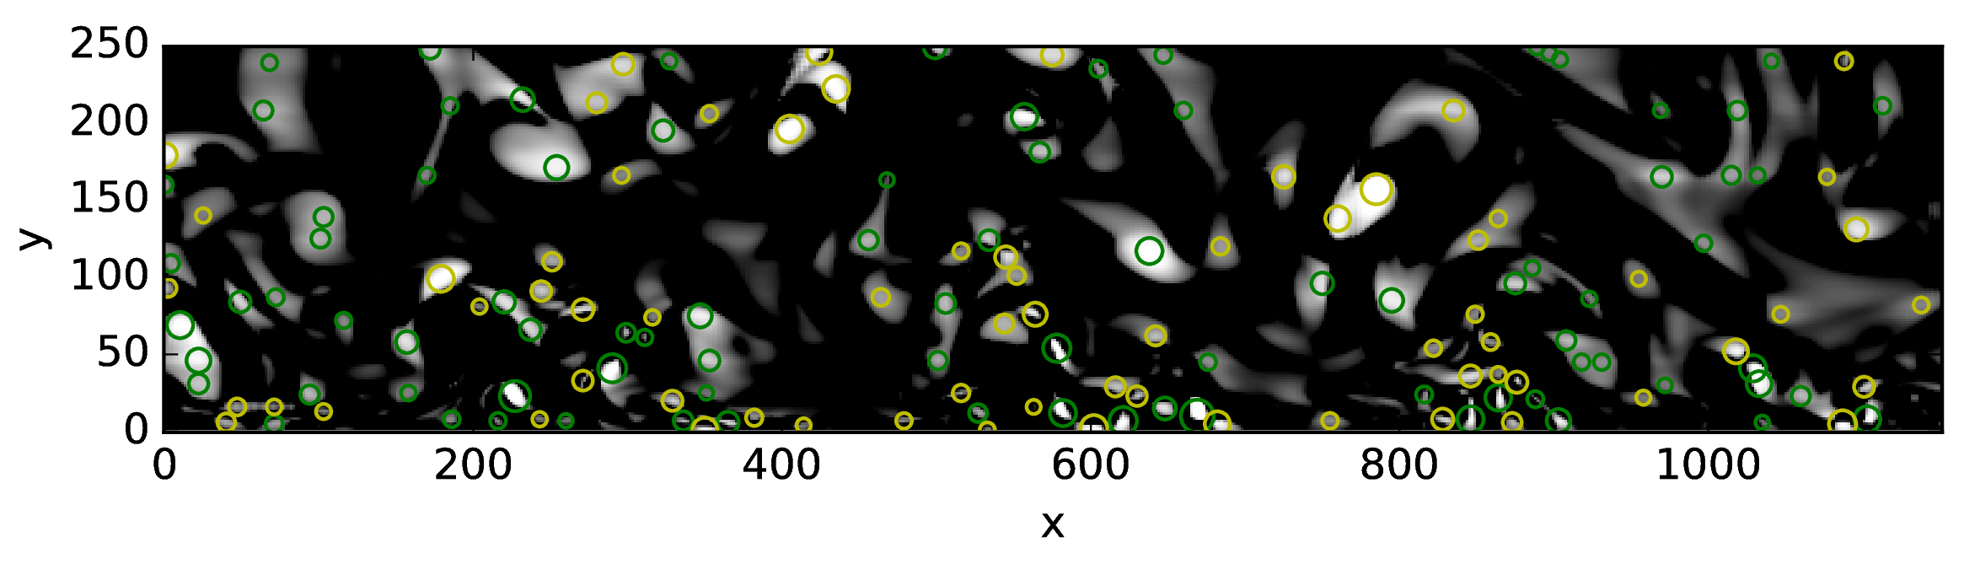
Localization of the extrema
Introduction Methodology Validation Results Conclusion Future work
Fluctuation of swirling strength field with a bigger box size for the localization of extrema
Vortex Detection and Fitting in Turbulent Flows – Guilherme Lindner

Slide 10
Fitting of coherent structures
Introduction Methodology Validation Results Conclusion Future work
Vortex Detection and Fitting in Turbulent Flows – Guilherme Lindner

Slide 11
Lamb-Oseen vortex
Introduction Methodology Validation Results Conclusion Future work
Vortex Detection and Fitting in Turbulent Flows – Guilherme Lindner

Slide 12
...
Introduction Methodology Validation Results Conclusion Future work
PIV swirling strength field
Vortex Detection and Fitting in Turbulent Flows – Guilherme Lindner

Slide 13
...
Introduction Methodology Validation Results Conclusion Future work
PIV swirling strength field
Vortex Detection and Fitting in Turbulent Flows – Guilherme Lindner

Slide 14
...
Introduction Methodology Validation Results Conclusion Future work
PIV swirling strength field
Vortex Detection and Fitting in Turbulent Flows – Guilherme Lindner

Slide 15
Future work
Introduction Methodology Validation Results Conclusion Future work
Standard output of results
Documentation (sphinx)
Organize fitting function (modular)
Vortex Detection and Fitting in Turbulent Flows – Guilherme Lindner

