Slide 1
TECHNICAL PRESENTATION
DIAL-ALERT
Early prediction of blood pressure defined
intradialytic hypotension
Franklin Guillano
Capstone Project, Step 6
September 2026
Academic clinical decision support prototype
DIAL-ALERT technical presentation / 01
Notes:
Presenter notes
• Open with the prediction question and emphasize that this is a retrospective academic prototype.
• The presentation follows the complete machine-learning lifecycle from data construction to governance.

Slide 2
Clinical prediction question and success criteria
A supervised binary-classification task with a fixed prediction boundary
Can information available near the start of haemodialysis identify sessions that later record systolic blood pressure below 90 mmHg?
POPULATION
PREDICTION TIME
TARGET
DECISION USE
Eligible adult haemodialysis sessions
Earliest valid active record within minutes 0 to 30
Any later SBP below 90 mmHg
Risk ranking for clinician review
Evaluation hierarchy
Primary ranking
Discrimination
Probability quality
Workflow utility
Average precision
ROC AUC
Brier score
Recall and PPV at alert capacity
Outcome and feature boundary: DIAL-ALERT Steps 2–4
DIAL-ALERT technical presentation / 02
Notes:
Presenter notes
• Average precision is the primary ranking metric because only about 8.5% of sessions meet the event definition.
• Business utility is assessed as event recall, positive predictive value, lift, and false alerts at a fixed review capacity.
• The target is a blood-pressure event, not a complete clinical diagnosis because symptoms and treatments are unavailable.
Sources
• DIAL-ALERT Step 2 report and Step 4 model report.
• Saito T, Rehmsmeier M. PLoS ONE. 2015. https://doi.org/10.1371/journal.pone.0118432

Slide 3
HEMOBP supports a large session cohort with 830 independent patients
Public longitudinal data link patient, session, and monitor records
106,758
eligible sessions
830
unique patients
8.49%
primary outcome prevalence
4.37 million monitor states in the raw source
Source: HEMOBP v3 and DIAL-ALERT cohort_flow.json
DIAL-ALERT technical presentation / 03
Notes:
Presenter notes
• The analytic unit is a session, while the effective independent sample is the patient.
• The public files contain 1,072 patient rows, compared with 1,075 reported in the source paper. All analyses use the observed release and disclose the difference.
• Cohort restrictions improve target validity but may introduce selection bias.
Sources
• Lin CJ et al. Scientific Data. 2019. https://doi.org/10.1038/s41597-019-0319-8
• HEMOBP v3. https://doi.org/10.6084/m9.figshare.6260654.v3
• Project report: reports/Franklin_Guillano_DIAL_ALERT_Data_Collection_and_Understanding_Report.pdf

Slide 4
Prediction features stop at the index time
The outcome uses later measurements only, preventing temporal leakage
Earlier sessions
and patient history
Index record
minutes 0 to 30
Later BP records
define the target
22 model inputs
Haemodynamic state
Fluid and treatment
Baseline SBP, DBP, MAP, pulse pressure
Fluid excess, UF rate, blood flow, dialysate settings
Longitudinal history
Patient context
Prior nadir SBP, prior IDH rate, prior session event
Age, recorded sex, diabetes, dialysis vintage
Excluded from predictors: later blood pressure, outcome fields, post-dialysis weight, dialysis end time, identifiers, and audit variables
Source: preprocessing specification and feature engineering dictionary
DIAL-ALERT technical presentation / 04
Notes:
Presenter notes
• The earliest valid active-treatment record within 30 minutes forms the prediction index.
• Sessions already below 90 mmHg at the index time are excluded.
• Missing values enter model pipelines through median and most-frequent imputation. Unusual but plausible values remain after explicit range checks.
Sources
• Project files: docs/preprocessing_specification.csv and docs/feature_engineering_dictionary.csv

Slide 5
Patient-level separation protects the evaluation
No patient appears in more than one development partition
496
164
170
training patients
64,053 sessions
validation patients
21,351 sessions
test patients
21,354 sessions
0 patient overlap
1
Grouped 3-fold CV
2
Validation decisions
3
Locked test
4
Patient bootstrap
Tune candidate pipelines on training patients
Choose calibration and F2 threshold
Evaluate once after all choices
500 resamples for uncertainty
Why it matters
Repeated sessions from the same patient can make random session splits look more accurate than true generalisation to new patients.
Source: split_summary.csv, split_assignments.csv.gz, model_config.json
DIAL-ALERT technical presentation / 05
Notes:
Presenter notes
• Patient-disjoint splitting is the central protection against repeated-measures leakage.
• The validation set handles calibration and threshold choice. The test set remains untouched until the final evaluation.
• Bootstrap resampling occurs at the patient level to preserve within-patient dependence.

Slide 6
Random forest met the prespecified selection rule
Selection rule: highest grouped-CV average precision, then lower validation Brier score within 0.01
Why random forest
CV AVERAGE PRECISION
0.440
VALIDATION BRIER SCORE
0.058
Boosting CV AP: 0.446; RF: 0.440. Brier comparison used candidates as fitted. Equal calibration remains untested.
Selected model: 250-tree random forest, minimum leaf size 15
Source: model_comparison.csv and final_test_metrics.json
DIAL-ALERT technical presentation / 06
Notes:
Presenter notes
• Seven configurations include linear, tree, boosted, PCA, embedded-selection, and prevalence baselines.
• The locked selection rule considers ranking first and probability quality when models are practically tied.
• Deep learning was not justified for a compact tabular snapshot with only 830 independent patient groups.
Sources
• Breiman L. Random Forests. Machine Learning. 2001. https://doi.org/10.1023/A:1010933404324
• Project artifact: artifacts/model_comparison.csv

Slide 7
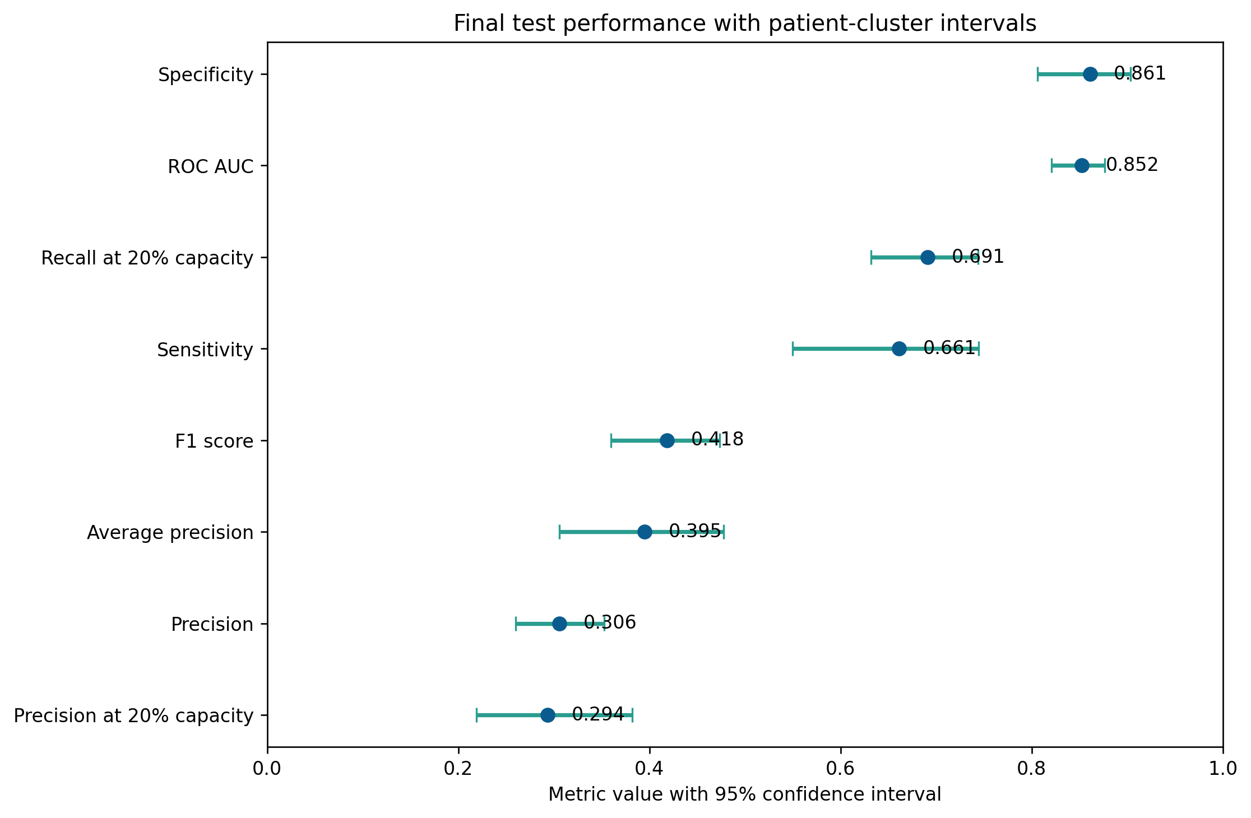
Held-out performance shows strong discrimination and modest precision
Locked assessment on 21,354 sessions from 170 previously unseen patients
0.852
ROC AUC
0.395
average precision
0.062
Brier score
Operating threshold 0.143
Sensitivity 66.1%
Specificity 86.1%
Precision 30.6%
Intervals: 500 patient-cluster bootstrap resamples
DIAL-ALERT technical presentation / 07
Notes:
Presenter notes
• At the validation-selected threshold, the test set contains 1,199 true positives, 615 false negatives, 2,719 false positives, and 16,821 true negatives.
• Average precision must be read against the 8.49% prevalence baseline.
• Wide intervals reflect only 170 test patients despite the large number of sessions.
Sources
• Project artifacts: artifacts/final_test_metrics.json and artifacts/test_metric_confidence_intervals.csv

Slide 8
Alert capacity determines the coverage and workload trade-off
Ranking utility shown across the proportion of sessions selected for review
20% review capacity
EVENT RECALL
69.1%
POSITIVE PREDICTIVE VALUE
29.4%
LIFT OVER PREVALENCE
3.46×
14.1 false alerts per 100 sessions
Capacity ranking is distinct from the fixed-threshold operating point
DIAL-ALERT technical presentation / 08
Notes:
Presenter notes
• The unit can choose review capacity based on staffing and the relative cost of missed events and false alerts.
• At 20% capacity the model identifies about 69% of observed events, but most reviewed sessions do not have the event.
• No clinical benefit follows automatically from ranking performance. A prospective intervention study is required.
Sources
• Project artifact: artifacts/capacity_metrics.csv

Slide 9
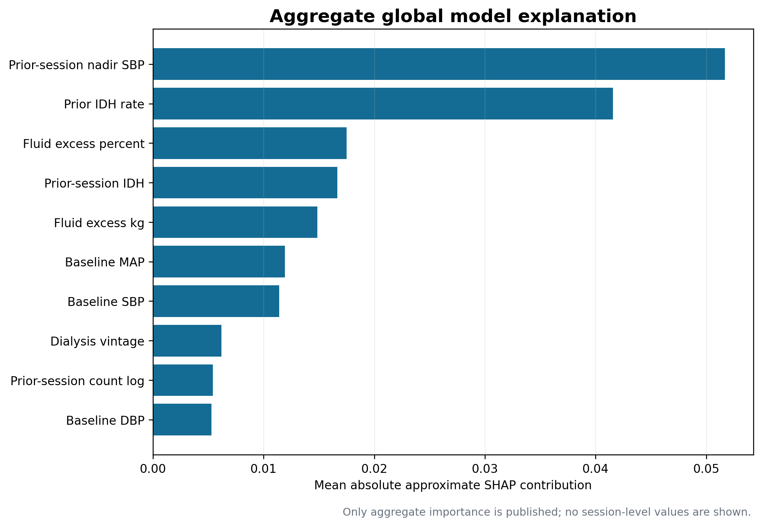
Prior haemodynamic instability drives most predicted risk
Aggregate SHAP with a separately declared synthetic local scenario
Consistent signals
Lower prior nadir SBP: higher predicted risk
Higher prior IDH rate: higher predicted risk
Greater fluid excess: higher predicted risk
Lower baseline pressure: higher predicted risk
Explanation limits
Monte Carlo SHAP is approximate. For the synthetic local scenario, the LIME-style surrogate had weighted R² 0.678 and absolute probability error 0.025. Neither method establishes causality or a treatment target.
Source: Step 5 explainability audit
DIAL-ALERT technical presentation / 09
Notes:
Presenter notes
• Permutation importance, aggregate SHAP, and synthetic-profile dependence curves agree that prior instability and fluid status dominate the model.
• The explanation describes the fitted model, not a causal mechanism.
• The local SHAP and LIME example is a manually constructed synthetic scenario, not an observed patient session.
• Local LIME output requires a fidelity warning because the surrogate only moderately approximates the random forest near that synthetic scenario.
Sources
• Lundberg SM, Lee SI. NeurIPS 2017. https://papers.neurips.cc/paper/7062-a-unified-approach-to-interpreting-model-predictions
• Ribeiro MT et al. KDD 2016. https://doi.org/10.1145/2939672.2939778
• Project artifacts: artifacts/step5_shap_summary.png, artifacts/step5_shap_local_synthetic.csv, and artifacts/step5_lime_local_metadata.json

Slide 10
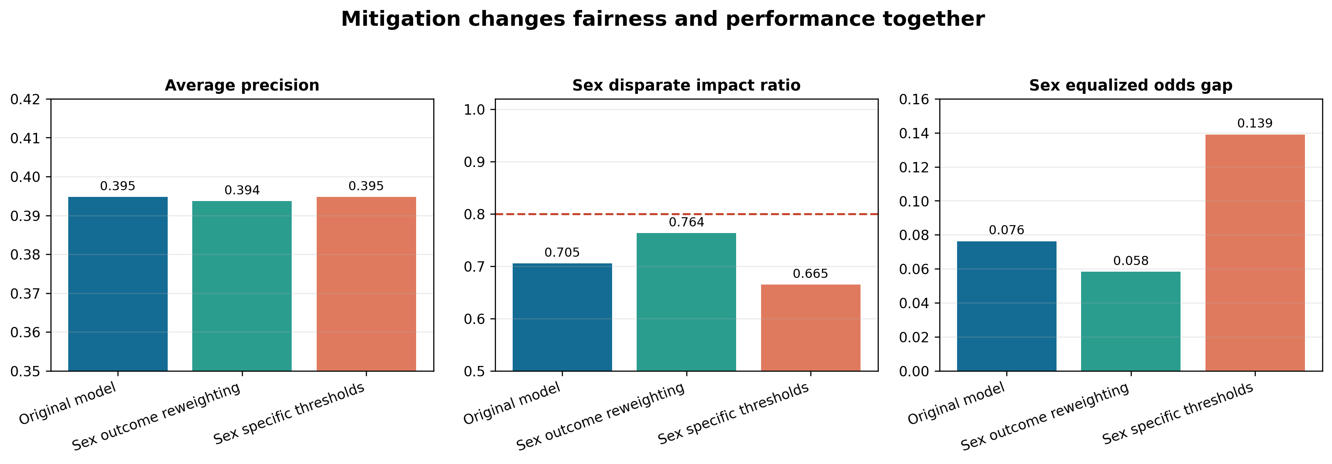
Fairness mitigation findings remain exploratory
Held-out fairness metrics must be reviewed with clinical utility and uncertainty
Reweighting explored
Threshold strategy rejected
Unmeasured fairness
Sex disparate-impact ratio 0.705 to 0.764. Equalized-odds gap 0.076 to 0.058. AP 0.395 to 0.394.
Sex-specific thresholds worsened the equalized-odds gap to 0.139 and lowered precision to 27.8%.
Race, ethnicity, socioeconomic status, and gender identity are unavailable. Age-group DI ratio is 0.541.
0.80 disparate-impact ratio is a descriptive screen, not a fairness certificate
DIAL-ALERT technical presentation / 10
Notes:
Presenter notes
• The recorded-sex mitigation improved two summary gaps with essentially unchanged average precision.
• The improvement does not eliminate disparity and may not transfer to another centre.
• Patient-equal weighting changes some estimates, intersections are unstable, and bootstrap intervals are wide.
• Sex-specific thresholds use a protected attribute at inference and performed worse on test patients, so they are rejected.
Sources
• Hardt M, Price E, Srebro N. NeurIPS 2016. https://arxiv.org/abs/1610.02413
• Project artifacts: artifacts/step5_mitigation_comparison.csv and artifacts/step5_disparities.csv

Slide 11
End-to-end reproduction successfully completed
Fresh Python 3.12 reproduction completed on 20 September 2026
Project structure
Simplified workflow — full commands in README
data/raw
Download HEMOBP source files; not bundled
1
python src/build_session_dataset.py
data/processed
Regenerate the session table; not bundled
2
python src/generate_eda.py
src
Build, train, evaluate, audit, and report scripts
configs
Seeds, features, CV, bootstrap, capacity
3
python src/train_evaluate.py
models
Selected predictor included; candidates regenerated
4
python src/audit_bias_fairness.py
artifacts
Aggregate metrics and plots; assignments regenerated
reports
Step 2 through Step 6 deliverables
HEMOBP Version 3 was reacquired and checksum-verified; the dataset was rebuilt, models retrained, outputs regenerated, and 15/15 automated tests passed.
Source: project repository and Step 4–5 manifests
DIAL-ALERT technical presentation / 11
Notes:
Presenter notes
• This slide connects the analytic results to the rubric requirement for saved configurations and artifacts.
• The patient split assignments, model threshold, package versions, and hashes support auditability.
• The public source data remain subject to their original license and citation requirements.

Slide 12
Eligibility is anchored to dialysis minute 120
Retrospective eligibility does not guarantee a 120-minute warning
Prediction time
Earliest valid active-dialysis BP in minutes 0 to 30; index SBP must be at least 90 mmHg.
Later observation
Require two distinct post-index measurement minutes and an observation at dialysis minute 120 or later.
Example
Index at minute 20 and observation at minute 120 can qualify. Actual time to the first event has not yet been measured.
DIAL-ALERT | Academic prototype

Slide 13
Two alert policies produce different workloads
Locked retrospective test results; define the prospective ranking batch
Fixed probability threshold of 0.143
Sensitivity 66.1%; precision 30.6%; 18.3 reviews and 12.7 false alerts per 100 sessions.
Review the highest-risk 20%
Recall 69.1%; precision 29.4%; 20 reviews and 14.1 false alerts per 100 sessions.
Uncertainty comes from 170 patients
95% CI: threshold sensitivity 55.0% to 74.5%; capacity recall 63.2% to 74.4%. Sessions are clustered within patients.
DIAL-ALERT | Academic prototype

Slide 14
Optional steps demonstrate different capabilities
Evidence is limited to the included code, checks and media
Step 8: local inference
Flask app, synthetic request, HTTP execution record and GIF demo. Local packaging does not establish clinical deployment.
Step 9: replay and live local demonstration
Step 9 includes an earlier saved-draft replay and a later live local AI assistant demonstration on the author’s Mac. Answer-quality limitations remain. Citation and numeric checks do not establish semantic correctness.
Reproduction boundary
Full source-to-training reproduction was completed on 20 September 2026. Results were numerically consistent with the locked reference rather than byte-for-byte identical.
DIAL-ALERT | Academic prototype

Slide 15
Proposed pilot targets are not results
Prespecify one alert policy and local safety stopping rules
Event detection
At least 65% of later SBP-below-90 events detected in eligible sessions.
False-alert workload
No more than 15 false alerts per 100 eligible sessions.
Review time
Median at most 2 minutes per displayed alert. Measure outcomes and full costs before claiming benefit.
DIAL-ALERT | Academic prototype

Slide 16
Internal validation supports a governed next study
The evidence is promising for risk ranking and insufficient for clinical deployment
Evidence supports
Evidence does not support
Risk ranking: ROC AUC 0.852 and AP 0.395
Capacity planning: 69.1% event recall at 20% review
Interpretability: clinically coherent history and fluid signals
Mitigation candidate: sex-outcome reweighting
Clinical benefit or cost savings
Autonomous diagnosis or treatment
Fairness across unavailable attributes
Transfer to another centre or future protocol
Next validation gates
External temporal and geographic validation, prospective silent mode, human factors, subgroup calibration, monitoring, and rollback
DIAL-ALERT technical presentation / 16
Notes:
Presenter notes
• End with a precise claim: the project completes the machine-learning lifecycle and justifies a governed validation study.
• It does not show that an alert changes treatment or improves outcomes.
• The next scientific question is transportability and prospective workflow safety.
Sources
• WHO. Ethics and governance of AI for health. 2021. https://www.who.int/publications/i/item/9789240029200
• TRIPOD+AI. BMJ. 2024. https://doi.org/10.1136/bmj-2023-078378

