Slide 1
EXECUTIVE PRESENTATION
DIAL-ALERT
A governed path to earlier review of
intradialytic hypotension risk
Franklin Guillano
Capstone Project, Step 6
September 2026
Decision brief: value, risk, and pilot strategy
DIAL-ALERT business presentation / 01
Notes:
Presenter notes
• Frame DIAL-ALERT as a decision support research program, not a finished clinical product.
• The executive question is whether the evidence justifies a controlled local validation and pilot.

Slide 2
The model concentrates risk, but deployment evidence is incomplete
170 test patients; 20% capacity recall 95% CI 63.2% to 74.4%
69.1%
29.4%
positive predictive value
at 20% review capacity
of observed events appear in the highest-risk 20% of sessions
3.46×
lift over event prevalence
Recommendation
Approve external validation and a prospective silent mode study. Do not use DIAL-ALERT to guide treatment until clinical benefit, workflow safety, and subgroup performance are demonstrated locally.
DIAL-ALERT business presentation / 02
Notes:
Presenter notes
• The 69.1% figure describes retrospective ranking at a fixed review capacity.
• It does not mean that 69.1% of events would be prevented.
• The requested decision is funding for evidence generation, not clinical rollout.
Sources
• Project artifact: artifacts/capacity_metrics.csv

Slide 3
DIAL-ALERT adds a review signal to the existing dialysis workflow
The clinician retains responsibility for assessment and action
1
2
3
4
Session begins
Risk score
Clinical review
Usual protocol
Index data available within the first 30 minutes
Model estimates later SBP below 90 mmHg
Staff confirm context, symptoms, and current treatment
Any action follows approved clinical policy
Human controls
Decision support label, clinician override, reason for override, no autonomous prescription, and an audit trail
Proposed workflow for evaluation, not an approved clinical process
DIAL-ALERT business presentation / 03
Notes:
Presenter notes
• DIAL-ALERT would create a review cue, not a diagnosis or treatment order.
• The pilot must measure how clinicians interpret, override, and act on the score.
• Integration should use the minimum necessary data and preserve an auditable human decision.

Slide 4
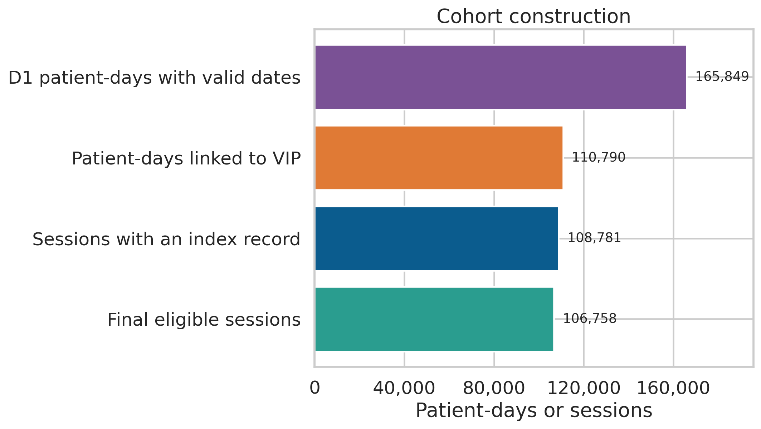
The evidence base is large by session count and narrow by setting
Public HEMOBP data provide strong longitudinal depth from one retrospective source
106,758
eligible sessions
830
unique patients
8.49%
event prevalence
Test set
21,354 sessions from 170 patients with zero overlap with development patients
Source: HEMOBP v3 and DIAL-ALERT cohort audit
DIAL-ALERT business presentation / 04
Notes:
Presenter notes
• The dataset is large enough to compare several tabular models and examine operational ranking.
• Generalisation remains uncertain because the data come from a single public retrospective source and only 170 patients form the test partition.
• The outcome is a blood-pressure threshold and does not include symptoms, interventions, or clinician assessments.
Sources
• Lin CJ et al. Scientific Data. 2019. https://doi.org/10.1038/s41597-019-0319-8
• Project report: reports/Franklin_Guillano_DIAL_ALERT_Data_Collection_and_Understanding_Report.pdf

Slide 5
At 20% review capacity, 5.9 observed events concentrate in the alert group
Expected counts per 100 sessions in the internal test population
8.5 observed events
20 alert reviews
These counts describe retrospective concentration of events. They do not estimate events prevented by clinical action.
Calculated from 8.49% prevalence, 69.13% recall, and 20% review capacity
DIAL-ALERT business presentation / 05
Notes:
Presenter notes
• Per 100 sessions, the model places approximately 5.9 of 8.5 observed events in the 20-session review group.
• The same review group contains approximately 14.1 sessions without the event, which creates staff workload and potential alert fatigue.
• A prospective study must determine whether review changes treatment safely and prevents meaningful outcomes.
Sources
• Project artifacts: artifacts/capacity_metrics.csv and artifacts/final_test_metrics.json

Slide 6
ROI depends on clinical effect, not model accuracy alone
The pilot should estimate benefits and costs before any investment claim
Net value = events avoided × cost of an avoidable event − review labor − intervention cost − integration and monitoring
Benefit evidence
Cost evidence
Change in clinically meaningful IDH events
Minutes of clinical review per alert
Avoided treatment interruption or escalation
Action rate and unintended intervention burden
Downstream utilisation linked to the event
Data integration, training, and support
Patient experience and recovery time
Ongoing monitoring, audit, and incident response
Break-even decision: proceed only when measured benefit exceeds the full operating cost at an acceptable safety and equity profile.
DIAL-ALERT business presentation / 06
Notes:
Presenter notes
• No cost savings are claimed because the retrospective data contain neither intervention effects nor reliable cost data.
• The pilot should record alert review time, action, adverse consequences, and downstream events.
• The economic evaluation must compare DIAL-ALERT with current practice, including implementation and governance costs.

Slide 7
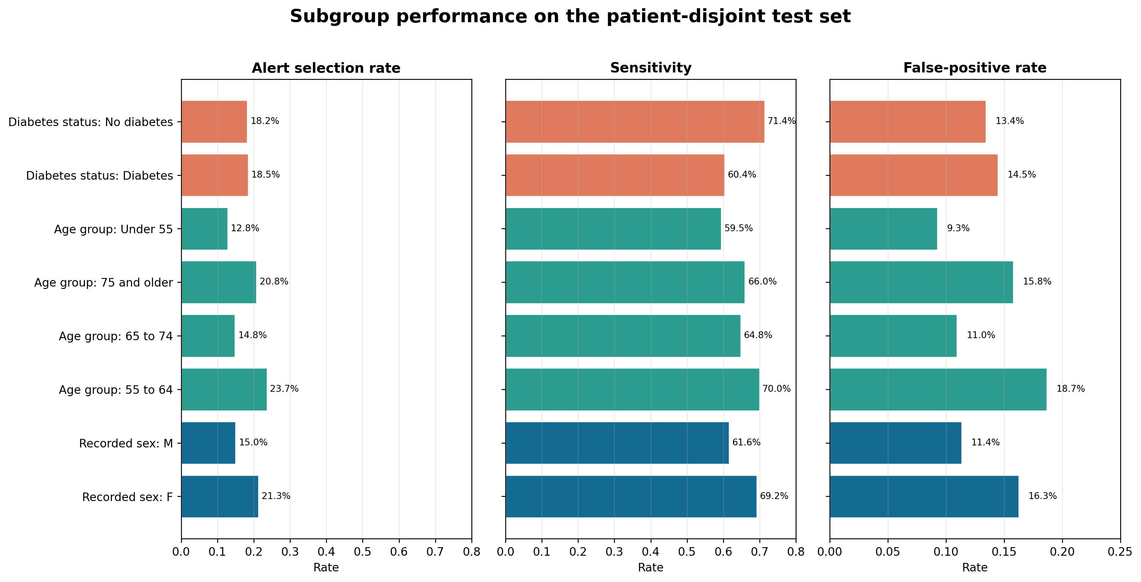
The main risks are clinical, operational, and equity related
Fairness varies by metric and several protected attributes are unavailable
Risk register
Exploratory fairness audit
Missed high-risk session
False negatives remain at every threshold
Recorded-sex selection ratio: 0.705
Reweighting candidate: 0.764
Age-group selection ratio: 0.541
Alert fatigue
20% capacity produces 14.1 false alerts per 100 sessions
Unequal performance
Recorded sex and age group gaps require review
Confirm on fresh patients before adopting mitigation.
Automation and privacy
Human override and minimum necessary data are mandatory
Race, ethnicity, socioeconomic status, and gender identity cannot be audited from the source data.
Source: Step 5 ethical AI and bias audit
DIAL-ALERT business presentation / 07
Notes:
Presenter notes
• Recorded sex shows a disparate-impact ratio of 0.705 and equalized-odds gap of 0.076 in the original model.
• Sex-outcome reweighting improves these summaries but does not eliminate disparity.
• Age-group disparate impact is 0.541. Diabetes selection rates are similar, but sensitivity differs.
• Unavailable attributes must be collected prospectively with consent and governance rather than inferred through proxies.
Sources
• Project artifacts: artifacts/step5_disparities.csv and artifacts/step5_attribute_availability.csv
• WHO. Ethics and governance of AI for health. 2021. https://www.who.int/publications/i/item/9789240029200

Slide 8
Governance controls must precede live alerts
Each gate requires documented evidence and an accountable owner
Gate
Evidence required
Accountable owner
1
External validity
Performance and calibration on current local patients
Clinical analytics lead
2
Silent workflow
Alert volume, timing, data quality, and drift without influencing care
Dialysis operations
3
Human factors
Comprehension, overrides, action patterns, and automation bias
Clinical safety lead
4
Equity and privacy
Subgroup errors, broader attributes, access controls, and retention
Governance board
5
Monitoring and rollback
Thresholds for drift, harm, downtime, and model withdrawal
Model owner
Governance position from the Step 5 ethical risk register
DIAL-ALERT business presentation / 08
Notes:
Presenter notes
• A model should not move to live alerts because a retrospective AUC appears strong.
• Each gate has evidence, ownership, and an explicit stop condition.
• The rollback plan should identify who disables the model, how clinicians are notified, and how affected decisions are reviewed.
Sources
• Project artifact: artifacts/step5_ethical_risk_register.csv

Slide 9
A staged pilot should assess feasibility and safety
Illustrative timing; progression requires evidence and safety review
Weeks 0–4
Weeks 5–8
Weeks 9–12
Local retrospective validation
Prospective silent mode
Supervised pilot
Rebuild features, check data quality, assess calibration, capacity, subgroups, and missingness
Generate scores without showing clinicians. Measure volume, latency, drift, and workflow timing
Show alerts only if prior gates pass. Record review time, action, overrides, safety, and patient outcomes
Gate: model and data fit for observation
Gate: technically reliable and operationally feasible
Gate: feasibility supports a larger study
Pre-register performance, workload, equity, and safety criteria before the pilot begins.
DIAL-ALERT business presentation / 09
Notes:
Presenter notes
• The plan deliberately separates technical validation from clinical exposure.
• Silent mode shows whether data arrive on time and whether the score behaves as expected without creating patient risk.
• The supervised pilot begins only if external validity, operational feasibility, privacy, and equity gates pass.

Slide 10
Proposed pilot targets are not results
Prespecify one alert policy and local safety stopping rules
Event detection
At least 65% of later SBP-below-90 events detected in eligible sessions.
False-alert workload
No more than 15 false alerts per 100 eligible sessions.
Review time
Median at most 2 minutes per displayed alert. Measure outcomes and full costs before claiming benefit.
DIAL-ALERT | Academic prototype

Slide 11
Decision requested: approve validation, not clinical deployment
The next investment should reduce uncertainty before introducing live alerts
Approve
Stop if
A local data and validation partner
Performance does not transport locally
Clinical, informatics, privacy, and equity owners
Alert burden exceeds safe staffing capacity
A prospective silent mode study
Subgroup error or calibration gaps are unacceptable
A predefined go or stop review at 90 days
Clinician behavior creates new safety risk
Until these gates are met, DIAL-ALERT remains an academic decision support prototype and must not determine treatment.
DIAL-ALERT business presentation / 11
Notes:
Presenter notes
• Ask leaders to approve the evidence-generating pathway and named governance ownership.
• Do not frame the decision as approval of a clinical tool.
• The 90-day review should decide whether a larger prospective effectiveness study is justified.

