Slide 1

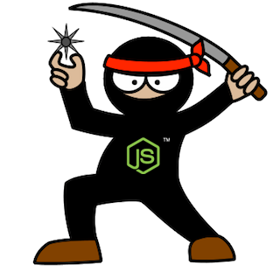
Supersize Node.js –
M&E Cloud Service Journey
Guillaume Brossard
David Richer
Sr. Engineer – M&E Cloud Services
Sr. Engineer – M&E Cloud Services

Slide 2

M&E Cloud Services - Context

Slide 3
Deployment

Slide 4
Deployment as code
Everything in source control
Sync and deploy
Different repository that the code
Branch and tag deployment repository

Slide 5
Cloud Formation
JSON file
File generation
Create and delete stack
Update existing stack

Slide 6
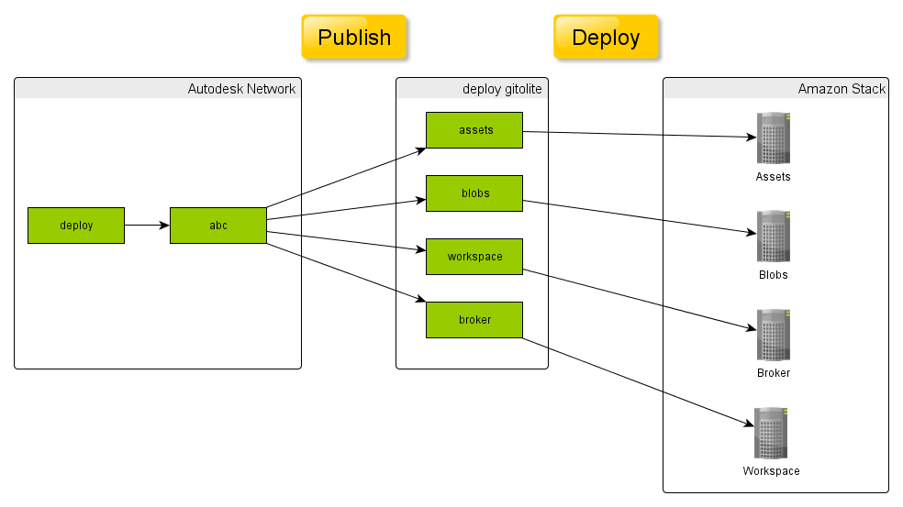
Publish
Notes:
Git
Node.js Modules
Decoupling from npm registry

Slide 7
Provisioning
Roles and Chef
Upstart

Slide 8
Provisioning - Chronology
Notes:
Steps from a vanilla Ubuntu image
Download and Install Chef
Run Chef
* Install OS packages
* Install node.js
* Get code from gitolite server
* npm rebuild
* Write upstart configuration
* Generate config file
* Start the service

Slide 9
Vagrant
Great way to quickly test Chef cookbooks

Slide 10
From Development to Production

Slide 11
Stack Family

Slide 12
Stack Monitoring

Slide 13
Stack Diagnostic and Debugging

