Slide 1

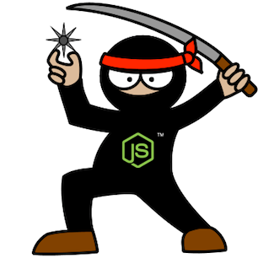
Supersize Node.js –
M&E Cloud Service Journey
Guillaume Brossard
David Richer
Sr. Engineer – M&E Cloud Services
Sr. Engineer – M&E Cloud Services

Slide 2
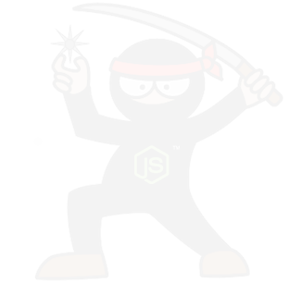
Deployment
Notes:
TODO: Define or delete

Slide 3
Deployment as code
Everything in source control
Sync and deploy
Use a different repository from the code
Branch and tag in deployment repository
Notes:
Each branch

Slide 4
Cloud Formation
JSON file
Template generation
Create and delete stack
Update existing stack
Notes:
Create and delete stack
Easy stack management
Update existing stack
Amazing capability to analyze the difference and only update needed resource
Talk about rolling update for AutoScaling group

Slide 5
Publish
Notes:
Gitolite
Node.js Modules
Decoupling from npm registry and git
TODO
Update drawing to remove abc repo box

Slide 6

Provisioning
Roles and Chef
Upstart
Vagrant
Notes:
Definition of the provisioning
Configure a vanilla Linux machine to be ready to operate
Vagrant
Great way to quickly test Chef cookbooks
We had greater plan for Vagrant usage at the beginning but we only use it to test cookbooks.

Slide 7
Provisioning - Chronology
Notes:
Steps from a vanilla Ubuntu image
Download and Install Chef
Run Chef
* Install OS packages
* Install node.js
* Get code from gitolite server
* npm rebuild
* Write upstart configuration
* Generate config file
* Start the service
Image? Why we choose not? What would change?

Slide 8
MongoDB?

Slide 9
From Development to Production
Notes:
TODO: Define or delete

Slide 10
Stack Family
Notes:
Stack family is a represented by a URL, the data evolve over time.
Each stack family has his own data, this allow to properly test data migration.
Seems obvious; but we delayed it a bit and it causes us issues.

Slide 11
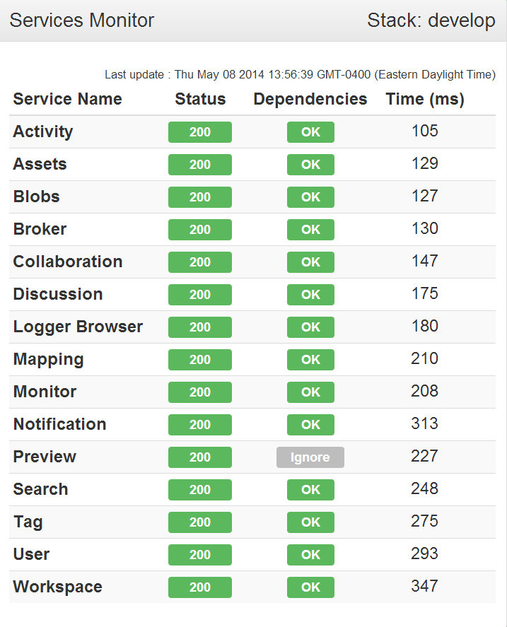
Stack Monitoring
Sys Admin Portal
Monitor Page
Logs
Tracing
Notes:
Monitor page should the individual status of each services and his dependencies.
TODO: Explain logs and tracing on a different page.
Live demo? Video? 3 slides?
Tracing
Log/Trace architecture
RabbitMQ
MongoDB

Slide 12
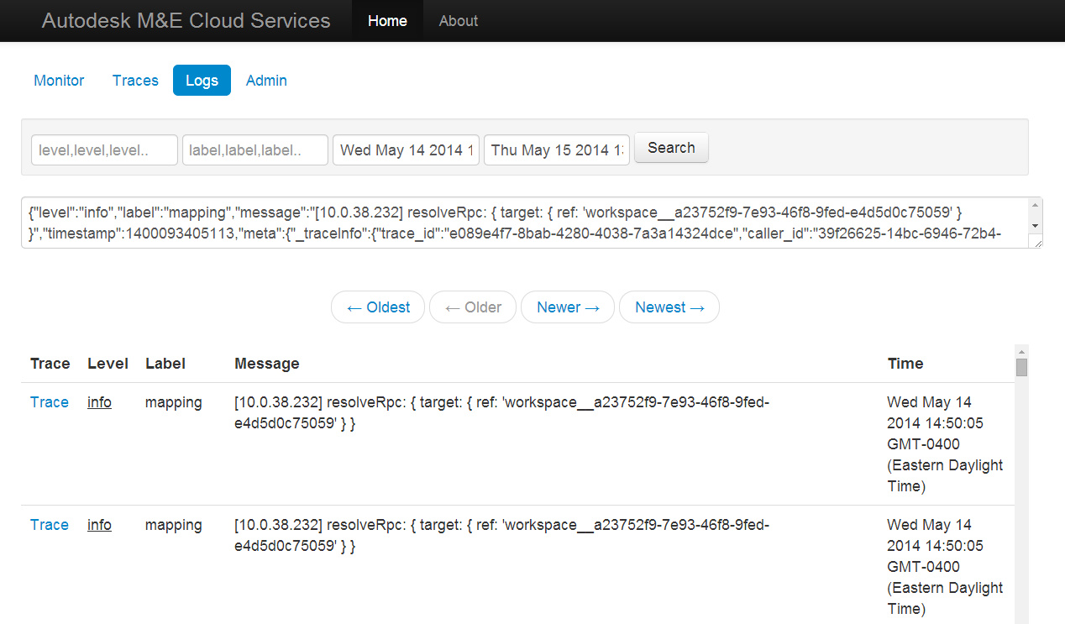
Logs

Slide 13
Log Architecture
Notes:
Log Architecture

Slide 14
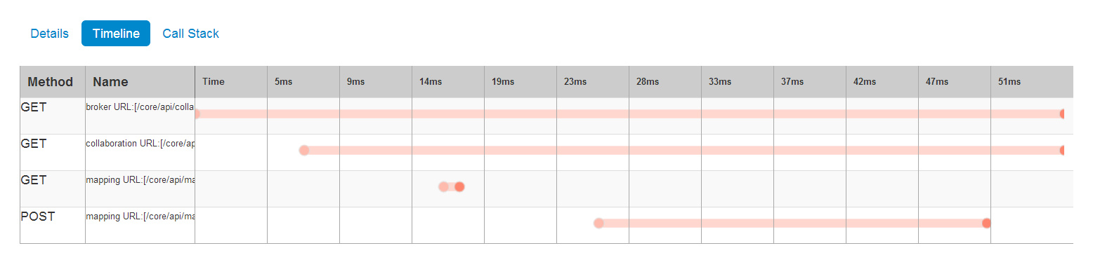
Tracing
Notes:
Log Architecture

Slide 15
Stack Diagnostic and Debugging
Access the stack via a NAT
Scripts
Tunnel to any instance
Tunnel to MongoDB using RoboMongo
Node.js remote debugging

