Slide 1

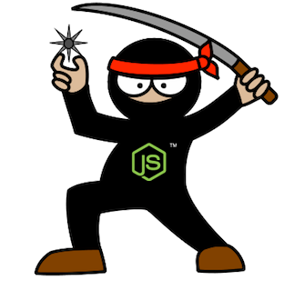
Node.js Novice to Ninja
Guillaume Brossard
David Richer
Sr. Engineer – M&E Cloud Services
Sr. Engineer – M&E Cloud Services

Slide 2

M&E Cloud Services - Context
Kick-off of a new 20+ developers initiative
Most developers have no web development experience
Our goal
Ensure shortest learning curve possible
Allow extensive reuse of web components
Facilitate fast development cycle of micro-services
Notes:
We used our experience on the P42 project, a joint venture with Dreamworks Animation to create a Production Management system.
The context:
Kick-of of a 20+ developers initiative.
MECS Asset-Based Collaboration: Web Application allowing collaboration, computing and asset management on the Autodesk Cloud.
In DCC integration inside Maya through a QtWebKit UI.
The people:
Mostly senior C++ engineers
Most have no web development experience
The goals:
Ensure shortest learning curve possible
Allow extensive reuse of web components
Facilitate fast development cycle of micro-services

Slide 3
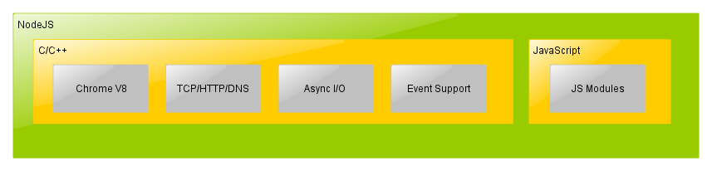
Node.js – What is it?
Notes:
Platform built on V8 engine (Chrome)
Google’s open source, C++ based JavaScript engine that actually runs JavaScript.
Node.js team took this C++ code and added other important libraries like TCP, HTTP and DNS to create Node.js
Non-blocking, event-driven I/O
Single threaded
In order to write a fast and scalable server application, we typically end up writing it in a multi-threaded fashion. While you can build great multi-threaded apps in many languages, it usually requires a lot of expertise to build them correctly. On the other hand, these libraries (along with Chrome’s V8 engine) provide a different architecture that hides the complexities of multi-threaded apps while getting the same or better benefits.
At the front, you have Chrome V8 engine (single threaded), event loop and other C/C++ libraries that run your JS code and listen to HTTP/TCP requests.
At the back of the server, you have libuv (includes libio) and other C/C++ libraries that provide asynchronous I/O.
Designed for distributed, data-intensive, real-time applications
Services written in JavaScript
Native C++ modules for computation intensive routines

Slide 4
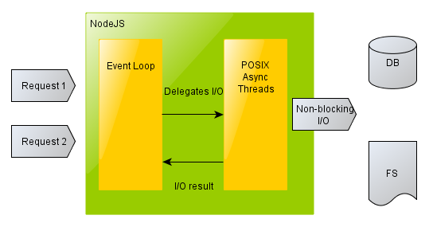
Node.js – I/O
Notes:
Non-blocking, event-driven I/O
Single threaded
In order to write a fast and scalable server application, we typically end up writing it in a multi-threaded fashion. While you can build great multi-threaded apps in many languages, it usually requires a lot of expertise to build them correctly. On the other hand, these libraries (along with Chrome’s V8 engine) provide a different architecture that hides the complexities of multi-threaded apps while getting the same or better benefits.
At the front, you have Chrome V8 engine (single threaded), event loop and other C/C++ libraries that run your JS code and listen to HTTP/TCP requests.
At the back of the server, you have libuv (includes libio) and other C/C++ libraries that provide asynchronous I/O.

Slide 5




Why Node.js?
Same language client-side/server-side
Asynchronous by nature
Simpler I/O model, free of locking and concurrency issues
Large collection of quality open source module
Node.js as the only dependency!
Notes:
Node.js Overall:
Lower I/O cost (compared to Apache)
Lower Memory footprint (compared to Apache)
A lot of public libraries, really popular
For us:
Scalability and stability proven by many serious users (LinkedIn, eBay, Yahoo)
Fast ramp up for our inexperienced developers
Node.js only dependency:
Development Environment set-up
Development
Infrastructure bindings (database, queues, etc.)
Tools (Task Runner aka Grunt, QA, etc.)

Slide 6
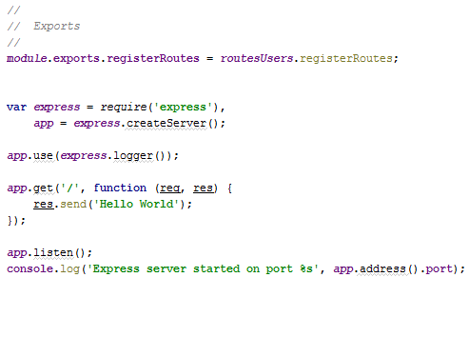
Express.js Hello World

Slide 7
Node.js for Enterprise
Attractive developer environment
Extensive sharing of components between teams
Easy Deployment (DevOps)
Local
VM
Amazon
Notes:
Node.js provide a lot for module size projects. But what about building big projects around Node.js? What is missing and/or not provided out of the box by Node.js?
We had the leisure to build the development environment from scratch, without any restriction from legacy applications or restriction on the technology to choose.
We wanted our environment to be developer centric, optimized for developer daily workflow.
At the same time, we wanted to facilitate deployment, to limit the bugs that sometimes appear when deploying in the Cloud.
The dream was to allow developers to quickly spawn the whole stack on their local workstation, on a VM network or on Amazon, each environment being as similar as possible to one another (increase development/production parity) -> DevOps
Also, the teams needs to be able to easily share components. (to develop)

Slide 8
npm - Node.js Package Manager
Easy integration of JavaScript and C/C++ modules
npm registry
One command to rule them all
npm install
Configuration through a JSON file
Each module controls its dependencies versions
Notes:
TECHNICAL NOTES:
- Node.js modules follows CommonJS specification (ecosystem specification out of the browser)
- Inspired from RubyGems
- Native modules are built using node-gyp (MSVC 2010/2012 on Windows, GCC on Unix)

Slide 9
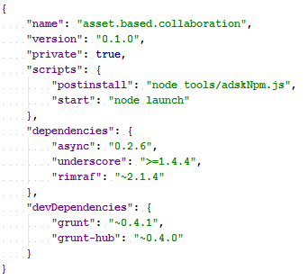
npm - Package.json

Slide 10
Development Environment
Developer workspace + components (services/web/api)
Leveraging npm power for our needs
One step installation using npm postinstall script
Easy to extend package.json format
Split between web services and static content
Notes:
Extend package.json to support linkDependencies, create symbolic link when a web service use a node module in the same workspace
webDependencies create symbolic link to web component that are served by the web service.
*** To add:
1- Add workspace slide
2- Add workflow diagram (workspace set-up)

Slide 11
Development Environment
Grunt.js – Javascript Task Runner for Node.js
Tests, Static Analysis, Code Coverage
Great community creating grunt plugins
Continuous Build Integration
Notes:
Great to use the same language for the task runner and for the development
*** Add company logos (Grunt, Electric Commander)

Slide 12
Sharing node modules between teams
Component-based architecture
Sharing node modules without npm registry
git.autodesk.com
npm fetch node module directly from a git repositry
Notes:
git.autodesk.com + npm support fetch node module directly from a git repositry
Only fetch tag version of repository to promote stability

Slide 13
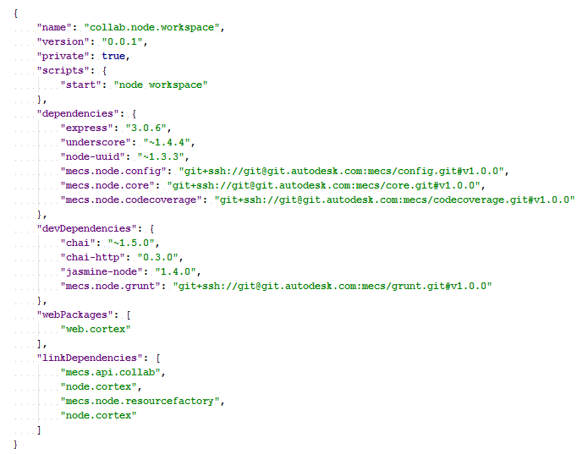
Sharing node modules between teams
Link to image
Notes:
git.autodesk.com + npm support fetch node module directly from a git repositry
Only fetch tag version of repository to promote stability

Slide 14
Deployment - VM
Vagrant + Oracle Virtual Box
Minimize difference between VM deployment and Amazon
Great way to quickly test Chef cookbooks
Notes:
*** Add company logos

Slide 15
Deployment - Chef
David do this!

Slide 16
Deployment - Amazon
Amazon Cloud Formation
Script to generate Cloud Formation file to reduce redundancies
EC2 instance are provisioned from vanilla Ubuntu using Chef
Route53 provide DNS for each stack like test.sandbox.scotty.mecs.autodesk.com
Notes:
We start from vanilla Ubuntu image
*** Image for Cloud Formation / Amazon Topology?

Slide 17
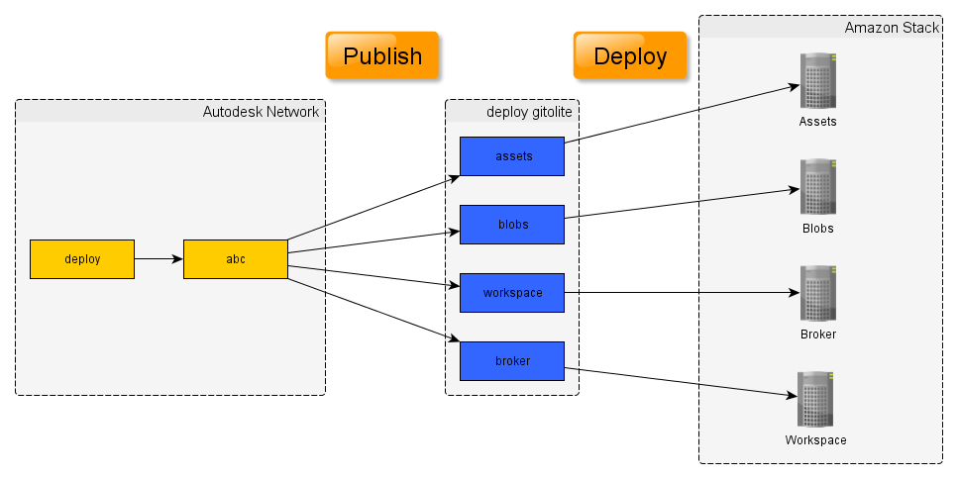
Deployment – Publish Web Service
Notes:
During publish, we package each web service with all his dependencies both internal and external. This allow us to deploy in the cloud without access to autodesk git server.
*** Change colors

Slide 18
Deployment – Application Configuration
Configuration Component (nconf)
Centralize way to access configuration
Deployment can override defaults
Notes:
Deployment can override defaults, chef generate a production.json
*** Diagram or code

Slide 19
Conclusion
David
Notes:
*** Add a bucket of icons
Full JavaScript stack use-case: Web Services and Production Management
Versioning System: GitHub
Package Manager: npm
Automation Tool: Grunt.js
Database: MongoDB/CouchDB
IDE: WebStorm
Release Tool: npm/Git
Deployment: Chef/Git
Hipster technology gaining credibility [DR]
Node modules
Databases: MongoDB, CouchDB, PostgreSQL, etc.
Amazon : aws-sdk, awssum
Build automation : Grunt.js
Chef recipes (deployment)
WebStorm – Node.js ready

Slide 20
Autodesk is a registered trademark of Autodesk, Inc., and/or its subsidiaries and/or affiliates in the USA and/or other countries. All other brand names, product names, or trademarks belong to their respective holders. Autodesk reserves the right to alter product and services offerings, and specifications and pricing at any time without notice, and is not responsible for typographical or graphical errors that may appear in this document.

Slide 21
Appendices

Slide 22
Technologies List
Development Environment
Node.js
npm
Grunt (Task Runner)
WebStorm (IDE)
Git Enterprise
Source Tree (Git Graphical Client)
Deployment
Gitolite (Light-weight git server)
Chef (Configuration Mgmt Tool)
Vagrant (Virtual DevEnv)
Amazon Web Services
Amazon Cloud Formation
Node.js Modules / JavaScript Libraries
express.js
async
underscore
nconf
aws-sdk
QA
JSLint (Static Code Analyzer)
Jasmine (BDD Testing framework)
Chai (BDD-TDD Assertion Library)
Istanbul (Code Coverage)
Karma (Test Runner)

Slide 23
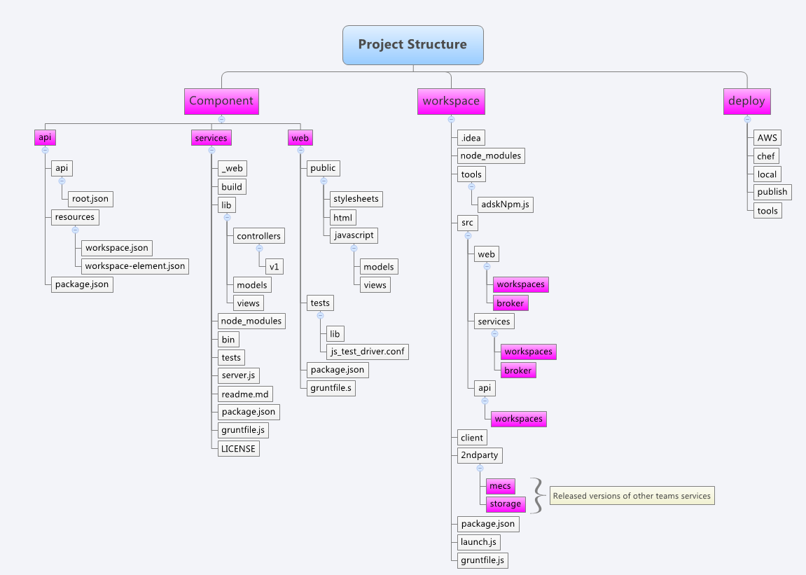
Code Organization
Link to image

Slide 24
Release Management
Content

Slide 25
Node.js - Pros and Cons
Still a really young technology
No solutions for trivial stuff (simple CRUD)
Consistent error-handling
Consistent HTML error codes
Bad at static file serving
Persistent memory
Increased changes for memory leaks
Easy to share data between clients

Slide 26
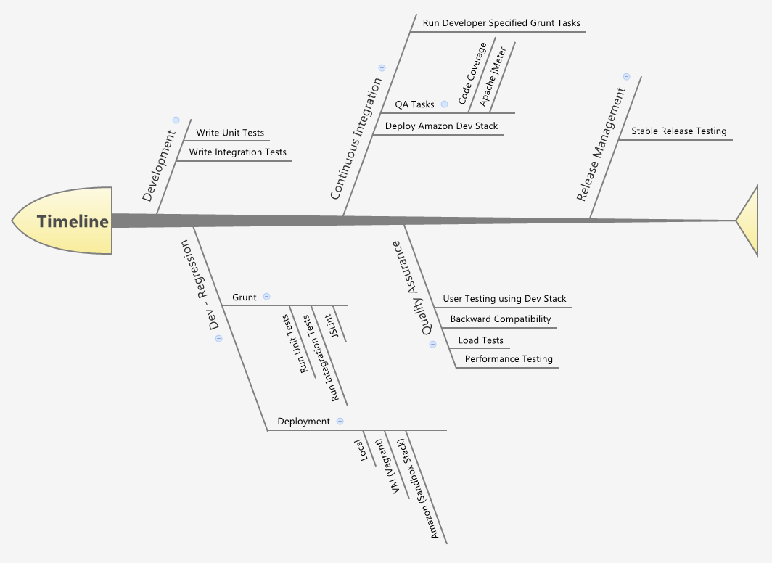
Quality Assurance Process
Link to image

Slide 27
Autodesk is a registered trademark of Autodesk, Inc., and/or its subsidiaries and/or affiliates in the USA and/or other countries. All other brand names, product names, or trademarks belong to their respective holders. Autodesk reserves the right to alter product and services offerings, and specifications and pricing at any time without notice, and is not responsible for typographical or graphical errors that may appear in this document.

