Slide 1

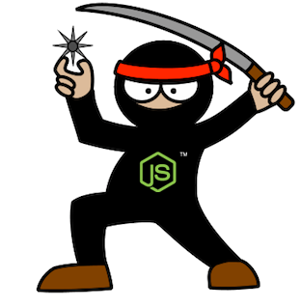
Supersize Node.js –
M&E Cloud Service Journey
Guillaume Brossard
David Richer
Sr. Engineer – M&E Cloud Services
Sr. Engineer – M&E Cloud Services

Slide 2

M&E Cloud Services - Context
Open the Cloud to Artists and Managers
Multi-segment team, using a Core Services stack
Notes:
January 2013, M&E Cloud Services
Our mission:
Open the Cloud to Artists and Managers using M&E products
Empower our users with collaboration features
The Product:
Multi-segment team
In-DCC integration
Tray Application
Specialized Web Services
Core stack for inter-operability
Challenge:
Build a deployment process flexible enough to support deployment of a multi-segment product.
None of the products where precisely defined initially

Slide 3
Deployment Goals
Easy deployment
Deployment as code
Small pieces to build something big
“Developer-centric” environment
Development to be deployment agnostic
Notes:
Easy Deployment
Sync and run script
Deployment as code
Sync branch and deploy (source control)
Small pieces to build something big
“Developer-centric” environment
Development to be deployment agnostic

Slide 4
Architecture Oversight
Notes:
At the beginning, we didn’t knew much about the final architecture of the system.
What we knew
The stack would be composed of many services.
Services would need to be scalable.
Configuration would change regularly.
From deploying services, our mind set changed to deploying a set of instances, playing one or many roles
Dynamic Layouting of Roles

Slide 5
Architecture How Node.js Tinted the Architecture
Notes:
Another thing we knew from the start was that our stack would be build around Node.js
How does Node.js tinted the architecture:
Not much dependencies
Encourage development of small services
Reusable modules
Web Storage (npm registry, Git)

Slide 6
Architecture Amazon
Notes:
The third fixed variable in our setup was that the stack would be deployed on Amazon.
What a great news. Amazon offers a multitude of tools that makes developers life easier:
Deployment
Cloud Formation
Scaling
Elastic Load Balancers
Auto-Scaling Groups
Security
Private stack
Services vs. DB Stack
DNSing
Route 53
NAT Instance

Slide 7
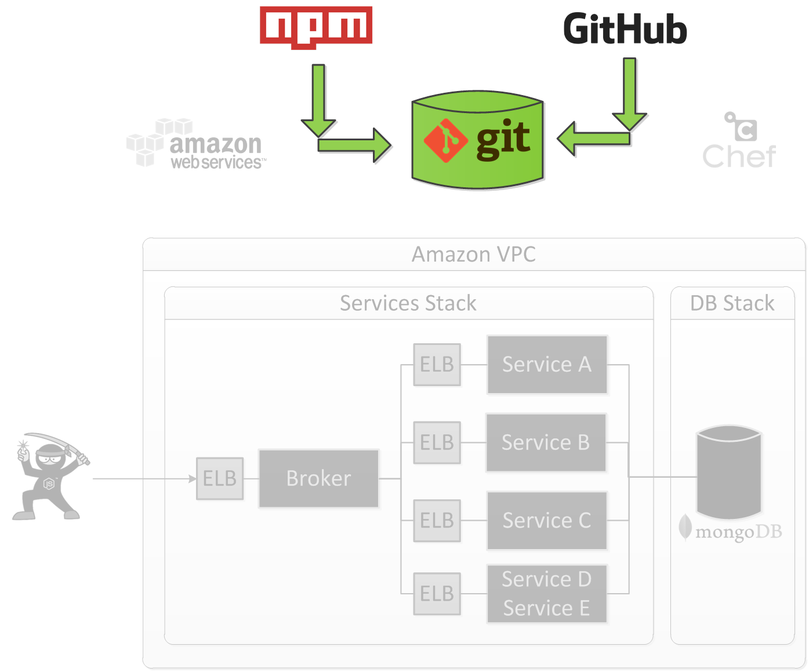
Publish
Notes:
TODO: Define or delete

Slide 8
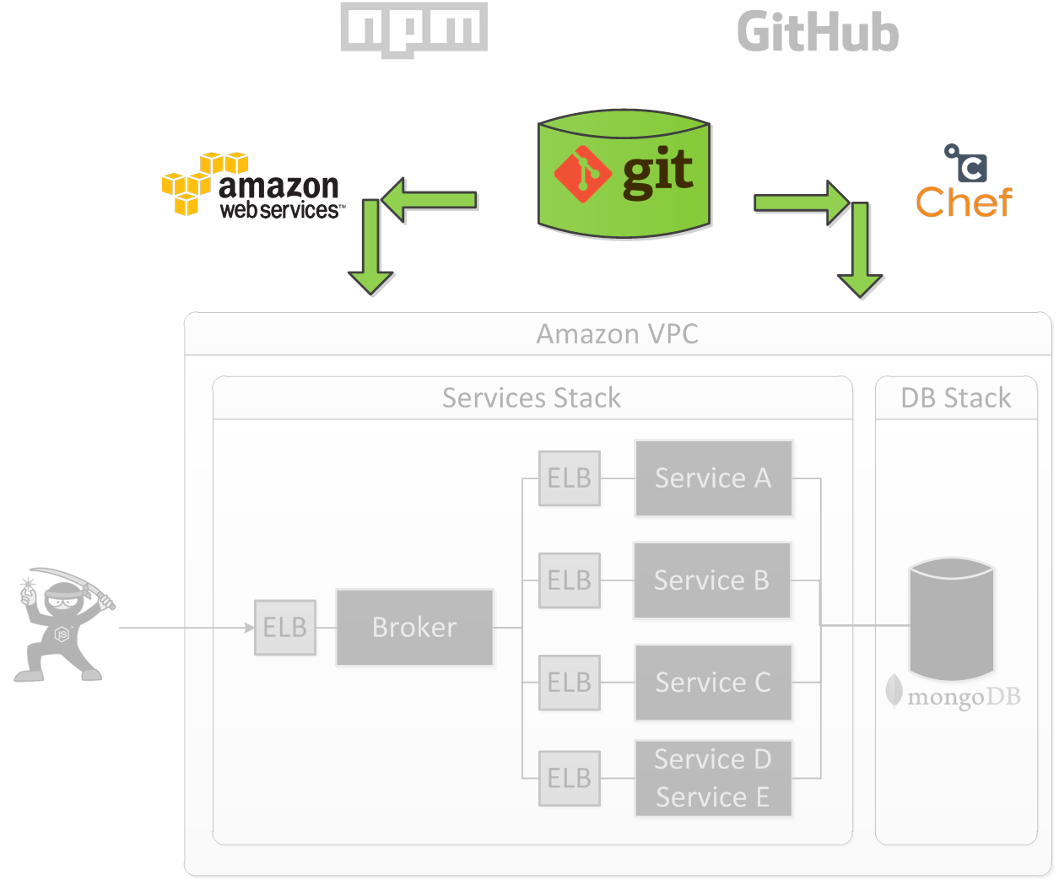
Provisioning

Slide 9
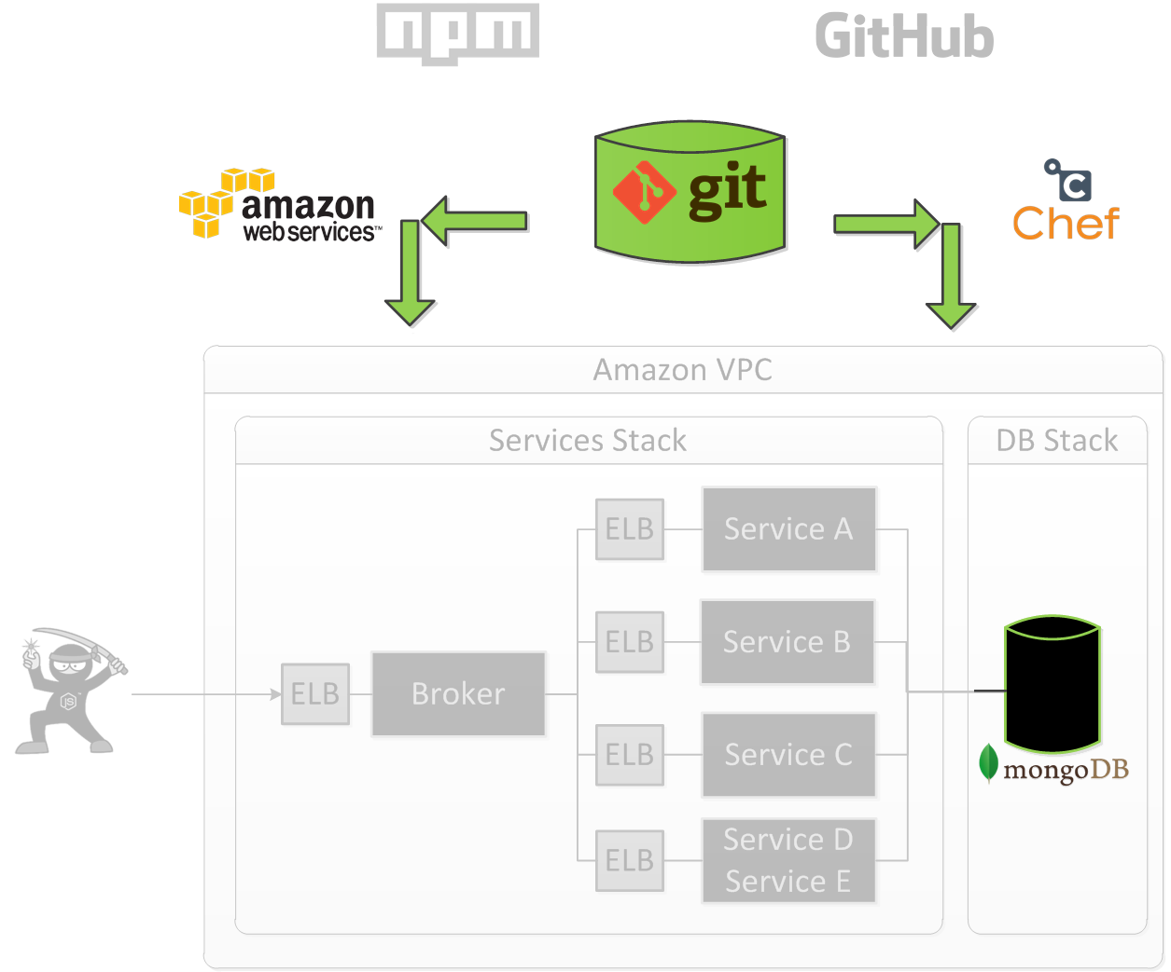
Provisioning - MongoDB

Slide 10
MongoDB – Replica Set

Slide 11
MongoDB – Chronology
Notes:
Revise with David

Slide 12
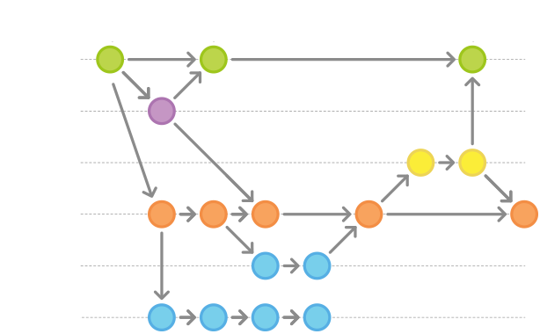
From Development to Production
Notes:
TODO: Define or delete

Slide 13
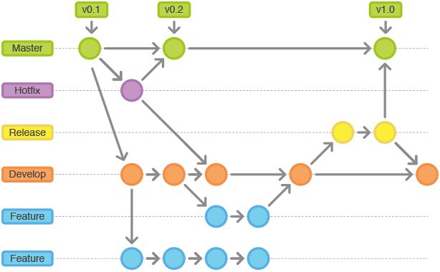
From Development to Production
Notes:
TODO: Define or delete

Slide 14
Lessons Learned The Good Parts
Shared Configuration (nconf)
Deployment from day 1
Investment in development/deployment tools
“Local” Deployment
Notes:
Shared Configuration (nconf)
Deployment from day 1
Investment in development
“Local” Deployment
Vagrant
Cross-platform technology
“Full” JavaScript stack

Slide 15
Lessons Learned The Bad Parts
Chef Server
Cloud Formation Abstraction
Npm registry
Notes:
Chef Server
Complex
Not used at its full potential as other tools gave us the same feature set
Consider packer (with chef solo only)
Cloud Formation template generation abstraction
We identify correctly the issue
Mustache not the right tool to do that
Npm registry
Correctly decoupled deployment from npm registry
Git protocol for node modules works, but it is slow + not reliable
Fetching from npm is not fast
Private npm registry would be preferable
Middle-ground solution with npm lazy, workspace

