Slide 1
Discovery .NET 6 and its ecosystem
Guillaume Chervet

Slide 2

Presentation
Guillaume Chervet
TechLead at AXA France
MVP Microsoft
https://axaguildev.github.io
https://twitter.com/guichervet
https://www.meetup.com/fr-FR/Microsoft-User-Group-Lille
https://www.guillaume-chervet.fr
guillaume.chervet@gmail.com

Slide 3
Subjects we will learn

Slide 4
Microsoft and Ecosysteme dotnet
Virtual(s) Machine and intermediate language
C# Language
Nuget Package manager
dotnet tool
Visual Studio & Visual studio online
Dotnet et docker
Entity Framework Core
ASP.NET Core
Xamarin & Uno &UWP (Windows required)
ML.NET
WebAssembly avec Blazor
Security with ASP.NET Core and Open ID Connect with Identity Server

Slide 5
This document
https://github.com/guillaume-chervet/course.dotnet/blob/master/documentations/dotnet6.pptx

Slide 6
PreRequired
>= 32 Go Hard Drive space
>= 8 Go ram
Operating System able to run docker

Slide 7
Tools to download
Visual Studio Community : https://visualstudio.microsoft.com/fr/
Resharper : https://www.jetbrains.com/resharper/download/download-thanks.html?platform=windows
Rider : https://www.jetbrains.com/rider/)
Docker : https://www.docker.com/products/docker-desktop
.NET 6 sdk lastest version : https://dotnet.microsoft.com/download/dotnet/6.0
SQL Server management studio : https://docs.microsoft.com/fr-fr/sql/ssms/download-sql-server-management-studio-ssms ?WT.mc_id=DOP-MVP-5003370
Free tools for students :
https://education.github.com/pack

Slide 8
Your presentation

Slide 9
Introduction

Slide 10
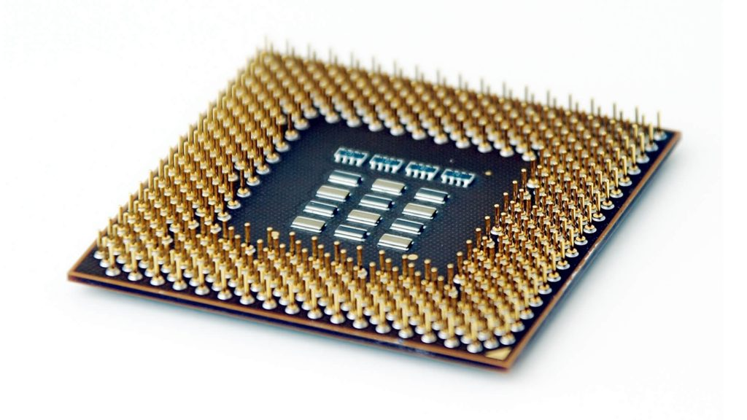
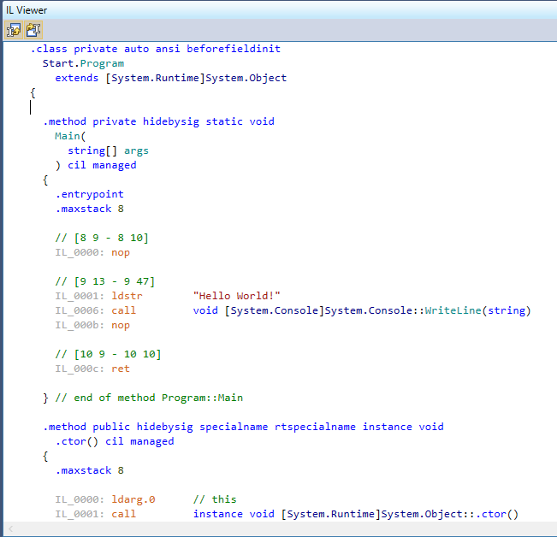
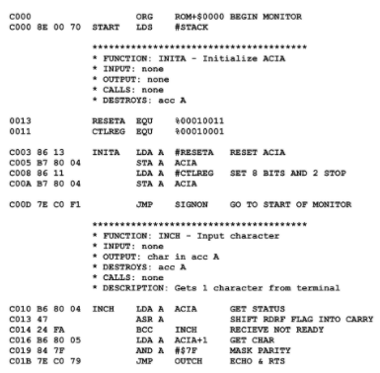
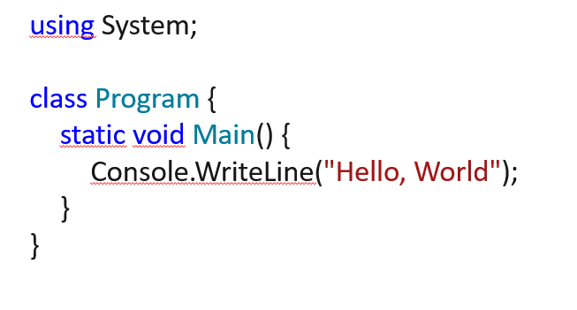
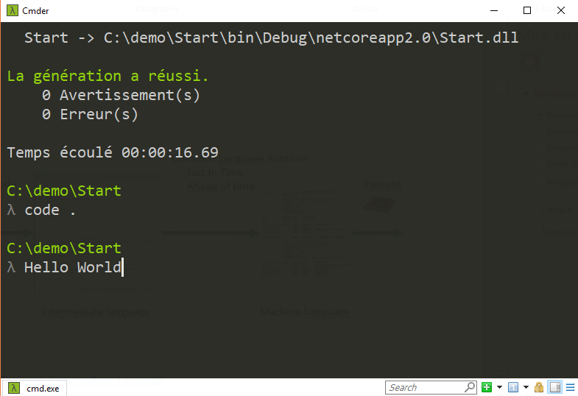
Common Language Runtime
(virtual machine)
Just In Time
Compile
Execute
Code
C#, F#, VB
Intermediate Language
Machine Language
https://en.wikipedia.org/wiki/Common_Intermediate_Language

Slide 11
Compile
Ahead of time
Execute
Code
C#, F#, VB
Machine Language
https://en.wikipedia.org/wiki/Common_Intermediate_Language

Slide 12
Asynchrony
Multithreaded
Parallelism

Slide 13
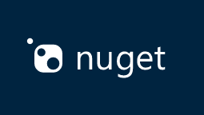
Nuget as package manager
https://www.nuget.org/

Slide 14
Lightness
Deployment flexibility
Multi-platform
Development tools
Open source
Supported by Microsoft
Notes:
Simon

Slide 15
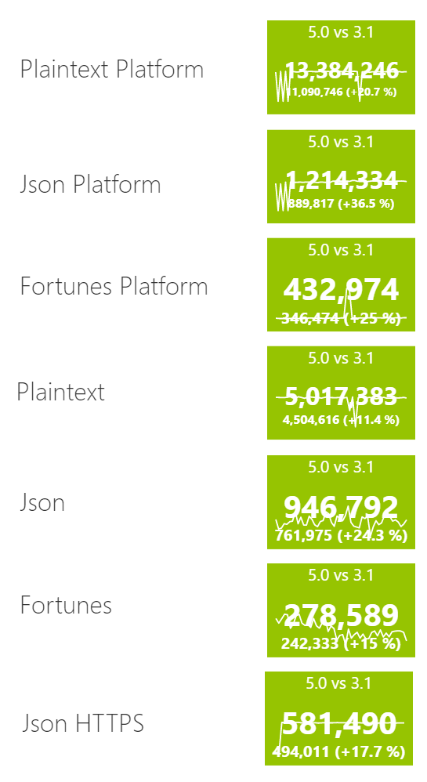
.NET 5 is performant
https://www.techempower.com/benchmarks/
Round 20 results - TechEmpower Framework Benchmarks

Slide 16
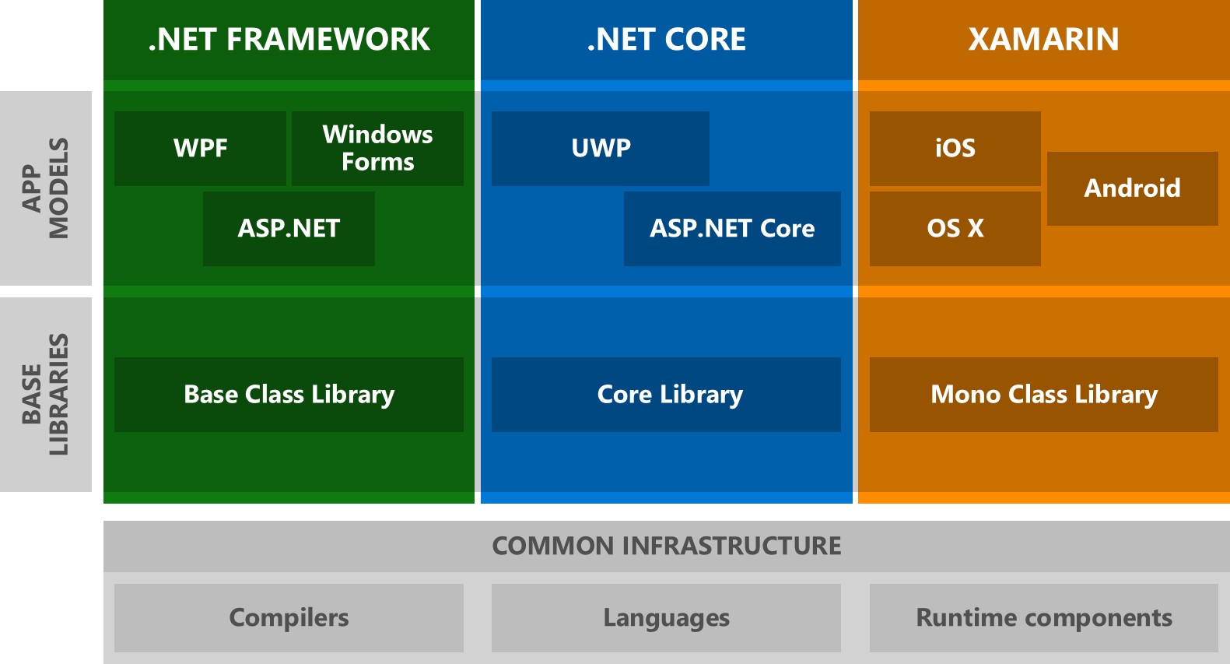
History

Slide 17
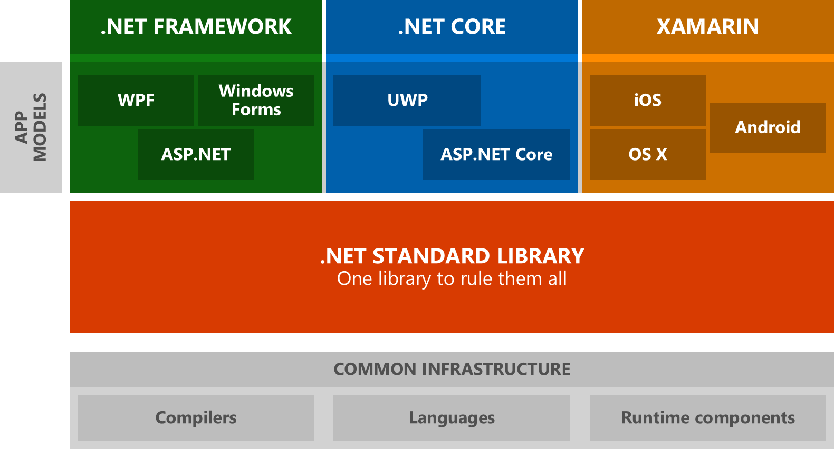
History

Slide 18
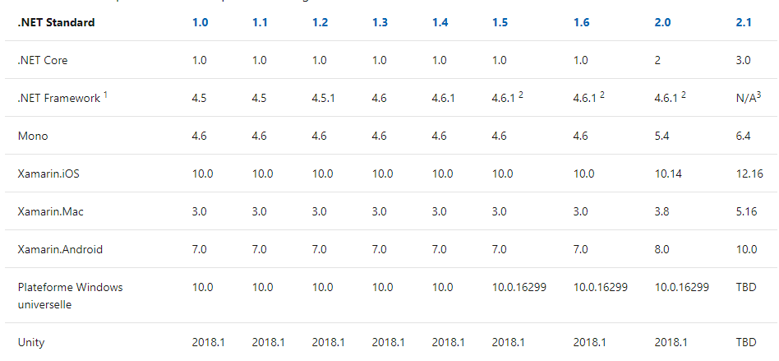
History
https://docs.microsoft.com/fr-fr/dotnet/standard/net-standard?WT.mc_id=DOP-MVP-5003370

Slide 19
.NET Vision - .NET 5 to 6 « wave »
Single SDK, one BCL, unified toolchain
Cross-plateform native UI
Cross-plateform web UI
Cloud native investments
Continue improvements in speed, size, diagnostics, Azure service
https://devblogs.microsoft.com/dotnet/the-future-of-net-standard

Slide 20
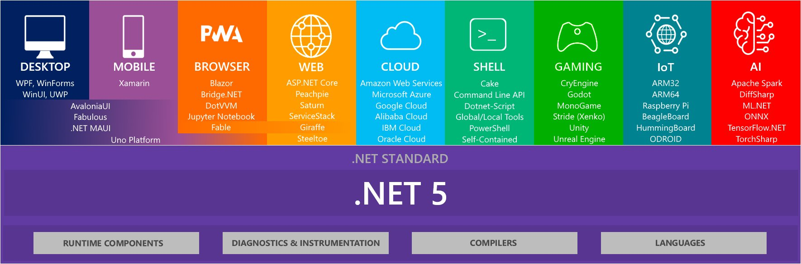
https://twitter.com/ben_a_adams/status/1307669860546215936/photo/1

Slide 21
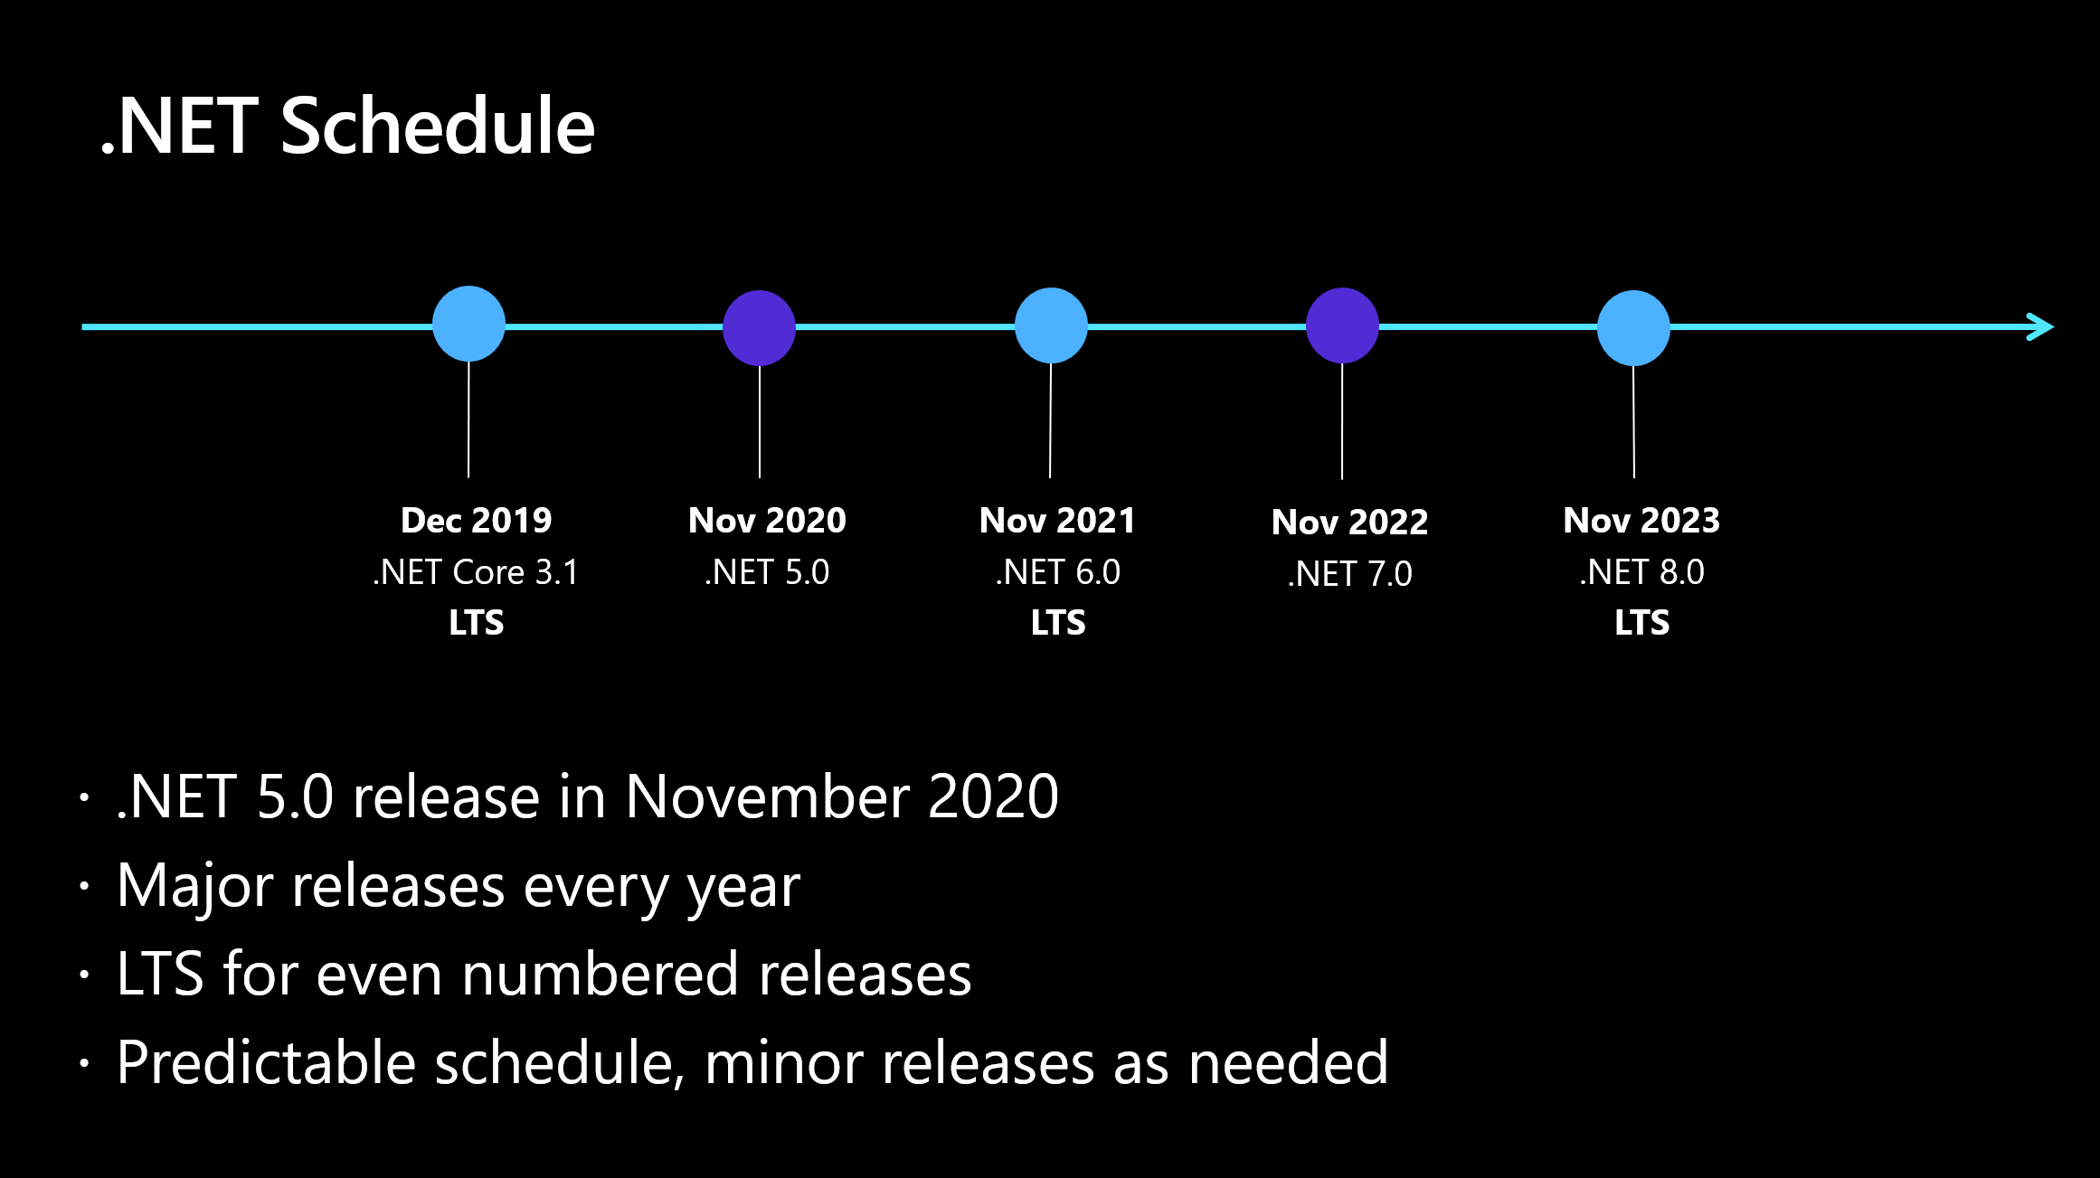

Slide 22
Progression axis
Performance
Lighter executable
Faster startup
https://www.techempower.com/benchmarks/

Slide 23
Use netstandard2.0 to share code between .NET Framework and all other platforms.
Use netstandard2.1 to share code between Mono, Xamarin, and .NET Core 3.x.
Use net5.0 for code sharing moving forward.
https://devblogs.microsoft.com/dotnet/the-future-of-net-standard

Slide 24
Dealing with OS-specific APIs
private static string GetLoggingDirectory() { if (OperatingSystem.IsWindows()) { using (RegistryKey key = Registry.CurrentUser.OpenSubKey(@"Software\Fabrikam")) { if (key?.GetValue("LoggingDirectoryPath") is string configuredPath) return configuredPath; } } string exePath = Process.GetCurrentProcess().MainModule.FileName; string folder = Path.GetDirectoryName(exePath); return Path.Combine(folder, "Logging"); }
https://devblogs.microsoft.com/dotnet/the-future-of-net-standard/

Slide 25
.NET 5 | .NET 6 | .NET 7
net5.0 | net6.0 | net7.0
 | net6.0-android | net7.0-android
 | net6.0-ios | net7.0-ios
net5.0-windows | net6.0-windows | net7.0-windows
net5.0-someoldos
https://devblogs.microsoft.com/dotnet/the-future-of-net-standard/

Slide 26
C#

Slide 27
C#
Imperative & Procedural
Object
Declarative (Functionnal)

Slide 28
C# Imperative
var amount = 0; var articlePrice = article.Price; switch (article.Category) { case "food": amount += articlePrice * 100 + articlePrice * 12; break; case "electronic": amount += articlePrice * 100 + articlePrice * 20 + 4; break; case "desktop": amount += articlePrice * 100 + articlePrice * 20; break; } amountTotal += amount * basketLineArticle.Number;

Slide 29
C# Procedural
public static int GetAmountTotal(List<BasketLineArticle> basketLineArticles) { var amountTotal = 0; foreach (var basketLineArticle in basketLineArticles) { var id = basketLineArticle.Id; var article = GetArticleFromDatabase(id); var amount = 0; var articlePrice = article.Price; switch (article.Category) { case "food": amount += articlePrice * 100 + articlePrice * 12; break; case "electronic": amount += articlePrice * 100 + articlePrice * 20 + 4; break; case "desktop": amount += articlePrice * 100 + articlePrice * 20; break; } amountTotal += amount * basketLineArticle.Number; } return amountTotal; } private static ArticleDatabase GetArticleFromDatabase(string id) {// return an article}

Slide 30
C# Object
public abstract class ArticleBase { public ArticleBase(string id, int price) { Id = id; Price = price; } public int Price { get; } public string Id { get; } public abstract int CalculateAmout(); } public class ArticleToy : ArticleBase { public ArticleToy(string id, int price) : base(id, price) { } public override int CalculateAmout() { var newPrice = Price -3 ; return newPrice * 100 + newPrice * 20; } }
var articleToy = new ArticleToy("id", 11);
articleToy.CalculateAmount()
Lifecycle
Inheritance

Slide 31
Declarative (functional)
How to obtain a state
int[] numbers = new int[7] { 0, 1, 2, 3, 4, 5, 6 }; var numQuery = from num in numbers where (num % 2) == 0 select num;

Slide 32
Hello world

Slide 33
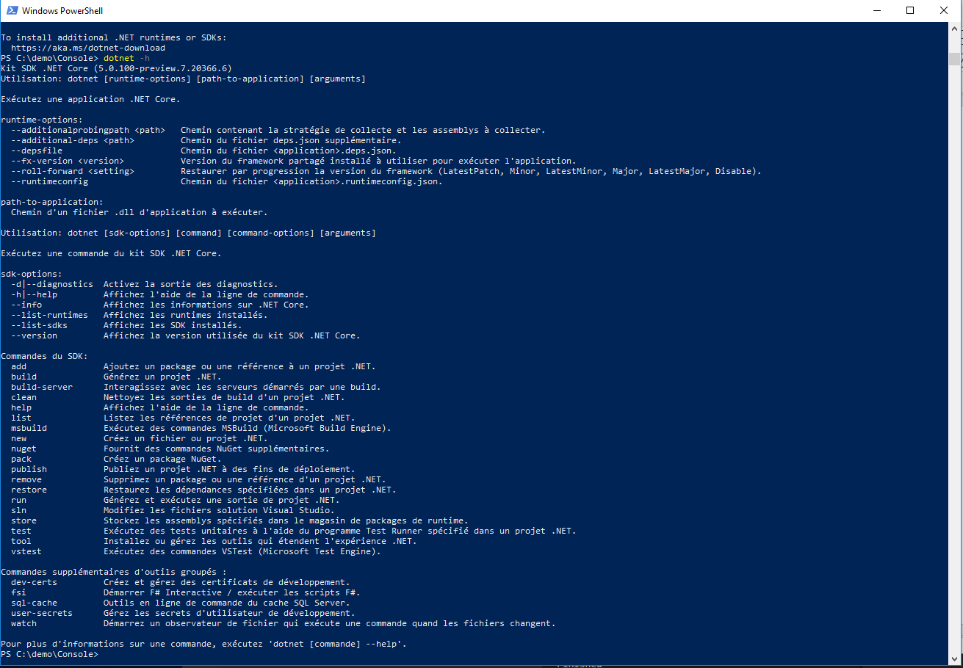
Dotnet cli
> dotnet --help

Slide 34
Hello world
using System;
namespace Demo {
class Hello {
static void Main() {
Console.WriteLine("Hello, World");
}
}
}
> dotnet new console -o Demo
> cd Demo
> dotnet run
https://docs.microsoft.com/fr-fr/dotnet/csharp/tour-of-csharp/?WT.mc_id=DOP-MVP-5003370

Slide 35
Demo.csproj
<Project Sdk="Microsoft.NET.Sdk">
<PropertyGroup>
<OutputType>Exe</OutputType>
<TargetFramework>net6.0</TargetFramework>
</PropertyGroup>
</Project>

Slide 36
Publish
> dotnet publish Demo.csproj -r win-x64 --self-contained=true /p:PublishSingleFile=true
Exemples de Runtime identifier :
win-x64
linux-x64
osx-x64
https://docs.microsoft.com/fr-fr/dotnet/core/rid-catalog?WT.mc_id=DOP-MVP-5003370
https://docs.microsoft.com/fr-fr/dotnet/core/tools/dotnet-publish?WT.mc_id=DOP-MVP-5003370

Slide 37
Publish Trim
dotnet publish Demo.csproj -r win-x64 --self-contained=true /p:PublishSingleFile=true /p:PublishTrimmed=true
https://docs.microsoft.com/en-us/dotnet/core/deploying/trim-self-contained?WT.mc_id=DOP-MVP-5003370

Slide 38
Publish AOT
dotnet publish Demo.csproj -r win-x64 --self-contained=true /p:PublishSingleFile=true /p:PublishTrimmed=true /p:PublishReadyToRun=true
https://docs.microsoft.com/fr-fr/dotnet/core/tools/dotnet-publish?WT.mc_id=DOP-MVP-5003370

Slide 39
Publish Release mode
dotnet publish Demo.csproj -r win-x64 -c Release --self-contained=true /p:PublishSingleFile=true /p:PublishTrimmed=true /p:PublishReadyToRun=true
https://docs.microsoft.com/fr-fr/dotnet/core/tools/dotnet-publish?WT.mc_id=DOP-MVP-5003370

Slide 40
Exercise
Install the lastest version of .net6
Use dotnet cli for building a «console» application named « Demo »
Publish your application as an independant executable file optimized for your OS

Slide 41
Global.json

Slide 42
Global.json
{
"sdk": {
"version": "2.2.200",
"rollForward": "latestMajor"
}
}
(disable, latestMajor, latestFeature, latestPatch)
> dotnet new globaljson --sdk-version 3.0.100
https://docs.microsoft.com/en-us/dotnet/core/tools/global-json ?WT.mc_id=DOP-MVP-5003370

Slide 43
Exercise
Generate « global.json » adapted to your current dotnet sdk version

Slide 44
Docker

Slide 45
Dockerfile
FROM mcr.microsoft.com/dotnet/sdk:6.0 AS build
WORKDIR /src
COPY . .
RUN dotnet publish "Demo.csproj" -c Release -r linux-x64 --self-contained=true /p:PublishSingleFile=true /p:PublishTrimmed=true /p:PublishReadyToRun=true -o /publish
FROM mcr.microsoft.com/dotnet/runtime-deps:6.0 AS final
WORKDIR /app
COPY --from=build /publish .
ENTRYPOINT ["/app/Demo"]
docker build . -t demo
docker run --rm demo
https://hub.docker.com/_/microsoft-dotnet-core

Slide 46
Dockerfile alpine
FROM mcr.microsoft.com/dotnet/sdk:6.0 AS build
WORKDIR /src
COPY . .
RUN dotnet publish "Demo.csproj" -c Release -r linux-musl-x64 --self-contained=true /p:PublishSingleFile=true /p:PublishTrimmed=true /p:PublishReadyToRun=true -o /publish
FROM mcr.microsoft.com/dotnet/runtime-deps:6.0-alpine3.13 AS final
WORKDIR /app
COPY --from=build /publish .
ENTRYPOINT ["/app/Demo"]
docker build . -t demo
docker run --rm demo
https://hub.docker.com/_/microsoft-dotnet-core

Slide 47
Docker security
Do not run your application with root user
Alpine are generaly used for local development

Slide 48
Exercise
On windows install WSL 2
Install docker (use WSL 2)
Add a Dokerfile to your project
Build then execute a docker image to run your « Hello World »

Slide 49
From Hello world to Fibonacci

Slide 50
Namespace
using System;
class Program {
static void Main() {
Console.WriteLine("Hello, World");
}
}
> dotnet build
https://docs.microsoft.com/fr-fr/dotnet/standard/assembly/?WT.mc_id=DOP-MVP-5003370

Slide 51
Namespace
class Program {
static void Main() {
System.Console.WriteLine("Hello, World");
}
}
> dotnet build
https://docs.microsoft.com/fr-fr/dotnet/standard/assembly/?WT.mc_id=DOP-MVP-5003370

Slide 52
Arguments
class Program {
static void Main(string[] args) {
System.Console.WriteLine("Hello " + args[0]);
}
}
dotnet run -- Guillaume
# Or
Demo.exe Guillaume

Slide 53
Fibonacci
class Program {
public static int Fib(int i) {
if(i<=2) return 1;
return Fib(i-2) + Fib(i-1);
}
}

Slide 54
Parse string to int
try {
int result = System.Int32.Parse(input);
System.Console.WriteLine(result);
} catch (FormatException) {
System.Console.WriteLine($"Unable to parse '{input}'");
}
https://docs.microsoft.com/fr-fr/dotnet/csharp/programming-guide/types/how-to-convert-a-string-to-a-number?WT.mc_id=DOP-MVP-5003370

Slide 55
Parse string to int
if (Int32.TryParse("-105", out int j)) Console.WriteLine(j);
else Console.WriteLine("String could not be parsed."); // Output: -105
https://docs.microsoft.com/fr-fr/dotnet/csharp/programming-guide/types/how-to-convert-a-string-to-a-number?WT.mc_id=DOP-MVP-5003370

Slide 56
Exercise
Create a program which take 1 argument as input and compute Fibbonacci from that argument
Run it: dotnet run -- 44

Slide 57
ReadLine
using System;
public class Example {
public static void Main() {
string line = Console.ReadLine();
if (line != null) Console.WriteLine("Result: " + line);
}
}

Slide 58
Demo.csproj
<Project Sdk="Microsoft.NET.Sdk">
<PropertyGroup>
<OutputType>Exe</OutputType>
<TargetFramework>net6.0</TargetFramework>
</PropertyGroup>
</Project>

Slide 59
Top level statements
int Fib(int i) {
if(i<=2) return 1; return Fib(i-2) + Fib(i-1); } System.Console.WriteLine(Fib(int.Parse(args[0])));
Top-level statements - C# tutorial | Microsoft Docs
dotnet run -- 24

Slide 60
Pattern matching
int Fib(int i) => i switch { int when i<=2 => 1, _ => Fib(i-2) + Fib(i-1) }; System.Console.WriteLine(Fib(int.Parse(args[0])));
https://www.youtube.com/watch?v=bEfBfBQq7EE&feature=youtu.be

Slide 61
Exercise
Re-factor your code to use top level statements
Re-factor « Fib » function in order to use Pattern matching
Run the program

Slide 62
My first F# Application

Slide 63
F# version
let rec Fib n = match n with | 1 | 2 -> 1 | n -> Fib(n-1) + Fib(n-2) let x = Fib(24) printf "%i" x

Slide 64
Exercise
Create a new console application using F# language
Run it
Update it with Fibonacci code
Run it
Download and install dotpeek (windows only) : https://www.jetbrains.com/decompiler
Open your .dll and inspect .il generic code

Slide 65
Array

Slide 66
Using « foreach » with arrays
int[] numbers = { 4, 5, 6, 1, 2, 3, -2, -1, 0 };
foreach (int i in numbers) {
System.Console.Write("{0} ", i);
}
// Output: 4 5 6 1 2 3 -2 -1 0
https://docs.microsoft.com/fr-fr/dotnet/csharp/language-reference/keywords/foreach-in?WT.mc_id=DOP-MVP-5003370

Slide 67
Using « for » with arrays
int[] numbers = { 4, 5, 6, 1, 2, 3, -2, -1, 0 };
for (int i = 0; i < numbers.Length; i++) {
Console.WriteLine(i);
}
https://docs.microsoft.com/fr-fr/dotnet/csharp/language-reference/keywords/for ?WT.mc_id=DOP-MVP-5003370

Slide 68
Mesure time
using System;
using System.Collections.Generic;
using System.Threading.Tasks;
using System.Diagnostics;
Stopwatch stopwatch = new Stopwatch();
stopwatch.Start();
Thread.Sleep(2000);
stopwatch.Stop();
TimeSpan stopwatchElapsed = stopwatch.Elapsed;
Console.WriteLine(Convert.ToInt32(stopwatchElapsed.TotalSeconds));

Slide 69
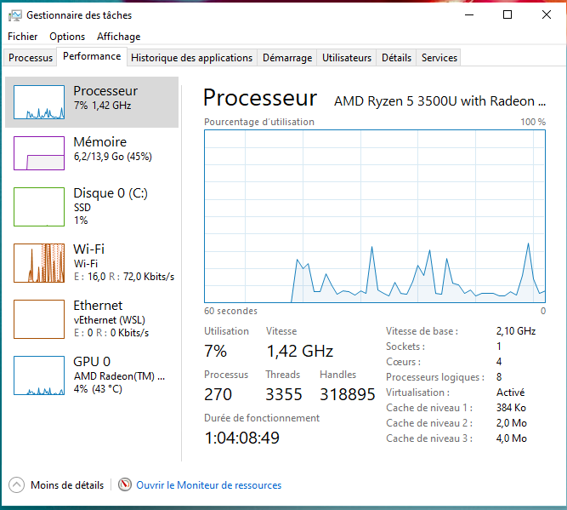
taskmgr

Slide 70
Exercise
Update the program to be able to take n argument as input and compute n Fibbonacci
Update your program to be able to mesure elapsed time
Run it with : dotnet run -- 44
Run it with : dotnet run -- 44 44 44 44
What do you see ?
Don’t forget to checkout your CPU

Slide 71
Task Introduction

Slide 72
Task
using System;
using System.Threading;
using System.Threading.Tasks;
Action<object> action = (object obj) => { Console.WriteLine("Task={0}, obj={1}, Thread={2}", Task.CurrentId, obj, Thread.CurrentThread.ManagedThreadId); };
Task t1 = new Task(action, "alpha");
t1.Start();
Console.WriteLine("t1 has been launched. (Main Thread={0})",
Thread.CurrentThread.ManagedThreadId);
t1.Wait();
https://docs.microsoft.com/fr-fr/dotnet/api/system.threading.tasks.task?view=netcore-3.1&WT.mc_id=DOP-MVP-5003370

Slide 73
Task<TResult>
using System;
using System.Threading.Tasks;
var t = Task<int>.Run( () => {
// Just loop.
int max = 1000000; int ctr = 0;
for (ctr = 0; ctr <= max; ctr++) {
if (ctr == max / 2 && DateTime.Now.Hour <= 12) { ctr++; break; }
}
return ctr; } );
Console.WriteLine("Finished {0:N0} iterations.", t.Result); } }
// The example displays output like the following:
// Finished 1,000,001 loop iterations.
https://docs.microsoft.com/en-us/dotnet/api/system.threading.tasks.task-1?view=netcore-3.1&WT.mc_id=DOP-MVP-5003370

Slide 74
Exercise
Update the program in order to use Task<int>
Run it with : dotnet run -- 44
Run it with : dotnet run -- 44 44 44 44
What do you see ?
Don’t forget to checkout your CPU

Slide 75
Code Editor

Slide 76
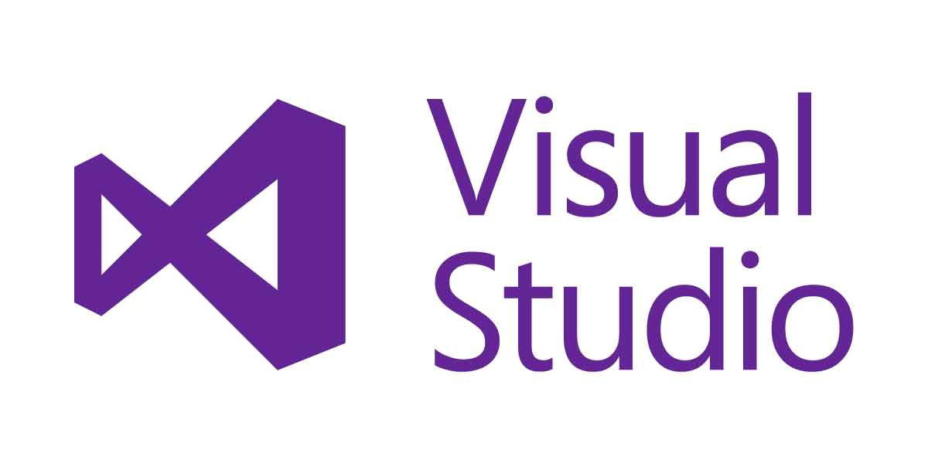

Visual Studio + Resharper
Rider

Slide 77

Jetbrain rider

Slide 78
Code
Refactor
Debug

Slide 79
Exercise
Install Visual Studio + Resharper or Rider
Set up Visual Studio Key Scheme for Resharper or Rider
Debug and observe Thread

Slide 80
Parallel Programming

Slide 81
Parallel programming
string[] files = Directory.GetFiles(@"C:\\Pictures\Sample Pictures", "*.jpg");
Parallel.ForEach(files, (currentFile) => {
// The more computational work you do here, the greater
// the speedup compared to a sequential foreach loop. Console.WriteLine($"Processing {filename} on thread { Thread.CurrentThread.ManagedThreadId}");
});
https://docs.microsoft.com/en-us/dotnet/standard/parallel-programming/how-to-write-a-simple-parallel-foreach-loop &WT.mc_id=DOP-MVP-5003370

Slide 82
Parallel lock
var o = new object(); var results = new List<int>(); Parallel.ForEach(args, (arg) => { var result = Fib(int.Parse(arg)); lock (o) { results.Add(result); } });

Slide 83
Concurrent collection
var results = new ConcurrentBag<int>(); Parallel.ForEach(args, (arg) => { var result = Fib(int.Parse(arg)); results.Add(result); });

Slide 84
ParallelOptions
var parallelOptions = new ParallelOptions(); parallelOptions.MaxDegreeOfParallelism = System.Environment.ProcessorCount ; var results = new ConcurrentBag<int>(); Parallel.ForEach(args, parallelOptions, (arg) => { var result = Fib(int.Parse(arg)); results.Add(result); });

Slide 85
Exercise
Warning: We won’t keep these modifications
Copy the project:
xcopy "../Demo" "../DemoParallel" /E/H
Remove the use of Task<int> and use « Parallel.ForEach » instead

Slide 86
Project organization

Slide 87
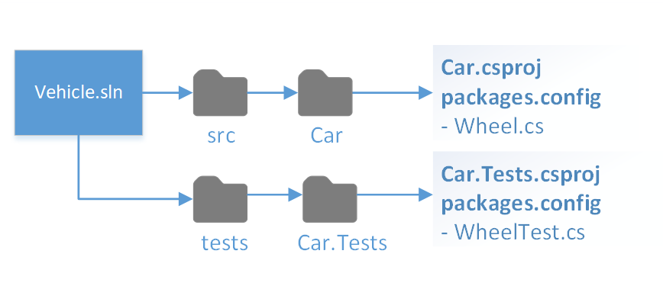
Project structure
https://docs.microsoft.com/fr-fr/dotnet/core/porting/project-structure?WT.mc_id=DOP-MVP-5003370

Slide 88
cd..
mkdir Fibonacci
mkdir Fibonacci\src
move .\Demo .\Fibonacci\src
cd Fibonacci

Slide 89
Project solution file: sln
dotnet new sln
dotnet sln Fibonacci.sln add .\src\Demo\Demo.csproj
type Fibonacci.sln

Slide 90
Library : Fibonacci.csproj
<Project Sdk="Microsoft.NET.Sdk">
<PropertyGroup>
<TargetFramework>net5.0</TargetFramework>
</PropertyGroup>
</Project>
dotnet new classlib –o .\src\Fibonacci

Slide 91
.\src\Fibonacci\Program.cs
using System; using System.Collections.Generic; using System.Diagnostics; using System.Threading.Tasks; namespace Fibonacci { public static class Compute { public static IList<int> Execute(string[] args) { var tasks = new List<int>();
return results; } } }
https://docs.microsoft.com/fr-fr/dotnet/csharp/programming-guide/classes-and-structs/static-classes-and-static-class-members?WT.mc_id=DOP-MVP-5003370

Slide 92
Add reference between projects
dotnet add .\src\Demo\Demo.csproj reference .\src\Fibonacci\Fibonacci.csproj
<Project Sdk="Microsoft.NET.Sdk"> <ItemGroup> <ProjectReference Include="..\..\src\Fibonacci\Fibonacci.csproj" /> </ItemGroup> </Project>

Slide 93
Exercise => use command line
Re-organize your project in order to respect dotnet project file structure :
.\fibonacci.sln
.\src\Fibonacci\Finonacci.csproj // You should create a project library
.\src\Demo\Demo.csproj
Move the code from « .\src\Fibonacci\Program.cs » to « .\src\Demo\Program.cs » in order to implements :
public static IList<int> Execute(string[] args) { var results = new List<int>();
return results; }
// « Demo » must use the Fibonacci library

Slide 94
Unit test

Slide 95
.\tests\Fibonacci.Tests.csproj
<Project Sdk="Microsoft.NET.Sdk"> <PropertyGroup> <TargetFramework>net6.0</TargetFramework> <IsPackable>false</IsPackable> </PropertyGroup> <ItemGroup> <PackageReference Include="Microsoft.NET.Test.Sdk" Version="16.9.4" /> <PackageReference Include="xunit" Version="2.4.1" /> <PackageReference Include="xunit.runner.visualstudio" Version="2.4.3"> <IncludeAssets>runtime; build; native; contentfiles; analyzers; buildtransitive</IncludeAssets> <PrivateAssets>all</PrivateAssets> </PackageReference> <PackageReference Include="coverlet.collector" Version="3.0.2"> <IncludeAssets>runtime; build; native; contentfiles; analyzers; buildtransitive</IncludeAssets> <PrivateAssets>all</PrivateAssets> </PackageReference> </ItemGroup> </Project>
dotnet new xunit –o .\tests\Fibonacci.Tests

Slide 96
using Xunit; namespace Fibonacci.Tests { public class FibonacciUnitTest { [Fact] public void Execute44ShouldRetrun701408733() { var result = Compute.Execute(new[] {"44"}); Assert.Equal(701408733, result[0]); } } }

Slide 97
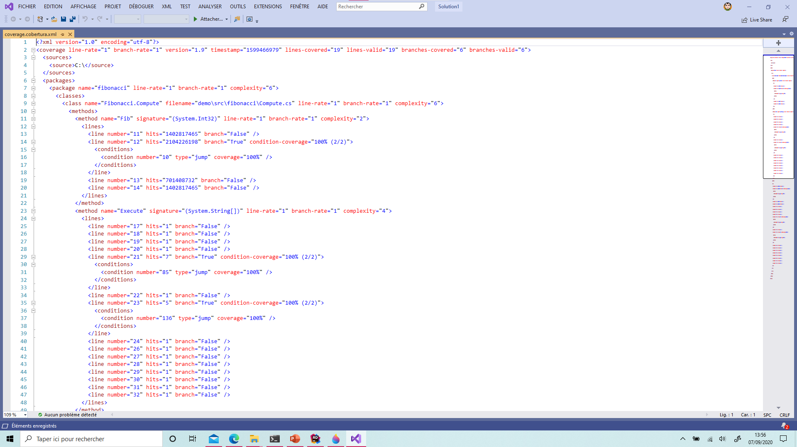
cd .\tests\Fibonacci.Tests
dotnet test --collect:"XPlat Code Coverage"
https://github.com/coverlet-coverage/coverlet

Slide 98
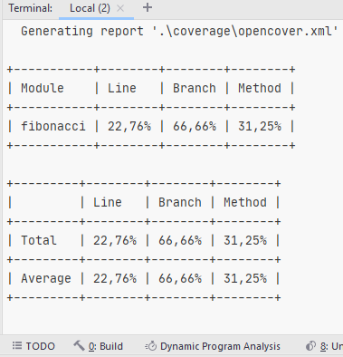
Coverlet
dotnet test --collect:"XPlat Code Coverage" -- DataCollectionRunSettings.DataCollectors.DataCollector.Configuration.Format=json,cobertura,lcov,teamcity,opencover
dotnet add package coverlet.msbuild
dotnet test /p:CollectCoverage=true /p:CoverletOutputFormat=opencover /p:CoverletOutput=./coverage/opencover.xml
https://github.com/coverlet-coverage/coverlet

Slide 99
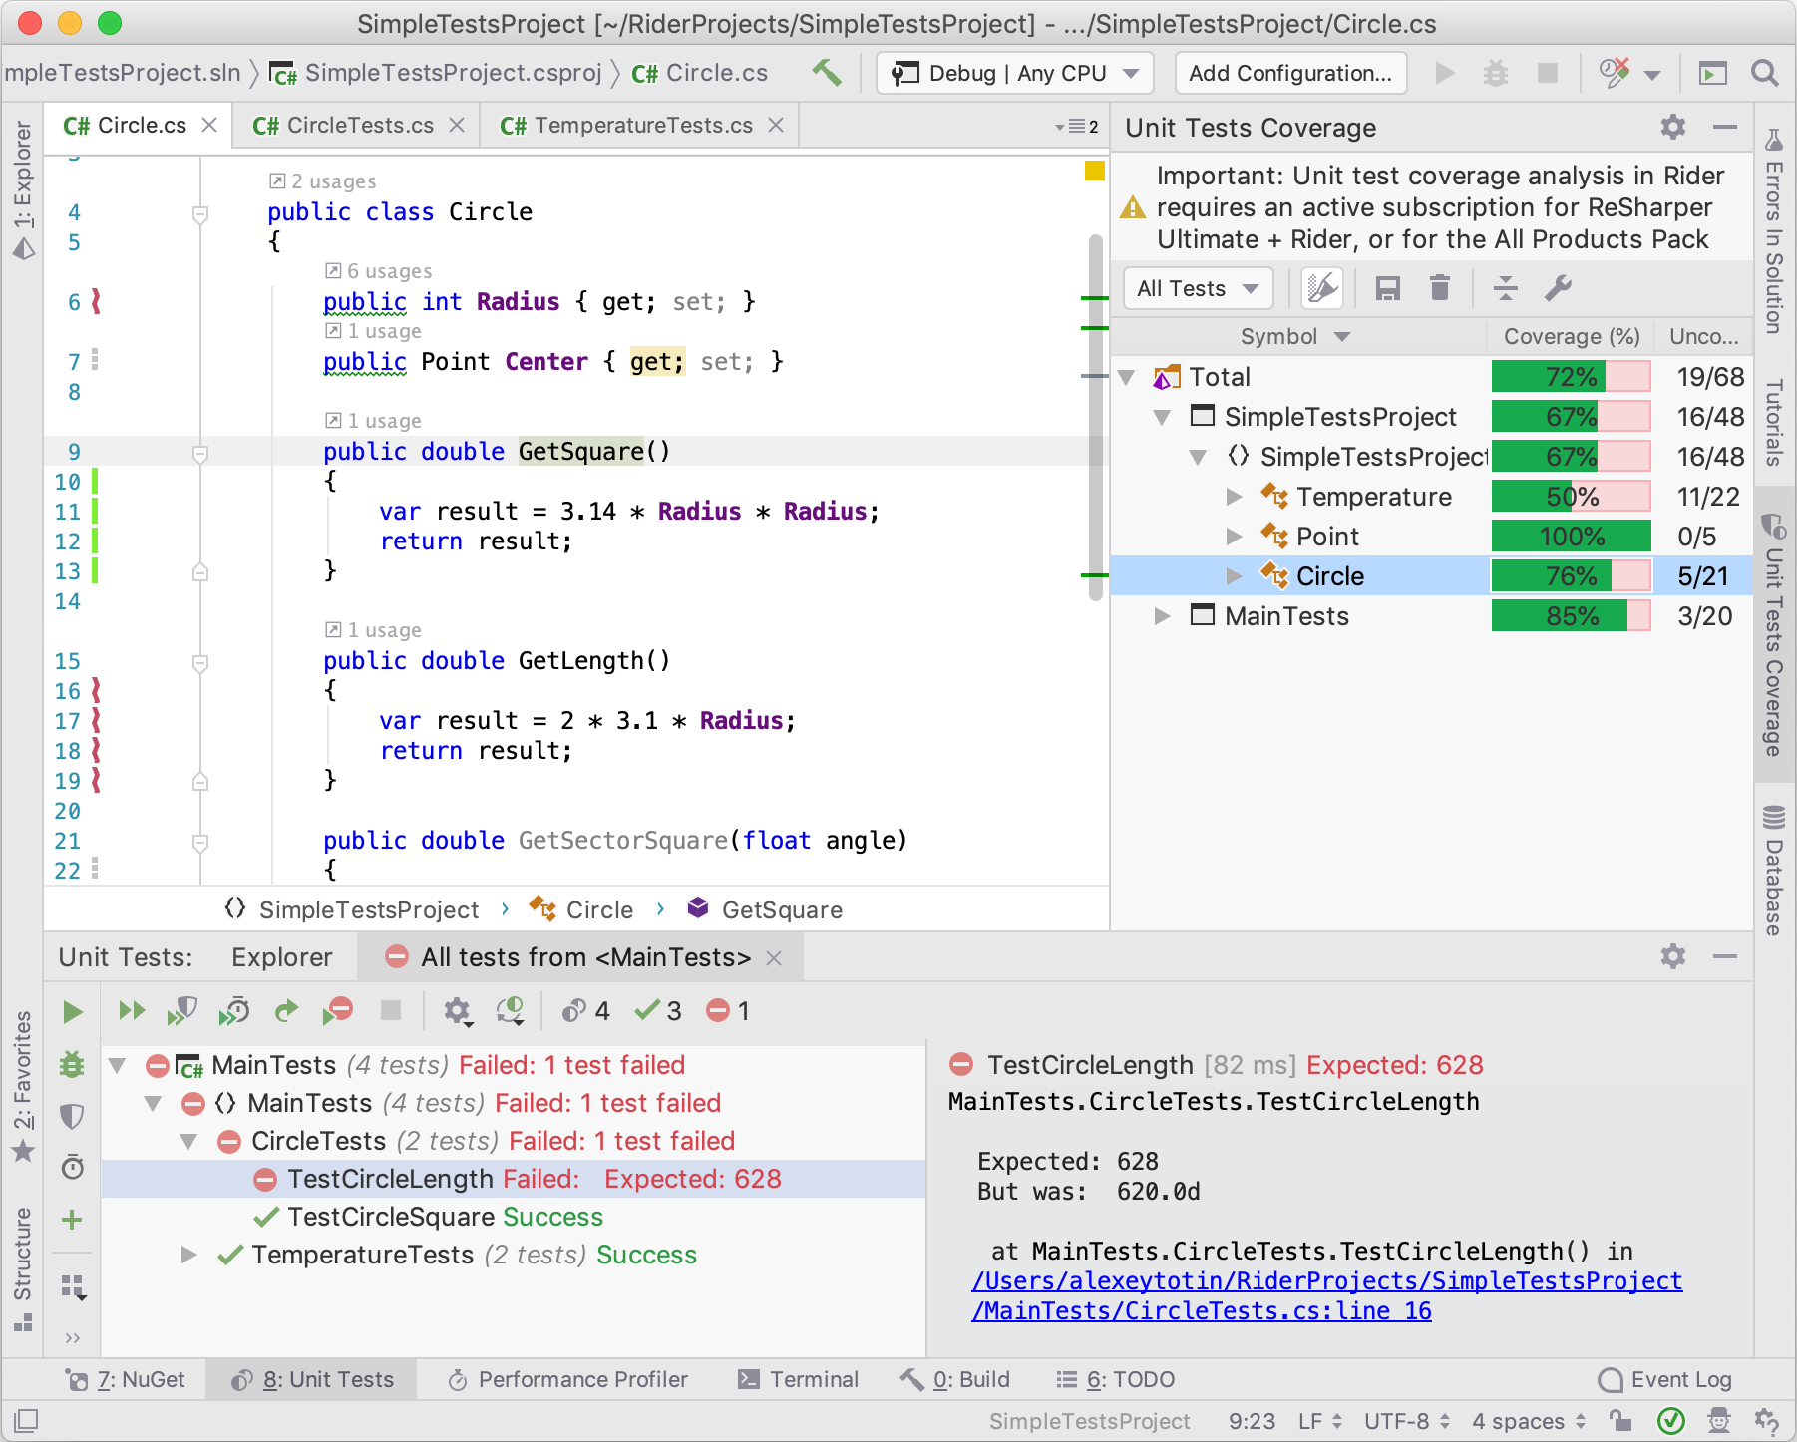
https://blog.jetbrains.com/dotnet/2019/04/10/code-coverage-macos-linux-rider-2019-1/

Slide 100
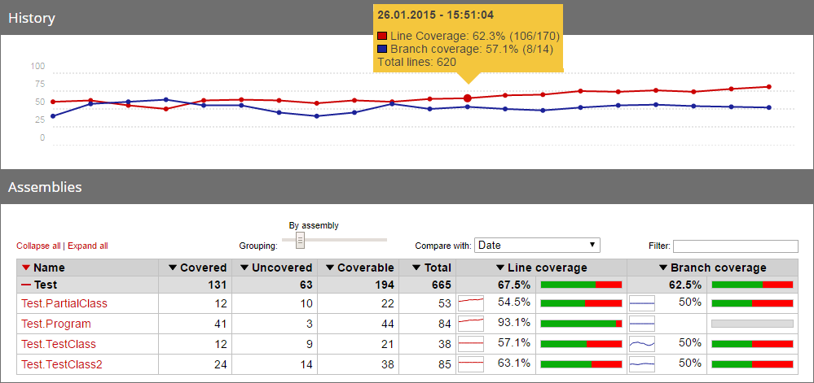
ReportGenerator
dotnet tool install dotnet-reportgenerator-globaltool --tool-path tools
tools\reportgenerator.exe "-reports:coverage\opencover.xml" "-targetdir:report"
https://github.com/danielpalme/ReportGenerator

Slide 101
Exercise, use command line
Add a xunit tests project which test .\src\Fibonacci\ Fibonacci.csproj // you should respect dotnet project convention
Generate code coverage and use ReportGenerator in order to build an html builtin result

Slide 102
Add web API

Slide 103
Fibonacci.Web.csproj
<Project Sdk="Microsoft.NET.Sdk.Web"> <PropertyGroup> <TargetFramework>net6.0</TargetFramework>
<Nullable>enable</Nullable>
<ImplicitUsings>enable</ImplicitUsings> </PropertyGroup> </Project>
dotnet new web –o .\src\Fibonacci.Web

Slide 104
using System.Text.Json; using Microsoft.AspNetCore.Builder; using Microsoft.AspNetCore.Hosting; using Microsoft.AspNetCore.Http; using Microsoft.Extensions.Hosting; public class Program { public static void Main(string[] args) { CreateHostBuilder(args).Build().Run(); } public static IHostBuilder CreateHostBuilder(string[] args) { return Host.CreateDefaultBuilder(args).ConfigureWebHostDefaults(webBuilder => { webBuilder.Configure(app => { app.UseRouting(); app.UseEndpoints(endpoints => { endpoints.MapGet("/Fibonacci", async context => { await context.Response.WriteAsync( JsonSerializer.Serialize(Fibonacci.Fibonacci.Compute(new []{"44", "43"}))); }); }); }); }); } }
https://docs.microsoft.com/en-us/dotnet/api/microsoft.aspnetcore.webhost.createdefaultbuilder?view=aspnetcore-3.1

Slide 105
Dockerfile
FROM mcr.microsoft.com/dotnet/sdk:6.0 AS build WORKDIR /src COPY . . RUN dotnet publish "./src/Fibonacci.Web/Fibonacci.Web.csproj" -c Release -r linux-x64 /p:PublishSingleFile=true -o /publish
FROM mcr.microsoft.com/dotnet/runtime-deps:6.0 AS final WORKDIR /app COPY --from=build /publish . ENTRYPOINT ["/app/Fibonacci.Web"]
docker build -t web
docker run -p 5003:80 --rm web

Slide 106
Exercise
Create an api using « dotnet new web »
Update the code in order to use Fibonacci library
Run it and test it
Create a dockerfile
Run your application from docker
docker build . –t web
docker run -p 5003:80 --rm web

Slide 107
Continuous integration with Github Actions
https://github.com

Slide 109
Continuous integration with Azure DevOps
https://azure.microsoft.com/en-us/services/devops

Slide 110

Github
dotnet new gitignore
cd..
git clone https://github.com/your-account/dotnet-fibonacci
move .\Fibonacci .\dotnet-fibonacci
git add .
git commit –m "update"
git push --set-upstream origin master
https://github.com/

Slide 111
Azure-pipelines.yml
pool:
vmImage: "Ubuntu 16.04"
steps:
- task: DotNetCoreInstaller@0
displayName: "Use .NET Core sdk 5.0.101"
inputs:
version: 5.0.101
- task: DotNetCoreCLI@2
displayName: "dotnet test"
inputs:
command: test
projects: "**/*tests.csproj"
arguments: '--configuration $(BuildConfiguration) /p:CollectCoverage=true /p:CoverletOutputFormat=opencover /p:CoverletOutput=./coverage/opencover.xml'
- task: DotNetCoreCLI@2
displayName: Publish
inputs:
command: publish
publishWebProjects: True
arguments: "--configuration $(BuildConfiguration) --output $(Build.ArtifactStagingDirectory) -r win-x64 --self-contained=true /p:PublishSingleFile=true /p:IncludeNativeLibrariesInSingleFile=true -f net5.0 /p:AssemblyVersion=1.0.0.0"
zipAfterPublish: True
- task: PublishBuildArtifacts@1
displayName: "Publish Artifact: $(Build.DefinitionName)-Artifact"
inputs:
ArtifactName: "$(Build.DefinitionName)-Artifact"
https://github.com/axa-group/radar/blob/master/azure-pipelines.yml

Slide 112
Exercise
Open source your project on github (don’t forget .gitignore)
Add a continuous integration using AzureDevops and azure-pipeline.yml file
Run unit test
Build publish .zip of « Demo » as output in the artifact

Slide 113
Exercise Sonar
Create personal login on Sonar Cloud
https://sonarcloud.io/
Add code analyses to sonar cloud in your CI (Continuous Integration)

Slide 114
Exercise Docker
Create personal login on Docker Hub https://hub.docker.com/
Add following feature in your CI
Build Demo Dockerfile
Push your image to your personal docker registry

Slide 115
Publish library to Nuget

Slide 116
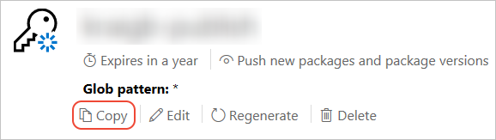
Publish to nuget.org
https://www.nuget.org/users/account/LogOn?returnUrl=%2F
https://docs.microsoft.com/fr-fr/nuget/nuget-org/publish-a-package?WT.mc_id=DOP-MVP-5003370#create-api-keys

Slide 117
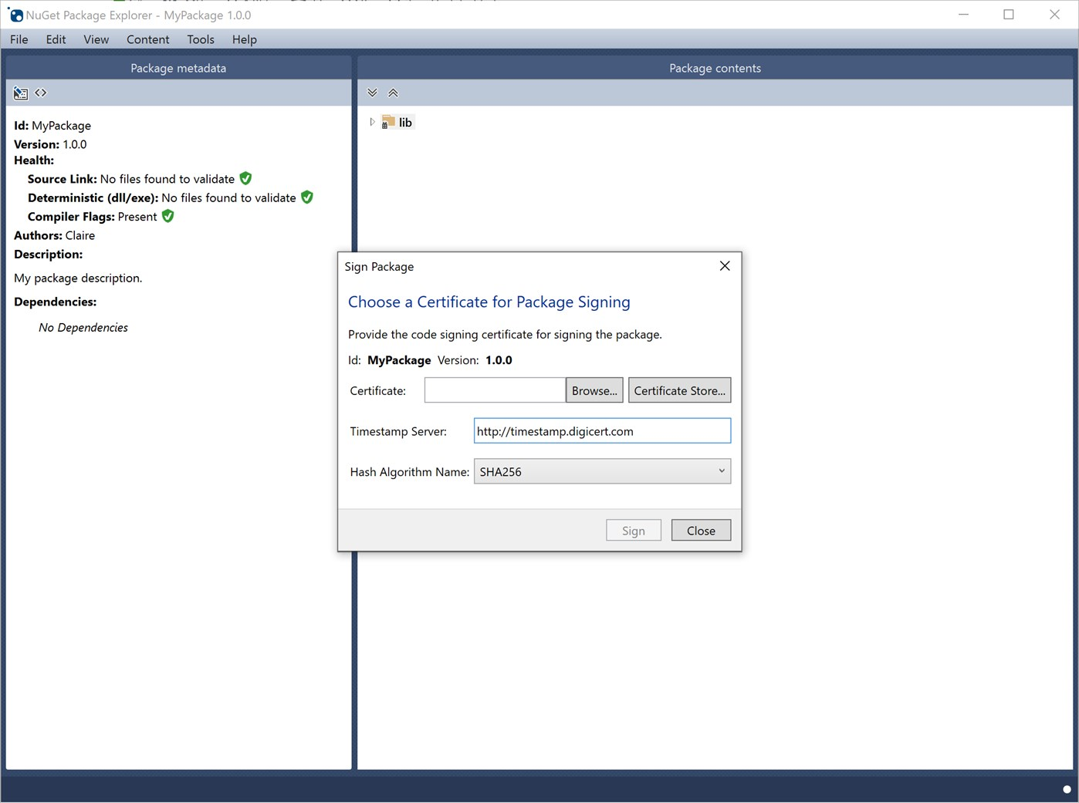
https://www.microsoft.com/fr-fr/p/nuget-package-explorer/9wzdncrdmdm3?activetab=pivot:overviewtab

Slide 118
Build package
dotnet pack .\src\Fibonacci\Fibonacci.csproj -p:PackageVersion=1.0.0
https://docs.microsoft.com/en-us/dotnet/core/tools/dotnet-pack?WT.mc_id=DOP-MVP-5003370

Slide 119
PackageId
<Project Sdk="Microsoft.NET.Sdk"> <PropertyGroup> <TargetFramework>netstandard2.0</TargetFramework> <PackageId>Guillaume.Chervet.Fibonacci</PackageId> </PropertyGroup> </Project>
https://docs.microsoft.com/fr-fr/dotnet/core/tools/csproj?WT.mc_id=DOP-MVP-5003370

Slide 120
Publish
dotnet nuget push .\src\Fibonacci\bin\Debug\Guillaume.Chervet.Fibonacci.1.0.0.nupkg --api-key YOUR_API_KEY --source https://api.nuget.org/v3/index.json
https://docs.microsoft.com/fr-fr/nuget/nuget-org/publish-a-package?WT.mc_id=DOP-MVP-5003370

Slide 121
Exercise
Rename you PackageId using this pattern :
Firstname.Lastname.Fibonacci
Publish your package on Nuget

Slide 122
Consume package from Nuget

Slide 123
PackageReference
dotnet add package Guillaume.Chervet.Fibonacci --version 1.0.0
<Project Sdk="Microsoft.NET.Sdk"> <ItemGroup> <PackageReference Include="Guillaume.Chervet.Fibonacci" Version="1.0.0" /> </ItemGroup> <PropertyGroup> <OutputType>Exe</OutputType> <TargetFramework>net5.0</TargetFramework> </PropertyGroup> </Project>

Slide 124
Exercise
Create new a console application name « DemoFromNuget »
Consume your package from nuget add the necessary code to make it works
Run the application

Slide 125
C# Language

Slide 126
C# Language
Object Type / Value Type
https://docs.microsoft.com/en-us/dotnet/csharp/programming-guide/classes-and-structs/objects?WT.mc_id=DOP-MVP-5003370
Object
https://docs.microsoft.com/fr-fr/dotnet/api/system.object?WT.mc_id=DOP-MVP-5003370
https://docs.microsoft.com/en-us/dotnet/csharp/programming-guide/classes-and-structs/inheritance?WT.mc_id=DOP-MVP-5003370
https://docs.microsoft.com/fr-fr/dotnet/csharp/language-reference/keywords/interface?WT.mc_id=DOP-MVP-5003370
https://docs.microsoft.com/en-us/dotnet/api/system.idisposable?WT.mc_id=DOP-MVP-5003370
Casting
https://docs.microsoft.com/en-us/dotnet/csharp/programming-guide/types/casting-and-type-conversions?WT.mc_id=DOP-MVP-5003370
Basket Demo Imperative/Object/Declarative
https://github.com/guillaumechervet/course.designpattern/tree/feature/oo-vs-fp/src/Basket

Slide 127
Add sqlserver database

Slide 128
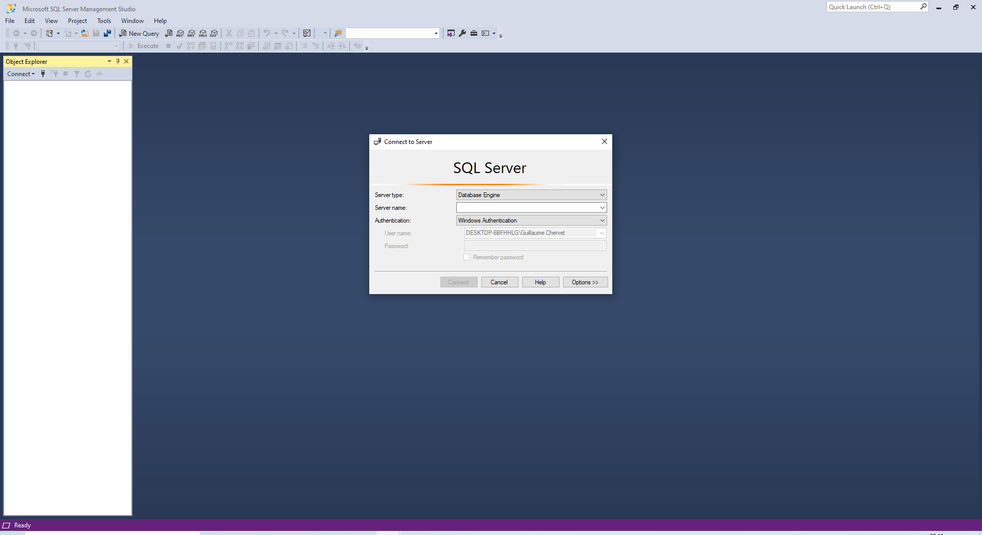
Sql server management studio
https://docs.microsoft.com/fr-fr/sql/ssms/download-sql-server-management-studio-ssms?WT.mc_id=DOP-MVP-5003370

Slide 129
docker-compose.yml
version: "3.4"
services:
db:
build: ./sqlserver
container_name: "fibonacci_db"
image: "mcr.microsoft.com/mssql/server"
ports:
- "1433:1433"
environment:
SA_PASSWORD: "Your_password123"
ACCEPT_EULA: "Y"

Slide 130
./sqlserver/dockerfile
FROM mcr.microsoft.com/mssql/server
ENV ACCEPT_EULA=Y
ENV SA_PASSWORD=Your_password123
COPY ./ /
ENTRYPOINT [ "/bin/bash", "entrypoint.sh" ]
CMD [ "/opt/mssql/bin/sqlservr" ]

Slide 131
./sqlserver/entrypoint.sh
#!/bin/bash
set -e
if [ "$1" = '/opt/mssql/bin/sqlservr' ]; then
if [ ! -f /tmp/app-initialized ]; then
function initialize_app_database() {
sleep 40s
/opt/mssql-tools/bin/sqlcmd -S localhost -U sa -P Your_password123 -d master -i ./initBase.sql
touch /tmp/app-initialized
}
initialize_app_database &
fi
fi
exec "$@"

Slide 132
./sqlserver/initBase.sql
USE [master]
CREATE DATABASE FibonacciData
GO USE FibonacciData
GO
CREATE SCHEMA sch_fib AUTHORIZATION [dbo];
GO
CREATE TABLE [sch_fib].[T_Fibonacci](
[FIB_Id] uniqueidentifier NOT NULL DEFAULT newid(),
[FIB_ Input] [int] NOT NULL,
[FIB_ Output] [bigint] NOT NULL,
CONSTRAINT [PK_Fibonacci] PRIMARY KEY CLUSTERED ([FIB_Id]))
https://docs.microsoft.com/en-us/dotnet/framework/data/adonet/sql-server-data-type-mappings?WT.mc_id=DOP-MVP-5003370

Slide 133
Reverse Engineering
dotnet add package Microsoft.EntityFrameworkCore.SqlServer
dotnet tool install --global dotnet-ef
dotnet add package Microsoft.EntityFrameworkCore.Design
dotnet ef dbcontext scaffold "Data Source=localhost,1433;Initial Catalog=FibonacciData;Integrated Security=False;User ID=sa;Password=Your_password123;MultipleActiveResultSets=True" Microsoft.EntityFrameworkCore.SqlServer
https://docs.microsoft.com/fr-fr/ef/core/managing-schemas/scaffolding?tabs=dotnet-core-cli&WT.mc_id=DOP-MVP-5003370

Slide 134
Evolving your model
public partial class T_Fibonacci { public Guid FibId { get; set; } public int FibInput { get; set; } public long FibOutput { get; set; } public DateTime FibCreatedTimestamp { get; set; } }
dotnet ef migrations add AddFibFibonacciCreatedTimestamp
dotnet ef database update
https://docs.microsoft.com/fr-fr/ef/core/managing-schemas/migrations?WT.mc_id=DOP-MVP-5003370

Slide 135
Select
using (var fibonacciDataContext = new FibonacciDataContext()) { var result = await fibonacciDataContext.TFibonacci.Where(f => f.FibInput == 44) .Select(f => f.FibOutput).FirstOrDefaultAsync(); if (result != default(long)) { … }
}
Eager loader
Explicit Loading
Lazy loading
https://docs.microsoft.com/en-us/ef/core/querying/related-data/eager?WT.mc_id=DOP-MVP-5003370

Slide 136
Insert
using (var fibonacciDataContext = new FibonacciDataContext()) { fibonacciDataContext.TFibonacci.Add(new TFibonacci() { FibInput = 44, FibCreatedTimestamp = DateTime.Now, FibOutput = 888888 });
fibonacciDataContext.TFibonacci.Add(new TFibonacci() { FibInput = 32, FibCreatedTimestamp = DateTime.Now, FibOutput = 666 }); await fibonacciDataContext.SaveChangesAsync(); return results; } }

Slide 137
Update
using (var fibonacciDataContext = new FibonacciDataContext()) { var fibonacci = await fibonacciDataContext.TFibonacci.Where(f => f.FibInput == 44) .FirstOrDefaultAsync(); fibonacci.FibOutput = 777;
await fibonacciDataContext.SaveChangesAsync();
}

Slide 138
Delete
using (var fibonacciDataContext = new FibonacciDataContext()) { var fibonacci = await fibonacciDataContext.TFibonacci.Where(f => f.FibInput == 44) .FirstOrDefaultAsync(); fibonacciDataContext.TFibonacci.Remove(fibonacci);
await fibonacciDataContext.SaveChangesAsync();
}

Slide 139
Exercise
Add a docker-compose which run SQL Server and its init SQL script
Reverse engineer the database to generate C# DataContext in your Fibonacci Library
Add FibCreatedTimestamp property to your C# class and update the database
Update the code in order to use your database. You must add a cache system to your fibonacci Library

Slide 140
unit test in memory context
Problem the unit test is coupled to the Database

Slide 141
Compute.cs \\ Dependency injection
namespace Fibonacci { public class Compute { private readonly FibonacciDataContext _fibonacciDataContext; public Compute(FibonacciDataContext fibonacciDataContext) { _fibonacciDataContext = fibonacciDataContext; } public async Task<IList<int>> Execute(string[] args) { var result = await _fibonacciDataContext.TFibonacci.Where(f => f.FibInput == 44) .Select(f => f.FibOutput).FirstOrDefaultAsync(); return new List<int>(); } } }
https://docs.microsoft.com/en-us/dotnet/csharp/programming-guide/classes-and-structs/objects?WT.mc_id=DOP-MVP-5003370

Slide 142
Program.cs
using System; using System.Threading.Tasks; using Fibonacci; namespace Demo { public class Program { public static async Task Main(string[] args) { using (var fibonacciDataContext = new FibonacciDataContext()) { var compute = new Compute(fibonacciDataContext); var results = await compute.Execute(args); foreach (var fibonacci in results) Console.WriteLine($"Result is {fibonacci}"); } } } }

Slide 143
InMemory Context
dotnet add package Microsoft.EntityFrameworkCore.InMemory
var builder = new DbContextOptionsBuilder<FibonacciDataContext>(); var dataBaseName = Guid.NewGuid().ToString(); builder.UseInMemoryDatabase(dataBaseName); var options = builder.Options; var fibonacciDataContext = new FibonacciDataContext(options); await fibonacciDataContext.Database.EnsureCreatedAsync();
https://docs.microsoft.com/en-us/ef/core/providers/in-memory?WT.mc_id=DOP-MVP-5003370

Slide 144
Exercise
Refactor « Compute.cs » in order to inject the « DataContext »
Update « Program.cs »
Run the « Demo.exe »
Update the unittest in order to use an InMemory Database
Run your the unittest

Slide 145
SQL One to Many

Slide 146
Log SQL Query
protected override void OnConfiguring(DbContextOptionsBuilder optionsBuilder) { if (!optionsBuilder.IsConfigured) { optionsBuilder.UseLoggerFactory(MyLoggerFactory).UseSqlServer( "Data Source=localhost,1433;Initial Catalog=FibonacciData;Integrated Security=False;User ID=sa;Password=Your_password123;MultipleActiveResultSets=True"); } } public static readonly ILoggerFactory MyLoggerFactory = LoggerFactory.Create(builder => { builder.AddConsole(); });
https://docs.microsoft.com/en-us/ef/core/miscellaneous/logging?WT.mc_id=DOP-MVP-5003370

Slide 147
Log SQL Query
dotnet add package Microsoft.Extensions.Logging
dotnet add package Microsoft.Extensions.Logging.Abstractions
dotnet add package Microsoft.Extensions.Logging.Console

Slide 148
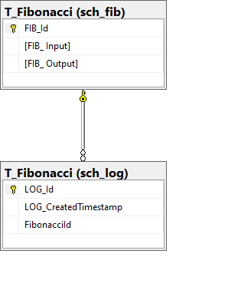
One to Many
public class TFibonacci { public Guid FibId { get; set; } public int FibInput { get; set; } public long FibOutput { get; set; } public IList<TLog> FibLogs { get; set; } } public class Log { public Guid Id { get; set; } public DateTime CreatedTimestamp { get; set; } public TFibonacci Fibonacci { get; set; } public Guid FibonacciId { get; set; } }
https://entityframework.net/one-to-many-relationship

Slide 149
Using fluent api
protected override void OnModelCreating(ModelBuilder modelBuilder) { // mapping ...
modelBuilder.Entity<Log>(entity => { // mapping ... modelBuilder.Entity<Log>() .HasOne(t => t.Fibonacci) .WithMany(t => t.FibLogs) .HasForeignKey(k => k.FibonacciId); }); OnModelCreatingPartial(modelBuilder); }

Slide 150
Insert with links
fibonacciDataContext.TFibonacci.Add(new TFibonacci { FibInput = Convert.ToInt32(args[index]), FibOutput = value.Result, FibLogs = new List<Log>() {new Log() {CreatedTimestamp = DateTime.Now}} }); await _fibonacciDataContext.SaveChangesAsync();

Slide 151
Insert with links
SELECT TOP(1) [t].[FIB_ Output]
FROM [sch_fib].[T_Fibonacci] AS [t]
WHERE [t].[FIB_ Input] = @__input_0
var result = await _fibonacciDataContext.TFibonacci.Where(f => f.FibInput == 44) .FirstAsync();
if (result != default) { result.FibLogs = new List<Log>(); result.FibLogs.Add(new Log() {CreatedTimestamp = DateTime.Now});
} await _fibonacciDataContext.SaveChangesAsync();

Slide 152
Three kinds of loading
Eager loading : default
Explicit loading
Lazy loading : discouraged

Slide 153
Eager loading with links
SELECT [t0].[FIB_Id], [t0].[FIB_ Input], [t0].[FIB_ Output], [t1].[LOG_Id], [t1].[LOG_CreatedTimestamp], [t1].[FibonacciId]
FROM (
SELECT TOP(1) [t].[FIB_Id], [t].[FIB_ Input], [t].[FIB_ Output]
FROM [sch_fib].[T_Fibonacci] AS [t]
WHERE [t].[FIB_ Input] = @__Parse_0
) AS [t0]
LEFT JOIN [sch_log].[T_Fibonacci] AS [t1] ON [t0].[FIB_Id] = [t1].[FibonacciId]
ORDER BY [t0].[FIB_Id], [t1].[LOG_Id]
var result = await _fibonacciDataContext.TFibonacci .Where(f => f.FibInput == 44) .Include(p => p.FibLogs) .FirstAsync(); if (result != default) { result.FibLogs.Add(new Log() {CreatedTimestamp = DateTime.Now}); } await _fibonacciDataContext.SaveChangesAsync();

Slide 154
Eager loading with links : multiple levels
using (var context = new BloggingContext()) {
var blogs = context.Blogs .Include(blog => blog.Posts).ThenInclude(post => post.Author) .ToList();
}
https://docs.microsoft.com/en-us/ef/core/querying/related-data/eager?WT.mc_id=DOP-MVP-5003370#including-multiple-levels

Slide 155
Projection
var projection = await _fibonacciDataContext.TFibonacci.Where(f => f.FibInput == input) .Select(f => new { FibOutput = f.FibOutput, FibInput = f.FibInput}).FirstOrDefaultAsync();
Console.Write(projection.FibInput); Console.Write(projection.FibOutput);

Slide 156
No-tracking queries
var result = await _fibonacciDataContext.TFibonacci .AsNoTracking() .Where(f => f.FibInput == input) .Select(f => f.FibOutput) .FirstOrDefaultAsync();
https://docs.microsoft.com/en-us/ef/core/querying/tracking?WT.mc_id=DOP-MVP-5003370#tracking-queries

Slide 157
Inner join queries : lambda
var result = _dbContext.Customer.Join(
_dbContext.CustomerDetails,
customer => customer.Id,
detail => detail.CustomerId,
(x,y) => new {
id = x.Id,
firstname = x.Firstname,
lastname = x.Lastname,
detailText = y.DetailText
});
https://www.niceonecode.com/Blog/62/Inner-Join-query-in-Entity-Framework-Core

Slide 158
Inner join queries : linq
var result = from customer in _dbContext.Customer
join detail in _dbContext.CustomerDetails
on customer.Id equals detail.CustomerId
select new
{
id = customer.Id,
firstname = customer.Firstname,
lastname = customer.Lastname,
detailText = m.DetailText
};
https://www.niceonecode.com/Blog/62/Inner-Join-query-in-Entity-Framework-Core

Slide 159
Exercise
Refactor your C# code in order to add a one to many relation as describe beside
Update your database using EF tools
Update your code (use default eager loading)
You must still have a cache system
You must log each call in the database
public class TFibonacci { public Guid FibId { get; set; } public int FibInput { get; set; } public long FibOutput { get; set; } public IList<TLog> FibLogs { get; set; } } public class Log { public Guid Id { get; set; } public DateTime CreatedTimestamp { get; set; } public TFibonacci Fibonacci { get; set; } public Guid FibonacciId { get; set; } }

Slide 160
Entity Framework Good Pratice

Slide 161
Entity Framework Good Pratice
Use many small independent context
Do not use Lazy Loading
Load only what you need
Minimise round trip
Repository Pattern
Use « no traking query » when you can
Use « pre-compile query » for complexe queries
https://docs.microsoft.com/en-us/dotnet/framework/data/adonet/ef/language-reference/compiled-queries-linq-to-entities?WT.mc_id=DOP-MVP-5003370

Slide 162
Configuration

Slide 163
Configuration file
appsettings.json
{ "Application": { "Name": "Fibonacci", "Message": "Bienvenue" } }
appsettings.Developement.json
appsettings.Production.json
{ "Application": { "Message": "Bienvenue en dev" } }
{ "Application": { "Message": "Bienvenue en prod" } }

Slide 164
Demo.csproj
<Project Sdk="Microsoft.NET.Sdk"> …
<ItemGroup> <None Update="appsettings.json"> <CopyToOutputDirectory>PreserveNewest</CopyToOutputDirectory> </None> <None Update="appsettings.Development.json"> <CopyToOutputDirectory>PreserveNewest</CopyToOutputDirectory> </None> <None Update="appsettings.Production.json"> <CopyToOutputDirectory>PreserveNewest</CopyToOutputDirectory> </None> </ItemGroup> … </Project>

Slide 165
Configuration package
dotnet add package Microsoft.Extensions.Configuration
dotnet add package Microsoft.Extensions.Configuration.Binder
dotnet add package Microsoft.Extensions.Configuration.EnvironmentVariables
dotnet add package Microsoft.Extensions.Configuration.Json
https://docs.microsoft.com/en-us/dotnet/core/extensions/configuration?WT.mc_id=DOP-MVP-5003370

Slide 166
How configuration work
public static async Task Main(string[] args) { var environmentName = Environment.GetEnvironmentVariable("ASPNETCORE_ENVIRONMENT"); IConfiguration configuration = new ConfigurationBuilder() .SetBasePath(Directory.GetCurrentDirectory()) .AddEnvironmentVariables() .AddJsonFile("appsettings.json", optional: false, reloadOnChange: true) .AddJsonFile($"appsettings.{environmentName}.json", optional: true, reloadOnChange: true) .Build();
var applicationName = configuration.GetValue<string>("Application:Name"); var applicationMessage = configuration.GetValue<string>("Application:Message"); Console.WriteLine($"Application Name : {applicationName}"); Console.WriteLine($"Application Message : {applicationMessage}"); }

Slide 167
Environment variable
dotnet run -- 44
set ASPNETCORE_ENVIRONMENT=Development
dotnet run-- 44
set ASPNETCORE_ENVIRONMENT=Production
dotnet run -- 44

Slide 168
Bind object
public static async Task Main(string[] args) { var environmentName = Environment.GetEnvironmentVariable("ASPNETCORE_ENVIRONMENT"); IConfiguration configuration = new ConfigurationBuilder() .SetBasePath(Directory.GetCurrentDirectory()) .AddEnvironmentVariables() .AddJsonFile("appsettings.json", optional: false, reloadOnChange: true) .AddJsonFile($"appsettings.{environmentName}.json", optional: true, reloadOnChange: true) .Build(); var applicationSection = configuration.GetSection("Application"); var applicationConfig = applicationSection.Get<ApplicationConfig>(); Console.WriteLine($"Application Name : {applicationConfig.Name}"); Console.WriteLine($"Application Message : {applicationConfig.Message}"); }
namespace Demo { public class ApplicationConfig { public string Name { get; set; } public string Message { get; set; } } }

Slide 169
Exercise
Add 3 configuration file as beside to your Demo project
appsettings.json
{ "Application": { "Name": "Fibonacci", "Message": "Bienvenue" } }
appsettings.Developement.json
appsettings.Production.json
{ "Application": { "Message": "Bienvenue en dev" } }
{ "Application": { "Message": "Bienvenue en prod" } }

Slide 170
Exercise
Display the content of Application.Name and Application.Message in the console when the application start
Run the application in Development mode: observe the result
Run the application in Production mode: observe the result

Slide 171
Logging

Slide 172
Logger Factory and ILogger
var applicationSection = configuration.GetSection("Application"); var applicationConfig = applicationSection.Get<ApplicationConfig>(); var loggerFactory = LoggerFactory.Create(builder => { builder.AddFilter("Microsoft", LogLevel.Warning) .AddFilter("System", LogLevel.Warning) .AddFilter("Demo", LogLevel.Debug) .AddConsole(); } ); var logger = loggerFactory.CreateLogger("Demo.Program"); logger.LogInformation($"Application Name : {applicationConfig.Name}"); logger.LogInformation($"Application Message : {applicationConfig.Message}");
https://stackoverflow.com/questions/53690820/how-to-create-a-loggerfactory-with-a-consoleloggerprovider

Slide 173
log Level
LogLevel | Value | Method | Description
Trace | 0 | LogTrace | Contain the most detailed messages. These messages may contain sensitive app data. These messages are disabled by default and should not be enabled in production.
Debug | 1 | LogDebug | For debugging and development. Use with caution in production due to the high volume.
Information | 2 | LogInformation | Tracks the general flow of the app. May have long-term value.
Warning | 3 | LogWarning | For abnormal or unexpected events. Typically includes errors or conditions that don't cause the app to fail.
Error | 4 | LogError | For errors and exceptions that cannot be handled. These messages indicate a failure in the current operation or request, not an app-wide failure.
Critical | 5 | LogCritical | For failures that require immediate attention. Examples: data loss scenarios, out of disk space.
None | 6 |  | Specifies that a logging category should not write any messages.
https://docs.microsoft.com/fr-fr/aspnet/core/fundamentals/logging?WT.mc_id=DOP-MVP-5003370

Slide 174
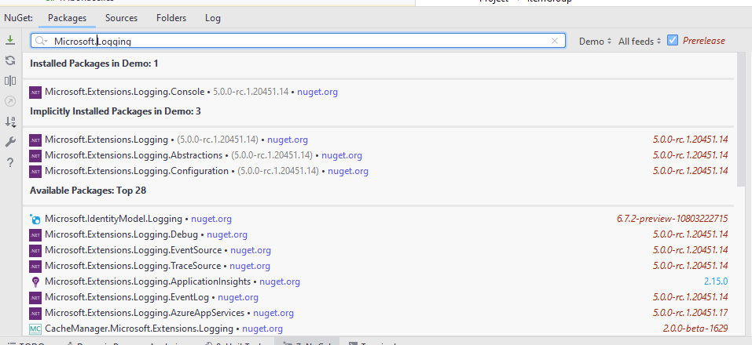
Logger package
dotnet add package Microsoft.Extensions.Logging.Console
https://docs.microsoft.com/fr-fr/aspnet/core/fundamentals/logging?WT.mc_id=DOP-MVP-5003370

Slide 175
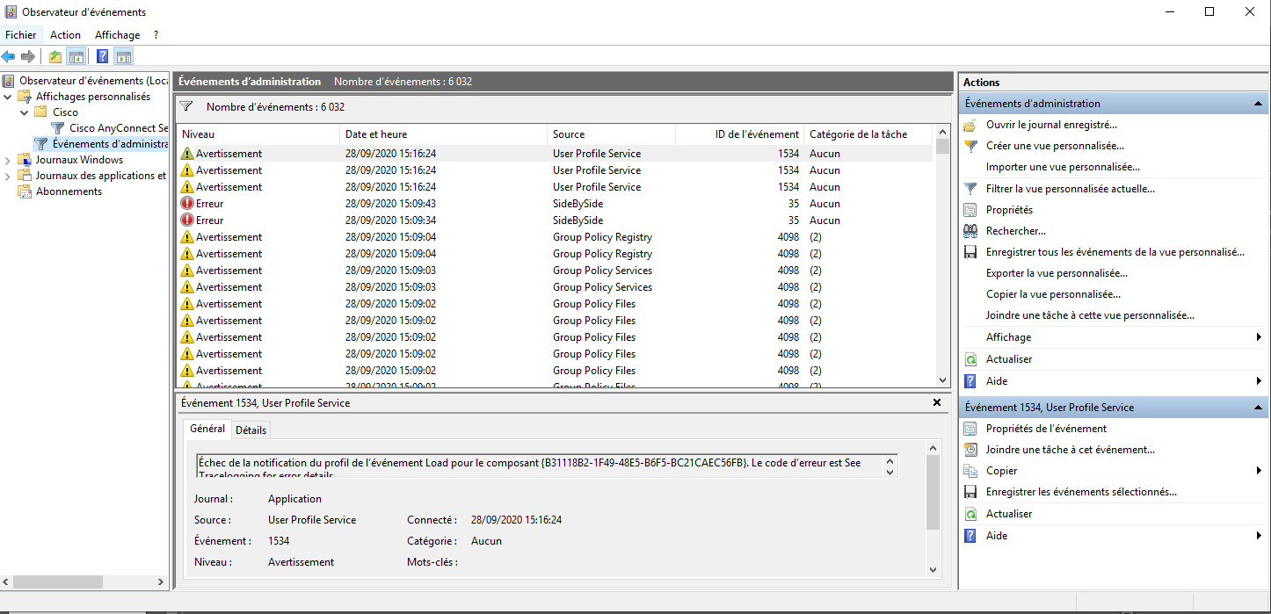
Events Windows

Slide 176
Exercise
Instead of logging with Console.WriteLine
Use the ILogger to log to the console
Search for Microsoft default TraceEvent library and add it to « Demo » project
Add and configure the TraceEvent logger in order to log the Windows Event System

Slide 177
Logging and configuration
appsettings.json
"Logging": { "LogLevel": { "Default": "Information", "Microsoft": "Warning", "System": "Warning" } }

Slide 178
Serilog
https://serilog.net/

Slide 179
Dependency Injection

Slide 180
ServiceCollection
appsettings.json
"Logging": { "LogLevel": { "Default": "Information", "Microsoft": "Warning", "System": "Warning" } }
var services = new ServiceCollection(); services.AddTransient<FibonacciDataContext>(); services.AddTransient<Compute>(); services.AddLogging(); using(var serviceProvider = services.BuildServiceProvider()) { var logger =serviceProvider.GetService<ILogger<Program>>(); logger.LogInformation($"Application Name : {applicationConfig.Name}"); logger.LogInformation($"Application Message : {applicationConfig.Message}"); var compute = serviceProvider.GetService<Compute>(); var results = await compute.Execute(args);
}

Slide 181
Service Lifetimes
Transient : Transient lifetime services are created each time they're requested from the service container. This lifetime works best for lightweight, stateless services.
Scoped : Scoped lifetime services are created once per client request (connection). Register scoped services with AddScoped.
In apps that process requests, scoped services are disposed at the end of the request.
When using Entity Framework Core, the AddDbContext extension method registers DbContext types with a scoped lifetime by default.
Singleton : Singleton lifetime services are created either: The first time they're requested.
By the developer, when providing an implementation instance directly to the container. This approach is rarely needed.
https://docs.microsoft.com/fr-fr/aspnet/core/fundamentals/dependency-injection?WT.mc_id=DOP-MVP-5003370#service-lifetimes

Slide 182
Exercise
Set up the depency injection => remove all custom « new »

Slide 183
Entity Framework connection string and configuration

Slide 184
Program.cs
services.AddDbContext<SchoolContext>(options => options.UseSqlServer(Configuration.GetConnectionString("DefaultConnection")));
appsettings.json
{ "ConnectionStrings": { "DefaultConnection": "Server=(localdb)\\mssqllocaldb;Database=ContosoUniversity1;Trusted_Connection=True;MultipleActiveResultSets=true" },
https://docs.microsoft.com/en-us/ef/core/miscellaneous/connection-strings?WT.mc_id=DOP-MVP-5003370

Slide 185
Exercise
Remove connection string from the code and add it to the configuration file

Slide 186
ASP.NET Core

Slide 187
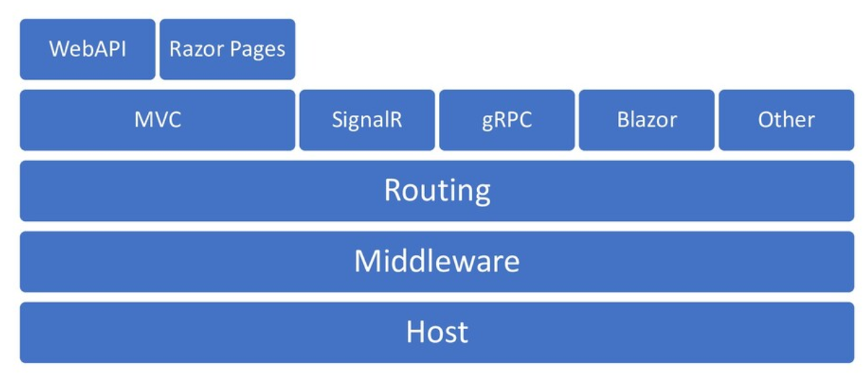
Architecture
https://twitter.com/davidfowl/status/1323337611704999942

Slide 188
Create a web API
dotnet new webapi -o .\src\WebApi
https://docs.microsoft.com/en-us/aspnet/core/introduction-to-aspnet-core?WT.mc_id=DOP-MVP-5003370

Slide 189
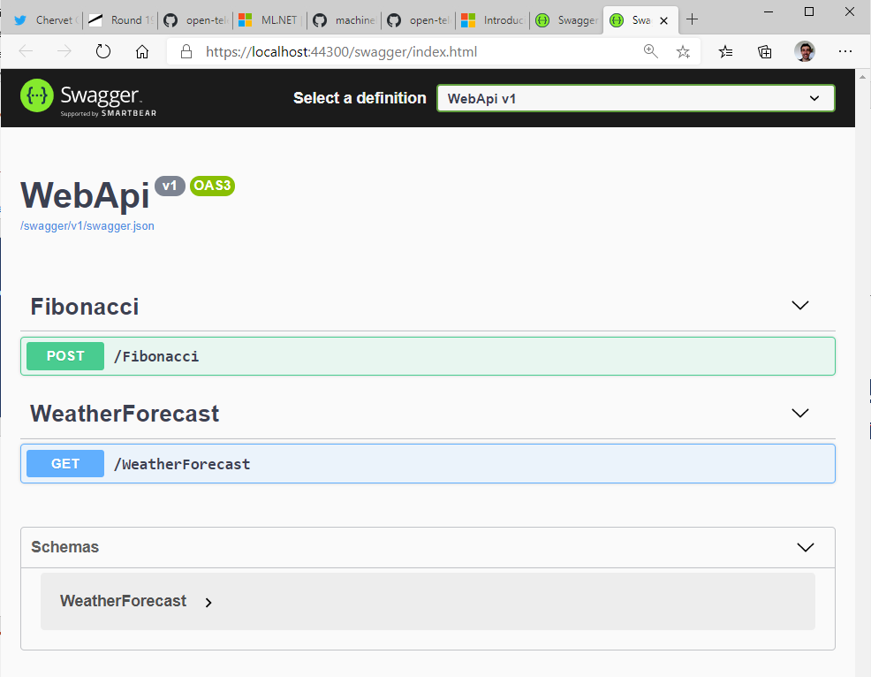
Add Fibonacci Controller

Slide 190
Exercise
Create a « webapi » template in « .\src\WebApi » directory
Add a fibonacci « Controller » and add an HTTP POST route that will compute fibonacci using your library « Fibonacci »
Test your API from swagger UI

Slide 191
My first middleware

Slide 192
Startup.cs
public class Startup {
public void Configure(IApplicationBuilder app) {
app.Use(async (context, next) => {
// Do work that doesn't write to the Response.
await next.Invoke();
// Do logging or other work that doesn't write to the Response.
});
app.Run(async context => {
await context.Response.WriteAsync("Hello from 2nd delegate.");
});
}
}
https://docs.microsoft.com/en-us/aspnet/core/fundamentals/middleware?WT.mc_id=DOP-MVP-5003370

Slide 193
Exercise
Add a middleware which log on every request the :
HTTP VERB
url path
Status code

