Slide 1
Discovery .NET 8 and its ecosystem
Guillaume Chervet

Slide 2

Presentation
Guillaume Chervet
TechLead at AXA France
MVP Microsoft
https://github.com/AxaFrance
https://twitter.com/guichervet
https://www.meetup.com/fr-FR/mtg-lille
https://www.guillaume-chervet.fr
guillaume.chervet@gmail.com

Slide 3
Subjects we will learn

Slide 4
Microsoft and Ecosysteme dotnet
Virtual(s) Machine and intermediate language
C# Language
dotnet tool
dotnet & docker
Visual Studio & rider
Nuget Package manager
Github Action & Azure DevOps
Entity Framework Core
ASP.NET Core
.NET MAUI
ML.NET
WebAssembly avec Blazor
Open ID Connect with Identity Server

Slide 5
This document
https://github.com/guillaume-chervet/course.dotnet/blob/master/documentations/dotnet6.pptx

Slide 6
PreRequired
>= 8 Go Hard Drive space
>= 8 Go ram
Operating System able to run docker

Slide 7
Tools to download
Visual Studio Community : https://visualstudio.microsoft.com/fr/
Resharper : https://www.jetbrains.com/resharper/download/download-thanks.html?platform=windows
Rider : https://www.jetbrains.com/rider/
Docker : https://www.docker.com/products/docker-desktop
.NET 8 sdk lastest version : https://dotnet.microsoft.com/download/dotnet/6.0
SQL Server management studio : https://docs.microsoft.com/fr-fr/sql/ssms/download-sql-server-management-studio-ssms ?WT.mc_id=DOP-MVP-5003370
Free tools for students :
https://education.github.com/pack

Slide 8
Your presentation

Slide 9
Introduction

Slide 10
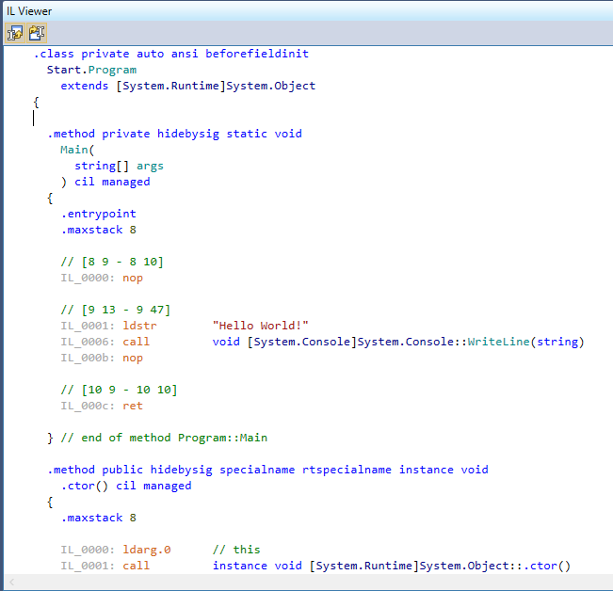
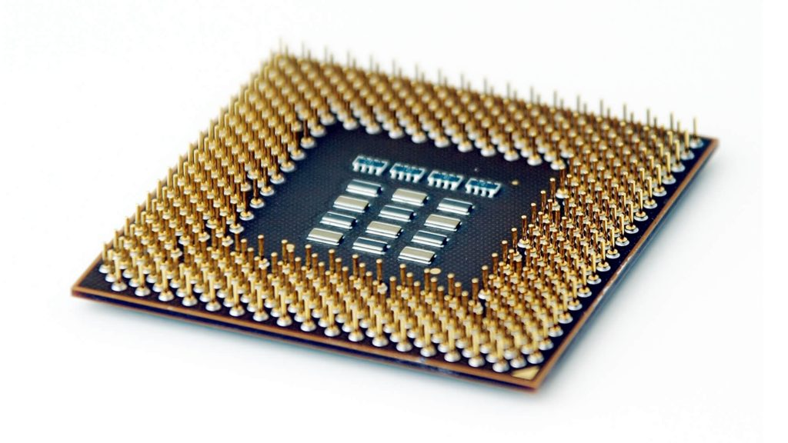
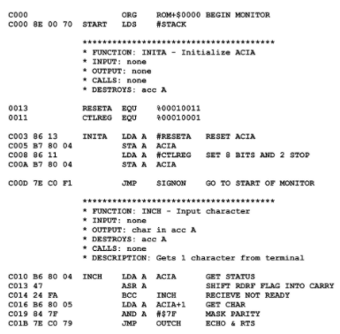
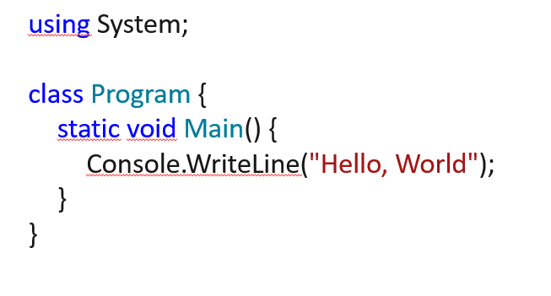
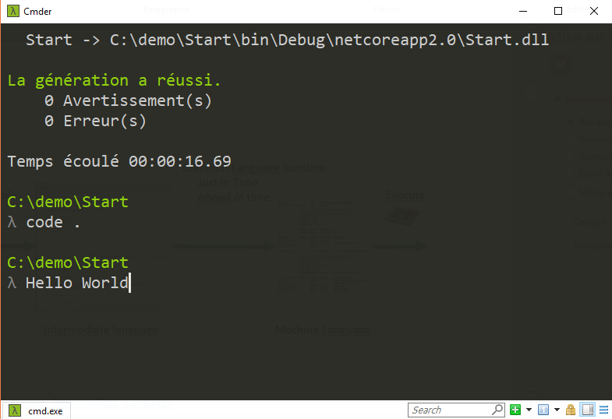
Common Language Runtime
(virtual machine)
Just In Time
Compile
Execute
Code
C#, F#, VB
Intermediate Language
Machine Language
https://en.wikipedia.org/wiki/Common_Intermediate_Language

Slide 11
Compile
Ahead of time
Execute
Code
C#, F#, VB
Machine Language
https://en.wikipedia.org/wiki/Common_Intermediate_Language

Slide 12
Asynchrony
Multithreaded
Parallelism

Slide 13
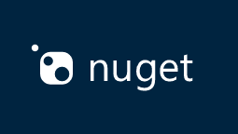
Nuget as package manager
https://www.nuget.org/

Slide 14
Lightness
Deployment flexibility
Multi-platform
Development tools
Open source
Supported by Microsoft
Notes:
Simon

Slide 15
.NET 8 is performant
https://www.techempower.com/benchmarks/

Slide 16
History of .NET
https://twitter.com/msdev_fr/status/1330891545285980162

Slide 17
.NET Vision - .NET 5 to 6 « wave »
Single SDK, one BCL, unified toolchain
Cross-plateform native UI
Cross-plateform web UI
Cloud native investments
Continue improvements in speed, size, diagnostics, Azure service
https://devblogs.microsoft.com/dotnet/the-future-of-net-standard

Slide 18
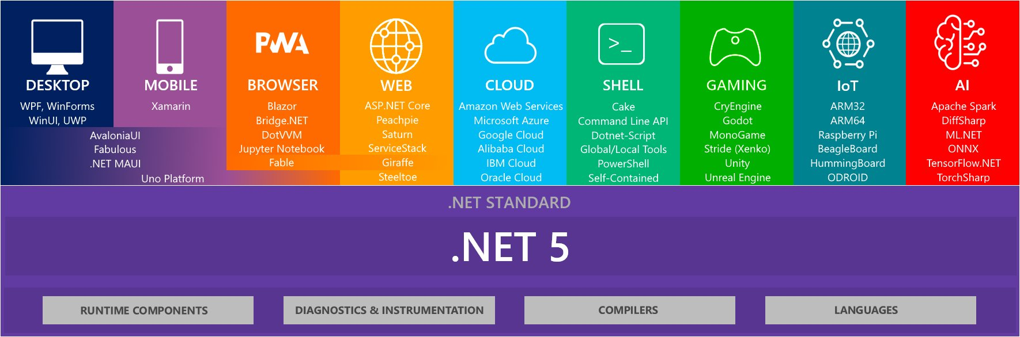
https://twitter.com/ben_a_adams/status/1307669860546215936/photo/1

Slide 19
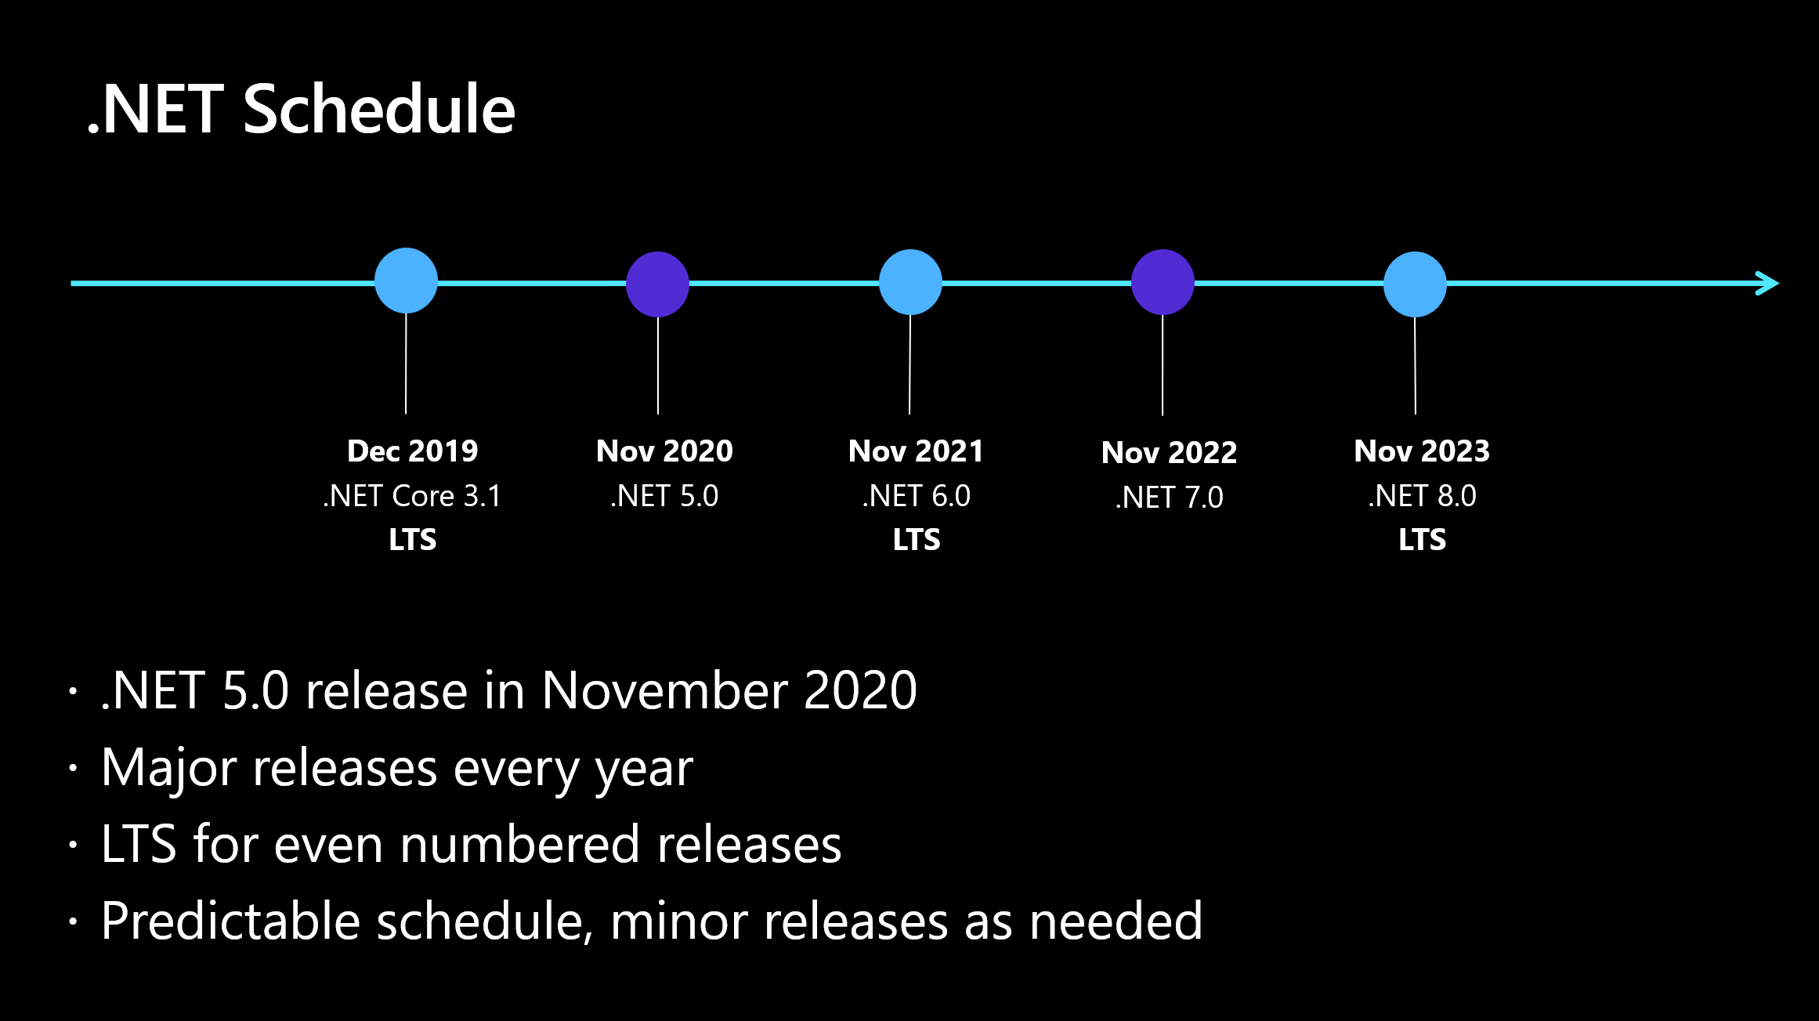

Slide 20
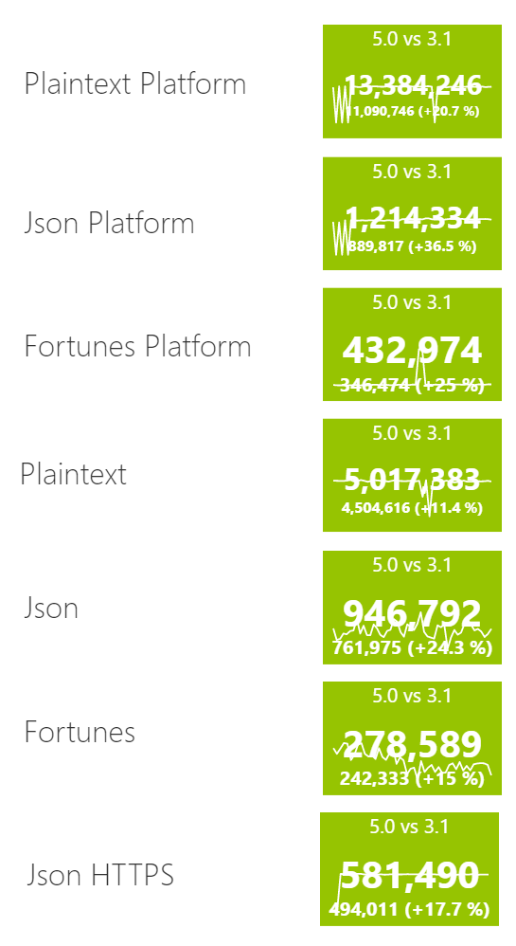
Progression axis
Performance
Lighter executable
Faster startup
https://www.techempower.com/benchmarks/

Slide 21
Use netstandard2.0 to share code between .NET Framework and all other platforms.
Use netstandard2.1 to share code between Mono, Xamarin, and .NET Core 3.x.
Use net5.0 for code sharing moving forward.
https://devblogs.microsoft.com/dotnet/the-future-of-net-standard

Slide 22
Dealing with OS-specific APIs
private static string GetLoggingDirectory() { if (OperatingSystem.IsWindows()) { using (RegistryKey key = Registry.CurrentUser.OpenSubKey(@"Software\Fabrikam")) { if (key?.GetValue("LoggingDirectoryPath") is string configuredPath) return configuredPath; } } string exePath = Process.GetCurrentProcess().MainModule.FileName; string folder = Path.GetDirectoryName(exePath); return Path.Combine(folder, "Logging"); }
https://devblogs.microsoft.com/dotnet/the-future-of-net-standard/

Slide 23
.NET 5 | .NET 6 | .NET 7
net5.0 | net6.0 | net7.0
 | net6.0-android | net7.0-android
 | net6.0-ios | net7.0-ios
net5.0-windows | net6.0-windows | net7.0-windows
net5.0-someoldos
https://devblogs.microsoft.com/dotnet/the-future-of-net-standard/

Slide 24
C#

Slide 25
C#
Imperative & Procedural
Object
Declarative (Functionnal)

Slide 26
C# Imperative
var amount = 0; var articlePrice = article.Price; switch (article.Category) { case "food": amount += articlePrice * 100 + articlePrice * 12; break; case "electronic": amount += articlePrice * 100 + articlePrice * 20 + 4; break; case "desktop": amount += articlePrice * 100 + articlePrice * 20; break; } amountTotal += amount * basketLineArticle.Number;

Slide 27
C# Procedural
public static int GetAmountTotal(List<BasketLineArticle> basketLineArticles) { var amountTotal = 0; foreach (var basketLineArticle in basketLineArticles) { var id = basketLineArticle.Id; var article = GetArticleFromDatabase(id); var amount = 0; var articlePrice = article.Price; switch (article.Category) { case "food": amount += articlePrice * 100 + articlePrice * 12; break; case "electronic": amount += articlePrice * 100 + articlePrice * 20 + 4; break; case "desktop": amount += articlePrice * 100 + articlePrice * 20; break; } amountTotal += amount * basketLineArticle.Number; } return amountTotal; } private static ArticleDatabase GetArticleFromDatabase(string id) {// return an article}

Slide 28
C# Object
public abstract class ArticleBase { public ArticleBase(string id, int price) { Id = id; Price = price; } public int Price { get; } public string Id { get; } public abstract int CalculateAmout(); } public class ArticleToy : ArticleBase { public ArticleToy(string id, int price) : base(id, price) { } public override int CalculateAmout() { var newPrice = Price -3 ; return newPrice * 100 + newPrice * 20; } }
var articleToy = new ArticleToy("id", 11);
articleToy.CalculateAmount()
Lifecycle
Inheritance

Slide 29
Declarative (functional)
How to obtain a state
int[] numbers = new int[7] { 0, 1, 2, 3, 4, 5, 6 }; var numQuery = from num in numbers where (num % 2) == 0 select num;

Slide 30
Hello world

Slide 31
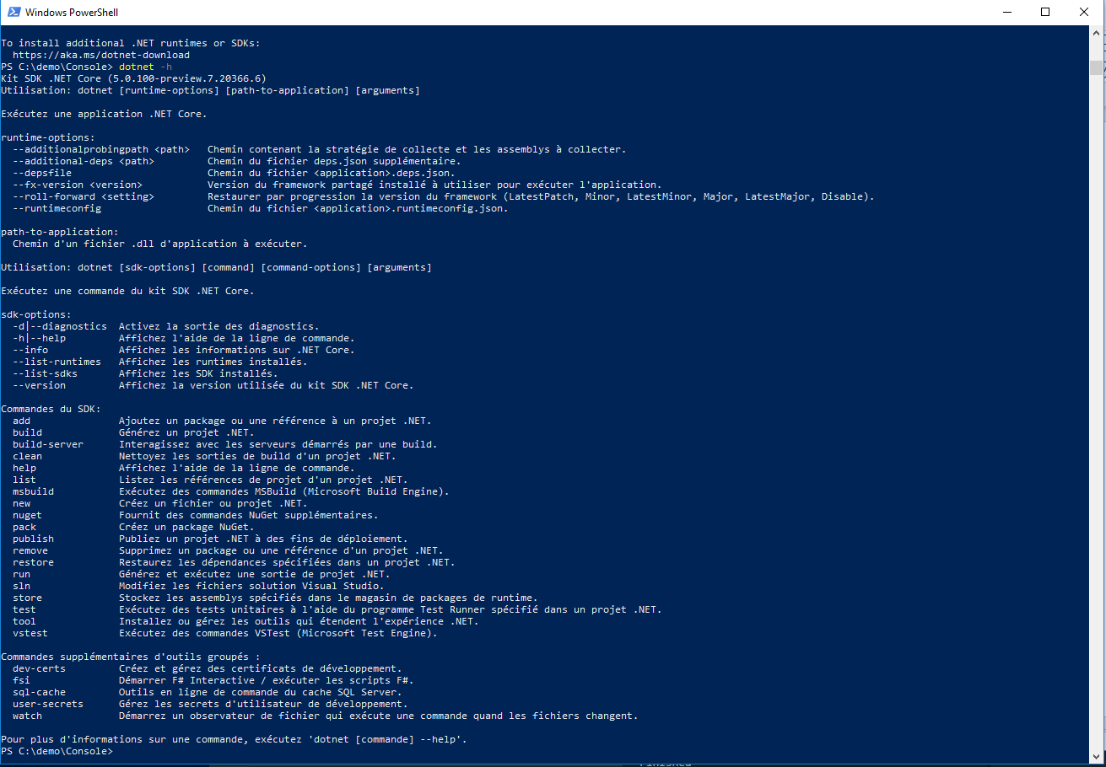
Dotnet cli
> dotnet --help

Slide 32
Hello world
Console.WriteLine("Hello, World");
> dotnet new console -o Demo
> cd Demo
> dotnet run
https://docs.microsoft.com/fr-fr/dotnet/csharp/tour-of-csharp/?WT.mc_id=DOP-MVP-5003370

Slide 33
Hello world old way
using System;
namespace Demo {
class Hello {
static void Main() {
Console.WriteLine("Hello, World");
}
}
}
https://docs.microsoft.com/fr-fr/dotnet/csharp/tour-of-csharp/?WT.mc_id=DOP-MVP-5003370

Slide 34
Demo.csproj
<Project Sdk="Microsoft.NET.Sdk">
<PropertyGroup>
<OutputType>Exe</OutputType>
<TargetFramework>net8.0</TargetFramework>
<ImplicitUsing>enable</ImplicitUsing>
<Nullable>enable</Nullable>
</PropertyGroup>
</Project>

Slide 35
Publish
> dotnet publish Demo.csproj -r win-x64 --self-contained=true /p:PublishSingleFile=true
Exemples de Runtime identifier :
win-x64
linux-x64
osx-x64
https://docs.microsoft.com/fr-fr/dotnet/core/rid-catalog?WT.mc_id=DOP-MVP-5003370
https://docs.microsoft.com/fr-fr/dotnet/core/tools/dotnet-publish?WT.mc_id=DOP-MVP-5003370

Slide 36
Publish Trim
dotnet publish Demo.csproj -r win-x64 --self-contained=true /p:PublishSingleFile=true /p:PublishTrimmed=true
From .net8 trim default is true
https://docs.microsoft.com/en-us/dotnet/core/deploying/trim-self-contained?WT.mc_id=DOP-MVP-5003370

Slide 37
Publish AOT
dotnet publish Demo.csproj -r win-x64 --self-contained=true /p:PublishTrimmed=true
<Project Sdk="Microsoft.NET.Sdk">
<PropertyGroup>
<OutputType>Exe</OutputType>
<TargetFramework>net8.0</TargetFramework>
<ImplicitUsing>enable</ ImplicitUsing>
<Nullable>enable</Nullable>
<PublishAot>true</PublishAot>
</PropertyGroup>
</Project>
Native AOT deployment overview - .NET | Microsoft Learn

Slide 38
Publish Release mode
dotnet publish Demo.csproj -r win-x64 -c Release --self-contained=true /p:PublishSingleFile=true /p:PublishTrimmed=true /p:PublishReadyToRun=true
https://docs.microsoft.com/fr-fr/dotnet/core/tools/dotnet-publish?WT.mc_id=DOP-MVP-5003370

Slide 39
Exercise
Install the lastest version of .NET 8
Use dotnet cli for building a «console» application named « Demo »
Publish your application as an independant executable file optimized for your OS

Slide 40
Global.json

Slide 41
Global.json
{
"sdk": {
"version": "2.2.200",
"rollForward": "latestMajor"
}
}
(disable, latestMajor, latestFeature, latestPatch)
> dotnet --list-sdks
> dotnet new globaljson --sdk-version 3.0.100
https://docs.microsoft.com/en-us/dotnet/core/tools/global-json ?WT.mc_id=DOP-MVP-5003370

Slide 42
Exercise
Generate « global.json » adapted to your current dotnet sdk version

Slide 43
Docker

Slide 44
Dockerfile
FROM mcr.microsoft.com/dotnet/sdk:8.0-preview AS build
WORKDIR /src
COPY . .
RUN dotnet publish "Demo.csproj" -c Release -r linux-x64 --self-contained=true /p:PublishSingleFile=true /p:PublishTrimmed=true /p:PublishReadyToRun=true -o /publish
FROM mcr.microsoft.com/dotnet/runtime-deps:8.0-preview AS final
WORKDIR /app
COPY --from=build /publish .
ENTRYPOINT ["/app/Demo"]
docker build . -t demo
docker run --rm demo
https://hub.docker.com/_/microsoft-dotnet-core

Slide 45
Dockerfile alpine
FROM mcr.microsoft.com/dotnet/sdk:8.0-preview AS build
WORKDIR /src
COPY . .
RUN dotnet publish "Demo.csproj" -c Release -r linux-musl-x64 --self-contained=true /p:PublishSingleFile=true /p:PublishTrimmed=true /p:PublishReadyToRun=true -o /publish
FROM mcr.microsoft.com/dotnet/runtime-deps:8.0-preview-alpine AS final
WORKDIR /app
COPY --from=build /publish .
ENTRYPOINT ["/app/Demo"]
docker build . -t demo
docker run --rm demo
https://hub.docker.com/_/microsoft-dotnet-core

Slide 46
Dockerfile alpine AOT
FROM mcr.microsoft.com/dotnet/sdk:8.0-preview-alpine AS build
WORKDIR /src
COPY . .
RUN apk add clang gcc lld musl-dev build-base zlib-dev krb5-dev
RUN dotnet publish "Demo.csproj" -c Release -r linux-musl-x64 /p:PublishAot=true /p:PublishTrimmed=true /p:PublishReadyToRun=true -o /publish
FROM docker.io/library/alpine:latest AS base
WORKDIR /app
COPY --from=build /publish .
ENV DOTNET_SYSTEM_GLOBALIZATION_INVARIANT=1
ENTRYPOINT ["/app/Demo"]
docker build . -t demo
docker run --rm demo

Slide 47
Docker security
Do not run your application in production with root user

Slide 48
Exercise
On windows install WSL 2
Install docker (use WSL 2)
Add a Dockerfile to your project
Build then execute a docker image to run your « Hello World »

Slide 49
From Hello world to Fibonacci
Introduction to the C# basis

Slide 50
Namespace
<Project Sdk="Microsoft.NET.Sdk">
<PropertyGroup>
<OutputType>Exe</OutputType>
<TargetFramework>net6.0</TargetFramework>
<ImplicitUsing>disabled</ImplicitUsing>
<Nullable>enable</Nullable>
</PropertyGroup>
</Project>
using System;
Console.WriteLine("Hello, World");
> dotnet build
https://docs.microsoft.com/fr-fr/dotnet/standard/assembly/?WT.mc_id=DOP-MVP-5003370

Slide 51
Namespace
System.Console.WriteLine("Hello, World");
Using System;
Console.WriteLine("Hello, World");
> dotnet build
https://docs.microsoft.com/fr-fr/dotnet/standard/assembly/?WT.mc_id=DOP-MVP-5003370

Slide 52
Class with Fibonacci
var fibonacci = new Fibonacci();
var result = fibonacci.Run(3);
class Fibonacci {
public int Run(int i) {
if(i<=2) return 1;
return Fib(i-2) + Fib(i-1);
}
}

Slide 53

Namespace
var fibonacci = new Leonardo.Fibonacci();
var result = fibonacci.Run(3);
namespace Leonardo {
class Fibonacci {
public int Run(int i) {
if(i<=2) return 1;
return Fib(i-2) + Fib(i-1);
}
}
}

Slide 54
Static method and class
var result = new Leonardo.Fibonacci.Run(3);
namespace Leonardo {
static class Fibonacci {
Public satic int Run(int i) {
if(i<=2) return 1;
return Fib(i-2) + Fib(i-1);
}
}
}

Slide 55
Arguments
System.Console.WriteLine("Hello " + args[0]);
dotnet run -- Guillaume
# Or
Demo.exe Guillaume

Slide 56
Arguments old way
class Program {
static void Main(string[] args) {
System.Console.WriteLine("Hello " + args[0]);
}
}
dotnet run -- Guillaume
# Or
Demo.exe Guillaume

Slide 57
Parse string to int
try {
int result = System.Int32.Parse(input);
System.Console.WriteLine(result);
} catch (FormatException) {
System.Console.WriteLine($"Unable to parse '{input}'");
}
https://docs.microsoft.com/fr-fr/dotnet/csharp/programming-guide/types/how-to-convert-a-string-to-a-number?WT.mc_id=DOP-MVP-5003370

Slide 58
Parse string to int
if (Int32.TryParse("-105", out int j)) Console.WriteLine(j);
else Console.WriteLine("String could not be parsed."); // Output: -105
https://docs.microsoft.com/fr-fr/dotnet/csharp/programming-guide/types/how-to-convert-a-string-to-a-number?WT.mc_id=DOP-MVP-5003370

Slide 59
Exercise
Create a program which take 1 argument as input and compute Fibbonacci from that argument
Run it: dotnet run -- 44

Slide 60
arguments

Slide 61
ReadLine
using System;
string line = Console.ReadLine();
if (line != null) Console.WriteLine("Result: " + line);

Slide 62
Demo.csproj
<Project Sdk="Microsoft.NET.Sdk">
<PropertyGroup>
<OutputType>Exe</OutputType>
<TargetFramework>net8.0</TargetFramework>
</PropertyGroup>
</Project>

Slide 63
Top level statements
int Fib(int i) {
if(i<=2) return 1; return Fib(i-2) + Fib(i-1); } System.Console.WriteLine(Fib(int.Parse(args[0])));
Top-level statements - C# tutorial | Microsoft Docs
dotnet run -- 24

Slide 64
Pattern matching
int Fib(int i) => i switch { int when i<=2 => 1, _ => Fib(i-2) + Fib(i-1) }; System.Console.WriteLine(Fib(int.Parse(args[0])));
https://www.youtube.com/watch?v=bEfBfBQq7EE&feature=youtu.be

Slide 65
Exercise
Re-factor your code to use top level statements
Re-factor « Fib » function in order to use Pattern matching
Run the program

Slide 66
My first F# Application

Slide 67
F# version
let rec Fib n = match n with | 1 | 2 -> 1 | n -> Fib(n-1) + Fib(n-2) let x = Fib(24) printf "%i" x

Slide 68
Exercise
Create a new console application using F# language
Run it
Update it with Fibonacci code
Run it
Download and install dotpeek (windows only) : https://www.jetbrains.com/decompiler
Open your .dll and inspect .il generic code

Slide 69
Array
We are going to compute many Fibonacci

Slide 70
Using « foreach » with arrays
int[] numbers = { 4, 5, 6, 1, 2, 3, -2, -1, 0 };
foreach (int i in numbers) {
System.Console.Write("{0} ", i);
}
// Output: 4 5 6 1 2 3 -2 -1 0
https://docs.microsoft.com/fr-fr/dotnet/csharp/language-reference/keywords/foreach-in?WT.mc_id=DOP-MVP-5003370

Slide 71
Using « for » with arrays
int[] numbers = { 4, 5, 6, 1, 2, 3, -2, -1, 0 };
for (int i = 0; i < numbers.Length; i++) {
Console.WriteLine(numbers[i]);
}
https://docs.microsoft.com/fr-fr/dotnet/csharp/language-reference/keywords/for ?WT.mc_id=DOP-MVP-5003370

Slide 72
Mesure time
using System;
using System.Collections.Generic;
using System.Threading.Tasks;
using System.Diagnostics;
Stopwatch stopwatch = new Stopwatch();
stopwatch.Start();
Thread.Sleep(2000);
stopwatch.Stop();
TimeSpan stopwatchElapsed = stopwatch.Elapsed;
Console.WriteLine(Convert.ToInt32(stopwatchElapsed.TotalSeconds));

Slide 73
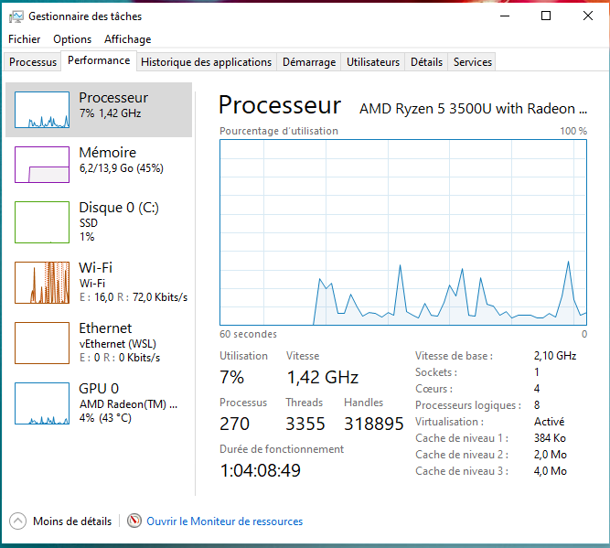
taskmgr

Slide 74
Exercise
Update the program to be able to take n argument as input and compute n Fibbonacci
Update your program to be able to mesure elapsed time
Run it with : dotnet run -- 44
Run it with : dotnet run -- 44 44 44 44
What do you see ?
Don’t forget to checkout your CPU

Slide 75
Task Introduction

Slide 76
Task
using System;
using System.Threading;
using System.Threading.Tasks;
Action<object> action = (object obj) => { Console.WriteLine("Task={0}, obj={1}, Thread={2}", Task.CurrentId, obj, Thread.CurrentThread.ManagedThreadId); };
Task t1 = new Task(action, "alpha");
t1.Start();
Console.WriteLine("t1 has been launched. (Main Thread={0})",
Thread.CurrentThread.ManagedThreadId);
t1.Wait();
https://docs.microsoft.com/fr-fr/dotnet/api/system.threading.tasks.task?view=netcore-3.1&WT.mc_id=DOP-MVP-5003370

Slide 77
Task<TResult>
using System;
using System.Threading.Tasks;
var t = Task<int>.Run( () => {
// Just loop.
int max = 1000000; int ctr = 0;
for (ctr = 0; ctr <= max; ctr++) {
if (ctr == max / 2 && DateTime.Now.Hour <= 12) { ctr++; break; }
}
return ctr; } );
Console.WriteLine("Finished {0:N0} iterations.", t.Result); } }
// The example displays output like the following:
// Finished 1,000,001 loop iterations.
https://docs.microsoft.com/en-us/dotnet/api/system.threading.tasks.task-1?view=netcore-3.1&WT.mc_id=DOP-MVP-5003370

Slide 78
Exercise
Update the program in order to use Task<int>
Run it with : dotnet run -- 44
Run it with : dotnet run -- 44 44 44 44
What do you see ?
Don’t forget to checkout your CPU

Slide 79
Code Editor

Slide 80


Visual Studio + Resharper
Rider

Slide 81

Jetbrain rider

Slide 82
Code
Refactor
Debug

Slide 83
Exercise
Install Visual Studio + Resharper or Rider
Set up Visual Studio Key Scheme for Resharper or Rider
Debug and observe Thread

Slide 84
Parallel Programming
We would like to know why and when it should be used.

Slide 85
Parallel programming
string[] files = Directory.GetFiles(@"C:\\Pictures\Sample Pictures", "*.jpg");
Parallel.ForEach(files, (currentFile) => {
// The more computational work you do here, the greater
// the speedup compared to a sequential foreach loop. Console.WriteLine($"Processing {filename} on thread { Thread.CurrentThread.ManagedThreadId}");
});
https://docs.microsoft.com/en-us/dotnet/standard/parallel-programming/how-to-write-a-simple-parallel-foreach-loop &WT.mc_id=DOP-MVP-5003370

Slide 86
Parallel lock
var o = new object(); var results = new List<int>(); Parallel.ForEach(args, (arg) => { var result = Fib(int.Parse(arg)); lock (o) { results.Add(result); } });

Slide 87
Concurrent collection
var results = new ConcurrentBag<int>(); Parallel.ForEach(args, (arg) => { var result = Fib(int.Parse(arg)); results.Add(result); });

Slide 88
ParallelOptions
var parallelOptions = new ParallelOptions(); parallelOptions.MaxDegreeOfParallelism = System.Environment.ProcessorCount ; var results = new ConcurrentBag<int>(); Parallel.ForEach(args, parallelOptions, (arg) => { var result = Fib(int.Parse(arg)); results.Add(result); });

Slide 89
Exercise
Warning: We won’t keep these modifications
Copy the project:
xcopy "../Demo" "../DemoParallel" /E/H
Remove the use of Task<int> and use « Parallel.ForEach » instead
https://docs.microsoft.com/fr-fr/windows-server/administration/windows-commands/xcopy?WT.mc_id=DOP-MVP-5003370

Slide 90
Project organization
We are going to re-organize the project and extract the Main code into an independant library

Slide 91
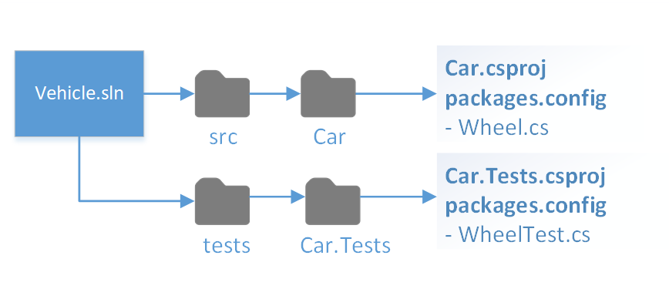
Project structure
https://docs.microsoft.com/fr-fr/dotnet/core/porting/project-structure?WT.mc_id=DOP-MVP-5003370

Slide 92
cd..
mkdir Fibonacci
mkdir Fibonacci\src
move .\Demo .\Fibonacci\src
cd Fibonacci

Slide 93
Project solution file: sln
dotnet new sln
dotnet sln Fibonacci.sln add .\src\Demo\Demo.csproj
type Fibonacci.sln

Slide 94
Library : Leonardo.csproj
<Project Sdk="Microsoft.NET.Sdk">
<PropertyGroup>
<TargetFramework>net8.0</TargetFramework>
</PropertyGroup>
</Project>
dotnet new classlib -o .\src\Leonardo

Slide 95
.\src\Leonardo\Fibonacci.cs
using System; using System.Collections.Generic; using System.Threading.Tasks; namespace Leonardo { public static class Fibonacci { public static Task<IList<int>> async RunAsync(string[] args) { var tasks = new List<int>();
await Task.Delay(2000);
return results; } } }
https://docs.microsoft.com/fr-fr/dotnet/csharp/programming-guide/classes-and-structs/static-classes-and-static-class-members?WT.mc_id=DOP-MVP-5003370

Slide 96
Add reference between projects
dotnet add .\src\Demo\Demo.csproj reference .\src\Leonardo\Leonardo.csproj
<Project Sdk="Microsoft.NET.Sdk"> <ItemGroup> <ProjectReference Include="..\..\src\Leonardo\Leonardo.csproj" /> </ItemGroup> </Project>

Slide 97
Exercise => use command line
Re-organize your project in order to respect dotnet project file structure :
.\fibonacci.sln
.\src\Leonardo\Leonardo.csproj // You should create a new project library
.\src\Demo\Demo.csproj
Move the code from « .\src\Demo\Program.cs » to « .\src\Leonardo\Fibonacci.cs » in order to implements // « Demo » must reference and use your new Leonardo library

Slide 98
Unit test

Slide 99
.\tests\Leonardo.Tests.csproj
<Project Sdk="Microsoft.NET.Sdk"> <PropertyGroup> <TargetFramework>net6.0</TargetFramework> <IsPackable>false</IsPackable> </PropertyGroup> <ItemGroup> <PackageReference Include="Microsoft.NET.Test.Sdk" Version="16.9.4" /> <PackageReference Include="xunit" Version="2.4.1" /> <PackageReference Include="xunit.runner.visualstudio" Version="2.4.3"> <IncludeAssets>runtime; build; native; contentfiles; analyzers; buildtransitive</IncludeAssets> <PrivateAssets>all</PrivateAssets> </PackageReference> <PackageReference Include="coverlet.collector" Version="3.0.2"> <IncludeAssets>runtime; build; native; contentfiles; analyzers; buildtransitive</IncludeAssets> <PrivateAssets>all</PrivateAssets> </PackageReference> </ItemGroup> </Project>
dotnet new xunit -o .\tests\Leonardo.Tests

Slide 100
using Xunit; namespace Leonardo.Tests { public class LeonardoUnitTest { [Fact] public void Execute6ShouldRetrun8() { var result = Leonardo.Fibonacci.RunAsync(new[] {"6"}); Assert.Equal(8, result[0]); } } }

Slide 101
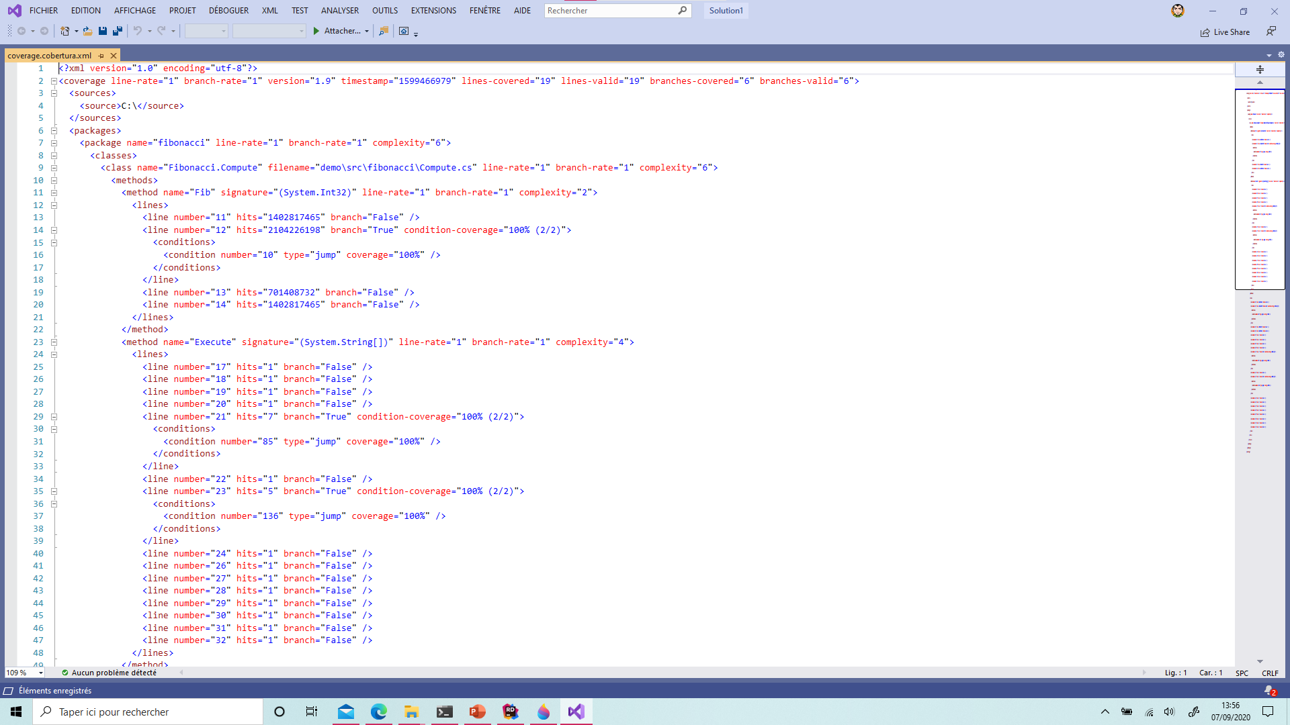
cd .\tests\Leonardo.Tests
dotnet test --collect:"XPlat Code Coverage"
https://github.com/coverlet-coverage/coverlet

Slide 102
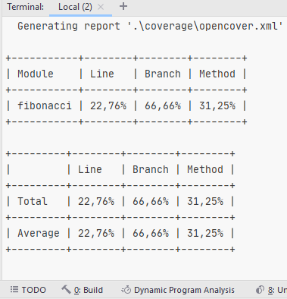
Coverlet
dotnet test --collect:"XPlat Code Coverage" -- DataCollectionRunSettings.DataCollectors.DataCollector.Configuration.Format=json,cobertura,lcov,teamcity,opencover
dotnet add package coverlet.msbuild
dotnet test /p:CollectCoverage=true /p:CoverletOutputFormat=opencover /p:CoverletOutput=./coverage/opencover.xml
https://github.com/coverlet-coverage/coverlet

Slide 103
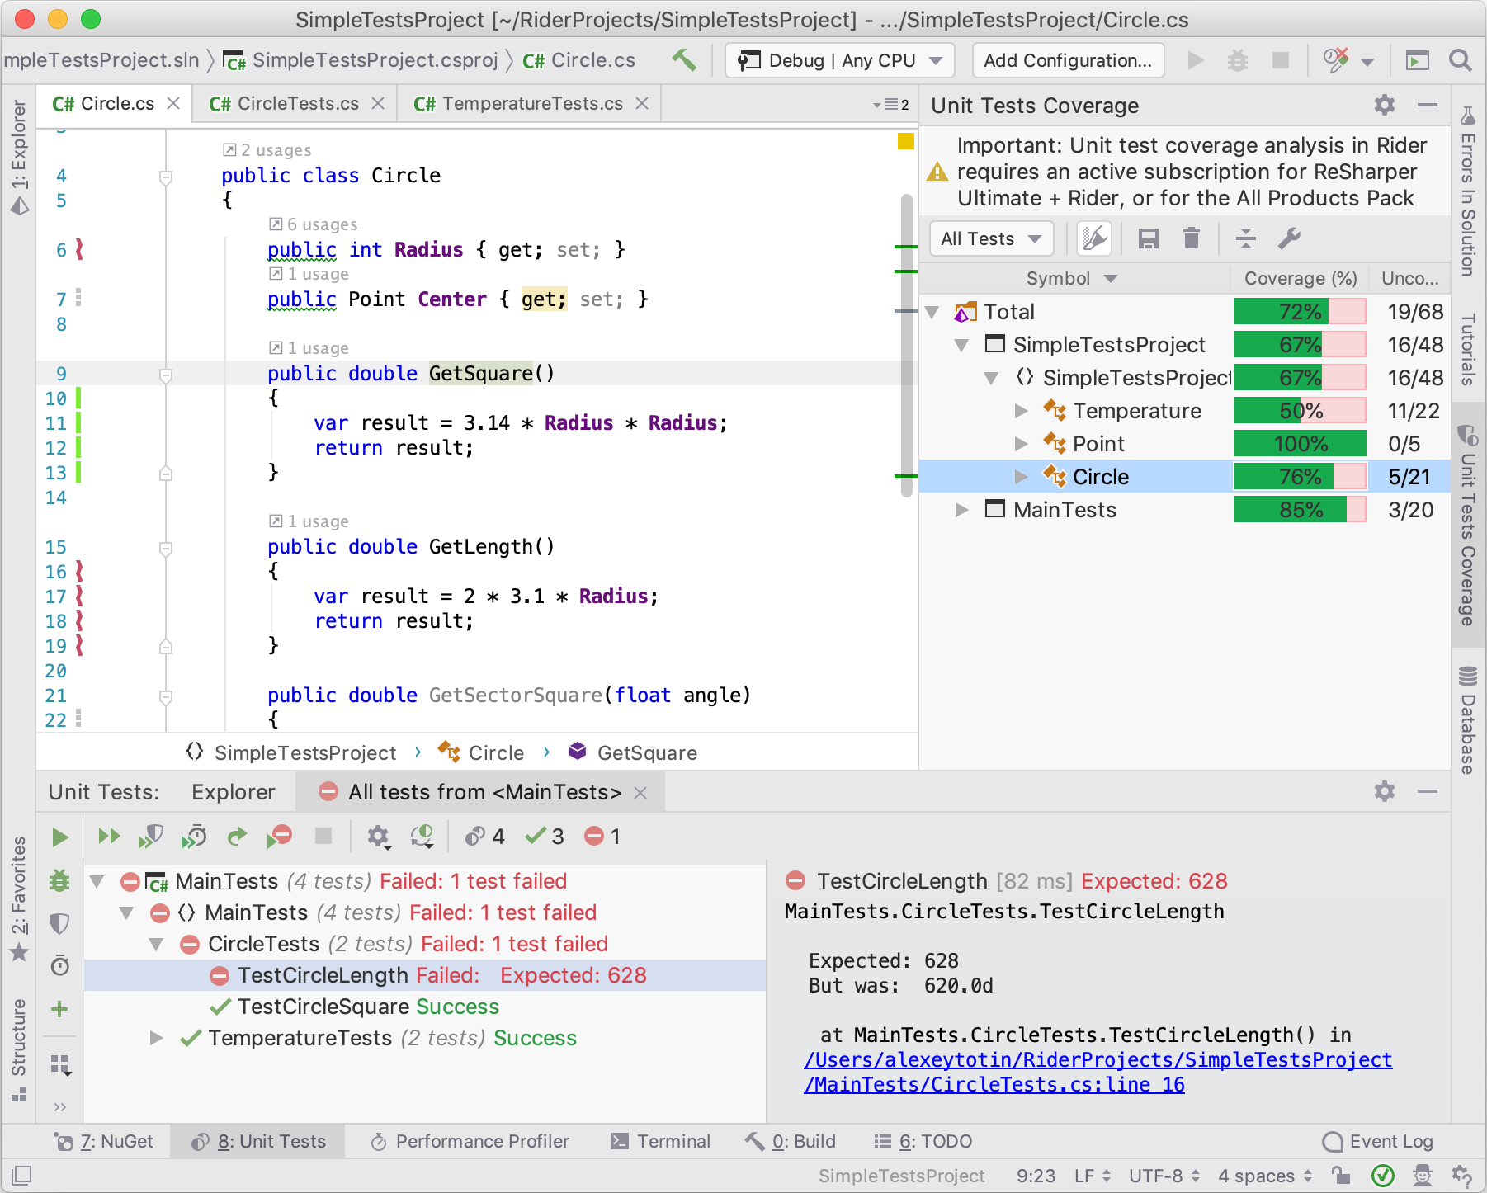
https://blog.jetbrains.com/dotnet/2019/04/10/code-coverage-macos-linux-rider-2019-1/

Slide 104
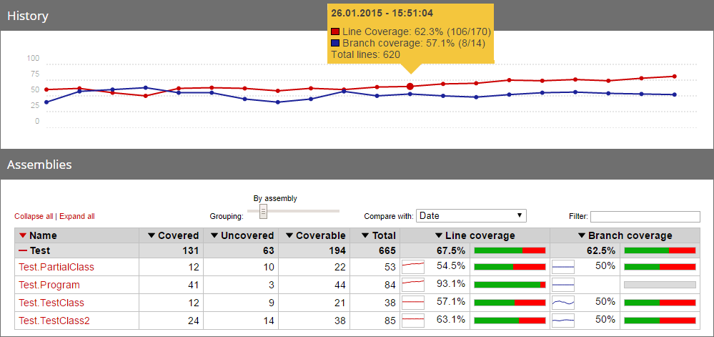
ReportGenerator
dotnet tool install dotnet-reportgenerator-globaltool --tool-path tools
# Windows only
tools\reportgenerator.exe "-reports:coverage\opencover.xml" "-targetdir:report"
# Linux,macos only
Tools/reportgenerator "-reports:coverage/opencover.xml" "-targetdir:report"
https://github.com/danielpalme/ReportGenerator

Slide 105
Exercise, use command line
Add a xunit tests project which test .\src\Leonardo\ Leonardo.csproj // you should respect dotnet project convention
Generate code coverage and use ReportGenerator in order to build an html builtin result

Slide 106
Add web API

Slide 107
Fibonacci.Web.csproj
<Project Sdk="Microsoft.NET.Sdk.Web"> <PropertyGroup> <TargetFramework>net8.0</TargetFramework>
<Nullable>enable</Nullable>
<ImplicitUsings>enable</ImplicitUsings> </PropertyGroup> </Project>
dotnet new web -o .\src\Leonardo.Web

Slide 108
var builder = WebApplication.CreateBuilder(args); var app = builder.Build(); app.MapGet("/Fibonacci",
async () => await Leonardo.Fibonacci.RunAsync(new []{"44", "43"})); app.Run();
https://docs.microsoft.com/en-us/dotnet/api/microsoft.aspnetcore.webhost.createdefaultbuilder?view=aspnetcore-3.1

Slide 109
Automatic reload
cd .\src\Leonardo.Web
dotnet watch

Slide 110
Dockerfile
FROM mcr.microsoft.com/dotnet/sdk:8.0-preview AS build WORKDIR /src COPY . . RUN dotnet publish "./src/Leonardo.Web/Leonardo.Web.csproj" -c Release -r linux-musl-x64 --self-contained=true /p:PublishSingleFile=true /p:PublishTrimmed=true /p:PublishReadyToRun=true -o /publish FROM mcr.microsoft.com/dotnet/runtime-deps:8.0-alpine-preview AS final WORKDIR /app COPY --from=build /publish . ENTRYPOINT ["/app/Leonardo.Web"]
docker build . -t web
docker run -p 5003:80 --rm web

Slide 111
Exercise
Create an api using « dotnet new web »
Update the code in order to use Leonardo library
Run it and test it
Create a dockerfile
Run your application from docker
docker build . -t web
docker run -p 5003:80 --rm web

Slide 112
Open Source your project to Github
https://github.com

Slide 113

Github
dotnet new gitignore
cd..
git clone https://github.com/your-account/dotnet-fibonacci
move .\Fibonacci .\dotnet-fibonacci
git add .
git commit –m "update"
git push --set-upstream origin master
https://github.com/

Slide 114
Continuous integration with Github Actions
https://github.com

Slide 115
Main.yml
name: CI on: push: branches: [ master ] pull_request: branches: [ master ] jobs: build: runs-on: ubuntu-latest steps: - uses: actions/checkout@v2 - uses: actions/setup-dotnet@v3 with: global-json-file: global.json - run: dotnet test /p:CollectCoverage=true /p:CoverletOutputFormat=opencover /p:CoverletOutput=./coverage/opencover.xml - run: dotnet publish ./src/Leonardo.Web/Leonardo.Web.csproj --self-contained true --output ./win-x64/fibonacci -c Release -r win-x64 /p:PublishSingleFile=true /p:PublishTrimmed=true /p:PublishReadyToRun=true - name: Upload WebApp1 Build Artifact uses: actions/upload-artifact@v2 with: name: Publish win-x64 Fibonacci path: ./win-x64/fibonacci

Slide 116
Exercise
Open source your project on github (don’t forget .gitignore)
Add a continuous integration using GihubActions and .yml file
Run unit test
Build publish « Demo » executable as output in the artifact

Slide 117
Continuous integration with Azure DevOps
https://azure.microsoft.com/en-us/services/devops

Slide 118
Azure-pipelines.yml
pool:
vmImage: "Ubuntu 16.04"
steps:
- task: DotNetCoreInstaller@0
displayName: "Use .NET Core sdk 5.0.101"
inputs:
version: 5.0.101
- task: DotNetCoreCLI@2
displayName: "dotnet test"
inputs:
command: test
projects: "**/*tests.csproj"
arguments: '--configuration $(BuildConfiguration) /p:CollectCoverage=true /p:CoverletOutputFormat=opencover /p:CoverletOutput=./coverage/opencover.xml'
- task: DotNetCoreCLI@2
displayName: Publish
inputs:
command: publish
publishWebProjects: True
arguments: "--configuration $(BuildConfiguration) --output $(Build.ArtifactStagingDirectory) -r win-x64 --self-contained=true /p:PublishSingleFile=true /p:IncludeNativeLibrariesInSingleFile=true -f net5.0 /p:AssemblyVersion=1.0.0.0"
zipAfterPublish: True
- task: PublishBuildArtifacts@1
displayName: "Publish Artifact: $(Build.DefinitionName)-Artifact"
inputs:
ArtifactName: "$(Build.DefinitionName)-Artifact"
https://github.com/axa-group/radar/blob/master/azure-pipelines.yml

Slide 119
Exercise
Open source your project on github (don’t forget .gitignore)
Add a continuous integration using AzureDevops and azure-pipeline.yml file
Run unit test
Build publish .zip of « Demo » as output in the artifact

Slide 120
Exercise Sonar
Create personal login on Sonar Cloud
https://sonarcloud.io/
Add code analyses to sonar cloud in your CI (Continuous Integration)

Slide 121
Exercise Docker
Create personal login on Docker Hub https://hub.docker.com/
Add following feature in your CI
Build Demo Dockerfile
Push your image to your personal docker registry

Slide 122
Publish library to Nuget

Slide 123
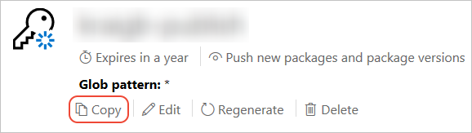
Publish to nuget.org
https://www.nuget.org/users/account/LogOn?returnUrl=%2F
https://docs.microsoft.com/fr-fr/nuget/nuget-org/publish-a-package?WT.mc_id=DOP-MVP-5003370#create-api-keys

Slide 124
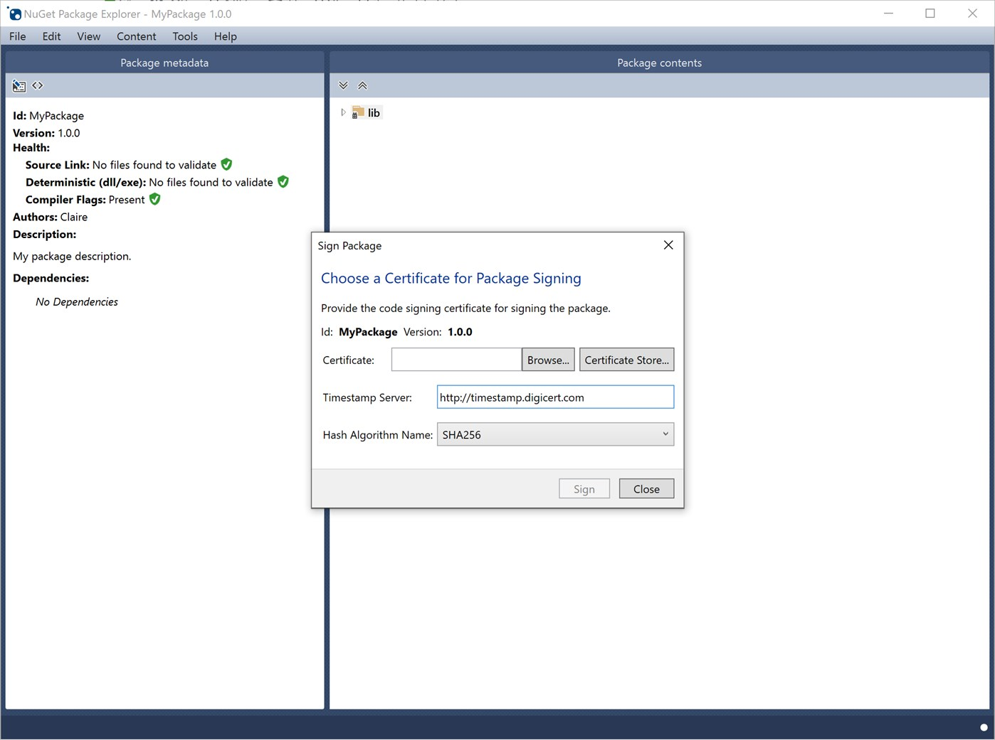
https://github.com/NuGetPackageExplorer/NuGetPackageExplorer

Slide 125
Build package
dotnet pack .\src\Leonardo\Leonardo.csproj -p:PackageVersion=1.0.0
https://docs.microsoft.com/en-us/dotnet/core/tools/dotnet-pack?WT.mc_id=DOP-MVP-5003370

Slide 126
PackageId
<Project Sdk="Microsoft.NET.Sdk"> <PropertyGroup> <TargetFramework>net6.0</TargetFramework> <PackageId>Guillaume.Chervet.Fibonacci</PackageId> </PropertyGroup> </Project>
https://docs.microsoft.com/fr-fr/dotnet/core/tools/csproj?WT.mc_id=DOP-MVP-5003370

Slide 127
Publish
dotnet nuget push .\src\Leonardo\bin\Debug\Guillaume.Chervet.Leonardo.1.0.0.nupkg --api-key YOUR_API_KEY --source https://api.nuget.org/v3/index.json
https://docs.microsoft.com/fr-fr/nuget/nuget-org/publish-a-package?WT.mc_id=DOP-MVP-5003370

Slide 128
Exercise
Rename you PackageId using this pattern :
Firstname.Lastname.Fibonacci
Publish your package on Nuget

Slide 129
Consume package from Nuget

Slide 130
PackageReference
dotnet add package Guillaume.Chervet.Fibonacci --version 1.0.0
<Project Sdk="Microsoft.NET.Sdk"> <ItemGroup> <PackageReference Include="Guillaume.Chervet.Fibonacci" Version="1.0.0" /> </ItemGroup> <PropertyGroup> <OutputType>Exe</OutputType> <TargetFramework>net6.0</TargetFramework> </PropertyGroup> </Project>

Slide 131
Exercise
Create new a console application name « ConsumeFromNuget »
Consume your package from nuget add the necessary code to make it works
Run the application

Slide 132
Azure
https://signup.azure.com/signup?WT.mc_id=DOP-MVP-5003370

Slide 133
C# Language

Slide 134
C# Language
Object Type / Value Type
https://docs.microsoft.com/en-us/dotnet/csharp/programming-guide/classes-and-structs/objects?WT.mc_id=DOP-MVP-5003370
Object
https://docs.microsoft.com/fr-fr/dotnet/api/system.object?WT.mc_id=DOP-MVP-5003370
https://docs.microsoft.com/en-us/dotnet/csharp/programming-guide/classes-and-structs/inheritance?WT.mc_id=DOP-MVP-5003370
https://docs.microsoft.com/fr-fr/dotnet/csharp/language-reference/keywords/interface?WT.mc_id=DOP-MVP-5003370
https://docs.microsoft.com/en-us/dotnet/api/system.idisposable?WT.mc_id=DOP-MVP-5003370
Casting
https://docs.microsoft.com/en-us/dotnet/csharp/programming-guide/types/casting-and-type-conversions?WT.mc_id=DOP-MVP-5003370
Basket Demo Imperative/Object/Declarative
https://github.com/guillaumechervet/course.designpattern/tree/feature/oo-vs-fp/src/Basket

Slide 135
Add sqlserver database

Slide 136
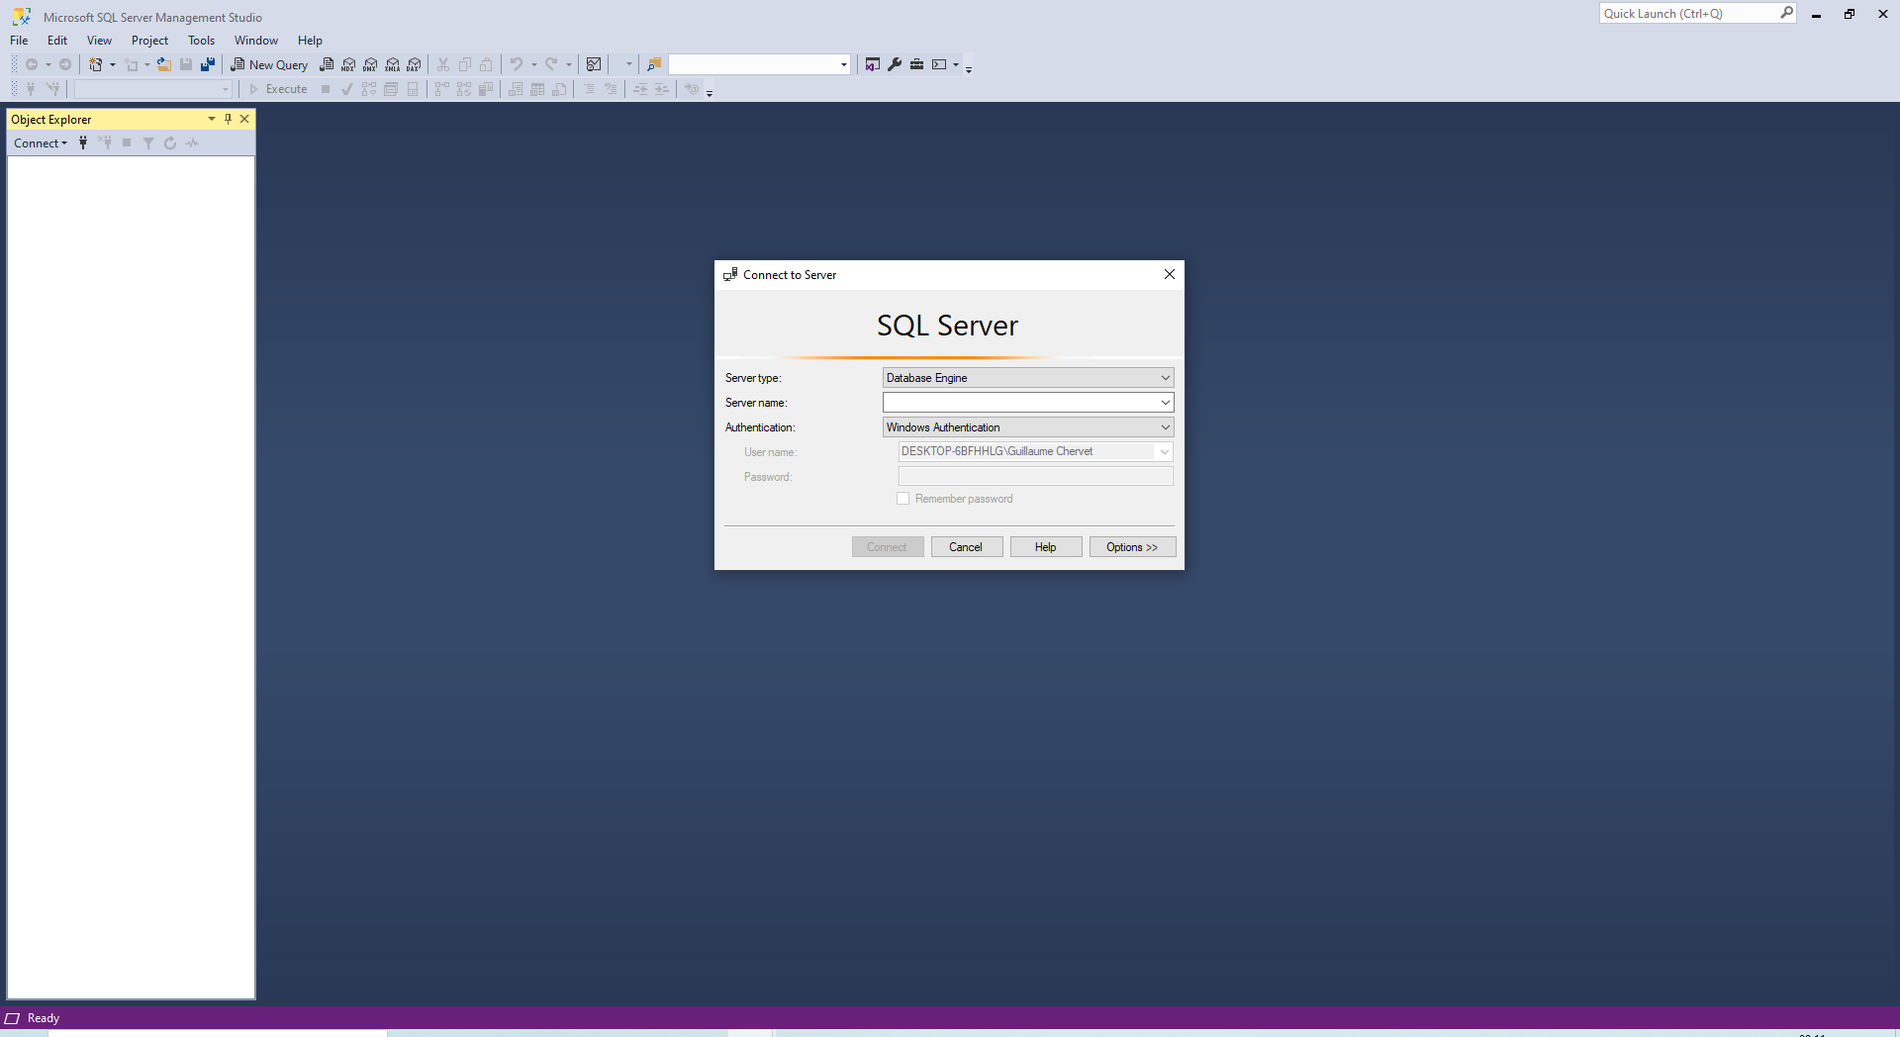
Sql server management studio
https://docs.microsoft.com/fr-fr/sql/ssms/download-sql-server-management-studio-ssms?WT.mc_id=DOP-MVP-5003370

Slide 137
docker-compose.yml
version: "3.8"
services:
database:
build: ./sqlserver
container_name: "fibonacci_db"
ports:
- "1433:1433"
environment:
SA_PASSWORD: "Your_password123"
ACCEPT_EULA: "Y"

Slide 138
./sqlserver/dockerfile
FROM mcr.microsoft.com/mssql/server
ENV ACCEPT_EULA=Y
ENV SA_PASSWORD=Your_password123
COPY ./ /
ENTRYPOINT [ "/bin/bash", "entrypoint.sh" ]
CMD [ "/opt/mssql/bin/sqlservr" ]

Slide 139
./sqlserver/entrypoint.sh
#!/bin/bash
set -e
if [ "$1" = '/opt/mssql/bin/sqlservr' ]; then
if [ ! -f /tmp/app-initialized ]; then
function initialize_app_database() {
sleep 40s
/opt/mssql-tools/bin/sqlcmd -S localhost -U sa -P Your_password123 -d master -i ./initBase.sql
touch /tmp/app-initialized
}
initialize_app_database &
fi
fi
exec "$@"

Slide 140
./sqlserver/initBase.sql
USE [master]
CREATE DATABASE FibonacciData
GO USE FibonacciData
GO
CREATE SCHEMA sch_fib AUTHORIZATION [dbo];
GO
CREATE TABLE [sch_fib].[T_Fibonacci](
[FIB_Id] uniqueidentifier NOT NULL DEFAULT newid(),
[FIB_ Input] [int] NOT NULL,
[FIB_ Output] [bigint] NOT NULL,
CONSTRAINT [PK_Fibonacci] PRIMARY KEY CLUSTERED ([FIB_Id]))
https://docs.microsoft.com/en-us/dotnet/framework/data/adonet/sql-server-data-type-mappings?WT.mc_id=DOP-MVP-5003370

Slide 141
Reverse Engineering
dotnet add package Microsoft.EntityFrameworkCore.SqlServer
dotnet tool install --global dotnet-ef
dotnet add package Microsoft.EntityFrameworkCore.Design
dotnet ef dbcontext scaffold "Data Source=localhost,1433;Initial Catalog=FibonacciData;Integrated Security=False;User ID=sa;Password=Your_password123;MultipleActiveResultSets=True" Microsoft.EntityFrameworkCore.SqlServer
https://docs.microsoft.com/fr-fr/ef/core/managing-schemas/scaffolding?tabs=dotnet-core-cli&WT.mc_id=DOP-MVP-5003370

Slide 142
Evolving your model
# Linux only
export PATH="$PATH:$HOME/.dotnet/tools/"
public partial class T_Fibonacci { public Guid FibId { get; set; } public int FibInput { get; set; } public long FibOutput { get; set; } public DateTime FibCreatedTimestamp { get; set; } }
dotnet ef migrations add InitialCreate
dotnet ef migrations add AddFibFibonacciCreatedTimestamp
dotnet ef database drop
dotnet ef database update AddFibFibonacciCreatedTimestamp
https://docs.microsoft.com/fr-fr/ef/core/managing-schemas/migrations?WT.mc_id=DOP-MVP-5003370

Slide 143
Select
using (var fibonacciDataContext = new FibonacciDataContext()) { var result = await fibonacciDataContext.TFibonaccis.Where(f => f.FibInput == 44) .Select(f => f.FibOutput).FirstOrDefaultAsync(); if (result != default(long)) { … }
}
Eager loader
Explicit Loading
Lazy loading
https://docs.microsoft.com/en-us/ef/core/querying/related-data/eager?WT.mc_id=DOP-MVP-5003370

Slide 144
Insert
using (var fibonacciDataContext = new FibonacciDataContext()) { fibonacciDataContext.TFibonaccis.Add(new TFibonacci() { FibInput = 44, FibCreatedTimestamp = DateTime.Now, FibOutput = 888888 });
fibonacciDataContext.TFibonaccis.Add(new TFibonacci() { FibInput = 32, FibCreatedTimestamp = DateTime.Now, FibOutput = 666 }); await fibonacciDataContext.SaveChangesAsync(); return results; } }

Slide 145
Update
using (var fibonacciDataContext = new FibonacciDataContext()) { var fibonacci = await fibonacciDataContext.TFibonaccis.Where(f => f.FibInput == 44) .FirstOrDefaultAsync(); fibonacci.FibOutput = 777;
await fibonacciDataContext.SaveChangesAsync();
}

Slide 146
Delete
using (var fibonacciDataContext = new FibonacciDataContext()) { var fibonacci = await fibonacciDataContext.TFibonaccis.Where(f => f.FibInput == 44) .FirstOrDefaultAsync(); fibonacciDataContext.TFibonaccis.Remove(fibonacci);
await fibonacciDataContext.SaveChangesAsync();
}

Slide 147
Exercise
Add a docker-compose which run SQL Server and its init SQL script
Reverse engineer the database to generate C# DataContext in your Fibonacci Library
Add FibCreatedTimestamp property to your C# class and update the database
Update the code in order to use your database. You must add a cache system to your fibonacci Library

Slide 148
unit test in memory context
Problem the unit test is coupled to the Database

Slide 149
Fibonacci.cs \\ Dependency injection
namespace Leonardo { public class Fibonacci { private readonly FibonacciDataContext _fibonacciDataContext; public Fibonacci(FibonacciDataContext fibonacciDataContext) { _fibonacciDataContext = fibonacciDataContext; } public async Task<IList<int>> RunAsync(string[] args) { var result = await _fibonacciDataContext.TFibonaccis.Where(f => f.FibInput == 44) .Select(f => f.FibOutput).FirstOrDefaultAsync(); return new List<int>(); } } }
https://docs.microsoft.com/en-us/dotnet/csharp/programming-guide/classes-and-structs/objects?WT.mc_id=DOP-MVP-5003370

Slide 150
Program.cs
using System; using System.Threading.Tasks; using Leonardo; namespace Demo { public class Program { public static async Task Main(string[] args) { using (var fibonacciDataContext = new FibonacciDataContext()) { var fibonacci= new Fibonacci(fibonacciDataContext); var results = await fibonacci.RunAsync(args); foreach (var fibonacci in results) Console.WriteLine($"Result is {fibonacci}"); } } } }

Slide 151
InMemory Context
dotnet add package Microsoft.EntityFrameworkCore.InMemory
var builder = new DbContextOptionsBuilder<FibonacciDataContext>(); var dataBaseName = Guid.NewGuid().ToString(); builder.UseInMemoryDatabase(dataBaseName); var options = builder.Options; var fibonacciDataContext = new FibonacciDataContext(options); await fibonacciDataContext.Database.EnsureCreatedAsync();
https://docs.microsoft.com/en-us/ef/core/providers/in-memory?WT.mc_id=DOP-MVP-5003370

Slide 152
Exercise
Refactor « Fibonacci.cs » in order to inject the « DataContext »
Update « Program.cs »
Run the « Demo.exe »
Update the unittest in order to use an InMemory Database
Run your the unittest

Slide 153
SQL One to Many

Slide 154
Log SQL Query
protected override void OnConfiguring(DbContextOptionsBuilder optionsBuilder) { if (!optionsBuilder.IsConfigured) { optionsBuilder.UseLoggerFactory(MyLoggerFactory).UseSqlServer( "Data Source=localhost,1433;Initial Catalog=FibonacciData;Integrated Security=False;User ID=sa;Password=Your_password123;MultipleActiveResultSets=True"); } } public static readonly ILoggerFactory MyLoggerFactory = LoggerFactory.Create(builder => { builder.AddConsole(); });
https://docs.microsoft.com/en-us/ef/core/miscellaneous/logging?WT.mc_id=DOP-MVP-5003370

Slide 155
Log SQL Query
dotnet add package Microsoft.Extensions.Logging
dotnet add package Microsoft.Extensions.Logging.Abstractions
dotnet add package Microsoft.Extensions.Logging.Console

Slide 156
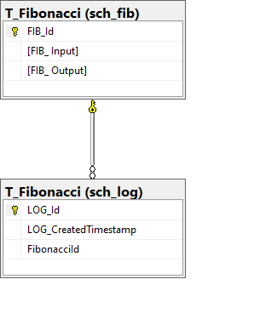
One to Many
public class TFibonacci { public Guid FibId { get; set; } public int FibInput { get; set; } public long FibOutput { get; set; } public IList<TLog> FibLogs { get; set; } } public class Log { public Guid Id { get; set; } public DateTime CreatedTimestamp { get; set; } public TFibonacci Fibonacci { get; set; } public Guid FibonacciId { get; set; } }
https://entityframework.net/one-to-many-relationship

Slide 157
Using fluent api
protected override void OnModelCreating(ModelBuilder modelBuilder) { // mapping ...
modelBuilder.Entity<Log>(entity => { // mapping ... modelBuilder.Entity<Log>() .HasOne(t => t.Fibonacci) .WithMany(t => t.FibLogs) .HasForeignKey(k => k.FibonacciId); }); OnModelCreatingPartial(modelBuilder); }

Slide 158
Insert with links
fibonacciDataContext.TFibonaccis.Add(new TFibonacci { FibInput = Convert.ToInt32(args[index]), FibOutput = value.Result, FibLogs = new List<Log>() {new Log() {CreatedTimestamp = DateTime.Now}} }); await _fibonacciDataContext.SaveChangesAsync();

Slide 159
Insert with links
SELECT TOP(1) [t].[FIB_ Output]
FROM [sch_fib].[T_Fibonacci] AS [t]
WHERE [t].[FIB_ Input] = @__input_0
var result = await _fibonacciDataContext.TFibonaccis.Where(f => f.FibInput == 44) .FirstAsync();
if (result != default) { result.FibLogs = new List<Log>(); result.FibLogs.Add(new Log() {CreatedTimestamp = DateTime.Now});
} await _fibonacciDataContext.SaveChangesAsync();

Slide 160
Three kinds of loading
Eager loading : default
Explicit loading
Lazy loading : discouraged
https://docs.microsoft.com/en-us/ef/core/querying/related-data/eager?WT.mc_id=DOP-MVP-5003370

Slide 161
Eager loading with links
SELECT [t0].[FIB_Id], [t0].[FIB_ Input], [t0].[FIB_ Output], [t1].[LOG_Id], [t1].[LOG_CreatedTimestamp], [t1].[FibonacciId]
FROM (
SELECT TOP(1) [t].[FIB_Id], [t].[FIB_ Input], [t].[FIB_ Output]
FROM [sch_fib].[T_Fibonacci] AS [t]
WHERE [t].[FIB_ Input] = @__Parse_0
) AS [t0]
LEFT JOIN [sch_log].[T_Fibonacci] AS [t1] ON [t0].[FIB_Id] = [t1].[FibonacciId]
ORDER BY [t0].[FIB_Id], [t1].[LOG_Id]
var result = await _fibonacciDataContext.TFibonaccis .Where(f => f.FibInput == 44) .Include(p => p.FibLogs) .FirstAsync(); if (result != default) { result.FibLogs.Add(new Log() {CreatedTimestamp = DateTime.Now}); } await _fibonacciDataContext.SaveChangesAsync();

Slide 162
Eager loading with links : multiple levels
using (var context = new BloggingContext()) {
var blogs = context.Blogs .Include(blog => blog.Posts).ThenInclude(post => post.Author) .ToList();
}
https://docs.microsoft.com/en-us/ef/core/querying/related-data/eager?WT.mc_id=DOP-MVP-5003370#including-multiple-levels

Slide 163
Projection
var projection = await _fibonacciDataContext.TFibonaccis.Where(f => f.FibInput == input) .Select(f => new { FibOutput = f.FibOutput, FibInput = f.FibInput}).FirstOrDefaultAsync();
Console.Write(projection.FibInput); Console.Write(projection.FibOutput);

Slide 164
No-tracking queries
var result = await _fibonacciDataContext.TFibonaccis .AsNoTracking() .Where(f => f.FibInput == input) .Select(f => f.FibOutput) .FirstOrDefaultAsync();
https://docs.microsoft.com/en-us/ef/core/querying/tracking?WT.mc_id=DOP-MVP-5003370#tracking-queries

Slide 165
Inner join queries : lambda
var result = _dbContext.Customer.Join(
_dbContext.CustomerDetails,
customer => customer.Id,
detail => detail.CustomerId,
(x,y) => new {
id = x.Id,
firstname = x.Firstname,
lastname = x.Lastname,
detailText = y.DetailText
});
https://www.niceonecode.com/Blog/62/Inner-Join-query-in-Entity-Framework-Core

Slide 166
Inner join queries : linq
var result = from customer in _dbContext.Customer
join detail in _dbContext.CustomerDetails
on customer.Id equals detail.CustomerId
select new
{
id = customer.Id,
firstname = customer.Firstname,
lastname = customer.Lastname,
detailText = m.DetailText
};
https://www.niceonecode.com/Blog/62/Inner-Join-query-in-Entity-Framework-Core

Slide 167
Exercise
Refactor your C# code in order to add a one to many relation as describe beside
Update your database using EF tools
Update your code (use default eager loading)
You must still have a cache system
You must log each call in the database
public class TFibonacci { public Guid FibId { get; set; } public int FibInput { get; set; } public long FibOutput { get; set; } public IList<TLog> FibLogs { get; set; } } public class Log { public Guid Id { get; set; } public DateTime CreatedTimestamp { get; set; } public TFibonacci Fibonacci { get; set; } public Guid FibonacciId { get; set; } }

Slide 168
Entity Framework Good Pratice

Slide 169
Entity Framework Good Pratice
Use many small independent context
Do not use Lazy Loading
Load only what you need
Minimise round trip
Repository Pattern
Use « no traking query » when you can
Use « pre-compile query » for complexe queries
https://docs.microsoft.com/en-us/dotnet/framework/data/adonet/ef/language-reference/compiled-queries-linq-to-entities?WT.mc_id=DOP-MVP-5003370

Slide 170
Configuration

Slide 171
Configuration file
appsettings.json
{ "Application": { "Name": "Fibonacci", "Message": "Bienvenue" } }
appsettings.Development.json
appsettings.Production.json
{ "Application": { "Message": "Bienvenue en dev" } }
{ "Application": { "Message": "Bienvenue en prod" } }

Slide 172
Demo.csproj
<Project Sdk="Microsoft.NET.Sdk"> …
<ItemGroup> <None Update="appsettings.json"> <CopyToOutputDirectory>PreserveNewest</CopyToOutputDirectory> </None> <None Update="appsettings.Development.json"> <CopyToOutputDirectory>PreserveNewest</CopyToOutputDirectory> </None> <None Update="appsettings.Production.json"> <CopyToOutputDirectory>PreserveNewest</CopyToOutputDirectory> </None> </ItemGroup> … </Project>

Slide 173
Configuration package
dotnet add package Microsoft.Extensions.Configuration
dotnet add package Microsoft.Extensions.Configuration.Binder
dotnet add package Microsoft.Extensions.Configuration.EnvironmentVariables
dotnet add package Microsoft.Extensions.Configuration.Json
https://docs.microsoft.com/en-us/dotnet/core/extensions/configuration?WT.mc_id=DOP-MVP-5003370

Slide 174
How configuration work
public static async Task Main(string[] args) { var environmentName = Environment.GetEnvironmentVariable("ASPNETCORE_ENVIRONMENT"); IConfiguration configuration = new ConfigurationBuilder() .SetBasePath(Directory.GetCurrentDirectory()) .AddEnvironmentVariables() .AddJsonFile("appsettings.json", optional: false, reloadOnChange: true) .AddJsonFile($"appsettings.{environmentName}.json", optional: true, reloadOnChange: true) .Build();
var applicationName = configuration.GetValue<string>("Application:Name"); var applicationMessage = configuration.GetValue<string>("Application:Message"); Console.WriteLine($"Application Name : {applicationName}"); Console.WriteLine($"Application Message : {applicationMessage}"); }

Slide 175
Environment variable
dotnet run -- 44
set ASPNETCORE_ENVIRONMENT=Development
dotnet run-- 44
set ASPNETCORE_ENVIRONMENT=Production
dotnet run -- 44

Slide 176
Bind object
public static async Task Main(string[] args) { var environmentName = Environment.GetEnvironmentVariable("ASPNETCORE_ENVIRONMENT"); IConfiguration configuration = new ConfigurationBuilder() .SetBasePath(Directory.GetCurrentDirectory()) .AddEnvironmentVariables() .AddJsonFile("appsettings.json", optional: false, reloadOnChange: true) .AddJsonFile($"appsettings.{environmentName}.json", optional: true, reloadOnChange: true) .Build(); var applicationSection = configuration.GetSection("Application"); var applicationConfig = applicationSection.Get<ApplicationConfig>(); Console.WriteLine($"Application Name : {applicationConfig.Name}"); Console.WriteLine($"Application Message : {applicationConfig.Message}"); }
namespace Demo { public class ApplicationConfig { public string Name { get; set; } public string Message { get; set; } } }

Slide 177
Exercise
Add 3 configuration file as beside to your Demo project
appsettings.json
{ "Application": { "Name": "Fibonacci", "Message": "Bienvenue" } }
appsettings.Developement.json
appsettings.Production.json
{ "Application": { "Message": "Bienvenue en dev" } }
{ "Application": { "Message": "Bienvenue en prod" } }

Slide 178
Exercise
Display the content of Application.Name and Application.Message in the console when the application start
Run the application in Development mode: observe the result
Run the application in Production mode: observe the result

Slide 179
Logging

Slide 180
Logger Factory and ILogger
var applicationSection = configuration.GetSection("Application"); var applicationConfig = applicationSection.Get<ApplicationConfig>(); var loggerFactory = LoggerFactory.Create(builder => { builder.AddFilter("Microsoft", LogLevel.Warning) .AddFilter("System", LogLevel.Warning) .AddFilter("Demo", LogLevel.Debug) .AddConsole(); } ); var logger = loggerFactory.CreateLogger("Demo.Program"); logger.LogInformation($"Application Name : {applicationConfig.Name}"); logger.LogInformation($"Application Message : {applicationConfig.Message}");
https://stackoverflow.com/questions/53690820/how-to-create-a-loggerfactory-with-a-consoleloggerprovider

Slide 181
log Level
LogLevel | Value | Method | Description
Trace | 0 | LogTrace | Contain the most detailed messages. These messages may contain sensitive app data. These messages are disabled by default and should not be enabled in production.
Debug | 1 | LogDebug | For debugging and development. Use with caution in production due to the high volume.
Information | 2 | LogInformation | Tracks the general flow of the app. May have long-term value.
Warning | 3 | LogWarning | For abnormal or unexpected events. Typically includes errors or conditions that don't cause the app to fail.
Error | 4 | LogError | For errors and exceptions that cannot be handled. These messages indicate a failure in the current operation or request, not an app-wide failure.
Critical | 5 | LogCritical | For failures that require immediate attention. Examples: data loss scenarios, out of disk space.
None | 6 |  | Specifies that a logging category should not write any messages.
https://docs.microsoft.com/fr-fr/aspnet/core/fundamentals/logging?WT.mc_id=DOP-MVP-5003370

Slide 182
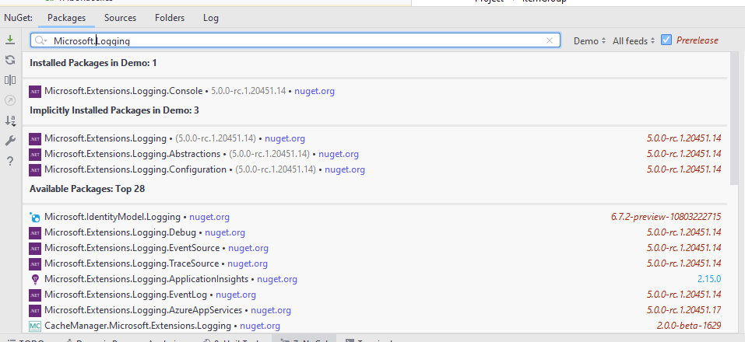
Logger package
dotnet add package Microsoft.Extensions.Logging.Console
https://docs.microsoft.com/fr-fr/aspnet/core/fundamentals/logging?WT.mc_id=DOP-MVP-5003370

Slide 183
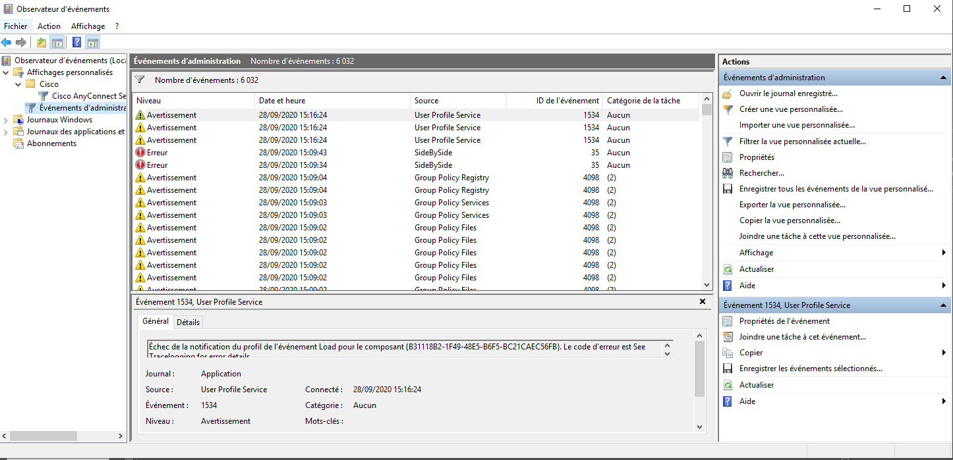
Events Windows

Slide 184
Exercise
Instead of logging with Console.WriteLine
Use the ILogger to log to the console
Search for Microsoft default TraceEvent library and add it to « Demo » project
Add and configure the TraceEvent logger in order to log the Windows Event System

Slide 185
Logging and configuration
appsettings.json
"Logging": { "LogLevel": { "Default": "Information", "Microsoft": "Warning", "System": "Warning" } }

Slide 186
Serilog
https://serilog.net/

Slide 187
Dependency Injection

Slide 188
ServiceCollection
appsettings.json
"Logging": { "LogLevel": { "Default": "Information", "Microsoft": "Warning", "System": "Warning" } }
var services = new ServiceCollection(); services.AddTransient<FibonacciDataContext>(); services.AddTransient<Fibonacci>(); services.AddLogging(configure => configure.AddConsole()); using(var serviceProvider = services.BuildServiceProvider()) { var logger =serviceProvider.GetService<ILogger<Program>>(); logger.LogInformation($"Application Name : {applicationConfig.Name}"); logger.LogInformation($"Application Message : {applicationConfig.Message}"); var fibonacci = serviceProvider.GetService<Fibonacci>(); var results = await fibonacci.Execute(args);
}

Slide 189
Service Lifetimes
Transient : Transient lifetime services are created each time they're requested from the service container. This lifetime works best for lightweight, stateless services.
Scoped : Scoped lifetime services are created once per client request (connection). Register scoped services with AddScoped.
In apps that process requests, scoped services are disposed at the end of the request.
When using Entity Framework Core, the AddDbContext extension method registers DbContext types with a scoped lifetime by default.
Singleton : Singleton lifetime services are created either : The first time they're requested.
By the developer, when providing an implementation instance directly to the container. This approach is rarely needed.
https://docs.microsoft.com/fr-fr/aspnet/core/fundamentals/dependency-injection?WT.mc_id=DOP-MVP-5003370#service-lifetimes

Slide 190
Exercise
Set up the depency injection => remove all custom « new »

Slide 191
Entity Framework connection string and configuration

Slide 192
Program.cs
services.AddDbContext<SchoolContext>(options => options.UseSqlServer(Configuration.GetConnectionString("DefaultConnection")));
appsettings.json
{ "ConnectionStrings": { "DefaultConnection": "Server=(localdb)\\mssqllocaldb;Database=ContosoUniversity1;Trusted_Connection=True;MultipleActiveResultSets=true" },
https://docs.microsoft.com/en-us/ef/core/miscellaneous/connection-strings?WT.mc_id=DOP-MVP-5003370

Slide 193
Exercise
Remove connection string from the code and add it to the configuration file

Slide 194
ASP.NET Core

Slide 195
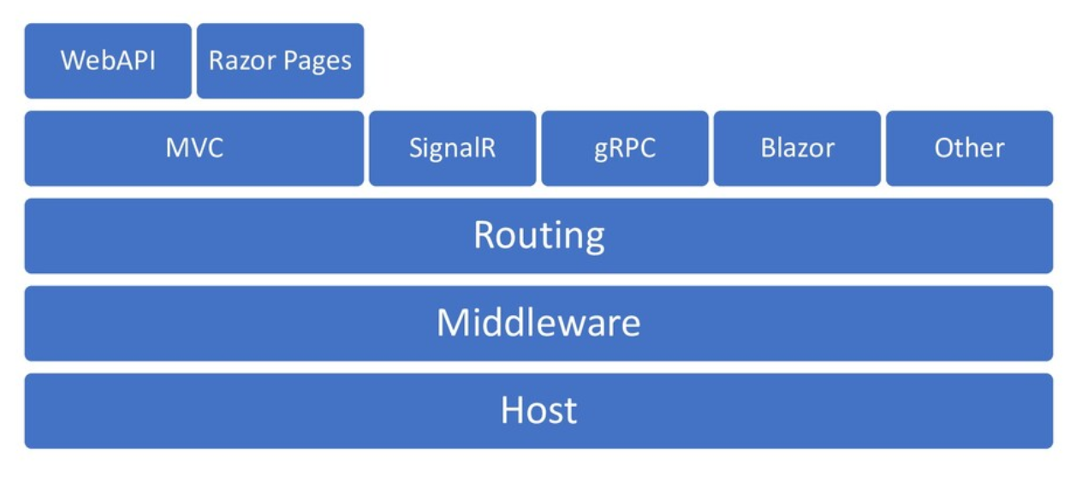
Architecture
https://twitter.com/davidfowl/status/1323337611704999942

Slide 196
Create a web API
dotnet new webapi -o .\src\WebApi
https://docs.microsoft.com/en-us/aspnet/core/introduction-to-aspnet-core?WT.mc_id=DOP-MVP-5003370

Slide 197
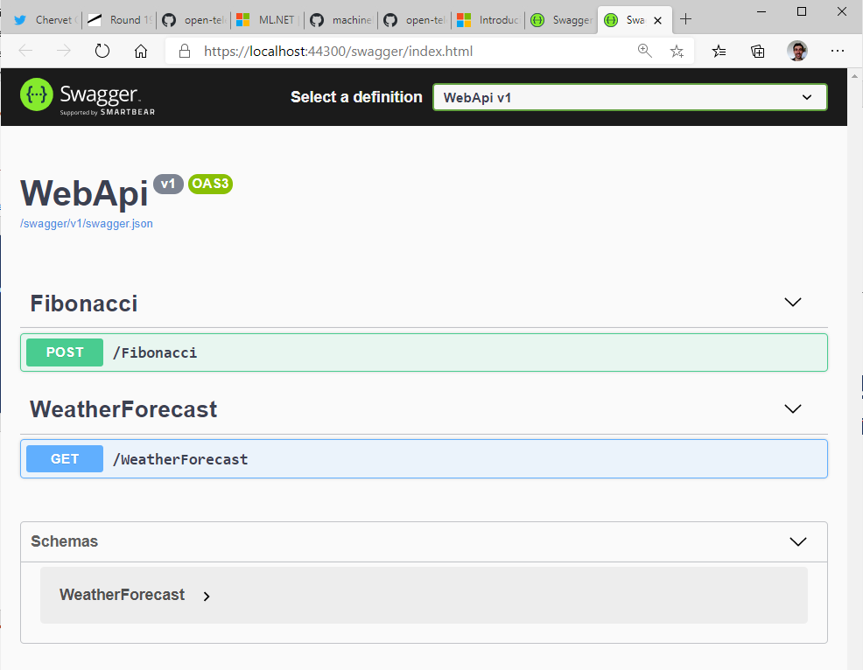
Add Fibonacci Controller

Slide 198
Exercise
Create a « webapi » template in « .\src\WebApi » directory
Add a fibonacci « Controller » and add an HTTP POST route that will compute fibonacci using your library « Leonardo »
Test your API from swagger UI

Slide 199
My first middleware

Slide 200
Startup.cs
public class Startup {
public void Configure(IApplicationBuilder app) {
app.Use(async (context, next) => {
// Do work that doesn't write to the Response.
await next.Invoke();
// Do logging or other work that doesn't write to the Response.
});
app.Run(async context => {
await context.Response.WriteAsync("Hello from 2nd delegate.");
});
}
}
https://docs.microsoft.com/en-us/aspnet/core/fundamentals/middleware?WT.mc_id=DOP-MVP-5003370

Slide 201
app.Use(async (context, next) => {
// Do work that doesn't write to the Response.
await next.Invoke();
// Do logging or other work that doesn't write to the Response.
});
app.Run(async context => {
await context.Response.WriteAsync("Hello from 2nd delegate.");
});
https://docs.microsoft.com/en-us/aspnet/core/fundamentals/middleware?WT.mc_id=DOP-MVP-5003370

Slide 202
public class RequestLoggingMiddleware { private readonly RequestDelegate _next; private readonly ILogger _logger; public RequestLoggingMiddleware(RequestDelegate next, ILogger<RequestLoggingMiddleware> logger) { _next = next; _logger = logger; } public async Task Invoke(HttpContext context) { await _next(context); } }

Slide 203
Exercise
Add a middleware which log on every request the :
HTTP VERB
url path
Status code

