Slide 2
Production Architecture scenario 1
Scenario : real time, we can modify user app and may be users devices => cheap and scale
Namespace Kubernetes : poc-whipser
User App
HTTP Post
API Fast API
Cpu/gpu
AI
Database

Slide 3
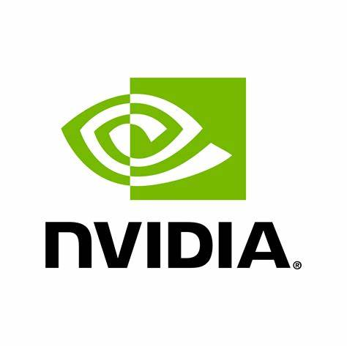
Production Architecture
Scenario : real time => may be expansive to scale
Namespace Kubernetes : poc-whipser
User App
Consume chunck
of text
Produce chunck
of text
HTTP Websocket
API Fast API
Kafka
Worker Whisper
AI
AI
Produce chunck
of .wave with a session ID
Consume chunck
of .wave
Consume chunck
of text
Worker Database
Database

Slide 4
Production Architecture
Step 1
HTTP POST function/api/audio :
Sound Bytes
Chunk Index
ClientID
Namespace Kubernetes : poc-whipser
Step 2
HTTP POST /async-function/ia-worker/transcribe - id
Redis
IA Worker
AI
User App
IA Worker
Slimfaas
API Fast API
Slimfaas
AI
HTTP Server Send Events
IA Worker
Step 4
API Fast API
Step 3
HTTP POST /publish-event/ia-worker/transcript/transcript-callback - Transcription
- Index du chunk
- clientID
AI

