Slide 1
3D Experience
Presentation

Slide 2
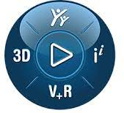
Single Platform grouping a lot of capabilities
Change Management
Worklow Management
Supplier Collaboration
Risk Management
Quality Management
Project Management
Business Intelligence
BOM(s) Management
DMU Management

Slide 3
Product Life Cycle
A PLM Tool should cover all steps & activities of Manufactured Life Cycle
Preparation Phase
DESIGN
MANUFACTURING
EXPLOITATION
RETIREMENT
REQUIREMENTS
Feasability study
Project definition
PRE-DESIGN
Preliminary- DESIGN
Detailled design
Check & validation
Documentation
Technical support
Change management
Maintenance
Recycle
Reuse
Dismounting
Removal
Decommissioning
Tools definition
Factory Design
Manufacturing Process
Check & validation
Production

Slide 4
Single Platform to cover the FULL Product Life Cycle process
Social & collaboration
logistic
sales
functional systems
manufacturing
functional systems
engineering
simulation
marketing

Slide 5
3Dexperience Platform available for any industries
healthcare
medical & cosmetic
retail
aerospace
train
naval
textile
NRJ
car

Slide 6
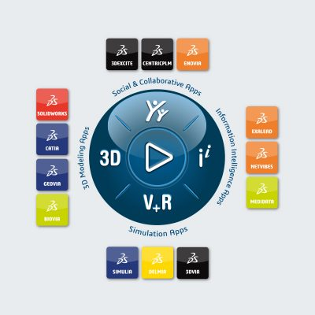
3Dexperience Platform emboard a large spectrum of apps
3D modelings apps
3Dexperience platform is working (in native) or with CATIA 3dx or with Solidworks. Both are Dassault Solutions but it’s possible to connect other CAD Software
Geovia provides a set of tool for geological and mining modelling
Simulation apps
Delmia is a rich client to support manufacturing businesses & processes
3DVia : online 3D space planning service to Imagine, Design and Share 3D housing projects, used also to provide thumbail of 3D model in web platform
Simulia :delivers realistic simulation software that helps engineers and analysts reveal the world we live in (stress, kinematics, …)
Information Intelligence apps
Set of application using BIG DATA & IA technologies in order to help designer to work better & faster
Social & collborative apps
Enovia is the centric of application ; The main web portail used to access for all apps.
Centric PLM is the the solution designed for food product
3DExcite : dedicated for marketing to design create brand experiences that inspire and captivate your audience, Work with VR & AR

Slide 7
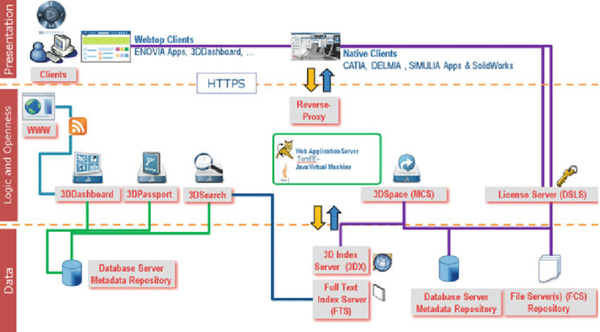
3Dexperience Platform functional architecture

