Slide 1


JAVA / SPRING / ANGULAR Academy
FMS-EA © Guillaume Pastor
28 / 09 / 2023
Notes:
Hello, thank you for being here.
I’m Guillaume Pastor.
Today’s presentation is about my training at FMS-EA.
In case you have questions, please ask them at the end of my presentation.

Slide 2
Table of Contents
A few about myself
End
Training Program
Angular
FMS-EA © Guillaume Pastor
Notes:
Here is the table of contents.
I've decided to break it down into four parts.

Slide 3


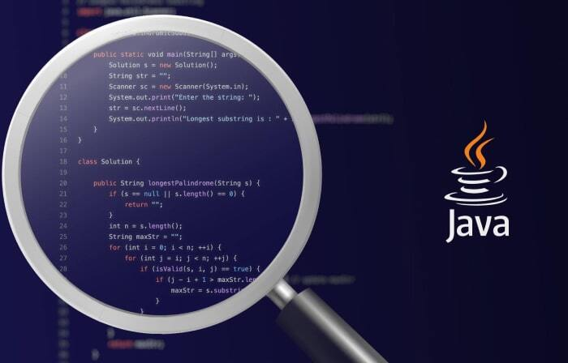

A few about myself
FMS-EA © Guillaume Pastor
Notes:
Let me start by saying few words about myself, before joining FMS-EA
I’m 42 years.
First, I was a builder for seventeen years, and I worked for “Socotrap”, a company based in Toulouse.
Then, because I got physical problems, I started a professional reconversion as an application developer.
During this training I was offered to join the FMS-Academy in January 2023.
I accepted this opportunity, because I have always been interested in IT.
What is an Adapted Enterprise ?
An Adapted Company gives employment to disabled people according to the right conditions given their abilities.
It supports them in their career plans and can be a gateway to other private and public employers.

Slide 4


JSA Training Program
4
FMS-EA © Guillaume Pastor
Notes:
Now, I‘m going to describe the Academy’s training program, which is made up of many modules.
I have chosen to break it down into three sets of modules.

Slide 5




Front-end programming
5
FMS-EA © Guillaume Pastor
Notes:
Let me talk about front-end programming​
What is that ?​
Front-end is the visible part of the application, allowing the user to enter and receive data.
Actually, front-end is what users see and interact with.​
To build a front-end application, you have to master these three languages.​
HTML stands for Hyper Text Markup Language. It is used to create and represent the content and structure of a web page.
CSS stands for Cascading Style Sheets. It’s a computer language used to format web pages. For example, you can change colours, fonts, sizes, and page layouts, and so on.
JS or JavaScript is an object-oriented scripting language, best known as the scripting language for web pages.

Slide 6


Front-end programming
6
FMS-EA © Guillaume Pastor
Notes:
Angular is an open-source framework for creating web applications, and more specifically so-called "Single Page Applications": web applications accessible via a single web page, making the user experience smoother and avoiding page loads for each new action.
TS means "TypeScript" and it's based on the JavaScript language.​
It’s a free and open source programming language developed by Microsoft to improve and secure the production of JavaScript code.​

Slide 7

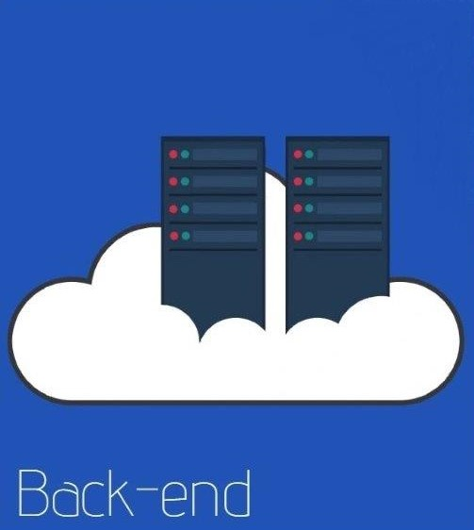


Back-end programming
7
FMS-EA © Guillaume Pastor
Notes:
Now, let me tell you about Back-end programming​.
What’s back-end ?​
Back-end is the hidden part of the application.
Back-end refers to the parts of the code of an application or software that enable it to properly work out, yet they are unreachable to the users.​
Java is a back-end language, it used to develop client-server applications.
Java Spring Boot is an open source tool that makes easier the use of Java-based frameworks to create microservices and Web applications. ​
Yet, before starting with Spring, you must have knowledge in Java.​
SQL is an another tool related to back-end programming. It stands for "Structured Query Language". ​
It’s a standardised computer language used to operate relational databases.

Slide 8
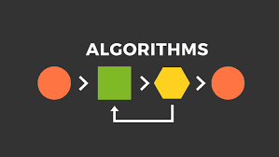


Development tools (set 1)
8
FMS-EA © Guillaume Pastor
Notes:
Now I’m going to tell you about development tools.​
Here are the tools that I used during my training :​
Algorithms are sets of rules telling the computer how to perform a task.​
In reality, a computer program is an algorithm that tells the computer what steps to perform to achieve a task and in which order. ​
UML , which means "Unified Modeling Language“, plays a key role in software development, as it does in non-software systems for many industries. It helps to present the behaviour and structure of a system or process in a meaningful way, to allow a developer to visualise it.

Slide 9


Development tools (set 2)
9
FMS-EA © Guillaume Pastor
Notes:
What is Git ?​
Git is a versioning software created in 2005 by Linus Torvalds, the creator of Linux.​
It’s a software that enables you to keep a change history to complete a project.
GitHub is a platform that works as a facilitator when it comes to Git.​
Like Git, GitHub allows developers to record different updates to complete a project and to go back to a previous version of the project.​
GitHub allows developers to copy all the files in a project and locate their version on the central server which is called a repository.​
Versioning software, or version management software, is a software that enables you to keep a change history to complete a project.

Slide 10


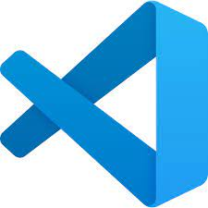
Development tools (set 3)
10
FMS-EA © Guillaume Pastor
Notes:
Here are some tools to help you write good code :​
IDE means Integrated Development Environment such as Eclipse, IntelliJ and Visual Studio Code.​
An integrated development environment (IDE) is a software application that helps programmers to efficiently develop software code.​

Slide 11


What’s Angular ?
Presentation of a part of my own choice
11
FMS-EA © Guillaume Pastor
Notes:
Now, I’m going to talk about Angular because I chose to focus on that tool in my presentation.​
What’s Angular ?​
Angular is an open-source front-end JavaScript framework.​
It was introduced to the market in 2010 under the name AngularJS and developed by Google,
It uses the JavaScript-based Typescript language for its components and HTML for its models to develop web and mobile applications.​
Actually, Angular is a framework and development platform for developing Single Page Applications (SPA), using Web technologies such as HTML, CSS and TypeScript.​

Slide 12
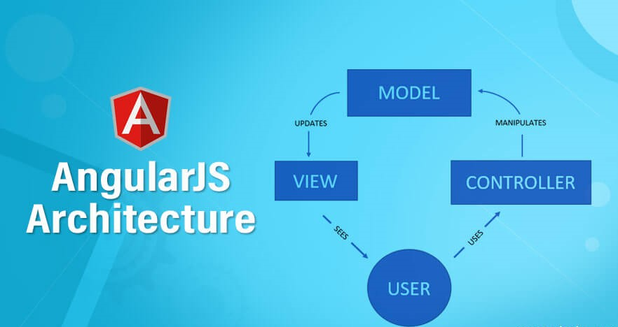

Angular Model
Presentation of a part of my own choice
12
FMS-EA © Guillaume Pastor
Notes:
What does the Angular framework consist of ?‍‍​
Angular applications use the MVC code model. Also used by several front-end and back-end frameworks, the acronym stands for these following three parts:​
- M for Model: It's related to the data that fills the page(s) of your application. ​
- V for View: It represents the user interface, in other words what you can see on the browser side. ​
- C for Controller: It contains all the information that makes a web application work. ​

Slide 13
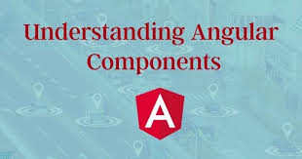
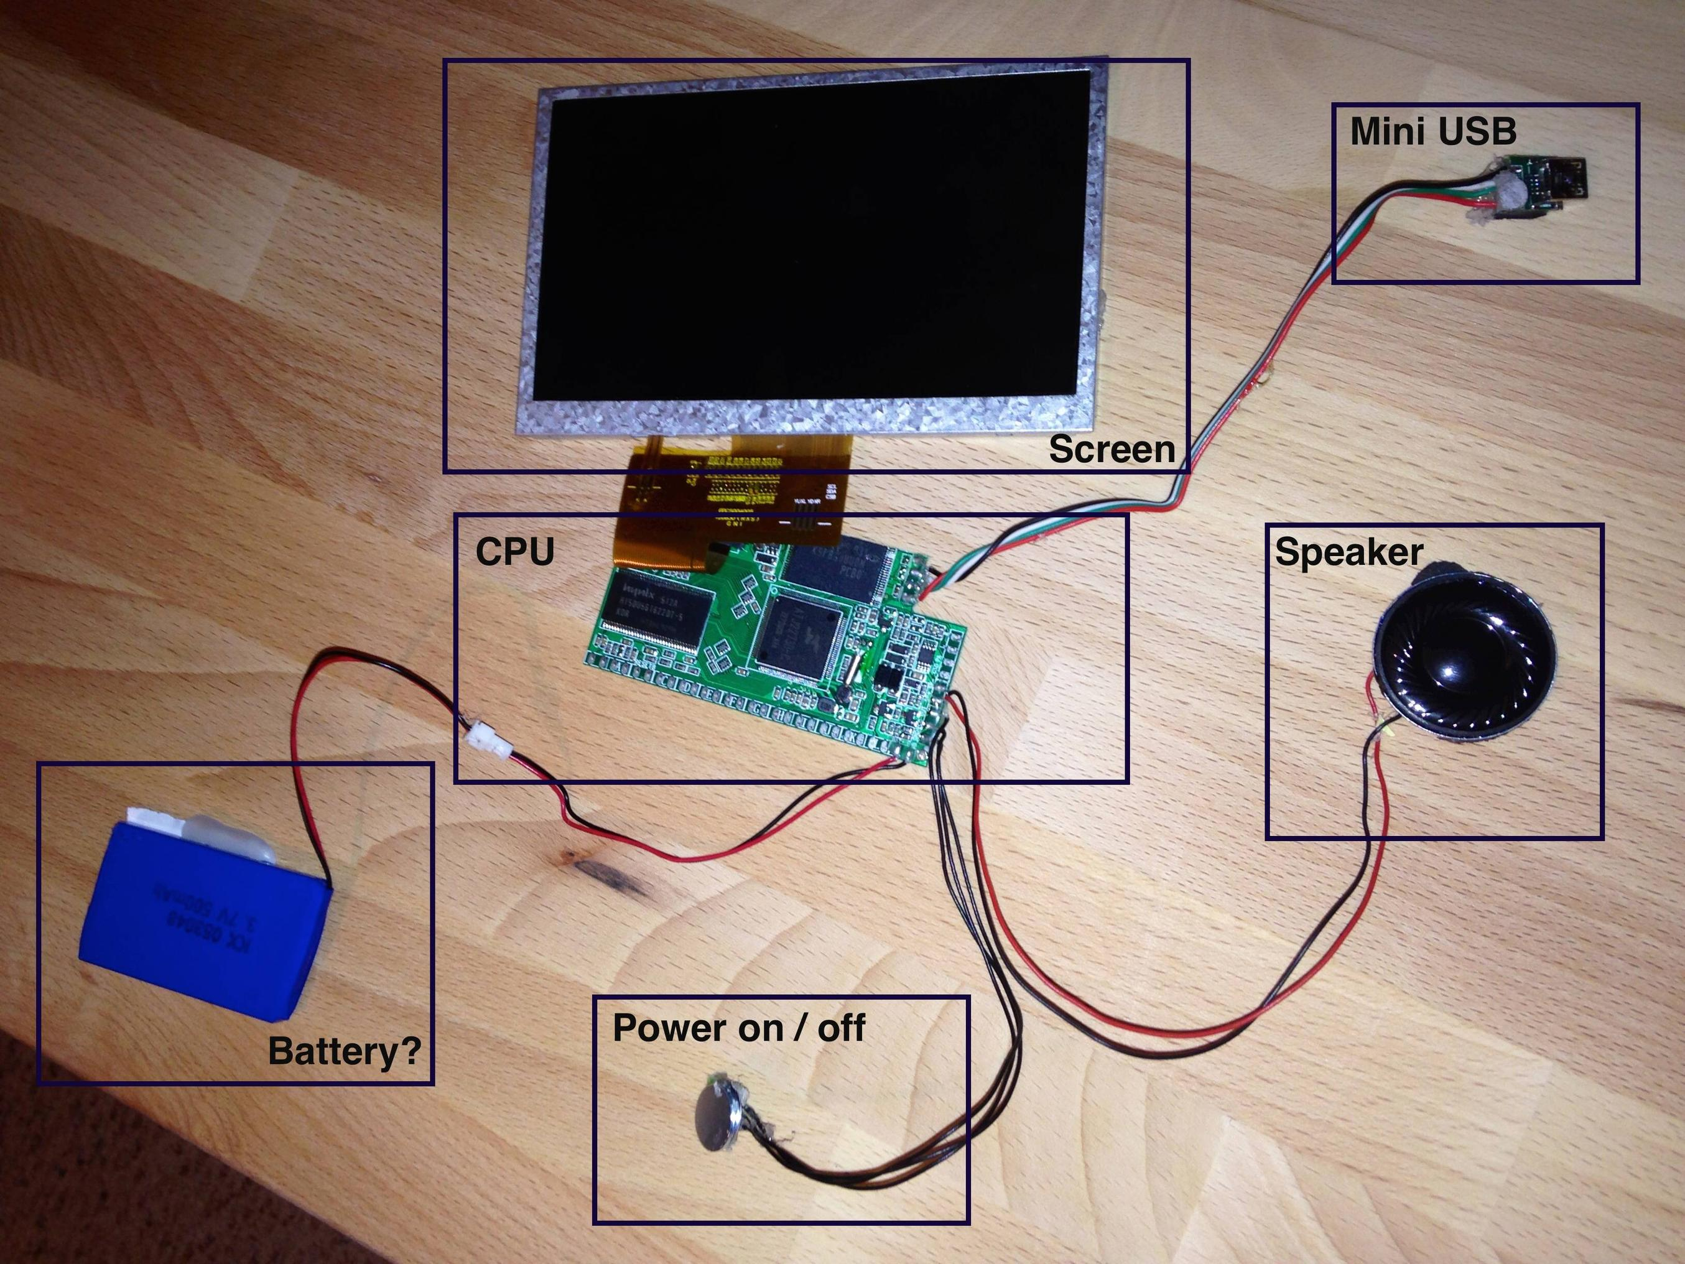
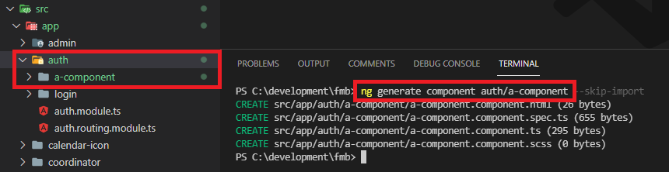
Components
Presentation of a part of my own choice
13
FMS-EA © Guillaume Pastor
Notes:
What is a component in Angular ?​
A component is a fundamental element of an Angular application.​
A component is a module that contains HTML, CSS and JavaScript code to display part of an application user interface.
A component can also include templates and directives to define the appearance and behaviour of the user interface.​
The second image shows a command for creating and generating an Angular component.​
To create this component, you need to go to the root of the project.​

Slide 14


Routing and Navigation
Presentation of a part of my own choice
14
FMS-EA © Guillaume Pastor
Notes:
Routing and Navigation​
Routing is the mechanism for navigating from one page to another on a website.​
In Angular, RouterLink is a directive for navigating to a different route declaratively.​
Navigation opens one or more components routed to one or more locations on the page.

Slide 15



Code Consistency and Reusability
Presentation of a part of my own choice
Easy to Learn, Use, and Test
15
FMS-EA © Guillaume Pastor
Notes:
Here is a list of the benefits of working with the Angular framework.​
Angular has a component-based structure which makes the components highly reusable and simplifies the development process.​
You can build the UI (User Interface) with moving components, while also ensuring a stable development process for developers.​
AngularJS can be easily learned by people with knowledge of JavaScript, HTML, and CSS.​
This way, learning AngularJS initiates further opportunities for developers in the Web development trade.​

Slide 16


Google Support and Excellent Community Support
Presentation of a part of my own choice
SPA-Oriented Features
16
FMS-EA © Guillaume Pastor
Notes:
It's actually recognized as one of the most reliable frameworks by the app development team members.​
Web toolkits by Google enables developers to develop a unique and user-friendly application.​
AngularJS and SPAs simply belong together, AngularJS supports the development of Single Page Applications.​
The primary purpose of developing single-page-applications is faster website transition.​

Slide 17

FMS-EA © Guillaume Pastor
Notes:
As a conclusion, I really enjoyed this course, both regarding its contents and the way it was led by Mohamed, our trainer, whom I thank a lot, as well as the other speakers.​
The training was intense and enriching, and I hope to become a full-stack developer in the future thanks to it.​
I learned a huge amount of knowledge both professionally and in human terms. ​
The quality of this Java Spring Angular training was excellent. We were very pleasantly welcomed and the atmosphere was great .​

Slide 18

Thank you all for listening
FMS-EA © Guillaume Pastor
Notes:
Well, my presentation is now over, thank you for listening. ​
I would like to thank FMS for welcoming me and trusting me with this training.​
Please feel free to ask me questions.

