Slide 1
PLM
OVERVIEW

Slide 2
SCOPE
This document presents a synthetic vision about how PLM serve Industrial processs.

Slide 3
AGENDA
Industrial Journey
What is PLM ?
PLM Market overview
PLM Business Landscape
PLM OF FUTURE
FMS & The PLM
Q & A

Slide 4
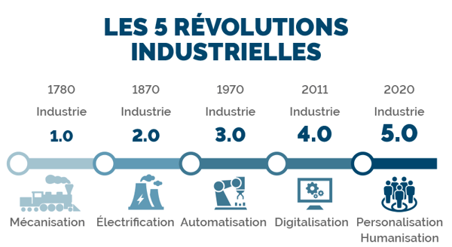
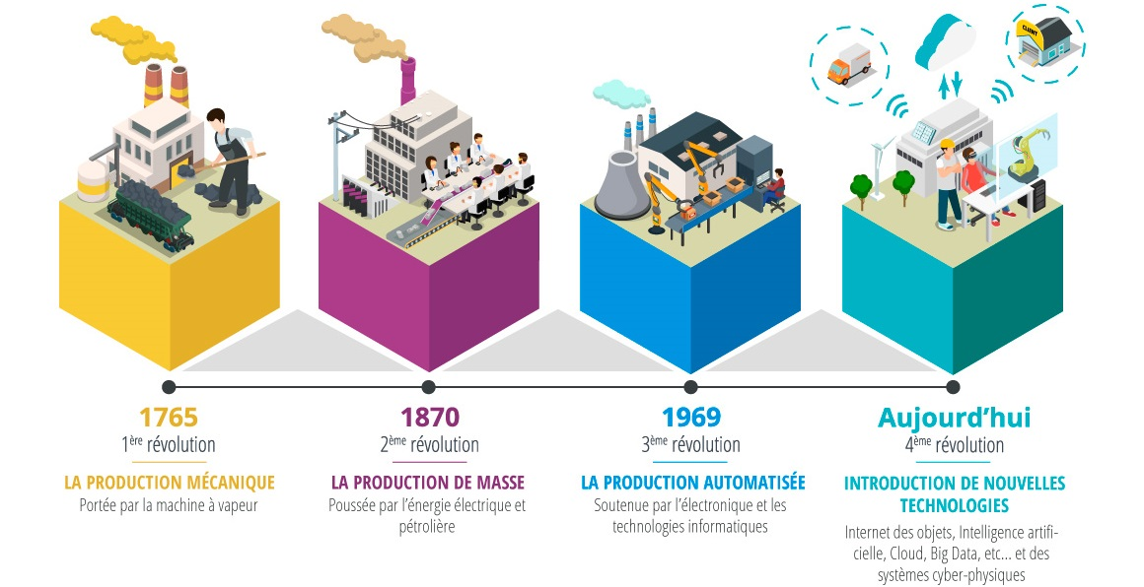
Industrial Journey
New age start by deployment of disruptive technology . Electricity, Internet, Computer, …
Between two ages we always have a transition phase. During transition phases new actors are coming in the market and other dispear or decrease).
Industry 1.0 was an artisanal phase. Products were built with a few panel of stakeholders.
FORD is the most emblematic representant of Industry 2.O. He introduced vertical organization (Taylorism).
Industry 3.0 Starts with oil price shock. Helping by computer & Electronic, Automatization has been introduced to reduce costs. Products built are also more complex
Actual Market needs personalized product (example car), products are very complex stakeholders are everywhere in the word; New technologies allows better collaboration, sharing to go to next step .

Slide 5

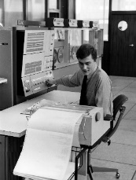
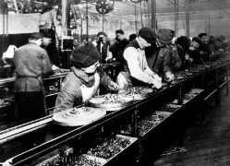
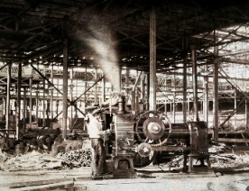
Industrial Journey
Industry 5.0
Industry 4.0
Industry 3.0
Industry 2.0
Industry 1.0
Humanisation Personnalisation
Cloud
Big DATA
5G/Fibre
IA
Digitalisation
2010
2000
Internet
Informatisation
1960
Electronique
Informatique
Production en masse (FORD)
1870
Electricité
Mécanisation
1780
Machine à vapeur

Slide 6
What is PLM ?
PLM is now the term is now used to represent the integrated set of software tools used in the design, review, and manufacture of products and product lines from initial conception, development, manufacture, distribution, to end of life.
1931
Now
1957
1985
1959
Patton wrote that there was consensus that the key element of the product lifecycle was that profits are high during the growth phase and decline due to competition during the maturity phase
Produce on request
Price defined by market
Product +Service
Jones who worked for Booz, Allen and Hamilton, theorized that there was a lifecycle that is characteristic of most products and he put forward this terminology :
Introduction
Growth
Maturity
Saturation
Decline
clear understanding that:
The price of new products should be as high as possible.
In the transition from maturity to saturation, competition between different manufacturers would reduce prices.
Towards the end of a product's life, the market and not the manufacturer would set its price.
One of the first recorded applications of PLM introduced by AMCV (Jeep/Grand Cherokee) -> CAD Application
Otto Kleppner developed a precursor to what we now understand as the basic product lifecycle where he suggested that products go through three stages:
Pioneering
Competitive
Retentive
Produce as much possible
Price defined by production cost
Notes:
https://www.concurrent-engineering.co.uk/Blog/bid/100180/A-Brief-History-of-Product-Lifecycle-Management

Slide 7
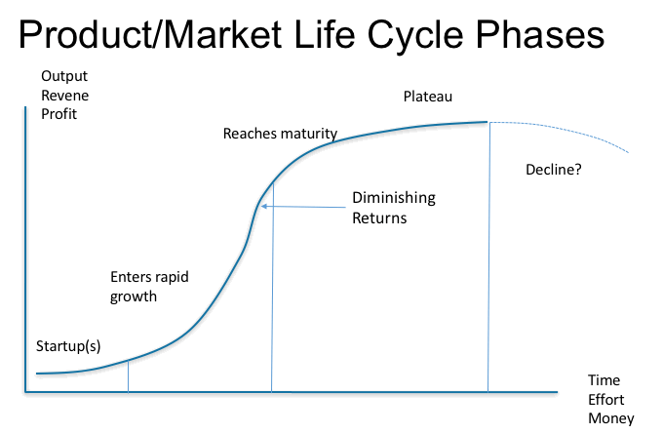
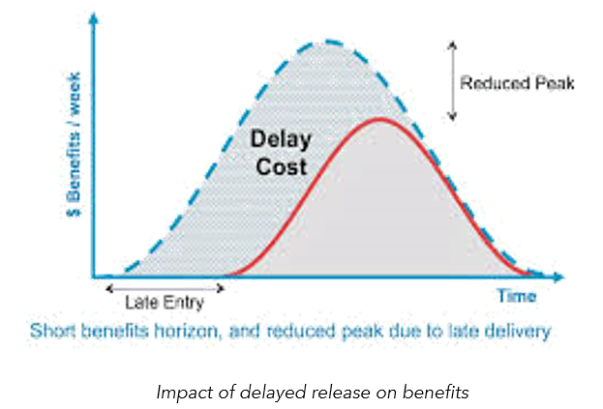
What is PLM ?
Value of product is highly tied with Time to Market
Time to Market is the period between the Idea and the effective distribution (sales)
Engineering & Manufacturing process are very complex & long
PLM reduced Time to Market & increase value of Products

Slide 8
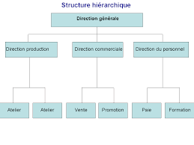
What is PLM ?
Definition
Product lifecycle management (PLM) is a discipline for managing the lifecycle of a product, encompassing processes and software systems for tracking and improving every development phase, from product ideation to manufacturing to retirement.
PLM has As with the American Motors initiative, an effective PLM system is fully integrated using the same data and information for all transactions, and thus ensuring data integrity and the minimisation of errors.
PLM Has also changed enterprise’s organisation
PLM
Taylorism
Product
Simulation
Design
Project Mangement
Configuration Mangement
Maintenance
Idea & Requirements
Build
Manufacture
Think Organisation around a PRODUCT

Slide 9
PLM Business Landscape
Manufactured Product Life cycle
LAUNCH
DESIGN
MANUFACTURING
EXPLOITATION
RETIREMENT
REQUIREMENTS
Feasability study
Project definition
PRE-DESIGN
Preliminary- DESIGN
Detailled design
Check & validation
Documentation
Technical support
Change management
Maintenance
Recycle
Reuse
Dismounting
Removal
Decommissioning
Tools definition
Factory Design
Manufacturing Process
Check & validation
Production

Slide 10
What is PLM ?
Key Capabilities
Product Data Management : Store & Organise Data in a single SOFT
CAD DATA
Office Documents
Manufacturing DATA
Meta Data
Change Process Management: manage changes throught several objects & workfow. Respecting quality of changes (iso xxx)
IOT: manage changes throught several objects & workfow. Respecting quality of changes (iso xxx)
Project Mangement: manage changes throught several objects & workfow. Respecting quality of changes (iso xxx)
Life Cycle Management: Manage the life cycle of DATA & Product using concepts as :
State
Revision
Workflow : to manage processes between states
Digital Mock Up : group all data used to build a Digital 3D representation of 3D :
Native CAD DATA
Light CAD Data converted (thumbail, Visualiser, …)
Data Analytic: manage changes throught several objects & workfow. Respecting quality of changes (iso xxx)
Social Network: manage changes throught several objects & workfow. Respecting quality of changes (iso xxx)
Bill Of Material Mangement: manage all BOM during all phases of Product Life Cycle :
E-BOM
M-BOM
As Planned
As Manufactured
Configuration Management: allows to visualize a Product with a specfic configuration with changes applied.
Virtual Reality: manage changes throught several objects & workfow. Respecting quality of changes (iso xxx)
Security: manage changes throught several objects & workfow. Respecting quality of changes (iso xxx)

Slide 11

PLM Business Landscape
Impacted businesses
MANAGEMENT
COMMERCIAL
FINANCE
DESIGN
MARKETING
R& D
MANUFACTURING
LOGISTIC
MANAGEMENT
CUSTOMERS
SUPPLIERS
VALIDATION
CERTIFICATION

Slide 12

PLM of FUTURE
New capabilities emerge from Market Needs & new technologies
DIGITAL & FACTORY TWIN
Concurrent & Real Time PLM
PLM
NEXT GENERATION
Real & Augmented Reality /Metaverse
Accessible from anywhere
Software as service
Offer immersive experiences
Social network/Communication
Immersive Experiences
IOT- DATA
Improved DATA Stream - BIG DATA
Democratize engineering knowledge
Work within communities
Automated PLM Services
PREDICTIVE PLM Services
Improved extended PLM (for suppliers)
No Code /Low code Concept
DATA Analytic
Interact with other SOFT and DATA Source
Automatize repetitive & predictive Tasks
Support Human Decision
Platform on Cloud
Micro Services Architecture oriented
IA
Offer new services for Customers
Manage LifeCycle for services & embedded software
DATA
Know How
New Technologies

Slide 13
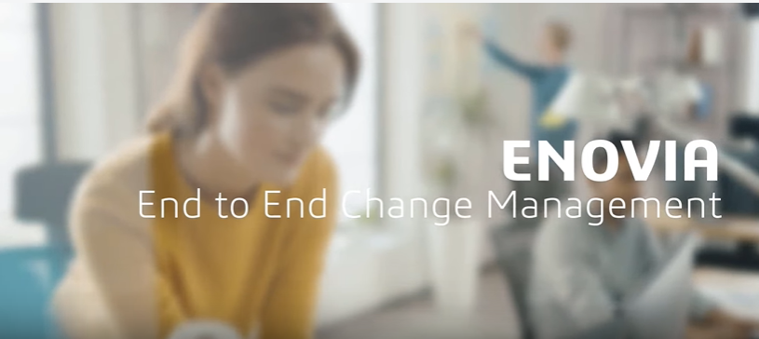
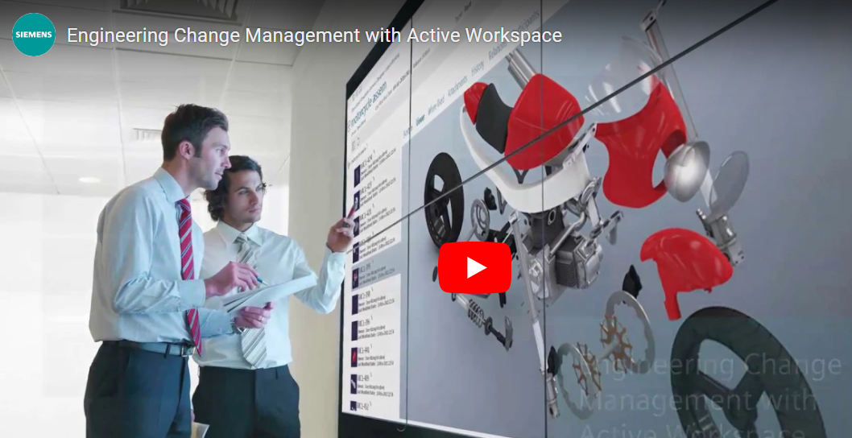
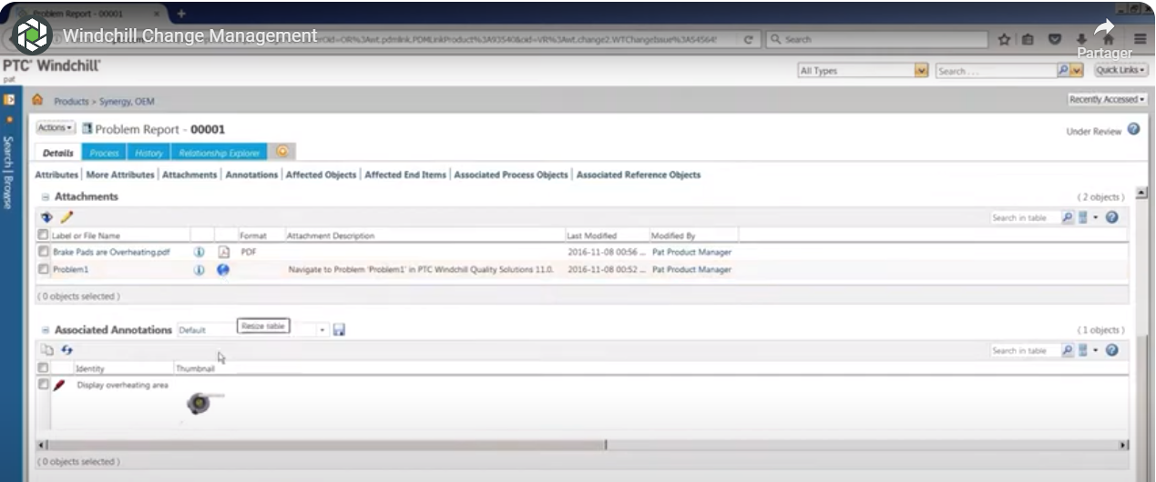
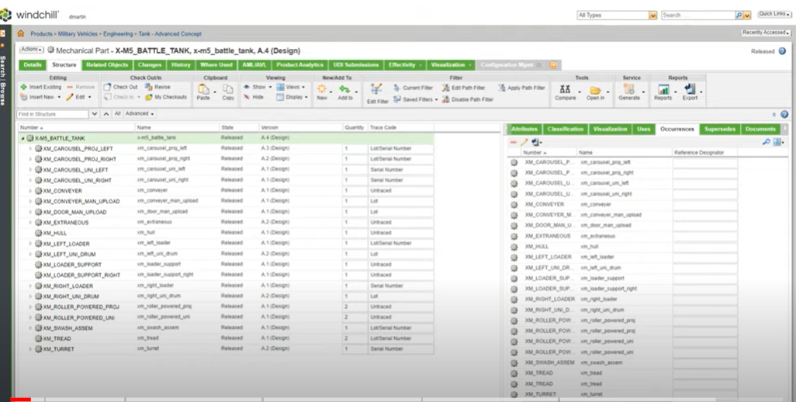
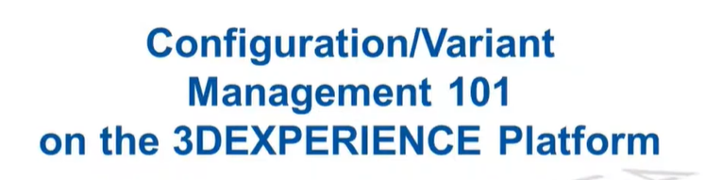
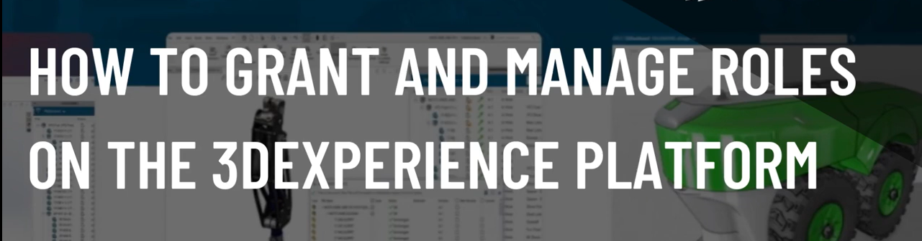
PLM Business Landscape
Some examples
Change Mangement
Configuration management
P&O
Data Analytic
Exalead OnePart
Configuration
TXO

Slide 14
PLM Deployment
VALUE ASSESSMENT
Propose a value perspective to current account knowledge & identified industry Solution expériences.
Refine Business Drivers? Objectives , processes & expected benefits throught client interviews.
Agrre with customer on KVI to qua,tify the expected Business Value.
Converge & agree on a Value Definition SOW
VALUE DEFINITION
Describe processes exécution pains, needs,& associated KPI to quantify processes performance expectations
Initialize architecture vision based on experience. client interviews.
Asses KPIs & KVIs Improvment magnitude
Initilaize a financial Business Case
Converge & agree on a Value Commitment SOW
VALUE COMMITMENT
Demonstrate & convince, maximising OOTB& Industry Process experience usage, the value expected, based on customer business processes rengineering
Define a secured value delivery scope of work.
Doument fit/gap analysis & risk mitigation plan
Confirme the processes KPIs
VALUE DELVERY
Exécute completness & built in quality to fulfill commited business value
Exécute the plan to deliver the project scope on quality, on timeand on budget.
Ensure adoption of changes by customer end-users
Monitor & measure the business KVI & processes KPIs
Document best-pratices

Slide 15
ACTIVITY
PLM Deployment
LEAD
OPPORTUNITY
PROJECT
VALUE ASSESSMENT
Understand Business Model
Undertstand challenges
Understand strategies
VALUE DEFINITION
Identify Business processes & pains
Define architecture vision
Define high level Architecture requirements
VALUE COMMITMENT
Select ISE/IPE, BP or IP
Indentify roles
GAPs (As is To be /Business & solution)
Define functionnal scope
Refine architecture vision
VALUE DELVERY
Study BPs & requirements
Refine functionnal scope
Detailled solutionarchitecture
Build solution delivery plan
Test Business scenarios
Role management
Parametrisation & Configuration
Applicatif migration
Training
Data Analytics
Business Architecture
Infrastructure
Validation
Support
Automation
Customisation

Slide 16



PLM Deployment
Existing System
New System in use partial or full scope
MCO + SUPPORT
Strategy 1
retirement
DATA
Migration
Applicatif
Migration
DATA
Migration (delta )
DATA
synchronisation
DATA
Migration (delta )
Implémentation phase
MCO + SUPPORT + Change Management (Training,….)
retirement
New system available for new program
Strategy 2
DATA
Load for test
DATA
Migration

Slide 17
PLM of FUTURE
PLM Essential Know How
Design
&
Manage Solution
Business &
Technical
Customer (s) Context
PLM Platform(s)
Specific business processes
Terminology/vocabulary
Technical/Operationnal PMT (Process/Method & Tools)
Contacts
Roles & user management
Parametrisation (DataModel/Configuration,…)
Data load & migration)
Web customisation
Native customisation
Specific languages
Automation
Generic Business processes (Product Llifecycle/Businesses/Organisation/…)
Design (structure/Systems/…)
Configuration Mangement
BOM management
Change Management
Evaluate & modelize Business needs
Business Requirements Management
Solution Architecture
Cost evaluation
SAFE
DEVOPS
MBSE
Web languages
Native Languages
SQL & NoSQL DB
REST API
DEVOPS (Tools/pipeline)
CLOUD
DATA (Load, Analytic,

Slide 18




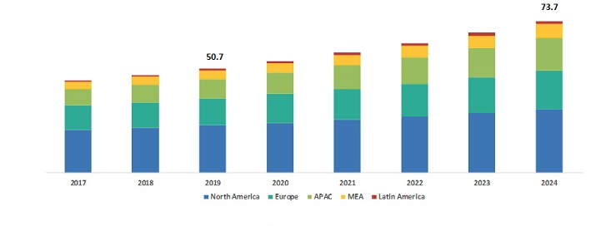


















PLM Market overview
PERSPECTIVE
INDUSTRIES
NUCLEAR
TRAIN
TEXTILE
OIL & GAZ
ELECTRO-Ménager
COSMETIQUE
AERONAUTIC
NAVAL
Automotive
SPACE
EDITORS
INTEGRATORS

Slide 19
FMS & The PLM Market

Slide 20
Q & A

