Slide 1
Machine Learning Classifier Performance
Taipei Data Science Meetup
October 18th, 2016
Guillaume Martin
github.com/guillaume-martin

Slide 2
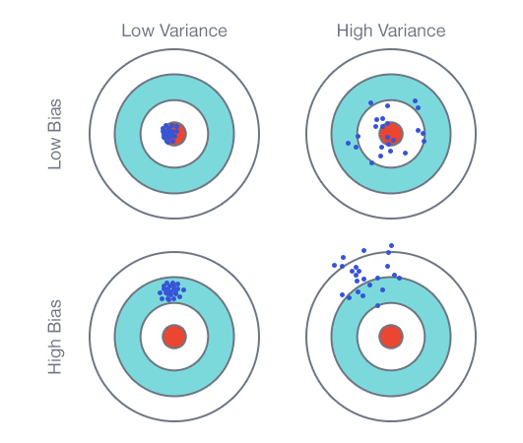
Bias vs Variance
Bias : The algorithm is constantly learning the wrong thing by not taking into account all the information in the data.
Variance : The algorithm is learning random things by fitting highly flexible models that follow error/noise in the data to closely.

Slide 3
Underfitting vs Overfitting
Underfitting : the model can neither model the training set nor generalize to new data. Often the result of excessively simple models.
  High bias
  Low variance
Overfitting : the model fits the training set too well. It is also learning the noise in the training data. It won't generalize well.
  Low bias
  High variance

Slide 4
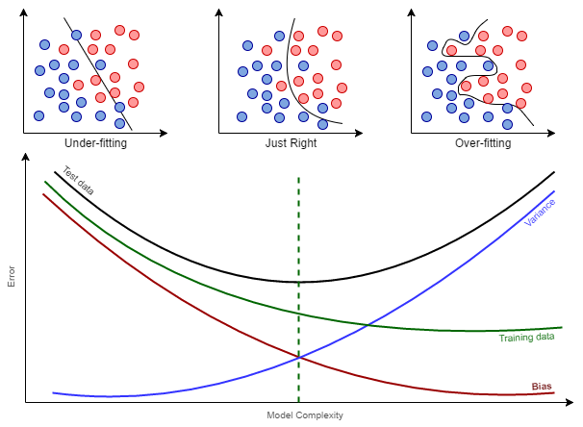
Underfitting vs Overfitting

Slide 5
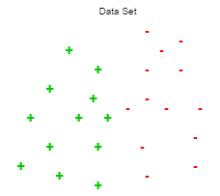
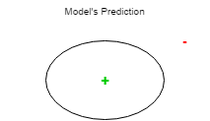
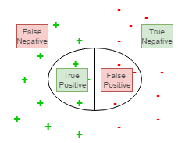
Confusion Matrix

Slide 6
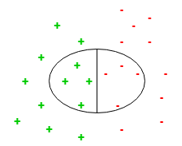
Confusion Matrix

Slide 7
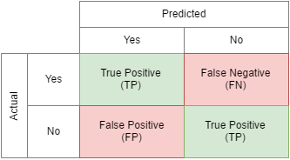
Confusion Matrix

Slide 8
Confusion Matrix Derivations
Accuracy : How often is the classifier correct.
True Positive Rate (TPR) or Sensitivity : When it's actually yes, how often does it predict yes.
False Positive Rate (FPR) or Fall-out : When it's actually no, how often does it predict yes.
True Negative Rate (TNR) or Specifiity : When it's actually no, how often does it predict no.
False Negative Rate (FNR) or Miss rate : When it's actually yes, how often does it predict no.

Slide 9
Precision / Recall
Recall : of all examples that actually were yes, what fraction did we predict correctly. This is the ability of a classifier to find all the positive samples. Aka Sensitivity or True Positive Rate (TPR).
Precision : of all the times we predicted yes, how many times was actually yes. This is the ability of a classifier not to label as positive a sample that is negative
We want to maximize both Recall and Precision.

Slide 10
F1- Score
This is the harmonic mean of Precision and Recall.
We want the model that will return the highest F1-Score
 |  | prediction
 |  | + | -
act | + | 32 | 8
 | - | 29 | 11
 |  | prediction
 |  | + | -
act | + | 37 | 3
 | - | 34 | 6
 |  | prediction
 |  | + | -
act | + | 34 | 6
 | - | 29 | 11
 | Model 1 | Model 2 | Model 3
Precision
Recall
F1-Score

Slide 11
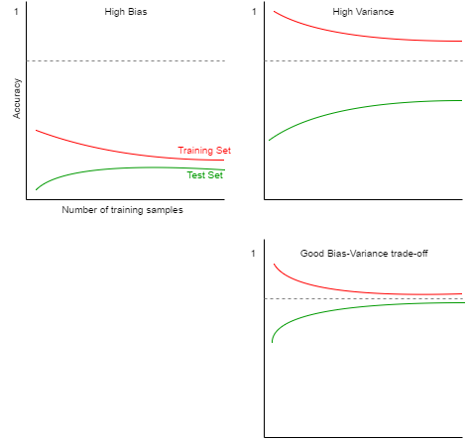
Learning Curves
Learning Curves represent the increase of learning (high accuracy/low error) with the increase of experience (# training examples).

Slide 12
ROC / AUC
ROC = Receiver Operator Characteristic
Shows the performance of a binary classifier as its discrimination threshold varies.

Slide 13
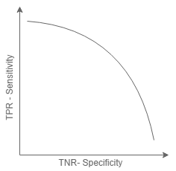
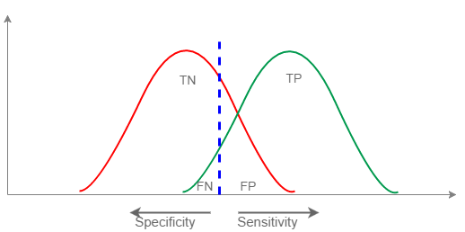
ROC / AUC
www.navan.name/roc

Slide 14
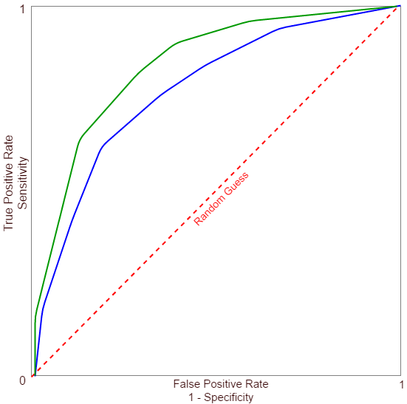
ROC / AUC
AUC values
0.9 – 1 : Excellent
0.8 – 0.9 : Good
0.7 – 0.8 : Fair
0.6 – 0.7 : Poor
0.5 – 0.6 : Fail

Slide 15
Improving Model
High Bias - Underfitting
  Add more features
  Use a more sophisticated model
  Use fewer samples
  Decrease regularization
High Variance - Overfitting
  User fewer features
  Use more training samples
  Increase regularization

Slide 16
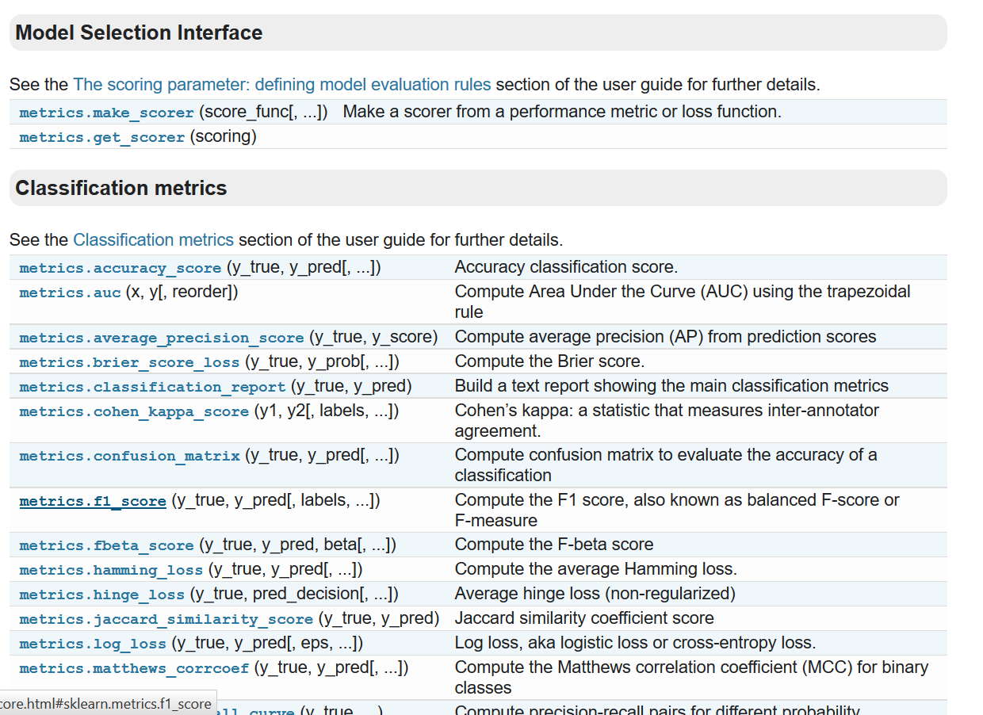
scikit-learn Metrics
http://scikit-learn.org/stable/modules/classes.html#module-sklearn.metrics

