Slide 1
◆ MONARCH · APC / CONTROLS UPDATE / 15 JUL 2026
The engine's warning protections are now verified
Virtual crankshaft + synthetic cylinder-pressure playback drove every warning and error in the engine safety chain with generated data.
Several issues detected and fixed along the way.
VERIFIED ON TARGET
NEW CAPABILITY
Fault-injection matrix
7 / 7 trace sets passed
Clean baselines all-green;
Each injected fault: over-pressure, late burn, knock, misfire, cycle-to-cycle variability tripped its own flag.
Synthetic pressure sets
The CAS loop replays generated pressure sets through the LabVIEW pressure analytics while the built-in EPT crank simulator spins, for repeatable fault drills.
◆ Noble Thermodynamics — Argon Power Cycle
Python ⇄ LabVIEW integration· SIL-1

Slide 2
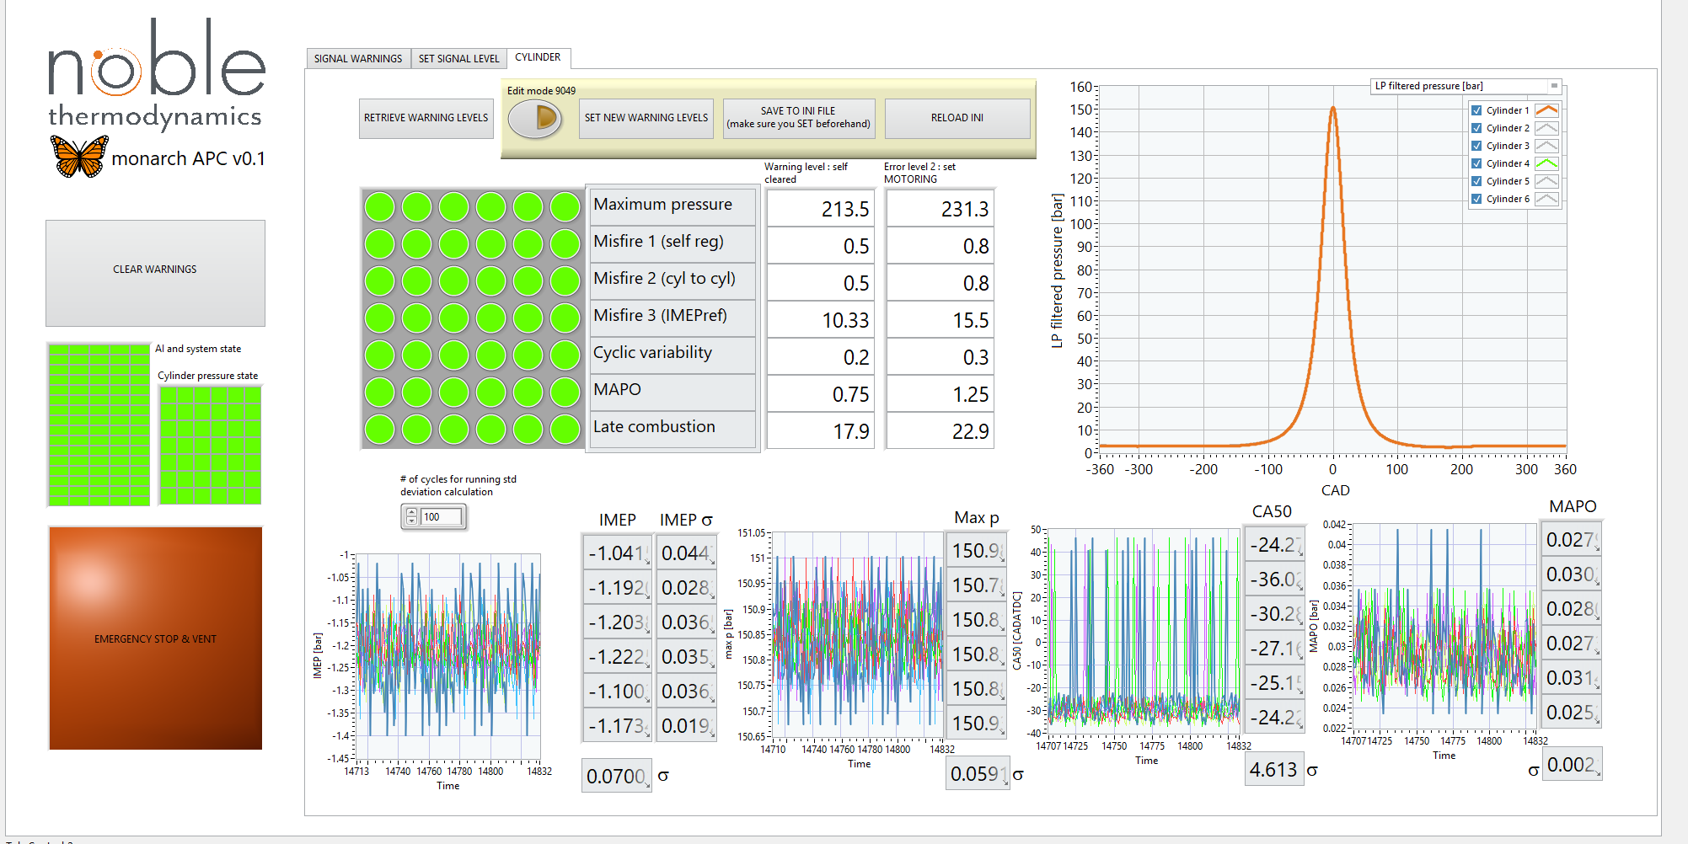
◆ MONARCH · APC / CONTROLS UPDATE / 15 JUL 2026
Motoring Baseline
◆ Noble Thermodynamics — Argon Power Cycle
Python ⇄ LabVIEW integration· SIL-1

Slide 3
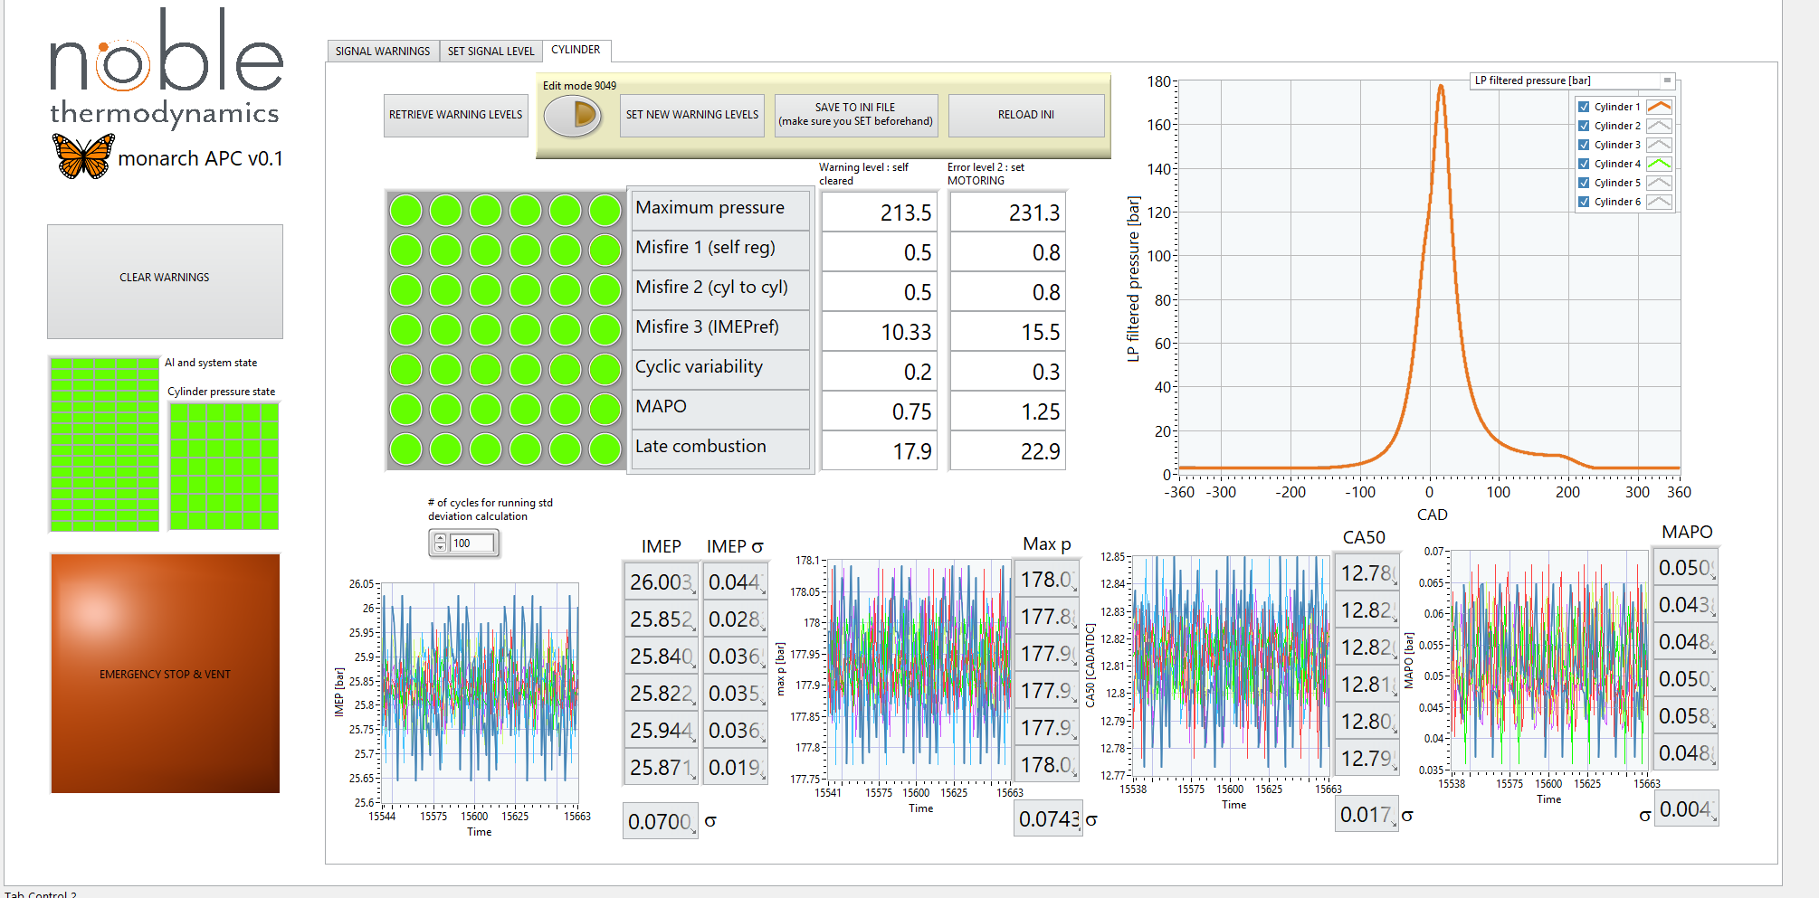
◆ MONARCH · APC / CONTROLS UPDATE / 15 JUL 2026
Firing Baseline
◆ Noble Thermodynamics — Argon Power Cycle
Python ⇄ LabVIEW integration· SIL-1

Slide 4
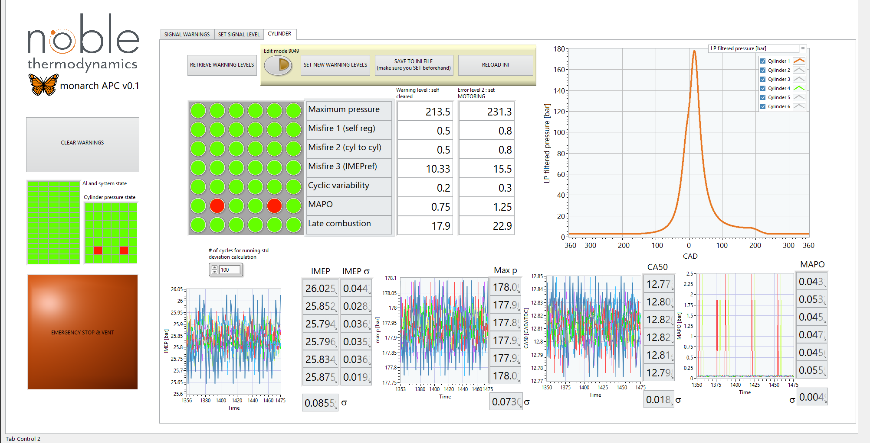
kn
◆ MONARCH · APC / CONTROLS UPDATE / 15 JUL 2026
Knocking pressure traces
Knocking cycles
◆ Noble Thermodynamics — Argon Power Cycle
Python ⇄ LabVIEW integration· SIL-1

Slide 5
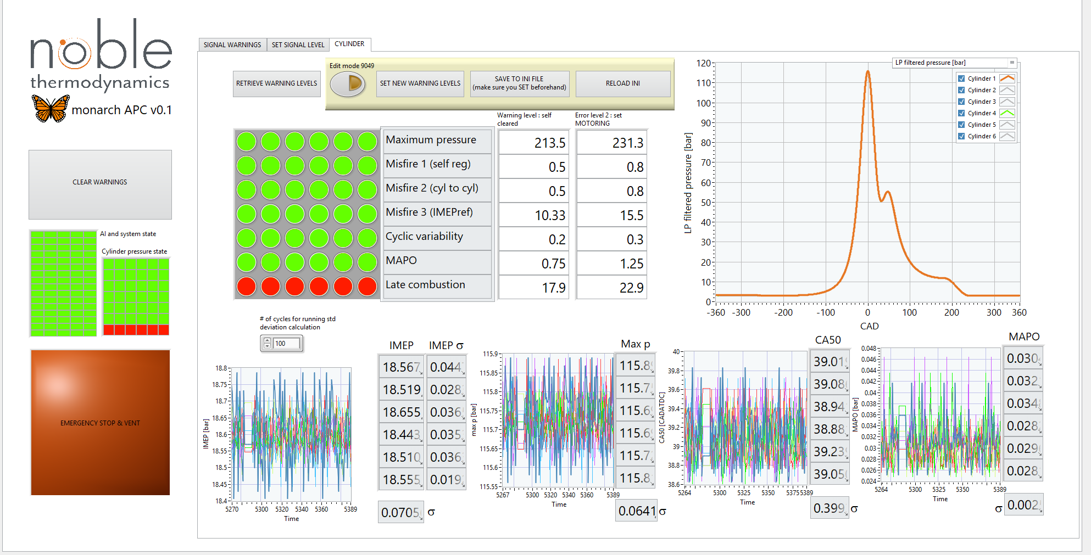
kn
◆ MONARCH · APC / CONTROLS UPDATE / 15 JUL 2026
Late CA50 pressure traces
Late combustion
Late CA50
◆ Noble Thermodynamics — Argon Power Cycle
Python ⇄ LabVIEW integration· SIL-1

Slide 6
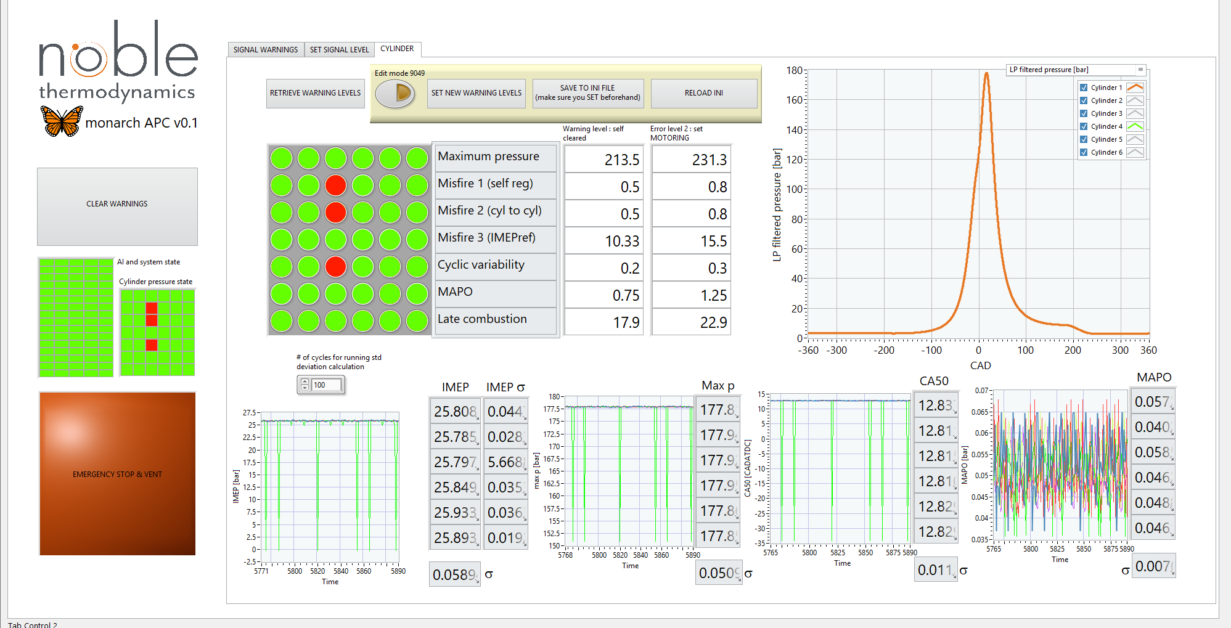
kn
◆ MONARCH · APC / CONTROLS UPDATE / 15 JUL 2026
Intermittently misfiring pressure traces
Misfiring cycles
◆ Noble Thermodynamics — Argon Power Cycle
Python ⇄ LabVIEW integration· SIL-1

Slide 7
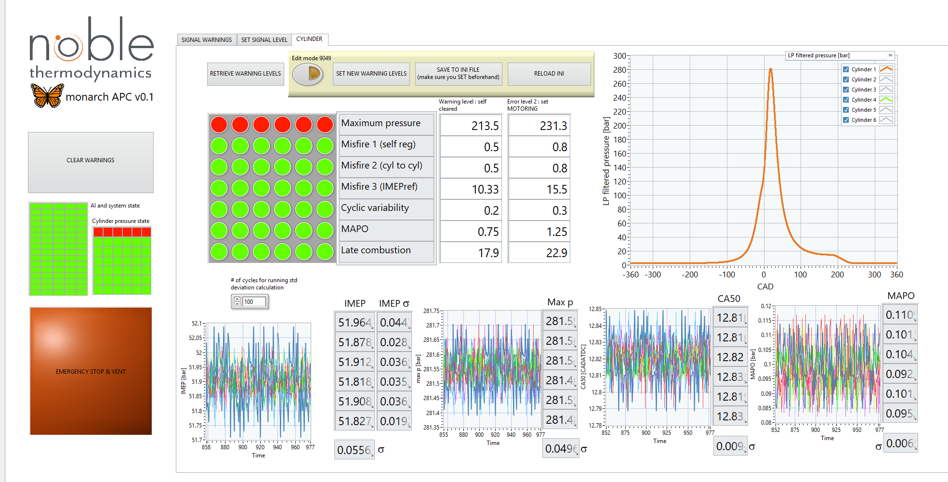
kn
◆ MONARCH · APC / CONTROLS UPDATE / 15 JUL 2026
High peak pressure
High peak pressure traces
◆ Noble Thermodynamics — Argon Power Cycle
Python ⇄ LabVIEW integration· SIL-1

Slide 8
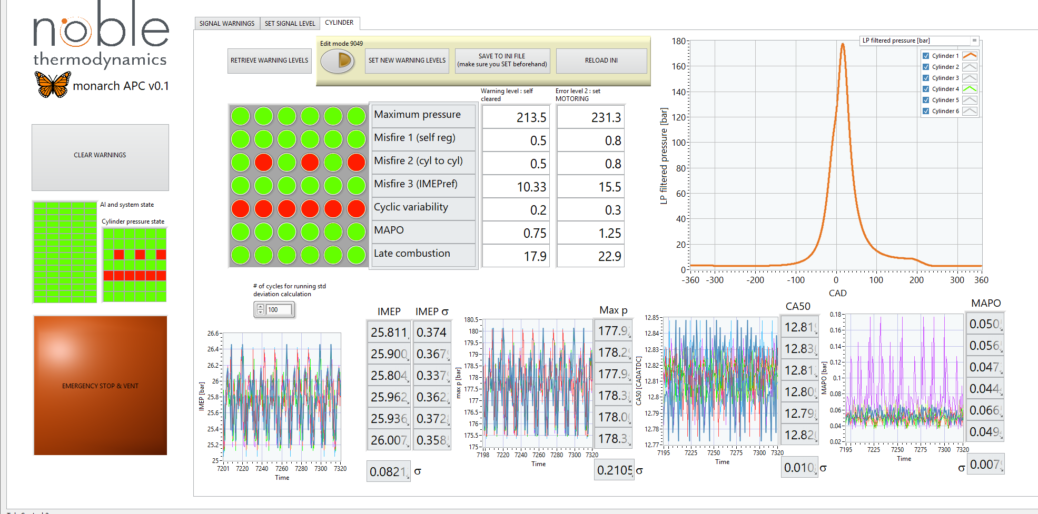
kn
◆ MONARCH · APC / CONTROLS UPDATE / 15 JUL 2026
High variability pressure traces
High variability
Note that, in practice, the variability threshold should be higher.
◆ Noble Thermodynamics — Argon Power Cycle
Python ⇄ LabVIEW integration· SIL-1

