Slide 1
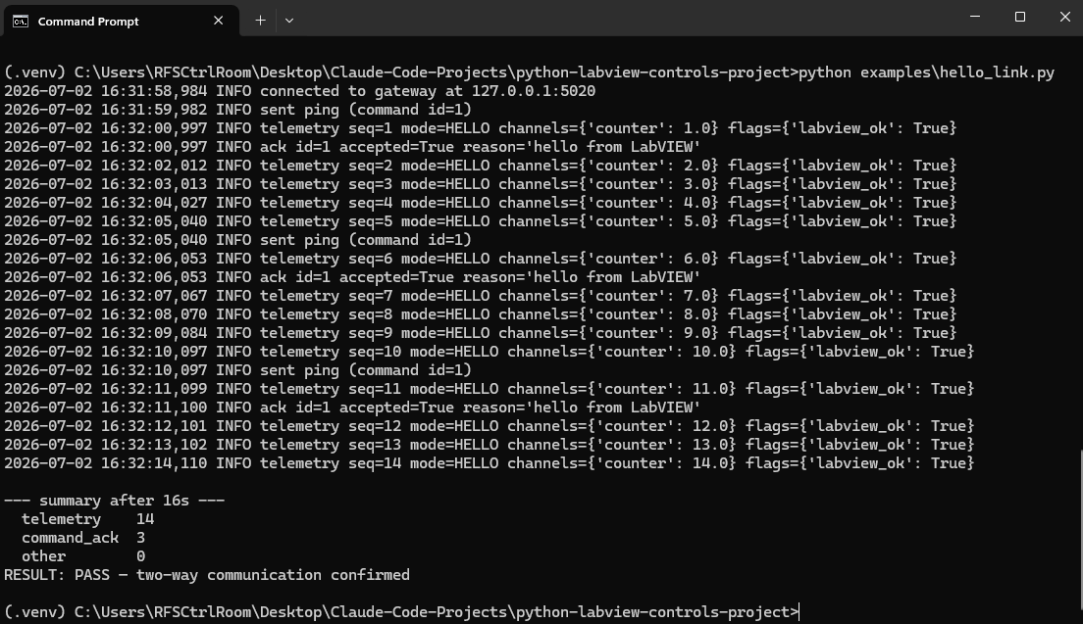
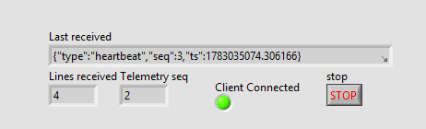
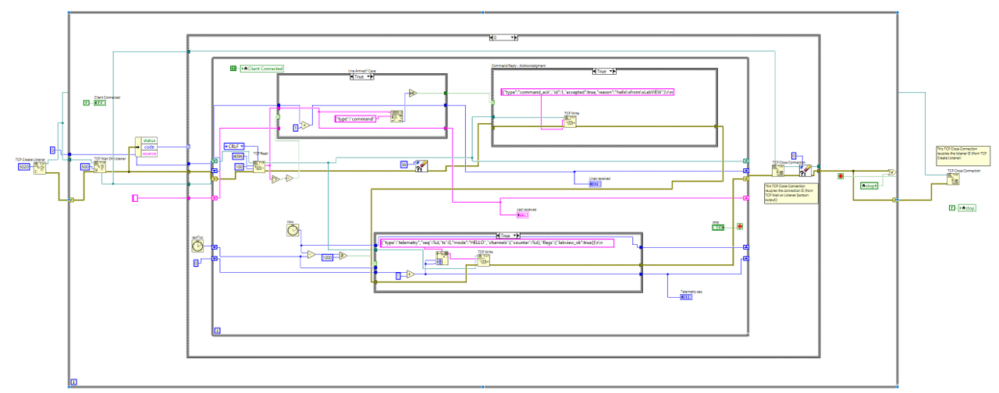
CONTROLS → PYTHON / LABVIEW INTEGRATION
The new Python layer is talking to LabVIEW
First end-to-end “Hello VI” connection test passed: the two systems exchanged data both ways, once a second, running side by side on the control-room PC.
THE TEST, IN PLAIN TERMS
▪ Built a minimal “hello” link between the new Python program and the existing LabVIEW system.
▪ LabVIEW streams a live value to Python once per second; Python sends commands back and LabVIEW acknowledges every one.
▪ Both ran on the same PC: and either side can restart and the link re-establishes itself.
✔ PASS — two-way communication confirmed
LabVIEW side: Client Connected
Python
script
Minimal ‘Hello VI’
LabVIEW
✓ Auto-reconnect
✓ ~1 Hz updates
Python console: live values every second → RESULT: PASS
✓ Two-way link
UNDER THE HOOD
2026-07-02
the LabVIEW test program

