Slide 1
Data Description
Class session No. 1 – Lesson 1
Duration: 3 hours
Block 1 – Session 1: Excel Fundamentals
Instructor: INSERT NAME
Module coordinators: Mercedeh ERFANIANGHASAB & Jérémy CELSE

Slide 2
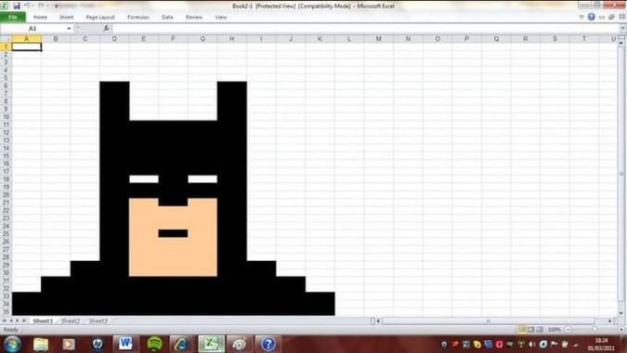
Session objectives
Become familiar with Excel
  Know how to create a simple data table
  Manage changes to the structure of a table
  Manage data sorting
  Manage the different types of copy, paste, and Paste Special
  Know how to fill/copy a formula and use the $ symbol correctly
  Perform basic calculations: sum, distribution, percentages, and percentage change
  Use the IF, AND & OR functions

Slide 3
1 – Getting started

Slide 4
Getting started
DATES | TECHNICIAN | TYPE OF WORK | TIME SPENT | LABOUR BILLED | PARTS BILLED | TOTAL INVOICE EXCL. VAT
03/01/2013 | MARC | INSTALLATION | 01:30 | 75,00 |  | 75,00
03/01/2013 | ALAIN | REPAIR | 01:45 | 87,50 | 27,30 | 114,80
03/01/2013 | JEAN-FRANCOIS | INSTALLATION | 00:45 | 37,50 |  | 37,50
04/01/2013 | MARC | REPAIR | 01:30 | 75,00 | 24,50 | 99,50
04/01/2013 | JEAN | REPAIR | 00:45 | 37,50 | 124,32 | 161,82
04/01/2013 | THIERRY | REPAIR | 02:30 | 125,00 |  | 125,00
04/01/2013 | JEAN-MARC | REPAIR | 02:45 | 137,50 | 158,57 | 296,07
05/01/2013 | ALAIN | REPAIR | 03:00 | 150,00 | 12,10 | 162,10
05/01/2013 | JEAN-FRANCOIS | INSTALLATION | 00:30 | 25,00 |  | 25,00
Let’s start with a simple table
Step 1: Copy this table into EXCEL

Slide 5
You should now be able to:
When the information is repeated, drag the column to copy or increment a value
Use the “Format” option to specify the input format (date, percentage…)
Use the decimal options to increase or decrease the number of decimal places
Adjust the formatting (bold, increase the font size…)
Write on two lines in a single cell
Sort data using the Sort option
Insert rows/columns
Copy and paste a formula/format
Notes:
To write on 2 lines within a single cell: ALT+ENTER

Slide 6
2- Basic calculations
Exercise S1.2

Slide 7
INSTRUCTIONS:
Download the ExerciseS1.2 file
Complete the grey cells
SALARY DETAILS
NAMES | AGES | SALARIES | %
BOUSSY | 40 | 2 371,00 €
BRULE | 42 | 3 234,00 €
CHNEIDER | 28 | 3 972,00 €
CHOMARD | 45 | 1 822,00 €
DAMIA | 39 | 3 214,00 €
DIEUDONNE | 39 | 2 982,00 €
GACHON | 32 | 1 941,00 €
GENTIL | 28 | 2 608,00 €
HEYMANS | 41 | 1 686,00 €
JOSIAN | 37 | 2 432,00 €
JOVELET | 34 | 3 022,00 €
KRETENAN | 29 | 2 582,00 €
LOPEZ | 42 | 3 148,00 €
MAUFRAN | 46 | 3 369,00 €
OCELI | 41 | 1 732,00 €
PERROT | 40 | 2 166,00 €
SANTAMANS | 53 | 2 993,00 €
TOTAL PAYROLL
HIGHEST SALARY
LOWEST SALARY
TOP 3 SALARIES
1
2
3
Basic calculations

Slide 8
Tips – key points to master –
Use the $ symbol to lock certain values
  https://www.excelformation.fr/symbole-dollar-reference-mixte-relative-mixte.html
Use the MIN function to find the smallest value
  MIN(specify the range containing the data)
Use the MAX function to find the largest value
  MAX(specify the range containing the data)
Create a ranking using the LARGE function
  LARGE(specify the range containing the data, rank required)

Slide 9
3 - Basic calculations (2)
Exercise S1.3

Slide 10
Basic calculations 2
INSTRUCTIONS:
Download the ExerciseS1.3 file
Complete the grey cells
SITES | HEADCOUNT 2013 | HEADCOUNT 2014 | PERCENTAGE CHANGE
EPINAL | 12 | 14
LYON | 25 | 28
MONTPELLIER | 12 | 12
NANTES | 13 | 17
NICE | 5 | 6
PARIS | 13 | 12
REIMS | 15 | 18
STRASBOURG | 16 | 15
TOULOUSE | 6 | 16

Slide 11
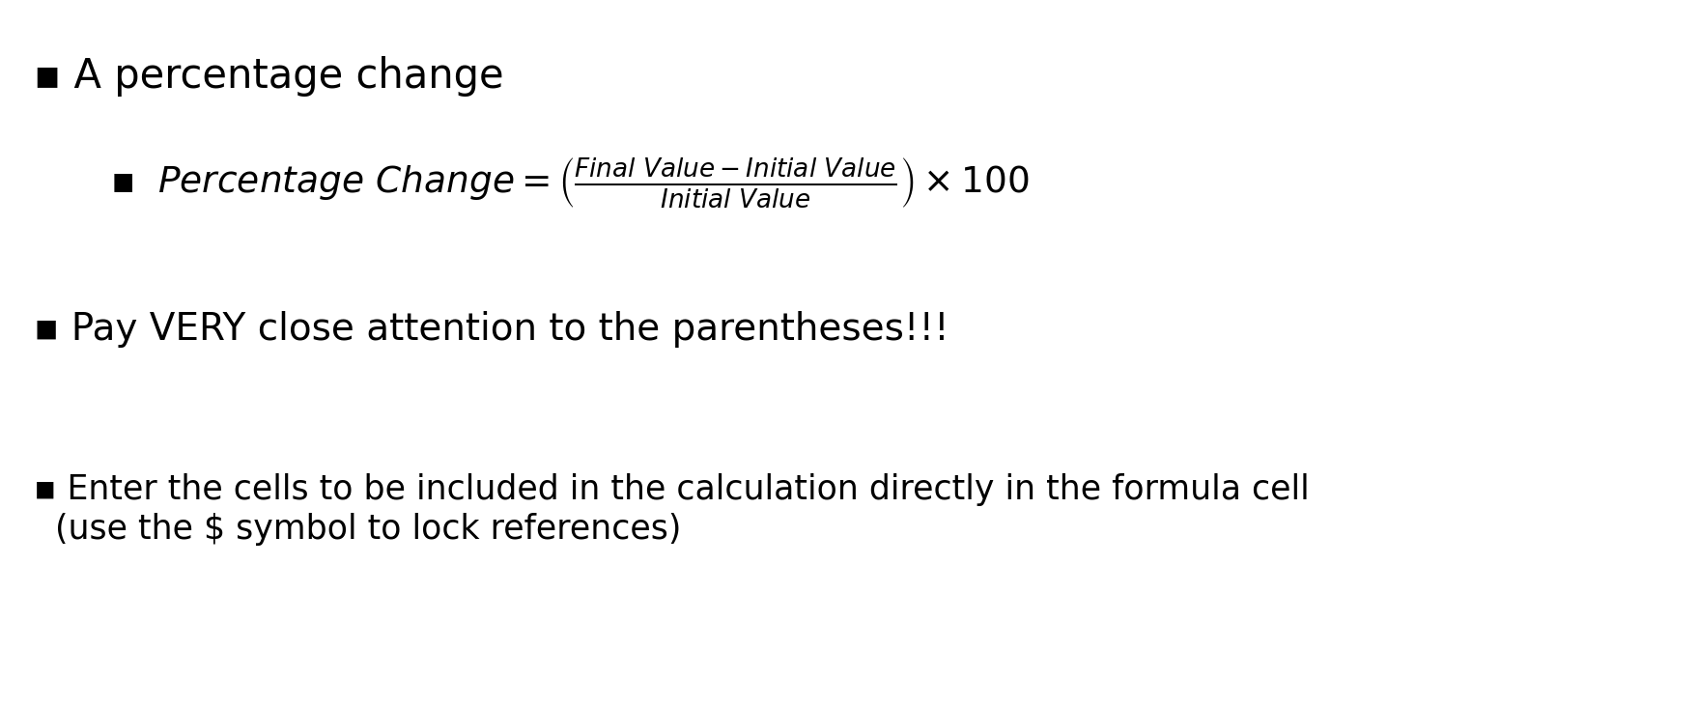
Tips – key points to master –
A percentage change
  $Percentage Change= \left(\frac{Value Final −Value Initial}{Value Initial}\right)×100$
Pay VERY close attention to the parentheses!!!
Enter the cells to be included in the calculation directly in the formula cell (use the $ symbol to lock references)

Slide 12
4- Application exercise
YOU & FOOD TRUCK

Slide 13
Instructions
Download the FoodTruck file and work on it
  Work on Session 1 – Worksheet 1
  Work on Session 1 – Worksheet 2
Worksheet 1: complete the columns % distribution and % change
Worksheet 2: Complete columns G to L of the orange table, the orange summary, and columns D, E & F of the green table
Check your work and call me over to verify it!

Slide 14
5 - Introducing the IF function
Exercise S1.4

Slide 15
Instructions
In column “C”, write “TOO COLD” when the temperature is strictly below 4°
In column “D”, write “TOO COLD” when the temperature is strictly below 4°, “OK” when it is between 4° and 6°, and “TOO HOT” when it is above 6°
Column C ==> Write “TOO COLD” when the temperature is strictly below 4°
Column D ==> Write “TOO COLD” when the temperature is strictly below 4°, “OK” when the temperature is between 4° and 6°, and “TOO HOT” when the temperature is above 6°
REFRIGERATOR TEMPERATURE CHECK
DATES | TEMPERATURES RECORDED | CHECK <4° | CHECK >4° and <=6°
01/01/2014 | 2
08/01/2014 | 11
15/01/2014 | 6
22/01/2014 | 10
29/01/2014 | 5
05/02/2014 | 13
12/02/2014 | 1
19/02/2014 | 7
26/02/2014 | 4
05/03/2014 | 8
12/03/2014 | 6
19/03/2014 | 7
26/03/2014 | 5
02/04/2014 | 10
03/04/2014

Slide 16
The “IF” function
Simple function
  IF(condition to test, “text to enter if the condition is true”, “text to enter if the condition is false”)
  Example:
    IF($B$4<4, “Too cold”, “”)
Nested function (be careful: risk of errors)
  Define the conditions first
  Pay attention to the parentheses
  Example:
    IF($B$4<4, “Too cold”, IF($B$4<=6, “OK”, “Too hot”))
Notes:
To write on 2 lines within a single cell: ALT+ENTER

Slide 17
6- Applying the IF function
Exercise S1.5

Slide 18
Instructions:
The bonus is equal to 5% of the additional revenue achieved above the target
SALES REPRESENTATIVE | TARGET | ACHIEVED | BONUS
ALTRAN | 1 254 600 | 940 950
CHALAVERT | 1 359 150 | 1 495 065
CONVENT | 1 568 250 | 1 630 980
JUMOT | 2 091 000 | 1 965 540
LEBEGUE | 1 986 450 | 2 017 815
RAMONET | 3 241 050 | 3 178 320
RUIZ | 1 986 450 | 1 547 340
VOLLE | 1 254 600 | 1 285 965
VIROLET | 4 704 750 | 4 725 660

Slide 19
Key points to know & remember
Apply the IF function
  IF(C4>=B4,,)
  Because the bonus is paid only when the target is exceeded
The bonus is then equal to 5% of the additional revenue, therefore
  0.05*(C4-B4) if the target is exceeded
  0 if the target is not exceeded
Solution:
  IF(C4>=B4, (C4-B4)*5%, 0)
  IF(C4>=B4, (C4-B4)*0.05, 0)
  IF(C4<B4, 0, (C4-B4)*5%)

Slide 20
7- The AND/OR functions
Exercise S1.6

Slide 21
Instructions:
An employee can receive a €500 bonus only if:
1) They have more than 8 years of service
2) They have a score of at least 12
3) They have no late arrivals
EMPLOYEES | YEARS OF SERVICE | NOTE | NUMBER OF LATE ARRIVALS | BONUS ALL 3 CONDITIONS | BONUS AT LEAST 1 CONDITION
BERGERON | 2 | 15 | 0
DUNAND | 5 | 12 | 2
FABRI | 12 | 6 | 1
GAULON | 6 | 15 | 0
GILLIBERT | 13 | 18 | 0
LELAY | 6 | 10 | 1
LE GRAND | 22 | 9 | 2
RULLET | 4 | 12 | 1
SABER | 9 | 15 | 2
SIMART | 16 | 18 | 0

Slide 22
The AND function
Simple function: returns 1 if all conditions are met
  AND(condition1, condition2, …)
  Example:
    IF(AND(B4>8,C4>=12,D4=0),500,0)

Slide 23
The OR function
Simple function (returns 1 if one condition is met)
  OR(condition1, condition2, …)
  Example:
    IF(OR(B4>8,C4>=12,D4=0),500,0)

Slide 24
8- Individual application
FOOD TRUCK Session 2 → GO!

Slide 25
Epilogue

Slide 26
By the end of this session, you should be able to
START WORKING WITH EXCEL
USE THE FUNCTIONS AVAILABLE ON THE RIBBON
USE SPECIFIC FUNCTIONS

Slide 27
Mercedeh ERFANIANGHASAB: Mercedeh.ERFANIANGHASAB@essca.fr (Lyon)
Jérémy CELSE: jeremy.celse@essca.fr (Bordeaux)

