Slide 1
Data Description
Course session No. 2 – Lesson 2
Duration: 3h
Block 1 – Session 2: Excel Fundamentals
Instructor: INSERT NAME
Module coordinators: Mercedeh ERFANIANGHASAB & Jérémy CELSE

Slide 2
Session objectives
Know how to create and manipulate a PivotTable (count, sum, filter)
Know how to format a PivotTable professionally
Create a PivotChart
Know how to use conditional formatting

Slide 3
1 - Using PivotTables and PivotCharts
Exercise S2.1

Slide 4
Exercise S2.1 – PivotTable (10 min)
Step 1: Go to the “Data” worksheet
review the data
place the cursor in one of the cells and insert a PivotTable: the PivotTable must be inserted in the “Step 1 PivotTable by Count” worksheet
A PivotTable has now been created; you now need to choose the data you want to display.
Notes:
Note: for all data to be included in the PivotTable, the columns and rows must be contiguous.

Slide 5
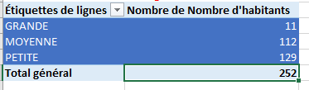
STEP 1 – PivotTable by Count
In the right-hand pane, select the fields you want to display in the PivotTable (by ticking them or dragging them into the relevant areas). Select all the data.
Display the number of cities for each municipality type (small, medium, and large) by selecting the appropriate fields.
Format your table
If it displays the sum by default, go to “Field Settings” and select “Count”

Slide 6
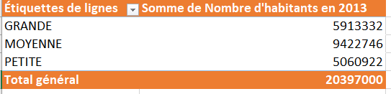
STEP 2 – PivotTable by Sum
Insert the PivotTable again in the appropriate worksheet
Display the population for each municipality type (small, medium, and large) by selecting the appropriate fields.
Format your table

Slide 7
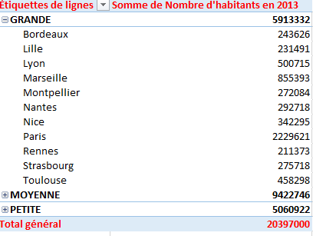
STEP 3 – PivotTable by Sum (details)
Insert the PivotTable again in the appropriate worksheet
Display the population for each municipality type, with details for each city.
Format your table

Slide 8
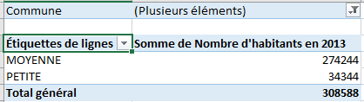
STEP 4 – PivotTable by Sum (Filter)
Insert the PivotTable again in the appropriate worksheet
Display the population for each municipality type and use municipality as a filter
Format your table
Display the values for Ajaccio and Albi only
Row Labels | Sum of Population
MEDIUM | 67507
Ajaccio | 67507
SMALL | 49342
Albi | 49342
Grand Total | 116849

Slide 9
2 - Creating a PivotChart
Exercise S2.2

Slide 10
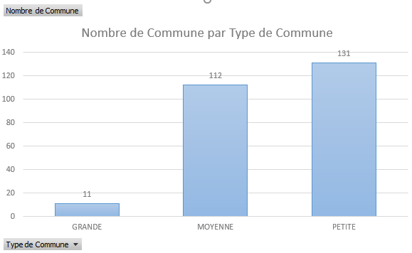
Exercise S2.2 – PivotCharts (10 min)
Go to the “Data” worksheet
place the cursor in one of the cells and insert a PivotChart: the PivotChart must be inserted in the “PivotChart” worksheet
When you click on the chart, the Design tab appears on the ribbon. Change the Quick Layout so that the values are visible.
Notes:
Note: for all data to be included in the PivotTable, the columns and rows must be contiguous.

Slide 11
Exercise S2.3 – Independent PivotTable and PivotChart work (20 min)
Review the data
Question 1. Create a PivotTable showing the total number of teaching hours by year and the associated PivotChart
Question 2. Create a PivotTable showing the total number of teaching hours by semester and the associated chart
Question 3. Create a PivotTable showing the total number of teaching hours by month and the associated PivotChart
Notes:
Note: for all data to be included in the PivotTable, the columns and rows must be contiguous.

Slide 12
3 - Conditional formatting
Exercise S2.4

Slide 13
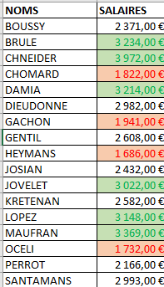
Exercise 2.4 – Conditional formatting (20 min)
Cells can be formatted manually by selecting the cell and applying a background colour.
  Home/Conditional Formatting
Conditional formatting can also automate formatting through the application of rules:
  Display salaries above €3,000 in green.
  Display salaries below €2,000 in red.
  Leave all other salaries white.
  Change the first three salaries to: €1,200, €1,400, and €1,800.
Notes:
Note: for all data to be included in the PivotTable, the columns and rows must be contiguous.

Slide 14
4 - Application exercise
The food truck continues its journey
20 min + 15 min

Slide 15
Instructions
Download the FoodTruck file to work with PivotTables and PivotCharts
Review the “Session 3” worksheets and follow the instructions on Worksheet 2.
The PivotTables must be created in new worksheets and then copied to the “correction” locations.

Slide 16
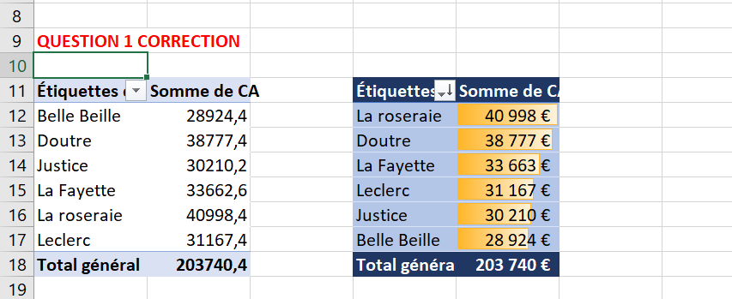
Question 1

Slide 17
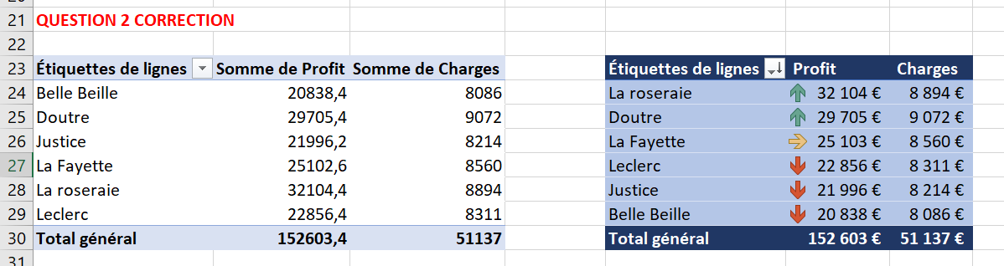
Question 2

Slide 18
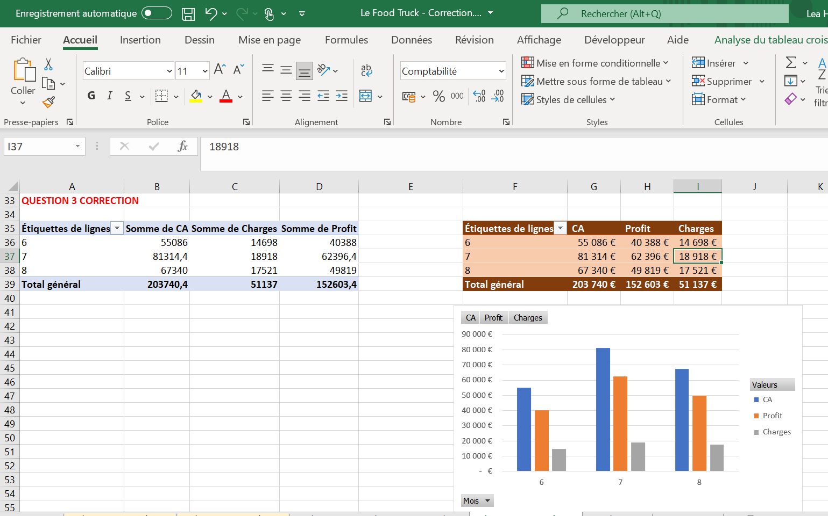
Question 3
This is a PivotTable with an associated PivotChart
You can insert a slicer to make it easier to display specific data

Slide 19
Epilogue

Slide 20
By the end of this session, you should be able to
Work with a PivotTable
Work with a PivotChart

Slide 21
Mercedeh ERFANIANGHASAB: Mercedeh.ERFANIANGHASAB@essca.fr (Lyon)
Jérémy CELSE: jeremy.celse@essca.fr (Bordeaux)

