Slide 1

Course session n°3 – lesson 1
Duration: 6h
Data Description
Block 2 – Session 1: Graphical representation of data and application
Instructor: INSERT NAME
Module coordinators: Mercedeh ERFANIANGHASAB & Jérémy CELSE

Slide 2
Session objectives
Identify a population, an individual and the nature of a variable.
Move from raw data to a summary table.
Calculate counts, frequencies and cumulative frequencies.
Choose and interpret the right graphical tool according to the variable.
Use Excel to summarize the data and produce graphs.
Concepts covered in the session:
MS03-001-G Data Description | Block 2 - Univariate treatment
1

Slide 3
Breakdown of the session
1. Vocabulary
2. Raw data
Population, individual, variable and modalities.
Organize a statistical series in a table.
3. Operations
4. Graphs
Counts, frequencies, increasing and decreasing cumulative values.
Bar charts, pie charts, histogram and cumulative curve.
5. Excel application
Company case study, tables and graphs.
Each concept is linked to an example or a short activity.
MS03-001-G Data Description | Block 2 - Univariate treatment
2

Slide 4
1. Statistical vocabulary

Slide 5
Population, individual, variable
Population
Statistical individual
Set of elements studied. It can be finite when the number of individuals is known, or infinite when it cannot be determined exactly.
An element of the population on which one or more variables are observed.
Variable = observed characteristic
Examples: gender, level of education, number of children, net salary.
MS03-001-G Data Description | Block 2 - Univariate treatment
3

Slide 6
Nature of variables
Nature
Examples
Common graph
Nominal qualitative
Gender, city, means of transport
Bars / pie charts
Ordinal qualitative
Satisfaction, level of education
Ordered bars
Discrete quantitative
Number of children, number of calls
Stick chart / step curve
Continuous quantitative
Salary, weight, duration
Histogram / continuous curve
MS03-001-G Data Description | Block 2 - Univariate treatment
4

Slide 7
Short activity: identify the nature
Hair colour of hair salon customers
Satisfaction level with a telephone operator
Number of people in Parisian households
Exact waiting time before a telephone answer
Question to ask students: for each variable, state whether it is qualitative/quantitative, nominal/ordinal, discrete/continuous.
MS03-001-G Data Description | Block 2 - Univariate treatment
5

Slide 8
2. From raw data to table

Slide 9
Raw data and statistical series
Univariate = one single variable observed
A variable is observed on all individuals in a population or a sample.
Raw data
Summary table
The responses are collected without any particular organization, often in an Excel column.
The modalities are grouped with their absolute counts nᵢ and frequencies fᵢ.
Modalities
nᵢ
fᵢ
x₁
…
…
x₂
…
…
Total
n
1
MS03-001-G Data Description | Block 2 - Univariate treatment
6

Slide 10
Example: nominal qualitative variable
Gender
Number
Frequency
M
15
62.5 %
F
9
37.5 %
Total
24
100 %
For a nominal variable, the order of the modalities has no particular meaning.
MS03-001-G Data Description | Block 2 - Univariate treatment
7

Slide 11
Example: discrete quantitative variable
Grade
Count
7
2
8
6
11
6
12
5
13
2
16.5
3
MS03-001-G Data Description | Block 2 - Univariate treatment
8

Slide 12
3. Basic operations

Slide 13
Count, frequency and cumulative values
fᵢ = nᵢ / n
Frequency expresses the share represented by a modality.
nᵢ⁺ et fᵢ⁺
Increasing cumulative value: counts or frequencies are added from the beginning up to modality i.
nᵢ⁻ et fᵢ⁻
Decreasing cumulative value: counts or frequencies are added from modality i to the end.
MS03-001-G Data Description | Block 2 - Univariate treatment
9

Slide 14
Guided exercise: temperatures
Temperature
Number of days
fᵢ
fᵢ⁺
-1
40
20 %
20 %
0
34
17 %
37 %
2
86
43 %
80 %
3
20
10 %
90 %
7
20
10 %
100 %
MS03-001-G Data Description | Block 2 - Univariate treatment
10

Slide 15
4. Choose the right graph

Slide 16
Variables qualitatives : Bar and Pie charts
Bar chart
Pie chart
Easily compare counts or frequencies across modalities.
Show the composition of a total, especially when the number of modalities is limited.
MS03-001-G Data Description | Block 2 - Univariate treatment
11

Slide 17
Discrete variable: stick chart and cumulative curve
Number of calls
Number of days
0
101
1
140
2
92
3
42
4
18
5
3
MS03-001-G Data Description | Block 2 - Univariate treatment
12

Slide 18
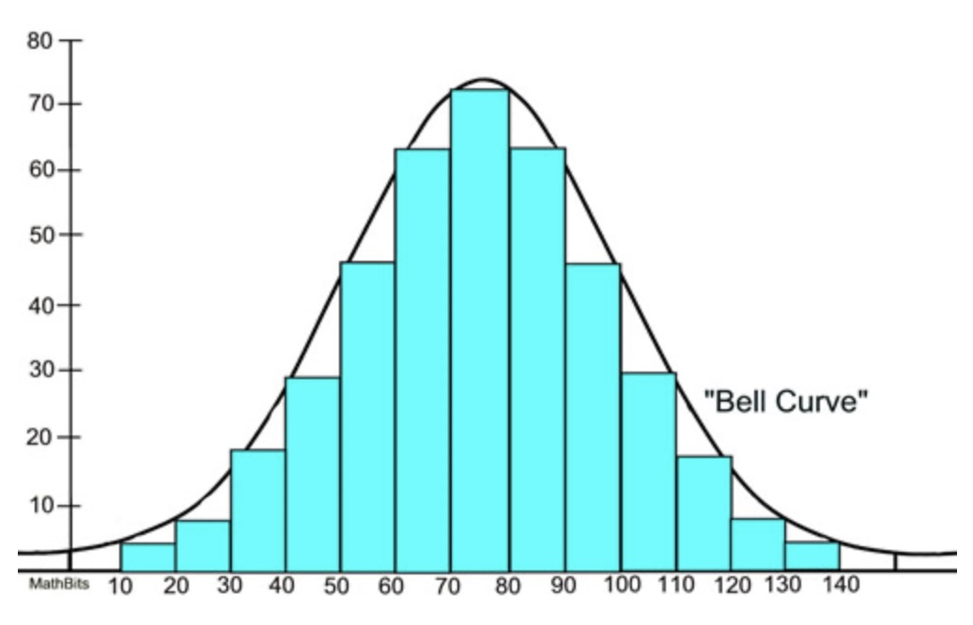
Continuous variable: histogram
Weight
Number
[0 ; 50]
20
[50 ; 60]
12
[60 ; 70]
11
[70 ; 100]
7
Important: if the classes do not have the same width, the height of the rectangle must be adjusted.
MS03-001-G Data Description | Block 2 - Univariate treatment
13

Slide 19
Open classes
First open class
Last open class
A class of the type “< a” is closed by convention using the width of the second class.
A class of the type “≥ a” is closed by convention using the width of the penultimate class.
Age
Number of visitors
< 18
5
[18 ; 20]
15
[20 ; 30]
20
[30 ; 35]
30
[35 ; 50]
23
≥ 50
7
MS03-001-G Data Description | Block 2 - Univariate treatment
14

Slide 20
5. Excel application

Slide 21
Excel: summarize the data
COUNT / COUNTA
Count numerical values or non-empty cells.
COUNTIF
Count cells that satisfy a criterion.
COUNTIFS
Count cells according to several criteria.
Create the summary tables for the variables Gender, Study and Number of children.
Calculate counts, frequencies and cumulative frequencies.
Build the appropriate graphs for each variable.
Use pivot tables when relevant.
MS03-001-G Data Description | Block 2 - Univariate treatment
15

Slide 22
Practical case: company A
Variable
Nature
Expected work
Gender
Nominal qualitative
Table + graph
Study
Ordinal qualitative
Table + graph
Nb of children
Discrete quantitative
Table + cumulative values
Salary
Continuous quantitative
Classes + histogram
Source used: Practical Work document – Session 3 and file PW – Session 3.xlsx.
MS03-001-G Data Description | Block 2 - Univariate treatment
16

Slide 23
Epilogue
By the end of this session, you should know
Identify the nature of a variable.
Build a summary table from raw data.
Calculate counts, frequencies and cumulative frequencies.
Choose a graph adapted to the variable studied.
Use Excel to produce tables and graphs.
Mercedeh ERFANIANGHASAB: Mercedeh.ERFANIANGHASAB@essca.fr (Lyon)
Jérémy CELSE: jeremy.celse@essca.fr (Bordeaux)
MS03-001-G Data Description | Block 2 - Univariate treatment
17

