Slide 1

Data Description
Session 1
Mercedeh ERFANIANGHASAB & Jérémy CELSE
Mercedeh.ERFANIANGHASAB@essca.fr | jeremy.celse@essca.fr

Slide 2
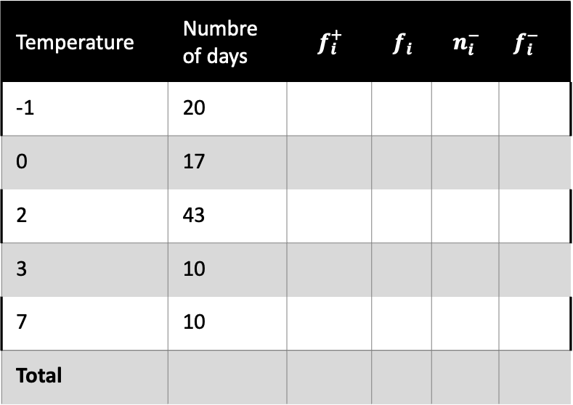
Exercise 1
Temperature | Numbre of days | $$f_{i}^{+}$$ | $$f_{i}$$ | $$n_{i}^{−}$$ | $f_{i}^{−}$
-1 | 20
0 | 17
2 | 43
3 | 10
7 | 10
Total
We studied the morning temperature (i.e. measured between 7am and 7.30am) over 100 days chosen randomly from the periods of winter observed for the last 20 years.
Complete the following table:

Slide 3
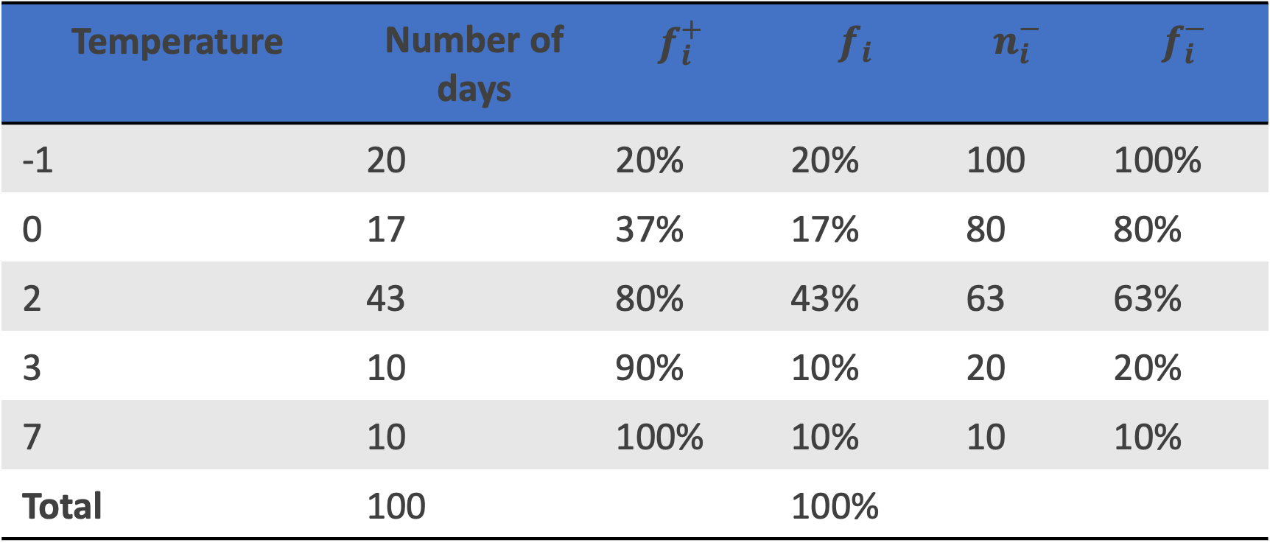
Exercise 1- Solution
Temperature | Number of days | $$f_{i}^{+}$$ | $$f_{i}$$ | $$n_{i}^{−}$$ | $f_{i}^{−}$
-1 | 20 | 20% | 20% | 100 | 100%
0 | 17 | 37% | 17% | 80 | 80%
2 | 43 | 80% | 43% | 63 | 63%
3 | 10 | 90% | 10% | 20 | 20%
7 | 10 | 100% | 10% | 10 | 10%
Total | 100 |  | 100%

Slide 4
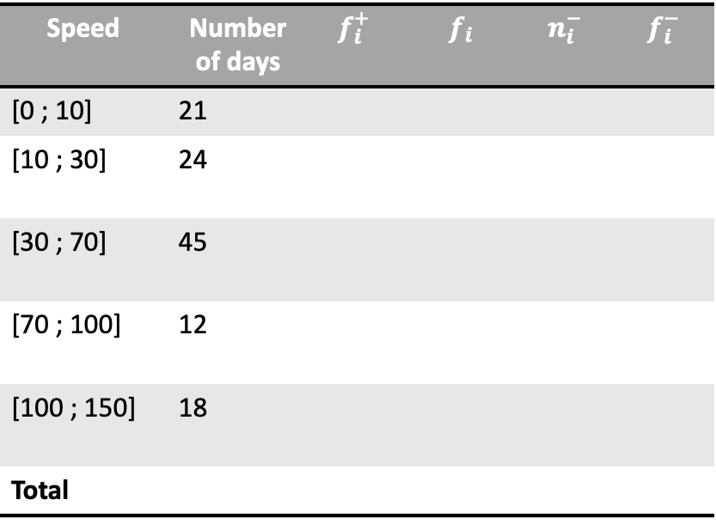
Exercise 2
Speed | Number of days | $$f_{i}^{+}$$ | $$f_{i}$$ | $$n_{i}^{−}$$ | $f_{i}^{−}$
[0 ; 10] | 21
[10 ; 30] | 24
[30 ; 70] | 45
[70 ; 100] | 12
[100 ; 150] | 18
Total
We studied the morning speed (i.e. measured (in Km/h) between 7am and 7.30am) of the wind on n days chosen randomly from the periods of winter observed for the last 20 years.
Complete the following table:

Slide 5
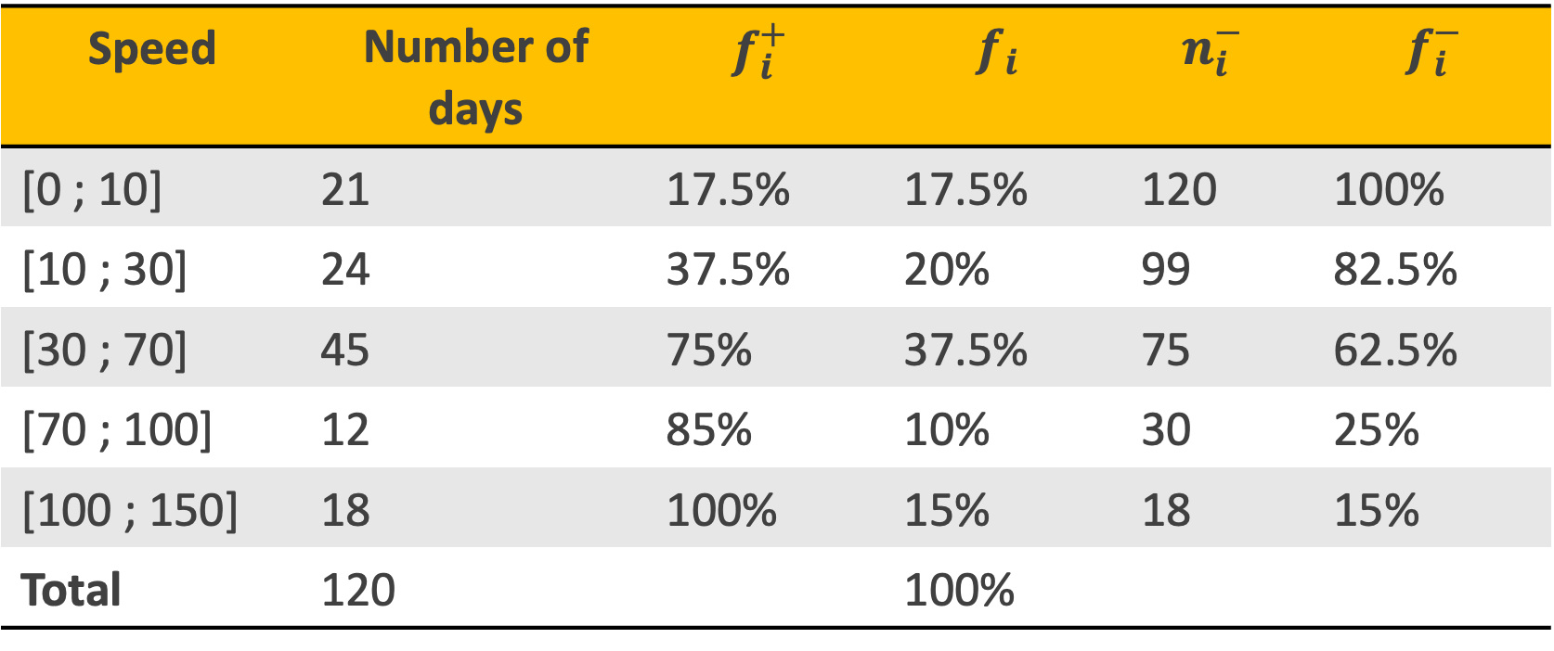
Exercise 2 - Solution
Speed | Number of days | $$f_{i}^{+}$$ | $$f_{i}$$ | $$n_{i}^{−}$$ | $f_{i}^{−}$
[0 ; 10] | 21 | 17.5% | 17.5% | 120 | 100%
[10 ; 30] | 24 | 37.5% | 20% | 99 | 82.5%
[30 ; 70] | 45 | 75% | 37.5% | 75 | 62.5%
[70 ; 100] | 12 | 85% | 10% | 30 | 25%
[100 ; 150] | 18 | 100% | 15% | 18 | 15%
Total | 120 |  | 100%

