Slide 1

Data Description
Session 1
Mercedeh ERFANIANGHASAB & Jérémy CELSE
Mercedeh.ERFANIANGHASAB@essca.fr | jeremy.celse@essca.fr

Slide 2
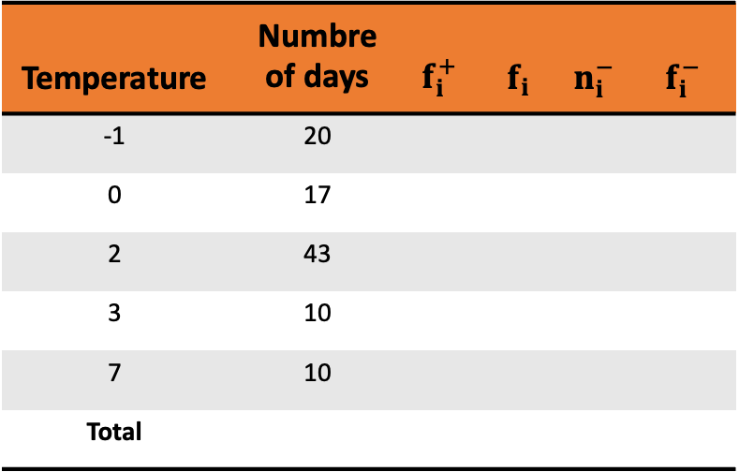
Exercise 1
We studied the morning temperature (i.e. measured between 7am and 7.30am) over 100 days chosen randomly from the periods of winter observed for the last 20 years.
Complete the following table:
Temperature | Numbre of days | $$f_{i}^{+}$$ | $$f_{i}$$ | $$n_{i}^{−}$$ | $f_{i}^{−}$
-1 | 20
0 | 17
2 | 43
3 | 10
7 | 10
Total

Slide 3
Note

Slide 4
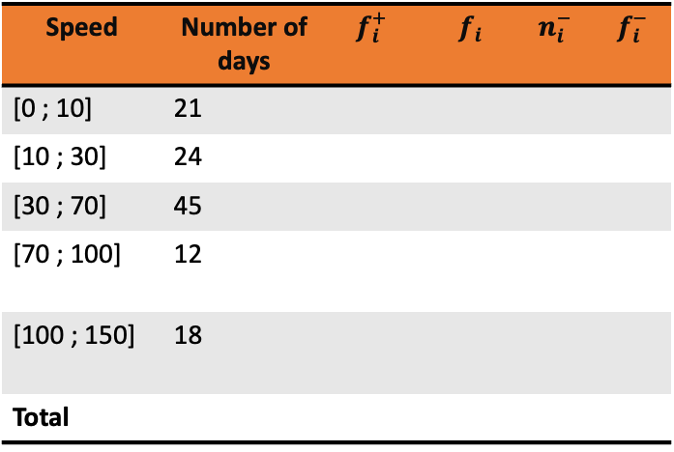
Exercise 2
We studied the morning speed (i.e. measured (in Km/h) between 7am and 7.30am) of the wind on n days chosen randomly from the periods of winter observed for the last 20 years.
Complete the following table:
Speed | Number of days | $$f_{i}^{+}$$ | $$f_{i}$$ | $$n_{i}^{−}$$ | $f_{i}^{−}$
[0 ; 10] | 21
[10 ; 30] | 24
[30 ; 70] | 45
[70 ; 100] | 12
[100 ; 150] | 18
Total

Slide 5
Note

