Slide 1
Data Description
Class session no. 9 – Lesson 6
Duration: 3h
Block 3 – Session 1: Bivariate Analysis and Application I
Instructor: INSERT NAME
Module Coordinators: Mercedeh ERFANIANGHASAB & Jérémy CELSE

Slide 2
Session Objectives
Topics covered in this session:
  Analyse two variables
  Read pairs of data
  Construct a scatter plot and locate the centroid
  Calculate and interpret covariance

Slide 3
Session Outline
1. Introduction
2. Raw Data
What is bivariate analysis? What type of relationship are we trying to characterise?
Read a series of pairs (xi ; yi) measured on the same individuals.
3. Scatter Plot
4. Centroid
Plot the pairs graphically and identify any visible trend.
Calculate and plot G(xbar ; ybar), the summary point of the scatter plot.
5. Covariance
Calculate and interpret covariance.
Each concept is immediately followed by a short activity.
More extensive calculations are limited to the mean: covariance and correlation are reserved for Session 2.
MS03-001-G Data Description | Block 3 - Bivariate Analysis
2

Slide 4
1. Introduction

Slide 5
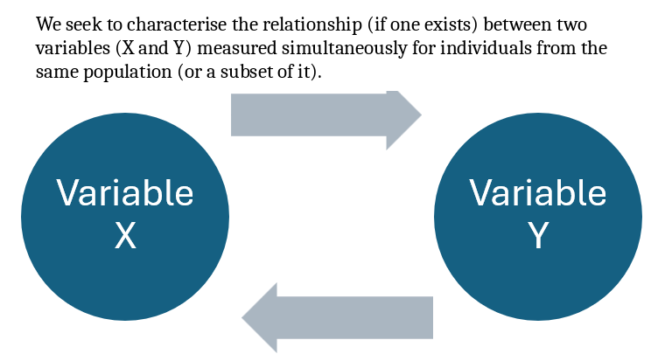
1. Introduction to Bivariate Data
Definition
Objective
Bivariate analysis examines two variables simultaneously, observed for the same statistical individuals.
Describe a possible statistical relationship: its existence, direction, and apparent form.
MS03-001-G Data Description | Block 3 - Bivariate Analysis
3

Slide 6
The existence of a relationship between the data from two variables does not imply “causality” → a relationship in which changes in one variable cause changes in another.
Important: a statistical relationship does not imply causality.
The first step is to look for a visible pattern in the data.
We begin by plotting the pairs rather than performing calculations.

Slide 7
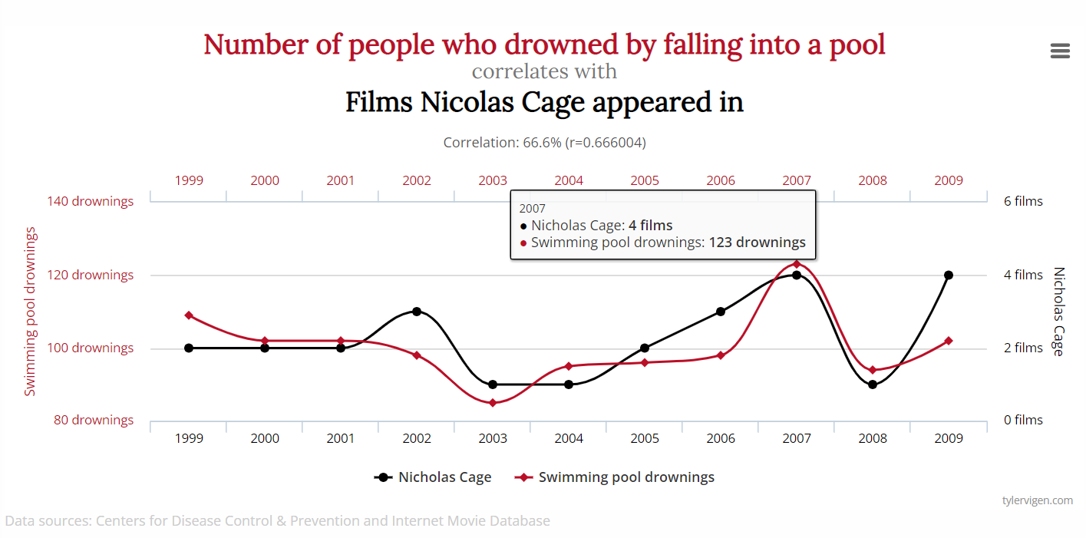

Slide 8
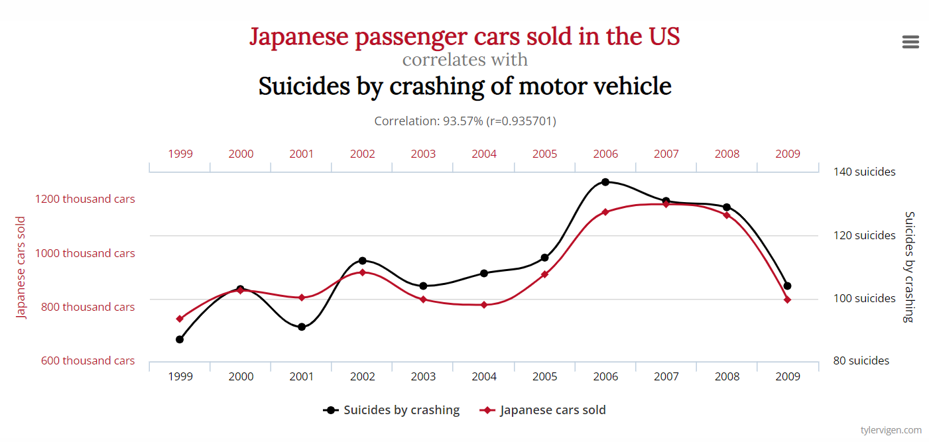

Slide 9
2. Graphical Bivariate Analysis

Slide 10
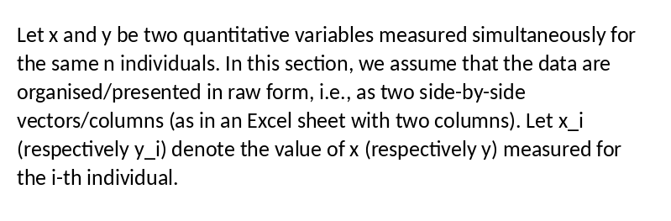
Applies only to quantitative variables.

Slide 11
Structure
Week
x: Monday
y: Saturday
Each row corresponds to one individual; each individual has two values: xi and yi.
1
800
1200
2
920
1300
3
760
1150
x is plotted on the horizontal axis.
y is plotted on the vertical axis.
The pair (xi ; yi) becomes a point on the graph.
4
1050
1450
5
980
1380
6
1100
1500
MS03-001-G Data Description | Block 3 - Bivariate Analysis
4

Slide 12
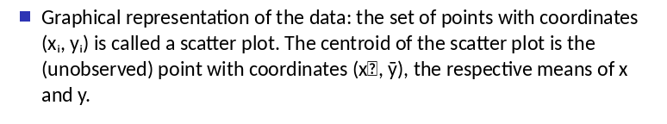
Applies to quantitative variables only

Slide 13
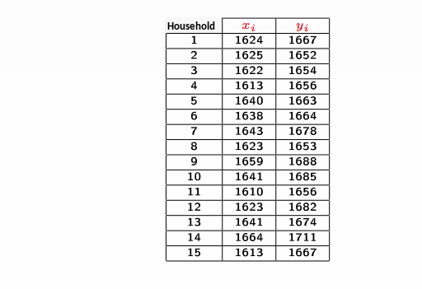


Example
Population: French households in which both the man and the woman are employed
Number of households studied = 15
Variables studied simultaneously for each household:
    The woman’s salary → $x$
    The man’s salary → $y$
Objective: assess whether a relationship exists between the data for $x$ et $y$
The data:
$$\overline{x}=1631.993$$
&
$\overline{y}=1670$

Slide 14
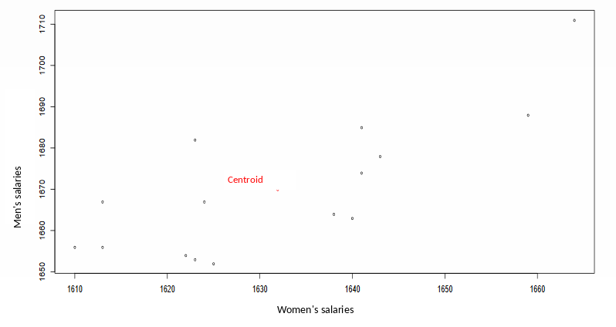
Graphical Representation – Scatter Plot

Slide 15
3. Covariance

Slide 16

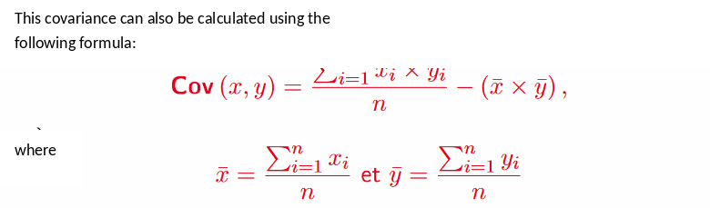
Formula

Slide 17
Interpretation
There are three possible cases:
Si Cov (x, y) = 0 → No correlation
Si Cov (x, y) > 0 → Positive correlation (the variables move in the same direction)
Si Cov (x, y) < 0 → Negative correlation (the variables move in opposite directions).

Slide 18
Example
Calculate the covariance

Slide 19
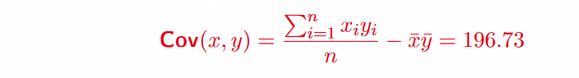
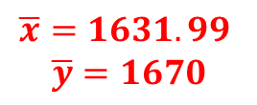
Example
Step 1: Calculate the two means
Step 2: Calculate the covariance
$$\overline{x}=1631.99$$
$$\overline{y}=1670$$

Slide 20

Details
 | Xi | Yi | XIYI
1 | 1624 | 1667 | 2707208
2 | 1625 | 1652 | 2684500
3 | 1622 | 1654 | 2682788
4 | 1613 | 1656 | 2671128
5 | 1640 | 1663 | 2727320
6 | 1638 | 1664 | 2725632
7 | 1643 | 1678 | 2756954
8 | 1623 | 1653 | 2682819
9 | 1659 | 1688 | 2800392
10 | 1641 | 1685 | 2765085
11 | 1610 | 1656 | 2666160
12 | 1623 | 1682 | 2729886
13 | 1641 | 1674 | 2747034
14 | 1664 | 1711 | 2847104
15 | 1613 | 1667 | 2688871
$$Cov \left(x,y\right)=\frac{40882881}{15}−(1631,93)(1670)$$
Sum = 40882881

Slide 21
Summary

Slide 22
By the end of this session, you should be able to:
Graphically represent data from two variables analysed jointly
Construct a scatter plot
Calculate and interpret covariance

Slide 23
Mercedeh ERFANIANGHASAB: Mercedeh.ERFANIANGHASAB@essca.fr (Lyon)
Jérémy CELSE: jeremy.celse@essca.fr (Bordeaux)

Slide 24
Special case: discrete vs continuous
Oh dear, I have a continuous variable X with 6 classes and a discrete variable Y with 4 categories!
How do I calculate the covariance?

