Slide 1
Data Description
Course session No. 10 – Lesson 7
Duration: 3 hours
Block 3 – Session 2: Bivariate Analysis and Application II
Instructor: INSERT NAME
Module coordinators: Mercedeh ERFANIANGHASAB & Jérémy CELSE

Slide 2
Session objectives
Topics covered in this session:
  Calculate the covariance between two variables of different types
  Calculate and interpret a coefficient of variation

Slide 3
1. Covariance between two variables of different types

Slide 4
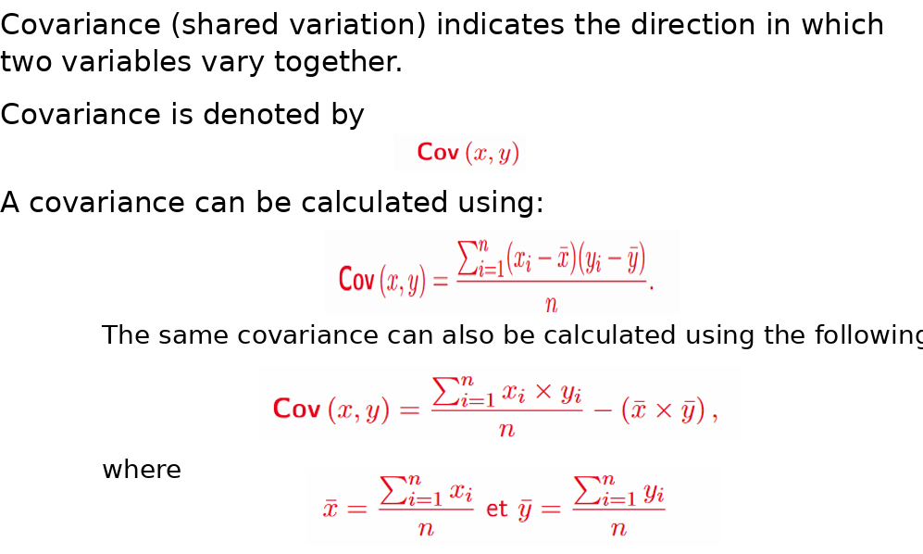
Review

Slide 5
Special case: discrete–continuous covariance
When one variable is continuous and grouped into classes, while the other is discrete
Variable X
Variable Y
Continuous, but observed in classes. Therefore, the exact individual values are not known.
Discrete, with a finite number of categories, for example 0, 1, 2, 3.
Learning objective
Key idea
Move from a contingency table to a covariance calculation without jumping straight to the formula.
First, convert the continuous variable into class midpoints, then calculate as you would with a weighted cross-tabulation.
Covariance measures how X and Y vary together.
However, X is grouped, so each class must be replaced by a representative value.
This representative value is the class midpoint.
MS03-001-G Data Description | Discrete–continuous case
1

Slide 6
Step 1 — Read the contingency table
Each cell
xᵢ \ yⱼ
0
1
2
3
Total
nᵢⱼ = number of observations in class xᵢ and category yⱼ.
24
14
6
5
3
28
28
12
7
5
4
28
34
10
10
3
2
25
The rows correspond to the class midpoints of X.
The columns correspond to the categories of Y.
The grand total is n = 124.
42
4
3
2
5
14
51
2
10
4
1
17
59
3
3
2
4
12
Total
45
39
21
19
124
Key point
Calculations use the class midpoints, not the class boundaries.
MS03-001-G Data Description | Discrete–continuous case
3

Slide 7
Step 2 — Calculate the two means
Mean of X
Mean of Y
Calculation using the marginal totals
In this example
nᵢ· is the total for row i.
n·ⱼ is the total for column j.
x̄ = 36,04
ȳ = 1,11
The means are not calculated directly from the individual cells of the table.
Instead, use the marginal totals because each row or column represents a group of observations.
MS03-001-G Data Description | Discrete–continuous case
4

Slide 8
Step 3 — Calculate the mean of the XY products
Idea
Simple interpretation
For each cell:
1. take the frequency nᵢⱼ;
2. multiply by the midpoint xᵢ;
3. multiply by the category value yⱼ.
xᵢ \ yⱼ
0
1
2
3
24
0
144
240
216
Sum of products
28
0
196
280
336
ΣΣ nᵢⱼxᵢyⱼ = 5 276
E(XY) = 5 276 / 124 = 42,55
34
0
340
204
204
42
0
126
168
630
51
0
510
408
153
59
0
177
236
708
MS03-001-G Data Description | Discrete–continuous case
5

Slide 9
Step 4 — Move from E(XY) to covariance
Most intuitive formula
Operational formula
Numerical application
Interpretation
E(XY) = 42,55
x̄ = 36,04
ȳ = 1,11
Cov(X,Y) = 42,55 − 36,04 × 1,11 = 2,44
The covariance is positive: in this example, higher values of X tend to be associated with higher values of Y.
Important: covariance retains the units of X and Y and is mainly used to indicate the direction of the relationship. To assess the standardised strength of the relationship, calculate the correlation coefficient.
MS03-001-G Data Description | Discrete–continuous case
6

Slide 10
2. Linear correlation coefficient

Slide 11
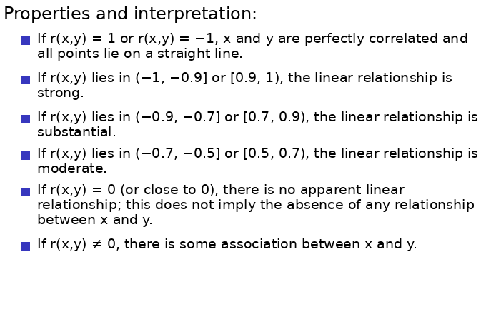
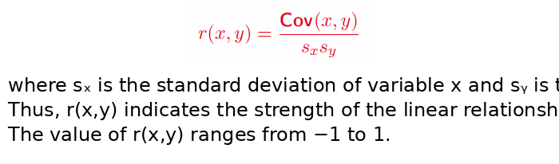
Formula

Slide 12
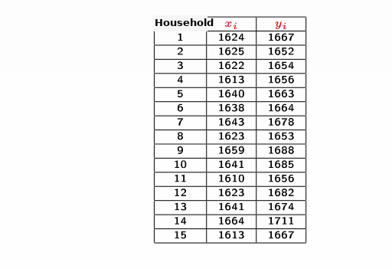
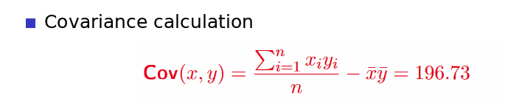
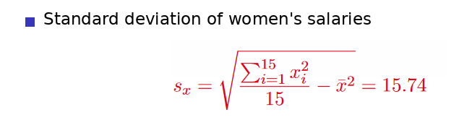
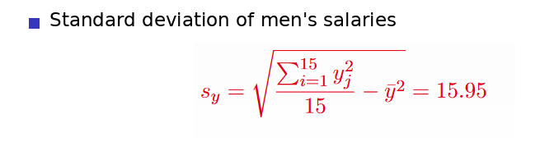
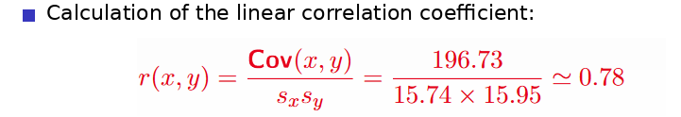
Example
Coefficient > 0, indicating a strong positive relationship between the two variables.

Slide 13
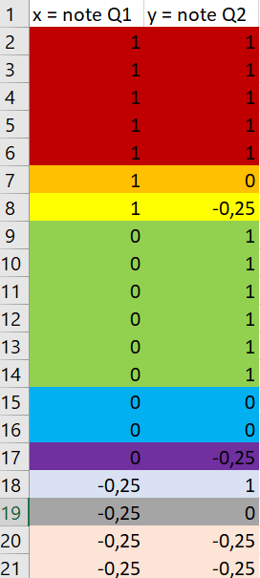
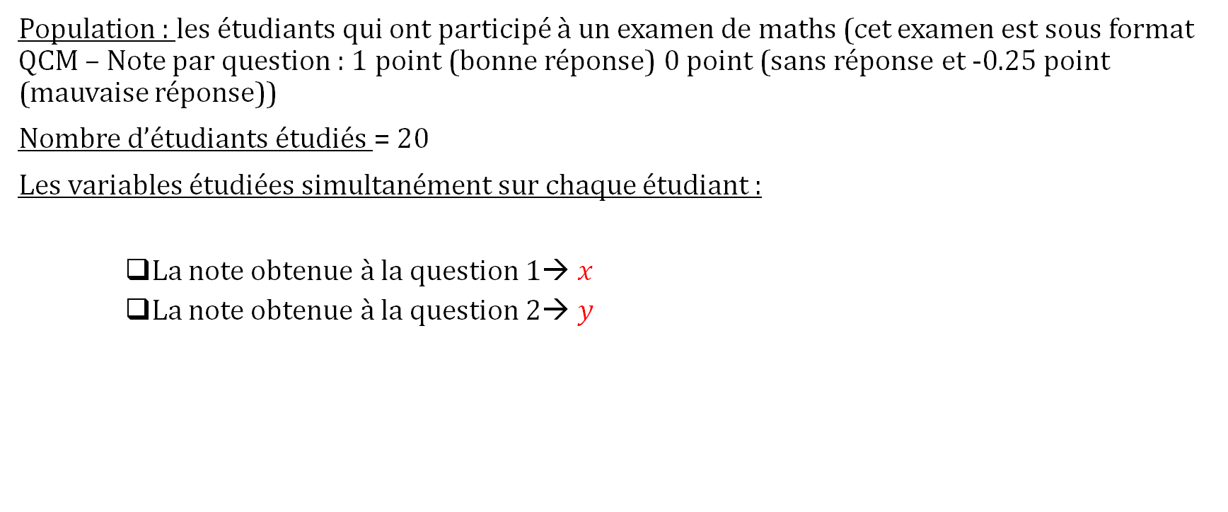
Special case: two quantitative variables presented in a contingency table
Population: students who took a mathematics exam. The exam used a multiple-choice format, with 1 point for a correct answer, 0 points for no answer, and −0.25 points for an incorrect answer.
Number of students studied = 20
The two variables measured for each student are:
    Score obtained on Question 1 →$x$
    Score obtained on Question 2 →$y$

Slide 14
Introductory example:
The data
x | Number of students
1
0
-0.25
x | y | 1 | 0 | -0.25
1 |  | 5 | 1 | 1
0 |  | 6 | 2 | 1
-0.25 |  | 1 | 1 | 2
y | Number of students
1
0
-0.25

Slide 15


Case of two quantitative variables whose data are presented in a contingency table
Introductory example:
The data
$$\overline{x}=0.3$$
$${ s}_{x}≈0.522$$
x | Number of students
1 | 7
0 | 9
-0.25 | 4
x | y | 1 | 0 | -0.25
1 |  | 5 | 1 | 1
0 |  | 6 | 2 | 1
-0.25 |  | 1 | 1 | 2
y | Number of students
1 | 12
0 | 4
-0.25 | 4
$$\overline{y}=0.55$$
$${ s}_{y}≈0.557$$

Slide 16

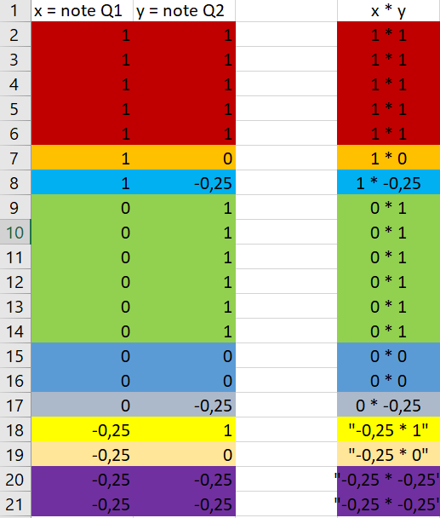


Introductory example:
Covariance calculation
$$= \frac{1∗1 ∗5+1 ∗0 ∗1+1∗−0,25 ∗1+0∗1 ∗6+0∗0 ∗2+0 ∗−0.25 ∗1+ …+\left(−0.25\right)∗\left(−0.25\right)∗2 }{20}$$
The covariance is equal to:
= $\frac{4.625}{20} −\left(0.3 ∗0.55\right)=0.06625$

Slide 17
Epilogue

Slide 18
By the end of this session, you should be able to
Calculate covariance regardless of the variable types
Calculate a linear correlation coefficient
Interpret a linear correlation coefficient

Slide 19
Mercedeh ERFANIANGHASAB: Mercedeh.ERFANIANGHASAB@essca.fr (Lyon)
Jérémy CELSE: jeremy.celse@essca.fr (Bordeaux)

Slide 20
Special case: discrete vs continuous
Uh-oh! I have a continuous variable X with 6 classes and a discrete variable Y with 4 categories!
How do I calculate the covariance?

