Slide 1

Data Description
Session 2
Mercedeh ERFANIANGHASAB
Jérémy CELSE
Mercedeh.ERFANIANGHASAB@essca.fr | jeremy.celse@essca.fr

Slide 2
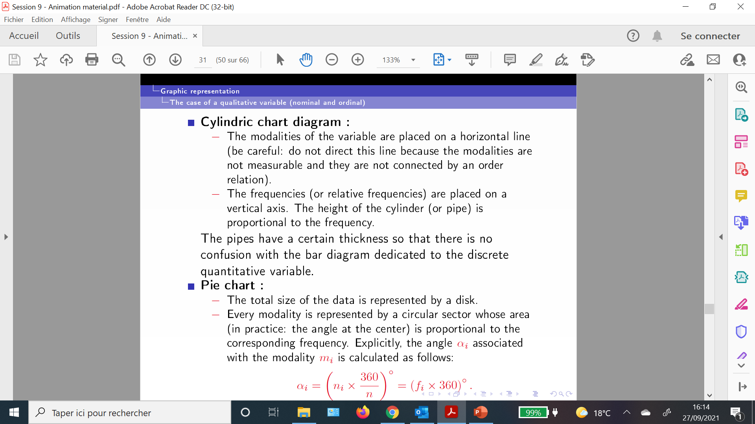

Graphical representation of data
The case of data from a qualitative variable :
The bar chart
The pie chart

Slide 3
Example
Source | Amount (billion)
VAT | 348
Income taxes | 163
Corporate taxes | 71
Taxes on petroleum products | 54
Other taxes | 161
Non-tax revenue | 41
The table below shows a country's budget

Slide 4
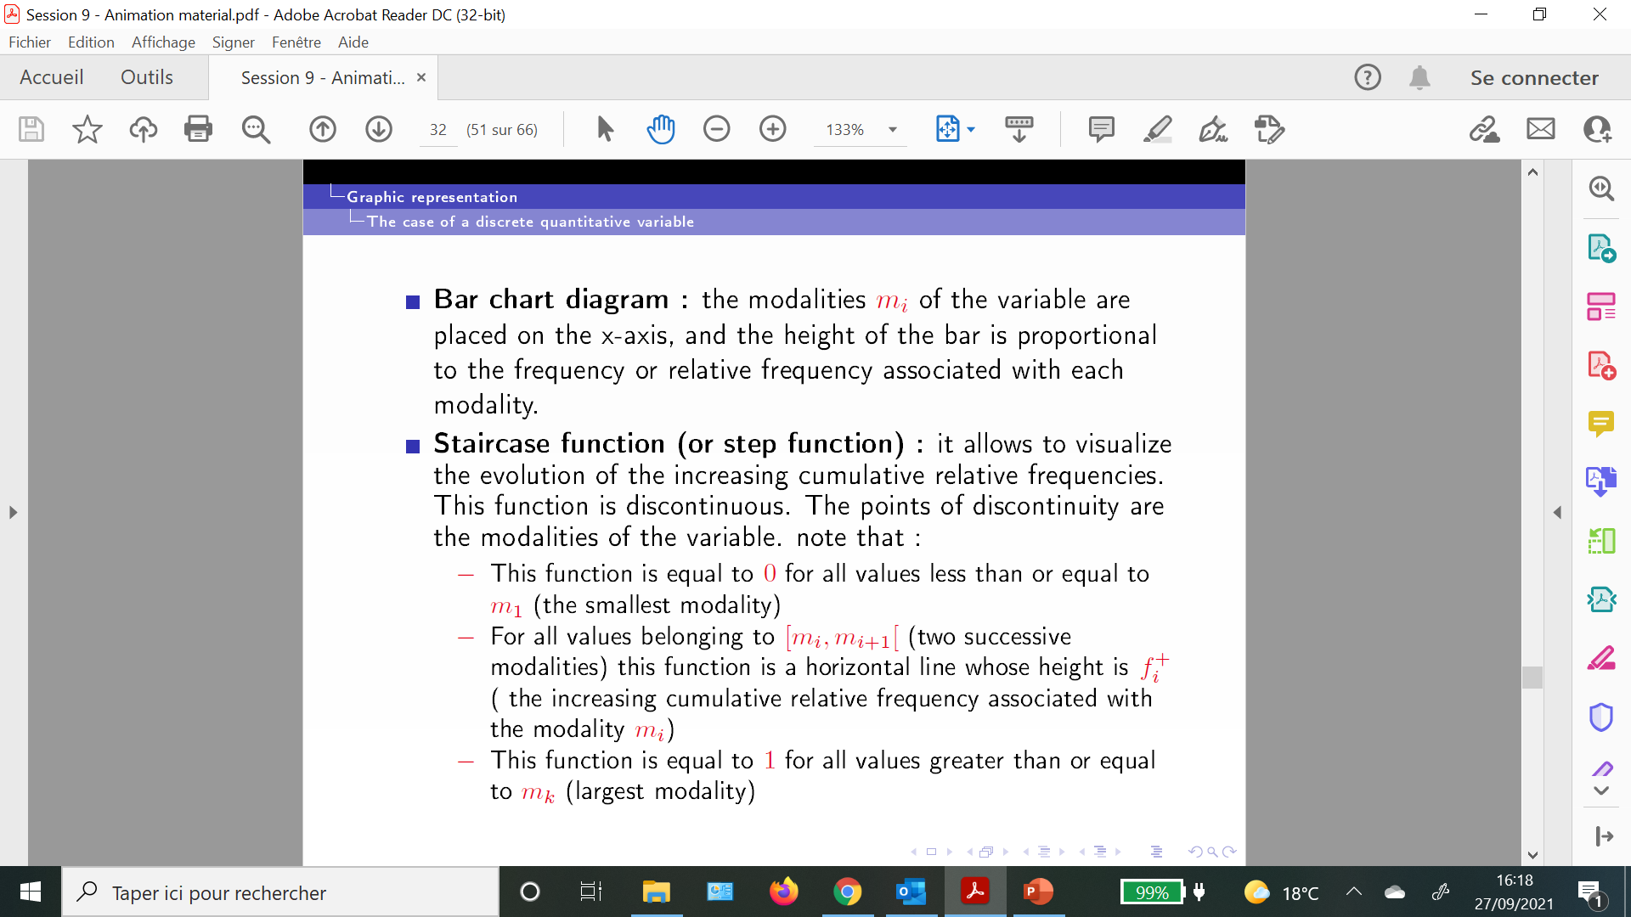
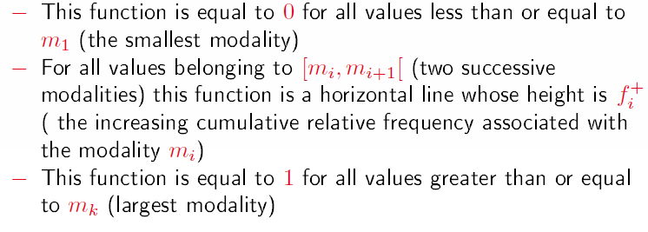
Graphical representation of data
The case of data from a discrete variable

Slide 5
Example
Data in table below represents the number of calls (observed over 396 days) received between 12.00 and 13.00, at the after sales service of a big store.
Objectives
Represent graphically the data
Plot the curve of increasing cumulative frequencies
Number of calls | Number of days
0 | 101
1 | 140
2 | 92
3 | 42
4 | 18
5 | 3

Slide 6
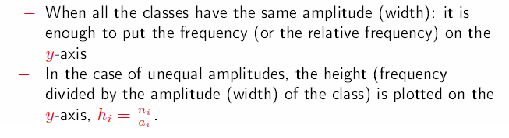
Graphical representation of data
The case of data in a continuous variable (grouped into classes)
The histogram is a graph composed of rectangles whose area is proportional to the size of the class

Slide 7
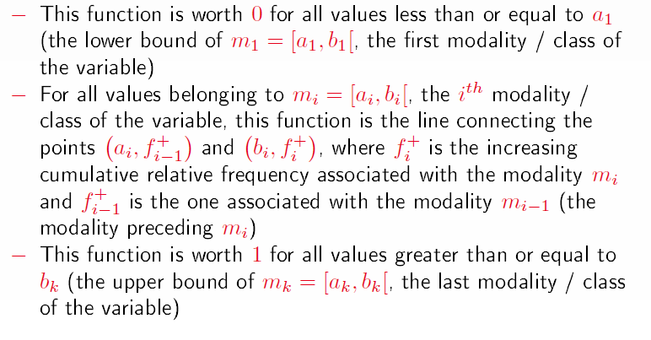
Graphical representation of data
The case of data in a continuous variable (grouped into classes)
The curve of increasing cumulative frequencies is continuous (it is not in steps)

Slide 8
Example
Weight | Number of patients
[0 ; 50] | 20
[50 ; 60] | 12
[60 ; 70] | 11
[70 ; 100] | 7
The data below represents the weight of 50 patients.
Objectives
Represent graphically the data
Plot the curve of increasing cumulative frequencies

Slide 9
The case of open classes
First open class → « < a »
And / Or
Last open class → « ≥ a »
By convention
The first open class is assigned the width of the second class
The last open class is assigned the width of the second last class
Remark:
If the "by convention" method takes us out of the variable definition domain, then we will use the definition domain to close the open classes

Slide 10
Exercise
Age | Number of visitors
< 18 | 5
[18 ; 20] | 15
[20 ; 30] | 20
[30 ; 35] | 30
[35 ; 50] | 23
≥ 50 | 7
The data below represents the age of visitors to a website:
Find the right proposal (among the four proposals below):
The variable studied is discrete quantitative
The bar chart is the right graphical tool to represent the data
The curve of increasing cumulative frequencies is continuous
The last class can be replaced (by convention) by [50, 70]

Slide 11
Exercise
Nb of products purchased | Number of visitors
0 | 20
1 | 35
2 | 24
4 | 16
5 | 5
The data below represents the number of products purchased during the visit of 100 visitors to a shopping center:
Find the right proposal (among the four proposals below):
The variable studied is qualitative ordinal
The bar chart is the right graphical tool to represent the data
The curve of increasing cumulative frequencies is discontinuous
80% of visitors have a number of products purchased less than or equal to 2

