Slide 1

Original Article
A Trial of Sugar-free or Sugar-Sweetened Beverages and Body Weight in Children
Janne C. de Ruyter, M.Sc., Margreet R. Olthof, Ph.D., Jacob C. Seidell, Ph.D., and Martijn B. Katan, Ph.D.
N Engl J Med
Volume 367(15):1397-1406
October 11, 2012

Slide 2
Study Overview
In this randomized trial, normal-weight children received a daily sugar-free, artificially sweetened drink or a similar-tasting, sugar-containing drink.
The sugar-free group had less weight gain and fat accumulation over the 18-month study period.

Slide 3
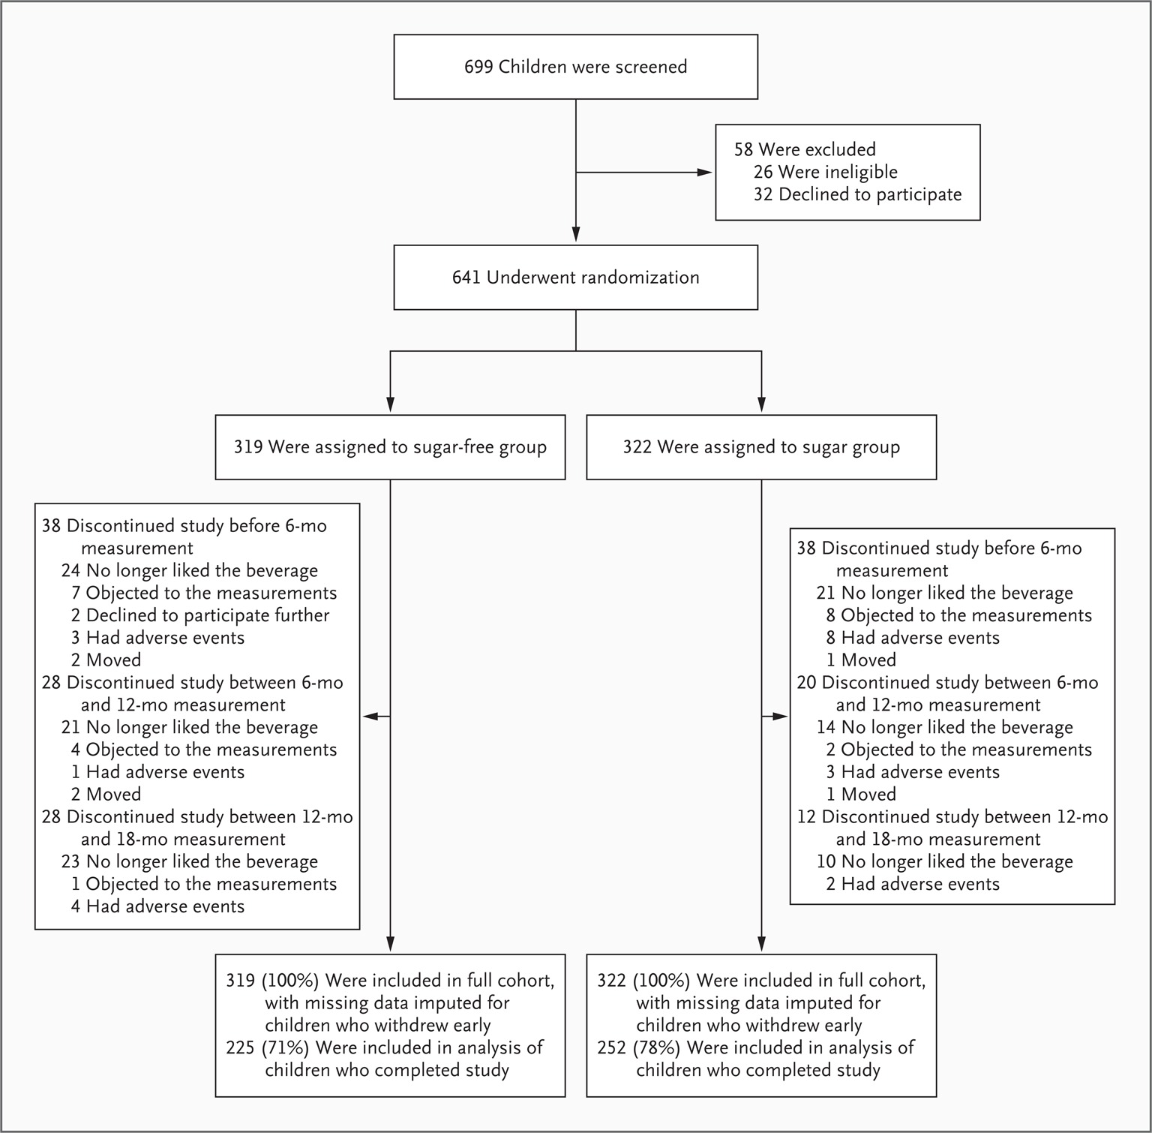
Screening, Randomization, and Follow-up of the Study Participants.
de Ruyter JC et al. N Engl J Med 2012;367:1397-1406
Notes:
Figure 1 Screening, Randomization, and Follow-up of the Study Participants. A total of 164 children stopped consuming the study beverages. Measurements in 136 of these children (79 children in the sugar-free group and 57 in the sugar group) were available at 18 months. Thus, measurements in 28 children who did not complete the study (15 children in the sugar-free group and 13 in the sugar group) were not available at 18 months. We randomly assigned 641 children, not 642, as previously reported,20 since after unblinding, one child whom we believed to have undergone randomization20 had not undergone randomization.

Slide 4
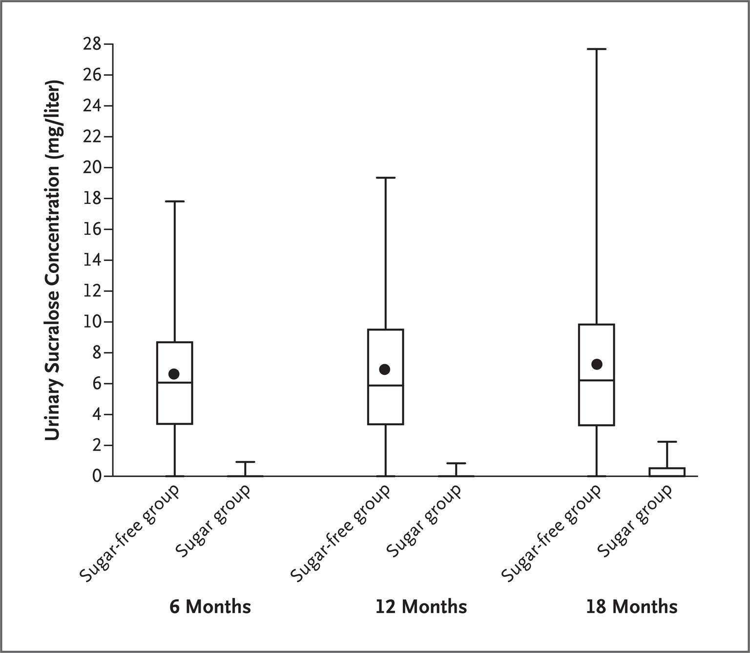
Urinary Sucralose Concentrations.
de Ruyter JC et al. N Engl J Med 2012;367:1397-1406
Notes:
Figure 2 Urinary Sucralose Concentrations. The sucralose concentration was determined in spot urine samples by means of liquid chromatography with mass spectrometry.21 Samples were obtained from randomly selected children who completed the study. We assigned a value of 0.01 to samples below the detection limit of 0.02 mg per liter. The upper and lower ends of the boxes indicate the 25th and 75th quartiles, the black dots means, the horizontal lines within the boxes medians, the upper whisker the maximum value, and the lower whisker the minimum value. Values for the sugar-free group are based on samples obtained from 116 children at 6 months and from 117 children at 12 and 18 months. Mean (±SD) urinary sucralose concentrations were 6.3±3.7 mg per liter at 6 months, 6.6±4.5 mg per liter at 12 months, and 7.0±5.6 mg per liter at 18 months; sucralose was undetectable in 3% of samples at 6 months, 8% of samples at 12 months, and 10% of samples at 18 months. Values for the sugar group are based on samples obtained from 54 children at 6 months and 36 children at 12 and 18 months. Mean values were 0.04±0.13 mg per liter at 6 months, 0.03±0.14 mg per liter at 12 months, and 0.31±0.56 mg per liter at 18 months; sucralose was undetectable in 93% of samples at 6 months, 97% of samples at 12 months, and 67% of samples at 18 months. We also pooled 543 samples from participants at baseline to produce 20 pools. The mean sucralose concentration in these samples was 0.06±0.07 mg per liter.

Slide 5
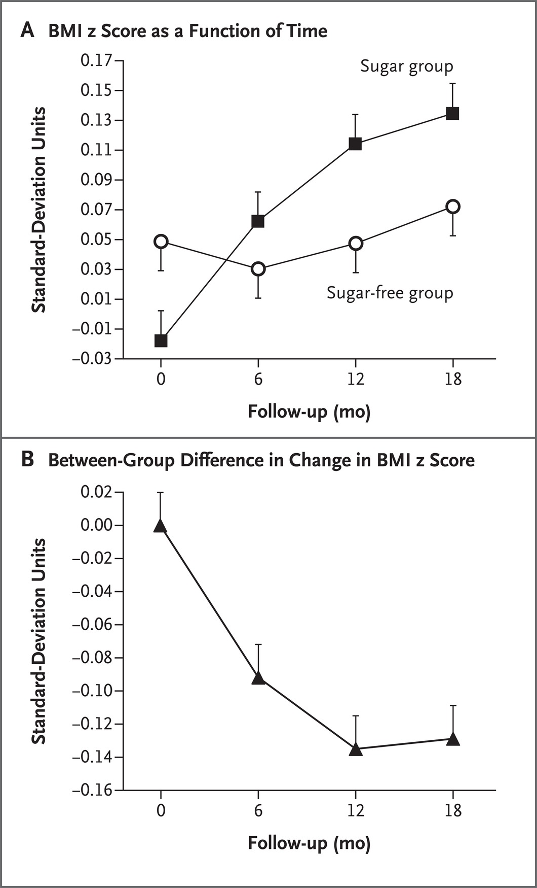
Body-Mass Index (BMI) z Score in the 477 Children Who Drank the Study Beverages for the Full 18 Months.
de Ruyter JC et al. N Engl J Med 2012;367:1397-1406
Notes:
Figure 3 Body-Mass Index (BMI) z Score in the 477 Children Who Drank the Study Beverages for the Full 18 Months. The z score for BMI is the BMI expressed as the number of standard deviations by which a child differed from the mean in the Netherlands for his or her age and sex. Panel A shows mean z scores for the two study groups over the 18-month study period. Panel B shows the between-group difference in the mean change from baseline (the mean change in the BMI z score in the sugar-free group minus the mean change in the sugar group), as a function of time. T bars in both panels indicate standard errors.

Slide 6
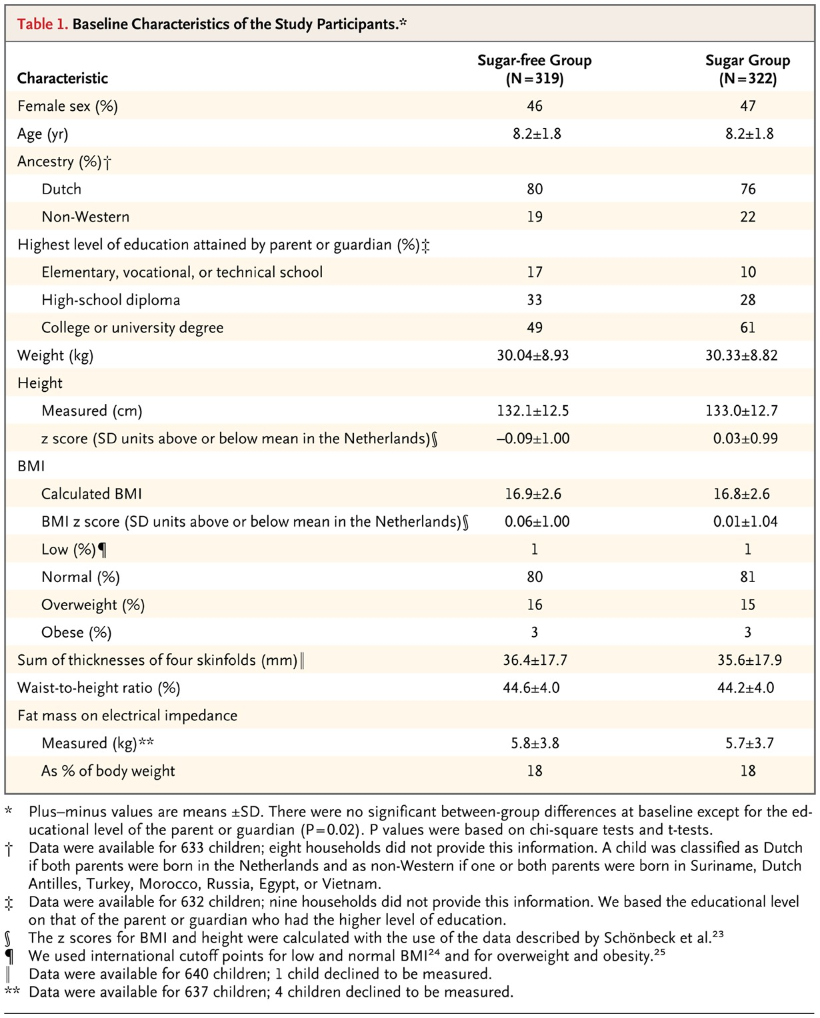
Baseline Characteristics of the Study Participants.
de Ruyter JC et al. N Engl J Med 2012;367:1397-1406
Notes:
Table 1 Baseline Characteristics of the Study Participants.

Slide 7
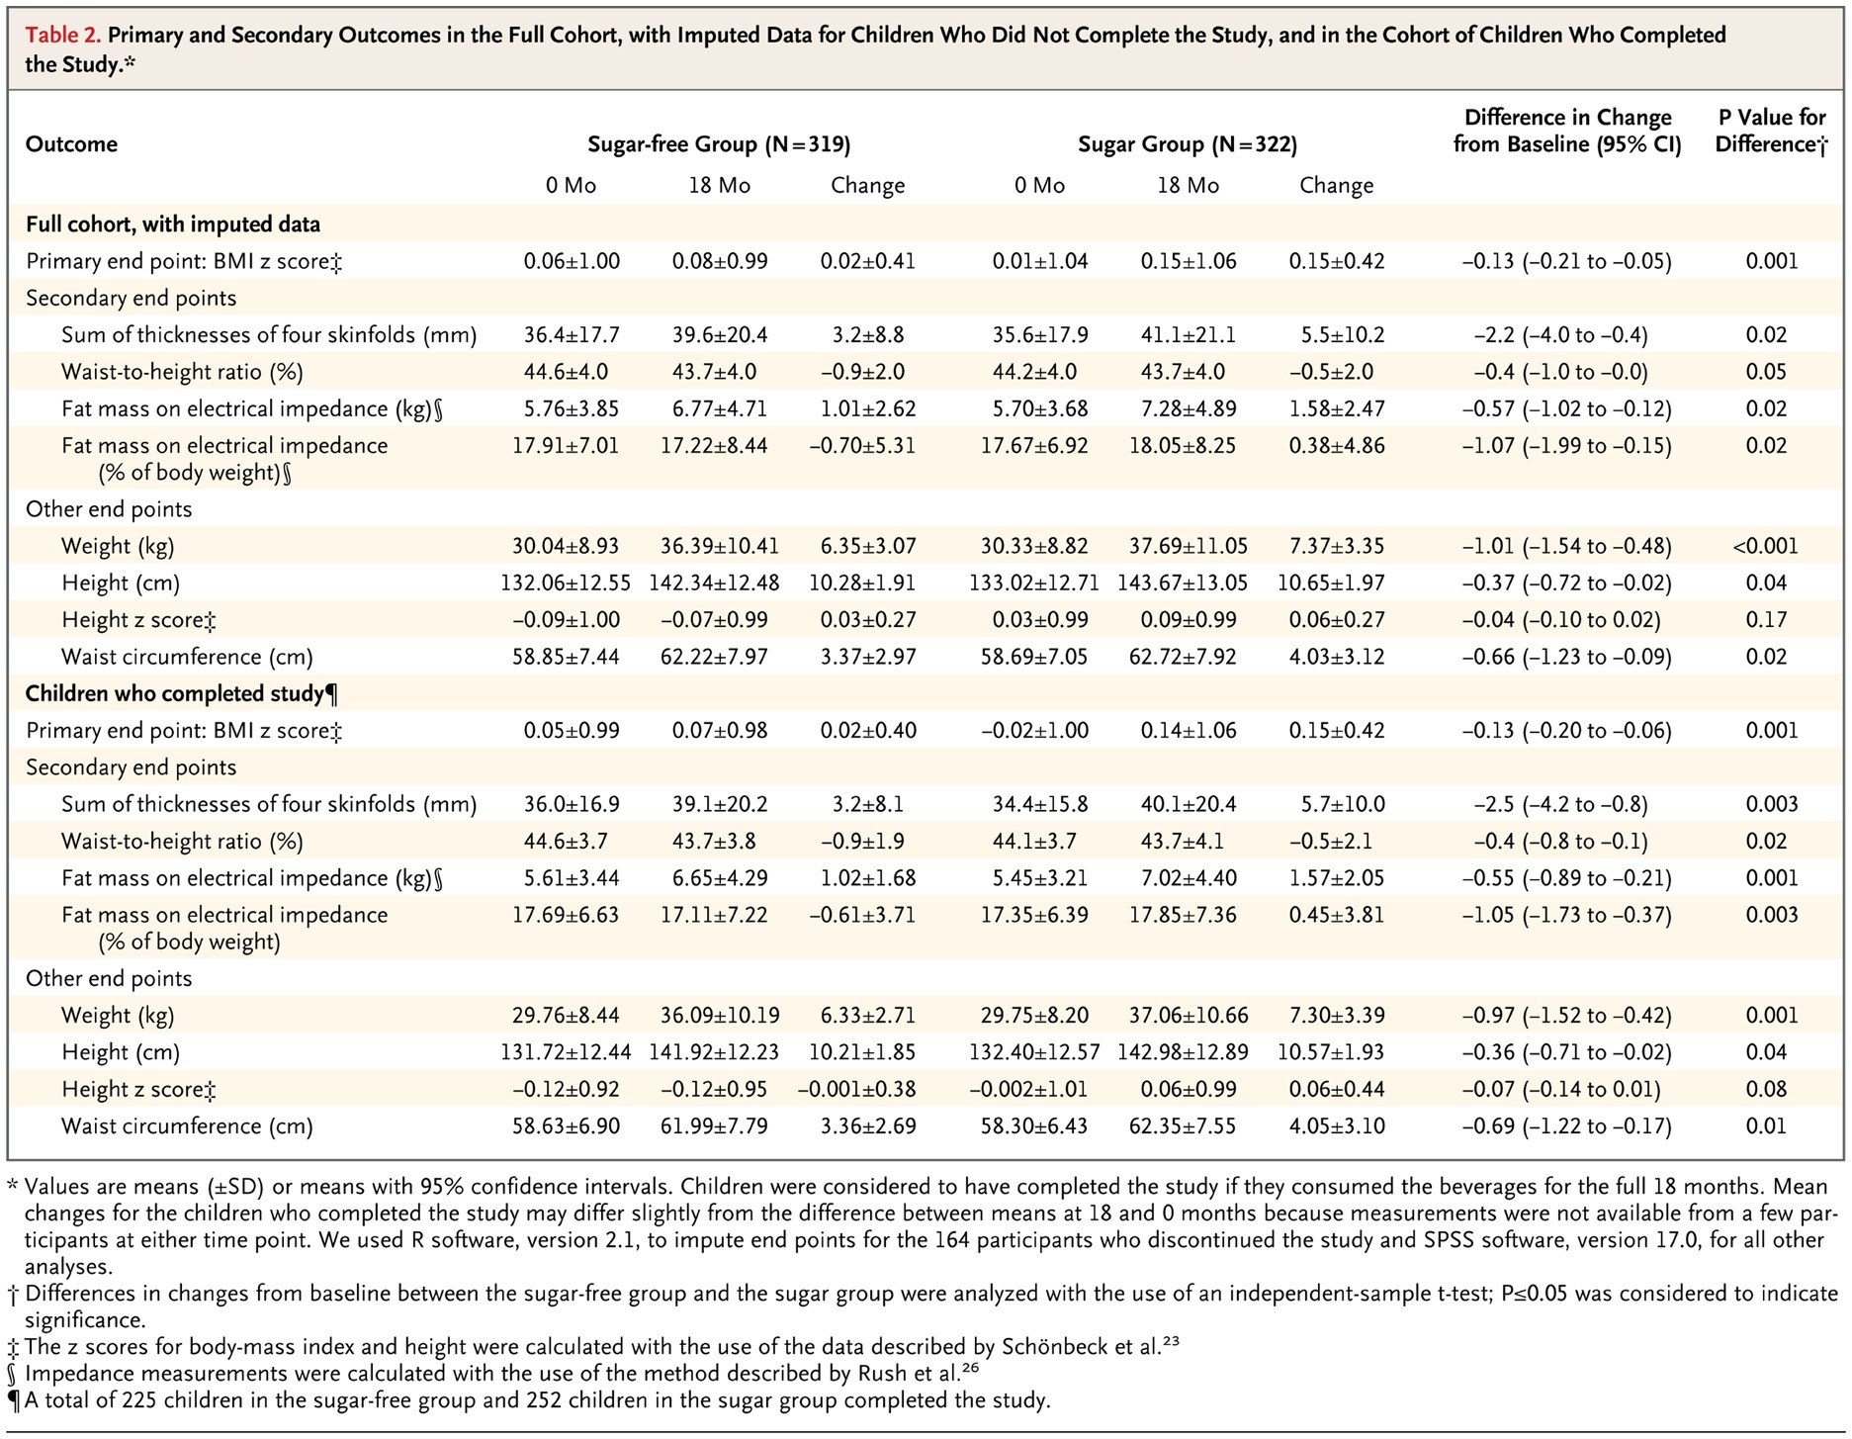
Primary and Secondary Outcomes in the Full Cohort, with Imputed Data for Children Who Did Not Complete the Study, and in the Cohort of Children Who Completed the Study.
de Ruyter JC et al. N Engl J Med 2012;367:1397-1406
Notes:
Table 2 Primary and Secondary Outcomes in the Full Cohort, with Imputed Data for Children Who Did Not Complete the Study, and in the Cohort of Children Who Completed the Study.

Slide 8
Conclusions
Masked replacement of sugar-containing beverages with noncaloric beverages reduced weight gain and fat accumulation in normal-weight children.

