Slide 1
C TO ASSEMBLER TRANSLATOR
GGG translator Presentation and overview

Slide 2
Contents
Brief introduction.
Lexicon.
Parser.
Implementation details.
#TODO.
Demonstration.

Slide 3
Brief introduction
Programming language used: Python 3.7.

Slide 4
Brief introduction
Programming language used: Python 3.7.
External library: Sly Lex-Yacc.

Slide 5
Brief introduction
Programming language used: Python 3.7.
External library: Sly Lex-Yacc.
Conceived to work as an AST.

Slide 6
Brief introduction
Programming language used: Python 3.7.
External library: Sly Lex-Yacc.
Conceived to work as an AST.
Designed to work only with a subset of C functionality.

Slide 7
Brief introduction
Programming language used: Python 3.7.
External library: Sly Lex-Yacc.
Conceived to work as an AST.
Designed to work only with a subset of C functionality.
Easily Scalable.

Slide 8
Brief introduction
Programming language used: Python 3.7.
External library: Sly Lex-Yacc.
Conceived to work as an AST.
Designed to work only with a subset of C functionality.
“Easily” Scalable.

Slide 9
Lexicon
Set of words that compounds a grammar.

Slide 10
Lexicon
Set of words that compounds a grammar.
Formed by: literal constants, tokens and regular expressions.

Slide 11
Lexicon
Set of words that compounds a grammar.
Formed by: literal constants, tokens and regular expressions.
Tokens: are the minimum representation with a meaning for our grammar.

Slide 12
Lexicon
Set of words that compounds a grammar.
Formed by: literal constants, tokens and regular expressions.
Tokens: are the minimum representation with a meaning for our grammar.
Regular expressions: are sequences of characters that define a search pattern.

Slide 13
Lexicon
Set of words that compounds a grammar.
Formed by: literal constants, tokens and regular expressions.
Contained inside a class called: CalcLexer
Tokens: are the minimum representation with a meaning for our grammar.
Regular expressions: are sequences of characters that define a search pattern.

Slide 14
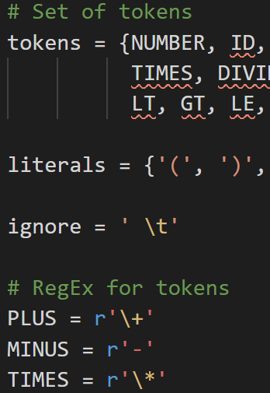
Lexicon
Illustration sample

Slide 15
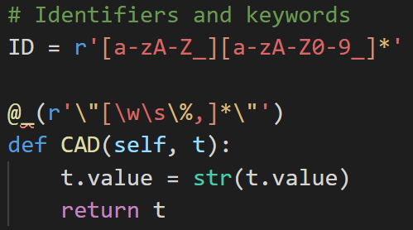
Lexicon
Illustration sample

Slide 16
Parser
Tool
Set of syntactic rules

Slide 17
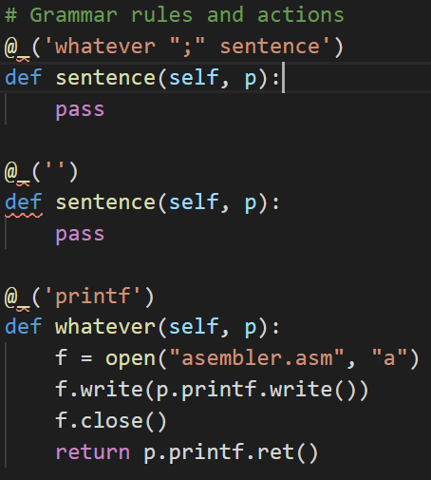
Parser
Tool
Set of syntactic rules
Contained inside a class: CalcParser.

Slide 18
Parser
Tool
Set of syntactic rules
Contained inside a class: CalcParser.
It uses rules called “empty”.

Slide 19
Parser
Tool
Set of syntactic rules
Contained inside a class: CalcParser.
It uses rules called “empty”.
Empty rules: implements the synthesized and inherited param system.

Slide 20
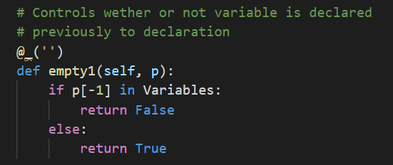
Parser
Tool
Set of syntactic rules
It uses rules called “empty”.
Empty rules: implements the synthesized and inherited param system.
They’re useful for control and checking purposes.

Slide 21
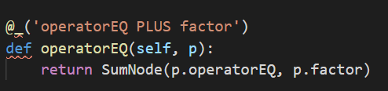
Implementation details
Nodes

Slide 22
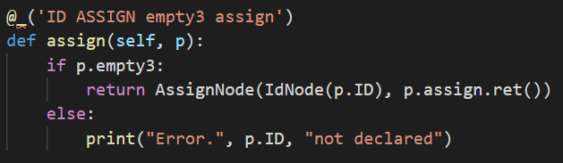
Implementation details
Nodes

Slide 23
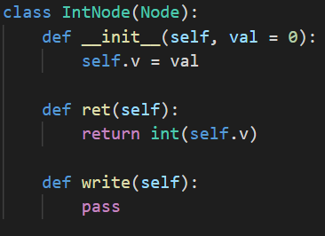
Nodes
They all have a constructor.

Slide 24
Nodes
They all have a constructor.
They implements 2 methods each.

Slide 25
Nodes
They all have a constructor.
They implements 2 methods each.
Both methods are accessors or getters.

Slide 26
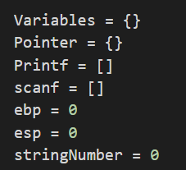
Implementation details
Global variables

Slide 27

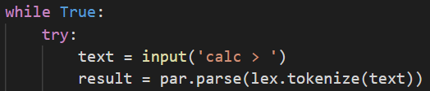
Implementation details
Main function and calling

Slide 28
Implementation details
Main function and calling

Slide 29
#TODO
Improve node system adding new nodes.
After all, is scalable

Slide 30
#TODO
Improve node system adding new nodes.
Include functions calling and definitions.
After all, is scalable

Slide 31
#TODO
Improve node system adding new nodes.
Include functions calling and definitions.
Flow control instructions.
After all, is scalable

Slide 32
Demonstration & Overview

Slide 33
Thank you all!
¿Any question?

