Slide 1
Guillem Cortiada-GSE45514
Title:Topical protein tyrosine kinase inhibitor effect on graft model of alopecia areata: time course
Introduction: Analysis of skin from C3H/HeJ grafted recipients with established alopecia areata (AA) following alopecic graft transplantation that were treated with topical Janus kinase (JAK) inhibitor ruxolitinib or tofacitinib for up to 24 wks.
Objective: The aim of the study is the genes expressions patterns after an alopecic graft transplant.
Experiment design: We have three groups of mouse that after an alopecic graft transplantation skin his skin were taken at initial time, 6, 12 and 24 weeks (in 24 weeks, we only have taken the 2 groups with treatment and only two samples in each one) after administration of ruxolitinib(jak1i), tofacitinib(jak3i) or reference substance role.
Organism: Mus musculus
Platform: GPL1261: Affymetrix Mouse Genome 430 2.0 Array
Response variable: Gene expression patterns
Groups: 3 groups (reference, treated with tofacitinib(jak3i), treated with ruxolitinib(jak1i)) (3 biological replicates were taken at each time point for each treatment modality)
Experimental design: Group design (Expression profiling by array)

Slide 2
Guillem Cortiada-GSE45514
Experimental Factors:
Batch = (Block) Scan date
Treatment = (treatment) Vehicle (PBS), tofacitinib, ruxolitinib
Timepoint = (timepoint) 0 weeks, 6 weeks, 12 weeks, 24 weeks
Sample size: 31 samples.
In 0, 6 and 12 weeks = (3(reference)+3(tofacitinib)+3(ruxolitinib))*3 = 27
In 24 weeks only 2(tofacitinib)+2(ruxolitinib)
Groups and Sample size:
3 assays: initial time point, reference substance role
3 assays: initial time point, tofacitinib
3 assays: initial time point, ruxolitinib
3 assays: 6 weeks, reference substance role
3 assays: 6 weeks, tofacitinib
3 assays: 6 weeks, ruxolitinib
3 assays: 12 weeks, reference substance role
3 assays: 12 weeks, tofacitinib
3 assays: 12 weeks, ruxolitinib
2 assays: 24 weeks, tofacitinib
2 assays: 24 weeks, ruxolitinib

Slide 3
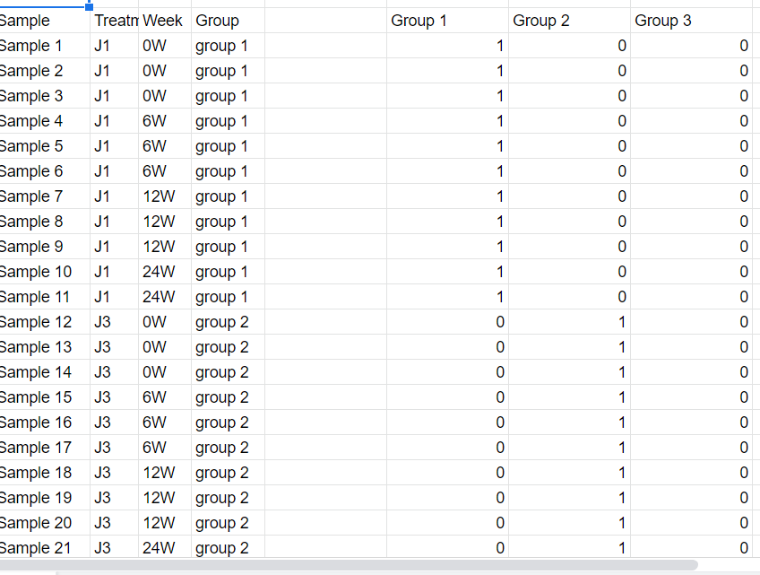
Guillem Cortiada-Linear Model

Slide 4
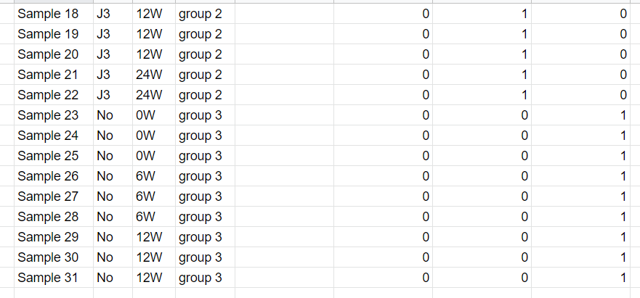
Guillem Cortiada-Linear Model

