Slide 1
How DNS Can Help to Vehicle Design
Guillem Borrell
Laboratorio de Mecánica de Fluidos Computacional
Universidad Politécnica de Madrid

Slide 2
¿What is DNS?
Numerical solution of the Navier Stokes equations
All the information that the equations can provide
From the physical point of view it is the truth.
  (The context is also important)
Essential tool for studying turbulence

Slide 3
¿Does anyone use DNS to design vehicles?

Slide 4
No.

Slide 5
¿Why?

Slide 6
Because DNS is suitable to understand a physical phenomenon, not for Engineering.

Slide 7
DNS is to Engineering what the LHC is to Electronics.
I know, I am going too far.

Slide 8
Physics VS Engineering
From the point of view of an engineer that now does DNS and some friends cheated to learn about finance.

Slide 9
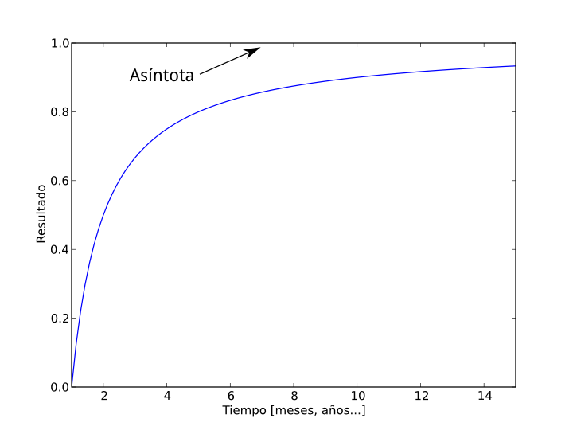
The curve of Engineering

Slide 10
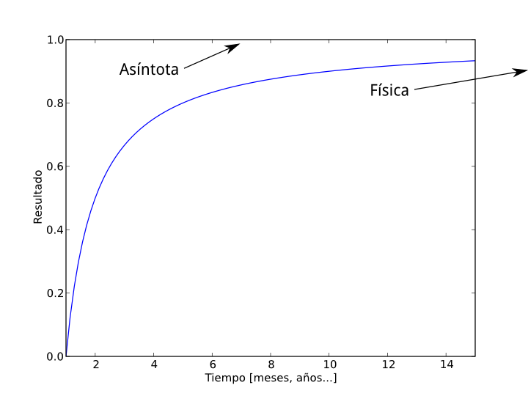
The curve of Engineering

Slide 11
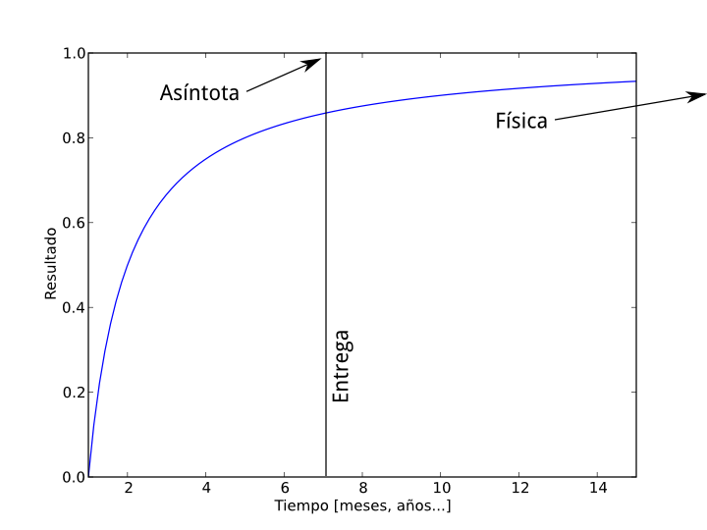
The curve of Engineering

Slide 12
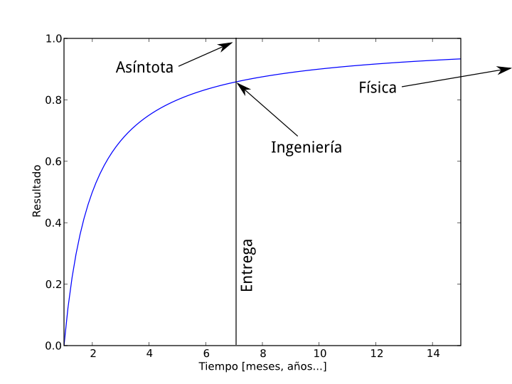
The curve of Engineering

Slide 13
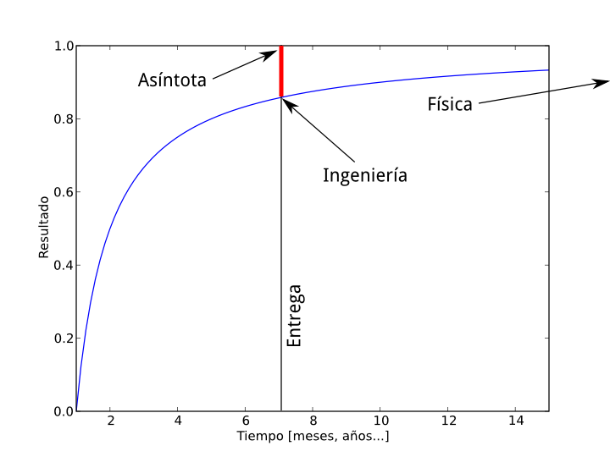
The curve of Engineering

Slide 14
Engineering is about Errors
Deadlines exist
  Economy, productivity, profit...
  Failing means losing money
The red line are our errors
The engineer must assume that errors exist and calibrate their effect.
  Not to finish means not to have results on time
Time and errors give the suitable workflow.

Slide 15
Physics is the horizon of Engineering
Research reduces errors with new tools and theories
Physics and Engineering have different worflows(not necessarily different tools).
  Impossible is nothing in Physics.
Both are separated by a constant gap.
  Horizon: imaginary line that is always far away.
  One cannot reach the horizon.
Things break.

Slide 16
There is a main source of error in Fluid Mechanics.

Slide 17
TURBULENCE

Slide 18
Available strategies.

Slide 19
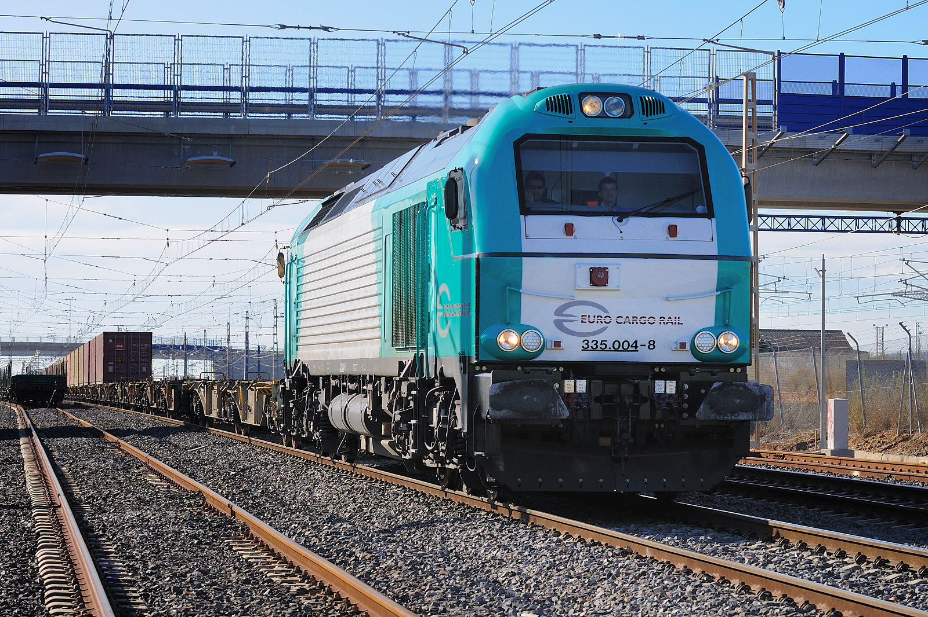
To ignore

Slide 20
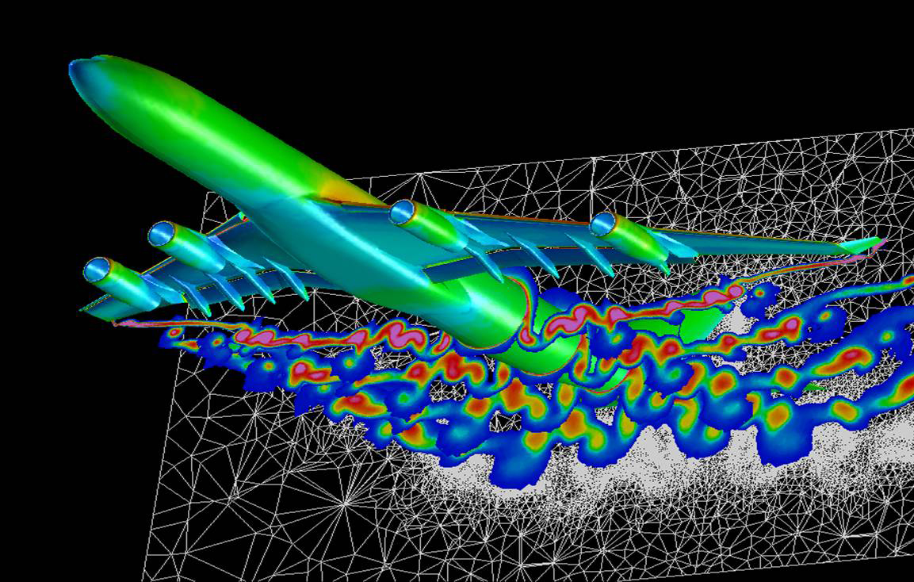
To model
Imagen: DLR

Slide 21
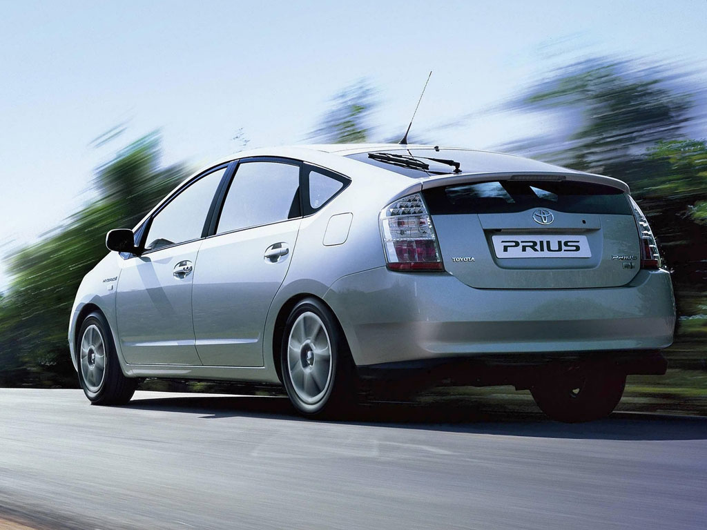
To force

Slide 22
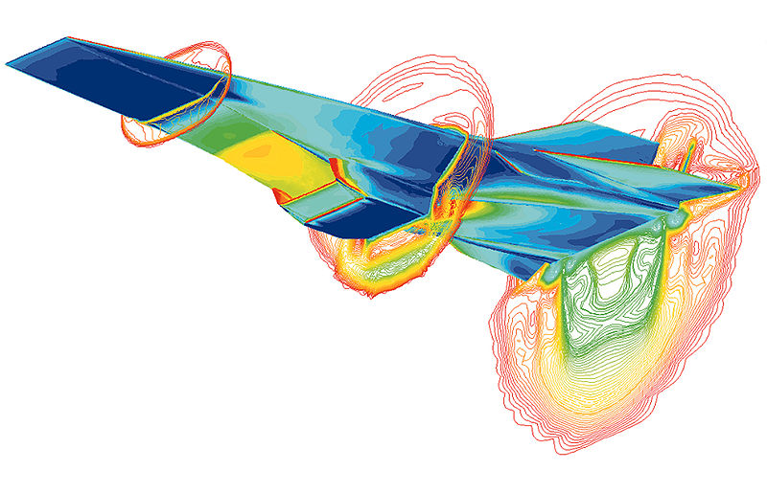
To evaluate (and forget)

Slide 23
¿Can it be computed?

Slide 24
DNS is used to solve NS equations.

Slide 25
DNS is the horizon
Solving NS equations require extreme computing resources
  A football ball
    100 Tflops for a month and 100 GB of memory.
  A F1 car:
    1 Pflops for a year and 1PB of memory.
    ¡For a single simulation!

Slide 26
DNS of a turbulent boundary layer
2 aerospace engineers and 1 chairman
6 months of preparation
3-4 months running
32000 processors
35.000.000 processor hours

Slide 27
Engineering has a workflow
“More than 6 hours (one night) is useless”

Slide 28
The Horizon
Physics and Engineering are separated by the timespan. The other differences are just a consequence.

Slide 29
But they are related!

Slide 30
When an Engineer assumes that the risk of the error is bigger than the risk of trying to reduce it.

Slide 31
Before '90
War
Contendants want the technologic supremacy
Give tons of resources to engineers that run to the horizon as fast as possible
  Most of projects fail.
  Huge risks can mean groundbreaking findings. (Atomic Bomb)

Slide 32
After '90. Sarcasm ON
Sarcasm OFF
Crazy and poor researchers find something interesting
  They formulate a theory.
  They reach no conclusion.
  They find something that can be applied
A company funds the project
Profit!

Slide 33
The process is the same

Slide 34
The mechanism is different

Slide 35
The difference is risk
Companies are more reluctant to take risks
More risk means more resources.
More resources means more probabilities
If you want something for sure don't do research
Do we have to give resources to people that don't guarantee results?

Slide 36
Conclusions
Fluid Mechanics in vehicle design is a wide discipline
  From structures to applied Mathematics.
Engineers are not trained to understand risks.
  It is not a political or philosophical matter.
Increasing productivity may decrease evolution.
  Black Swan: not taking risks at all it is risky.

Slide 37
Thank you guillem@torroja.dmt.upm.es

