Slide 1
Blockchain and Smart Contracts Explained (and Simplified)
Guillem Borrell Nogueras
NFQ & UC3M

Slide 2
The mandatory slide about me
@guillemborrell. http://guillemborrell.es
PhD. Aerospace Engineering
Now at NFQ & UC3M researching on distributed systems for the real world.
Used Python before it was cool.
  Do you remember Numeric?
  Did you ever use Gnuplot?
Co-organizer of the first PyData in Spain.

Slide 3
NFQ sponsors this!
Because we‘re hiring!
Come talk to us, we‘re nice people.

Slide 4
All my PyData stuff
Github: guillemborrell/PyDataBCN

Slide 5
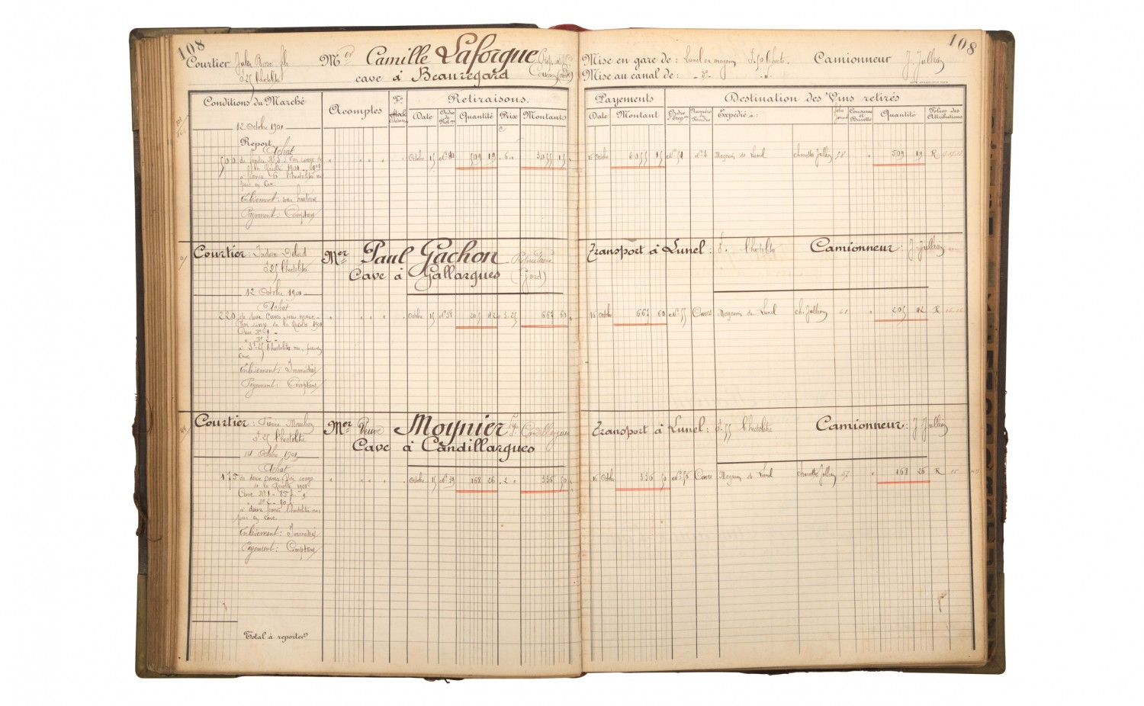

Slide 6
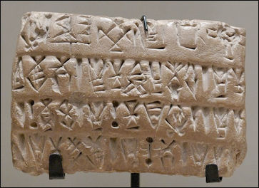

Slide 7
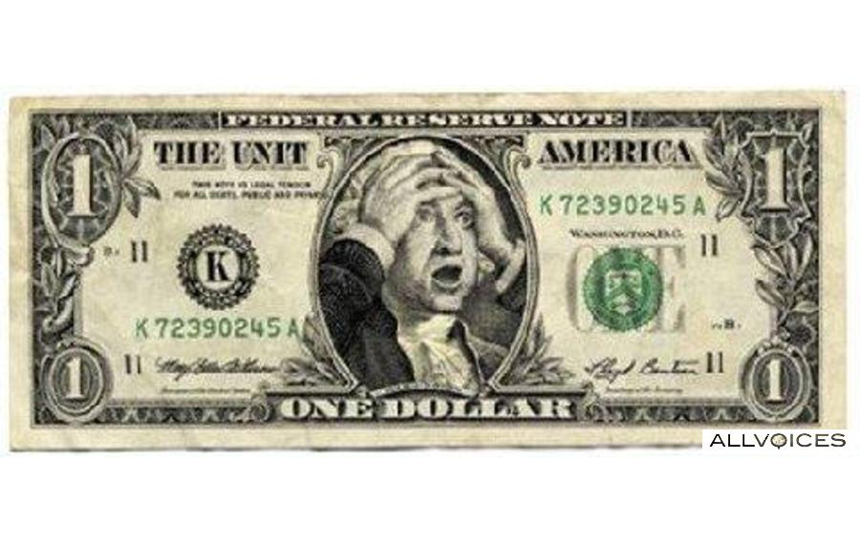

Slide 8


Slide 9
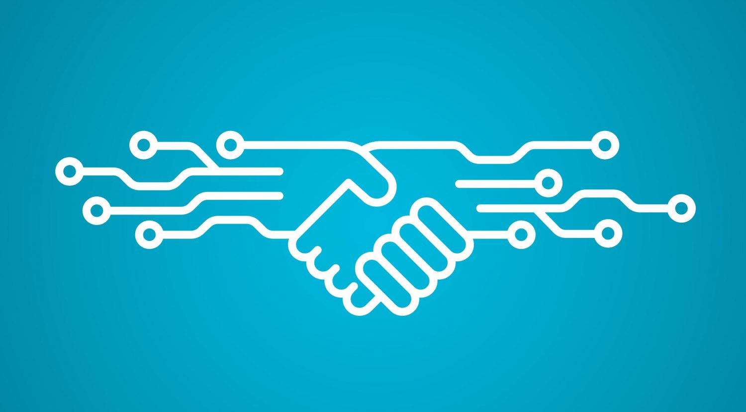

Slide 10
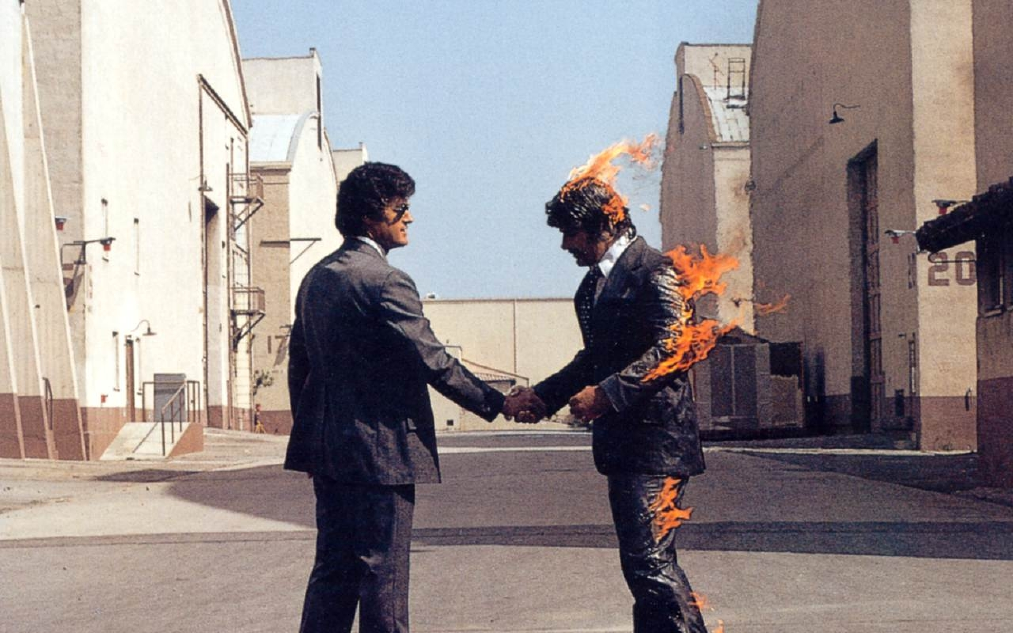

Slide 11
All my PyData stuff
Github: guillemborrell/PyDataBCN

