Slide 1
Python for Distributed Systems
PyData Madrid. April 8th 2016
Guillem Borrell i Nogueras
https://github.com/guillemborrell/pydata-madrid

Slide 2
Me
Aerospace Engineer. PhD.
I worked with supercomputers.
I dealt with lots of data.
In some cases I actually built the supercomputers I used.
I build high-performance distributed tools for a living.
@guillemborrell http://guillemborrell.es

Slide 3
High performance distributed systems

Slide 4


Slide 5
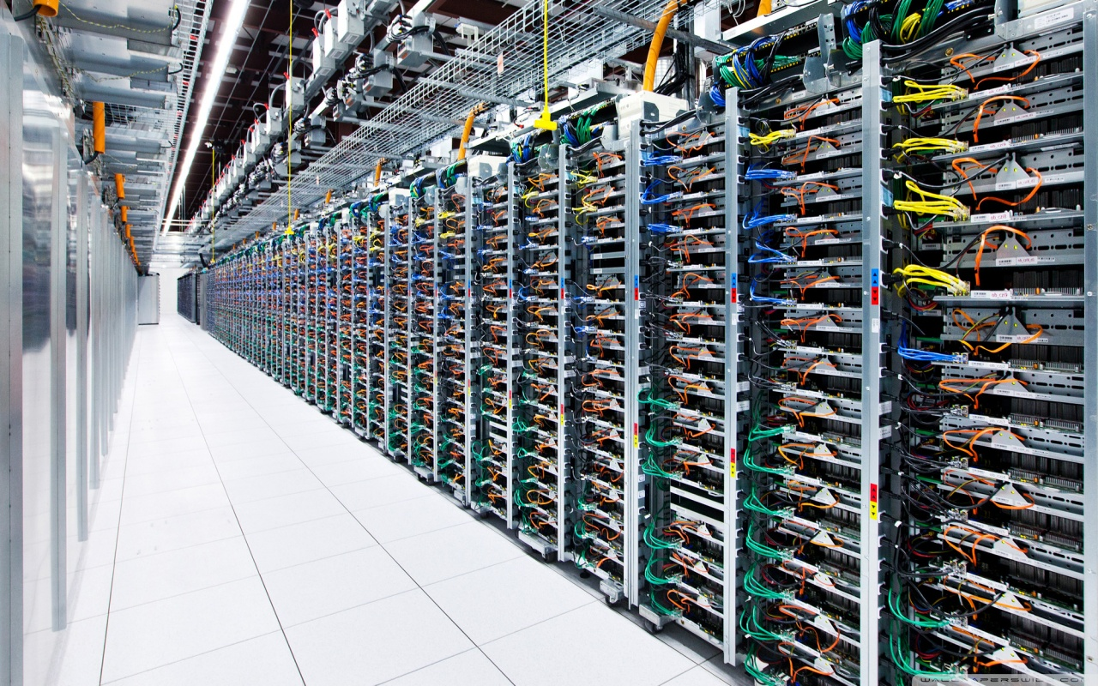

Slide 6
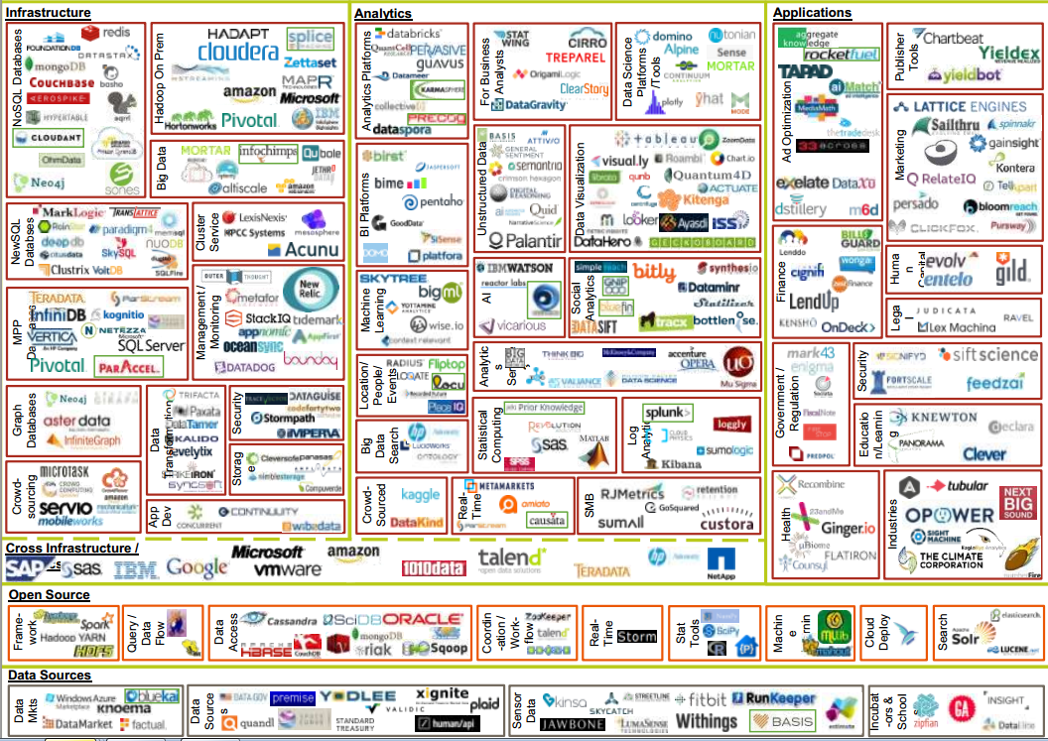

Slide 7
Let’s start from ground up.
And let’s be ambitious.

Slide 8
The Unicorn idea.

Slide 9

The Julia set.

Slide 10
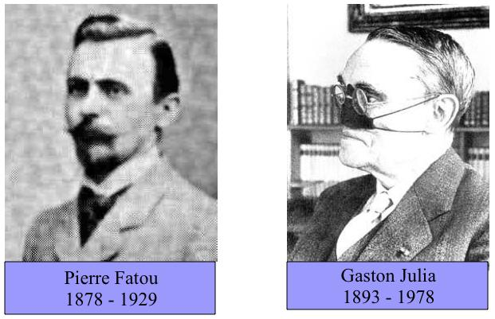


Slide 11
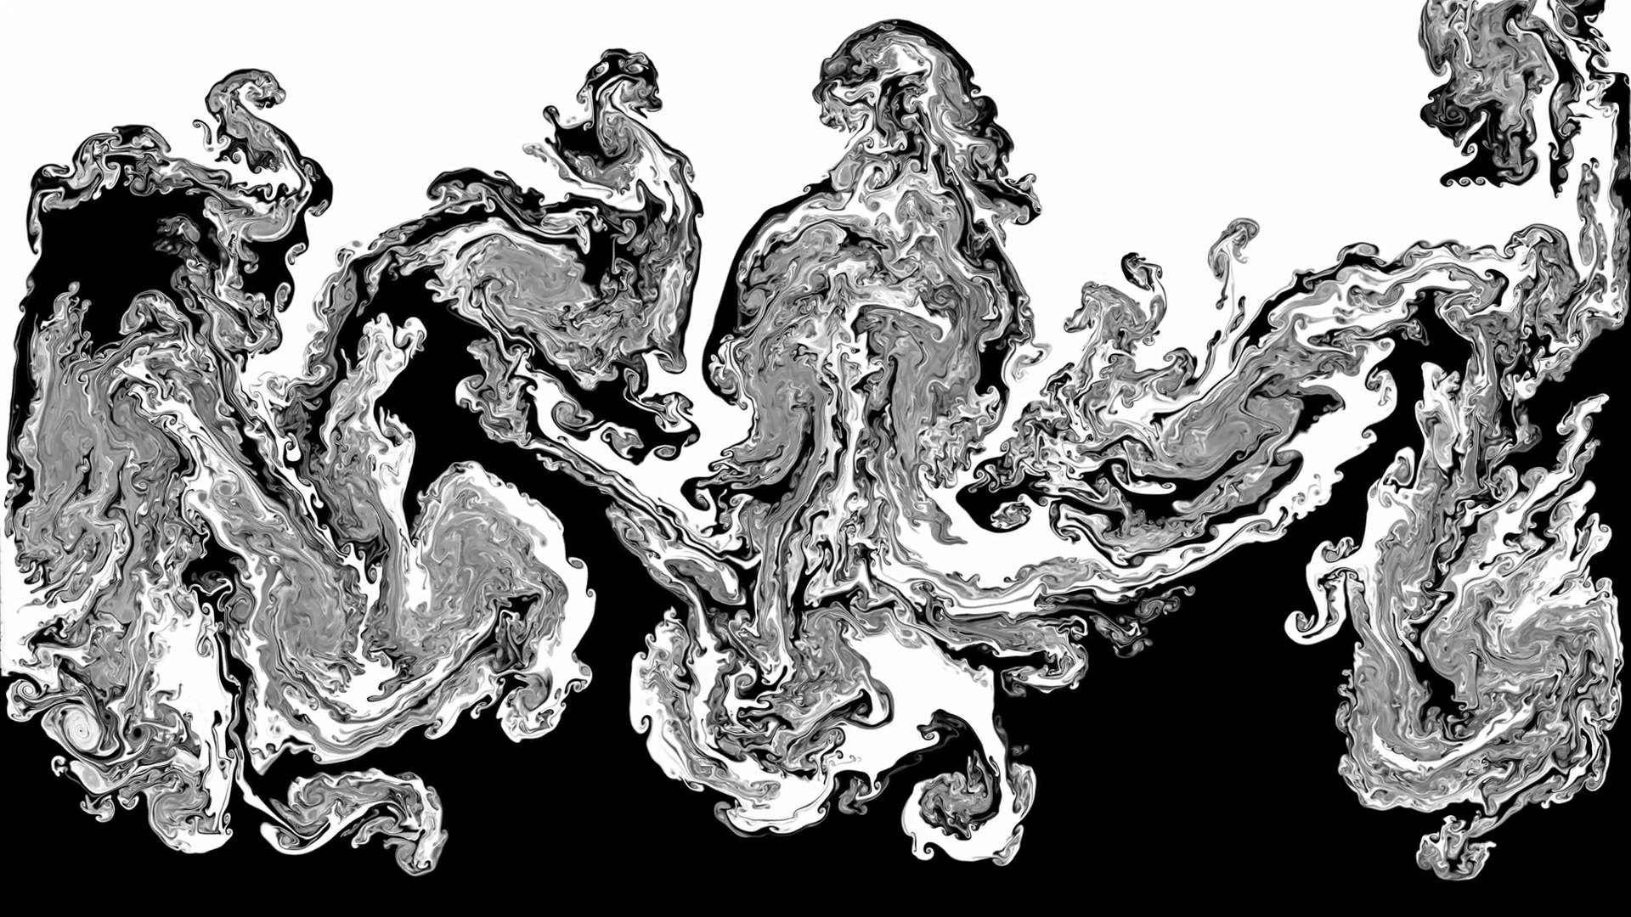

Slide 12


Slide 13
Let’s make a Julia set.

Slide 14
Now we have an application
Something that is useful, but takes a good amount of resources. Like CPU/IO intensive stuff.
But applications are for cellphones and pirates
Services = $, €, ¥…
We need a name, an elevator pitch, and a REST API to hire a frontend developer.
We will make something that works in the Angel round.

Slide 15
Fractal.ly

Slide 16
Find beauty in complexity…
Web scale!

Slide 17
The REST API

Slide 18
Is it scalable?
Is it responsive?
Is it efficient?

Slide 19
Let’s make it a little more efficient.

Slide 20
Now we visit a business angel.
And we got money to rent servers!

Slide 21
Let’s make it parallel.

Slide 22
Parallelization is about domain decomposition
Split the problem in separated portions.
The portions should share the minimum amount of information. (CAP)
Exploit low-hanging fruits.
It is fine to deal with each request in parallel. We have to be pragmatic, it’s not about publishing a CS paper.

Slide 23
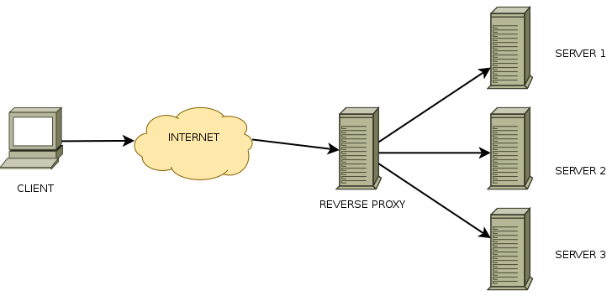
A reverse proxy.

Slide 24
Is it scalable?
Is it responsive?
Is it efficient?

Slide 25
We have our first users. They complain because the application is not responsive enough.

Slide 26
We hire a frontend developer.
And we make the application asynchronous.

Slide 27
Polling is a good way to deal with asynchronicity.

Slide 28
But the application is not as responsive as we expected

Slide 29


Slide 30
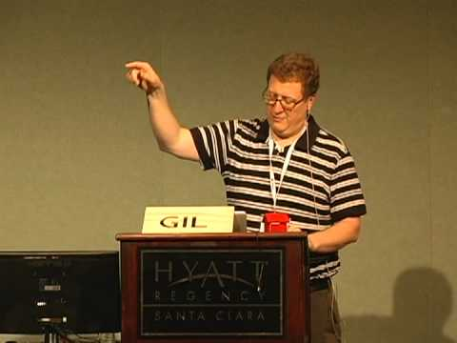

Slide 31
The GIL is there because the alternatives are quite frightening.

Slide 32
Split I/O intensive process from CPU intensive processes.

Slide 33
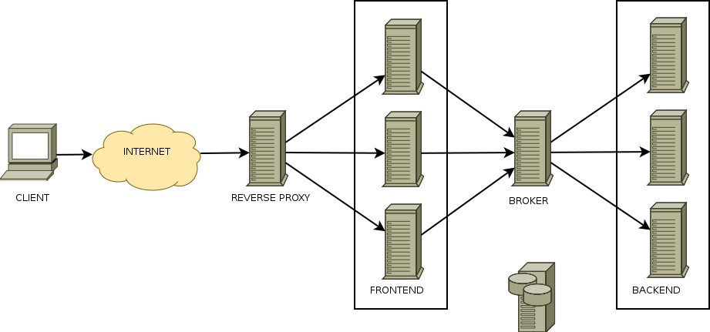

Slide 34
We need message passing.

Slide 35
A message queue
ØMQ

Slide 36

A serialization format

Slide 37
Is it scalable?
Is it responsive?
Is it efficient?

Slide 38


Slide 39
We now have a parallel, distributed, multi-threaded, multi-language, responsive and efficient service to obtain julia sets WEB SCALE!

Slide 40


Slide 41
Questions?

