Slide 1
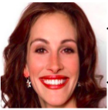
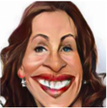
Replica - cycleGAN
Goal: use the state-of-the art technique applied to a new domain (faces and caricatures)

Slide 2
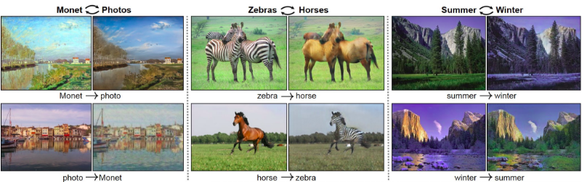
Replica - cycleGAN
Domains of the pretrained networks:

Slide 3
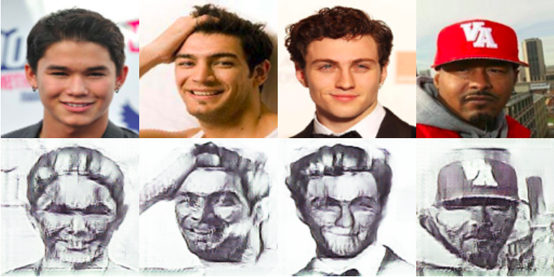
Replica - cycleGAN
Vanilla cycleGAN usage
Bad results
Prohibitive in time

Slide 4
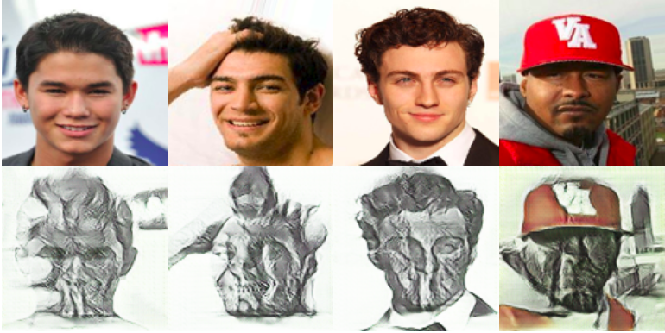
Replica - cycleGAN
Vanilla cycleGAN usage
Bad results
Prohibitive in time

Slide 5
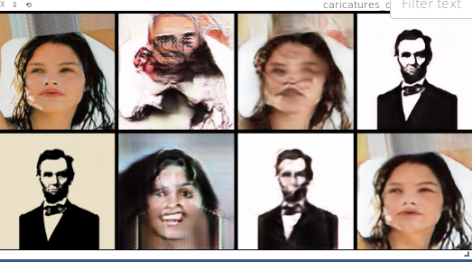
Replica - cycleGAN
Vanilla cycleGAN usage
Bad results
Prohibitive in time

Slide 6
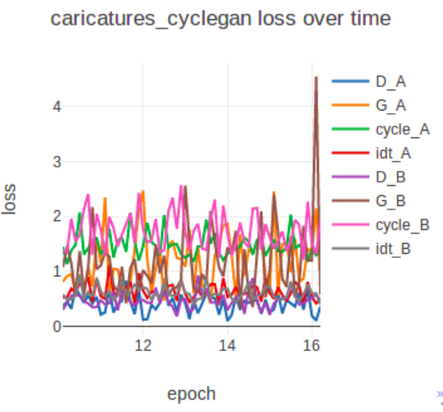
Replica - cycleGAN
Vanilla cycleGAN usage
Bad results
prohibitive in time

Slide 7
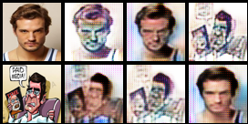
Replica - Customizations
Input size reduction to 64x64 pixels
Feasible
Blurry images

Slide 8
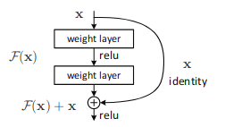
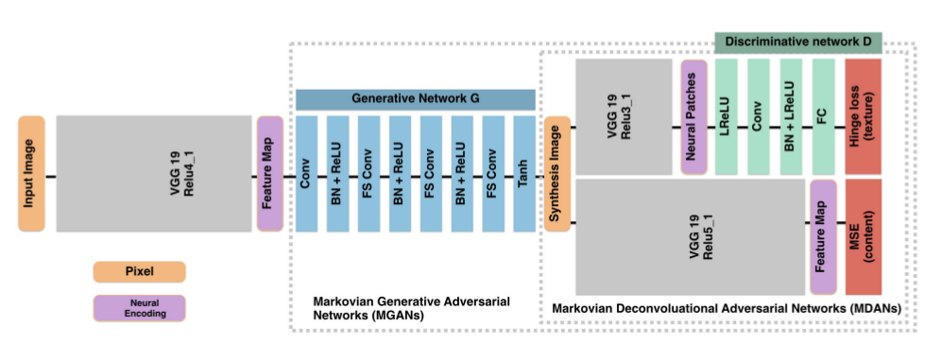
Replica - Customizations
Modify G and D networks
networks are built and trained from scratch
no pooling layers found

Slide 9
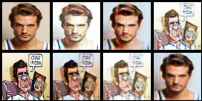
Replica - Customizations
Modify G and D networks:
the number of ResNetBlocks in Generative network (default is 9)
the number of downsampling layers in ResNet, consisting of Convolution, normalization and Relu (default value is 2)
the number of discriminator layers in Discriminative network (default value is 3)
a parameter that affects the number of layer’s outputs of the discriminative networks (minimum discriminator layer output default value is 8)
the parameters ndf and ngf that affect the number of layers outputs in both generative and discriminative networks (default value is 128 and 128)

Slide 10
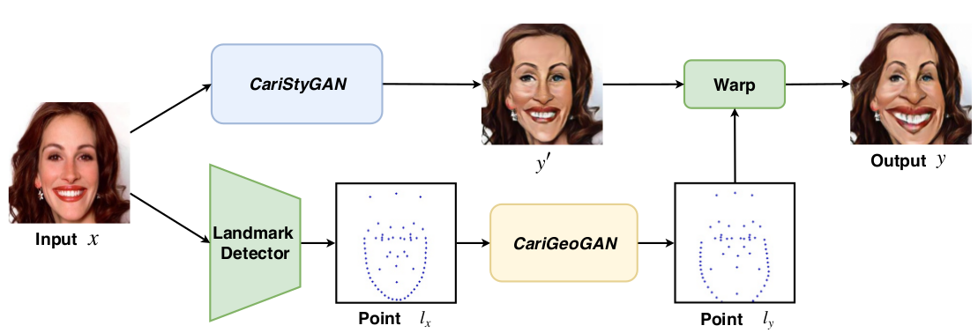
Replica - Customizations
Improvements:
there’s no shape modification → CariGAN

