Slide 1


A GENTLE INTRODUCTION TO MACHINE LEARNING ALGORITHMS, WITH EXAMPLES
Guillem Plasencia Gallofré
Adaptive Financial Consulting

Slide 2
What will this talk be about?
Briefly introduce myself
Machine learning algorithms
Deep neural networks
Computer vision examples

Slide 3
Briefly introduce myself
Machine learning algorithms
Deep neural networks
Computer vision examples

Slide 4


Briefly introduce myself
Feb. 2004 Defended my PhD. on biochemistry and molecular biology (but I liked computers better)
Barely knew how to program in Perl (yes, Perl… was (is?) to life sciences as Python is to machine learning)
May 2004 - Apr 2019: I joined a small company (2 people back then) where I learnt
about data science and programming. We developed predictive models for R&D chemists developing new drugs at pharmaceutical companies.
April 2019 - now: After I joined Adaptive Financial Consulting I’ve worked in teams developing highly available, clustered, financial trading applications deployed in the cloud.
@guillempg
www.linkedin.com/in/guillem-plasencia-gallofre

Slide 5
Briefly introduce myself
Machine learning algorithms
Deep neural networks
Computer vision examples

Slide 6
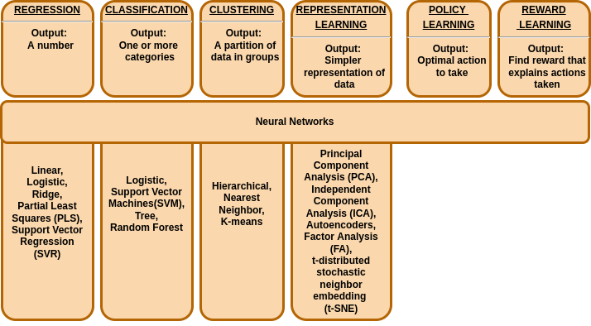
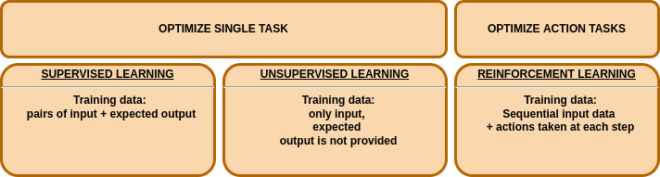
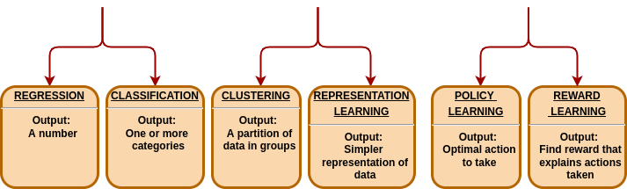
Machine learning algorithms
All these tasks can be performed
by Neural Networks

Slide 7
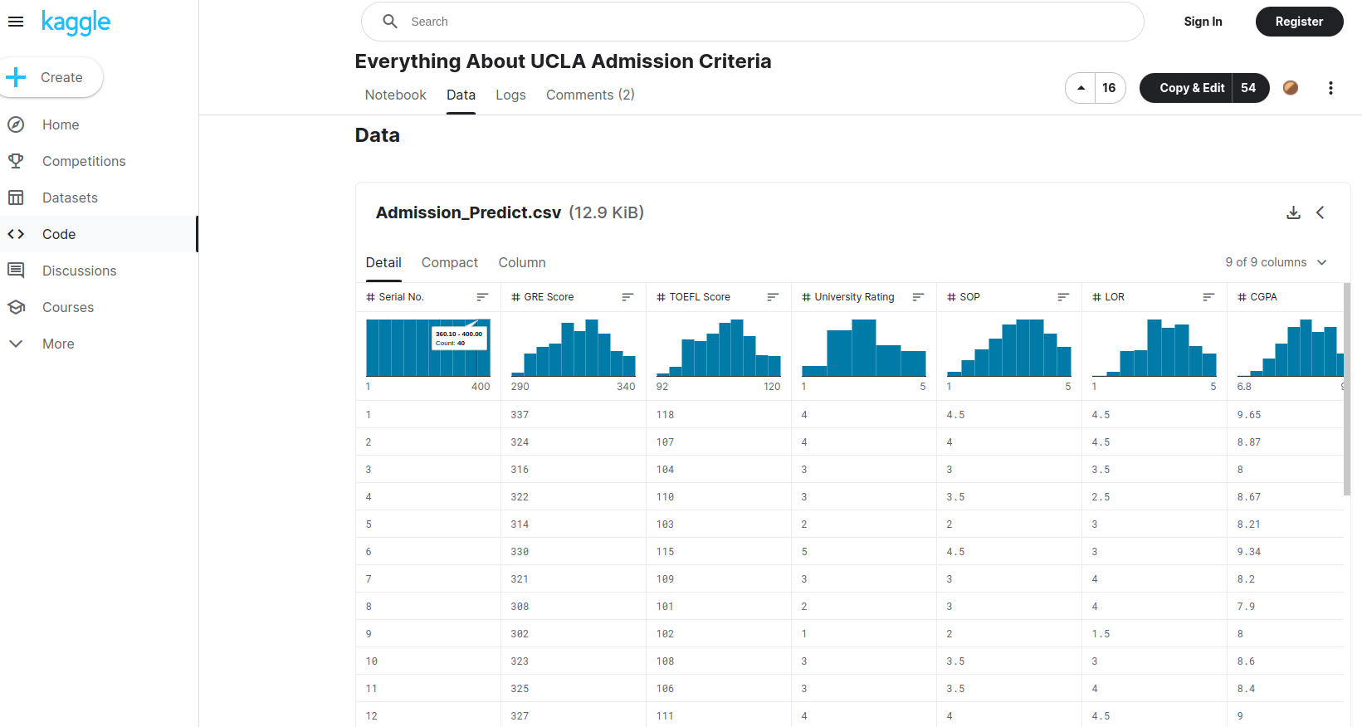
UCLA admissions dataset
https://www.kaggle.com/code/ashishpatel26/everything-about-ucla-admission-criteria/data

Slide 8
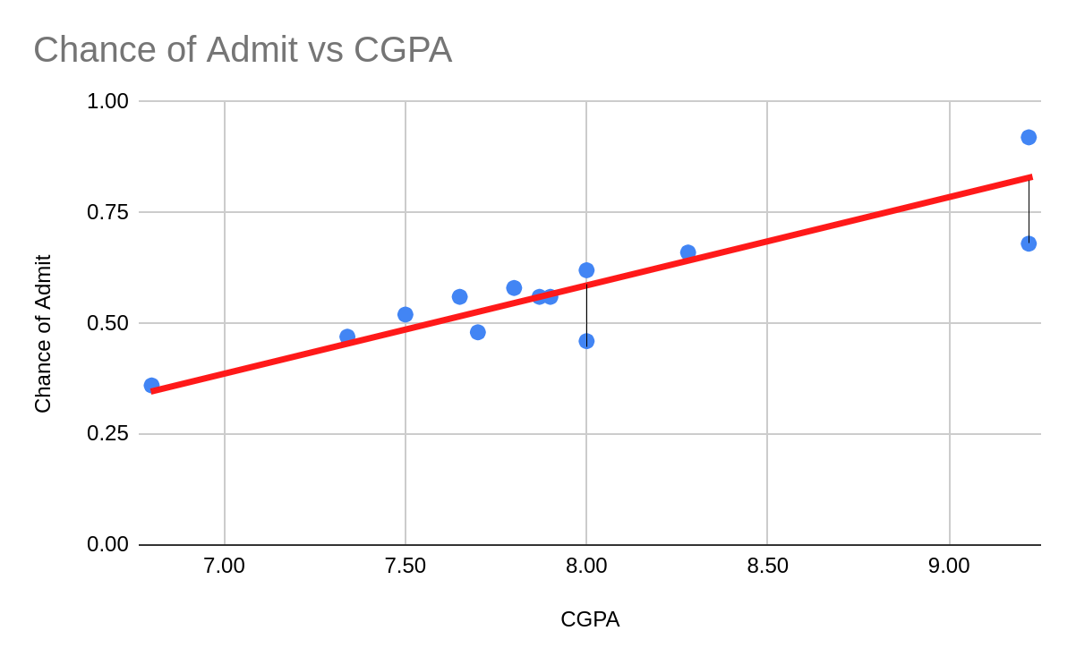
Machine learning algorithms: Linear Regression
Squared errors, to
prevent blue and
red cancelling each other
Uses mean squared errors (MSE), which is very sensitive to outliers
Assumes a linear relationship

Slide 9
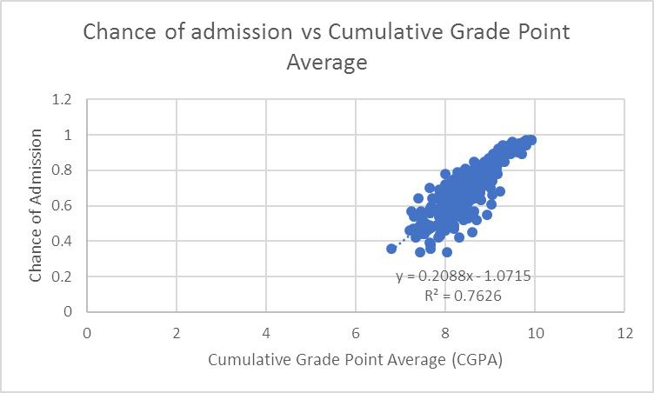
Machine learning algorithms: Linear Regression
Source: https://www.kaggle.com/code/ashishpatel26/everything-about-ucla-admission-criteria/data

Slide 10
Machine learning algorithms: Partial Least Squares (PLS)
Y
X
Chance of Admit | GRE Score | TOEFL Score | University Rating | SOP | LOR | CGPA | Research
0.92 | 337.00 | 118.00 | 4.00 | 4.50 | 4.50 | 9.65 | 1.00
0.76 | 324.00 | 107.00 | 4.00 | 4.00 | 4.50 | 8.87 | 1.00
0.72 | 316.00 | 104.00 | 3.00 | 3.00 | 3.50 | 8.00 | 1.00
0.80 | 322.00 | 110.00 | 3.00 | 3.50 | 2.50 | 8.67 | 1.00
0.65 | 314.00 | 103.00 | 2.00 | 2.00 | 3.00 | 8.21 | 0.00
Find “components” (directions in the hyperspace of X and of Y) that correlate as much as possible X and Y
PLS handles well highly correlated and noisy variables
Source: https://www.kaggle.com/code/ashishpatel26/everything-about-ucla-admission-criteria/data

Slide 11
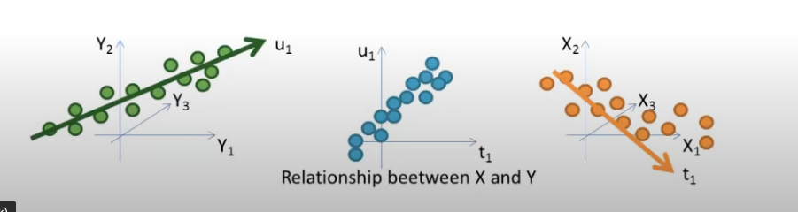
Machine learning algorithms: Partial Least Squares (PLS)
Find u1 and t1 that maximizes covariance between X and Y
Find u2 orthogonal to u1 that maximizes covariance between X and Y
…
Y
X
Source: https://www.youtube.com/watch?v=WKEGhyFx0Dg&ab_channel=Addinsoft

Slide 12
Machine learning algorithms: Partial Least Squares (PLS)
Chance of Admit | GRE Score | TOEFL Score | University Rating | SOP | LOR | CGPA | Research
0.92 | 337.00 | 118.00 | 4.00 | 4.50 | 4.50 | 9.65 | 1.00
Score₁ = 337.00*w₁+ 118.00*w₂ + 4.00*w₃ + 4.50*w₄ + 4.50*w₅ + 9.65*w₆ + 1.00*w₇
Score₁ = 337.00*w₁+ 118.00*w₂ + 4.00*w₃ + 4.50*w₄ + 4.50*w₅ + 9.65*w₆ + 1.00*w₇
loadings
0.76 | 324.00 | 107.00 | 4.00 | 4.00 | 4.50 | 8.87 | 1.00
Score₂ = 324.00*w₁+ 107.00*w₂ + 4.00*w₃ + 4.00*w₄ + 4.50*w₅ + 8.87*w₆ + 1.00*w₇

Slide 13
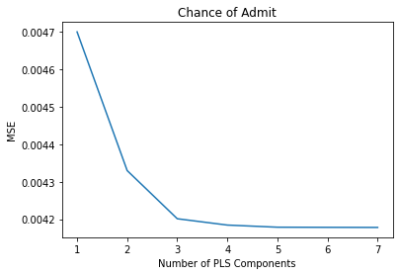
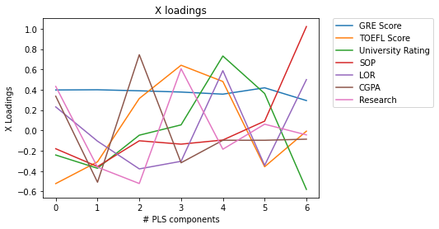
Machine learning algorithms: Partial Least Squares (PLS)
When do we stop calculating PLS components?

Slide 14
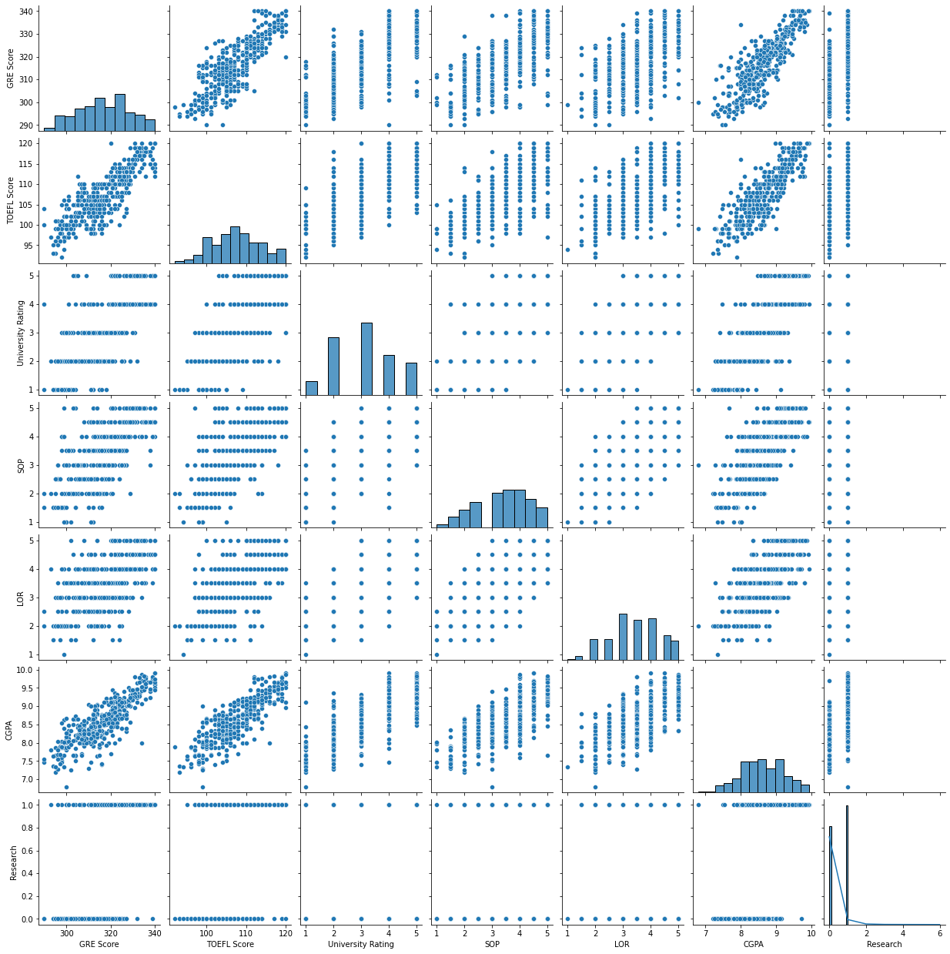
Machine learning algorithms: Principal Component Analysis (PCA)
Pairwise plots of our 7-dimensional dataset
Isn’t there an easier way to visualize this dataset?
Yes! Using dimensionality reduction techniques, like PCA.
Find “components” (as in PLS, directions in the hyperspace) that maximize the variance
PCA requires standardizing variables (substract the mean and divide by standard deviation) to avoid bias when some variables are in a much different scale than others

Slide 15
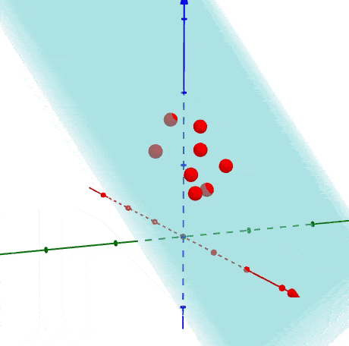
Machine learning algorithms: Principal Component Analysis (PCA)
Find the hyperplane (6D in our dataset) that
maximizes variance when data points are projected onto it, the principal component 1 (PC1).
Then find an orthogonal hyperplane that again
maximizes variance (PC2), and iterate until
desired number of components.
Source: https://medium.com/@ashwin8april/dimensionality-reduction-and-visualization-using-pca-principal-component-analysis-8489b46c2ae0

Slide 16
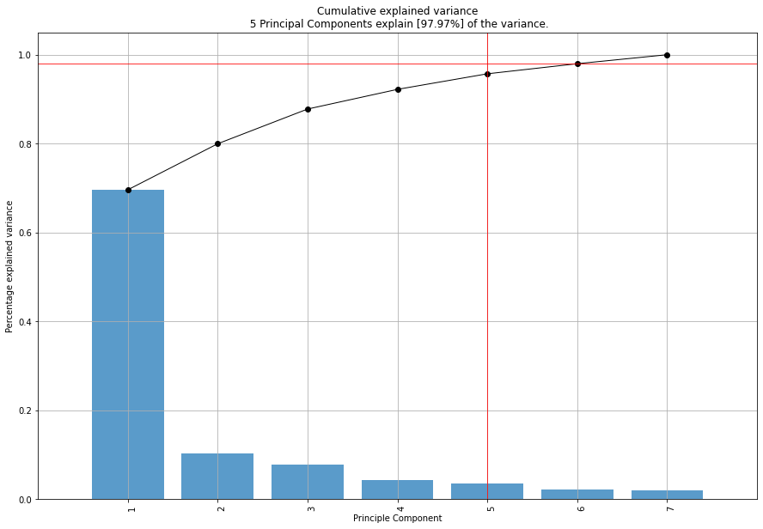
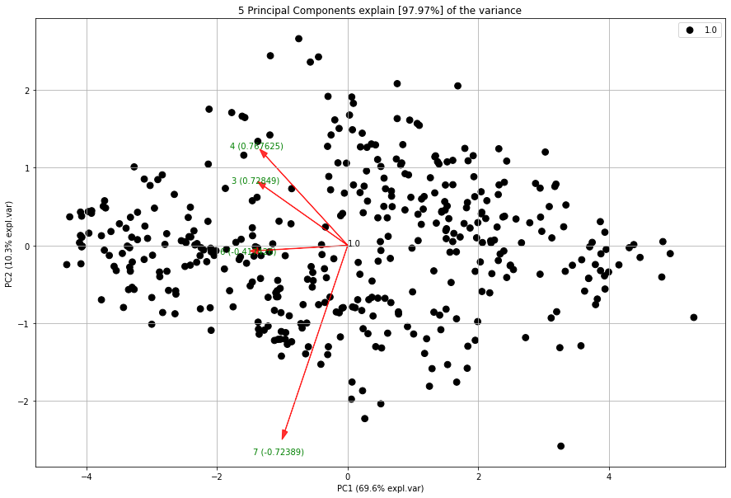
Machine learning algorithms: Principal Component Analysis (PCA)
When to stop? Each further principal component explains less variance. In our dataset, with 2 principal components we explain 80% of the variance.

Slide 17
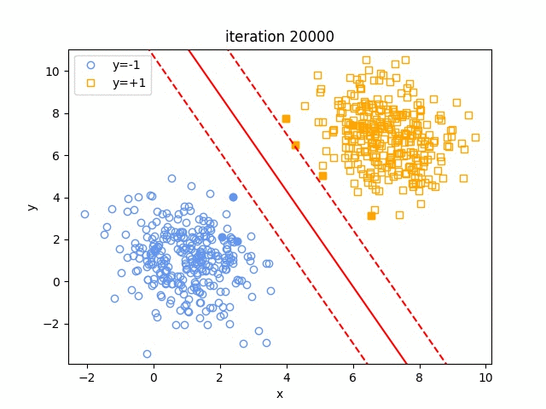
Machine learning algorithms: Support Vector Machine (SVM)
Easy linearly separable example
SVM classifier does maximize margin from solid line (boundary) to the “supports” (filled data points)
Source: https://nianlonggu.com/2019/05/27/tutorial-on-SVM/

Slide 18
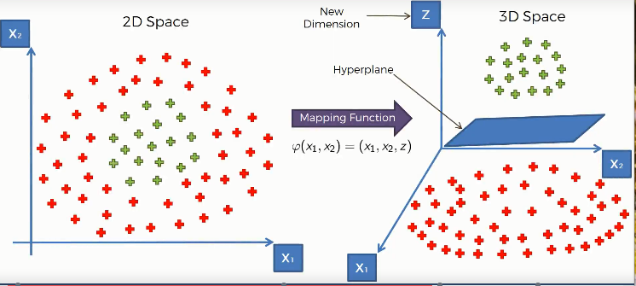
Machine learning algorithms: Support Vector Machine (SVM)
But SVM classifiers also work on non-linearly separable examples: using a “kernel” that transforms input N-dimensional data into M-dimensional, with M > N.
https://www.kaggle.com/code/prashant111/svm-classifier-tutorial/notebook

Slide 19
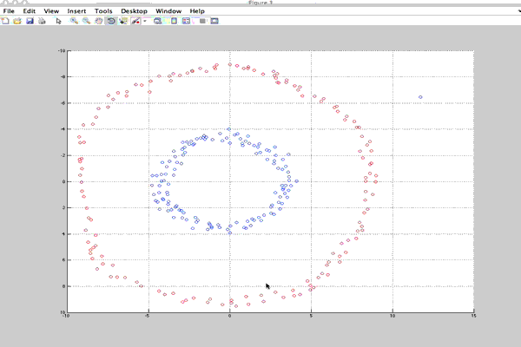
Machine learning algorithms: Support Vector Machine (SVM)
Source: http://rvlasveld.github.io/blog/2013/07/12/introduction-to-one-class-support-vector-machines/

Slide 20
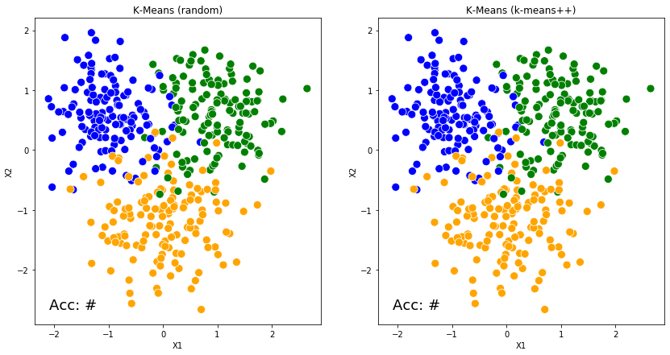
Machine learning algorithms: K-means clustering
Source: https://medium.com/@phil.busko/animation-of-k-means-clustering-31a484c30ba5

Slide 21
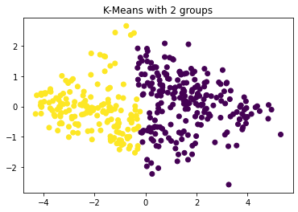
Machine learning algorithms: K-means clustering
Minimizes within-cluster variances
On our 2 component PCA (whose first component explains the most variance) it’s expected to see a vertical division for K-Means with 2 clusters is requested.

Slide 22
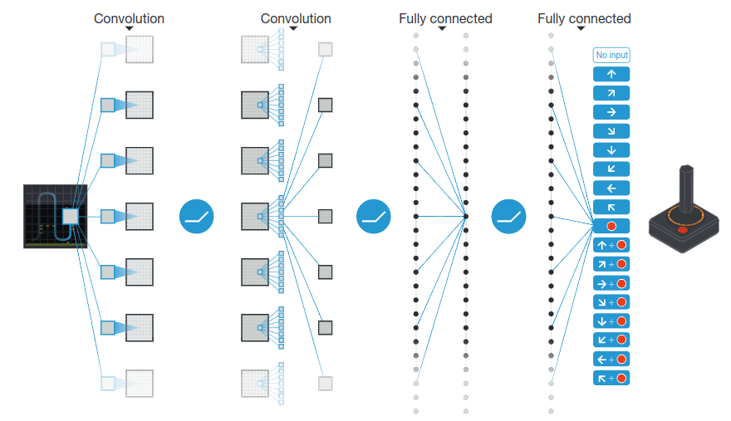
Machine learning algorithms: Reinforcement Learning (DQN: Deep-Q Network)
Mnih, V., Kavukcuoglu, K., Silver, D. et al. Human-level control through deep reinforcement learning. Nature 518, 529–533 (2015). https://doi.org/10.1038/nature14236
DQN GitHub repo: https://github.com/cameronphchen/DQN

Slide 23
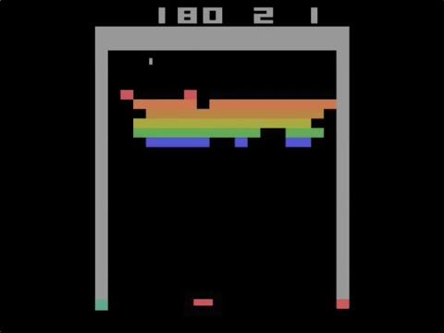
Machine learning algorithms: Reinforcement Learning (DQN: Deep-Q Network)
Mnih, V., Kavukcuoglu, K., Silver, D. et al. Human-level control through deep reinforcement learning. Nature 518, 529–533 (2015). https://doi.org/10.1038/nature14236
DQN GitHub repo: https://github.com/cameronphchen/DQN

Slide 24
Briefly introduce myself
Machine learning algorithms
Deep neural networks
Computer vision examples

Slide 25
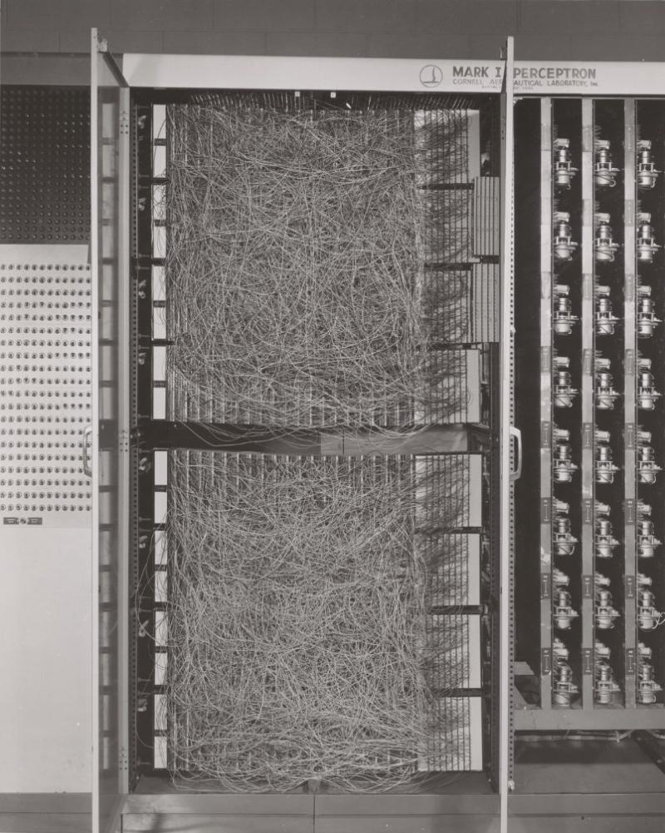
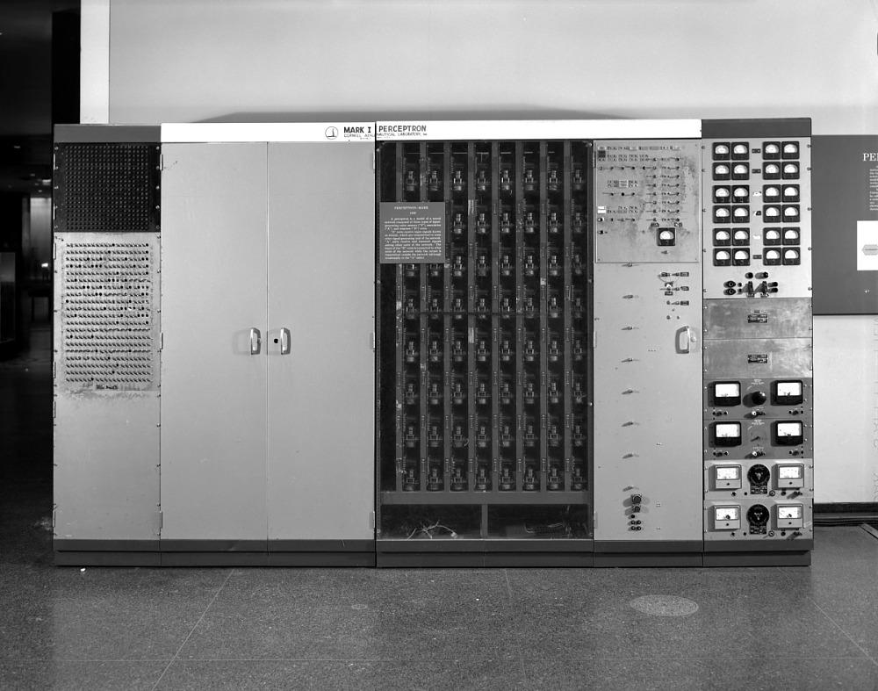
Deep neural networks
Artificial Neuron
(1953 McCulloch & Pitts)
Perceptron
(1957 Frank Rosenblatt )
x₁
w₁
x₁
x₂
w₂
σ
Output = σ(w^{T}x+b)
x₂
w₃
x₃
w₄
x₃
x₄
w₅
x₄
x₅
x₅

Slide 26
Deep neural networks
Perceptron
(1957 Frank Rosenblatt )
x₁
x₂
x₃
x₄
x₅

Slide 27
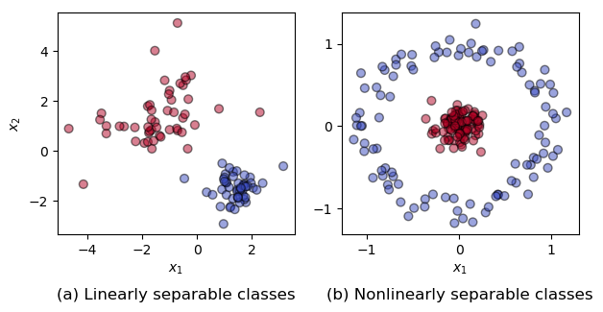
Deep neural networks
Multi layered perceptrons can solve non-linear problems, but how to find w_{i} ?
(1986/1987 Rumelhart, Hinton, Williams and LeCun work on backpropagation)
Perceptron can’t solve non-linear problems
(1969 Minsky & Papert)
N
x₁
x₁
x₂
x₂
x₃
x₃
x₄
x₄
x₅
x₅

Slide 28
Deep neural networks
Multi layered perceptrons can solve non-linear problems, but how to find w_{i} ?
(1986/1987 Rumelhart, Hinton, Williams and LeCun work on backpropagation)
N
x₁
x₂
x₃
x₄
x₅

Slide 29
Backpropagation
Backpropagation
result
Y
X
-
?
Error =
=

Slide 30
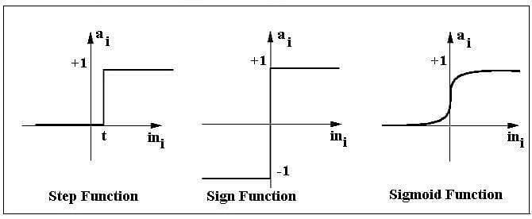
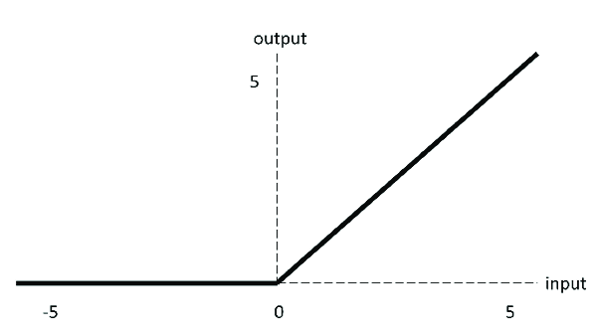
Deep neural networks
Multi layered networks were slow and unstable to train
(2010 Yoshua Bengio et.al. published the ReLu activation function σ)
N
x₁
x₂
x₃
x₄
ReLu
x₅

Slide 31
Deep neural networks
2015 DQN (reinforcement learning) developed by DeepMind learnt to play videogames from zero (trial and error).

Slide 32
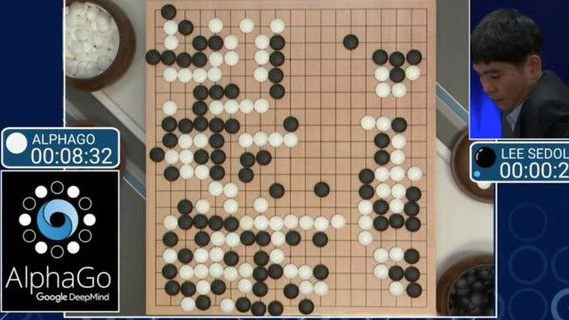
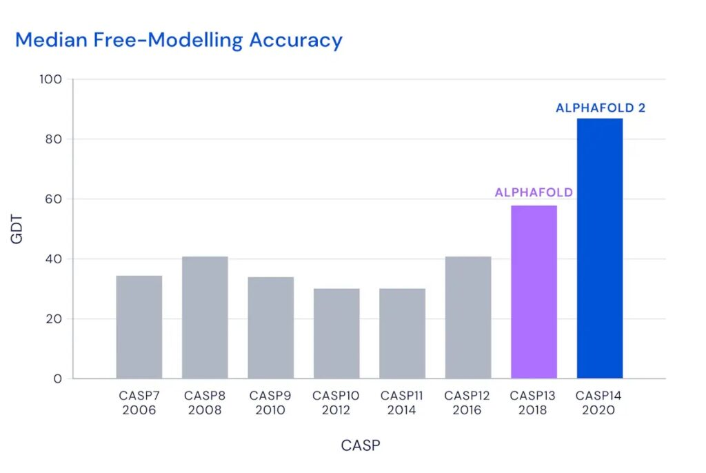
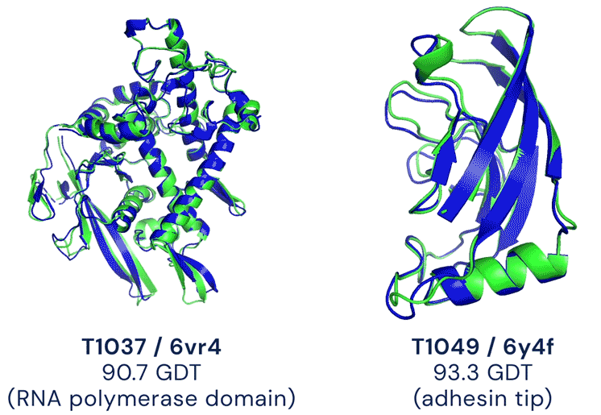
Deep neural networks
2016 AlphaGo, a program that plays Go developed by DeepMind defeated the world Go champion Lee Sedol
2018-2020 AlphaFold and AlphaFold2 developed by DeepMind gave outstanding protein 3D structure predictions

Slide 33
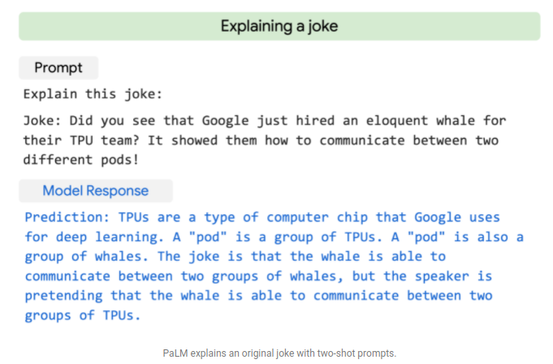
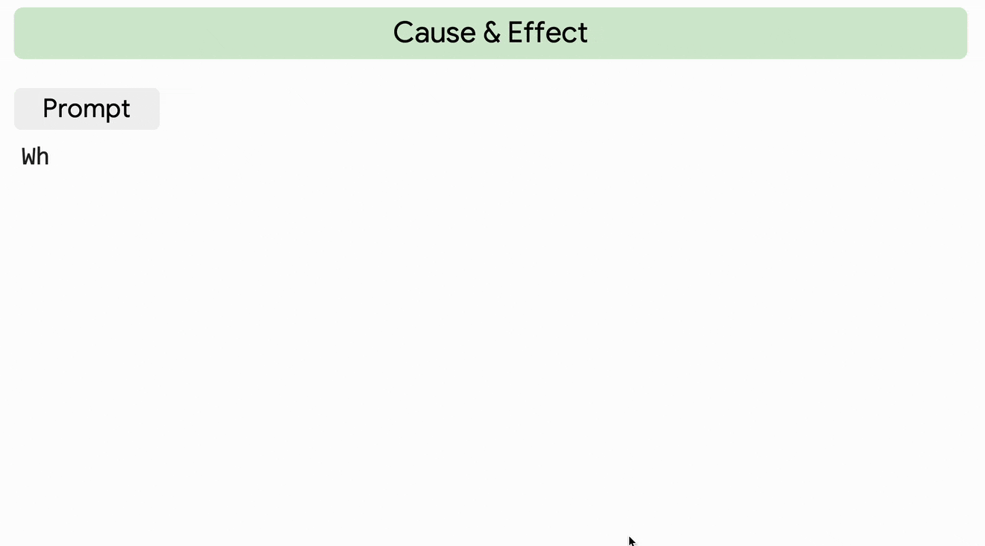
Deep neural networks
2022 PaLM (by Google) is a language model that can do many language tasks, with impressive results.
https://ai.googleblog.com/2022/04/pathways-language-model-palm-scaling-to.html

Slide 34
Briefly introduce myself
Machine learning algorithms
Deep neural networks
Computer vision examples

Slide 35
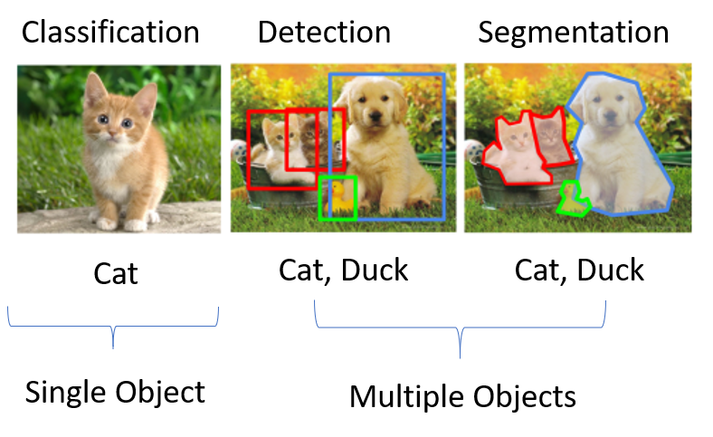
Computer vision tasks
Instance

Slide 36
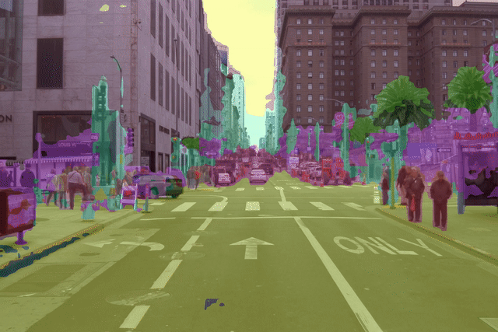
Computer vision tasks
Semantic segmentation
https://t.co/FVvUnwZhbC

Slide 37
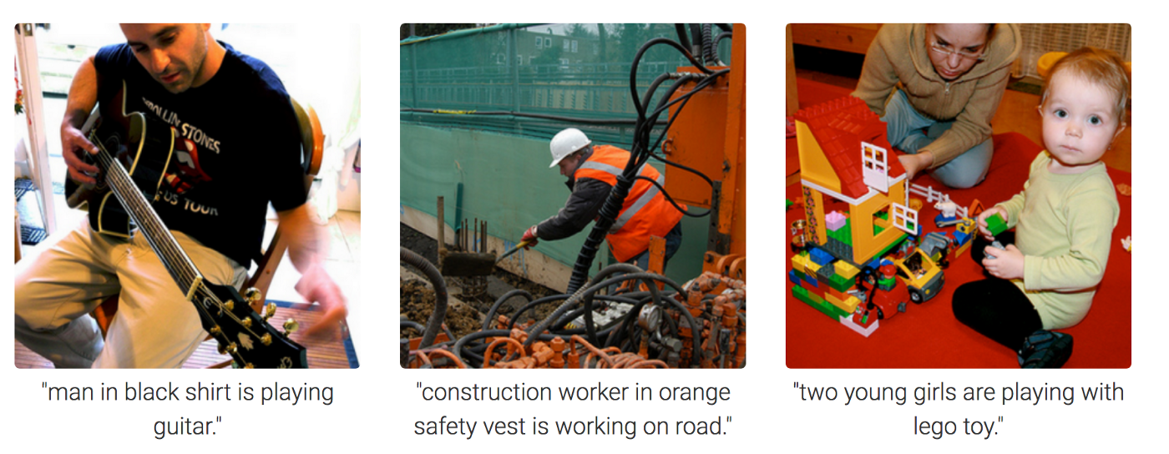
Computer vision tasks
Image captioning

Slide 38
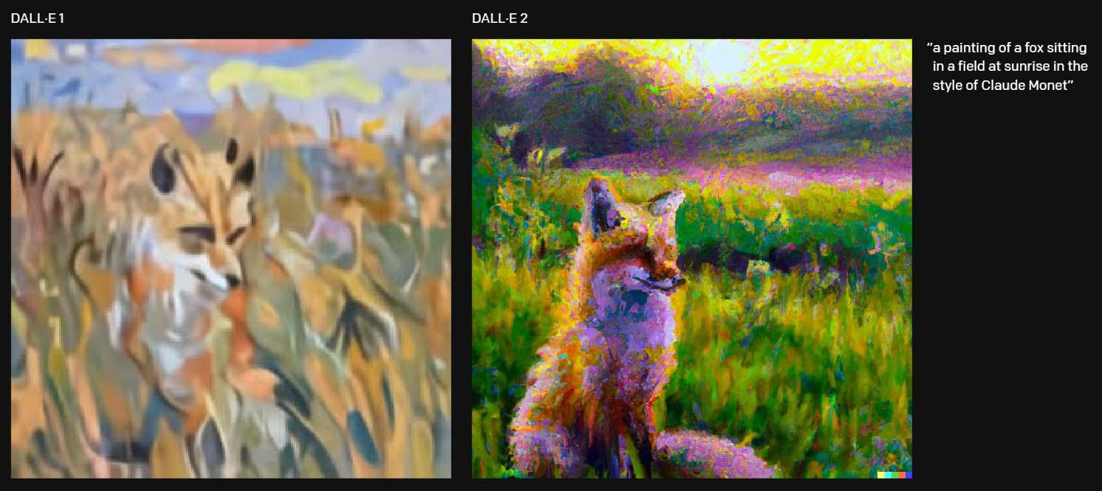
Computer vision tasks
Image generation from text caption
https://openai.com/dall-e-2/

Slide 39
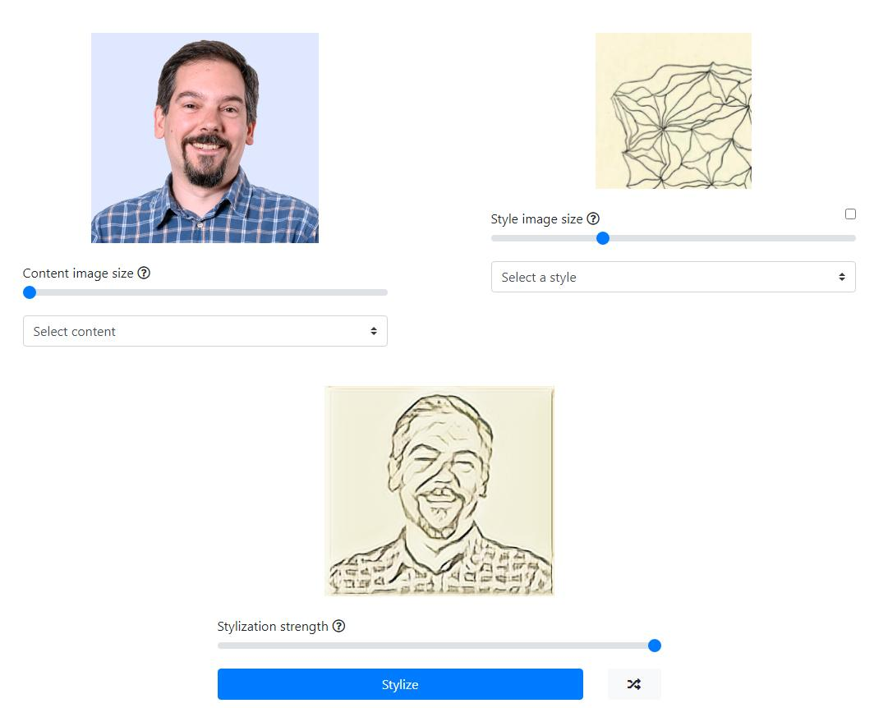
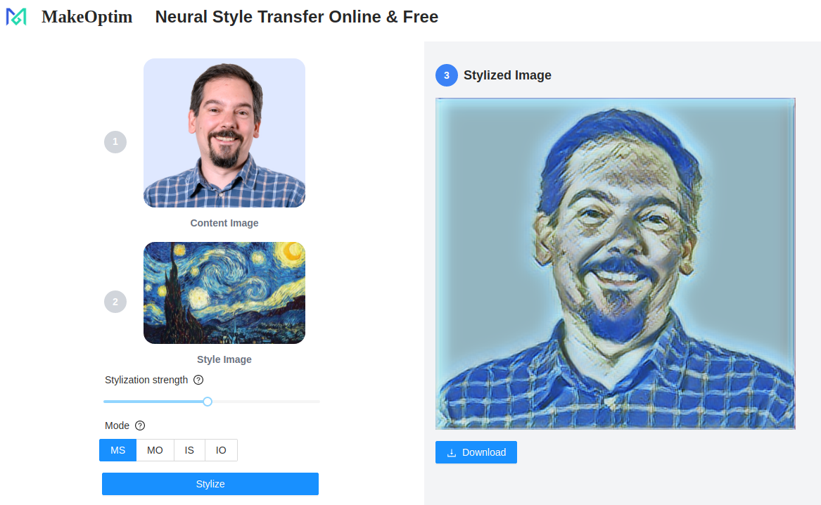
Computer vision tasks
Style transfer to another image
https://reiinakano.com/arbitrary-image-stylization-tfjs/
https://style-transfer.makeoptim.com/

Slide 40
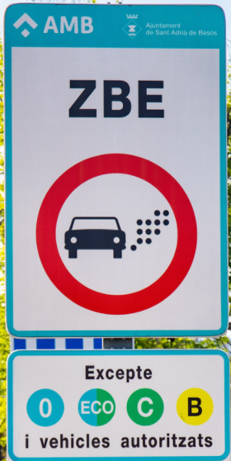
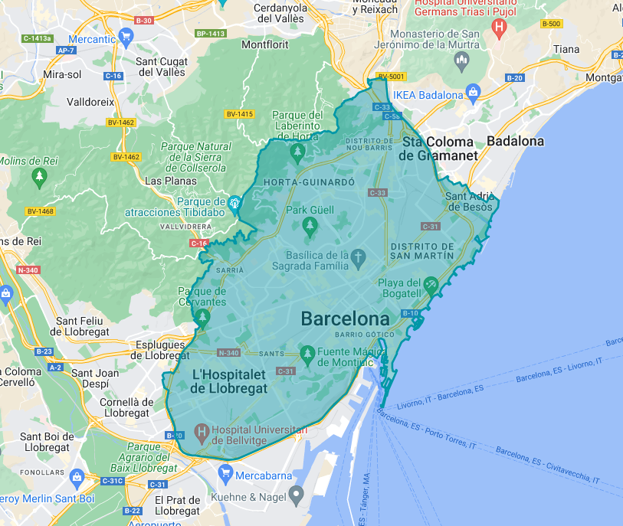
Computer vision example: car plate detection and recognition (motivation)

Slide 41
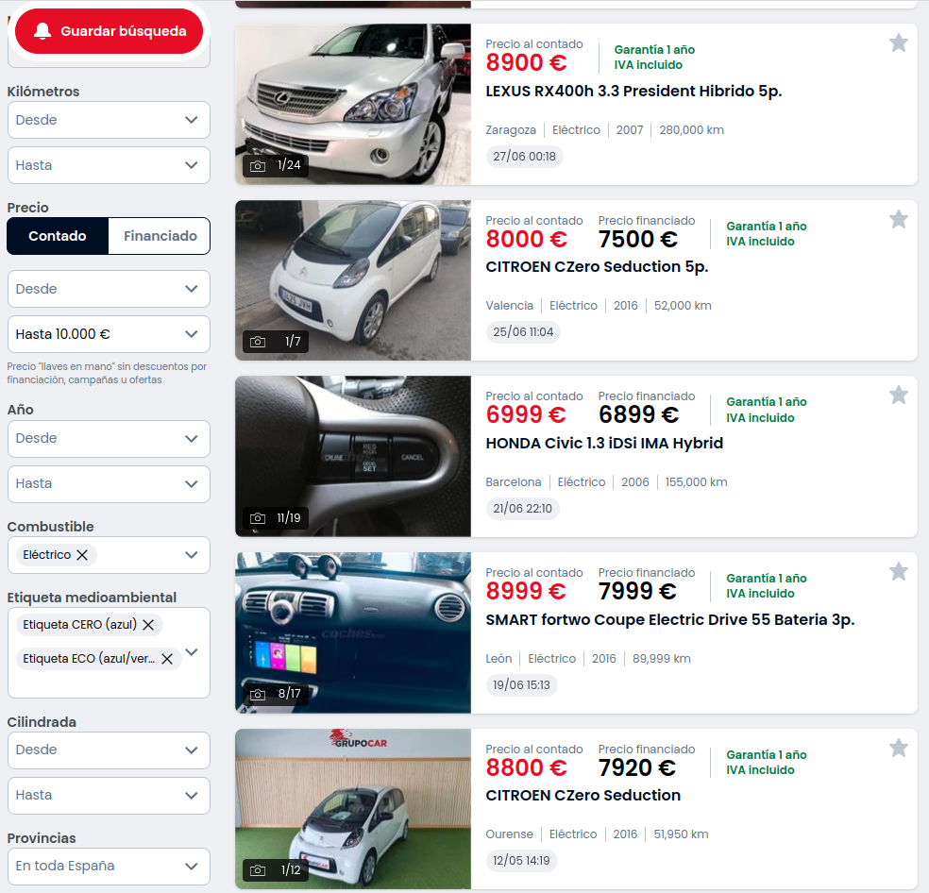
Website for used cars: coches.net
Environmental
emissions
category
A couple months ago
this filter wasn’t there

Slide 42
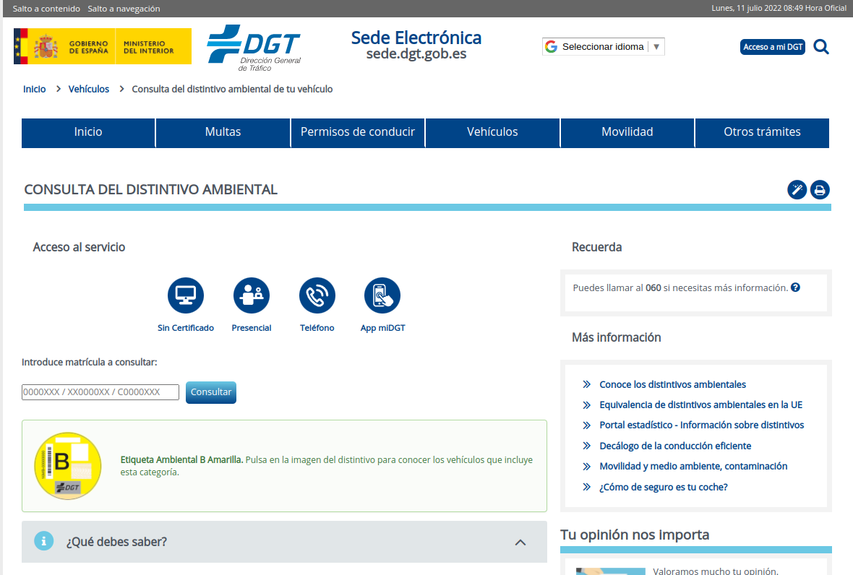
Spanish Traffic bureau website (check environmental category)
License plate
Enviromental category

Slide 43
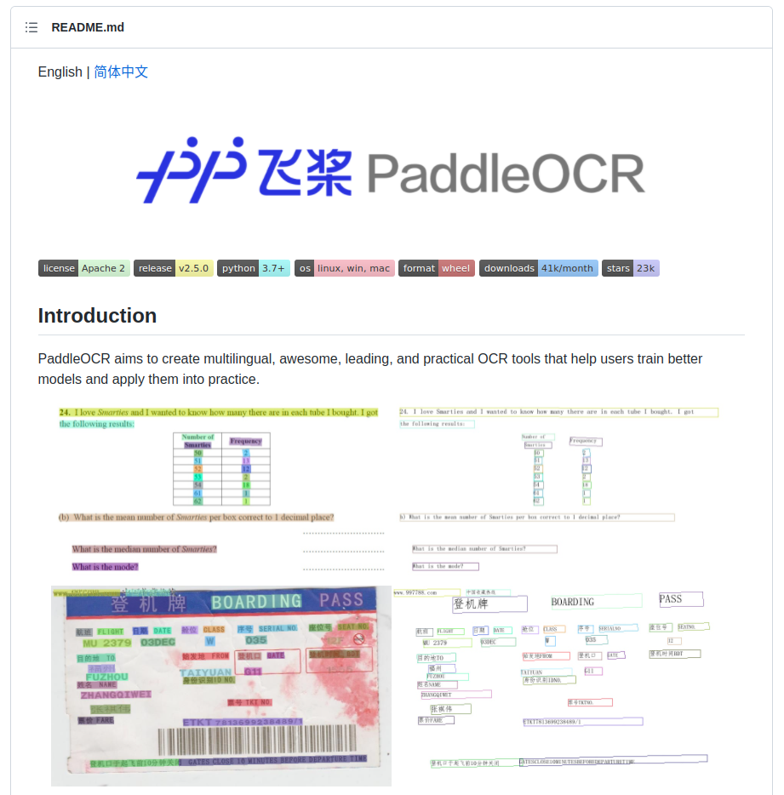
PaddleOCR model
https://github.com/PaddlePaddle/PaddleOCR

Slide 44
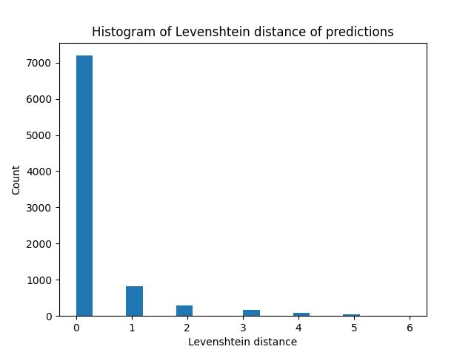


How good is paddleOCR?
Artificial dataset of 10000 plate numbers generated
  Images of plate numbers rotated, scaled and embedded into unrelated background images [1]
Levenshtein distance (number of editions needed to get the actual value) assessed for PaddleOCR predictions (ie. 0 is perfect, 7 is every single digit or letter predicted for the license plate is wrong)
[1] https://github.com/matthewearl/deep-anpr

Slide 45
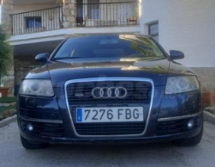
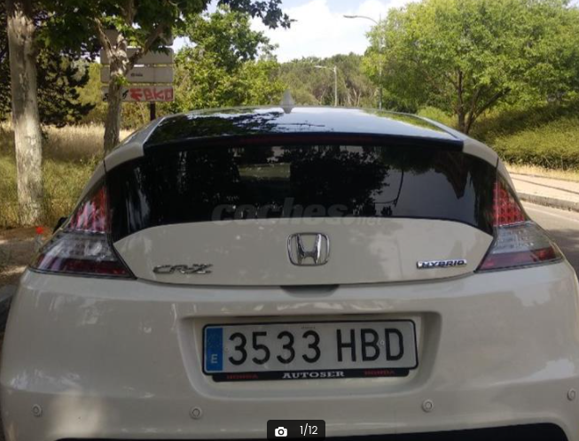
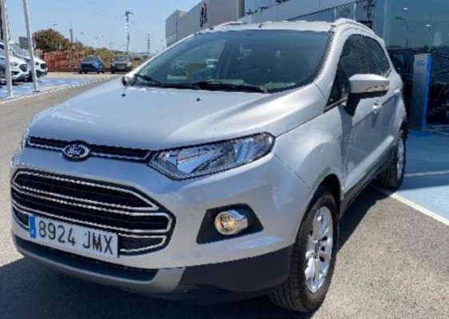
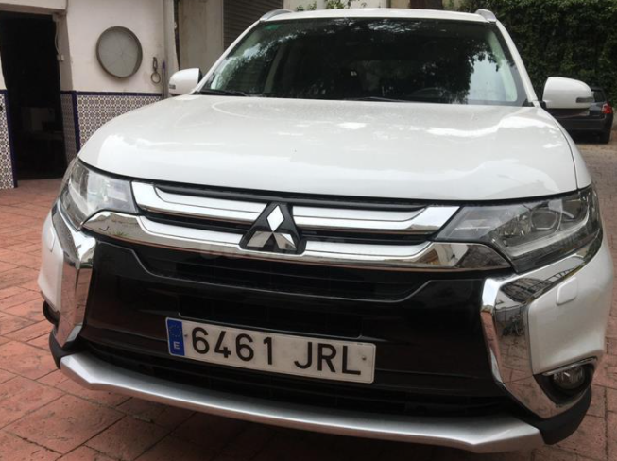
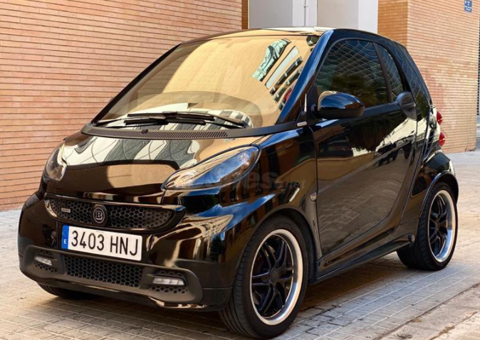
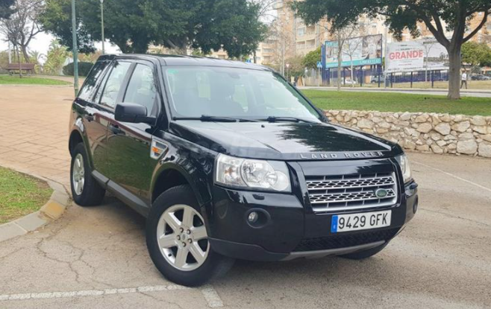
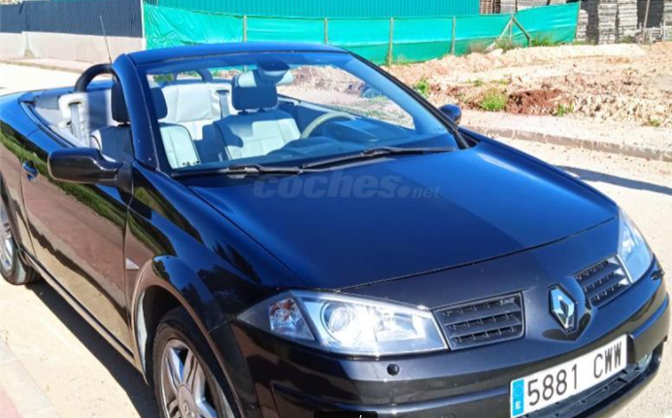
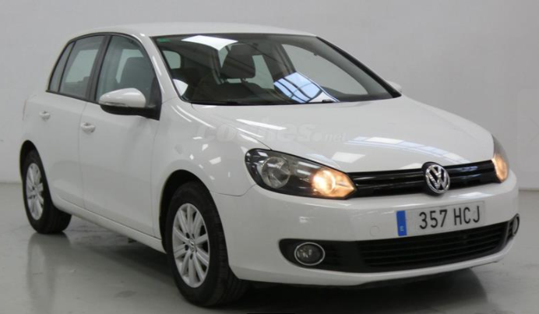




Test set

Slide 46



Test set

Slide 47


Error analysis of preliminary results

Slide 48

Error analysis of preliminary results

Slide 49
Improve PaddleOCR with regex matching
Filter output from PaddleOCR to match this regex pattern:
^[EB]?[0-9]{1,4}\s?[BCDFGHJKLMNPQRSTVWXYZ]{1,3}$
1 to 3 letters excluding vowels
Optional blank space
1 to 4 digits between 0 and 9 (depending on the angle of the image, some digits might not be readable)
Optional leading “E” (sometimes misrecognized as “B”) for spanish plates

Slide 50



Results (PaddleOCR + regex filter)

Slide 51

That was easy, right? Nope
It was my third approach, the previous two that I gave up on failed to provide accurate results on the plate, or accurate bounding boxes.
PaddleOCR outperformed both approaches.

Slide 52
Take away notes
Don’t reinvent the wheel, explore how do others do it
Always check quality of predictions and do error analysis
Don’t give up

Slide 53


Meet us (Edu, Sophie, Jaume and myself) at Adaptive booth #39 to have a nice chat on technology.
We’re hiring, ask us for one of our open positions or visit our website if you feel more comfortable:
https://weareadaptive.com/careers
THANK YOU!
@guillempg
www.linkedin.com/in/guillem-plasencia-gallofre

