Slide 1
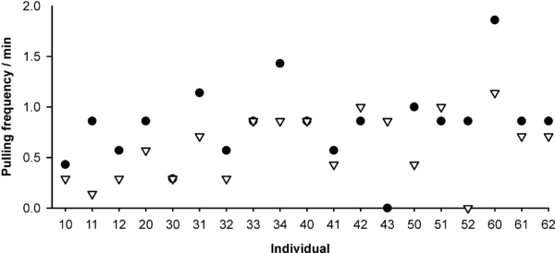

Figure 2. Experience Influences Cooperation
Rutte C, Taborsky M (2007) Generalized Reciprocity in Rats. PLoS Biol 5(7): e196. doi:10.1371/journal.pbio.0050196
http://127.0.0.1:8081/plosbiology/article?id=info:doi/10.1371/journal.pbio.0050196

