Slide 1
Operant Conditioning
January 26th, 2010
Psychology 485

Slide 2
Outline
History & Introduction
Three major questions:
What is learned?
Why learn?
How does learning happen?

Slide 3
Classical vs. Operant
Classical
Requires reflex action
Neutral stimulus associated with US
Outside of subject’s control
Operant
Strengthening/weakening of “voluntary” action
Subject responds or doesn’t

Slide 4
Classical vs Operant
Classical = Prediction problem
What’s going to happen?
Operant = Control problem
What to do to maximize reward?

Slide 5
What’s in a Name?
Operant learning: subject operates on environment
Instrumental conditioning: subject is instrumental in obtaining outcome

Slide 6
Control of Behaviour
Control_{E}
Learn to control an animal’s behaviour through manipulation of its environment
Discriminative Stimuli - S_{D}
Control_{A}
Understand behaviour as an agent controlling its actions based on predicted outcomes

Slide 7
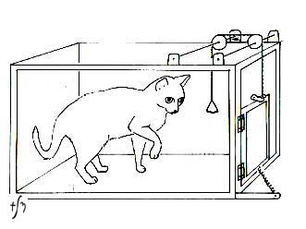
Instrumental Conditioning
E. L. Thorndike
Puzzle boxes
Law of Effect
Any behaviour followed by an appetitive stimulus will increase in frequency
Vice versa

Slide 8
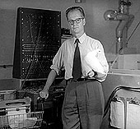
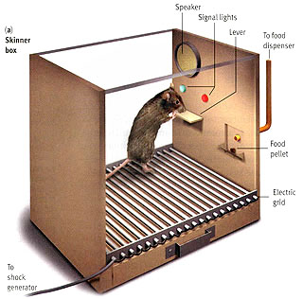
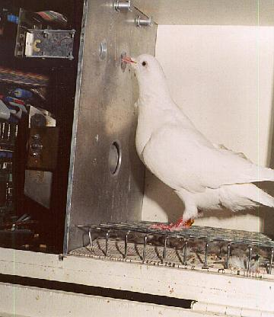
Operant Conditioning
B. F. Skinner
Operant boxes
Free operant procedure

Slide 9
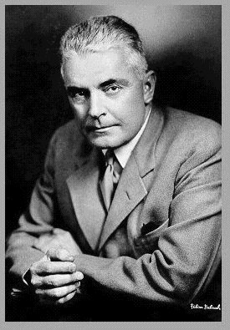
Blank Slate
“Give me a dozen healthy infants, well-formed, and my own specified world to bring them up in and I'll guarantee to take any one at random and train him to become any type of specialist I might select – doctor, lawyer, artist, merchant-chief and, yes, even beggar-man and thief, regardless of his talents, penchants, tendencies, abilities, vocations, and race of his ancestors.”

Slide 10
Blank Slate
“Give me a dozen healthy infants, well-formed, and my own specified world to bring them up in and I'll guarantee to take any one at random and train him to become any type of specialist I might select – doctor, lawyer, artist, merchant-chief and, yes, even beggar-man and thief, regardless of his talents, penchants, tendencies, abilities, vocations, and race of his ancestors. I am going beyond my facts and I admit it, but so have the advocates of the contrary and they have been doing it for many thousands of years.”

Slide 11
What is learned?

Slide 12
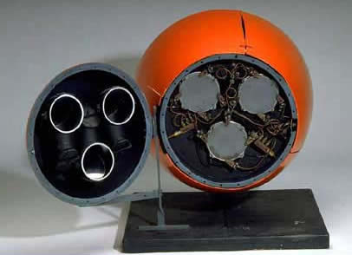
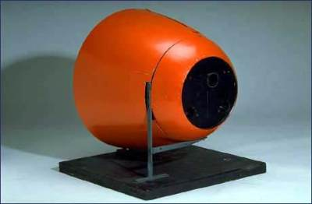
What can be learned?
Skinner believed any complex behaviour could be conditioned
Walden Two
Pigeon Project

Slide 13
Contiguity & Contingency
= bar press
= food
Perfect contingency
Strong Responding
Degraded contingency
Weak Responding

Slide 14
Contiguity & Contigency
Superstitious behaviours
Skinner
15 s FT reinforcement
Reinforcement not contingent on behaviour
Pigeons repeat behaviour that occurs before reinforcement
Contiguity, but not contingency

Slide 15
Contiguity & Contingency
Different contingencies lead to different behaviour patterns
Schedules of reinforcement
Fixed vs Variable
Ratio vs Interval

Slide 16
Type of Association
S
R
O
Stimulus → Response association
Outcome serves to strengthen (or weaken) association
“Stamps in” the connection

Slide 17
Type of Association
S
R
O
Response → Outcome association
Goal directed behaviour

Slide 18
Response→Outcome
Colwill & Rescorla (1986)
Phase 1 Devaluation Test
Push Left→Pellet Pellet+LiCl Right?
Push Right→Sucrose Sucrose+LiCl Left?
Left Pushes
# Pushes
Right Pushes
Pellet Devalued Sucrose Devalued

Slide 19
Type of Association
S
R
O
Stimulus primes outcome
Motivates responding that leads to outcome
DOE
Pavlovian-Instrumental Transfer

Slide 20
Differential Outcomes Effect
Control Group
DOE Group
Peas & Corn
Peas
No reward
No reward
No reward
No reward
Peas & Corn
Corn
Faster learning, better accuracy & retention for DOE group
Suggests S-R-O encoding

Slide 21
Pavlovian-Instrumental Transfer
Phase 1 Phase 2 Test
Lever→Food Light→Food Light: #Presses? No Light: #Presses?
# Presses
The presence of the CS intensifies operant responding
Light No CS

Slide 22
Why learn through operant conditioning?

Slide 23
Why operant?
Seems obvious:
Getting more reinforcement is sure to be beneficial to the organism
But, what is a reinforcer?
What exactly are we working for?
Reinforcement is a difficult term to define non-circularly

Slide 24
Premack Principle
Behaviors are reinforcing, not stimuli
To predict what will be reinforcing, observe the baseline frequency of different behaviors
Highly probable behaviors will reinforce less probable behaviors

Slide 25
Response Deprivation Hypothesis
Low frequency behaviors can reinforce high frequency behaviors (and vice versa)
All behaviors have a preferred frequency = the behavioral bliss point
Deprivation below that frequency is aversive, and organisms will work to remedy this
Notes:
Example: How often do you scratch your leg? Not very often. But if you are put in a cast, you will come to feel that leg-scratching is very desirable.

Slide 26
Positive & Negative Reinforcers
Response Rate:
Increases
Decreases
Positive Reinforcement Lever Press → Food | Positive Punishment Lever Press → Shock
Negative Reinforcement Lever Press → Shock off | Negative Punishment Lever Press → Food removed
Added
Stimulus:
Removed

Slide 27
How does learning happen?

Slide 28
Choice: Matching
How to allocate behaviors between multiple options based on the consequences of actions?
Led to behavioural & neuro-economics
Prospect Theory
Resp A Rf. Rate A
Resp B Rf. Rate B
=

Slide 29
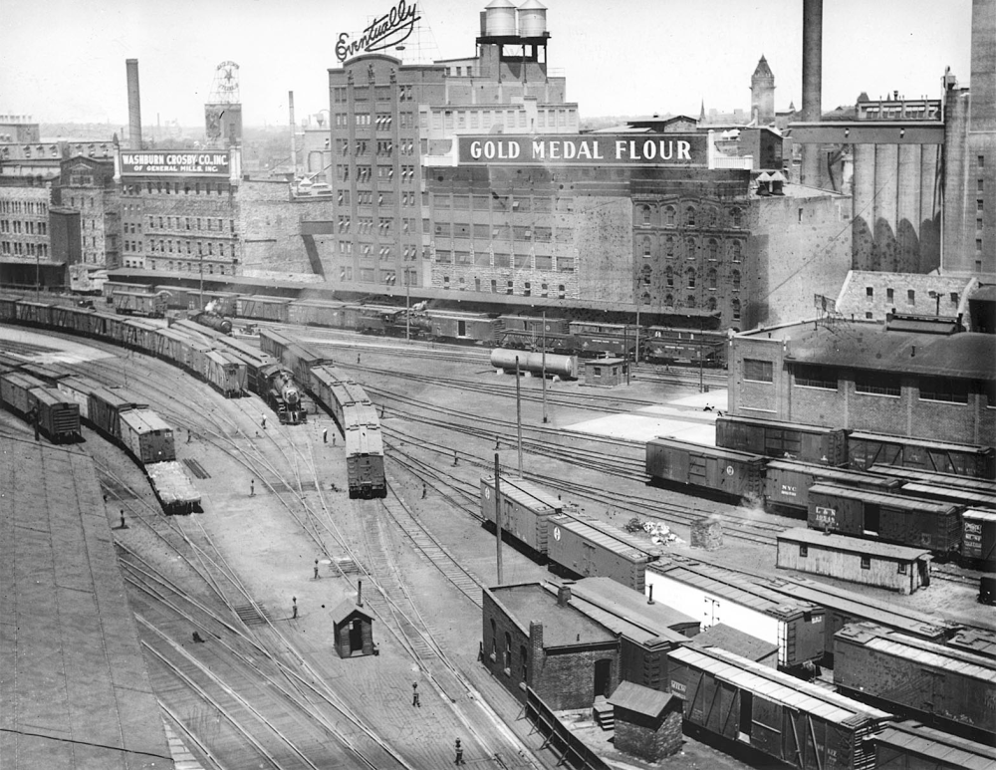
Shaping
How to create novel responses?
Skinner (1943)
Pigeon bowling
“responses that more closely approximated the final form”
Successive approximations
First described in 1937
Why would this surprise Skinner?

Slide 30
Limitations
Some behaviours cannot be easily conditioning
Yawning, scratching
Belongingness
Presence of female won’t reinforce biting
Instinctual Drift
Importance of animal’s natural ecology

Slide 31
Nature vs Nurture
Which is more important?
Which is “stronger”?
A.I. – built in algorithms or learning?

