Slide 1
Social Enterprise Career Explorer
A living database of impact organizations built for the next generation of social impact leaders.
→ secareerexplorer.vercel.app
Notes:
Semi

Slide 2
Objectives
A curated, high-value resource to jumpstart their search for impact-aligned summer/full-time roles. A database of databases
Build a structured and actionable database, with a focus on high-signal/quality:
HBS grads or Faculty in the team
Size/Budget/Growth that allows MBA hiring
Recognized leaders in their field
Synthesize internal HBS resources (e.g. second year cases) with external resources to continue the journey
Help students understand and find HBS-aligned organizations faster, accelerating the transition into the space.
Notes:
Guille

Slide 3
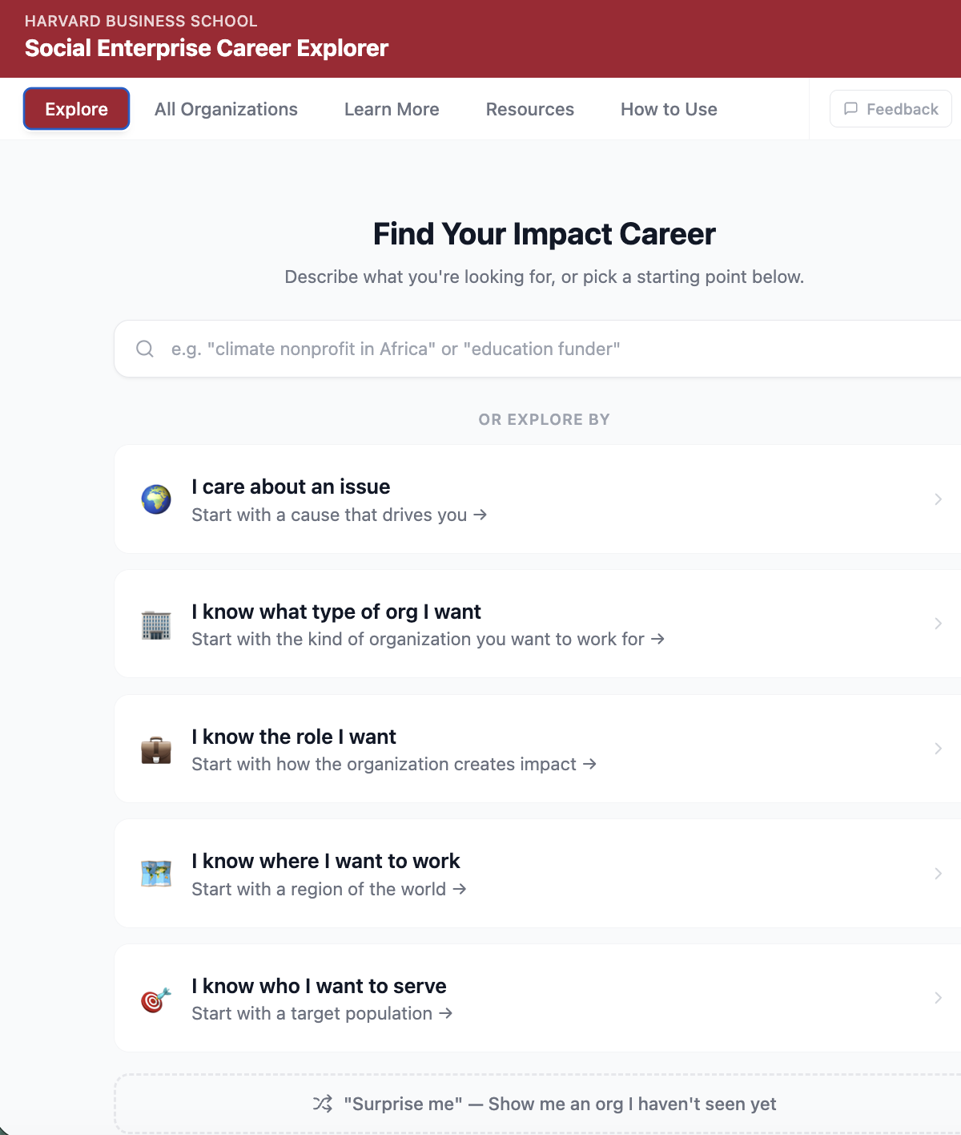
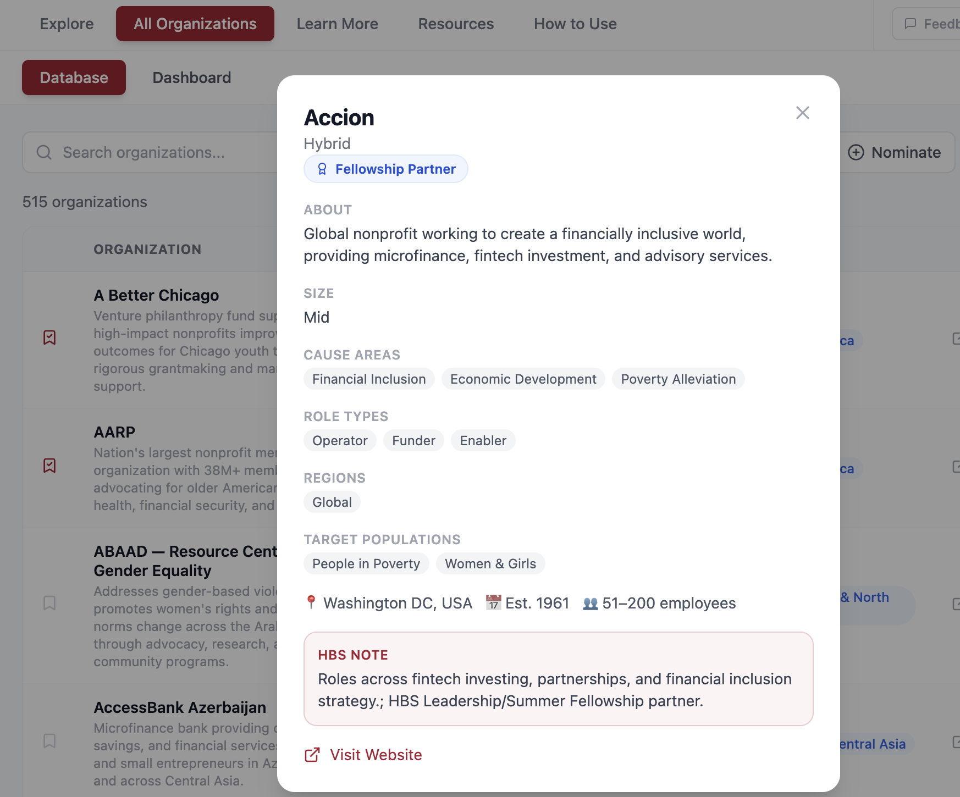
What we did
Collected 510+ orgs across HBS cases, fellowship partners
Reviewed taxonomy with Baker Library and schema with HBS Executive Fellow, Gerald, Brian, CPD and SEI
Built full stack with Claude, Vercel hosting and Supabase (DB management)
Iterated with student feedback (5 interviews)
Incorporated XX resources for students to keep exploring

Slide 4
Demo Time
secareerexplorer.vercel.app

Slide 5

Next Steps / Open Questions
Hosting & Infrastructure
Content & Growth
Where should it live?
SEI website vs. SE Club website
Long-term ownership and maintenance
HBS login integration
Expanding the database
What exceptional orgs are we missing?
Connecting to 12twenty and alumni data
Faculty feedback and guidance

